Slide 1
AIDA-2020
TA – Transnational Access Facilities
(3rd Year Report)
Stjepko Fazinić
On Behalf of WP10, WP11 & WP12

Slide 2
Outline
1. Introduction
2. WP10 – Beam Test Facilities
3. WP11 – Irradiation Test Facilities
4. WP12 -Detector Characterization Facilities
5. Summary

Slide 3
1. Introduction
TRANSNATIONAL ACCESS (TA)
Aim: To provide support to users for evaluation of detector technologies in terms of radiation hardness, particle response and electromagnetic interference.
Two types of access
  In person (users present at the facility)
  Remote access to scientific services
WP10: Beam test facilities (TA1)
WP11: Irradiation test facilities (TA2)
WP12: Detector characterisation facilities (TA3)
3-37

Slide 4
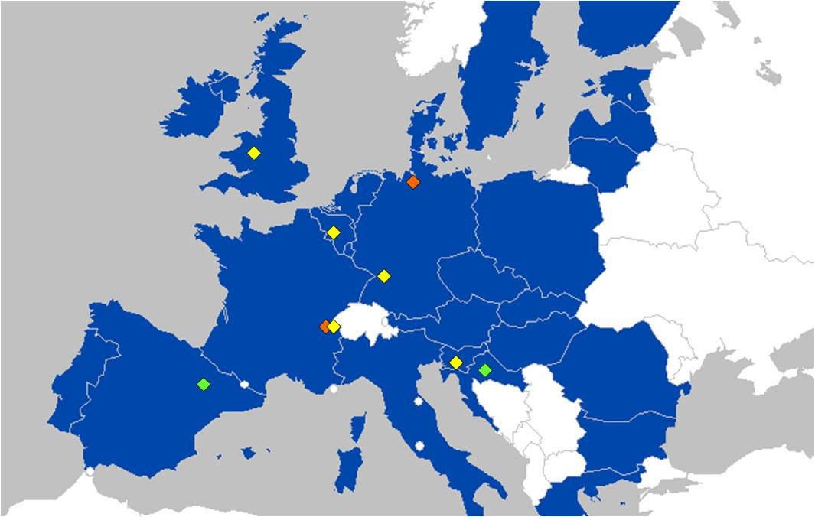
1. Introduction
10 Facilities are offered
Work Package No | Work Package Title | Lead Participant Short Name
WP10 (TA1) | Beam test facilities | CERN DESY
WP11 (TA2) | Irradiation test facilities | CERN (IRR-GIF+) JSI KIT UCLouvain UoB
WP12 (TA3) | Detector characterisation facilities | RBI ITAINNOVA

Slide 5
1. Introduction
List of TA facilities and tasks:
10.1: CERN PS and SPS Test Beams
10.2: DESY-II Test Beam Facility
11.1: CERN IRRAD & GIF++
11.2: JSI TRIGA Reactor, Slovenia
11.3: KIT KAZ, Germany
11.4: UCLouvain CRC, Belgium
11.5: UoB MC40 Cyclotron, UK
12.1: RBI-AF, Croatia
12.2: ITAINNOVA – EMClab, Spain

Slide 6
1. Introduction
TA cycle
Step 1: Informal request – contact the facility coordinator
Step 2: Application Form – user fill out and send it
Step 3: Selection
  primarily the responsibility of the facility coordinator,
  acting with approval of the User Selection Panel (USP)
  Resources usage monitored by User Selection Panel
Step 4: Access & Reimbursement
  Users complete a confirmation of transnational access form, and facility-specific reimbursement form and return them to the facility coordinator
  Reimbursement is handled by each facility, in line with facility rules.
Step 5: Publications
  Scientific publications, talks or any other publication associated with AIDA-2020 TA should include an acknowledgment to the TA / AIDA2020.

Slide 7
Outline
1. Introduction
2. WP10 –Beam Test Facilities
3. WP11 –Irradiation Test Facilities
4. WP12 -Detector Characterization Facilities
5. Summary

Slide 8
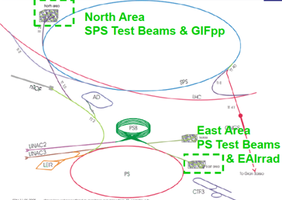
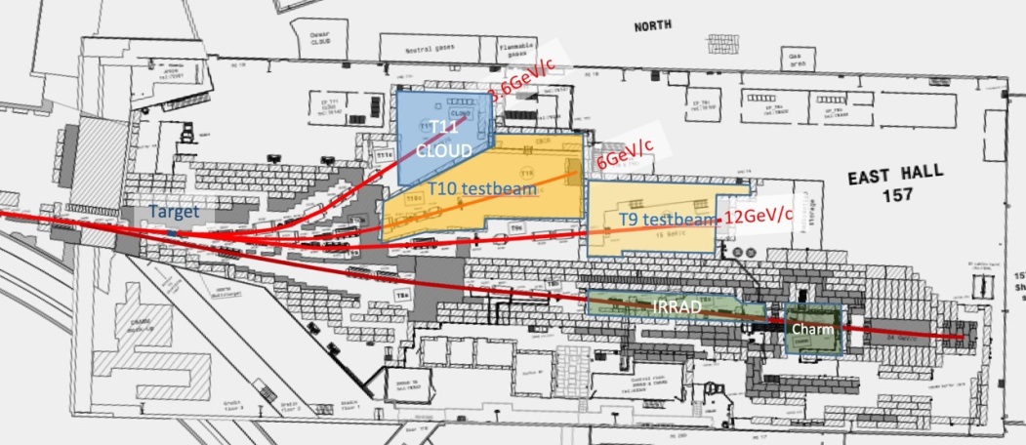
2. WP10.1. –CERN
Test Beams
  CERN TA-TB (Switzerland) provided 2 beam lines:
  at CERN PS (1 to 12 GeV/c) and
  at SPS (15 to 400GeV/c)
CERN TA-TB (EAST AREA)

Slide 9
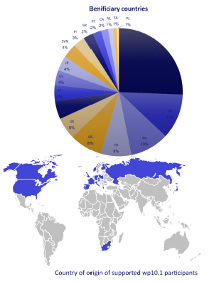
2. WP10.1. –CERN
Test Beams
- 24 projects supported in 2015 and 18 projects in 2016, then funds ran out (alltogether 42 projects)
- 196 visits to CERN supported, 10 days on average.
- Participants from 19 countries
- 45 talks/publications, 19 with the AIDA2020 acknowledgments
- 19 projects still have not reported a publication.
CERN test beam stop at the end of 2018, restart:
- SPS Q2-2021
- PS Q3-2021, with a fully renovated East Area.

Slide 10
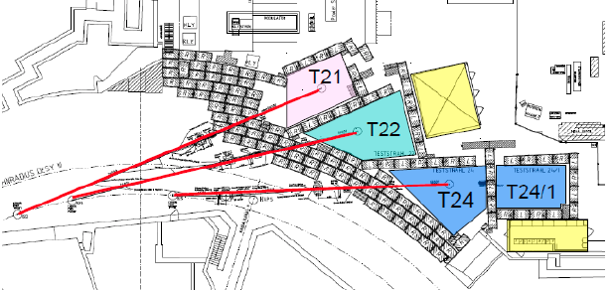
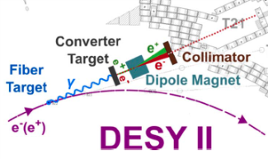
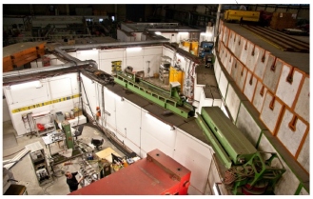
2. WP10 .2 – DESY
Test Beam
Three test beam lines
Electron or positron beam from 1-6 GeV (spread ∼5%)
Beam generation:
  DESY II beam converted into bremsstrahlung at carbon fiber targets
  Converter target: e⁻/e⁺
  Magnet to select type and energy
  Rates up to several kHz depends on beam line, enegy, target material, collimator setting
DESY TA-TB

Slide 11
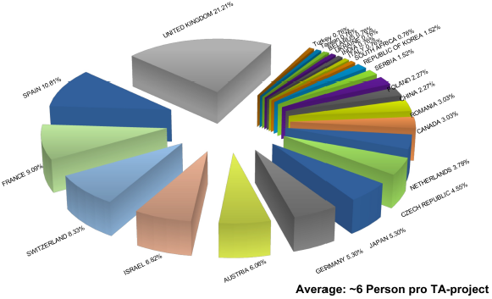
2. WP10 –DESY
Test Beam
Users from 23 countries
Supported 22 projects
30 expected
92 % of the pledged access hours delivered
3 more TA in 2018
132 users from 23 countries (117 supported)
So far 3 publications
DESY | User Projects |  | Total users | TA units
 | Submissions | Selected
M1-M36 | 22 | 22 | 132 117 supported | 7750 (92%)
M1-M48 | 30 |  | 120 | 8400

Slide 12
Outline
1. Introduction
2. WP10 –Beam Test Facilities
3. WP11 –Irradiation Test Facilities
4. WP12 -Detector Characterization Facilities
5. Summary

Slide 13
3. WP11 –Irradiation Test Facilities
The WP11 Transnational Access is focused on irradiation tests.
It covers six different irradiation facilities:
  1. CERN IRRAD & GIF++, Switzerland
    24 GeV protons, mixed field, gammas
  2. JSI TRIGA reactor, Slovenia
    Reactor neutrons, gammas
  3. KIT KAZ, Germany
    Accelerator protons (23 MeV)
  4. UCLouvain CRC, Belgium
    Accelerator neutrons (NIF), heavy ions (HIF) – SE Studies
  5. UoB MC40 Cyclotron, United Kingdom
    Accelerator protons (27 MeV)

Slide 14
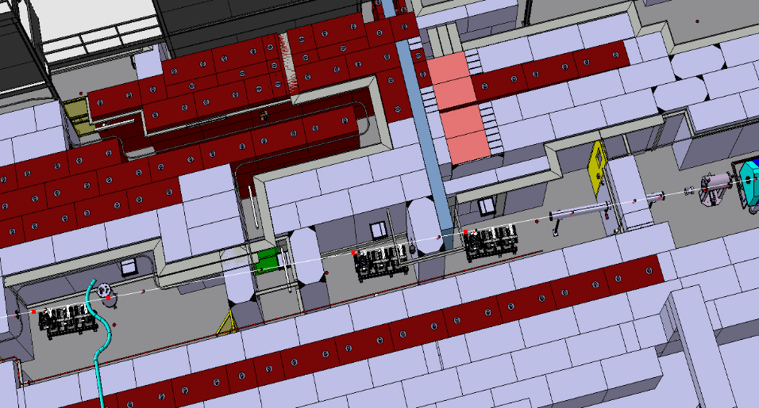
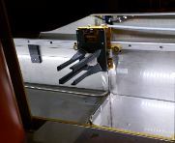
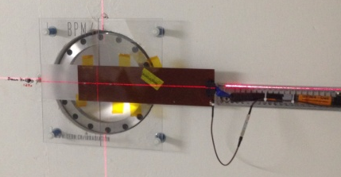
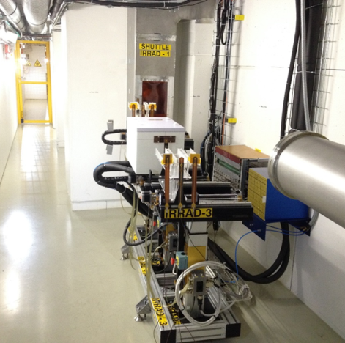
3. WP11.1 CERN - IRRAD
Testing components of the HEP experiments
Beam of 24 GeV/c and size of 12×12 mm²
Spills of 400 msec every ~10 sec
Fluence of 1×10¹⁶ p/cm² in 14 days
Scanning also in dimensions of 10×10 cm²
Low temperature irradiation (-25°C)
Cryostat
with LHe 1.9K
Shuttle System
Fixed-BPM
BEAM
IRRAD Tables
Detectors
Electonics
30m
Calorimetry samples

Slide 15
3. WP11.1 CERN - IRRAD
Number of delivered units already close to proposal value
Number of users higher than anticipated
Number of projects is less than anticipated
Funds still available for this year (last year of operation before LS2)
USERS from
8 countries
CERN IRRAD | User Projects |  | Total users | TA units
 | Submissions | Selected
M1-M32 | 14 | 14 | 58 | 3710 (92%)
M1-M48 | 30 |  | 60 | 4032

Slide 16
3. WP11.1 CERN – GIF++
GIF++ Aerial View

Slide 17


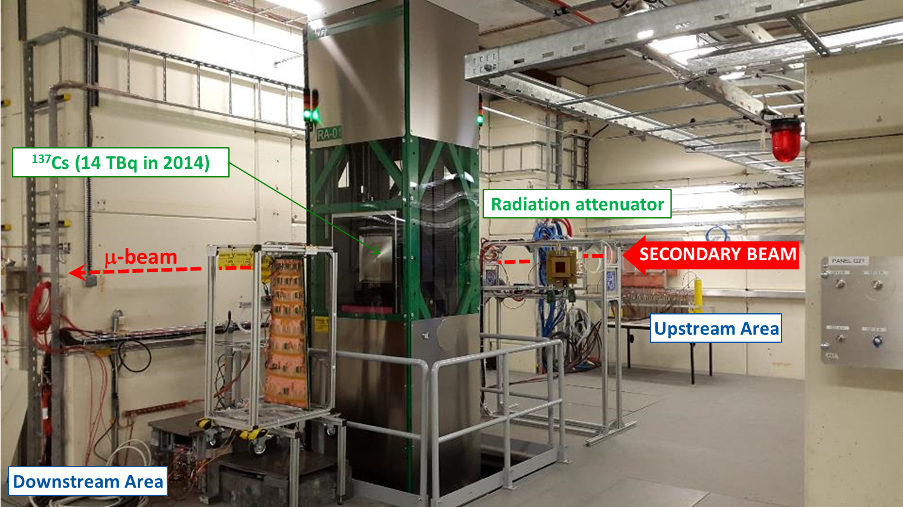
3. WP11.1 CERN – GIF++
    Typically for muon systems of HEP experiments
    E_{g} = 0.66 MeV; max. dose-rate ~0.5 Gy/h @ 1m from source (±37º angle) and 2.5 Gy/h @ glass contact
    Several attenuation factors available (up to ~50’000)
    μ-beam from T2 on H4 beam-line (100 GeV; ~10⁴ /spill)

Slide 18
3. WP11.1 CERN – GIF++
Number of delivered units already passed proposal value
Number of users higher than anticipated
Number of projects is less than anticipated
Some funds are still available for this year
USERS from
8 countries
CERN GIF++ | User Projects |  | Total users | TA units
 | Submissions | Selected
M1-M36 | 13 | 13 | 99 | 4140 (103%)
M1-M48 | 20 |  | 50 | 4032

Slide 19
Conclusions on TA to IRRAD and GIF++
Conclusions on TA to IRRAD and GIF++
TA program and financing continue as planned in 2018
  Deliverable will be reached in 2018
No more beams from the end of 2018 to the end of AIDA2020
GIF++ gamma source will be in operation
  TA will continue at GIF++ during LS2, if funds will still be available
Up to now only 10 publications collected (out of 27 projects)
expecting more with analysis of irradiated sensors progressing

Slide 20
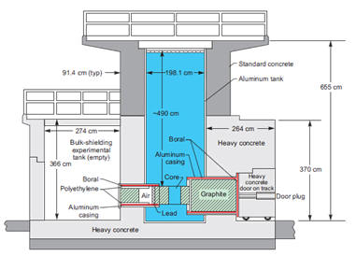
3. WP11.2 JSI
Transnational access to TRIGA MarkII reactor
Samples can be shipped, no visitors expected!

Slide 21
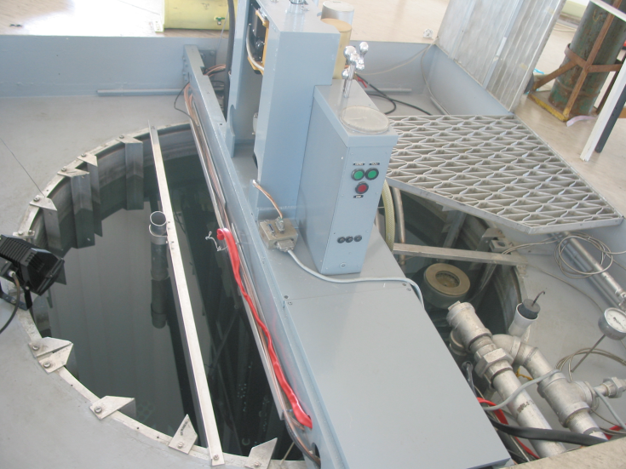
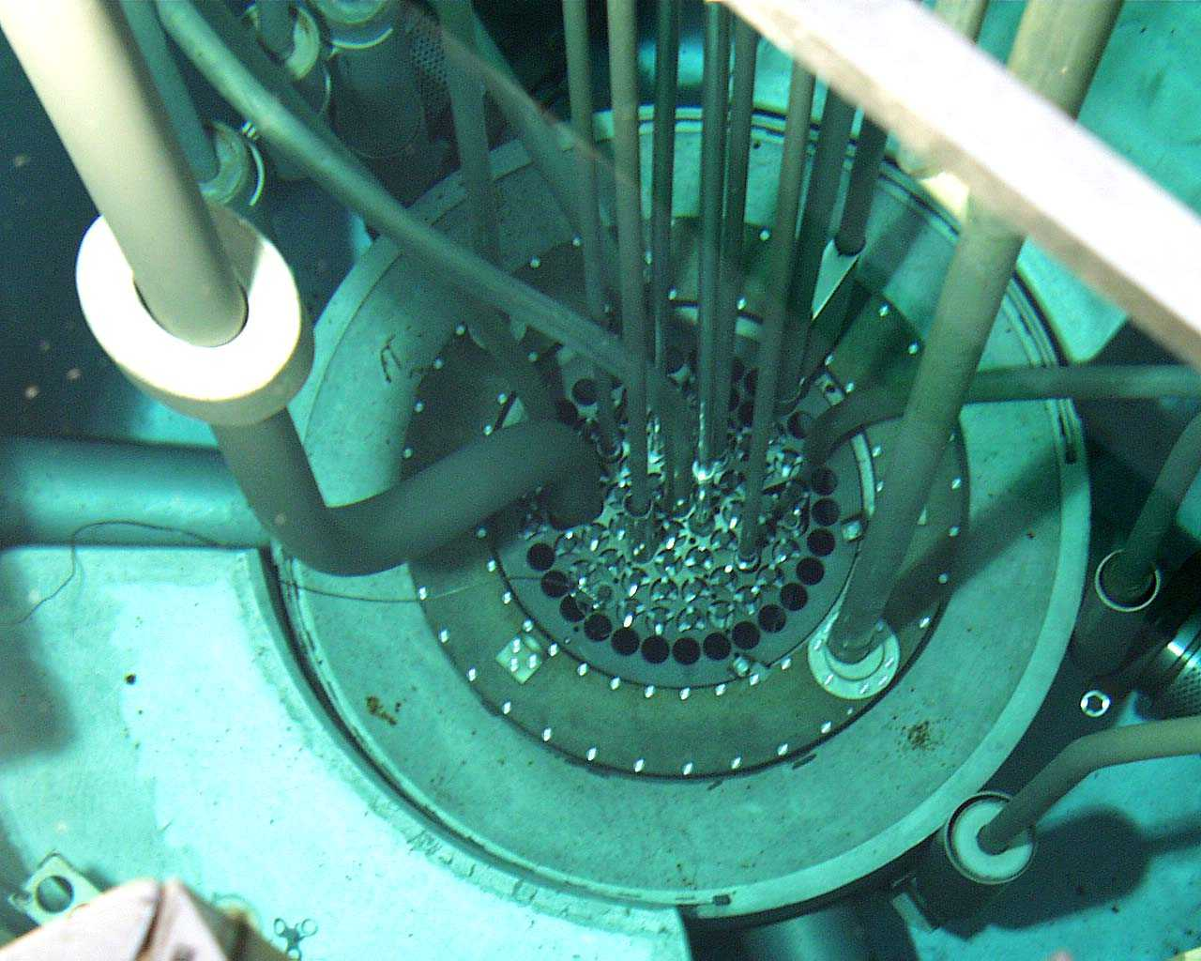
3. WP11.2 JSI
Central tube
Φ_{max} ⁼ 6 10¹² n_{eq}cm⁻²
Large tube (sample width up to
≈ 6 cm)
Φ_{max} ⁼ 3.57 10¹² n_{eq}cm⁻²
Small tube (sample width
up to ≈24 mm)
Φ_{max} ⁼ 1.54 10¹² n_{eq}cm⁻²
10¹⁶ n_{eq}cm⁻² in 6500 s
Accuracy about 10%

Slide 22
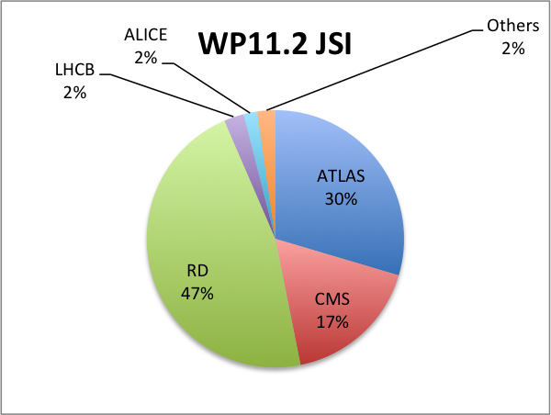
3. WP11.2 JSI
M1 – M36
463 units delivered in 86 projects, approx 480 irradiations
> 15 publications
JSI | User Projects |  | Total users | TA units
 | Submissions | Selected
M1-M32 | 79 | 79 | 189 | 435 (87%)
M1-M48 | 50 |  | 150 | 500

Slide 23
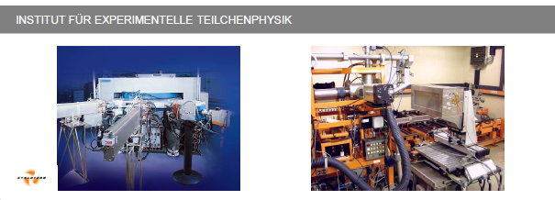
3. WP11.3 KIT
Accelerated protons
Energy ∼23 MeV
current ∼2μA (100 nA – 20 μA)
Samples can be shipped, no visitors expected!
Max. Object width 44 cm
Max. Object height 17 cm

Slide 24
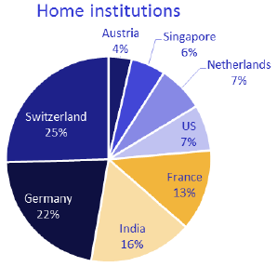
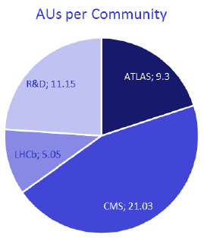
3. WP11.3 KIT
USERS from
8 countirs
Projects 20 out of 30 (67%)
Users 75 out of 90 (83%)
Access units 46.5 out of 100 h (47%)
In preparation for 2018: ∼15h ATLAS, ∼10h CMS, ...
Only few publications (3)

Slide 25
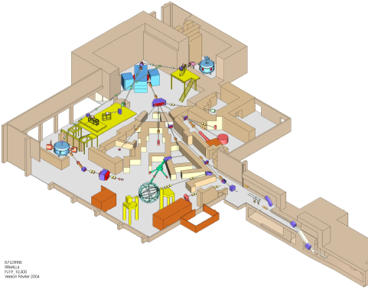
3. WP11.4 UCL
CRC facilities at Louvain-laNeuve
Three irradiation facilities:
NIF: Neutron Irradiation Facility
Fast neutrons (0-50 MeV)
Flux 10¹¹ n/(cm² s)
LIF: Proton Irradiation Facility
Protons 10-60 MeV
Flux 10⁸ p/(cm² s)
HIF: Heavy-Ion irradiation Facility
heavy Ion ‘’cocktails’’
Electronic failures induced by radiation
(Single Event Effects)

Slide 26
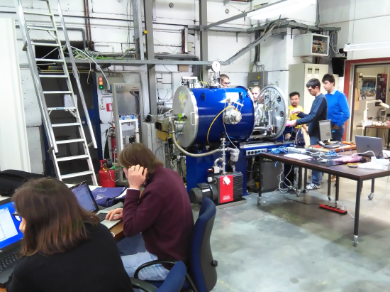
3. WP11.4 UCL

Slide 27
3. WP11.4 UCL
80% of foreseen projects and 99% of Access Units allocated
1 irradiation hour left: it will be used for quality test
still receiving irradiation requests (3-4/year)
Most groups come back as normal users
"> 2" research publications so far
Irradiations using other lines (NIF: fast neutrons and LIF: protons) available on special request
UCLouvain | User Projects |  | Total users | TA units
 | Submissions | Selected
M1-M32 | 8 | 8 | 27 | 79 (99%)
M1-M48 | 10 |  | 50 | 80

Slide 28
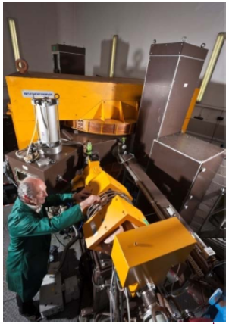
3. WP11 .5 – UoB
At the MC40 cyclotron at the University of Birmingham a high intensity irradiation line was commissioned for particle physics in
early 2013
– Proton energies up to 40 MeV
are possible at extraction with currents ranging from pA to up to 2 μA
Beam spot 10 x 10 mm (collimated)
Flux up to 10¹³ protons/s/cm²
– Available as “Remote Scientific Service”

Slide 29
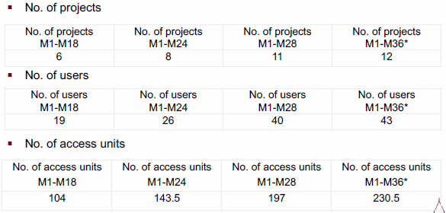
3. WP11 .5 – UoB
- Publications 10
UoB | User Projects |  | Total users | TA units
 | Submissions | Selected
M1-M36 | 12 | 12 | 43 | 230.5 (96%)
M1-M48 | 60 |  | 180 | 240

Slide 30
OUTLINE
1. Introduction
2. WP10 –Beam Test Facilities
3. WP11 –Irradiation Test Facilities
4. WP12 -Detector Characterization Facilities
5. Summary

Slide 31
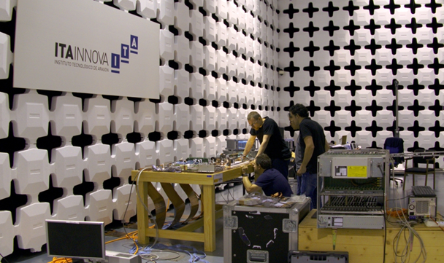
4. WP12. 1 ITAINNOVA
EMC Laboratory of Instituto Tecnológico de Aragon (ITAINNOVA) in Spain for EM noise characterization.
EMC facilities allow to perform Electromagnetic Compatibility Tests
  Non–standard test (Specially focused on HEP)
  Standard ( According to European Directive 2004/108/EC)

Slide 32
4. WP12 .1 ITAINNOVA
4 TA-WP12.2 accesses have been completed
  TA-ITAINNOVA – (54 % TA units - Completed)
Access has been requested from 3 countries
  Germany, Austria and Italy
The activity has slowed down the last year but it is expected to speed it up during second part of the year (and during 2019)
ITAINNOVA | User Projects |  | Total users | TA units
 | Submiss. | Selected
M1-M36 | 5 | 5 | 10 (2) | 640 (54%)
M1-M48 | 12 |  | 12 | 1200

Slide 33
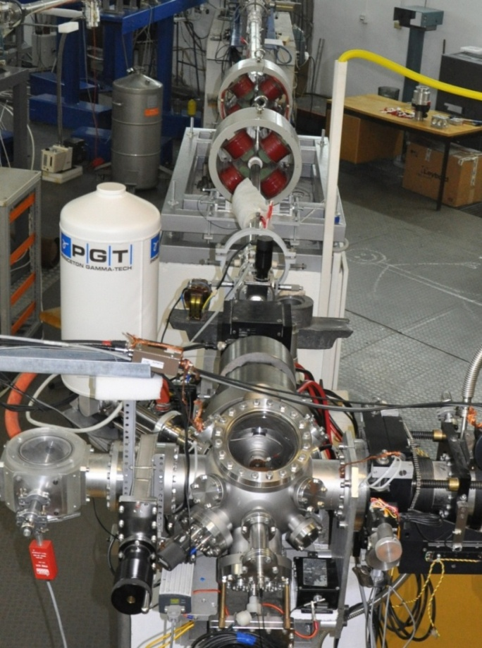
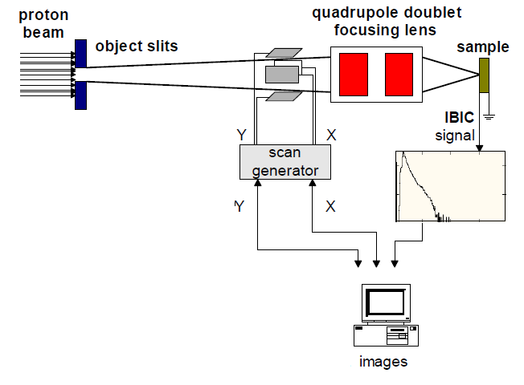
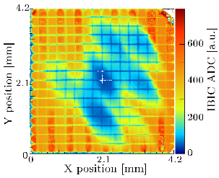
4. WP12. 2 RBI
Ruđer Bošković Institute offers Tandem Accelerator Facility to study:
charge collection properties of detector materials by IBIC method
perform radiation hardness tests and defects mapping
Quadrupole triplet
Focusing lens
IBIC - charge collection efficiency image

Slide 34
4. WP12 .2 – RBI
TA-RBI (M1-M36):
- 12 TA approved and done (75 % completed)
- 27 users, 20 supported
- Users from 7 countries
Austria, France, Germany, Greece, Italy,
Serbia, United Kingdom
RBI | User Projects |  | Total users | TA units
 | Submissions | Selected
M1-M36 | 12 | 12 | 27 20 supported | 480 (75%)
M1-M48 | 16 |  | 24 | 640

Slide 35
4. WP12 -Detector Characterization Facilities
Scientific output of users (publications, conferences)
TA - ITAINNOVA (M1-M36):
- 2 papers published
- both in 2016
- 4 contributions to conferences
- 3 oral contributions
- 1 poster
- 2 On Track contributions
TA-RBI (M1-M36):
- 5 papers published
- 1 in 2016, 2 in 2017,
- 2 in 2018
- 9 contributions to conferences
- 2 keynote speakers
- 3 invited talks
- 4 oral contributions
- 2 MSc theses
- 2 On Track contributions

Slide 36
5. Summary

Slide 37
5. Summary
TA activities are going well
  Almost all activities are on schedule
  On average planned Access Units are almost completed
  No need for corrective actions
  However, number of publications is still low when compared with the number of completed projects

