Slide 1
AIDA-2020
WP2: Innovation & Outreach
Aurelie Pezous, CERN
AIDA-2020 3rd Annual Meeting, 25th April 2018

Slide 2
Objectives
  Scientific Coordination
  Communication, dissemination and outreach
  Industrial relations and technology transfer
  Management of the Proof-of-Concept (PoC) fund
  Pre-industrialisation of large area silicon detectors

Slide 3

Task 2.3 Industrial relations and technology transfer
Academia meets Industry Symposium
Why on Non-Destructive Testing?
Market study:
    2016: 15 billions $
    GR: 8-10 %
Technologies used in NDT:
    X-ray technologies (closed to HEP)

Slide 4
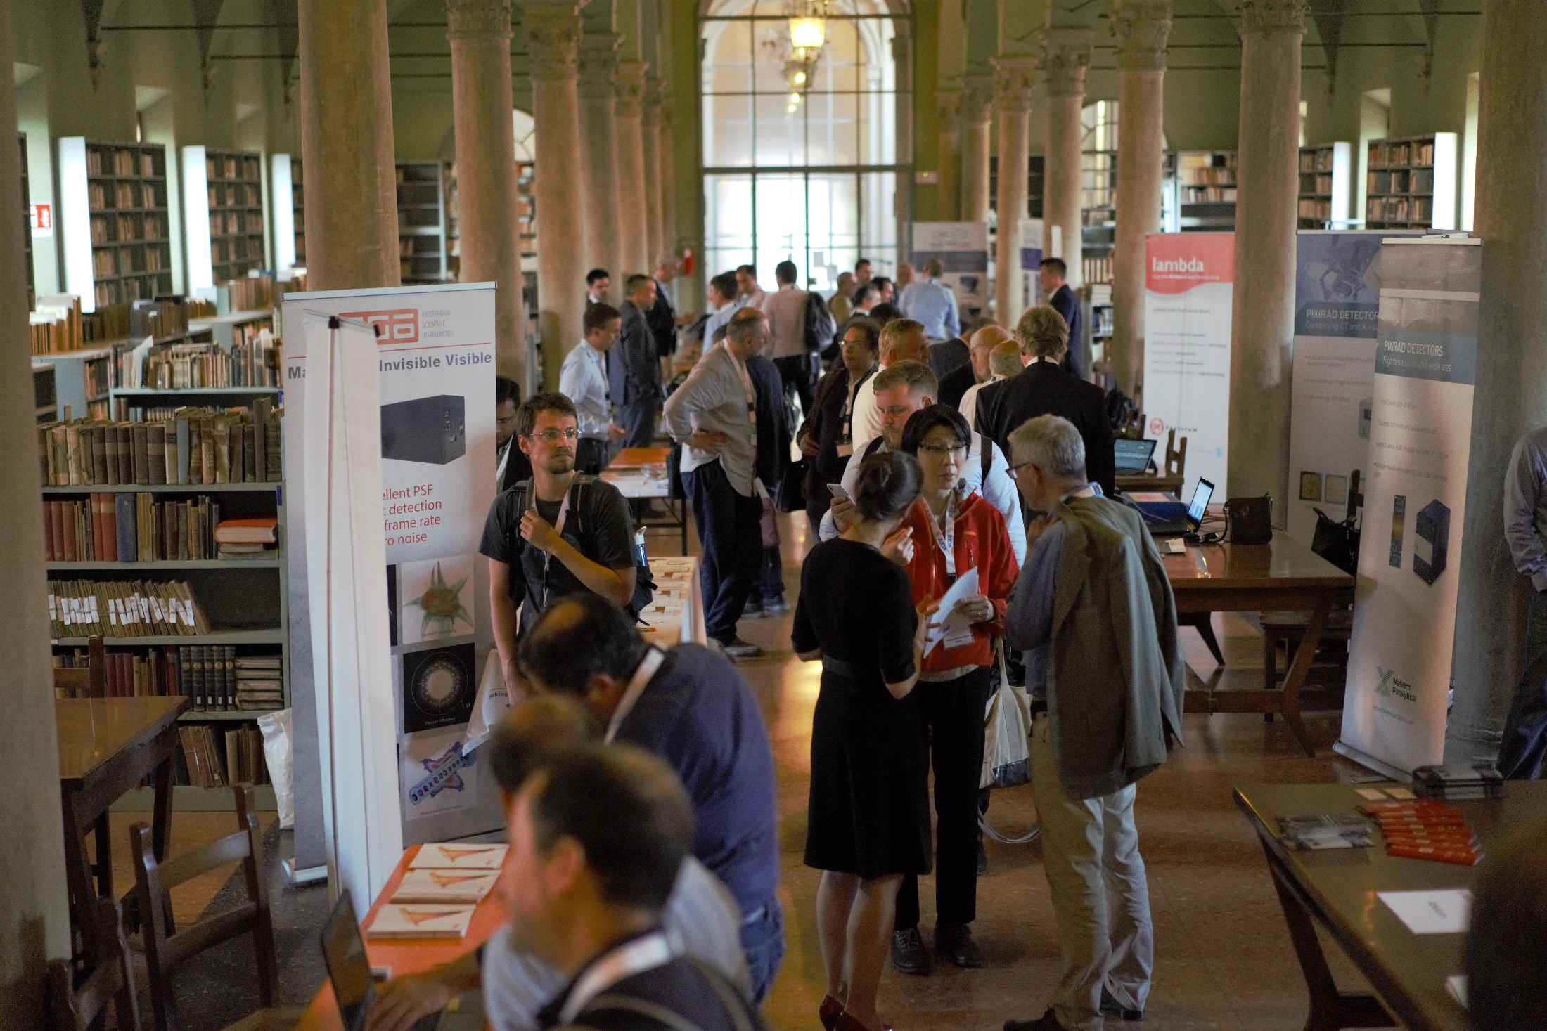
Task 2.3 Industrial relations and technology transfer
Key elements
12 companies with a booth (+140%)
18 speakers:
  4 from academia (-60%)
  14 from industry (+100%)

Slide 5
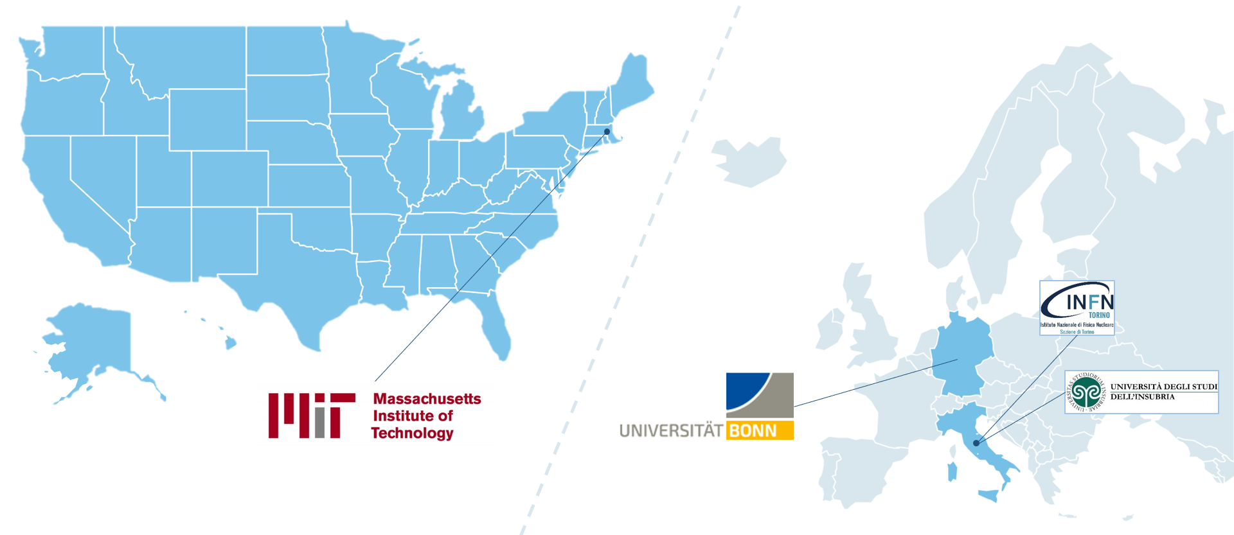
Task 2.3 Industrial relations and technology transfer
From academia:

Slide 6
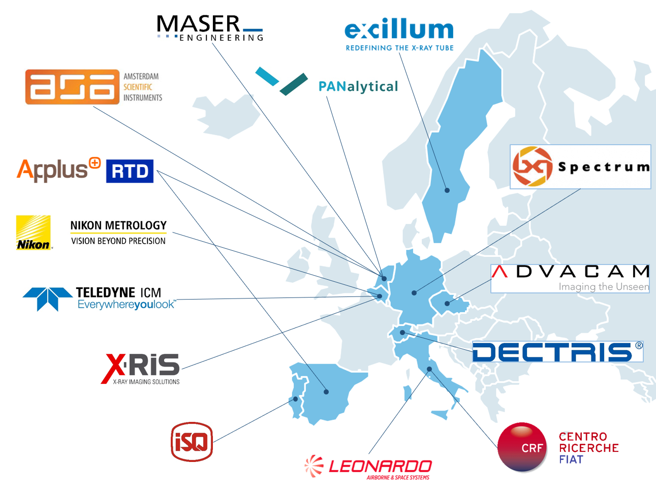
Task 2.3 Industrial relations and technology transfer
From industry:

Slide 7

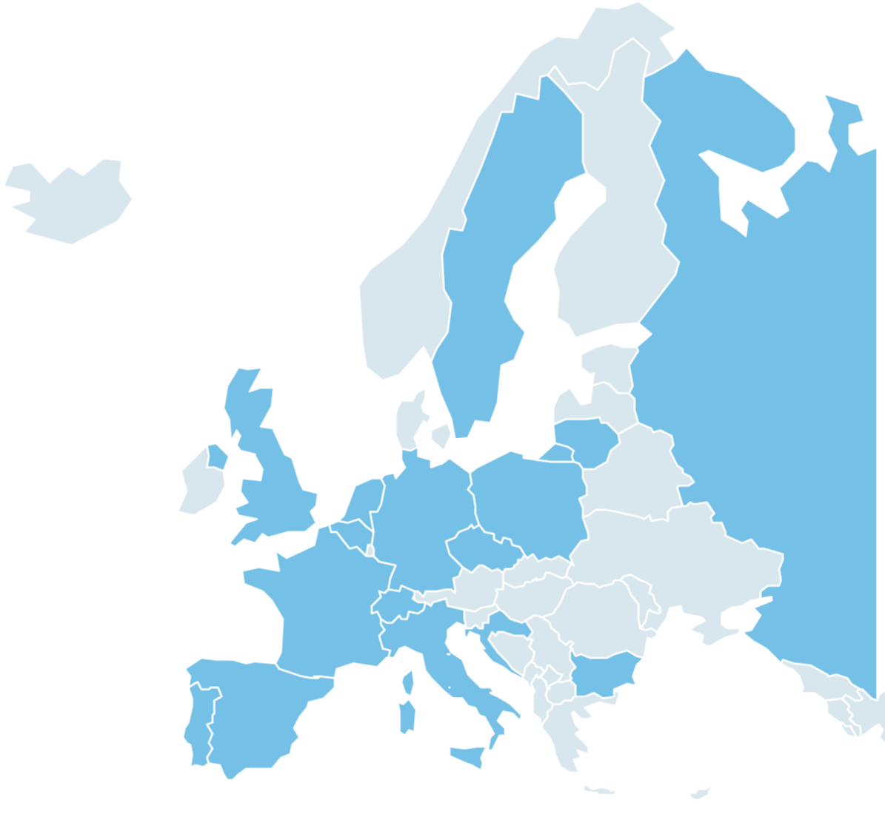

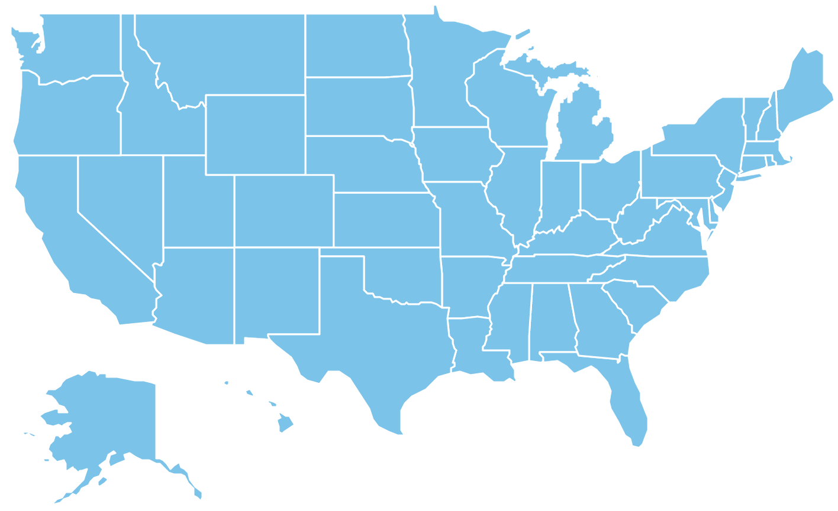
Task 2.3 Industrial relations and technology transfer
87 participants (+45%) from 18 countries
    31 from industry
    56 from academia

Slide 8
Task 2.3 Industrial relations and technology transfer
Academia meets Industry Symposium:
Detectors Sources
Producers
Integrators
End users

Slide 9
Task 2.3 Industrial relations and technology transfer
Academia meets Industry Symposium
B2B meetings:
  11 meetings organized industry-industry
  7 meetings organized industry-academic
  1 meeting organized Academia-Academia
  + All the discussions during coffee breaks and networking event
Notes:
- Argonne National Laboratory / ASI
- CEA/Irfu / Direct Conversion
- MIT / ASI
- MIT / Direct Conversion
- Max-Plank-Society / ASI
- IPP / Nikon Metrology
- Vilnius University / ASI

Slide 10
Task 2.3 Industrial relations and technology transfer
How to measure the impact of an Academia meets Industry?
Feedback:
  Online survey available
  Interview will be schedule with the industrial speakers in September as a follow-up.
  Numbers of contract in discussion and /or signed thanks to the event

Slide 11
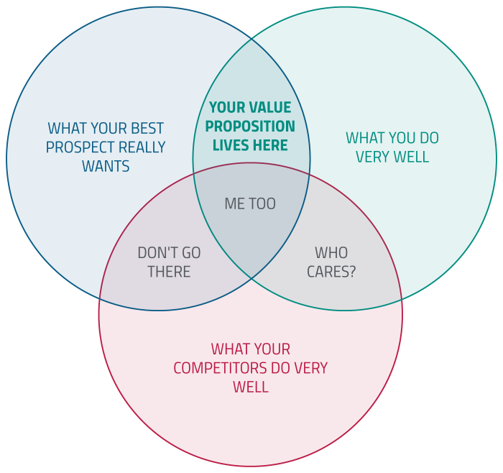
Task 2.3 Industrial relations and technology transfer
How to improve the KT/TT from AIDA2020 to Industry?
  Prepare a value proposition of what is unique in each WP:
    1slide to explain what is done or what is the specific know-how developpedin AIDA2020, what is in it for Industry and the type of industry that might be interested

Slide 12
Task 2.3 Industrial relations and technology transfer
Why should we start this activity?
  To show EC that we understand the requirements to work closer to industries
  Having a set of slides to be presented to industry to partner for the next project
  Having a set of slides to be presented to industry during the next BSBF

Slide 13
Task 2.4 Management of the Proof-of-Concept (PoC) fund
Objectives of PoC:
  General field of detector development
  Collaborative project industry oriented
  Bringing technologies closer to the market
→ Impact beyond high energy physics

Slide 14
Task 2.4 Management of the Proof-of-Concept (PoC) fund
3 projects funded:
Budget € | Title | Lead Institute | Partners
45,600 € | Silicon‐based Microdosimetry System for Advanced Radiation Therapies | Instituto de Microelectronica de Barcelona
74,825 € | Advanced Through Silicon Vias for Pixel Detectors | University of Bonn | Fraunhofer IZM
66,641 € | RaDoM | CERN | Politecnico di Milano, Mi.am

Slide 15
Task 2.4 Management of the Proof-of-Concept (PoC) fund
Silicon‐based Microdosimetry System for Advanced Radiation Therapies
Motivations:
  1 out of 2 persons born today will be diagnosed with cancer in their lifetime (SEER Cancer Statistics Review 1975-2013)
  More than 50% of all cancer patiens will receive radiotherapy for curative or palliative aims
  Hadrontherapy is a fast-growing modality of radiation therapy
Objectives:
Realization of a new microdosimetry tool optimized for clinical application for verification of hadron treatment plans.

Slide 16
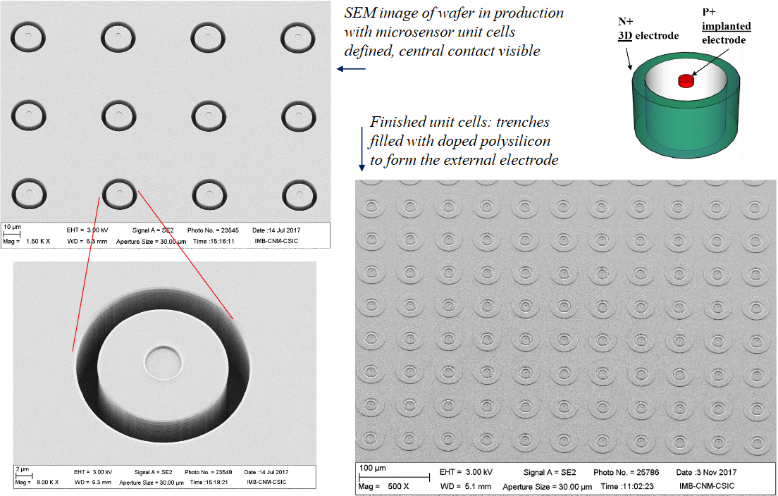
Task 2.4 Management of the Proof-of-Concept (PoC) fund
Silicon‐based Microdosimetry System for Advanced Radiation Therapies
The system consists of CSIC’s novel silicon microsensors together with a multi-channel readout electronics and will be capable to provide detailed microdosimetric distributions in space and in time.

Slide 17
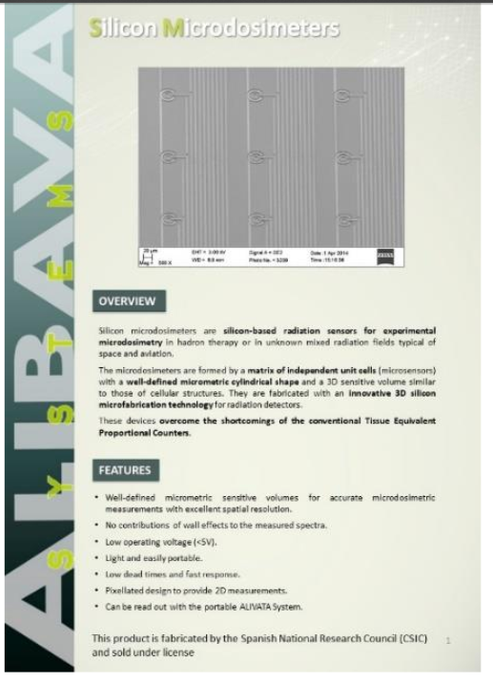
Task 2.4 Management of the Proof-of-Concept (PoC) fund
Silicon‐based Microdosimetry System for Advanced Radiation Therapies
Partner with Alibava system
Looking for other fields of application

Slide 18
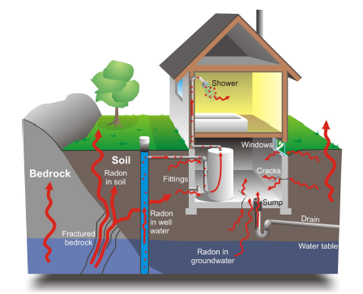
Task 2.4 Management of the Proof-of-Concept (PoC) fund
RaDoM
Radon gas is the most important source of ionizing radiation among those of natural origin.
Currently the dose is estimated by measuring radon and/or radon progeny concentrations.
In the dose estimation, lots of parameters are taken as default, such as the aerosol size, the equilibrium factor, particle density and shape, etc, leading to significant uncertainties.
Matching fund from CERN-MAPF

Slide 19
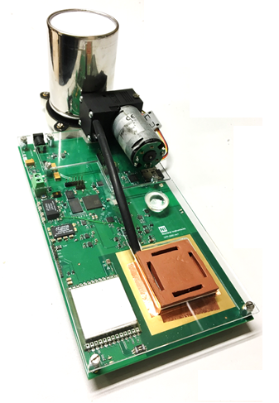
Task 2.4 Management of the Proof-of-Concept (PoC) fund
RaDoM: current status
High resolution alpha particle spectrometer:
  radon, thoron and actinium daughters
External plug-in radon concentration probe
15-minute time resolution
Embedded shock, temperature and humidity sensors
Optional environmental sensors, e.g. CO₂
Powered by Linux
LoRa, WiFi, Bluetooth, LTE connectivity
Cloud platform
iOS and android apps
200 mm
110 mm

Slide 20
Task 2.4 Management of the Proof-of-Concept (PoC) fund
RaDoM: starting the spin-off journey
RaDoM project was selected from 450 applicants as one of the 75 finalists for the MassChallenge2017 Accelerator Programme in Switzerland and passed the VentureKick Phase 1 selection for funding
3 Pilot projects are running
30pages business plan ready for investors

Slide 21
Task 2.4 Management of the Proof-of-Concept (PoC) fund
Advanced Through Silicon Vias for Pixel Detectors
Goal: establish high yield TSV + RDL process for pixel modules
  straight vias through ultra thinned FE-I4 wafers and chips: note 2x2 cm2 chip size
  80 – 100 µm thickness (to be optimized),
  aspect ratio = 2 : 1 (via diameter 60 µm)
  thin wafer backside process using carrier wafer
  complete development including flip-chipping process for the final pixel module
Challenges of the project:
  reliable TSV fabrication ... yield hoped/expected to be much better than for project 2
  thin (100 µm) wafers are needed for the goal of “large yield” challenge is the handling of large and very thin wafers/chips
  surprises during flip-chipping can also be an issue

Slide 22
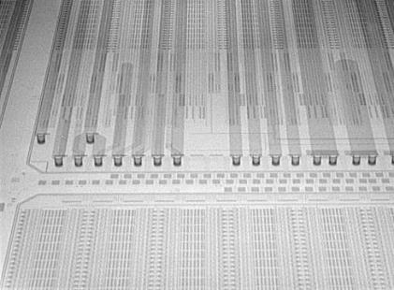
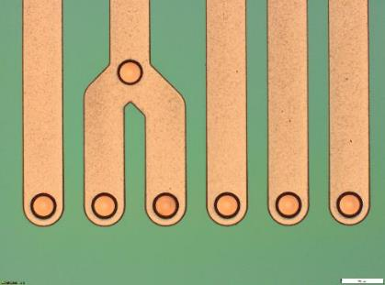
Task 2.4 Management of the Proof-of-Concept (PoC) fund
Advanced Through Silicon Vias for Pixel Detectors
Detectable breakdown voltage starting at 40V, max. 100V
Process optimization possible → benchmark of 80V breakdown achievable but not required here

Slide 23
Task 2.4 Management of the Proof-of-Concept (PoC) fund
Advanced Through Silicon Vias for Pixel Detectors
Several Industrial projects started based on this development

Slide 24
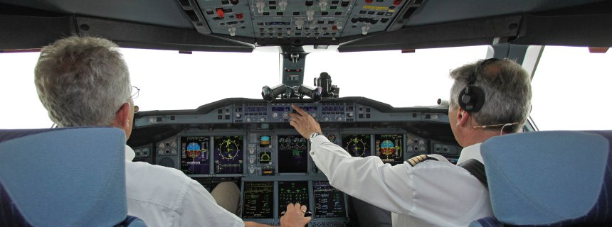
Task 2.5 Pre-industrialisation of large area silicon detectors
Dual Source Strategy
To have (at least) a second option which can immediately take over in case of problems is in principle not a bad idea
  Imagine: quality issues, bankruptcy, earthquakes,…

Slide 25
Task 2.5 Pre-industrialisation of large area silicon detectors
Market survey: Common MS CMS/ATLAS
  Identify an EU company able to produce sensors on a large scale
Step 1: Companies need to return the “Technical Questionnaire” document where the responses need to fulfil the requirements set in the “Qualification Criteria” document → ADIA-2020 Milestone MS30 (2016)
Step 2: Companies need to provide samples free of charge of functional devices of e.g. previous project → 2nd annual meeting (2017)
  ATLAS and CMS qualified samples developed by HEPHY-ÖAW as 8” proof-of-principle
Step 3: CMS/ATLAS orders (and remunerates) a batch of prototype sensors according to CMS layout and specs → ongoing 2018
  ATLAS and CMS ordered close-to-final prototypes as described in the TDRs

Slide 26
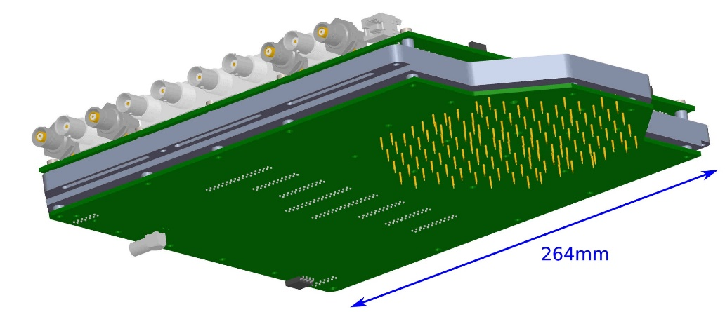
Task 2.5 Pre-industrialisation of large area silicon detectors
HGCAl sensors:
  Infineon: production of Si pad sensors for HGCal
Quality constantly improving
  One remaining problem: premature IV breakdowns, scaling with sensor size
  Addressed now by thicker backside implantation
Full probe card development

Slide 27
Milestones and Deliverables
Milestones since last annual meeting:
  MS45: 1st AIDA-2020 “Academia meets Industry” event (M24)
  MS71: Progress review of the selected projects(s) for the PoC Fund (M34)
  MS79:2nd AIDA-2020 “Academia meets Industry” event (M36)- in progress

Slide 28
Coming year
Follow-up PoC projects
Prepare value proposition with WP leaders and TTO

