Slide 1
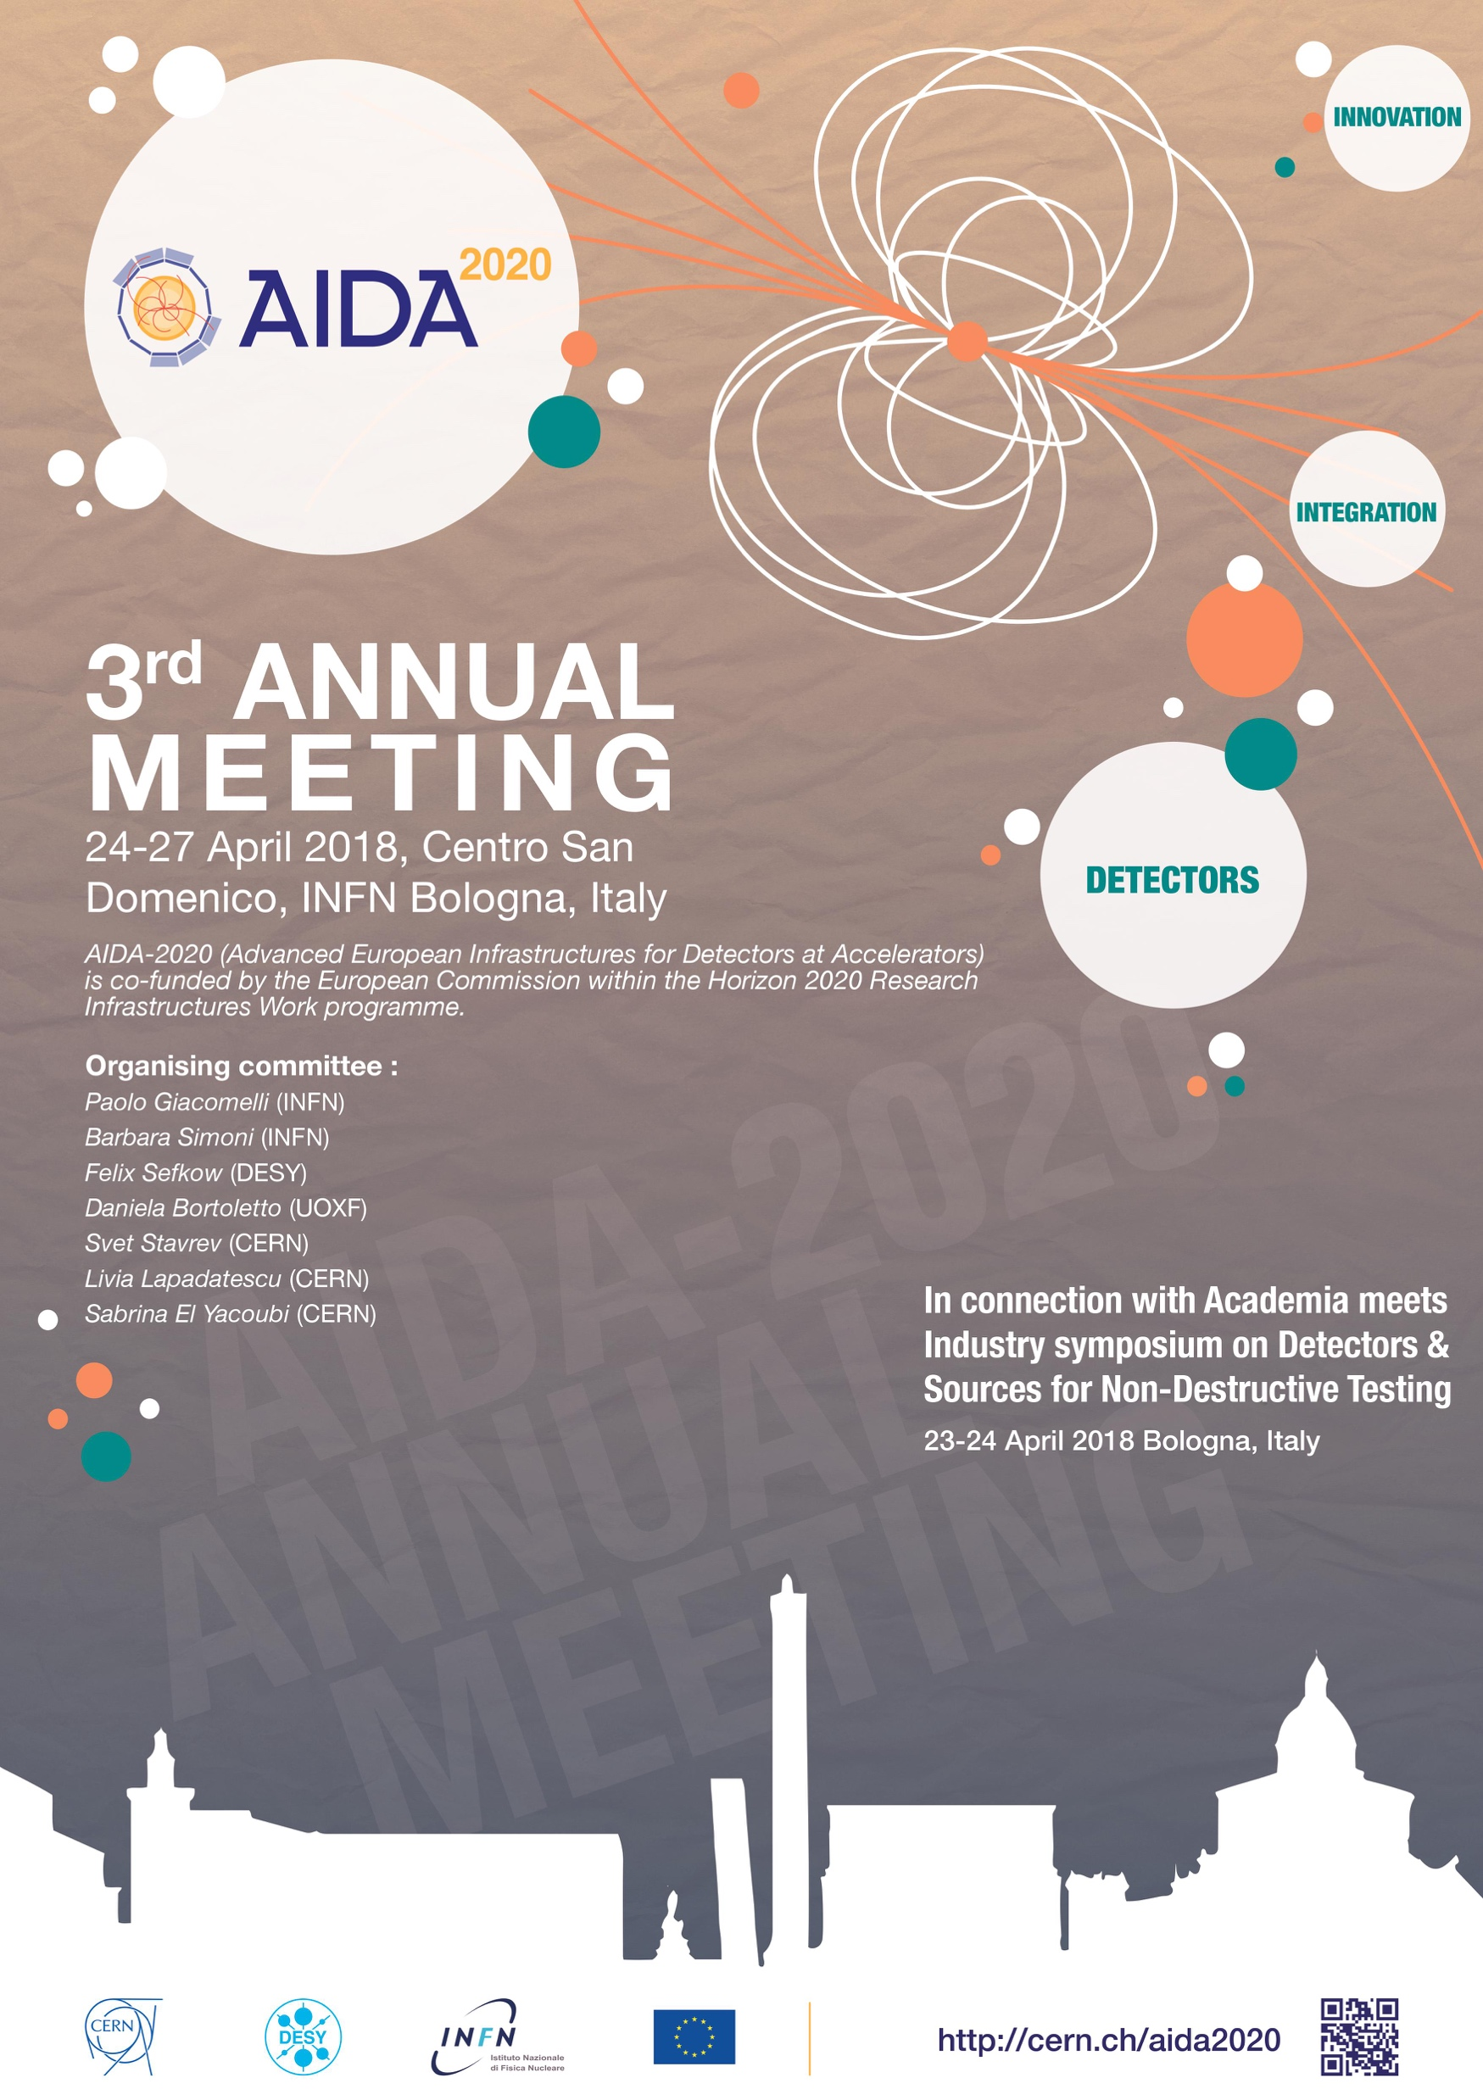
Report from the Science Advisory Board 3rd Annual Meeting
Marcel Demarteau on behalf of the SAB
Bologna, April 27, 2017

Slide 2
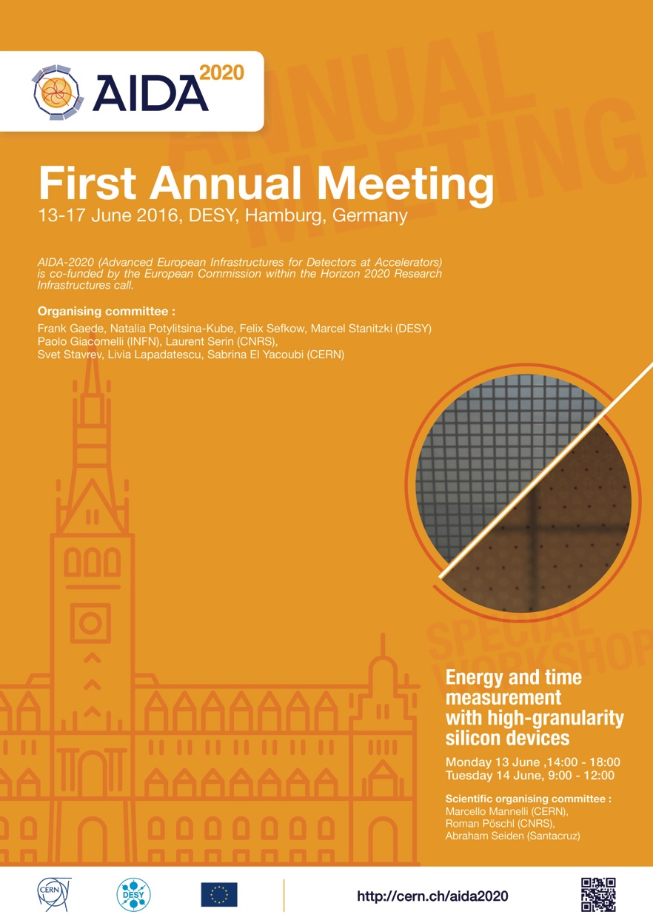
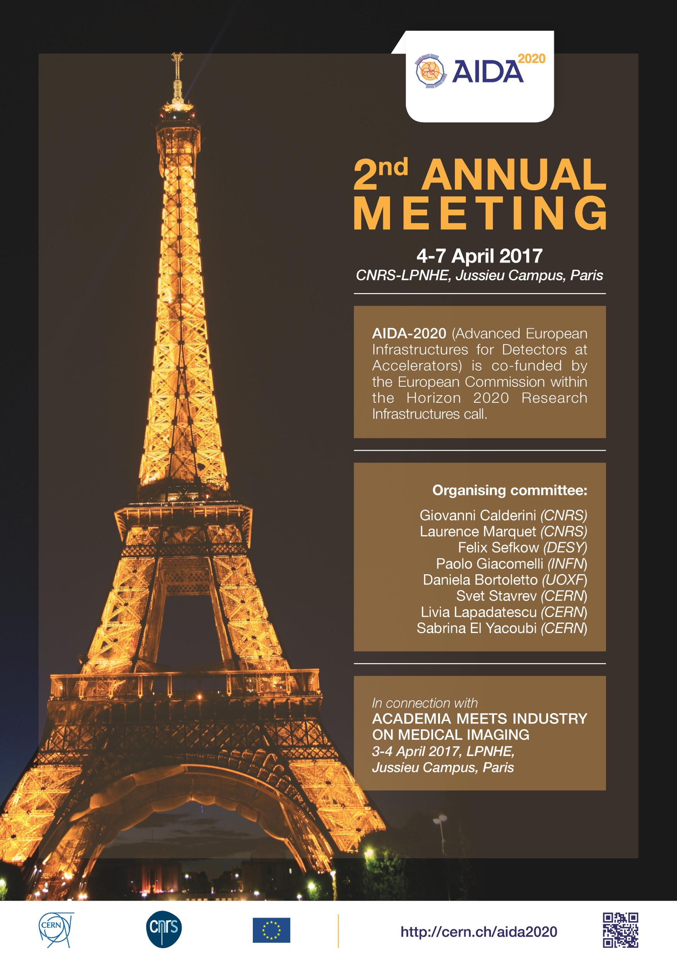
Annual Meetings
Thank you for the great venues,
terrific hospitality, great food, superb support, ….

Slide 3
Third Annual Meeting
First two workshops were impressive
Third workshop as impressive:
123 participants
24 parallel sessions with a total of 110 excellent presentations in parallel sessions
Very enthusiastic and dedicated teams in each working group and excellent progress reported by all groups.
Many young scientists involved !
Congratulations on the accomplishments to date!
Thank you!

Slide 4
Venue
Many fascinating talks, but perhaps a most intriguing hidden message?

Slide 5
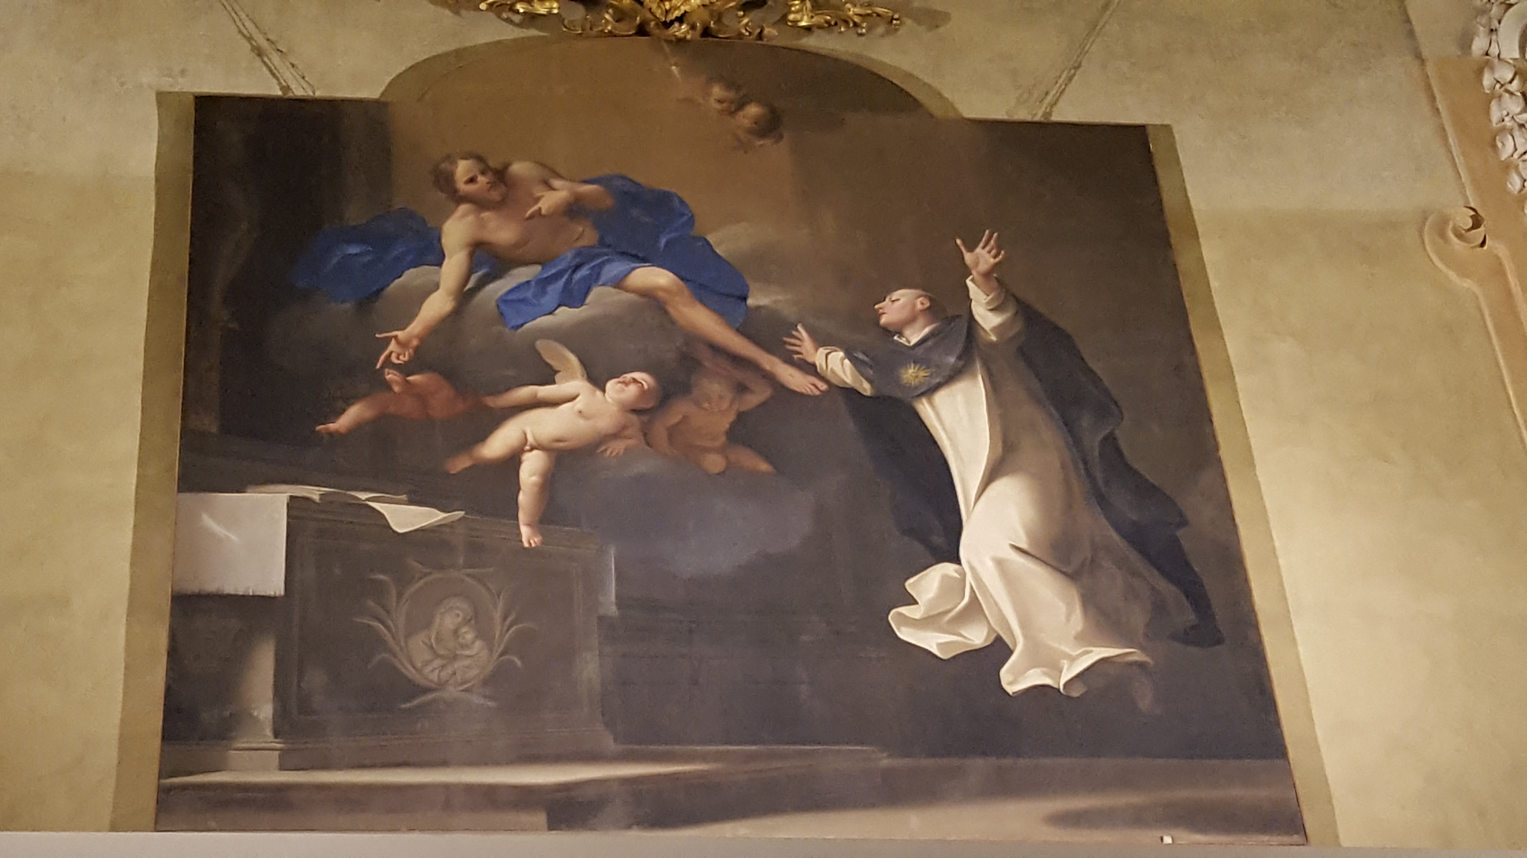
Venue

Slide 6


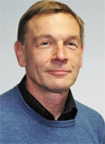
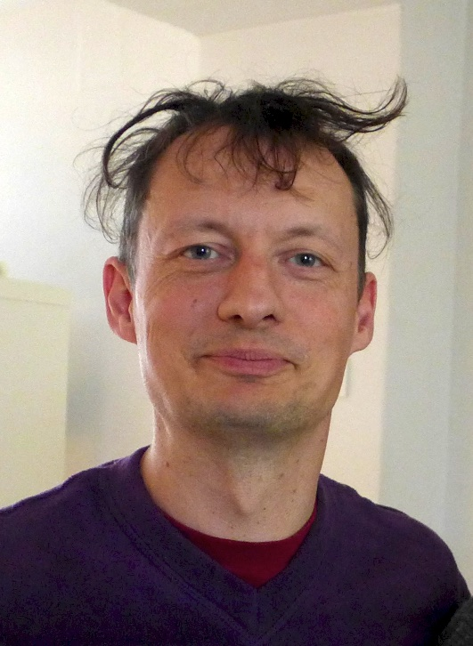
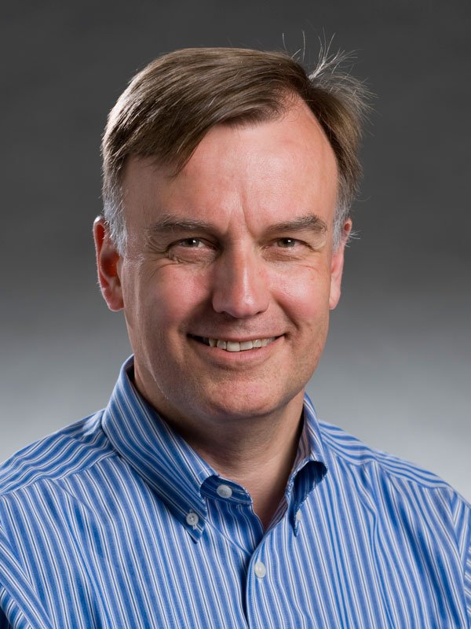
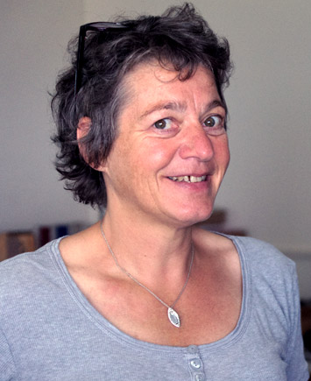
Reminder of the SAB
Ariella Cattai
CERN
Marcel Demarteau Argonne
Peter Mättig Wuppertal
Greame Stewart CERN
Jim Strait Fermilab
Isabelle Wingerter Annecy
Lead for
WP2
WP9
WP13
Lead for
WP2
WP6
WP7
Lead for
WP4
WP2
WP11
WP12
WP15
Lead for
WP3
WP2
WP5
Lead for
WP1
WP2
WP8
Lead for
WP2
WP10
WP14

Slide 7
SAB Charge and Activities
We understand our task to provide constructive advice to the Management Team (MT) on a regular basis on technical and strategic matters related to the scientific program of the projects
Dialogue with MT resumed ~2 months ago
SAB had a telecon on April 11, 2018 with all members attending
Submitted a list of questions to MT
Submitted a list of questions to MT related to the various work packages
Received from MT:
Draft on Extension of AIDA-2020 as sent to the Governing Board
Reactions and Responses to the 2017 Report
Responses to the Questions to the MT
Responses to the WP-Specific Questions
MT and SAB members had working lunch meeting on Wednesday
SAB members had working lunch on Thursday
We are here to help!

Slide 8
AIDA 2020
Integrated infrastructure initiative in EU FP8 “Horizon 2020”
Loose definition of “infrastructure” = common interest
Project with four year duration; currently at the mid-point
EU contribution 10 M€
Total budget 29.7 M€
19 participating countries
38 beneficiaries
Activities:
Joint Research
Networks
Transnational Access

Slide 9
General Observations
THE metric used to gauge the value of the work of the scientific community is publications in peer reviewed journals
Last year, the project was at the mid-point, but publications were only at the ~25% level of the set goal (180).
This year, huge improvement. Congratulations!
Target 60 (journal), 50 (conference), 180 (total)
Today 37 (journal), 33 (conference), 145 (total)
However, some work packages are better than others.
Within a work package, there are large differences:
WP15: Ratio of publications to number of selected project varies from ~90% to ~5% for different facilities
Closer monitoring, and incentive mechanism, is recommended.

Slide 10
General Observations
Good to see more interaction among the different work packages; it is often the sharing of ideas and concepts that leads to innovative developments
All working groups have strong ties to running or proposed experiments. Further strengthening these relations and strengthening relation among work packages is encouraged
Value of the work greatly enhanced if it advances technologies of current experiments and adopted by proposed experiments

Slide 11
WP1: Observations
WP 1: Project management and coordination
The management team continues to do a excellent of job running this wide-ranging and important program. The success of the program is a tribute to the work of the management team.
The program is about 75% of the way through its 4‐year duration, and in general it is progressing according to plan.
Almost all (81 of 87) milestones due up until now have been met on‐time or with only inconsequential delays. Most of the missed milestones are expected to be achieved soon.
30 of 39 deliverables due have been achieved. The overall delay is on the order of 2 months. The proposed no-cost extension of the program could help AIDA 2020 meet all of its deliverables with excellent results.
Overall spending is on track, with some work packages spending a bit ahead of schedule and others a bit behind. AIDA‐2020 management continues to monitor the expenditures properly.

Slide 12
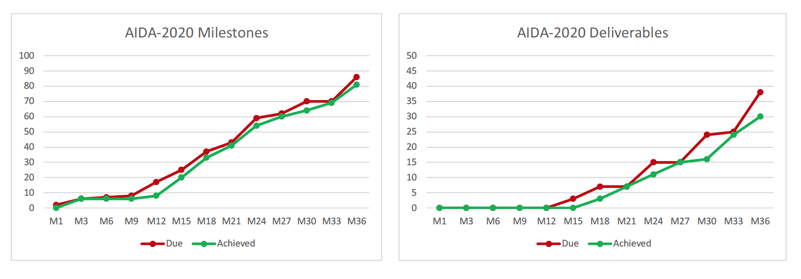
Schedule
Achieving the schedule of deliverables and milestones is very good, even though some have been late. After all, this is R&D and some delay is to be expected.

Slide 13
WP1: Extension
WP 1: Management
The nominal end date of AIDA 2020 is April 2019. The MT is considering submitting a request for a no-cost 12 month extension of the project until April 2020.
This would bridge the gap to the next EC call, which closes around March 2020. It provides an opportunity to “keep the community together”, that is, continue to do work in areas that met their goals already and prepare for the next call. A perhaps key example is transnational access. The transnational access has been a clear success story of AIDA and retaining its strength would add great value. Management is encouraged to preserve this capability.
In addition, the extension provides for an opportunity to increase the impact of AIDA 2020 in certain areas

Slide 14
WP1: Extension
WP 1: Management
The MT shared with the SAB the proposed set of deliverables to be extended:
Eight deliverables extended due to unforeseen delays (WP7,9,10,14,15)
Nine deliverables extended due to increased scope (WP2,3,4,5,6,8,12)
The Committee supports the extension request and strongly agrees with the motivation for increased impact of various tasks.

Slide 15
WP1: Extension
WP 1: Management
The committee strongly advises the team to use the extension period to re-evaluate the accomplishments and impacts of the work packages to provide input in the preparation for the next proposal.
The AIDA-2020 program is highly integrated with the LHC upgrades and other approved projects, which has its advantages and disadvantages.
Significant changes in experimental research needs are foreseen due to projects moving into construction. This will have a significant impact on the future structure of this program, which will have to be properly taken into account for a successful new proposal. A rigorous evaluation of the core AIDA contributions is suggested.
The AIDA-2020 team is encouraged to start engaging in an active dialogue with a broad community outside the current core AIDA-2020 membership to guide the formulation of the next proposal submission.

Slide 16
WP2: Observations
WP 2: Innovation and outreach
Impact of communication (website, newsletter) developments is being measured using industry benchmarks. It is recommended to compare the results using other (physics) benchmarks.
Industrial relations and technology transfer: Academia Meets Industry (AMI) was well attended
Impact will be studied (survey, contacts)
Improvements of the Knowledge Transfer, Technology Transfer from AIDA2020 to industry for 2018-2019
It is suggested to continue to monitor the impact of the first AMI workshop.
Proof of Concept: three projects seeking impact beyond HEP
Two projects (RaDoM, SMART) have built devices under tests
TSV is a common development with IZM, which is exploiting the process for other companies
Industrialisation of large areas silicon detectors: market survey
ATLAS & CMS are evaluating prototype sensors
Milestones since last AIDA2020 general meeting met.
Science Advisory Board
27 April, 2018

Slide 17
WP2: Observations
WP 2: Innovation and Outreach;
The reviewers acknowledge the very interesting suggestion on how to improve the KT/TT from AIDA2020 to Industry by preparing a proposition of what is unique in each WP. → It would be profitable to identify in each WP a contact person who systematically accompanies KT/TT in the compilation process.
The Proof of Concept (PoC) formula found large support in the community and has been very successful. The PoC concept and the outcomes should be further and widely publicised in the HEP community. The extension of the program should help in providing a better assessment of the impact of the POC projects.

Slide 18
WP3: Observations
WP 3: Advanced Software
Detector Geometry toolkit DD4hep and other DD-suite programs are attracting interest from quite a few experiments (CMS, Belle II), very positive
Use in large productions for ILC is proving robustness
On the threshold of becoming a successful commonly used piece of software
Documentation and support can now help to make adoption successful
Vectorised geometry toolkit demonstrated to make a real difference to real experiments
Now need to work on documentation to support further adoption
Particle Flow algorithms seem well established for neutrino and lepton experiments
Does not perform well for hadronic experiments, due to pile-up issues (resolving this is critical for MS92)
Progress in tracking* and EDM is less than would have been hoped for in the last year
Tracking affected by entry of common ACTS toolkit into the community
Integration of AIDA2020 work into this project looks the best outcome for community, justifying some delay
EDM toolkit has a very promising design and prototype
Needs development work to really show performance boosts for IO and for vectorised data access
Frameworks* work has been affected adversely by external factors
Work on how conditions and alignments are managed between the framework and DDAlign and DDCond really needs clarified – designs don’t seem to work together well right now
Licensing made progress – good
But LGPL now favoured over GPL as some experiments wish to license their software more openly
*Good candidates for project extensions, given these external factors

Slide 19
WP4: Observations
WP 4: Microelectronics and Interconnects
AIDA contributes successfully to essential developments in front–end electronics.
Last year important steps towards prototyping R/O electronics for pixel and calorimeters @ LHC upgrades:
Key project for pixel upgrade: 65nm chip inside RD53: first chips arrived Dec 17 – good performance, first modules 2 weeks ago!
The delivery was delayed for reasons outside of AIDA
This means a tight schedule for LHC – upgrade
Calorimeter chips on time (del. End of 2017); Testing started a month ago
Probably too late for LHC upgrade but important for future:
Very good progress in interconnects: have been included in FEI4 pixel chips and wait to be tested. Understandable request to shift beyond M48.
Excellent to see the progress in these difficult areas

Slide 20
WP5: Observations
WP 5: Data acquisition system for beam tests
Trigger Logic Unit production recovered well after initial production issues
Installation at various beam lines has been successful
CERN equipping all AIDA-type beam likes with AIDA2020 TLUs is a vindication of the utility of WP5
EUDAQ2 being used for first real data taking is a large success
AHCAL and LYCORIS Si Tracker use has helped show the system really works all together
Problems with speed of LCIO conversion demonstrate an opportunity for WP3’s PODIO EDM
Engagement with WP14 and WP15 is a strength of AIDA2020
Look forward to next set of tests, incorporating CMS HGCAL
DQM4HEP has needed extensive refactorization
Worth taking the time to do this properly
Direct integration with EUDAQ2 is an important goal to achieve
License change to LGPL instead of GPL would be desirable
Proposed extension of final deliverable, use of common DAQ at test beams, makes a lot of sense
This will allow extended use of this DAQ infrastructure to be reported back to the EU
"Ensuring journal publications happen for main components is very important"

Slide 21
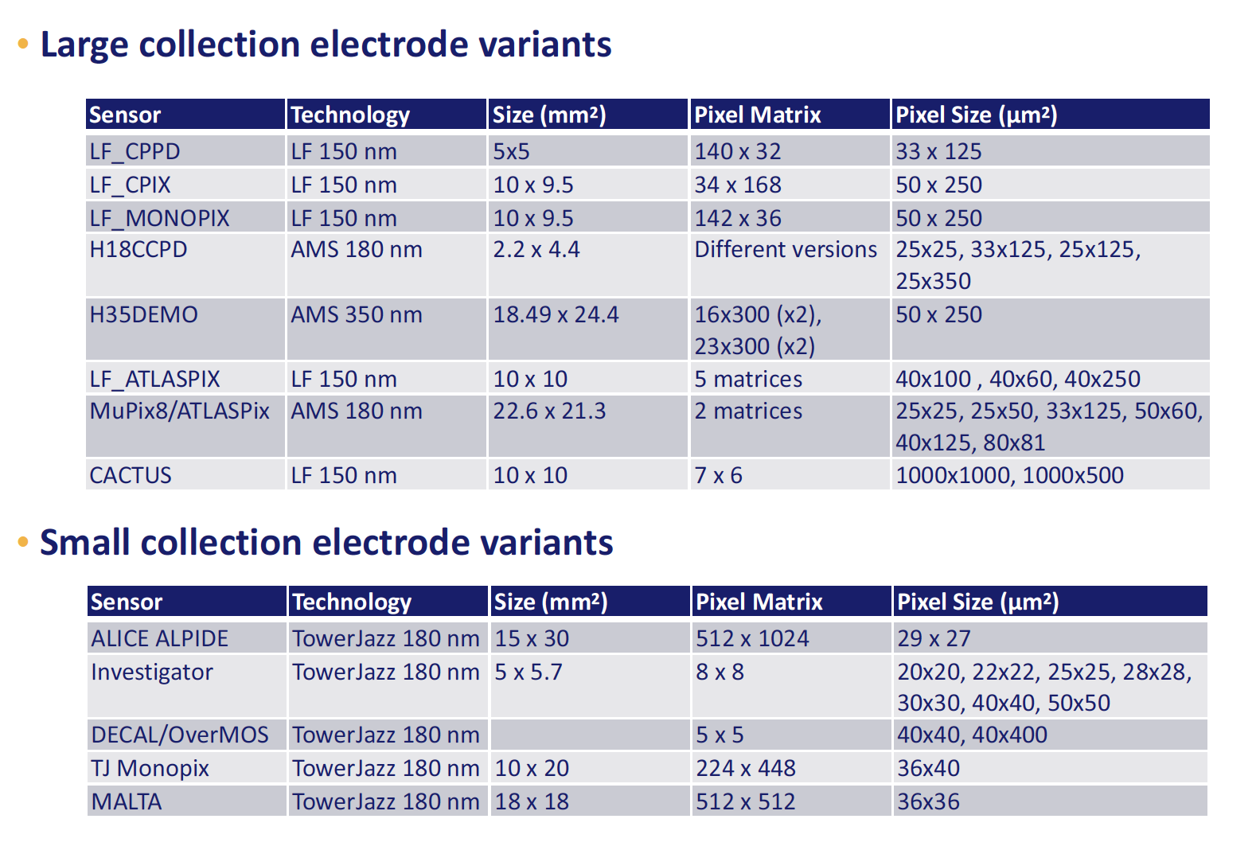
WP6: Observations
WP 6: Novel CMOS sensors
Huge scope exploring innovative tracking-detector technologies based on active CMOS sensors and well organized task structure

Slide 22
WP6: Observations
WP 6: Novel CMOS sensors
Three main tasks: Simulation, Sensor Development, Hybridisation
Designs fully supported by TCAD simulations
All devices being studied for radiation hardness and characterized in test beams
Excellent collaboration between the institutions, good task sharing excellent use of testbeam infrastructure.
All milestones met; two key deliverables will be delayed with the extension:
Radiation tolerance assessment
Optimised interconnection process
Good publication record over the course of the last year
Activities very well integrated with the LHC experiments
Research extremely valuable for upgrades and next generation experiments; extension of the deliverables very strongly motivated

Slide 23
WP7: Observations
WP 7: Advanced Hybrid Pixel detectors
Three technologies (planar, 3D, LGAD) being studies in the framework of WP7
Excellent progress in all four key areas of the work package:
TCAD simulations
Common process optimisation for hybrid pixel sensors
Detector validation for tracking devices
Detector validation for LGAD sensors
Production:
The 3D and LGADs manufacturing processes started at CNM-CSIC during the first quarter of 2018, scheduled to be completed by M39 (LGAD) and M42(3D)
FBK has completed the small-cell 3D run, and the sensors are now ready with UBM to be interconnected to the RD53A chip. Devices to be shared with ATLAS and CMS. WP7 is making crucial contributions. The production of these modules is foreseen for May 2018.
The start of the planar sensors run with active edges at FBK has been delayed by the longer time needed by preparation of the SOI wafers. It is foreseen to start in June and it should be completed in time for meeting the milestone
TCAD Simulations well advanced with continuous sophistication of the radiation damage models, notably the surface damage modeling.

Slide 24
WP7: Observations
WP 7: Advanced Hybrid Pixel detectors
Three deliverables suggested to be extended (TCAD modeling, pixel and LGAD characterization); the work is highly relevant for the HL-LHC program and the extension of the deliverables are well motivated.
The work carried out within WP7 contributes in important ways to the technology development of pixel detectors, and informs the LHC upgrade programs in important ways.
At the initiation of the work package some technologies were relatively immature; AIDA has helped in the maturation process.
WP7 is in certain areas (LGAD, 3D) providing first devices for the experiments.
Excellent coordination and integration with the LHC experiments, leveraging each others resources and expertise.
The work load of this work package is very high and needed for the LHC upgrades. Excellent coordination is required; it seems LHC experiments will be the drivers.

Slide 25
WP8: Observations
WP 8: Large Scale Cryogenic Liquid Detectors
Excellent work continues to be done to develop a number of key technologies that advance the state-of-the art in very large LAr neutrino detectors.
Instrumentation for monitoring purity and other key parameters
Large-scale dual-phase charge readout planes with gas amplification
Light readout with cryogenic PMTs; exploring use of SiPMs
Very-high voltage: 300 kV feedthrough; large cathodes and field cages.
The 1x1x3 m³ WA105 demonstrator collected 350 k cosmic ray events, and provided valuable information about all of the technologies listed above.
Synergy with WP3 on event reconstruction (Pandora) and WP13 on gaseous detectors (LEM); closer collaboration is encouraged
Work is proceeding toward the completion and operation of the 6x6x6 m³ dual-phase ProtoDUNE detector by the end of this year.
The Baby MIND detector is starting to take data in the T2K neutrino beam. Attention now needs to turn to studies of magnetization of large liquid detectors with superconducting transmission lines.

Slide 26
WP8: Observations
WP 8: Large Scale Cryogenic Liquid Detectors
WP8 met its 5 milestones in March with the release of interim reports on all sub-tasks.
The results of this work are being well disseminated.
The interim reports cite nine published conference papers related to this work.
However, the WP8 group needs to be more diligent in acknowledging support from the EU Horizon 2020 program, since only 5 of the 9 papers include this.
Results are being collected in a twiki page: https://twiki.cern.ch/twiki/bin/view/AIDA2020WP8/WebHome
A major (~60 pages) paper is in preparation for submission in the near future.
Five deliverables (full reports on the work of the five tasks) are due between M40 and M46.
WP8 could benefit from extension of the AIDA 2020 program, particularly to:
Fully exploit the 6x6x6 m³ prototype, which has been delayed due to external circumstances.
More completely explore the potential use of superconducting transmission lines for the magnetization of large volumes.

Slide 27
WP9: Observations
WP 9: New support structures and μ-channel cooling
Micro-channel cooling is a cutting-edge research program that could provide important spin-off applications and should be fully supported. In particular it was appreciated that:
The good progress and achievements over the last months (on fabrication methods - QA/QC with (non)destructive procedures - large testing campaign – successful R&D on connectivity)
The large work of revision and upgrades on the CO₂ test facility that will provide fundamental systematic measurements in controlled situations → the team is strongly encouraged to timely produce all the documentation needed to reproduce the CO2 test facility set-up.
The significant progress on the Oxford Airflow System. Once in operation, the set-up could provide very valuable and unpublished results on displacement / vibration of mechanical components under a controlled gas flow. → Results could drive a breakthrough in low-mass cooling systems hence, it is strongly suggested to fully support this activity.

Slide 28
WP10: Observations
WP 10: Test beam (TA DESY & TA CERN)
DESY infrastructure
Three beam lines, two equipped with Pixel Beam telescopes (three out of four teams request use of telescopes), one 1T solenoid, one big dipole
Common slow control system integrated to EUDAQ2: ready for users
Realised vs project: more users supported, 92% of units delivered.
CERN infrastructure
24 projects in 2015, 18 in 2016, then funds run out
CERN beam lines not available in 2019-2020
Mode of operation (giving access to equipped beam lines, with support) has been very successful for R&D developments
Transnational Access is working well and is appreciated by users: try to preserve similar access post-AIDA2020
Level of publications still low: effort to publish results in the time line of AIDA2020
Science Advisory Board
27 April, 2018

Slide 29
WP11 + WP12: Observations
WP 11 + 12: Transnational Access for Test Facilities
All transnational facilities are significant for AIDA’s theme of detector development.
Transnational access is a big success of AIDA and underlines the complementarity and broadness of European infrastructure for testing particle detectors.
Also during last 12 months: a significant use across experiments, countries and detectors
It appears crucial and in line with the European spirit to maintain access at minimal cost at least during the extension period – hopefully continued with AIDA 2025
(Note: test beams crucial in time towards producing detectors for upgrade)

Slide 30
WP13: Observations
WP 13: Gas Detectors: MPGD
A lot of progress, achievements and successful reply to the questions raised by SAB at the last meeting. Strong appreciation for:
The successful and timely completion of the milestones
The successful standardization of the quality control systems, electronics, power supply, testing and monitoring equipment, DAQ software, and common infrastructures.
The successful qualification of the new candidate materials for thick MPGDs
The successful studies & characterization of a new high rate µ-RWELL
The successful application of an optical system to control the foil/micromesh mechanical tensioning

Slide 31
WP13: Observations
WP 13: Gas Detectors: MPGD
There is good progresses towards the design of a miniaturized Multi-Chip Module. Nonetheless, some severe production problems have shown up. The team is strongly encouraged to implement the proposed correction strategy
Strong appreciation for maintaining constant contacts with production industries during the R&D phase. The team is strongly encouraged to maintain these contacts all along the production window.
Strong appreciation for optimizing the production/assembly in a clean environment and finalizing the production protocol and QA/QC → strong encouragement to guarantee and systematically monitor the implementation of the production protocol in all the production/assembly centers.

Slide 32
WP13: Observations
WP 13: Gas Detectors: RPC
RPCs still remain the key technology for fast triggering of present and future large-area detectors. → maintenance and optimization of detectors/performances are of major importance and should deserve dedicated and focused attention.
In this framework the reviewers acknowledge:
The successful work of validation of new resistive materials complemented by encouraging results obtained with small prototypes in tests beam.
The successful optimisation of large size high space resolution thin-gap RPC structures.
The demanding effort for characterising eco-friendly gases.
The progresses on the high-rate characterisation of large-size RPC prototypes.

Slide 33
WP14: Observations
WP 14: Infrastructure for advanced calorimeters
Four key tasks:
Task 14.2 Test infrastructure for innovative calorimeters with optical readout
Task 14.3 Test infrastructure for innovative calorimeters with semiconductor readout
Task 14.4 Readout systems for innovative calorimeters
Task 14.5 Mechanical and thermal tools for innovative calorimeters
14.2 Large progress; equipment (former deliverables) are performing well
14.3 Large progress; test infrastructures have been developed.
14.4 Performing well; successful application of the EUDAQ infrastructure
14.5 Large progress
The three deliverables for M36 have a slight delay; report drafts exist or are being written.
Number of publications is good; many more results are expected and should be published.
An extension of AIDA2020 by one year would serve to “external users”.
Science Advisory Board
27 April, 2018

Slide 34
WP15: Observations
WP 15: Infrastructure at Test Facilities
Continuous upgrade infrastructure for these European test beam facilities mandatory to optimize their usefulness and adopt to new requirements
Allows also to strengthen the complementarity and focused use of the facilities. Very important in developing a European structure that includes also smaller labs and universities.
This efficient approach is beautifully reflected in the now ‘finished’ database for irradiation facilities that simplifies the selection of the appropriate one.
The AIDA contributions are in almost all cases on track, with the exception of the second beam line at INFN (moved into extension period) and the DESY beam telescope.
But: improvement of infrastructure is a continuous task! In view of the extension, it would be excellent if the good contact between users and providers could be continued in the AIDA framework. This would allow to further optimize facilities in a European context.

Slide 35
Conclusions
AIDA-2020 is has had a great year with tremendous progress in all areas; highly successful program.
The impact of AIDA-2020 to date has been significant; with the extension the impact can even be more powerful.
A lot of exciting work ahead; at the same time, there will be significant pressures on various work packages to deliver.
It is excellent to see the collaboration between the (upgrades of) experiments and AIDA-2020, where the activities of each other are nicely leveraged
The coming year will be an important year for AIDA-2020 to ensure maximum impact of the current program and start shaping its successor program. The future program will be of very different nature. The committee urges the team to continue to forcefully engage immediately.
We’d like to thank the organizers for the great program and hospitality and all participants for the presentations and discussions.
Good luck!

Slide 36
Backup

Slide 37
Work Package Team Leads
Technology Transfer Officer
WP2: Aurélie Pezous Aurélie Pezous
WP3: Witold Pokorski, Frank Gäde Witold Pokorski
WP4: Christophe de la Taille, Valerio Re Christophe de la Taille
WP5: Matthew Wing, David Cussans Matthew Wing
WP6: Paul Dervan, Sebastian Grinstein Ivan Peric
WP7: Anna Macchiolo, Ivan Vila Cinzia da Via
WP8: Dario Autiero, Sebastien Murphy Christian Regenfus
WP9: Paolo Petagna, Georg Viehhauser Alessandro Mapelli
WP10: Henric Wilkens, Natalia Potylitsina-Kube
WP11: Marko Mikuz, Alexander Dierlamm
WP12: Stjepko Fazinic, Fernando Arteche
WP13: Silvia Dalla Torre, Imad Laktineh Silvia Dalla Torre
WP14: Roman Pöschl, Frank Simon Etiennette Auffray Hillemanns
WP15: Federico Ravotti, Marcel Stanitzki Juozas Vaitkus

