Slide 1
AIDA-2020 Communication
Romain Muller, CERN
AIDA-2020 3rd Annual Meeting, 25-27th April 2018

Slide 2
Task 2.2 – Communication, Dissemination & Outreach
Task 2.2 Objectives:
Plan and implement project communication strategy
Establish & integrate communication commitment into all WPs
Ensure the flow of information within the project (internal)
Report the results of the project to a wider audience (external)
Create engagement materials for industry and public
Establish links with new detector communities within/beyond HEP

Slide 3





Highlights
9 newsletter issues
492 newsletter subscribers
25,000+ website visitors
1,200,000+ website hits
10/10 TA videos published

Slide 4


Communication actions
Logo
Presentation template
Project website
Newsletter
Social media
TA videos
Industrial forums
No AIDA-2020 specific social media. But we trigger other channels as necessary.

Slide 5
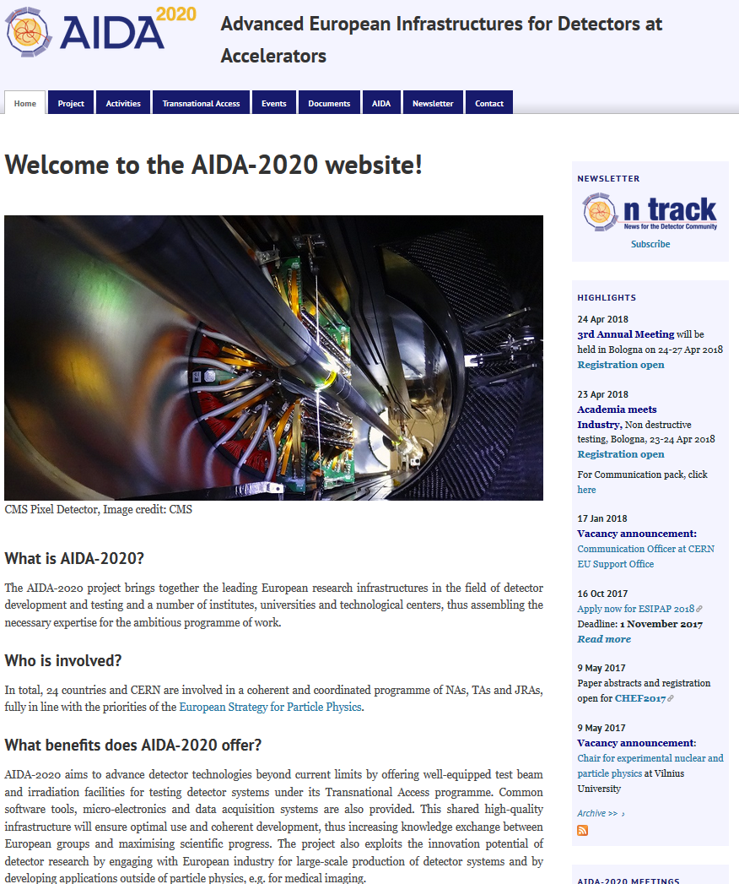
Website

Slide 6
Website stats
25k unique visitors
721/month
1,200k website hits
35k/month

Slide 7
Unique visitor stats by month

Slide 8
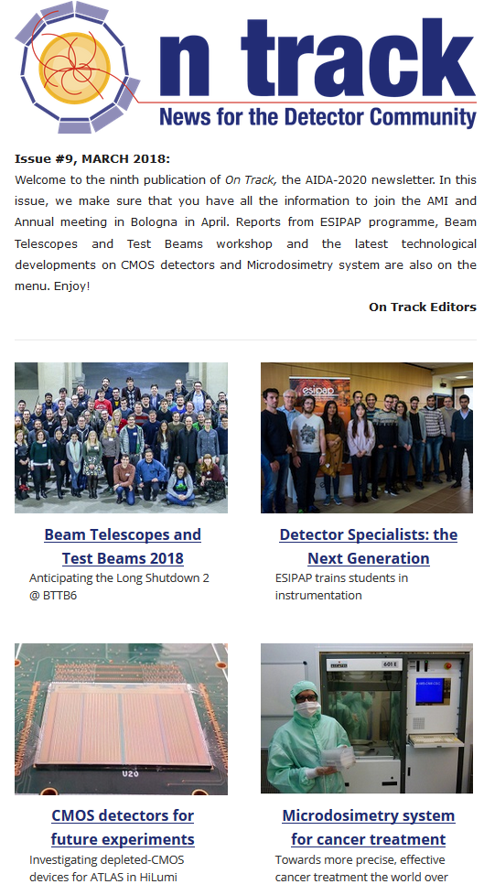
Newsletter
Project newsletter “On Track:
Initially bi-annually publication, aiming to increase frequency to quarterly (at least)
Topics: AIDA-2020 news, events, announcements + highlights from the detector community
9 issues published to date
492 subscribers (+9)
Updated layout/design of website and
email since launch

Slide 9
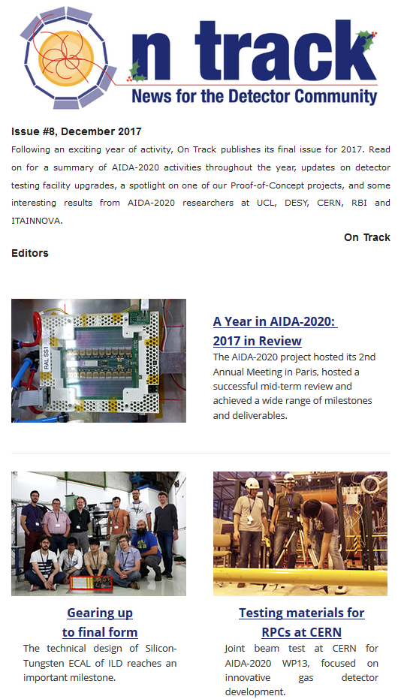
Newsletter
Editorial team of two – Romain Muller (CERN) & Barbara Warmbein (DESY)
Editors source, research, write and publish stories about AIDA-2020 and related research
Article pitches are always welcome!
  AIDA-2020-newsletter-editor@cern.ch
Article submissions accepted - RM & BW will provide editorial support

Slide 10
Newsletter stats
Opens rate: 1.5 times better than industry benchmark
Clicks rate: 3 times better than industry benchmark

Slide 11
Newsletter articles per WP

Slide 12
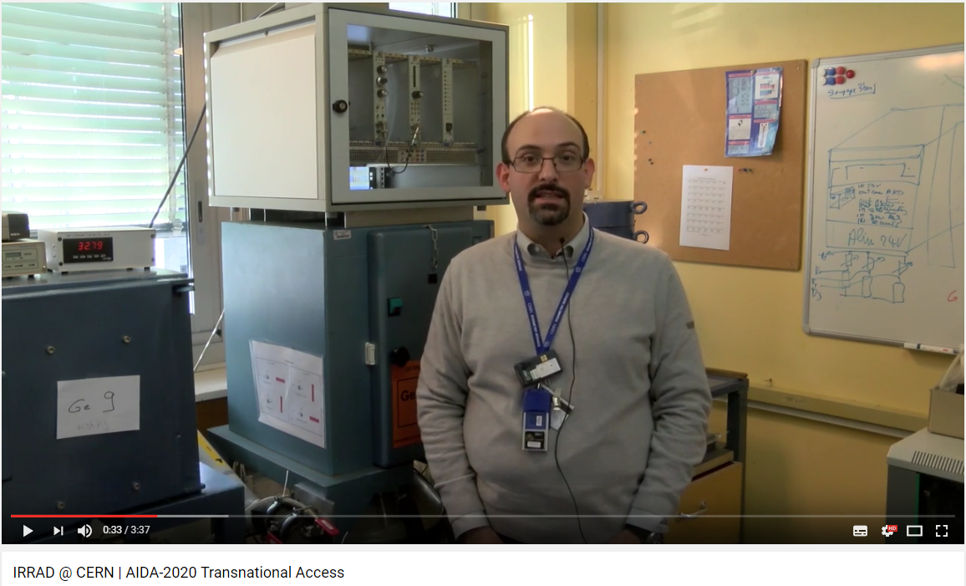
Transnational Access videos
Informational video series for the 10 facilities available via the TA programme
10 out of 10 videos completed & published
Dedicated AIDA-2020 YouTube channel set up
Screenshot of the IRRAD facility video (ft. Federico Ravotti)

Slide 13
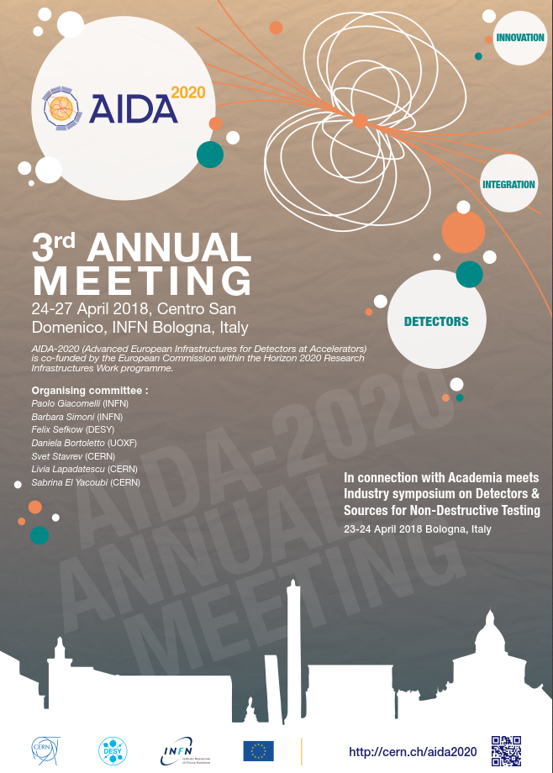
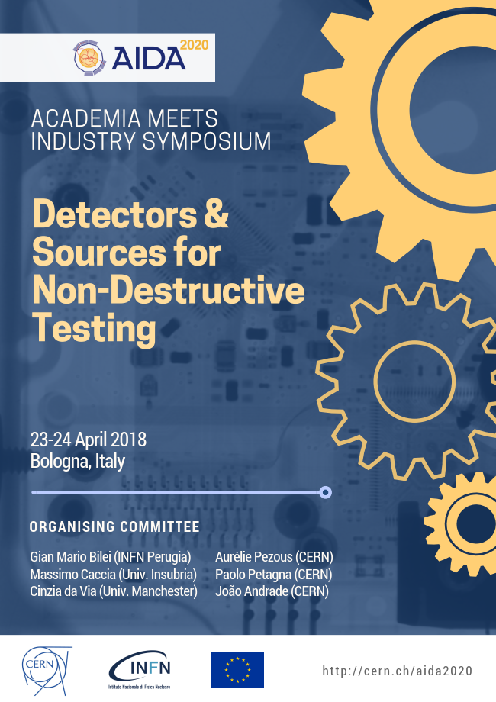
Event posters
3rd Annual
Meeting poster
Academia meets Industry event poster

Slide 14
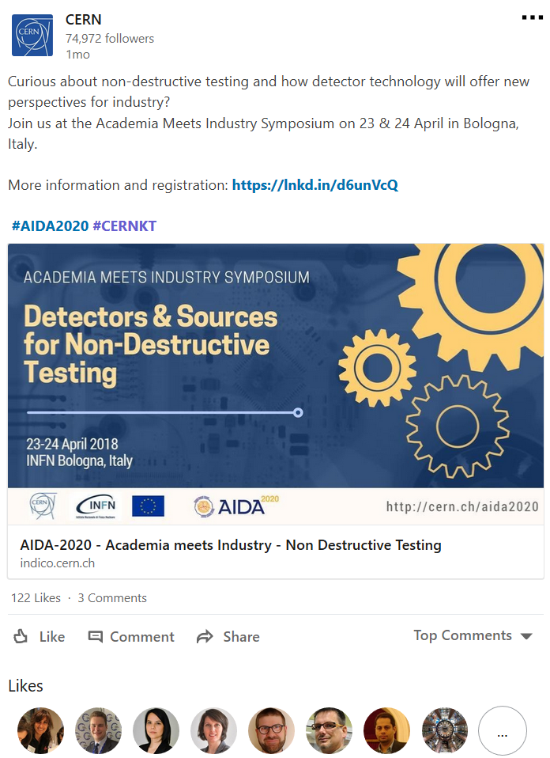
Academia Meets Industry event advertising
More pro-active about advertising the AMI event, providing a wider range of advertisement materials via more platforms
  Communications pack
  To all AIDA-2020 participants
  To all external participants
  To multiplier organisations
Posters
  At CERN
  At Bologna + To all AIDA-2020 institutes
  Websites
  AIDA-2020 & On Track
  CERN KT
Social media
  CERN LinkedIn account -> 35K+ exposed
  Personal LinkedIn accounts (of KT staff)

Slide 15
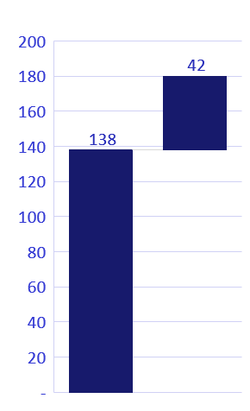
Publications
Target = 180 publications (over project duration)
  Including 60 journal publications + 50 conference proceedings
Current = 138 publications
  Including 37 journal publications (62%) of target & 32 conference proceedings (64%)
138/180 = 77%
Overall, in target.
But: need more journal/conference papers to meet target, extension might help in this respect to leverage more opportunities for publication

Slide 16
Future plans
More articles in external outlets (ie. CERN Courier)
At least 4 issues of ‘On Track’ in 2018 covering all WPs
More systematic social media sharing

Slide 17
Thank you for listening
Contact: r.muller@cern.ch

