Slide 1





AIDA 2020 3rd Annual meeting
WP15
Upgrades to the Birmingham scanning system in 2017-2018.
Contributions from : Paul Kemp-Russell,
Richard French, Hector Marin-Reyes, Ben Kitchener, Gabriel Kapellmaan, Alice Cryer, Kieren Howarth

Slide 2
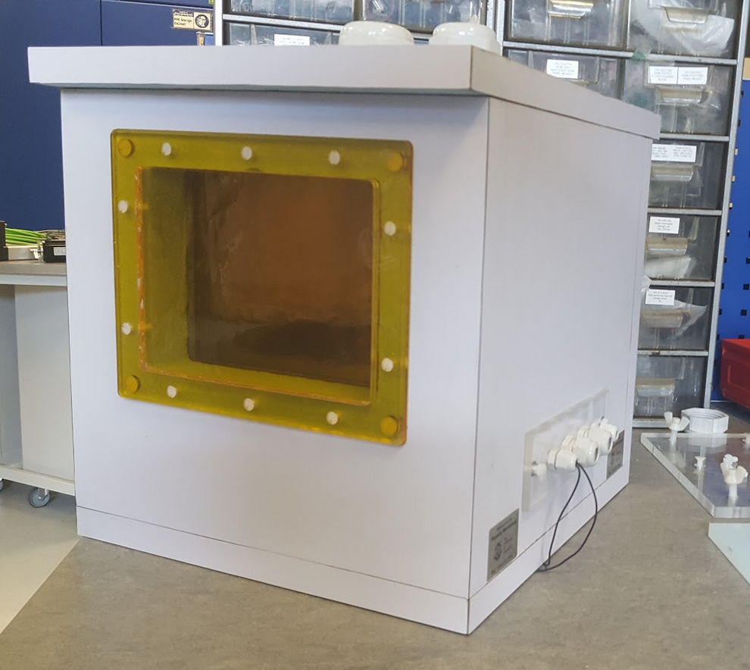
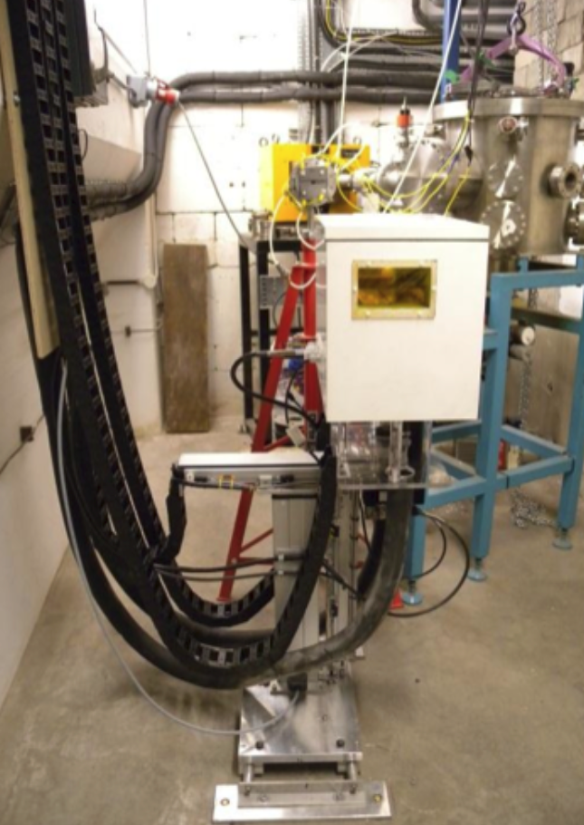
2017-18 Development summary: Progress beyond the original 2014-2017 concept and prototype LN2 cooled thermal chamber (cold box) and Cartesian robotic system.
This box was a originally prototyped to use the Norhof N2, 900 series micro-dosing system.
This allows the operator to very carefully control the dose rate of liquid N2 into the box to keep a constant temperature.
Obviously the cooling medium N2 can achieve temperatures well below the standard
-25deg C, obtained by glycol /radiator cooling methods.
We put a minimum limit of -60deg C of cooling on this box, below that the insulating foam box carcass was not stable.
Utilises a PTFE tray complete with heatsink to capture/diffuse the LN2 and to prevent direct contact with the Styrofoam LBX material.

Slide 3
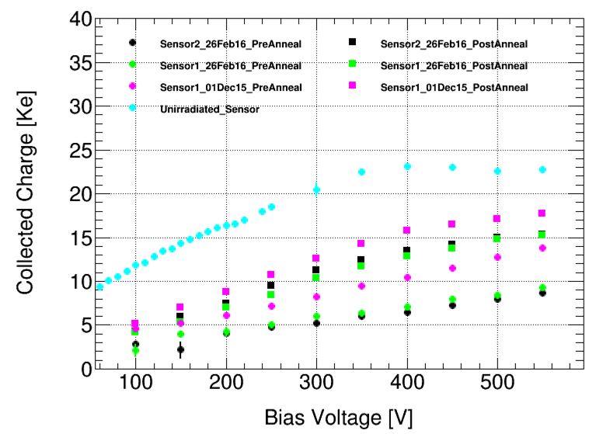
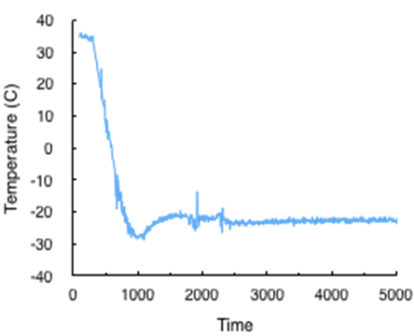
LN2 Cooling & Sensor CCE using prototype cold box at birmingham
Success measured as the CCE in sensors now matches other AIDA 2020 irradiation facilities (Feb 2016)
Temperature within the “prototype” thermal chamber when cooled, operates uniformly at -25°C
Therefore any “production” cold box should replicate this performance.

Slide 4
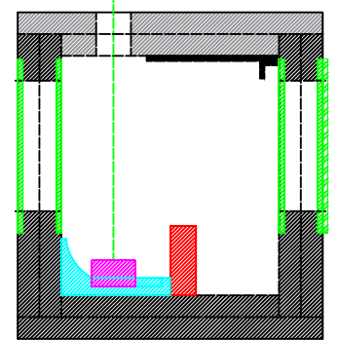
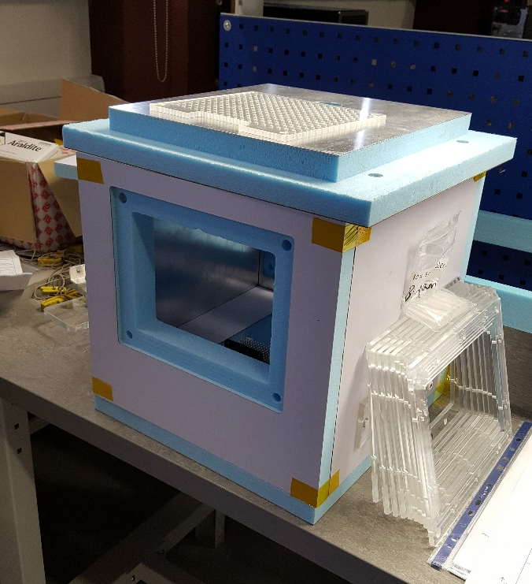
New design LN2 box…. construction Completed by Sheffield April 2018.
Increased window size for greater scanning ability.
Smaller overall box dimensions for system stability.
Size of sample mount area maintained (as per D15.8 2018 report)

Slide 5
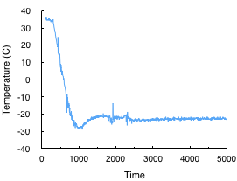
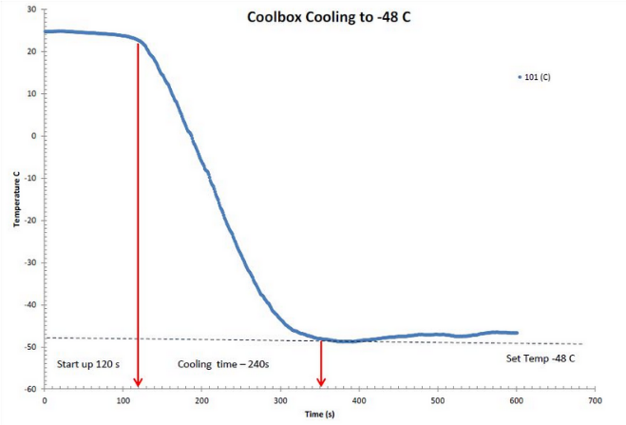
TESTING NEW LN2 box…. construction Completed by Sheffield April 2018.
C2014-17 Coolbox Cooling (stable with sensor)
C2017-18 Coolbox Cooling (-48 C max stable power)
Final Cold Box
New improved support (Z) pillar for better movement control (new).
Reduced fan and heatsink size proportional to box
Reduction of internal heat-load from fan.
Cooling stable to operational (measured) irradiation temperatures at Birmingham.

Slide 6

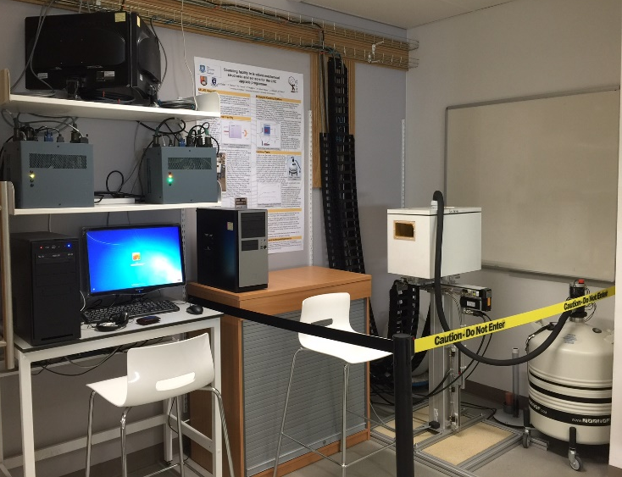
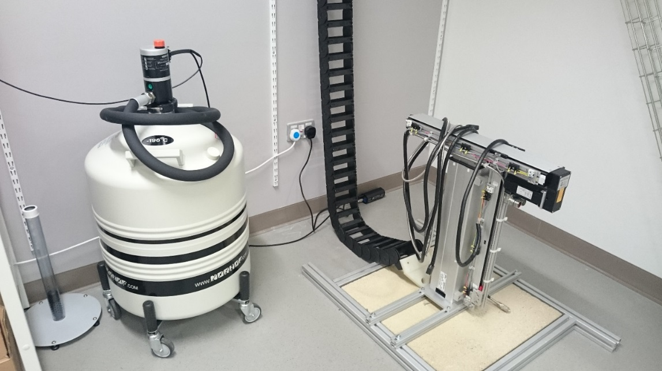
Duplicate R&D System in sheffield
To test and implement upgrades to the scanning system and software, a second scanning system and LN2 cooling unit is undergoing installation in Sheffield Robotics. Sited in the 300m² Robotics Foundry in the new purpose built 7 story, 5355m² Pam Liversidge Building for “Interdisciplinary Research”.
This 2nd system is used for:
Remote troubleshooting of the system in Birmingham
Testing of software to improve user instructions
Student teaching
Staff training (software, engineering & users)
Continued upgrades to the prototype system.
Have provided considerable staff training to Birmingham University staff on system software development.

Slide 7
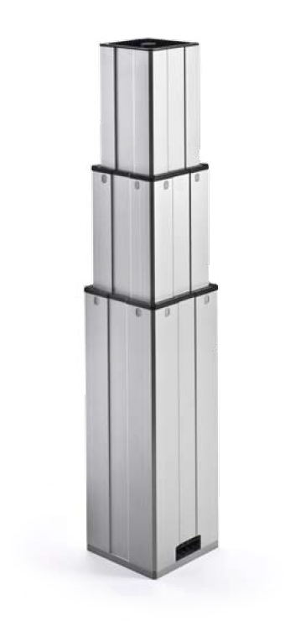
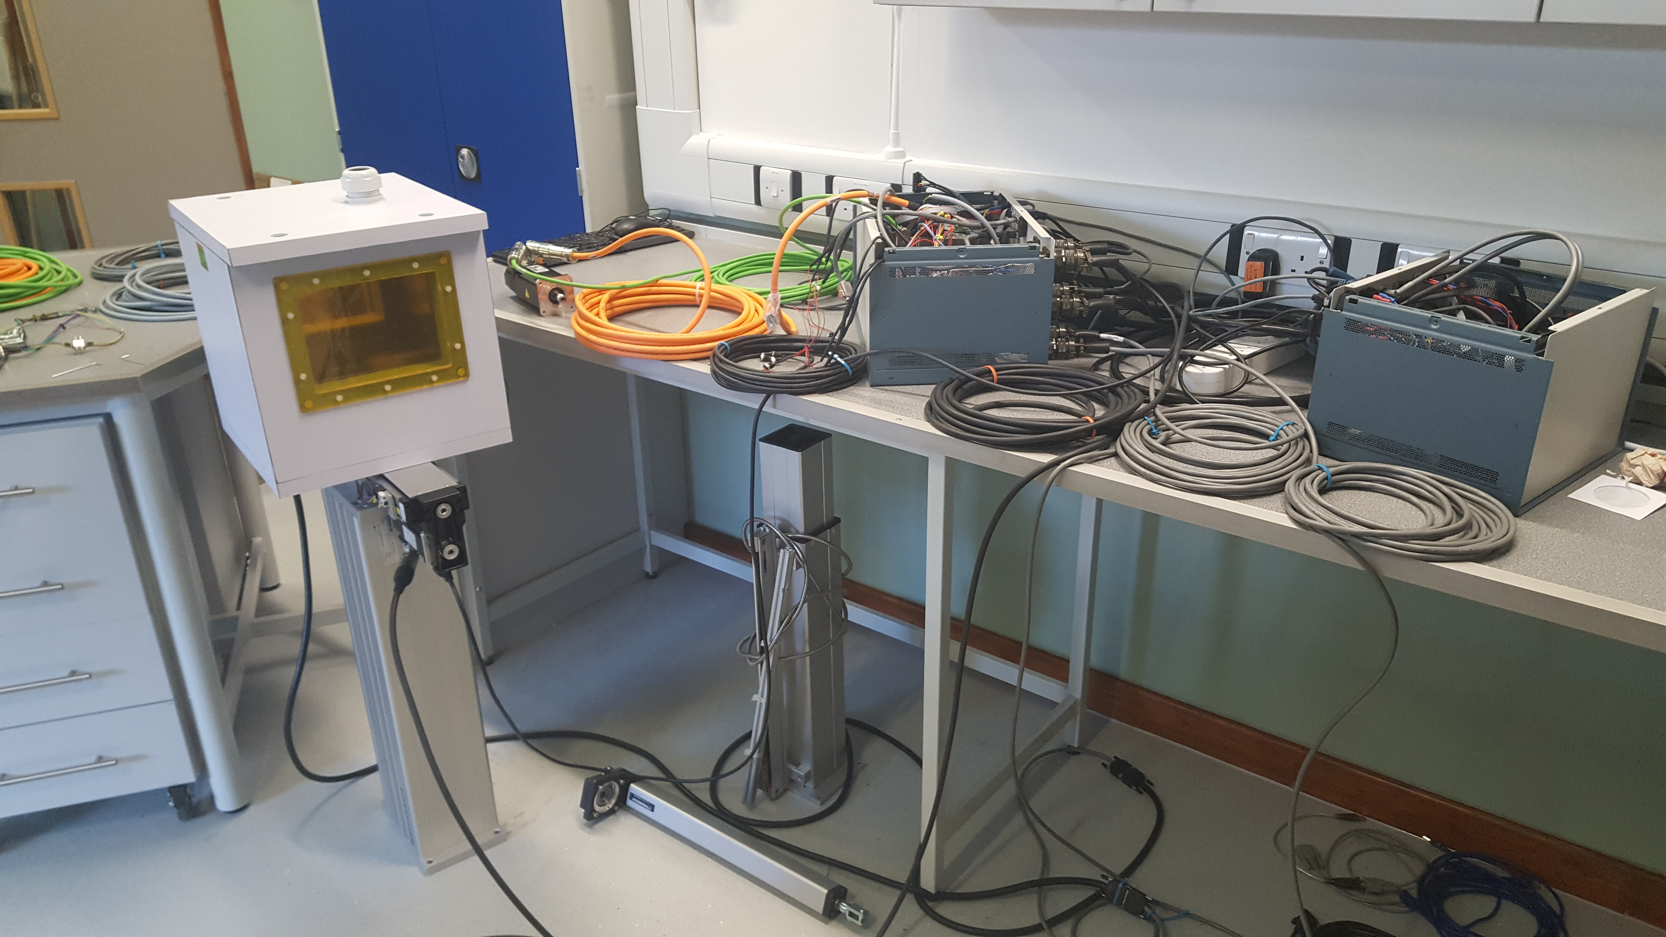
Revision of lifting pillar
The SKF lifting pillar (taken from previous AIDA FP7 design) over time, has become a source of operational problems at Birmingham.
The desired speed of operation (frequency) has exceeded the duty cycle of the motor within the pillar.
A new lifting pillar housing has been procured.
A high capacity stepper motor has been procured.
The assembly of the new custom made lifting pillar is now completed with a modified pillar housing to accept the new motor made in Sheffield.

Slide 8
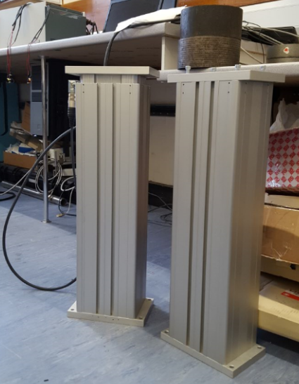
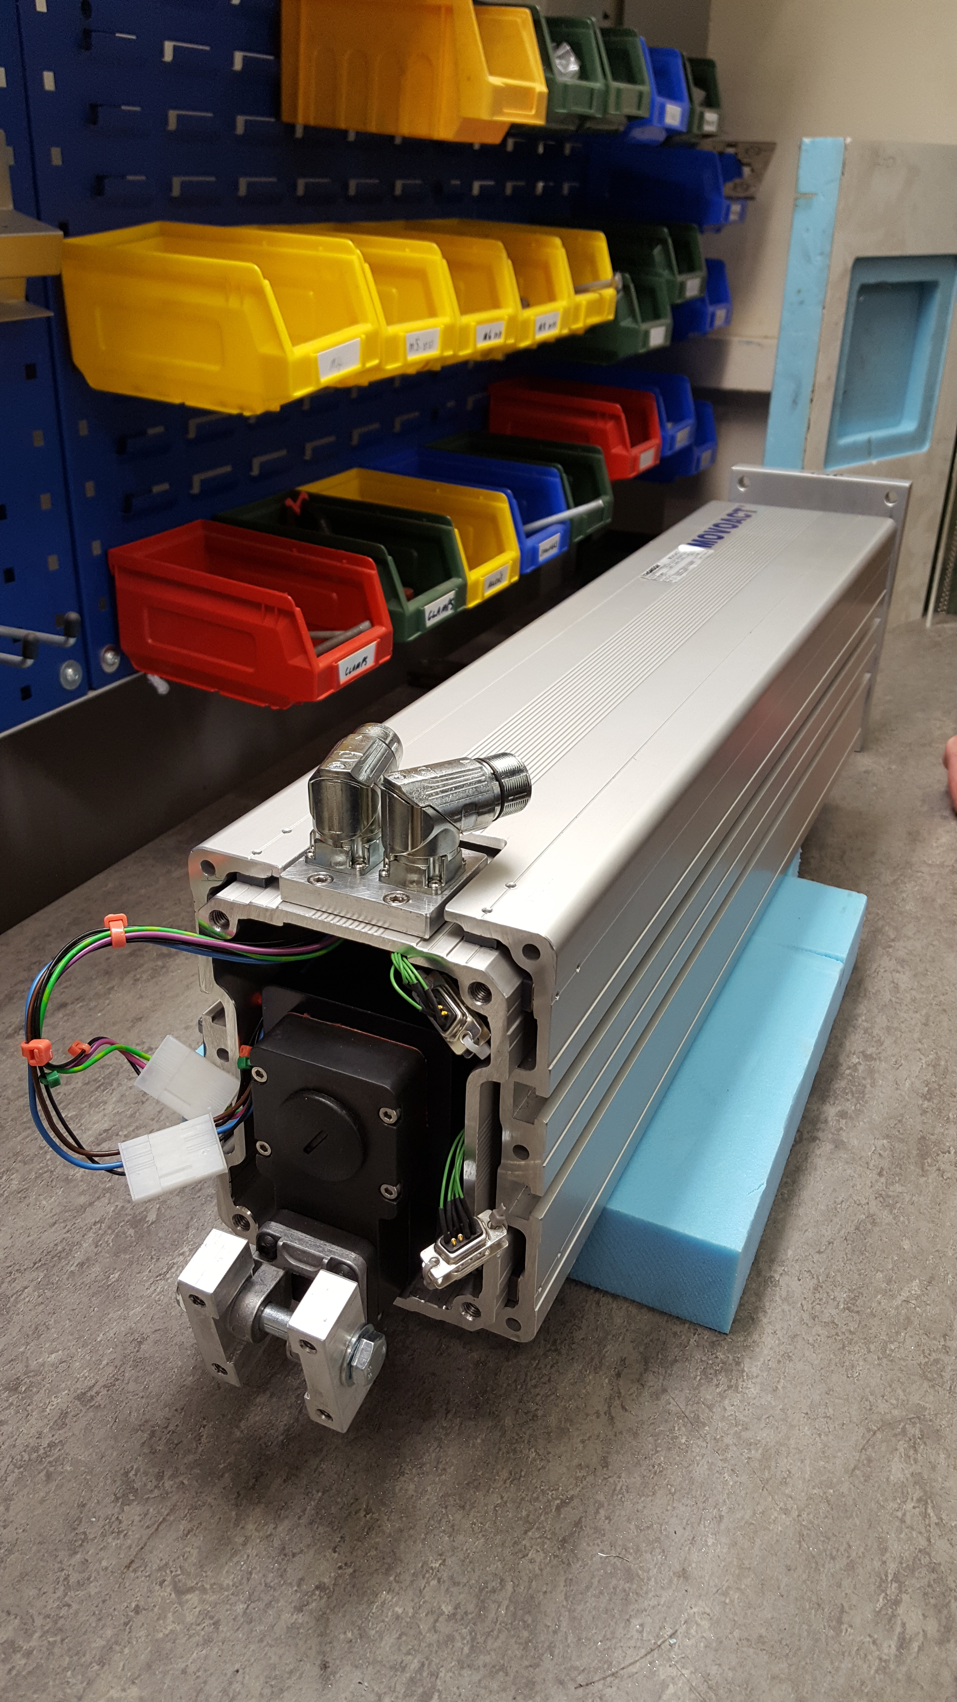
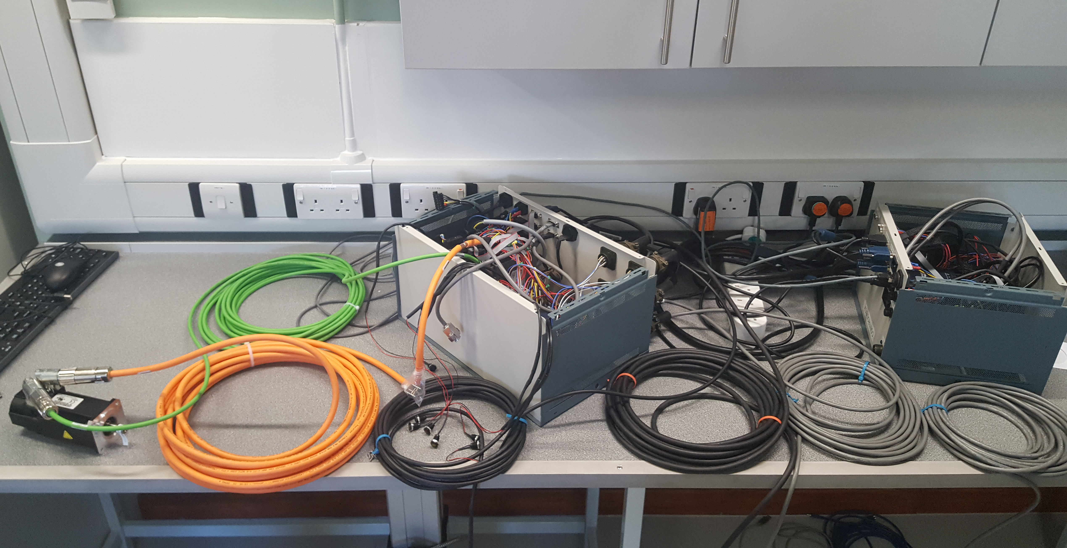
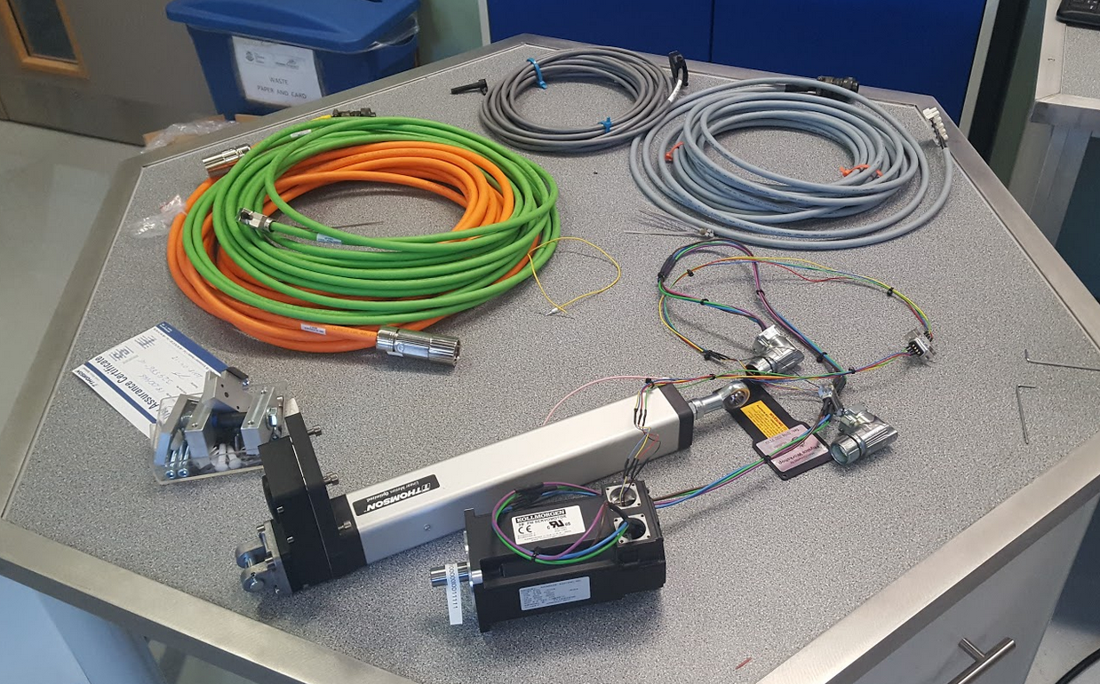
Revision of lifting pillar
The original SKF pillar was the most compact COTS telescopic lifting pillar.
  Low duty cycle; Terrible positional accuracy; Required significant customisation to work effectively
The NEW UoS lifting pillar is not as compact (vertical) but more stable
  New cold box designed to incorporate extra height of pillar
  Motor control is simplified with internal encoders.
  Requires complete re-design of control “boxes” and wiring.
Conclusive test results: Ready for installation at Birmingham during next operational shut down in 2018. Est. Sheffield installation will be during the late summer period of 2018.
Payload testing for positional accuracy and repeatability
Testing of motor with newly constructed control units (harmonic stepper balancing + duty cycle + communication testing)
Rewiring COTS motor
Condensing wiring and connector volume inside smaller housing (acts as shielding)

Slide 9
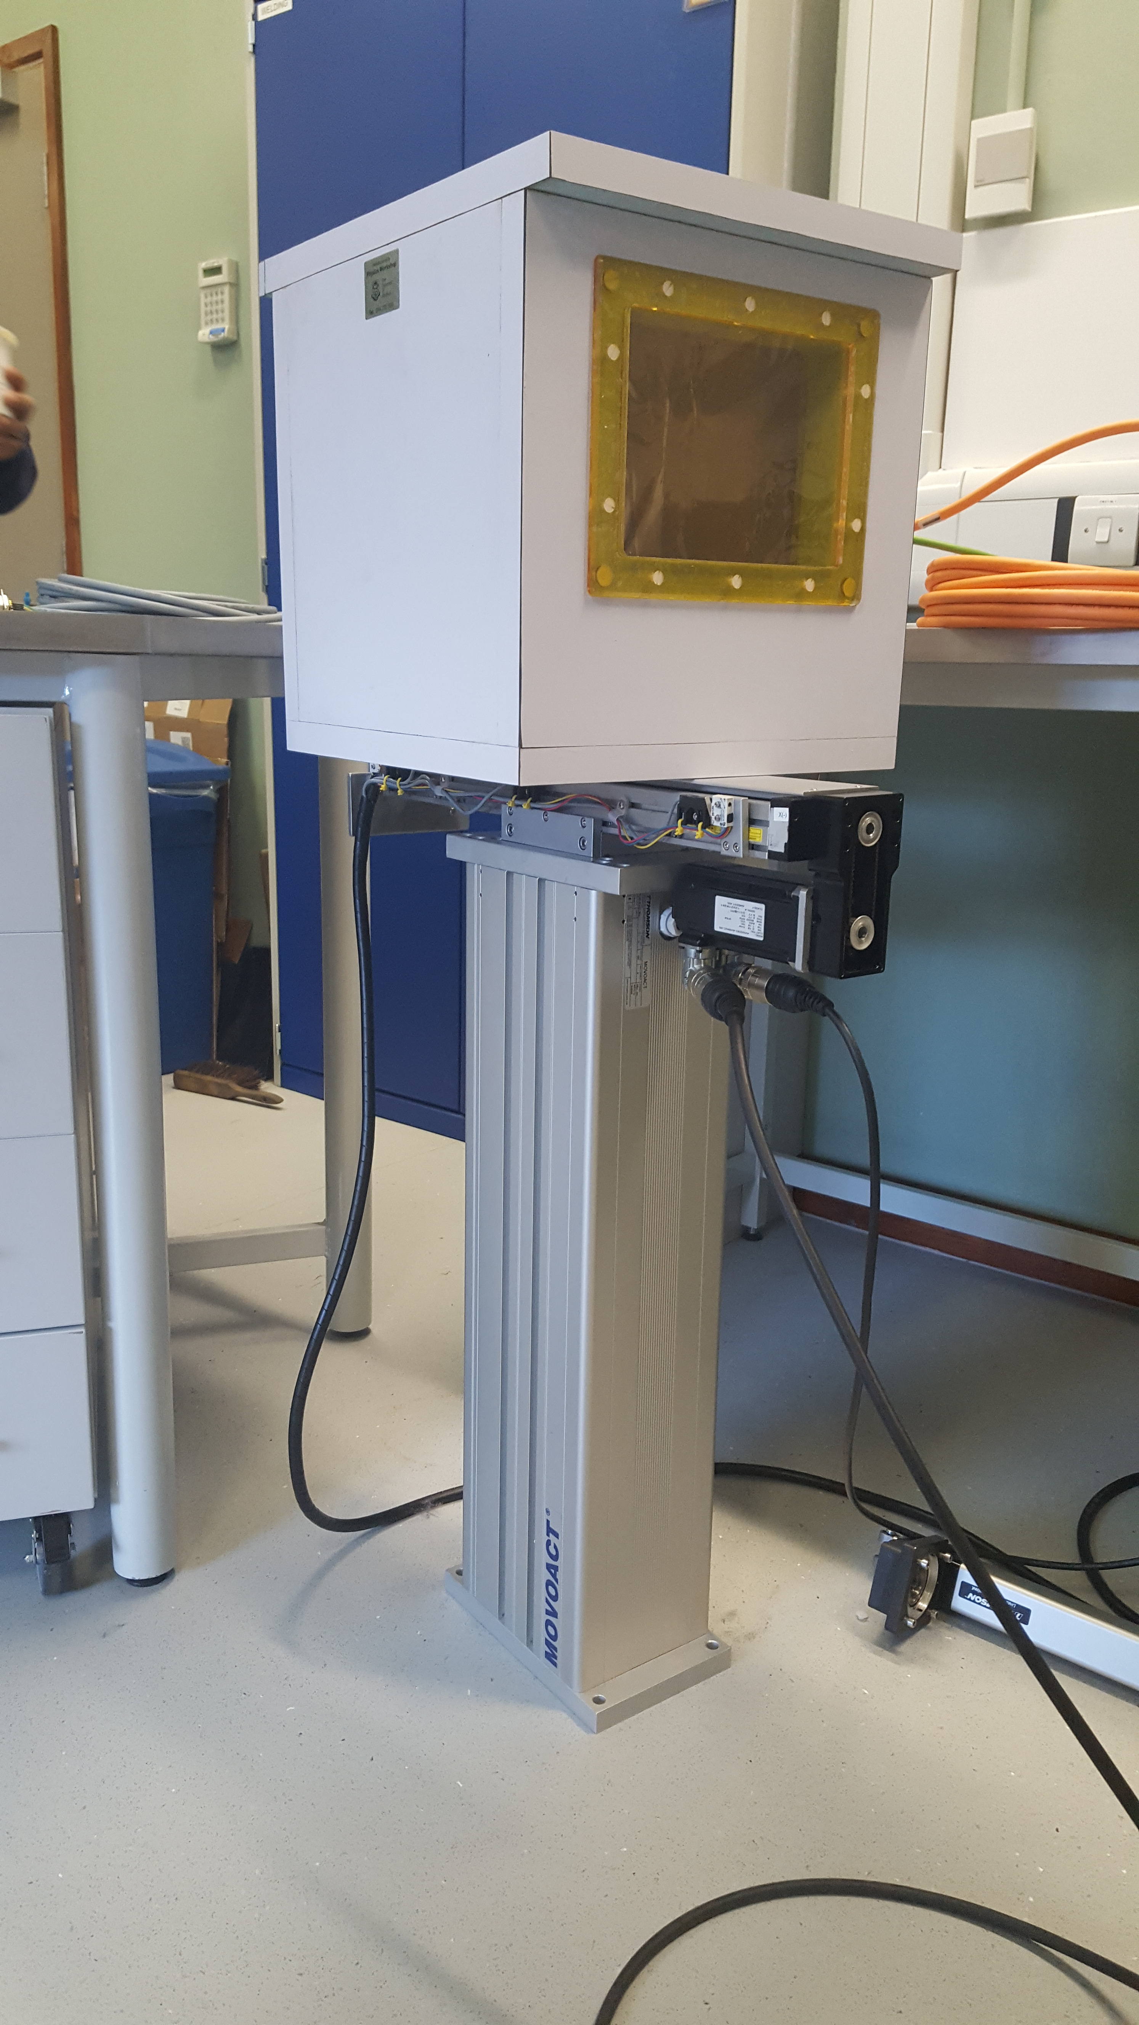
READY TO GO
Thank you to all who contributed to this presentation

