Slide 1
Si and GaN for large fluence irradiation monitoring
J.Vaitkus¹, E.Gaubas¹, T.Ceponis¹, D.Meskauskaite¹, J.Pavlov¹, V.Rumbauskas¹,
M.Moll², F.Ravotti²
¹ Vilnius University, Institute of Photonics and Nanotechnology
² CERN
Outline:
Motivation
Samples and irradiations, anneals
Measurement Techniques: Temperature dependent carrier trapping lifetime (TDTL), Pulsed photoionization spectroscopy (PPIS), Deep-level transient spectroscopy (DLTS)
Results on Fz and Cz Si irradiated by electrons and hadrons
Results on multicrystaline Si irradiated by 8 MeV protons
Results on GaN irradiated by 1MeV neutrons
Commercial GaN LED structures as dosimeters of 1.6 MeV proton irradiation
Summary

Slide 2
Comparison of characteristics of the pion, neutron and proton as irradiated and isothermally (T_{an} =80 C) annealed Si
Our work is based on these effects:
Comparison of exciton spectra in
SI-GaN (MOCVD) irradiatet to different hadron fluence.
GuenakhFest, University of Florida

Slide 3
Motivation
J.Vaitkus│Si and GaN for large fluence irradiation monitoring│AIDA-2020 WP15│2018
The better understanding of radiation damage of Si particle detectors is important in order:
  to extend sensor lifetime and their radiation hardness or
  to restore their functionality after degradation caused by irradiations − one of the ways to recover detector operational features is heat treatment at technically acceptable temperatures.
Multicrystalline silicon (mc-Si) use for the detection of charged particles − inexpensive material for mass production.
Semi-insulating GaN is a promising material for particle tracking detectors and for imaging detectors − there still remains a lack of detailed studies of the defects in the as-grown material and their interaction with radiation induced defects, particularly in heavily irradiated samples.

Slide 4
Si samples and irradiations
J.Vaitkus│Si and GaN for large fluence irradiation monitoring│AIDA-2020 WP15│2018
c-Si
Type of irradiation | Electrons |  | Protons |  | Pions
Energy | 6.6 MeV |  | 24 GeV/c |  | 300 MeV/c
Fluence range | 10¹⁶-5×10¹⁶ e/cm² |  | 10¹²-10¹⁶ p/cm² |  | 10¹¹-3×10¹⁵ π⁺/cm²
Si material | CZ n-Si | CZ p-Si | FZ n-Si | CZ p-Si | CZ n-Si | FZ n-Si
Dopant concentration | 10¹⁵ cm⁻³ | 3×10¹⁵cm⁻³ | 10¹² cm⁻³ | 10¹² cm⁻³ | 10¹² cm⁻³ | 10¹² cm⁻³
Anneals:
The isochronal anneals have been performed at the temperatures in the range of 80˚-280˚C.
The hadron irradiated samples were isothermally (at 80 ˚C) annealed up to 5 hours before isochronal (24 h) anneals.
mc-Si substrates for commercial solar-cell production
Type of irradiation | Protons
Energy | 8 MeV
Fluence range | 10¹²-10¹⁶ p/cm²
Si material | p-Si
Dopant concentration | 10¹⁵ cm⁻³
Anneals:
1st annealing step: 80° C, 30 min
2st annealing step: 1st + 200° C, 60 min
3st annealing step: 2st + 300° C, 60 min
4st annealing step: 3st + 400° C, 60 min

Slide 5
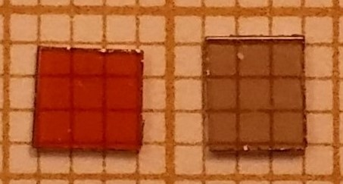
AT GaN samples and irradiations
J.Vaitkus│Si and GaN for large fluence irradiation monitoring│AIDA-2020 WP15│2018
semi-insulating (SI) bulk GaN
grown by the ammonothermal method
450 µm thick
doped with Mg (GaN:Mg) and Mn (GaN:Mn)
GaN:Mn
GaN:Mg
 | Neutrons
Energy | 1 MeV
Fluence range | 10¹²-5×10¹⁶ e/cm²
GaN material | GaN:Mg | GaN:Mn
Dopant concentration | ~10¹⁹ cm⁻³ | ~10¹⁸ cm⁻³
Commercial MOCVD GaN LED structures as dosimeters
(Optosupply OSB4XNE1E1E, peak wavelength λ=465 nm)

Slide 6
Measurement Technique:
Temperature dependent carrier trapping lifetime (TDTL)
J.Vaitkus│Si and GaN for large fluence irradiation monitoring│AIDA-2020 WP15│2018
T_{peak} for which the largest K_{tr}, ascribed to a single type trapping centres, is obtained, can be found by solving the transcendental equations:
A=Δn_{C}/N_{C,V,T=300K}
Simulated trapping coefficients (K_{tr}) as a function of temperature for trapping level with activation energy of 0.4eV and 0.23eV in Si. N_{C,e,Ntr}(T) - the effective density of band states for trapped carriers, ∆n(T) - the excess carrier density.
E. Gaubas, E. Simoen and J. Vanhellemon. . Solid State Sci. Technol. 5, (2016) P3108.
E. Gaubas, T. Ceponis,L. Deveikis,D. Meskauskaite,J. Pavlov, V. Rumbauskas, J. Vaitkus, M. Moll, F. Ravotti, Materials Science in Semiconductor Processing, 75 (2018) 157–165

Slide 7
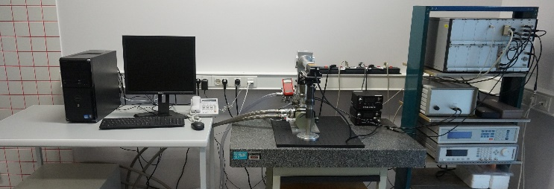
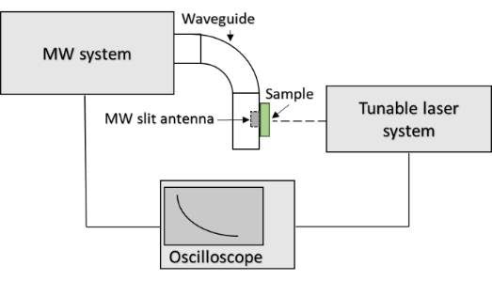
Measurement Technique:
J.Vaitkus│Si and GaN for large fluence irradiation monitoring│AIDA-2020 WP15│2018
Deep-level transient spectroscopy (DLTS)
Capacitance (C-DLTS) and current (I-DLTS) spectra over temperature range of 10-300K were recorded by using a HERA-DLTS System 1030 spectrometer.
The PhysTech software installed within HERA-DLTS spectrometer was employed for analysing of the measured DLTS spectra.
Pulsed photoionization spectroscopy (PPIS)
The PPIS were implemented using excitation by a tuneable wavelength laser and measurements of the photo-response by applying microwave probed photoconductivity transient (MW-PC) technique.
Here tuneable wavelength nanosecond laser Ekspla NT342B (pulse duration 4 ns, wavelength tuning from 210 to 2300 nm) were employed.

Slide 8
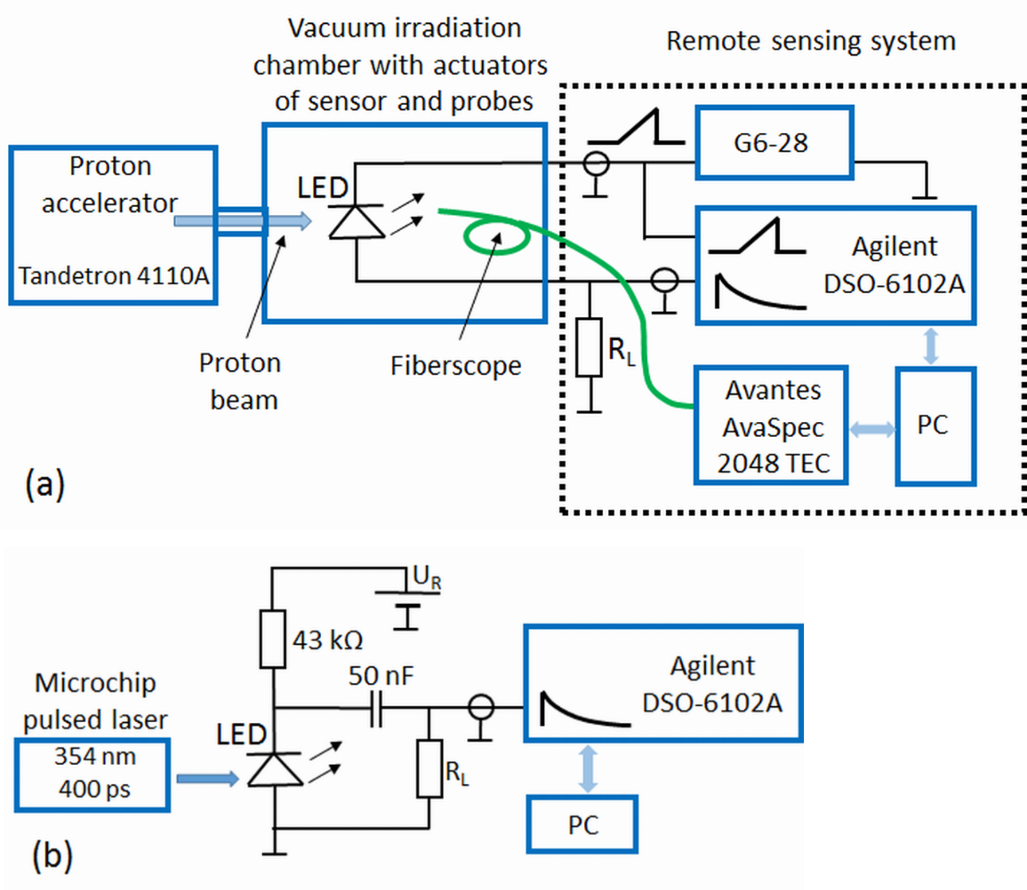
Measurement Techniques:
J.Vaitkus│Si and GaN for large fluence irradiation monitoring│AIDA-2020 WP15│2018
Pulsed barrier evaluation by linearly increased voltage (BELIV)
Proton induced luminescence spectroscopy (PIL)

Slide 9
Results on Fz and Cz Si irradiated by electrons and hadrons n-type and p-type CZ Si irradiated by 6.6 MeV electrons
J.Vaitkus│Si and GaN for large fluence irradiation monitoring│AIDA-2020 WP15│2018
No peaks in low temperature wing were observed in heavily irradiated n- and p-type CZ samples.
The radiation induced defects, ascribed to vacancy related complexes, TD and to H related defects have been observed in the electron irradiated Si samples.
Application of the TDTL technique allowed to identify the trapping centres appeared after heat treatment at T_{an}≥80˚C even in heavily irradiated samples.

Slide 10
J.Vaitkus│Si and GaN for large fluence irradiation monitoring│AIDA-2020 WP15│2018
Results on Fz and Cz Si irradiated by electrons and hadrons
n-type FZ and p-type CZ Si irradiated by 26 GeV/c protons
The predominant peaks for the n-type FZ Si samples are attributed to V- and H-related defects.
DLTS measurement are not suitable for p-type CZ Si samples irradiated by 26 GeV/c protons, due to the low concentration of the effective doping.
As deduced using TDTL, the V₂⁼ , H-related and VO complexes are predominant radiation defects in the p-type CZ Si.
The TDTL spectroscopy is a reliable tool for tracing of the radiation defect evolution for the range of elevated fluences.

Slide 11
Results on mc-Si irradiated by 8 MeV protons
J.Vaitkus│Si and GaN for large fluence irradiation monitoring│AIDA-2020 WP15│2018
Variations of τ_{R} appear for ms-Si samples irradiated (synchronously) with the same fluence.
Variations within fluence dependent τ_{R} in mc-Si due to initial material quality (trapping indicates intrinsic defects).

Slide 12

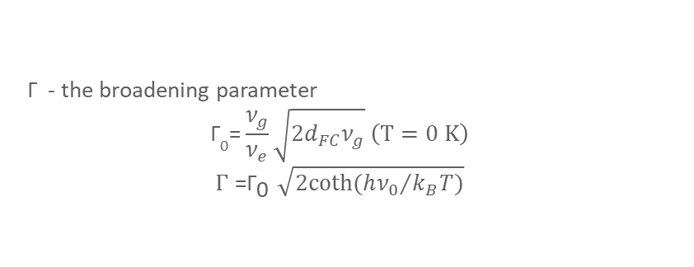
J.Vaitkus│Si and GaN for large fluence irradiation monitoring│AIDA-2020 WP15│2018
Results on GaN irradiated by 1 MeV neutrons
GaN:Mn
GaN:Mg
 | Non-irradiated |  | Irradiated with Φ=10¹⁶ cm⁻²
GaN:Mn | Photo-activation energy (eV) | Γ | Photo-activation energy (eV) | Γ | Defect type
 | E_{Mn-1}=1.40 | 0.05 | E_{Mn-1}^{irr}=1.42 | 0.08 | Mn related
 | E_{Mn-2}=1.98 | 0.25 | E_{Mn-2}^{irr}=1.98 | 0.22 | Might be oxygen related
 | E_{Mn-3}=2.40 | 0.15 | E_{Mn-3}^{irr}=2.37 | 0.25 | Ga_{I} or N_{I}
 | E_{Mn-4}=2.97 | 0.25 | E_{Mn-4}^{irr}=2.96 | 0.28 | Unidentified
GaN:Mg | E_{Mg-1}=1.30 | 0.02 | − | − | Donor/acceptor state
 | E_{Mg-2}=1.70 | 0.15 | E_{Mg-1}^{irr}=1.71 | 0.22 | V_{N}Mg_{Ga}
 | E_{Mg-3}=2.07 | 0.23 | E_{Mg-2}^{irr}=2.05 | 0.27 | V_{Ga}
 | E_{Mg-4}=2.39 | 0.15 | E_{Mn-3}^{irr}=2.37 | 0.25 | Ga_{I} or N_{I}
 | − | − | E_{Mg-4}^{irr}=2.45 | 0.16 | Unidentified or N_{I}
 | E_{Mg-5}=3.00 | 0.32 | E_{Mg-5}^{irr}=3.00 | 0.35 | Unidentified
 | E_{Mg-6}=3.30 | 0.2 | E_{Mg-6}^{irr}=3.30 | 0.27 | Mg_{I}
Γ - the broadening parameter
$${\text{Γ}}_{\text{0}}\text{=}\frac{ν_{g}}{ν_{e}}\sqrt{2d_{FC}ν_{g}} \left(T=0 K\right)$$
$$Γ{\text{=}\text{Γ}}_{\text{0}}\sqrt{2coth({hν_{0}}/{k_{B}T})}$$

Slide 13
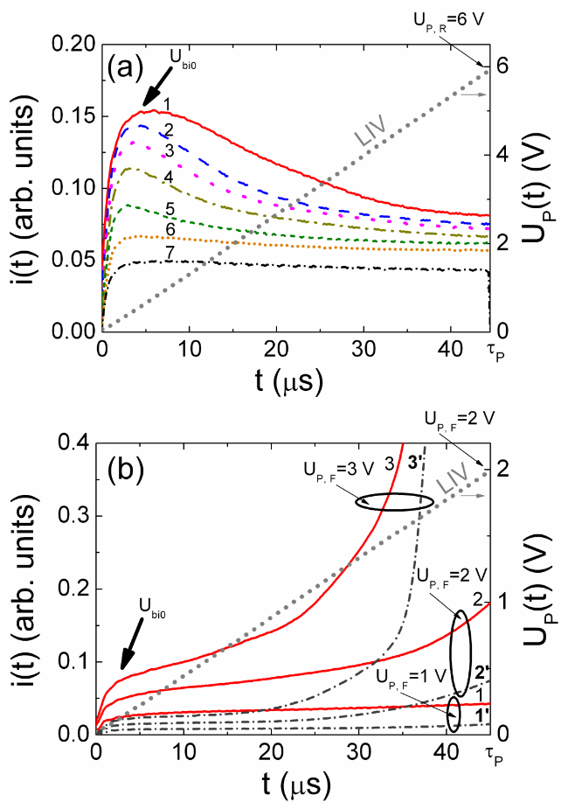
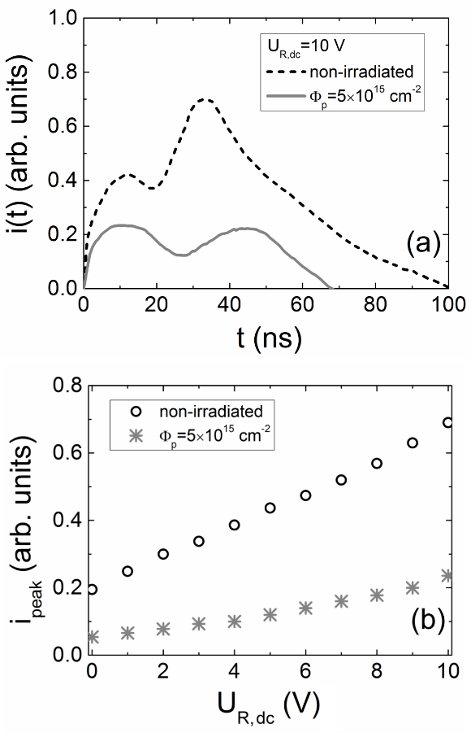
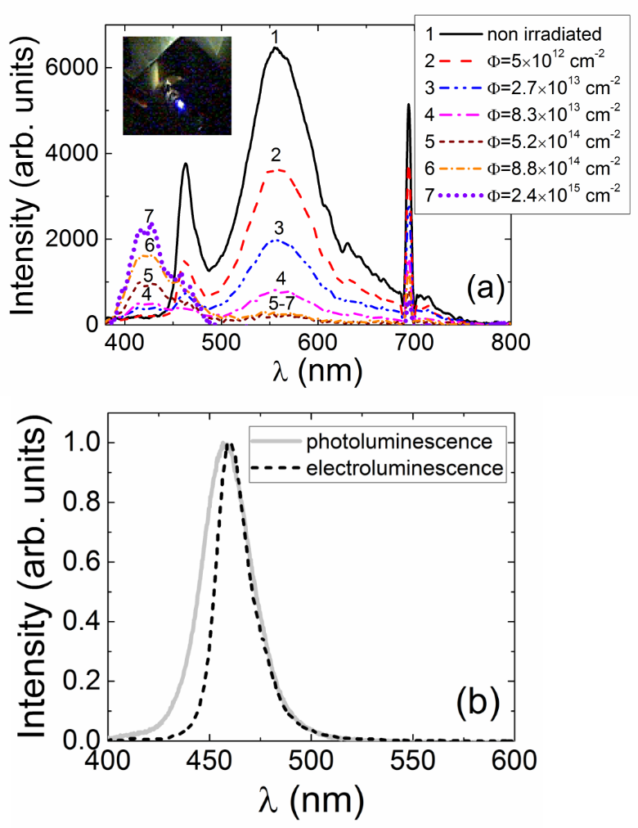
J.Vaitkus│Si and GaN for large fluence irradiation monitoring│AIDA-2020 WP15│2018
GaN LED-based structures for remote dosimetry of 1.6 MeV protons
Evolution of the BELIV current transients for the reverse (a) and forward (b) biased GaN LED (τ_{PL} = 45 μs). (a) LED irradiated with the proton fluences of 0 (1); 5×10¹⁴ p/cm² (2); 8×10¹⁴ p/cm² (3); 1×10¹⁵ p/cm² (4); 2×10¹⁵ p/cm² (5); 3×10¹⁵ p/cm² (6); and 5×10¹⁵ p/cm² (7), respectively (U_{P,R} = 6 V). (b) Pristine LED (1-3) and LED irradiated with the fluence of 5×10¹⁵ p/cm² (1′ – 3′) for peak voltage U_{P,F} of 1 V (1 and 1’), 2 V (2 and 2’), and 3 V(3 and 3’).
TCT transients (a) and peak-current (b) as a function of reverse-bias voltage measured on pristine and heavily irradiated LED-based sensor.
(a) - Evolution of the proton induced luminescence spectra as a function of proton fluence. In the inset,- a picture of the proton-induced luminescence on GaN LED-based sensor, installed within irradiation chamber. (b) – Comparison of spectra of the laser induced photoluminescence and electroluminescence, recorded on pristine LED.
E. Gaubas, T.Ceponis, D. Meskauskas, J. Pavlov, A.Zukauskas, V. Kovalevskij,V. Remeikis
Sensors and Actuators A 267 (2017) 194–199

Slide 14
Summary
J.Vaitkus│Si and GaN for large fluence irradiation monitoring│AIDA-2020 WP15│2018
  The non-monotonous variations of trap densities after different anneal steps have been identified in heavily electrons and hadrons irradiated silicon by combining the DLTS and TDTL spectroscopy.
  The similarity between DLTS spectra, obtained for rather low fluence irradiations by protons and pions, indicate that the irradiation with various type penetrative hadrons induce the same defects (the oxygen, vacancy and hydrogen related complexes and TD).
  Contactless TDTL technique allows simultaneous control of interactions among several radiation defects within large fluences irradiated Si structures.
  The AT-GaN material performance showed insignificant changes after neutron irradiation with large fluences (up to 5×10¹⁶ e/cm² ).
  GaN LED-based sensors can be used for the synchronous detection of hadron irradiation by recording the optical (B-L) and electrical signals (I_{SC} and TCT transients).

Slide 15
J.Vaitkus│Si and GaN for large fluence irradiation monitoring│AIDA-2020 WP15│2018
Thank you for your attention!
Acknowledgments
This research was implemented according to AIDA-2020 TNA grants. This study was partially supported by Lithuanian Academy of Sciences, grants LMA-CERN-2017/2018. The work was partly performed in the framework of the CERN RD50 collaboration.
Authors are also indebted for pion irradiations performed at the proton accelerator, Paul Scherrer Institute, Villigen, Switzerland and for electron irradiations performed at the Institute of Solid State and Semiconductor Physics, Minsk, Belarus.

