Slide 1
WP12. Detector Characterisation Facilities
WP12.1.: RBI Accelerator facility
S. Fazinić
Ruđer Bošković Institute, Bijenička c. 54, 10000 Zagreb, Croatia

Slide 2

Outline
1. Introduction
2. Facility
3. AIDA2020 TA status for WP12.1
4. Examples of AIDA2020 TA runs
5. Future activities and summary

Slide 3
1. Introduction
At the RBI Accelerator Facility users can study:
• in vacuum and in-air imaging of charge collection properties by Ion Beam Induced Current (IBIC) technique using protons of up to 10 MeV with 1 μm resolution and heavier ions on demand; as well as time resolved IBIC (TR-IBIC);
• real-time controlled damaging of small detector (material) areas using protons or heavier ions. Such areas can then be studied by various techniques, including IBIC.
For such studies users have on disposal the RBI ion microprobe and other end stations depending on the actual objectives of the proposed work.

Slide 4
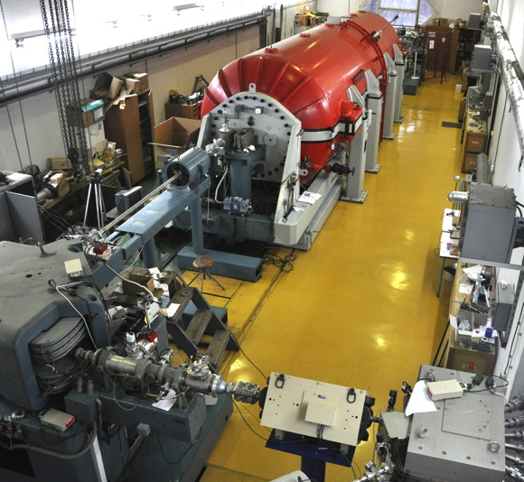
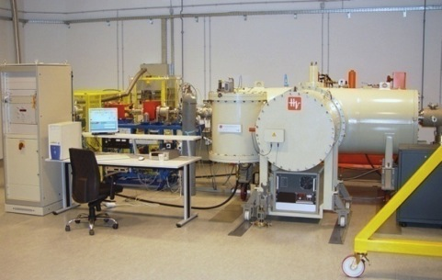
2. Facility
RBI Tandem Accelerator facility
6.0 MV EN Tandem Van de Graaff accelerator
1.0 MV HVE Tandetron accelerator

Slide 5
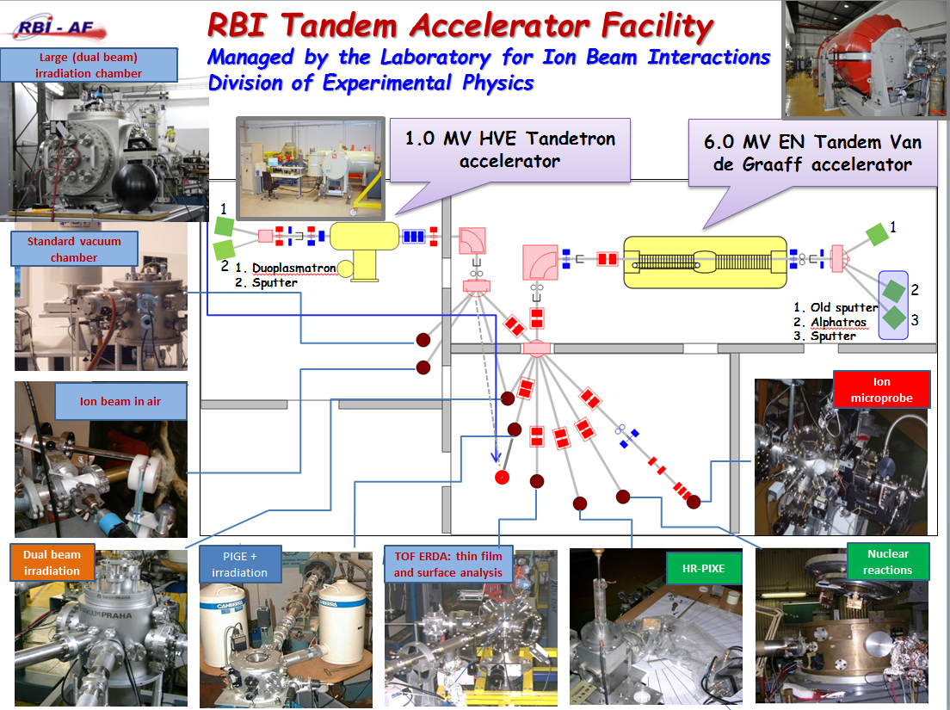
2. Facility
9 TA
3 TA

Slide 6
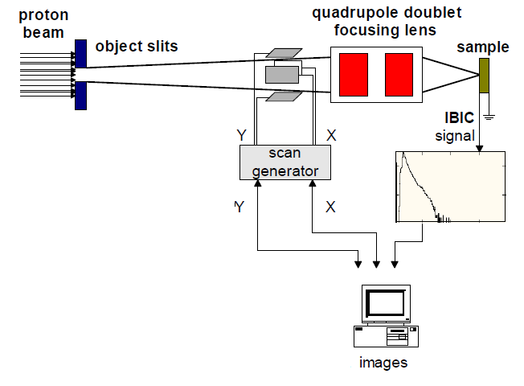
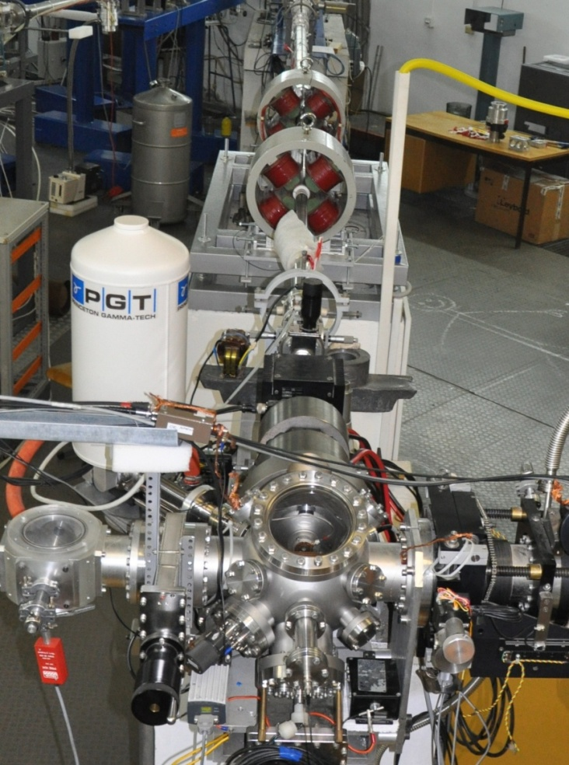
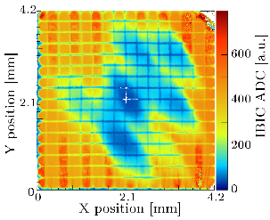
2. Facility
Standard ion microprobe
Quadrupole triplet
Focusing lens
Sample:
- in vacuum
- in air
IBIC - charge collection efficiency image

Slide 7
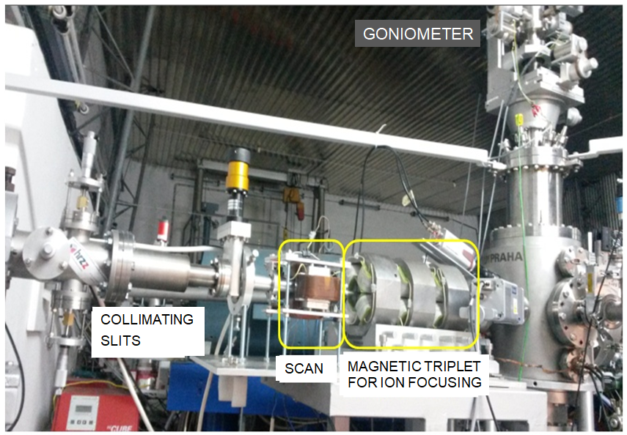
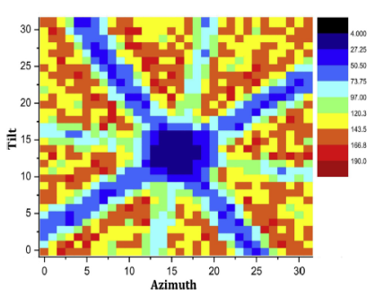
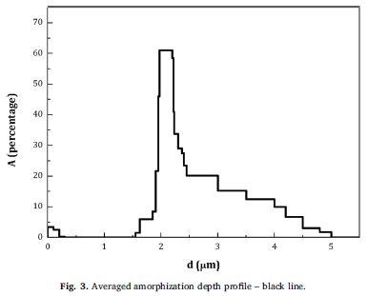
2. Facility
Irradiation & Analysis:
Channeling
IBIC
RBS
In construction at the moment
New ion microprobe – dual beam station
Irradiation, damage creation, analysis
Example
≈ 10¹⁶ at/cm² 4 MeV C implanted in diamond
in <100> axial channeling direction
RBS/c 2D map
of virgin diamond
in <100> direction

Slide 8
3. AIDA2020 TA status
TA-RBI (M1-M36):
- 12 TA activities approved and completed (75 %)
- 480 TA units (hours) out of planned 640 units (75%)
Each TA is planned as 5 days, i.e. 40 h, activity
- 27 users present at the facility, 20 supported by
AIDA2020 TA (out of 24 planned, 83%)
- Users from 7 countries:
Austria, France, Germany, Greece, Italy, Serbia, UK
RBI | User Projects |  | Total users | TA units
 | Submissions | Selected
M1-M36 | 12 | 12 | 20 | 480 (75%)
M1-M48 | 16 |  | 24 | 640
8-4

Slide 9
3. AIDA2020 TA status
TA projects by year:
2015 (2):
  AIDA-2020-RBI-2015-1, Systematic study of radiation damage in scCVD diamond material irradiated with relativistic Au beams, Jerzy Pietraszko, GSI Darmstadt, HADES, Germany (26-30.10.2015.)
  AIDA-2020-RBI-2015-3, Investigation of channeling depth profiles of high energy carbon and silicon ions implanted in diamond and SiC crystals for detector characterization, Michael Kokkoris, National Technical University of Athens, Greece (23-27.11.2015.)
2016 (3):
  AIDA-2020-RBI-2015-2, Diamond Membranes for Radioisotope Batteries BATDiαm, Michal Pomorski, CEA, LIST, France (15-19.2.2016.)
  AIDA-2020-RBI-2015-4, 3D diamond, Alexander Oh, University of Manchester, UK (11-15.4.2016.)
  AIDA-2020-RBI-2016-1, IBIC characterization of single crystal diamond based Shottky diodes for microdosimetry application, Claudio Verona, ‘Tor Vergata’ University, Italy (24-28.10.2016).
2017 (5):
  AIDA-2020-RBI-2016-2, Microbeam tests of silicon telescope for clynical dosimetry, G. Magrin, Austron, Austria (18-20.1. and 9-10.2.2017.)
  AIDA-2020-RBI-2016-3, Investigation of channeling depth profiles of high energy carbon and silicon ions implanted in SiC /Si crystals for detector characterization, University of Athens, Greece (30.1.-3.2. 2017.)
  AIDA-2020-RBI-2017-1: Diamond Membrane Microdosimeter, M. Pomorski, CEA, France (2-5.5.2017.)
  AIDA-2020-RBI-2017-4: Characterization of a large area CVDdiamond TimeofFlight detector with interdigitated electrodes for energyloss measurements of lowenergy ions in laserinduced plasmas , W. Cayzac, CMLA, ENS Paris, Saclay, France (6-10.11.2017)
  AIDA-2020-RBI-2017-5: Polycrystalline 3D Diamond IBIC and TRIBIC characterisation, A. Oh, Univ Manchester, UK (27.11.-2.12.2017).
2018 (2 until April):
  AIDA-2020-RBI-2017-3: Study of channeling depth profiles of high energy silicon ions implanted in diamond and silicon crystals at various fluences for detector characterization, S. Petrovic, Vinča, Serbia (12-16.2.2018).
  AIDA-2020-RBI-2017-2: Analysis of micrometer and millimeter-long graphite pillars buried in sc-CVD diamond , G. Conte, Roma Tre University, Rome, Italy (12-14.9.2017. and 20-21.3.2018)
9-4

Slide 10
3. AIDA2020 TA status
Publications, conferences, etc...
TA-RBI (M1-M36):
- 5 papers published
- 9 contributions to conferences
- 2 keynote speakers
- 3 invited talks
- 4 oral contributions
- 2 MSc theses
- 2 On Track contributions
10-4

Slide 11
3. AIDA2020 TA status
5 papers published
  1 in 2016
  2 in 2017
  2 in 2018
  M. Erich et al, EBS/C proton spectra from a virgin diamond crystal, NIMB 381 (2016) 96-102.
  MJ Booth et al, Study of cubic and hexagonal cell geometries of a 3D diamond detector with a proton micro-beam, Diamond and Related Materials Volume 77 (2017) 137-145.
  M. Pomorski et al., Super-thin scCVD Diamond Membrane Radiation Detectors: Fabrication, Characterization and Applications, Proc. of the 3rd Int. Conference on Sensors and Electronic Instrumentation Advances (SEIA’2017)
  M. Erich et al, Channeling implantation of high energy carbon ions in a diamond crystal: Determination of the induced crystal amorphisation, NIMB 416 (2018) 89-93.
  C. Verona et al, Toward the use of single crystal diamond based detector for ion-beam therapy microdosimetry, Radiation Measurements 110 (2018) 25-31.
11-4

Slide 12
3. AIDA2020 TA status
Contributions to conferences by year:
  2015 (1 → 1 oral):
  J. Pietraszko at al., ‘Radiation damage in scCVD diamond material measured with relativistic Au ions for future CBM/HADES experiments at FAIR’, oral presentation, 4th ADAMAS Workshop at GSI , December 4, 2015, GSI Helmholtzzentrum für Schwerionenforschung,, Germany
  2016 (4 → 2 oral + 2 invited):
  J. Pietraszko at al., ‘Systematic study of radiation hardness of single crystal CVD diamond material investigated with an Au beam and IBIC method’, oral presentation, DPG Spring Meeting, Darmstadt, 14 - 18 March 2016
  Veljko Grilj at al., ’Radiation hardness study on multi-strip diamond sensor ‘, invited talk, 15th ICNMTA 2016, 31st Jul-5th Aug 2016
  A. Oh ‘3D diamond detectors for particle tracking and dosimetry’, invited talk, European Materials Research Society Symposium Materials for electronics and optoelectronic applications, Warsaw, Poland, 19-22 Sep 2016.
  M. Kokkoris, ‘CSIM – A new code for the simulation of channeling EBS/RBS spectra’, oral presentation at the 12th European Conference on Accelerators in Applied Research and Technology (ECAART12) , University of Jyväskylä, Finland, 3 – 8 July, 2016.
  2017 (4 → 1 oral + 1 invited + 2 keynote speakers):
  I.Haughton ‘Fabrication and testing of large area 3D diamond detectors’, invited talk, 19th International Workshop on Radiation Imaging Detectors - IWORID2017’’, Krakow, Poland, 2-6 Jul 2017
  M. Pomorski ‘Ultra-thin membrane and 3D diamond detectors: from fabrication to applications’, speaker at the Journée thématique: Fabrication de détecteurs semi-conducteurs (JTRSC2017), Paris, France, 14 Jun 2017
  A. Oh ‘Diamond Sensors for Charged Particle Tracking and Dosimetry’ keynote speaker at 3rd International Conference on Sensors and Electronic Instrumentation Advances (SEIA’2017), 20-22 Sep 2017, Moscow, Russia
  M. Pomorski, Super-thin scCVD Diamond Membrane Radiation Detectors: Fabrication, Characterization and Applications, keynote speaker at 3rd International Conference on Sensors and Electronic Instrumentation Advances (SEIA’2017), Sep 2017, Moscow, Russia
12-4

Slide 13
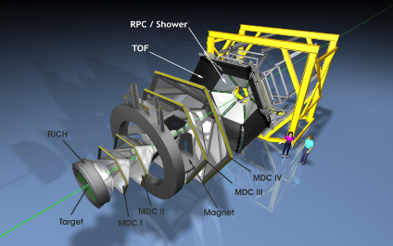
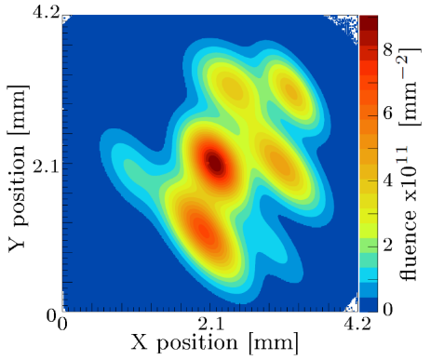
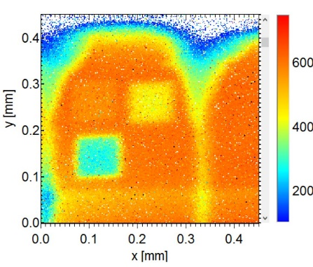
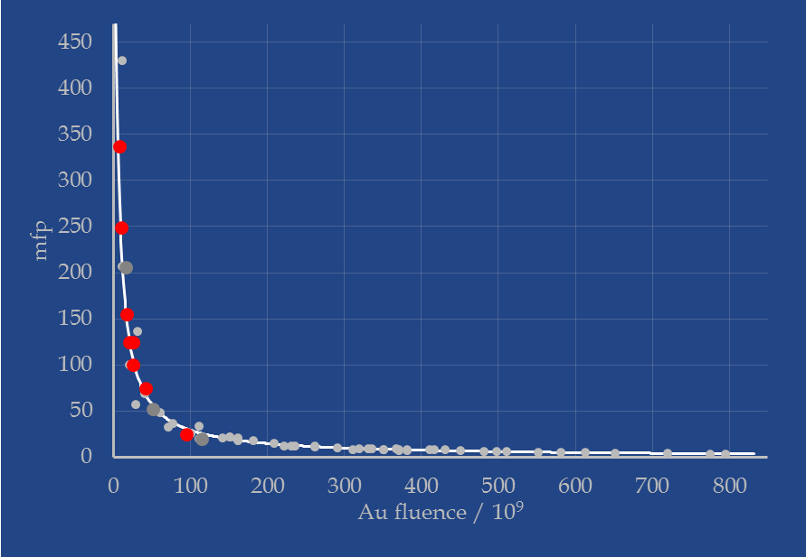
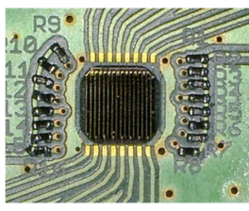
4. Examples of
AIDA2020 TA runs
  AIDA-2020-RBI-2015-1
  Systematic study of radiation damage in scCVD diamond material irradiated with relativistic Au beams, Jerzy Pietraszko, GSI Darmstadt, HADES, Germany
Number of traps:
Au / p_{4.5MeV} / p_{24GeV} = 1 / 30 / 2430
p_{4.5MeV} / p_{24GeV} = 81
Correlating fluences from different sources and detector degradation (scCVD diamond strip detector)

Slide 14
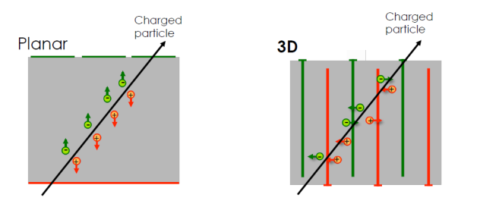
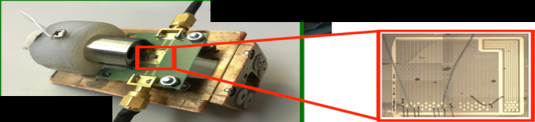
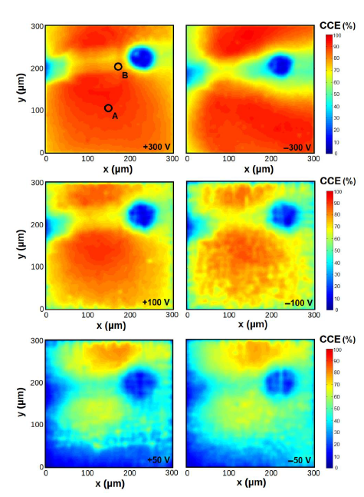
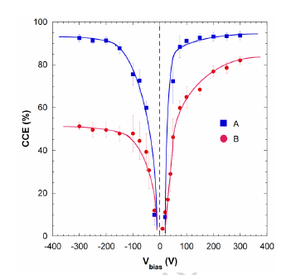
4. Examples of
AIDA2020 TA runs
  AIDA-2020-RBI-2015-4 and
  AIDA-2020-RBI-2017-5
  3D diamond, Alexander Oh,
  University of Manchester, UK
  AIDA-2020-RBI-2017
  buried graphite pillars in CVD diamond, G. Conte,
  Roma Tre Univ and INFN, Italy
Average CCE measured far away
and close (B) to the pillar
  CCE maps for different biases and geometries
IBIC map in case of front-side irradiation
at different bias voltages.

Slide 15
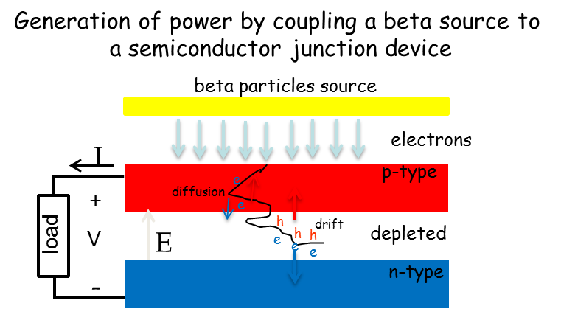
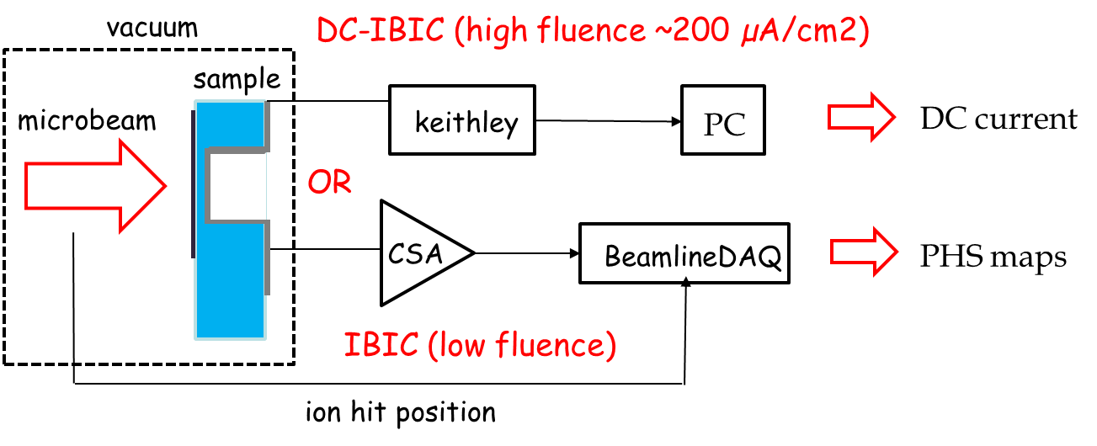
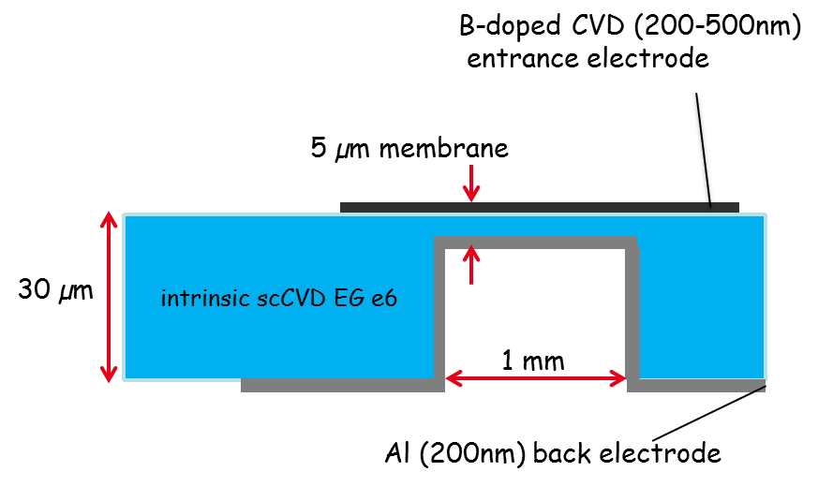
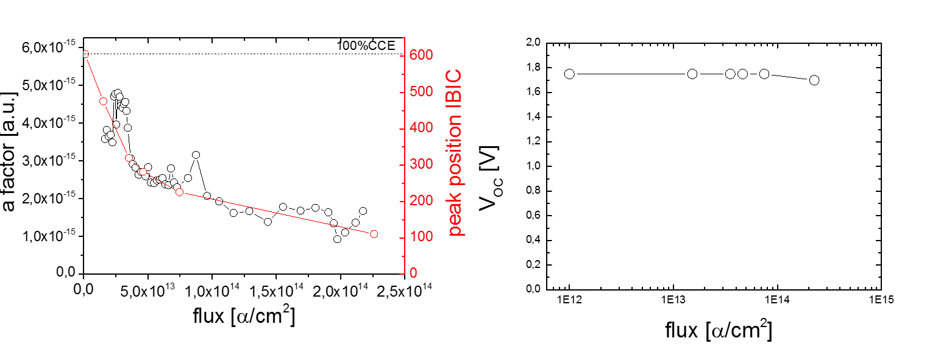
4. Examples of
AIDA2020 TA runs
  AIDA-2020-RBI-2015-2
  Diamond Membranes for Radioisotope Batteries BATDiαm, Michal Pomorski, CEA, LIST, France
α instead of β
particles

Slide 16
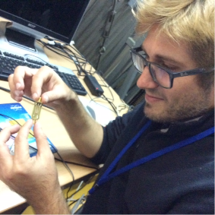
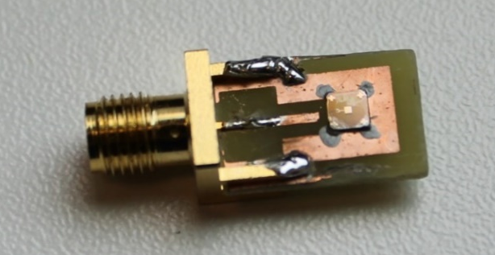
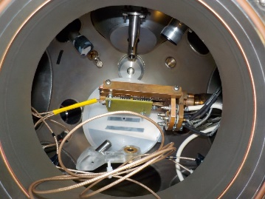
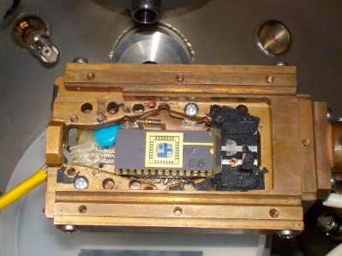
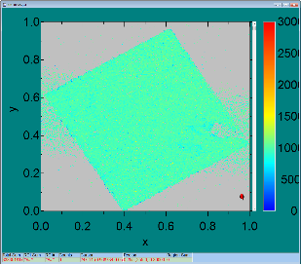
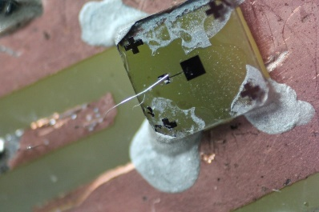
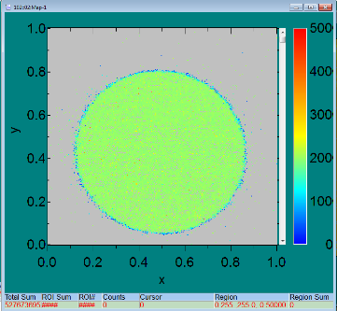
4. Examples of
AIDA2020 TA runs
  AIDA-2020-RBI-2016-1
  IBIC characterization of single crystal diamond based Shottky diodes for microdosimetry application, Claudio Verona, ‘Tor Vergata’ University, Italy
  AIDA-2020-RBI-2016-2
  Microbeam tests of silicon telescope for clynical dosimetry, G. Magrin, Austron, Austria

Slide 17
5. Summary
So far at RBI 12 different experiments have been carried out through the TA program
This is 75% of totaly planned 16 experiments
These activities used 480 access units (hours), which is 75% of planned 640 units
Total 27 users were present at the facility, of which 20 funded by the project (out of 24 planned – 83%)
So far 9 conference contributions, 5 publications, 2 thesses, 2 on-track contributions

Slide 18
5. Summary
Until the project end we have space for 4 more TA activities and 160 TA units
We are right now discussing with potential users for two more TA experiments, both related to pixel CMS upgrade
Then there is a possibility for 2 more TA experiments until the project end
According to the initial plan we predicted the need for 24 users present for all the TA activities assuming 1 to 2 users at the facility during TA runs. Initial estimate was to have 1 user at 8 and 2 users at another 8 TA runs (total 24). Soon after we realized that we need 2 users in more runs, so in 12 runs we had 20 users. We have enough funds to have 2 users for the remaining 4 TA runs (leading to total 28 users supported by the project.

Slide 19
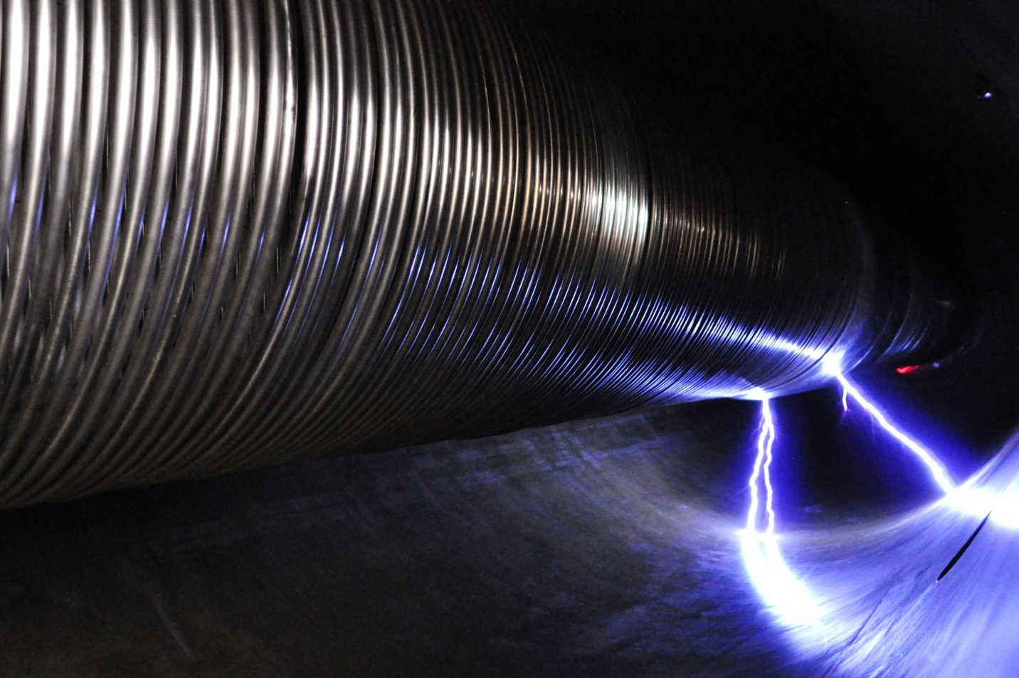
Thank you for attention!

Slide 20
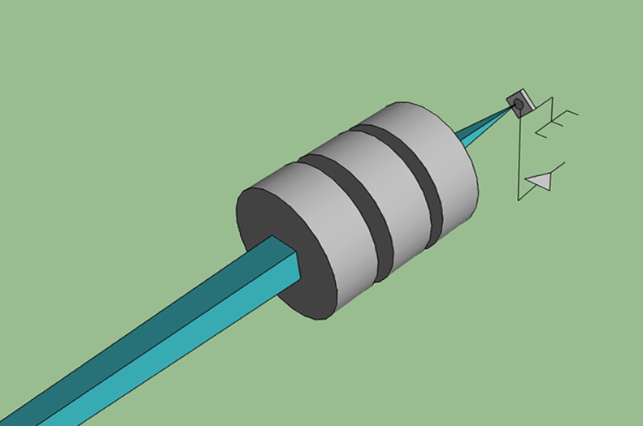
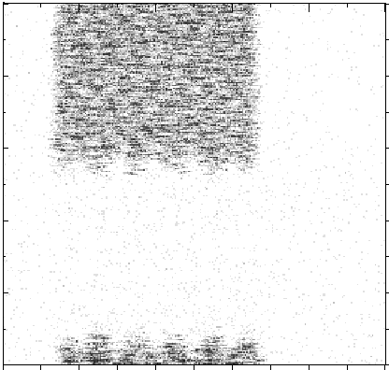
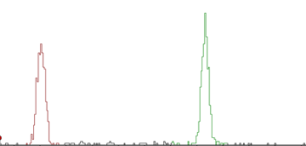
Additional slide - IBIC
What is needed for IBIC?
❷ POSITION
- Focusing and scanning
❸ IONS
- p, α, Li, C, O,..
❹ RANGE
- 1 to 1000 μm
100 pA current –
620 ions in 1 μs
signal
ion beam
+V
❶ RATE
- 0 - 10⁶ p/s
0.1 fA current –
620 ions/second
250 nm

Slide 21
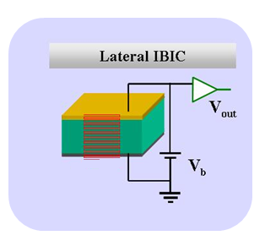
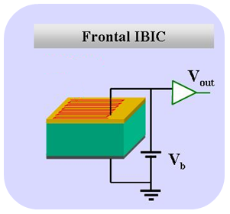
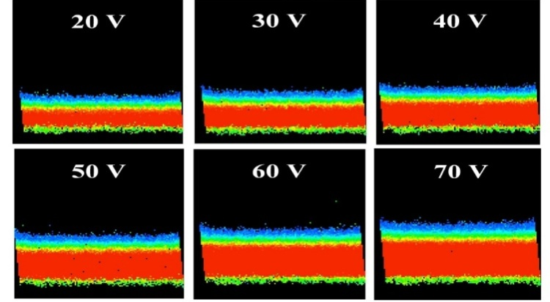
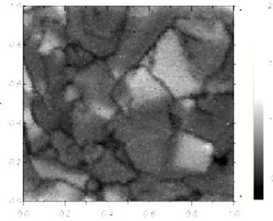
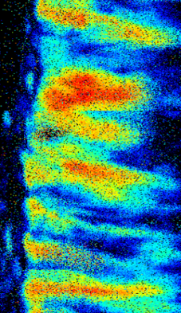
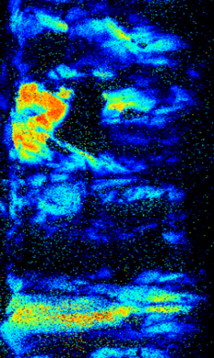
Aditional slide - IBIC
IBIC imaging - configurations
2 MeV p⁺
2 MeV He⁺

Slide 22
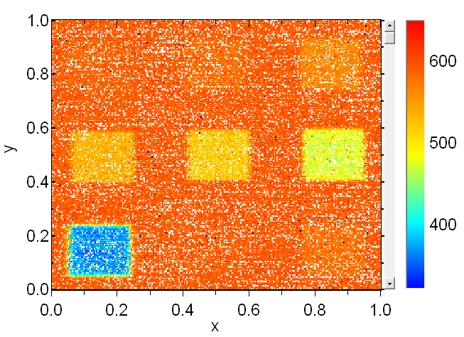
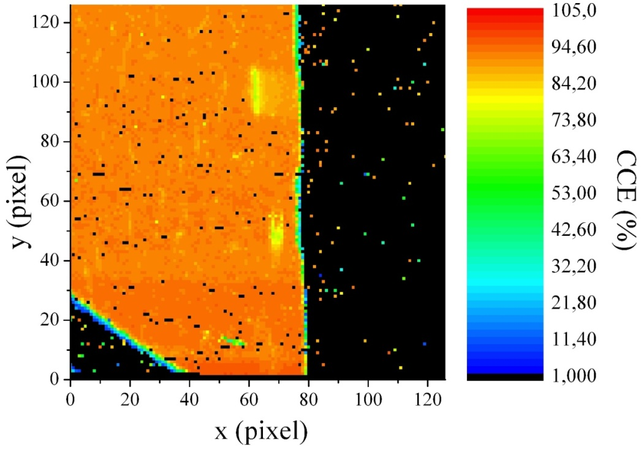
Additional slide
Radiation hardness tests Defects mapping
selective damage introduction
Lateral damage creation
frontal IBIC defect mapping
Bragg peak clearly visible
on-line monitoring of CCE
degradation and total fluence

