Slide 1





Update on surface TCAD Radiation Damage Modeling in Silicon Detectors
F. Moscatelli^{(1,2)}, D. Passeri^{(3,1)}, A. Morozzi⁽¹⁾, G.-F. Dalla Betta⁽⁴⁾, G.M. Bilei⁽¹⁾
(1) INFN Perugia, Perugia, Italy
(2) CNR-IOM Perugia, Perugia, Italy
(3) Department of Engineering, University of Perugia, Perugia, Italy
(4) Department of Industrial Engineering-University of Trento and TIFPA,, Trento, Italy

Slide 2
Outline
Motivations
Experimental Measurements (X-rays irradiation)
  Different test-structures (Gated Diodes, MOS capacitors, MOSFETs)
  Different providers (FBK, HPK, IFX) and substrates (p-type, n-type)
  Simulation Results and Comparison with experimental data
  Surface damage
    Update of the TCAD Si/SiO₂ interface damage model

Slide 3
AIDA2020 - Perugia
INFN and University of Perugia are involved in WP7.
7.2 TCAD model radiation damage:
- development of a TCAD model for the study of radiation damage effect
in silicon detectors valid up to the particle fluences expected at the end
of HL-LHC operations in the inner layers of the pixel systems (ATLAS/CMS).
Main goal synopsis:
  extension of the past “Perugia” TCAD model to simulate the effects of radiation damage on solid-state silicon devices;
  development of a comprehensive bulk damage as well as surface trap states build up modeling for a particle fluence > 2×10¹⁶ 1MeV n_{eq}/cm².
Participants: G.M. Bilei (INFN PG staff), D. Passeri (UniPG staff),
F. Moscatelli (CNR-IOM staff), E. Fiandrini (UniPG staff),
A. Morozzi (INFN post-doc).

Slide 4
Work Plan
Completed
On going
Added
To do.
Measurements
Simulations
Measurements on dedicated test structures e.g. gated diodes, MOS capacitors and MOSFETs on p-stop and p-spray/different substrates.
Different technologies/providers (e.g. FBK, IMM, HPK, IFX …).
High-Frequency and Quasi-Stationary C, MOSFET and I-V characteristics, …
Irradiation campaign with gammas,
X-rays and neutrons/(protons).
Measurements after irradiation → trap parameter extraction, TCAD model validation.
Predictive application of the model → sensor design and optimization
Bulk radiation damage modelling:
- extension of the three-level UniPG modelling (capture cross sections, charge multiplication, avalanche effects).
Surface radiation damage modelling:
- oxide fixed charge and interface trap state @dose;
- systematic study of acceptor/donor states at different energies and doses.
Comparison with literature data/dedicated measurements in terms of static behaviour (R, C) and charge collection properties.
Comprehensive modelling (bulk + interface, 2D/3D).

Slide 5
Motivations
Simulate the effects of radiation damage on silicon devices at very high fluences (HL-LHC operation > 2×10¹⁶ 1MeV n_{eq}/cm²).
Development of a combined bulk damage effect and interface trap states build-up numerical TCAD model:
    Physically-grounded approach,
    Extend the predictive capability to high fluences,
    Keep low the number of traps (e.g. avoiding fitting parameters / minimize the number of traps),
    Compatibility with already developed bulk damage model
    No over-specific modeling (e. g. device and technology independent)
Extraction from simple test structures of relevant parameters to be included within the model
Validation of the new modeling scheme through comparison with measurements of different test structures before and after irradiation.
Modeling the radiation damage effects.
Predictive insight of the behaviour of detectors, aiming at their performance optimization.
Goal

Slide 6
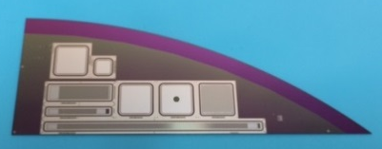
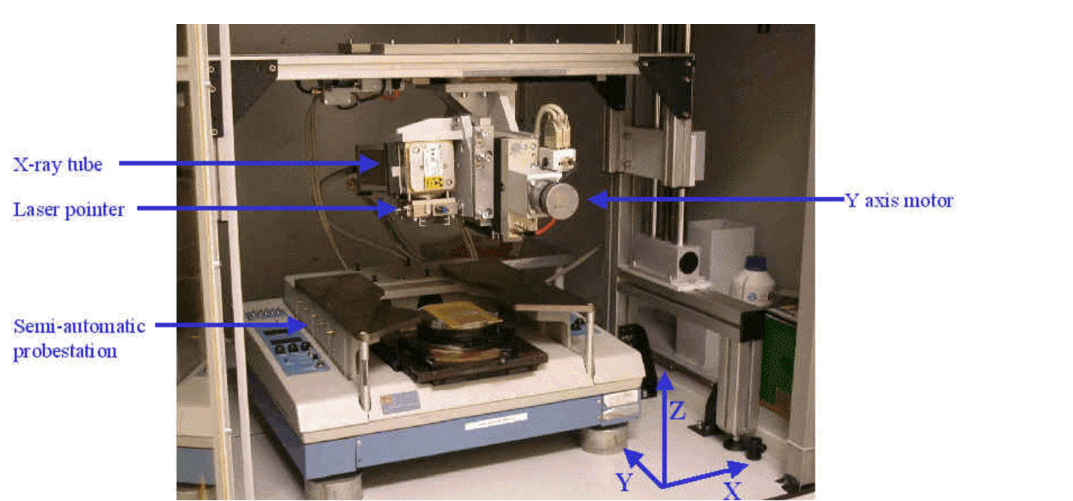
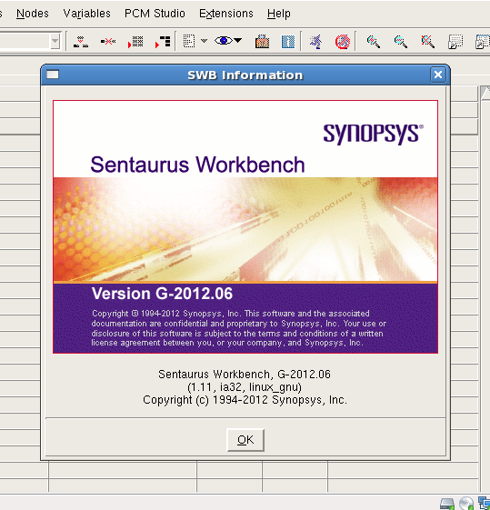
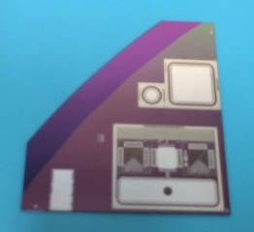
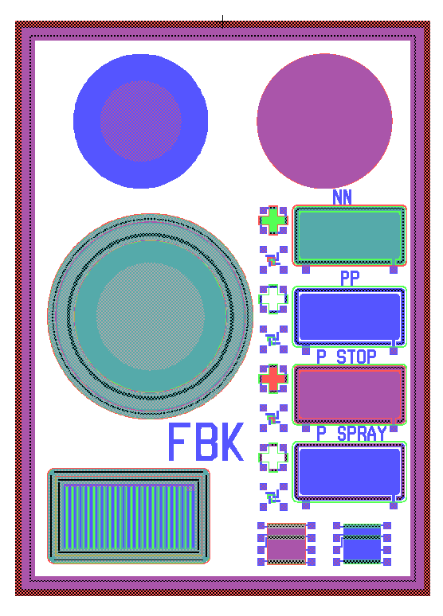
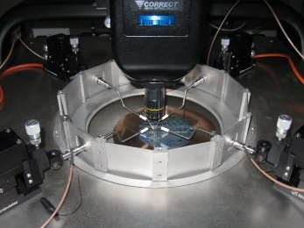
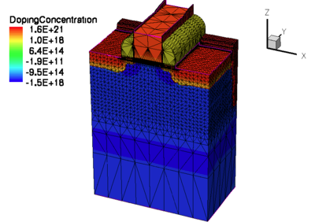
New “University of Perugia” model
MODEL
PARAMETERS EXTRAPOLATION
TEST STRUCTURE
MEASUREMENTS
MODEL VALIDATION
Setting-up the measurements:
Measurement Campaign: X-ray irradiation
  carried out in Padova (IT)
  doses range: 50 - 20 Mrad (SiO₂)
Different devices, different providers, different substrates (p-on-n and n-on-p)
Measurements after irradiation / annealing 80°C 10 min.
DETECTOR OPTIMIZATION

Slide 7
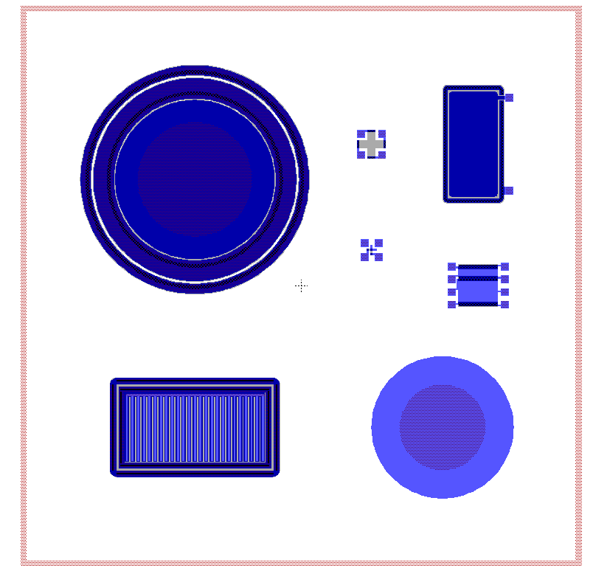
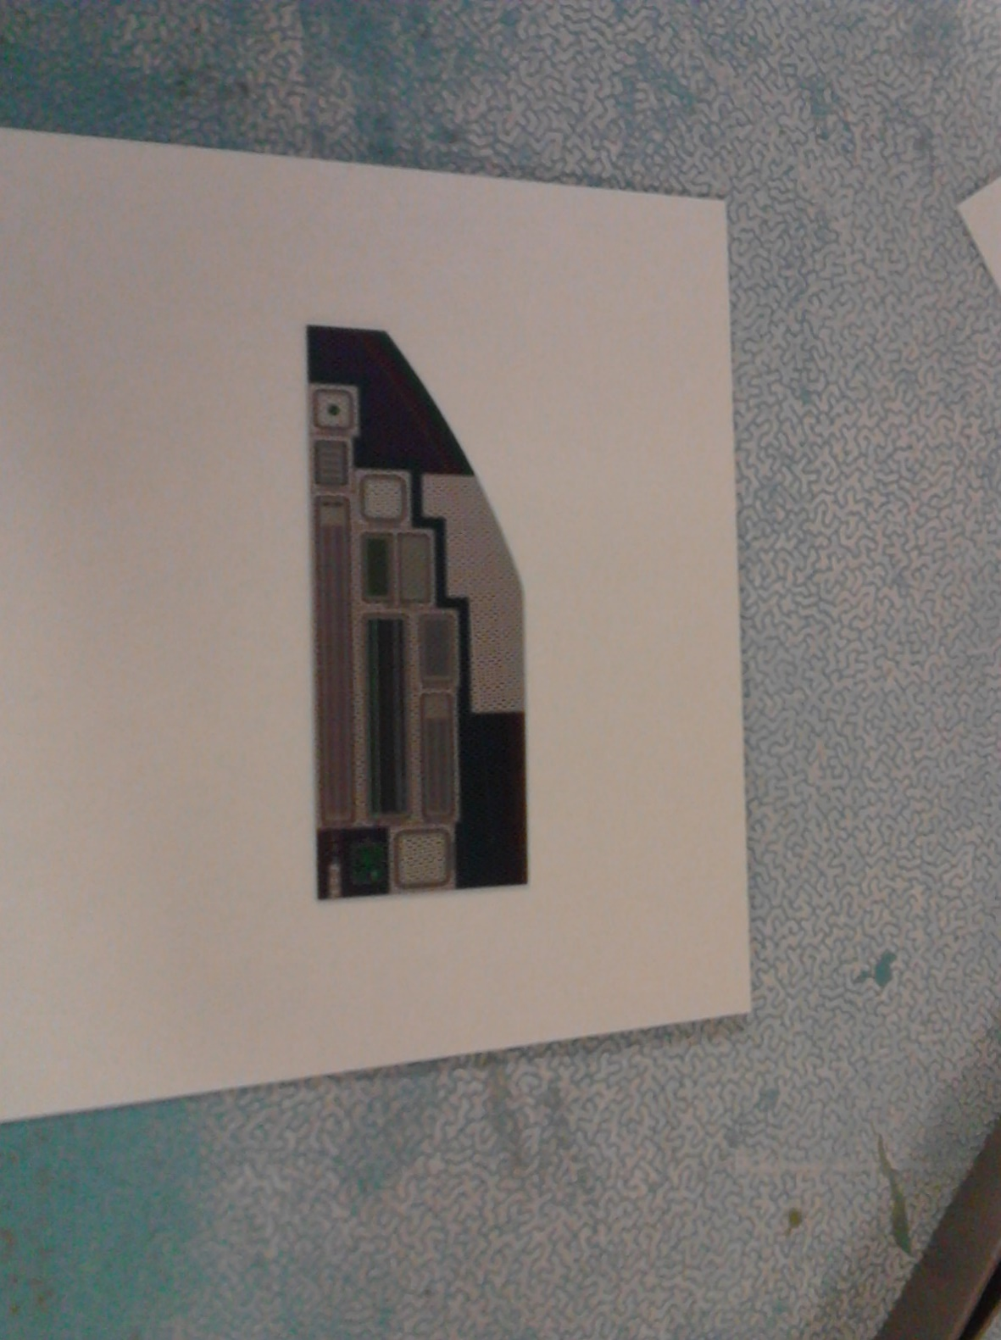
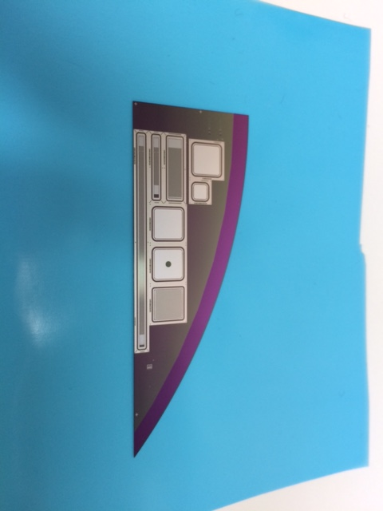
Test Structures
FBK
HPK
IFX
p-on-n
MOSFET
MOS
capacitor
Cap-TS
for Rint
MOS
capacitor
Gated-diode
Gated-diode
Al-gate MOS
capacitor
Gated-diode
n-on-p
Al-gate MOS
capacitor
    Test Structures: MOS capacitors, Gated Diodes, MOSFETs, Strips (R_{int} meas.)
    Substrates: n and p
    Strip Isolation: p-stop and p-spray (for p-type substrate)
MOSFET
Gated-diode

Slide 8
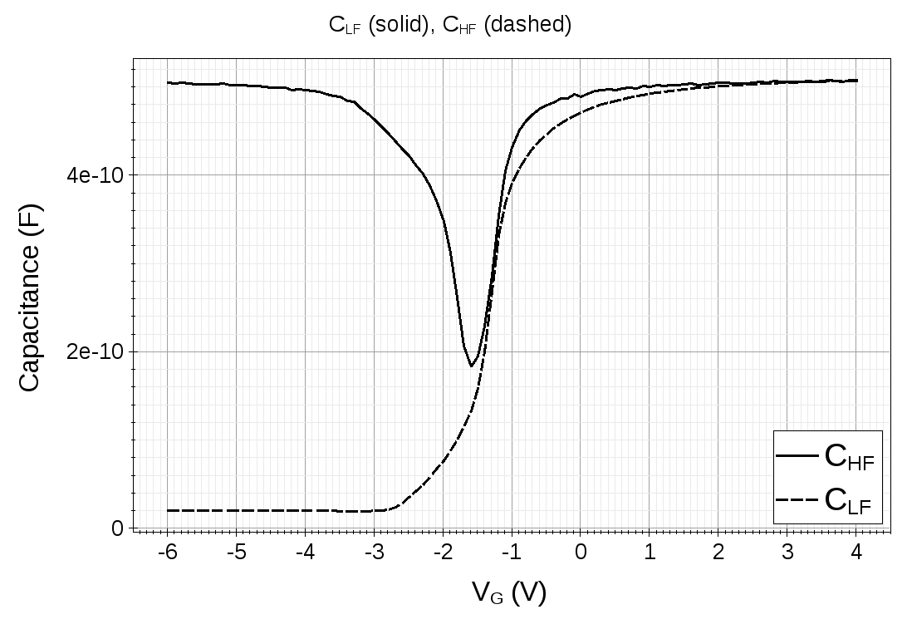
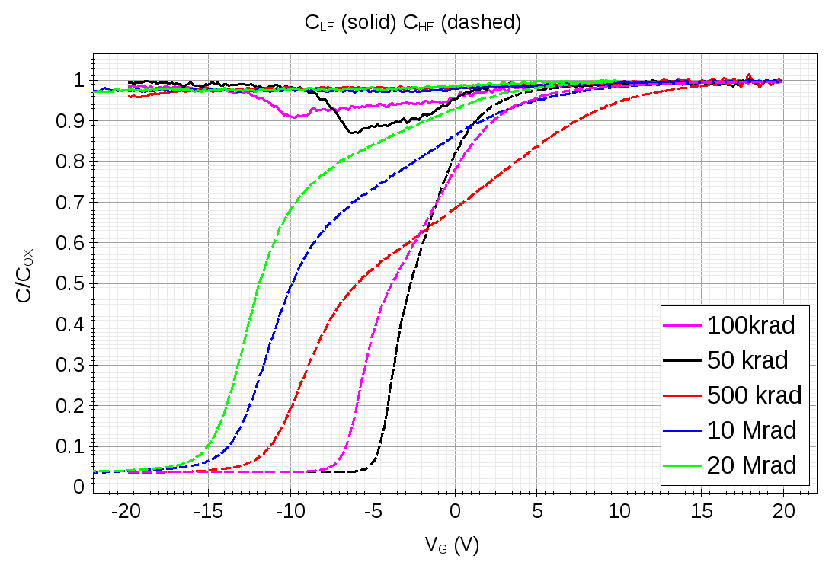
FBK - MOS Capacitors: measurements
n-type substrate
HF measurements at 100 kHz with a small signal amplitude of 15 mV.
The QS characteristics were measured with delay times of 0.7 s using a voltage step of 100 mV.
Effective oxide charge density N_{EFF} obtained from V_{FB} measurements.
Unbiased devices during the irradiation steps.
Pre X-ray
Post X-ray

Slide 9
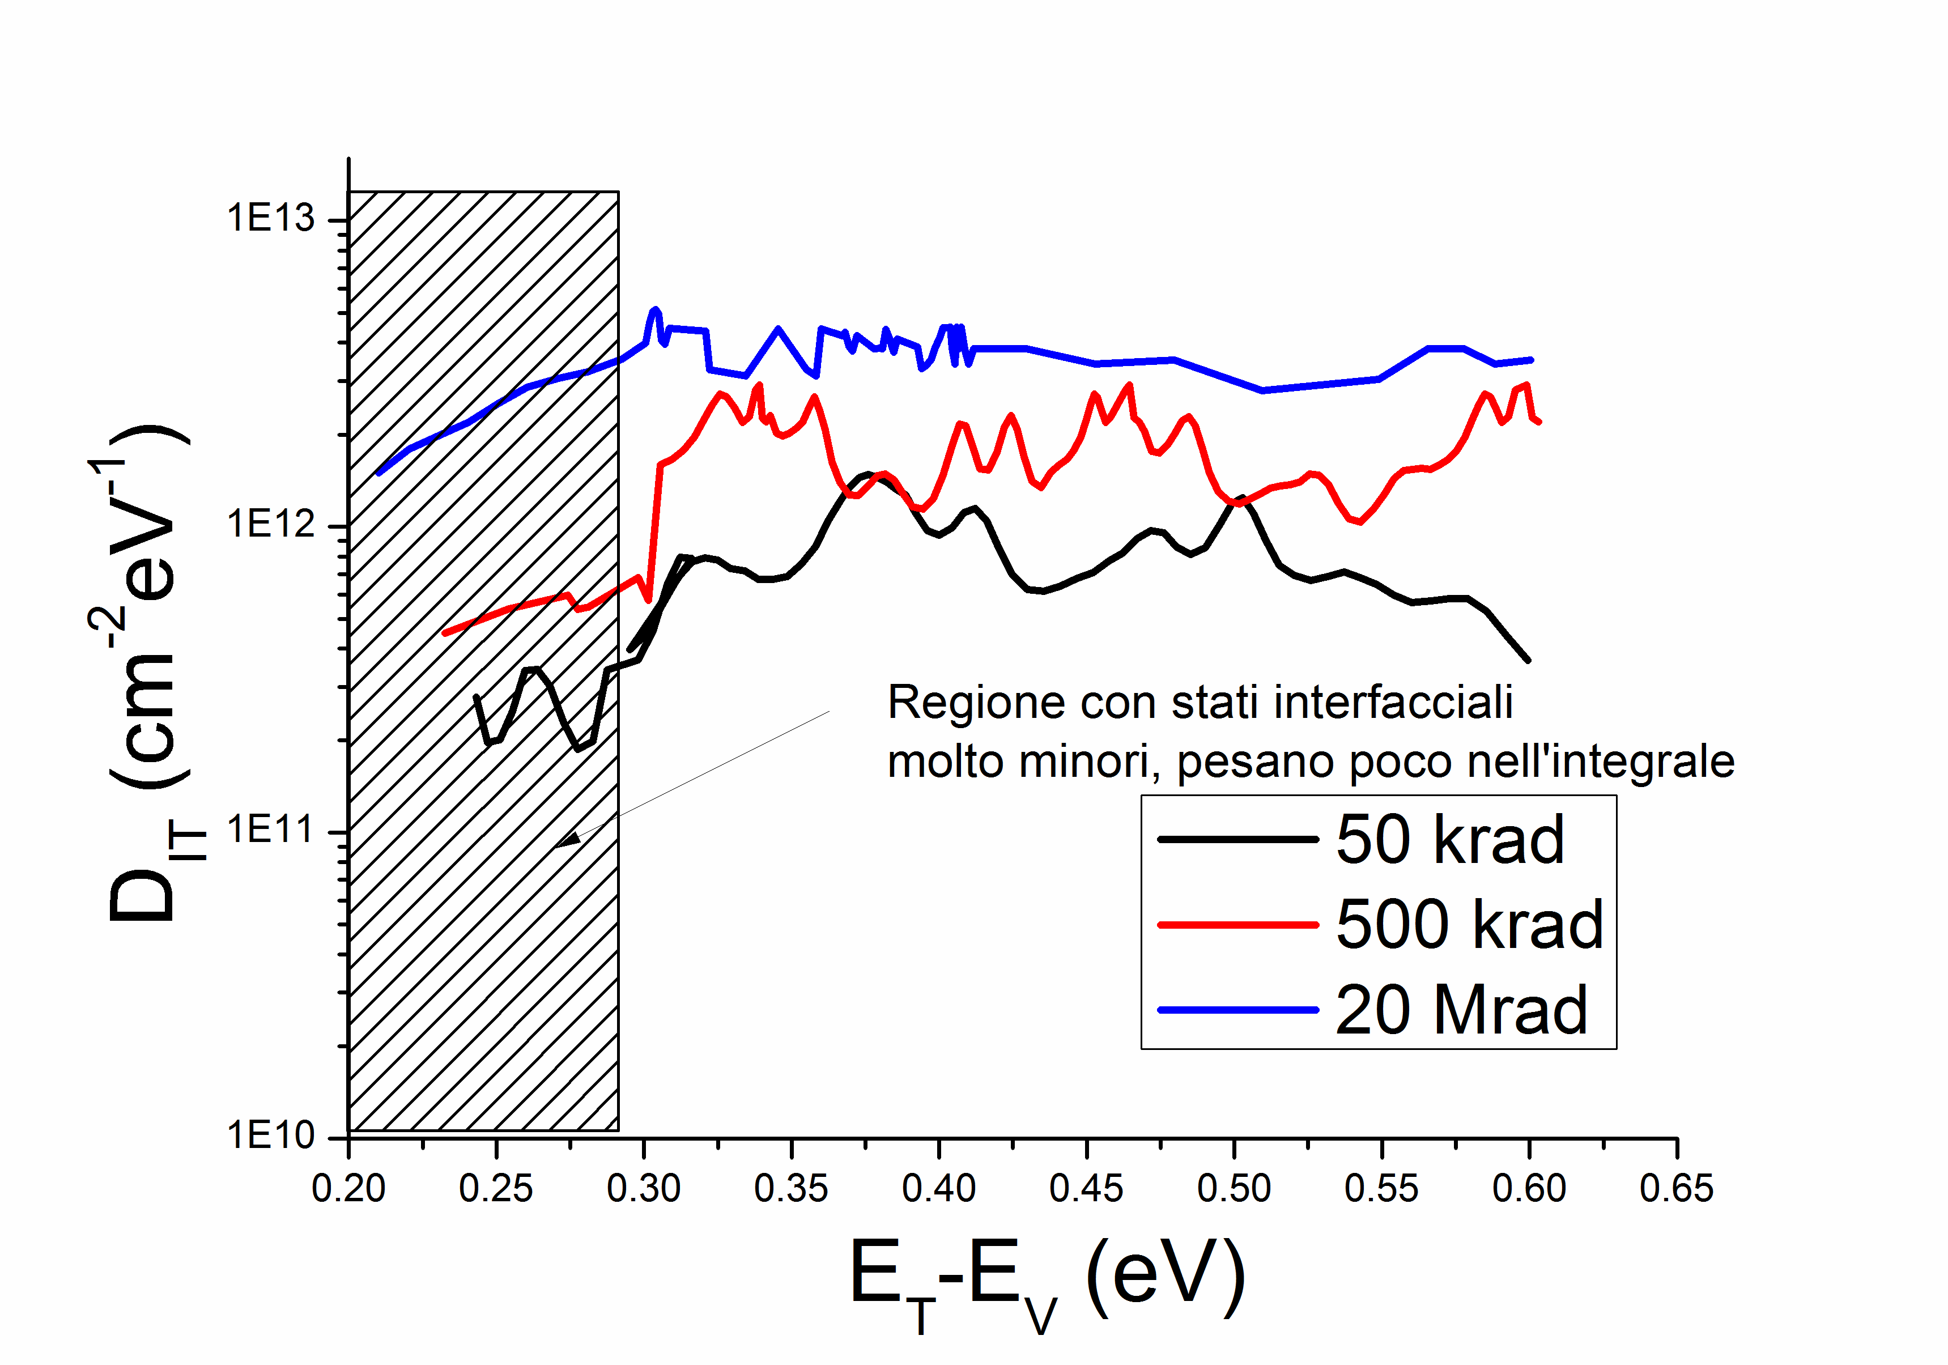
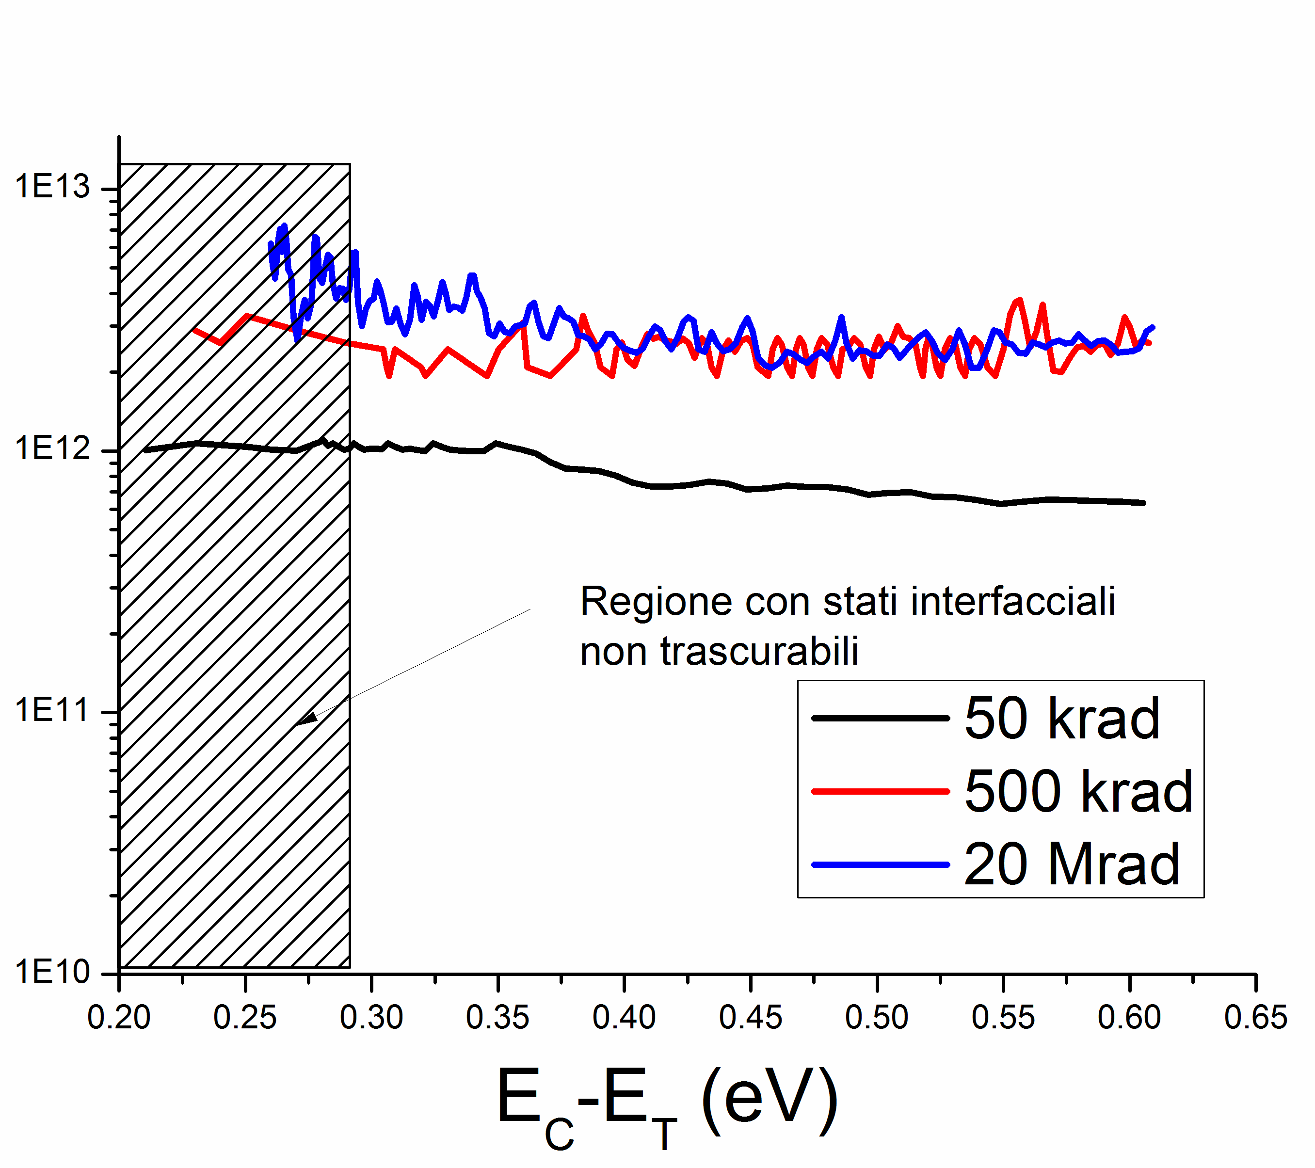
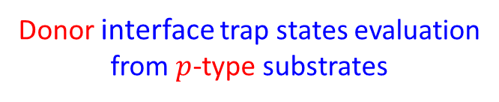
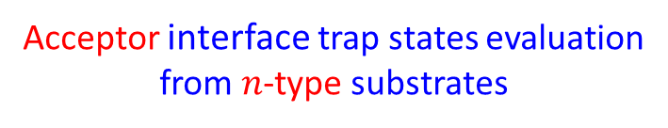
FBK - MOS Capacitors: parameters extraction
The interface trap density (D_{IT}) was estimated by using the C-V High-Low method.
Donor interface trap states evaluation
from $p$-type substrates
Acceptor interface trap states evaluation
from $n$-type substrates
Relatively low interface
trap state density region
Non-negligible interface
trap state density

Slide 10
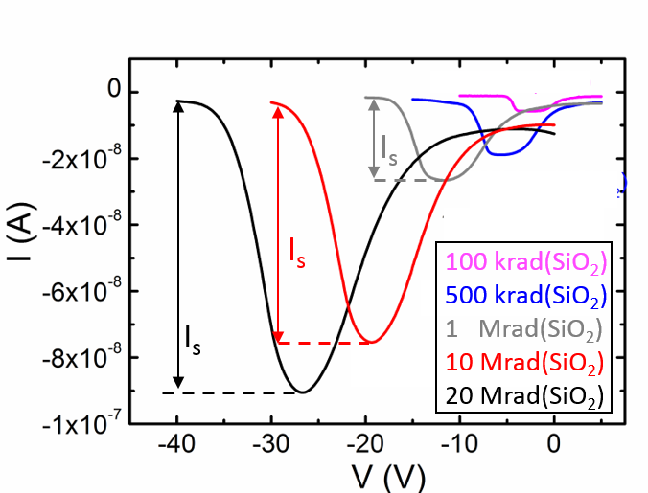
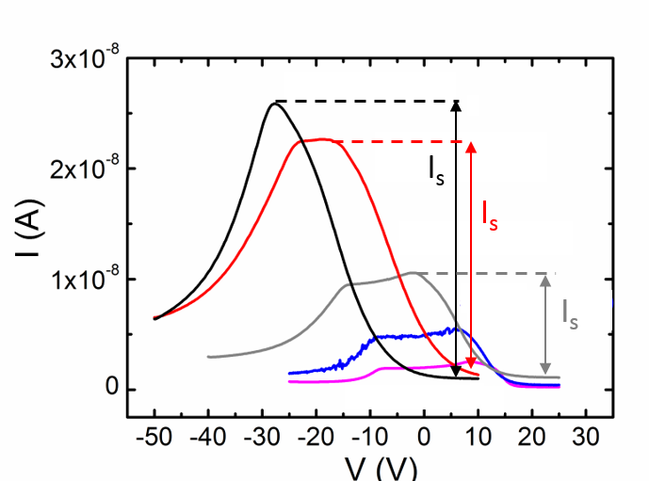
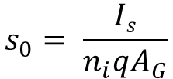

FBK – Gated Diodes
Unbiased devices during the irradiation steps.
From I-V measurements the surface velocity s₀ was evaluated as a function of the dose.
$$s_{0}= \frac{Is}{n_{i}qA_{G}}$$
$$s_{0}= \frac{π}{2} σ_{s}v_{th}D_{it}k_{B}T$$
n-type substrate
p-type substrate

Slide 11
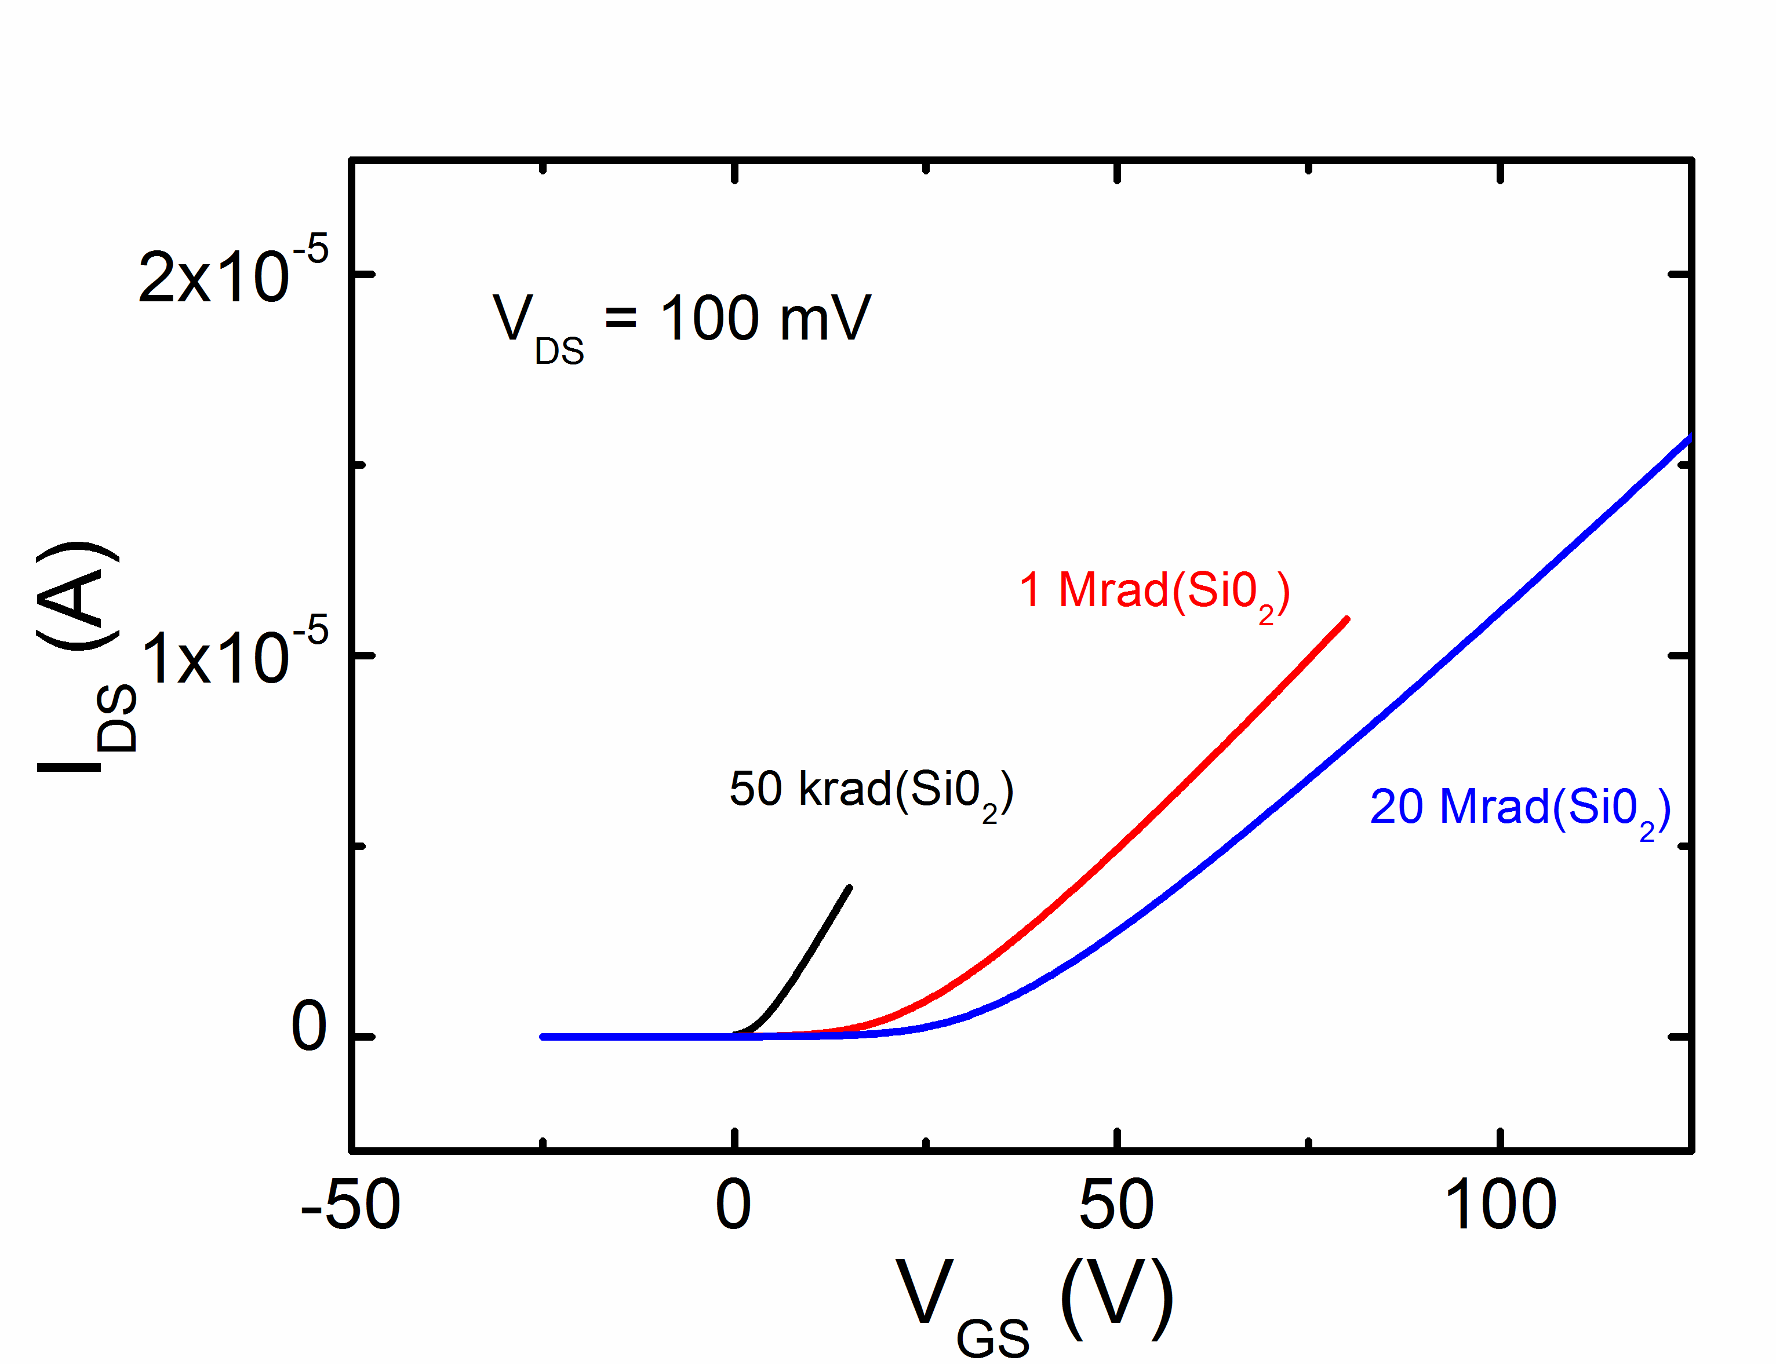
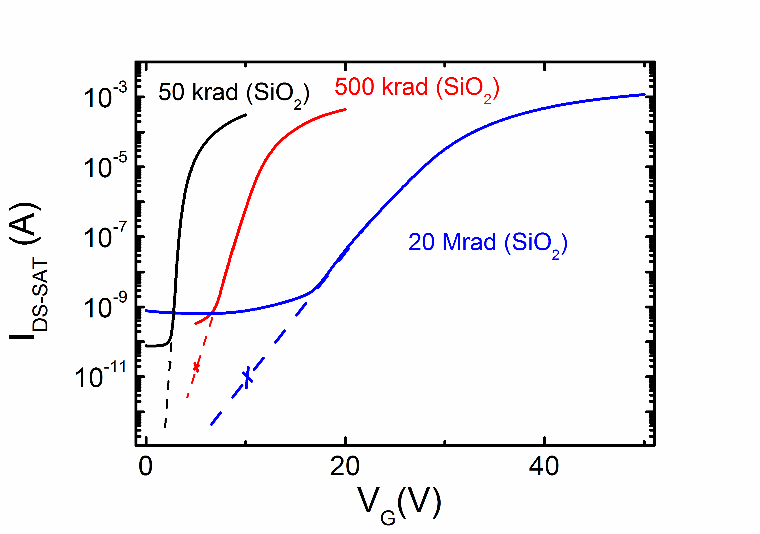

FBK - MOSFETs
V_{th} = -0.8 ÷ 0.1 V (unirradiated)
Unbiased devices during the irradiation steps
Radiation → interface traps (N_{IT}) + trapped-oxide (N_{OX}) → V_{th} shift (ΔV_{th}).
ΔV_{th} is separated into a contribution due to N_{IT} and due to N_{OX,} from I_{DS}-V_{GS} of MOSFET (method proposed in McWorther Applied Physics Letters 48, 133 (1986))
${∆V}_{th}={∆V}_{N_{it}}$ + ${∆V}_{N_{ox}}$
nMOSFET
x
x
x
pMOSFET

Slide 12
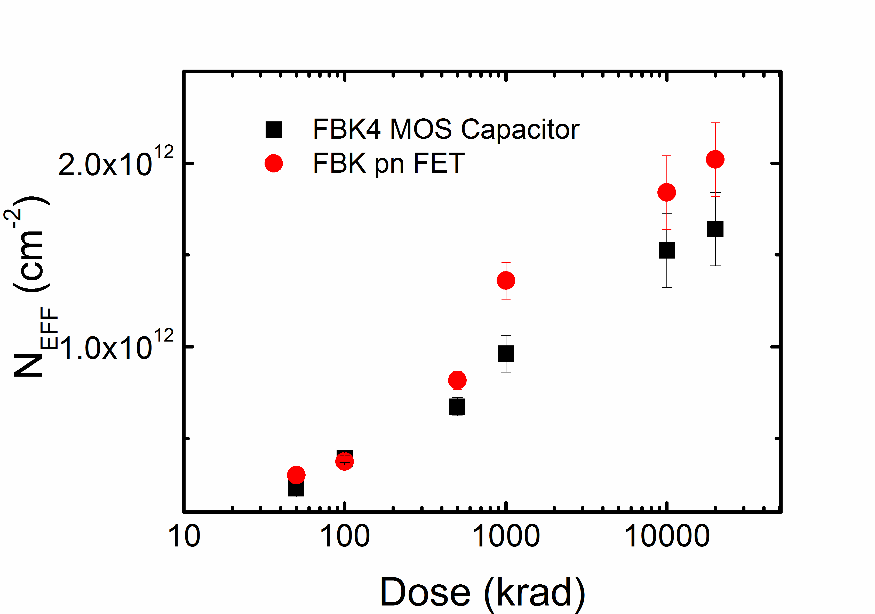
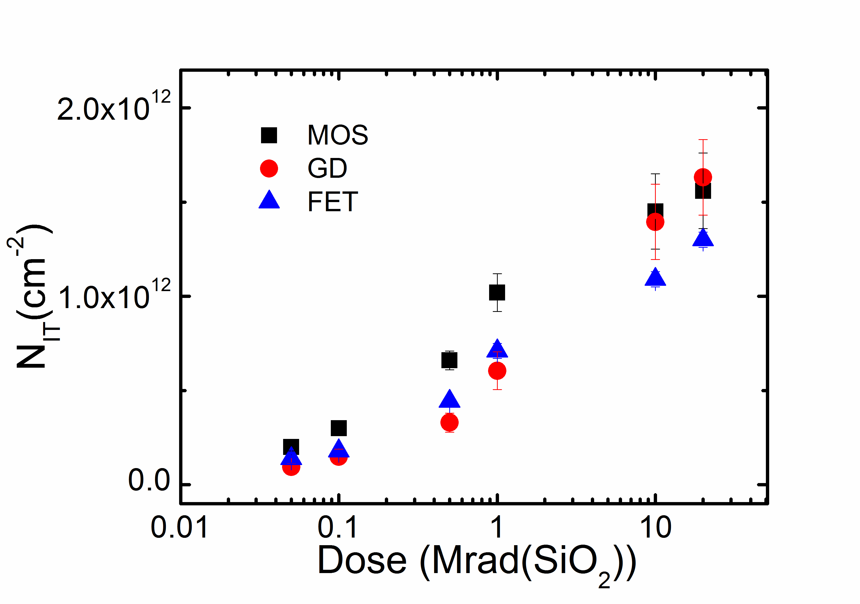
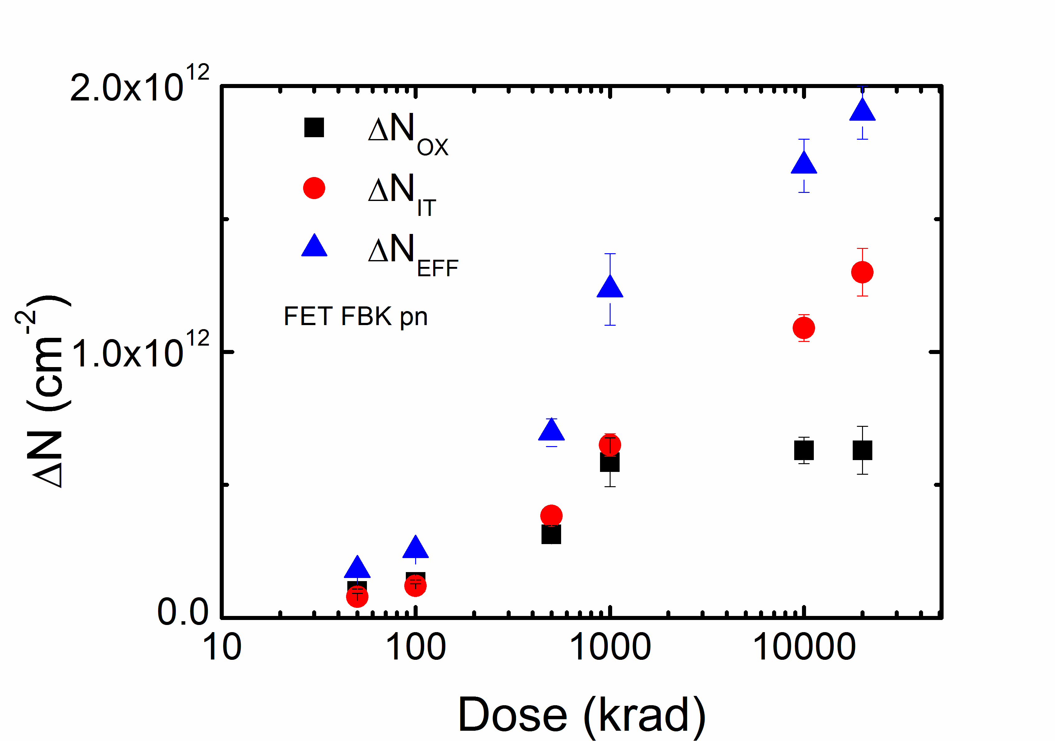


Summary of measurements – p-type substrate
Effective oxide charge density (N_{EFF})
Integrated interface trap density (N_{IT})
Describe the Donor trap state characterisics
${∆N}_{EFF}={∆N}_{IT}$ + ${∆N}_{OX}$
$${∆N}_{OX},{∆N}_{IT}$$
as INPUT PARAMETERS to the TCAD tool

Slide 13
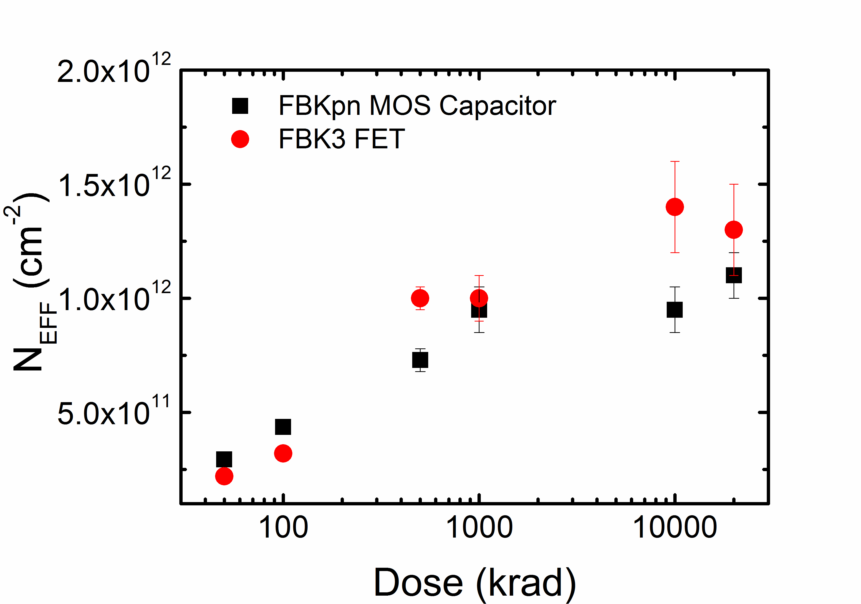
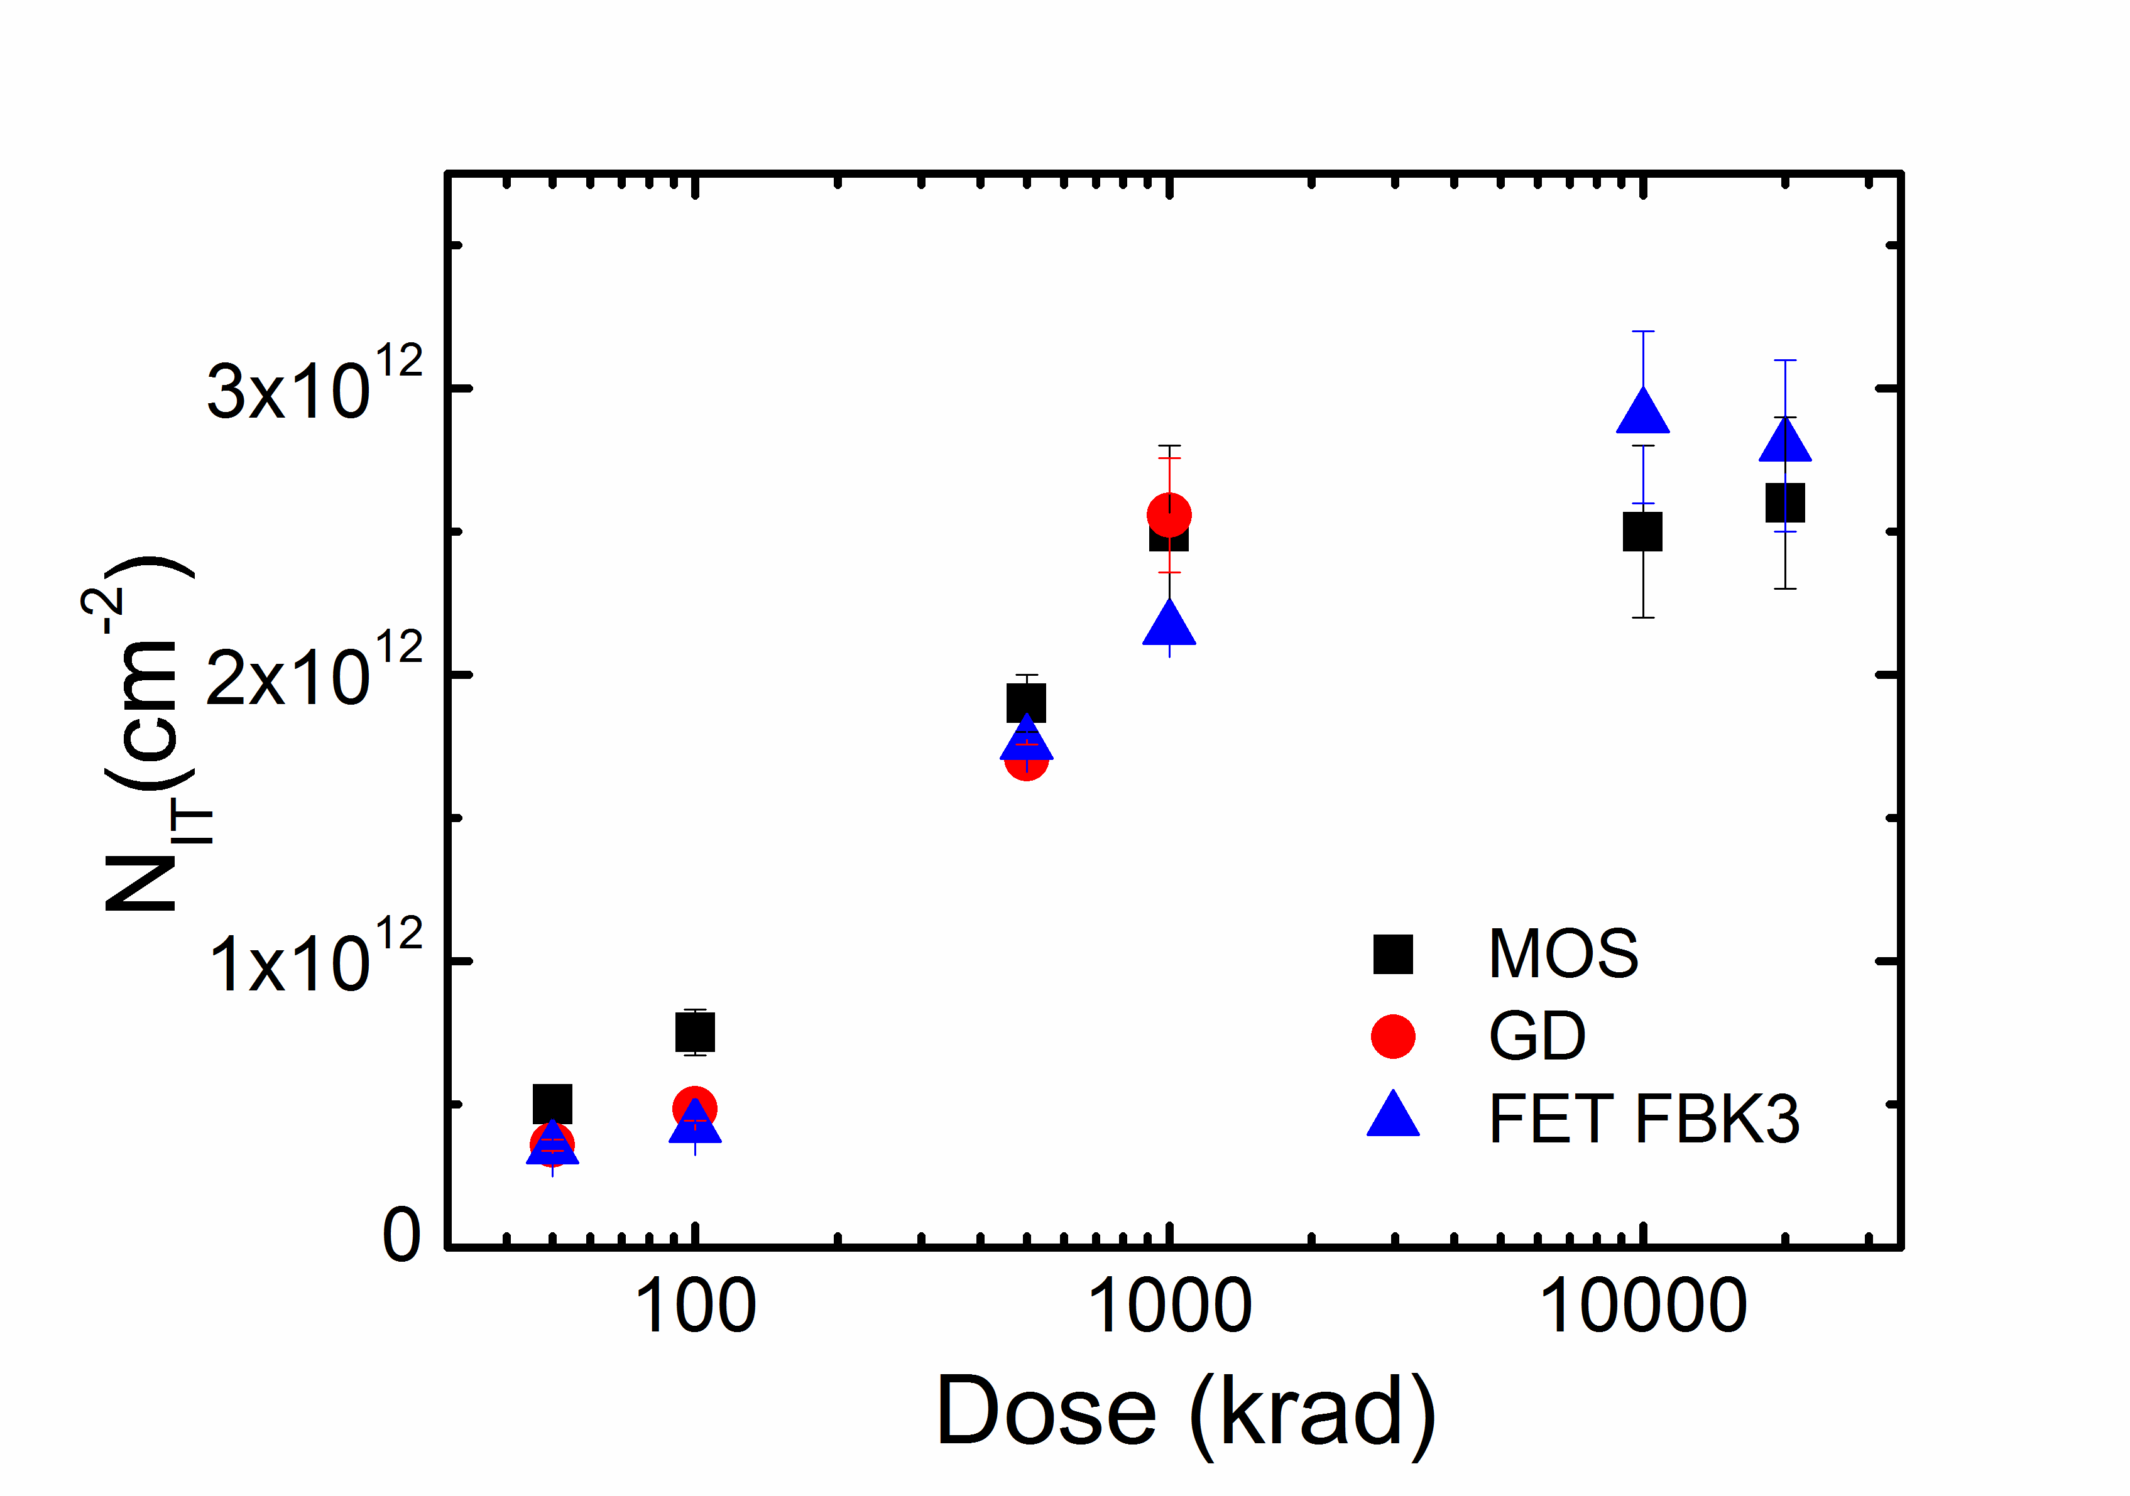
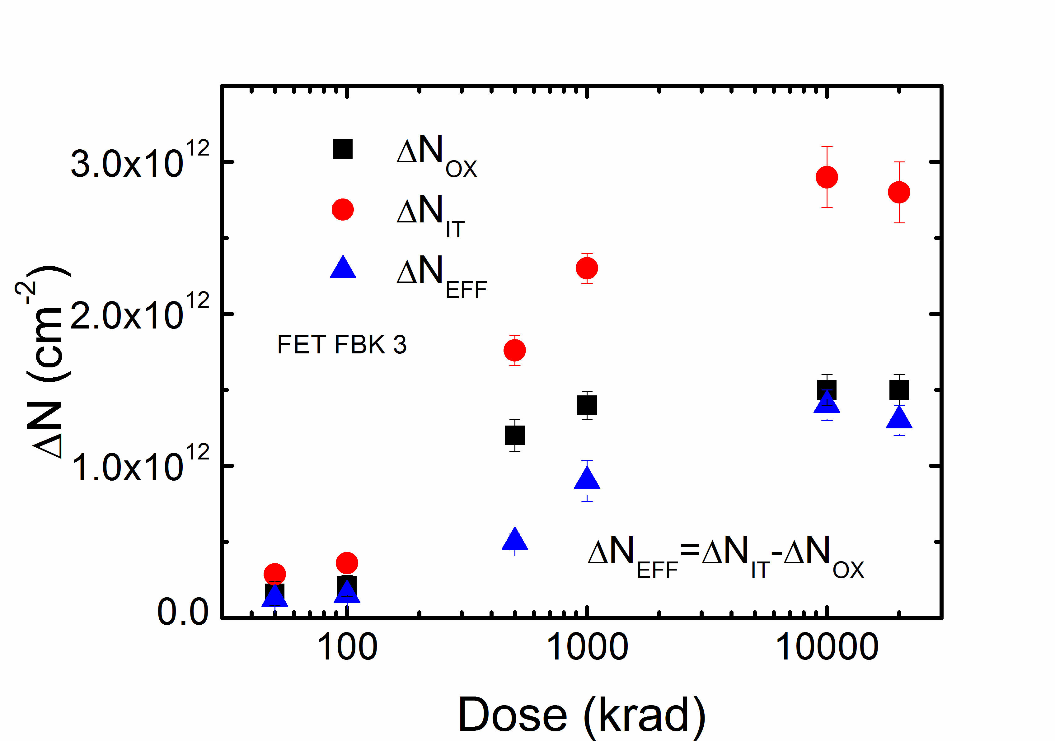
Summary of measurements – n-type substrate
Effective oxide charge density (N_{EFF})
Integrated interface trap density (N_{IT})
Describe the Acceptor trap state characterisics
${∆N}_{EFF}={∆N}_{IT}$ + ${∆N}_{OX}$
$${∆N}_{OX},{∆N}_{IT}$$
as INPUT PARAMETERS to the TCAD tool

Slide 14
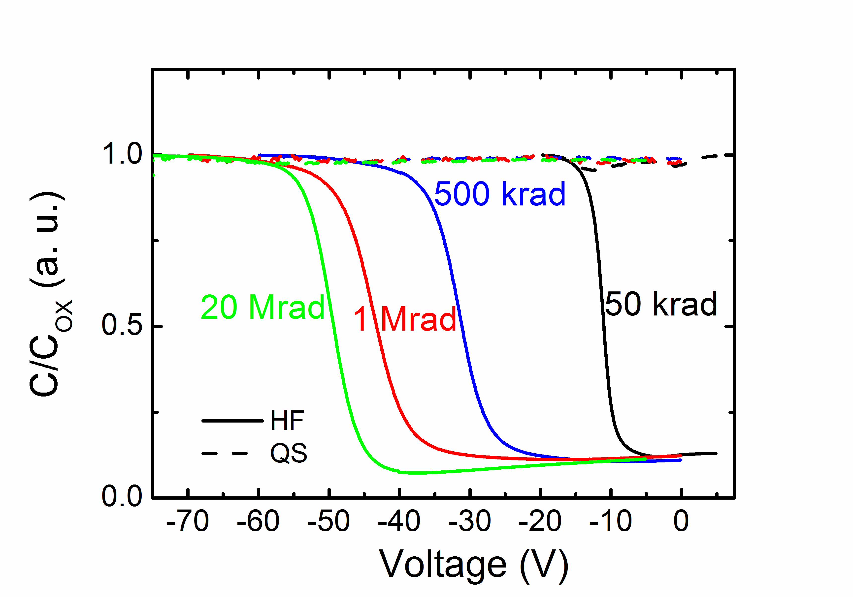
IFX: MOS C-V Measurements after X-rays
p-type substrate
V_{FB} ≅ -10 V at 50 krad
V_{FB} ≅ -17 V at 100 krad
V_{FB} ≅ -30 V at 500 krad
V_{FB}≅-42 V at 1 Mrad
V_{FB}≅-50 V at 10-20 Mrad

Slide 15
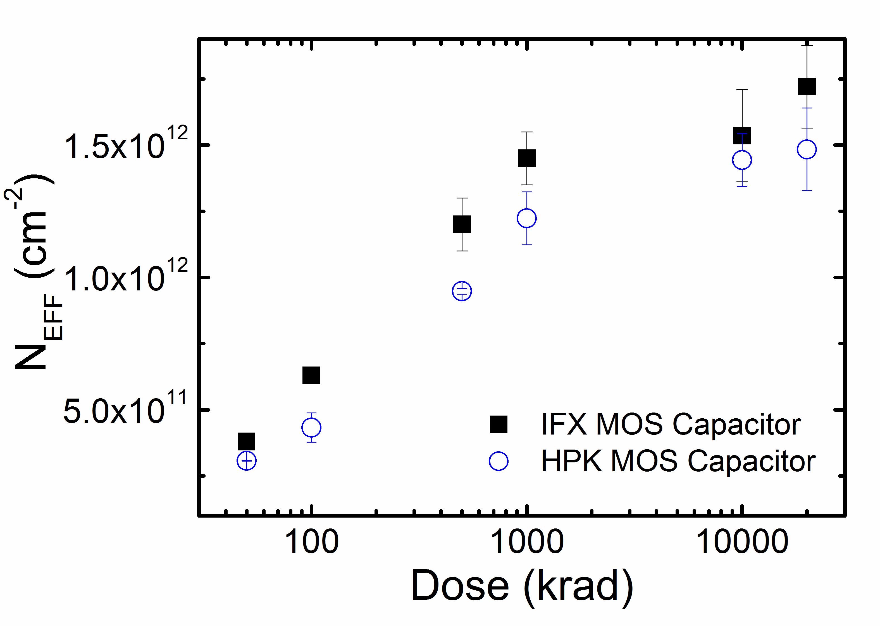
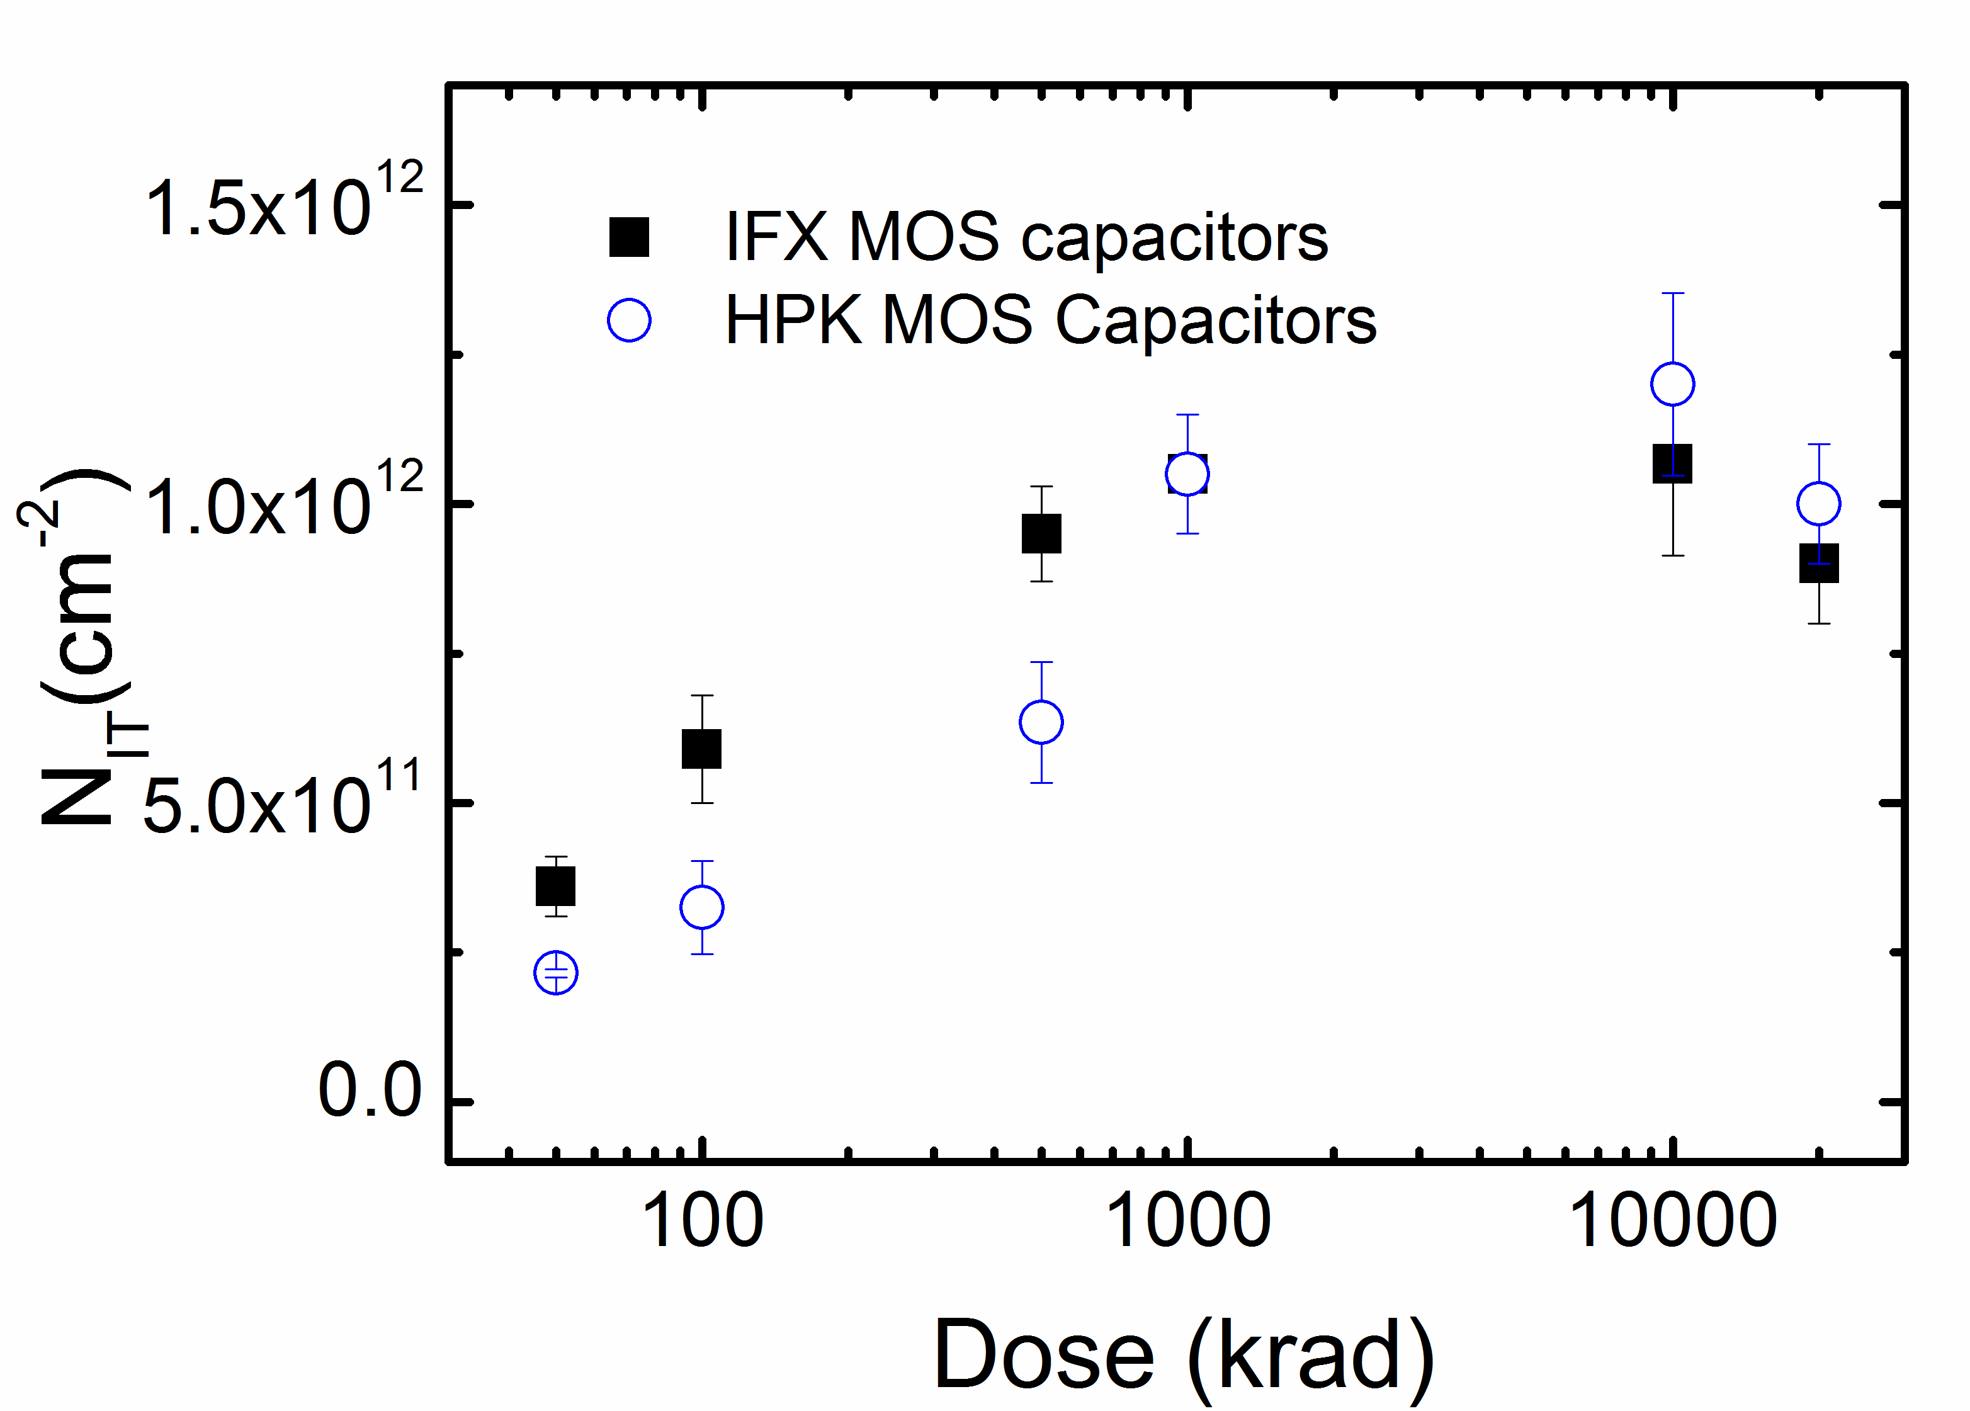
HPK and IFX: p-type Summary of measurements
p-type substrate
N_{EFF} and N_{IT} :
  Extrapolated parameters with the same methodologies of FBK
  Similar values between the two vendors

Slide 16
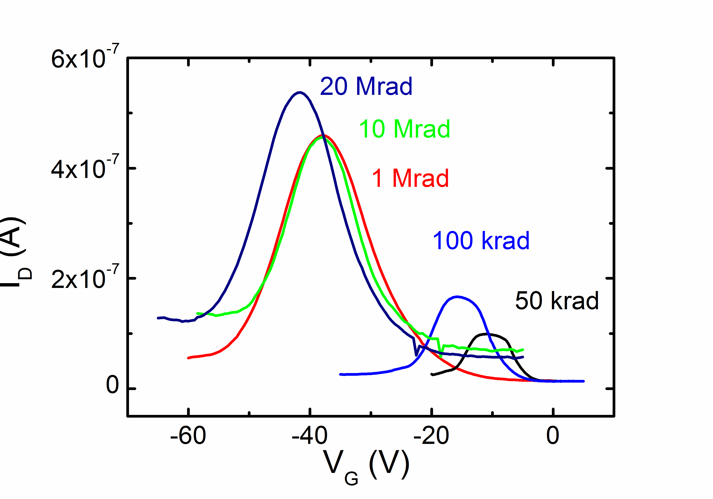
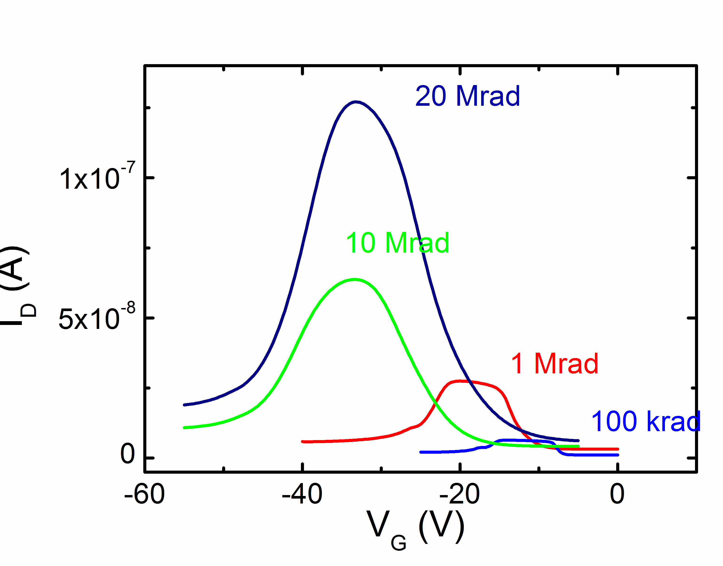
IFX and HPK: p-type GCD after X-ray irradiation
IFX
HPK
Area 11.71 mm²
Area 6.14 mm²
Annealing 80°C 10 min
Surface velocity s₀ evaluated as a function of the dose

Slide 17
New “University of Perugia” model
MODEL
PARAMETERS EXTRAPOLATION
TEST STRUCTURE
MEASUREMENTS
MODEL VALIDATION
DETECTOR OPTIMIZATION

Slide 18
Surface Damage Model: Levels
Interface trap state energy modelling
E_{C}
Conduction Band
E_{C} - 0.40
E_{V} + 0.70
E_{C} - 0.60
E_{V}
Valence Band
Type | Peak Energy (eV) | Density (cm⁻²)
Acceptor | E_{C} - 0.40 | 40% of acceptor N_{IT} [1] (N_{IT}=M·N_{OX})
Acceptor | E_{C} - 0.60 | 60% of acceptor N_{IT} [1] (N_{IT}=M·N_{OX})
Donor | E_{V} + 0.70 | 100% of donor N_{IT} (N_{IT}=M·N_{OX})
F. Moscatelli et al., Combined Bulk and Surface Radiation Damage Effects at Very High Fluences in Silicon Detectors: Measurements and TCAD Simulations, IEEE Transactions on Nuclear Science, 2016, Vol. 63, Issue: 5, 2716 - 2723.

Slide 19


Surface Damage Model: Gaussian
Interface trap state energy modelling
E_{C}
Conduction Band
E_{C} - 0.40
E_{V} + 0.70
E_{C} - 0.60
E_{V}
Valence Band
Type | Peak Energy (eV) | Density (cm⁻²) | σ (eV)
Acceptor | E_{C} - 0.40 | 40% of acceptor N_{IT} [1] (N_{IT}=M·N_{OX}) | 0.07
Acceptor | E_{C} - 0.60 | 60% of acceptor N_{IT} [1] (N_{IT}=M·N_{OX}) | 0.07
Donor | E_{V} + 0.70 | 100% of donor N_{IT} (N_{IT}=M·N_{OX}) | 0.07
F. Moscatelli et al., Effects of Interface Donor Trap States on Isolation Properties of Detectors Operating at High-Luminosity LHC, IEEE Transactions on Nuclear Science, 2017, Vol. 64, Issue: 8, 2259 - 2267

Slide 20
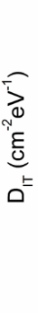
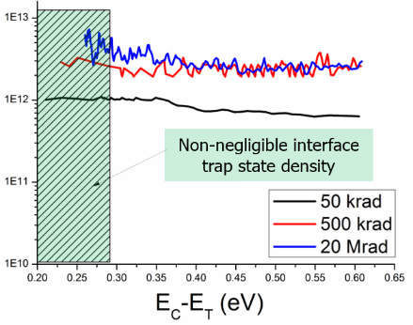

Surface Damage Model: Uniform Bands
Interface trap state energy modelling
E_{C}
Conduction Band
Acceptor Band
E_{C} - 0.56 eV
Donor Band
E_{V} + 0.6 eV
E_{V} + 0.3 eV
E_{V}
Valence Band
Type | Energy (eV) | Band width (eV) | Concentration (cm⁻²)
Acceptor | E_{C} - 0.30 | 0.56 | Dit = Dit(Φ)
Donor | E_{V} + 0.45 | 0.30 | Dit = Dit(Φ)

Slide 21
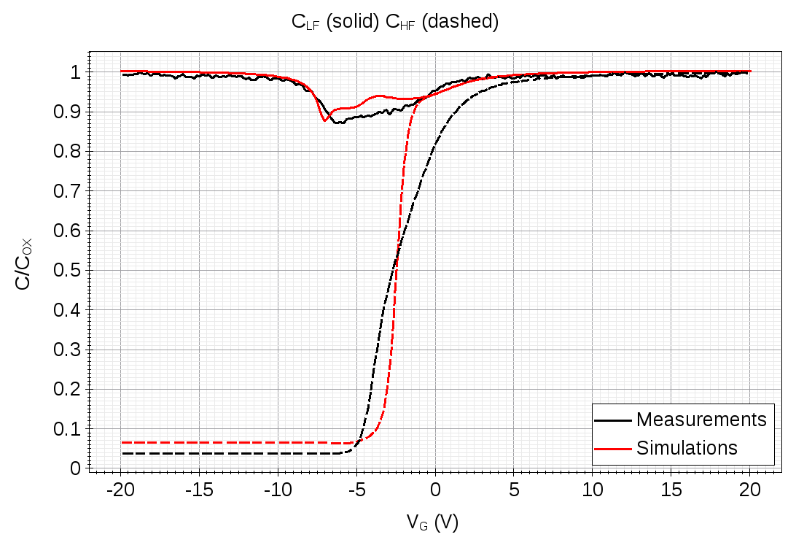
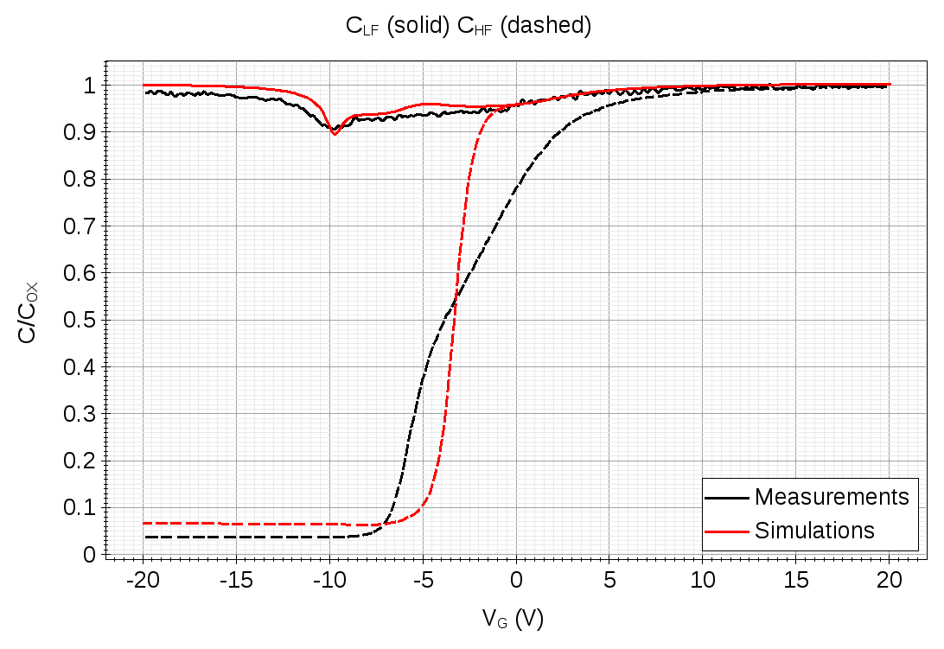
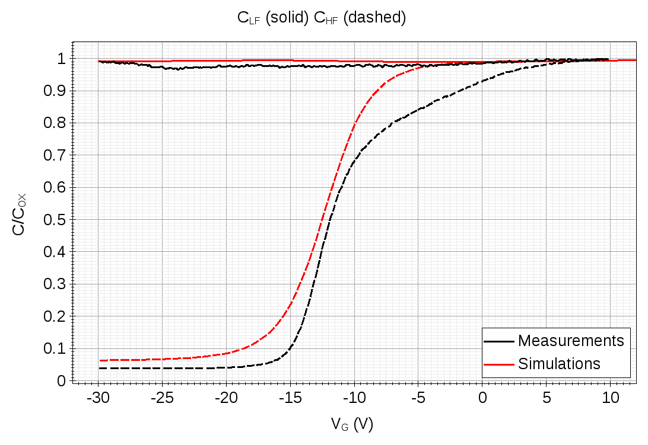
FBK MOS Capacitors – Model validation
n-type substrate
Irradiated structures FBK p-type.
C-V measurements compared to simulations at different doses from 0.05 to 20 Mrad(SiO₂).
  Good agreement!
@ 50 krad
@ 100 krad
@ 10 Mrad
@ 20 Mrad

Slide 22
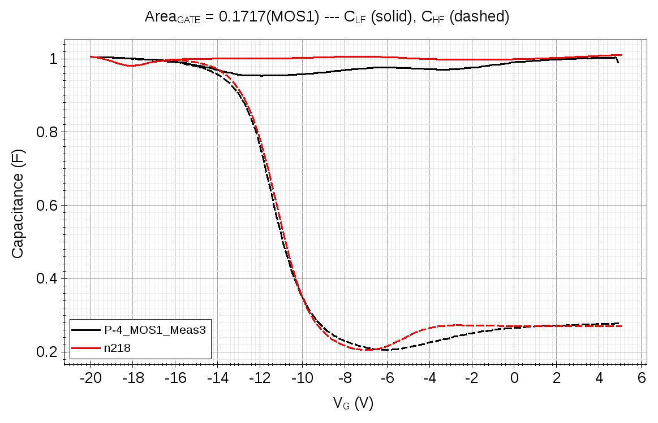
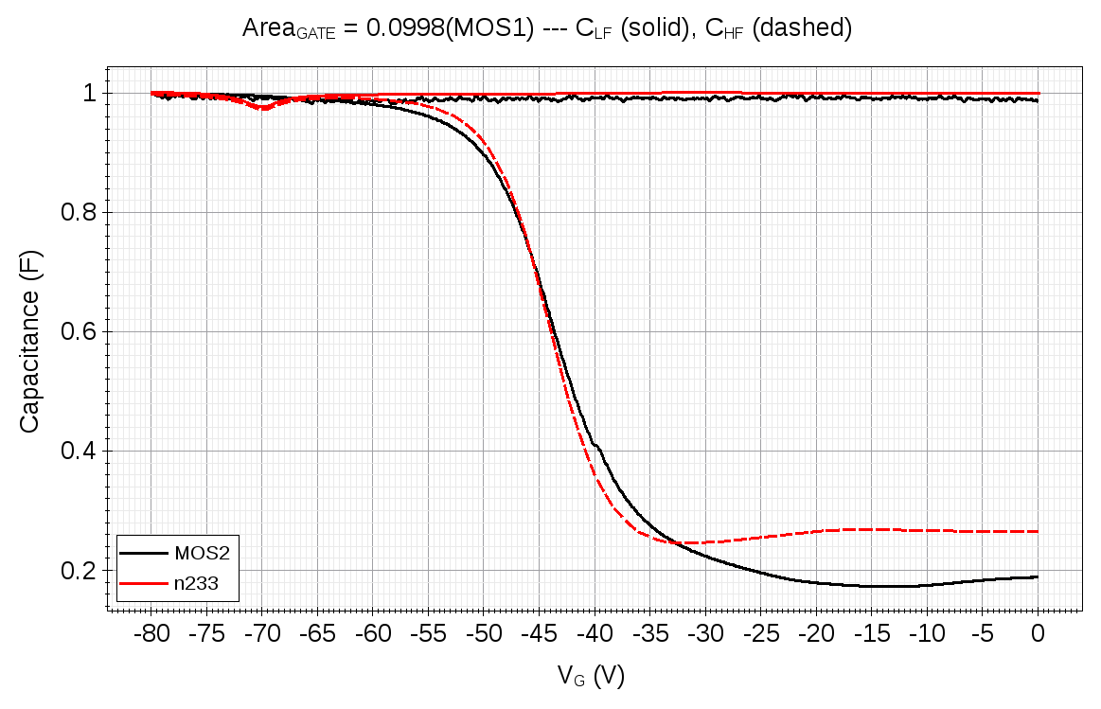
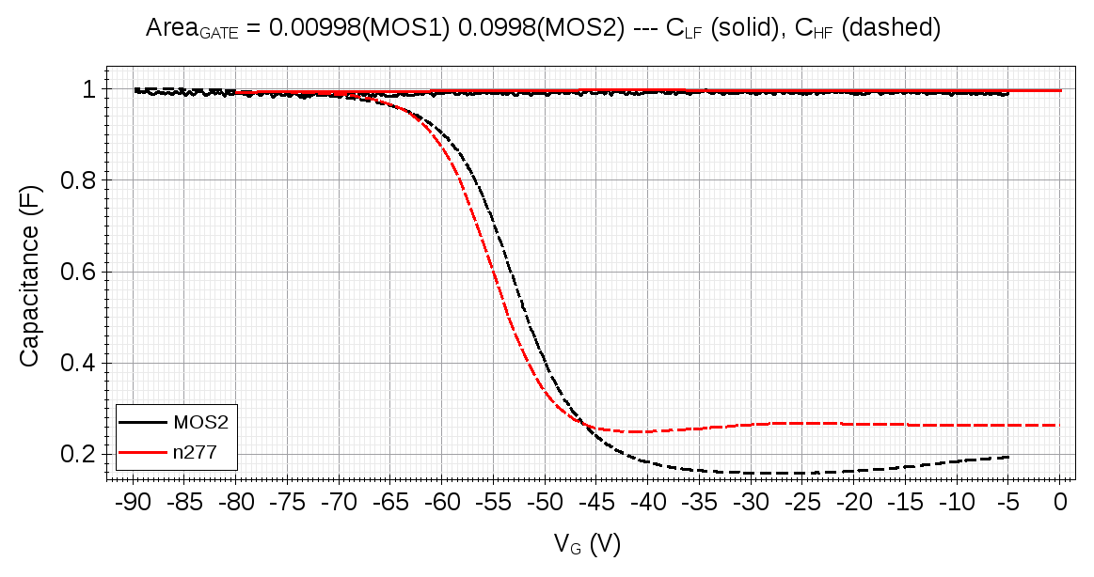
HPK MOS capacitors: simulations
p-type substrate
Irradiated structures HPK p-type.
C-V measurements compared to simulations at different doses from 0.05 to 20 Mrad(SiO₂).
  Good agreement!
  same TCAD surface model of
  FBK, but with different values
  (i.e. extrapolated from meas)
50 krad
1 Mrad
20 Mrad

Slide 23
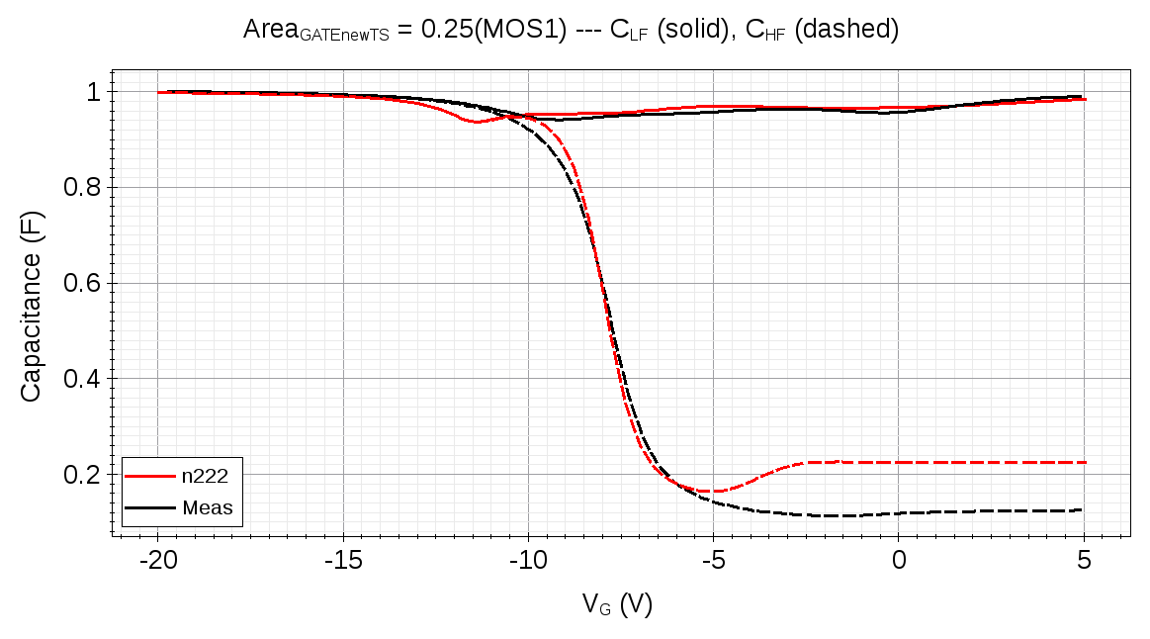
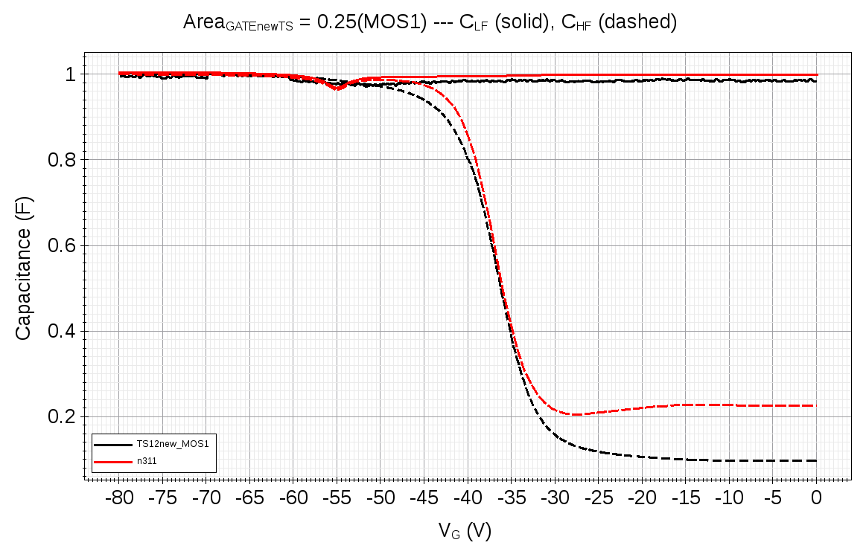
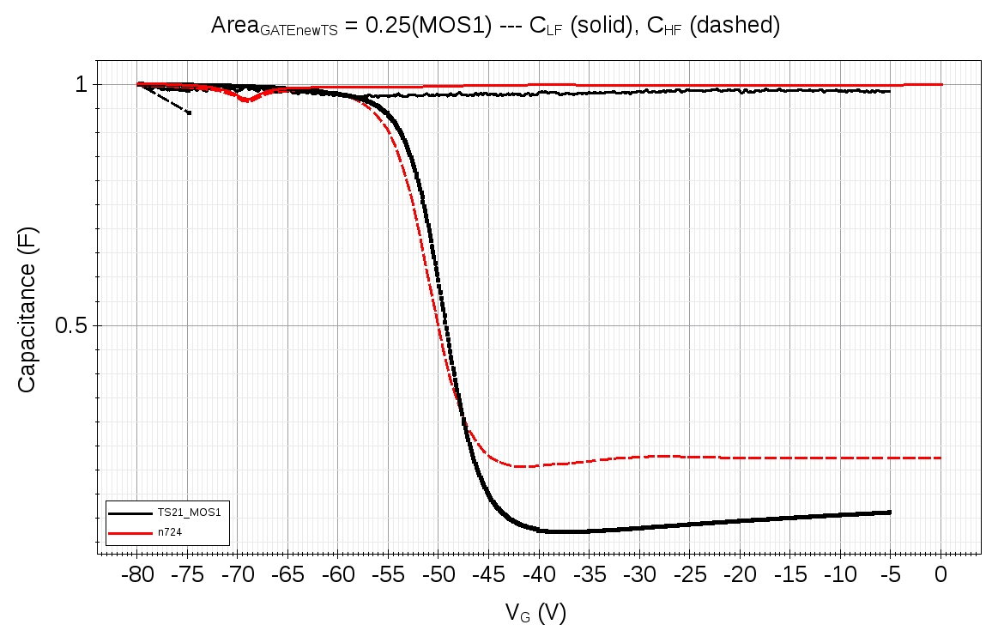
IFX MOS capacitors: simulations
p-type substrate
Irradiated structures IFX p-type.
C-V measurements compared to simulations at different doses, from 0.05 to 20 Mrad(SiO₂).
  Good agreement for IFX devices!
  same TCAD surface model of FBK, but with different values (i.e. extrapolated from meas)
50 krad
1 Mrad
20 Mrad

Slide 24
Conclusions and future plans
  Extensive measurements campaign:
    X-ray with doses 0.05-20 Mrad(SiO2).
    Dedicated FBK, HPK and IFX p-on-n and n-on-p test structures before and after irradiation with X-rays.
  Surface radiation damage effects deeply investigated aiming at the extrapolation of the most relevant parameters:
    cross-check of N_{EFF}, N_{IT}, N_{OX} evaluated by different methodologies from different test structures.
  Development of the radiation damage modelling scheme (bulk + surface),
  suitable for commercial TCAD tools (e.g. Synopsys Sentaurus).
    No over-specific modeling.
    Predictive capabilities of the “University of Perugia” TCAD model extended to HL-LHC radiation damage levels (e.g. Φ > 2.0×10¹⁶ 1 MeV n_{eq}/cm²).
  Application to the analysis and optimization of different classes of (pixel) detectors to be used in the future HEP experiments (3D detectors, 2D planar detectors, timing …).

