Slide 1



WP9: New support structures and micro-channel cooling
Status Update of the microfabrication activities at cern
Riccardo Callegari
24/04/2018

Slide 2
Introduction
Microchannels
Intro on connectors
Pressure tests
Conclusion
Objectives:
Improve the integration of ultra-light support structures and cooling devices in the design of future detectors
Develop the missing building blocks for a generalized implementation of micro-channel cooling devices
Provide common standards for the fabrication and testing of micro-channel cooling devices
Develop a facility for low-mass support structure testing, with adequate standards for characterization and validation
Provide and validate test structures and libraries for FEA simulations
https://aida2020.web.cern.ch/activities/wp9-new-support-structures-and-micro-channel-cooling

Slide 3
Introduction
Microchannels
Intro on connectors
Pressure tests
Conclusion
Silicon is:
Brittle
Anisotropic
Its fabrication requires clean and controlled environments & it can be time consuming and costly
So why silicon as structural material?
As sensible part of the experiments and read-out electronics are in silicon, to have a cooling system made of the same material avoids a CTE mismatch;
Great integration potential through standard microfabrication techniques;
High thermal conductivity.
The goal is indeed to induce the least interference possible with the particle trajectories.

Slide 4
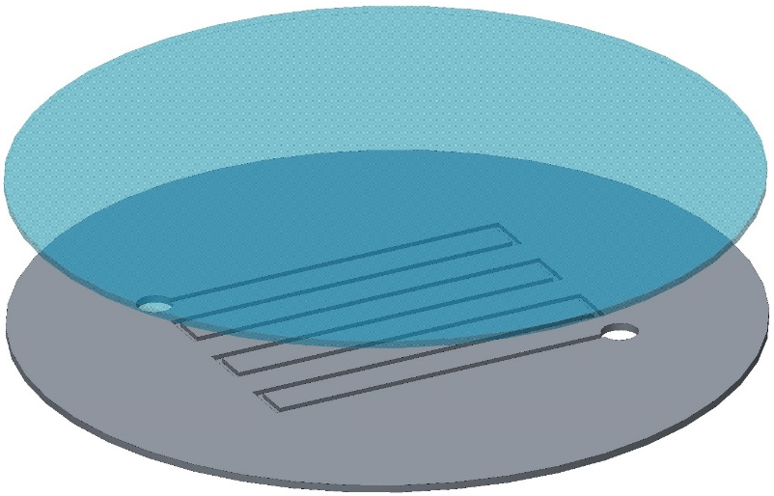
Introduction
Microchannels
Intro on connectors
Pressure tests
Conclusion
How silicon microchannels can be produced: wafer bonding
By anodic bonding: the pattern of the microchannels is etched on a silicon wafer. The channels are sealed with a glass wafer through anodic bonding process (400 ᵒC).
4” wafer: consolidated process available at CERN, in close collaboration with Center of MicroNanoTechnology at EPFL.
Time of fabrication ≈ few days (from 1 day to 1 week)
6” wafer: consolidated process available at FBK, Trento
By silicon direct bonding: the pattern of the microchannels is etched on a silicon wafer. The channels are sealed with a silicon wafer through direct bonding process (1000 ᵒC).
Process developed with external partners (silicon-to-silicon direct bonding is a critical step)

Slide 5
Introduction
Microchannels
Intro on connectors
Pressure tests
Conclusion
How silicon microchannels can be produced: buried channels
Without bonding process: a pattern of small trenches (few micrometers) is etched on a silicon wafer. The channels are opened with an isotropic etching from the bottom of the trenches directly inside a single silicon wafer.
Process available at FBK, optimization studies ongoing with CERN.
a) Trench etching | b) Passivation layer deposition | c) Anisotropic etching
d) Channel isotropic etching | e) Passivation removal | f) Trench sealing

Slide 6
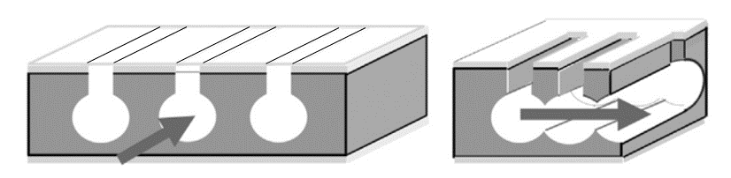
Introduction
Microchannels
Intro on connectors
Pressure tests
Conclusion
Buried channels
Boscardin et al., 2013

Slide 7
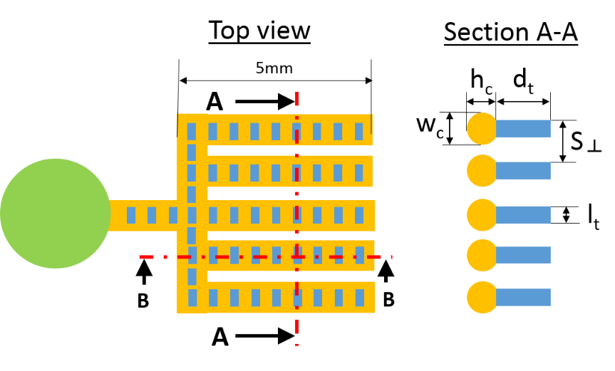
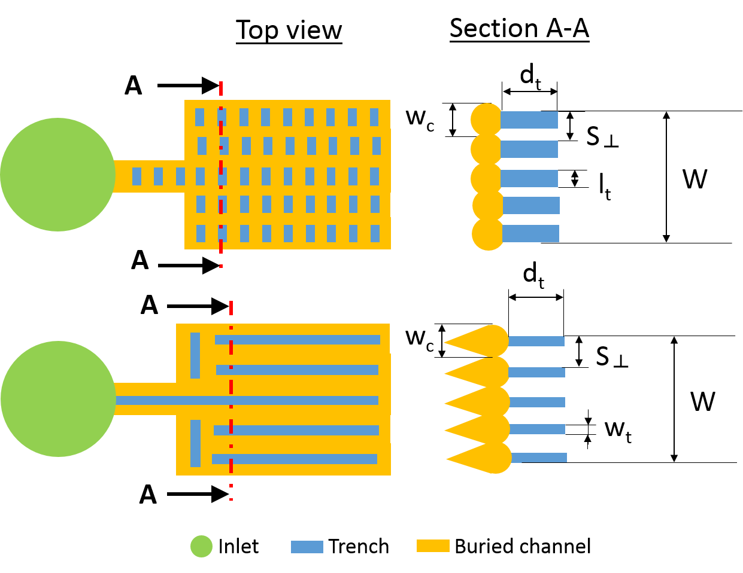
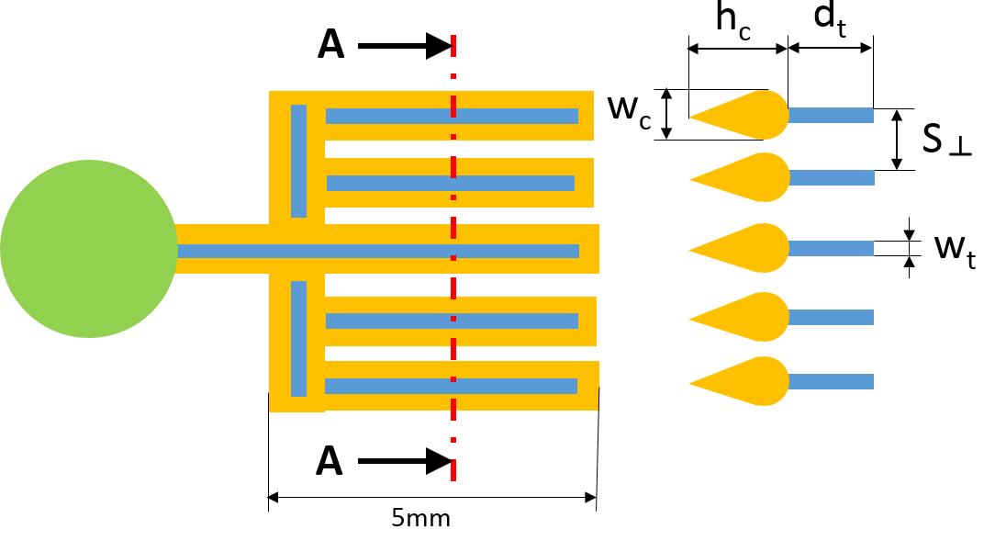
Introduction
Microchannels
Intro on connectors
Pressure tests
Conclusion
Buried channels
When w_{c} < S┴ the channels are independent and RAMIFIED.
High pressure allowed but also high resitance to flow
When w_{c} ≥ S ┴ the channels coalesce in a SINGLE channel of width W.
Limited mechanical resistance but low resistance to flow
P_{fail}>250 bar

Slide 8
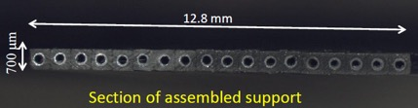
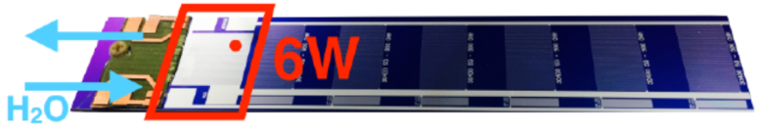
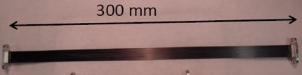
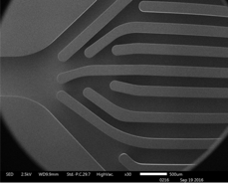
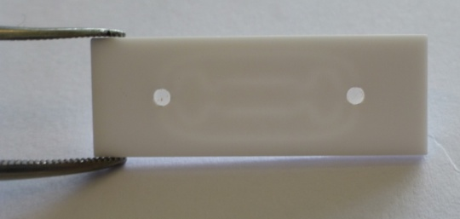
Introduction
Microchannels
Intro on connectors
Pressure tests
Conclusion
Microchannels can be also produced:
SOI substrate with embedded DRIE channels
Valencia-Bonn-Munich
PEEK+CFRP pultruded pipes array
Pisa
see also: 2016 JINST 11 P06018
Images courtesy of A. Messineo and F. Bosi
3D printed ceramic channels demonstrators
CERN + Manchester (+ industry):

Slide 9
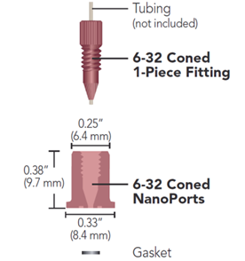
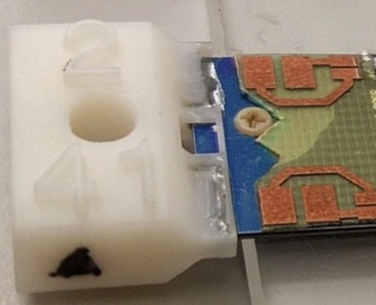
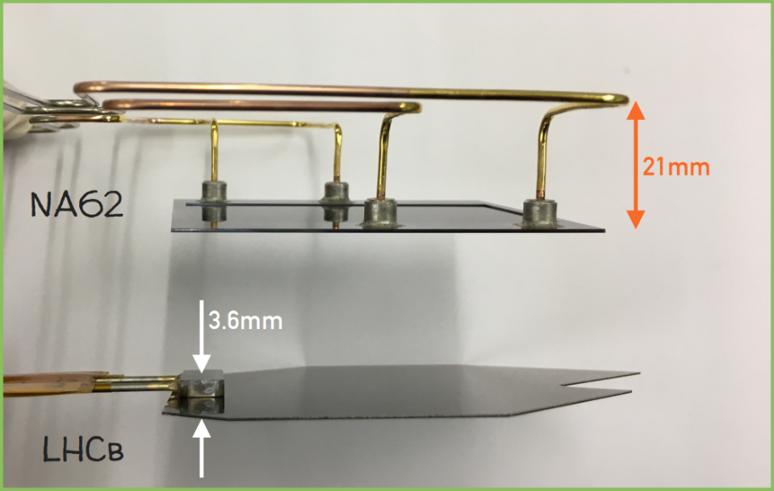
Introduction
Microchannels
Intro on connectors
Pressure tests
Conclusion
How to interface the microchannels to the cooling plant?
Commercial (ex. NanoPortTM): used in preliminary tests on the cooling plates for NA62 experiments;
Soldered: used nowadays on the cooling plates for NA62 and LHCb experiments;
3d printed: tailored design for specific application.
See the dedicated presentation about microfluidic connectors.
Milestone 77: Report on “standard connector for micro-channels” available: http://cds.cern.ch/record/2314041
IFIC, Valencia

Slide 10
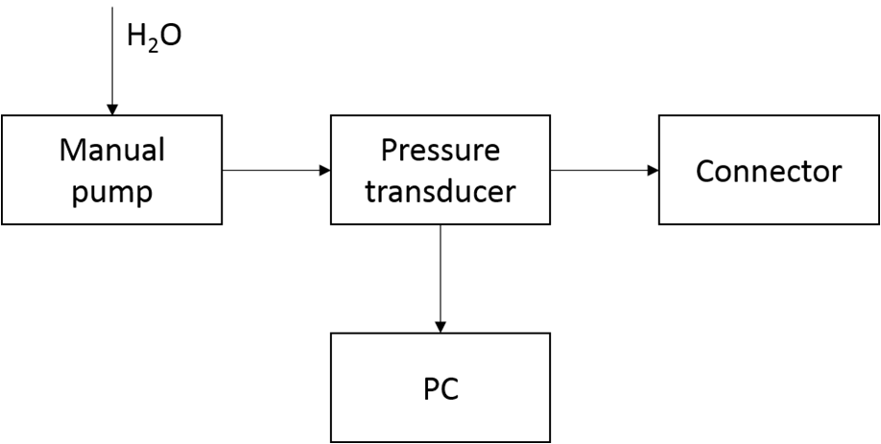
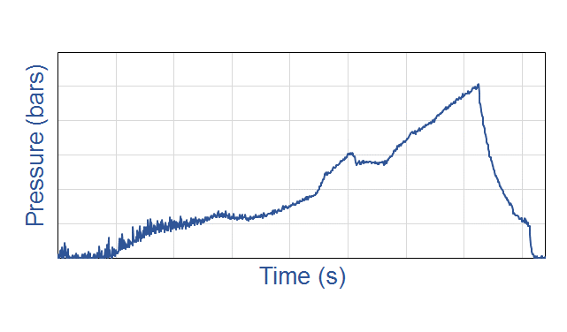
Introduction
Microchannels
Intro on connectors
Pressure tests
Conclusion
QA/QC procedure developed at CERN
Non-destructive testing
Scanning Acoustic Microscopy images to show defects in the bonding interface
Every cooling plates from external supplier come us with a SAM analysis in attachment
Destructive testing
  Pressure test are performed at CERN
  Every cooling plates is surrounded by tens of samples for destructive pressure tests

Slide 11
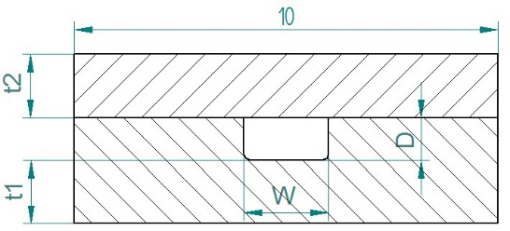
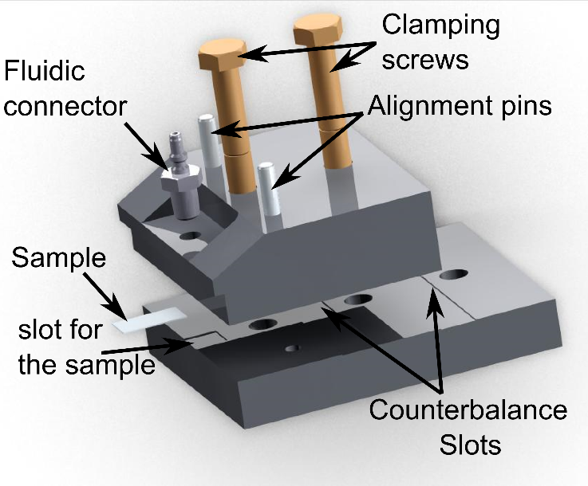
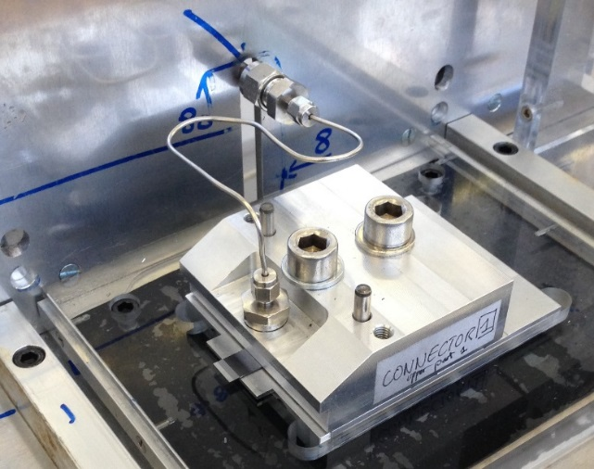
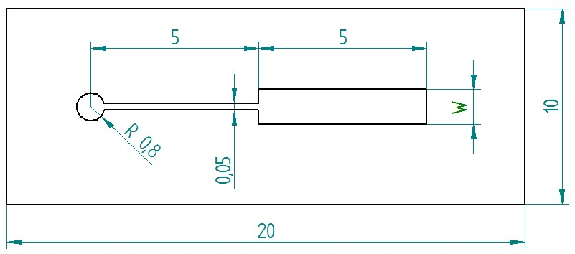
Introduction
Microchannels
Intro on connectors
Pressure tests
Conclusion
Standardized process:

Slide 12
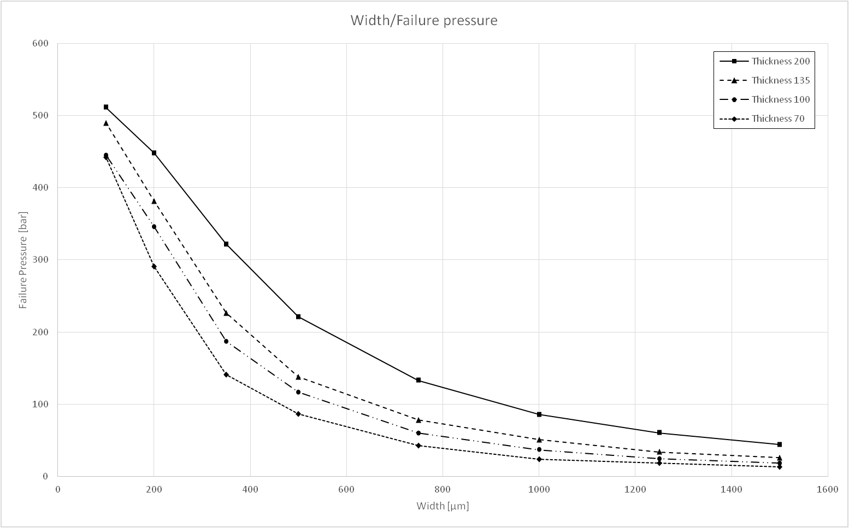
Introduction
Microchannels
Intro on connectors
Pressure tests
Conclusion
What we obtain:
Large number of samples → rich library of experimental data for FEA simulations

Slide 13
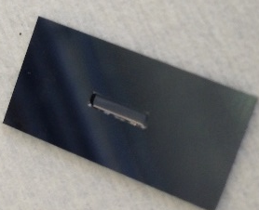
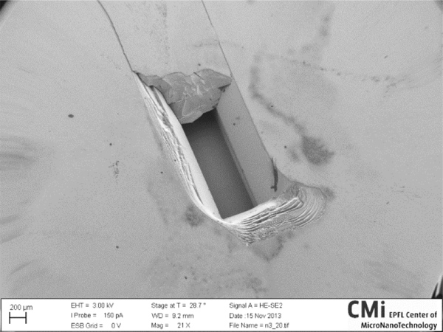
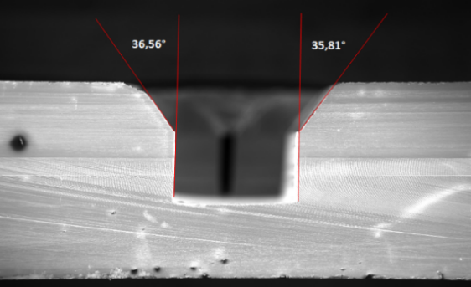
Introduction
Microchannels
Intro on connectors
Pressure tests
Conclusion
Fracture analysis

Slide 14
Introduction
Microchannels
Intro on connectors
Pressure tests
Conclusion
Why the results from pressure tests are useful?
Fracture mechanics study
  to determine silicon resistance under pressure load and be able to minimize the thickness of the cooling plate without rupture
Quality control
  For the cooling plates that are received from external suppliers for LHC and non-LHC experiments
To investigate new fabrication approaches and materials
The setup is easy to use and available to everyone
All types of samples can be tested (e.g ALICE and ATLAS upgrade components under study)
Future improvements:
Automation
Cycles for fatigue tests

Slide 15
Introduction
Microchannels
Intro on connectors
Pressure tests
Conclusion
Conclusions
We have the know-how to:
Design and manufacture microchannels devices;
Test microchannels devices;
Glue or solder connectors to laboratory test setups or to functional devices in experiments.

Slide 16


