Slide 1

WP 13.2.1
Establishing new resistive materials for high rate RPCs
P. Fonte

Slide 2
WP 13.2.1
DESCRIPTION
A list of low resistivity materials like HPL, Glass, Ceramics and new plastics is established;
Their resistivity (bulk, surface) and homogeneity are studied;
Their ageing properties due to large integrated doses are also determined;
The materials are qualified by determining the rate response and ageing properties of RPCs (single and multi-gap) by exposing these materials to intense sources/beams
DELIVERABLES
“Validation of new resistive materials for high rate RPCs through the study of the rate and ageing properties of small RPC prototypes (single and multi-gap-detectors) exposed to intense sources/beams.” [M36]

Slide 3
Global schedule
 | Year 1 | Year 2 | Year 3 | Year 4
Definition of standards/procedures
Inventory and procurement of materials
Exploratory tests electrical/RPC
Electronics development
Detailed tests in lab of chambers made out of the best candidate materials
Address ageing
Beam test of small but realistic systems
Conclusion and reporting
We are here

Slide 4
Materials considered
Beam-tested
low ρ PVdF+C (plate 400x300x2 mm³ produced by injection by the Lyon group)
KREFINE™ (large plate bought, cut and distributed to the participants)
Phosphate glass (kindly provided by Tsinghua University)
Thin (0.4mm) soda-lime glass for reference
Not tested because of too small size
Pestov glass (obtained from GSI stock)
Ceramics (developed by HZDR - Helmholtz-Zentrum Dresden-Rossendorf)
Procedures
Besides traditional beam-testing, all chambers were tested at several stages by
argon-discharge, allowing to measure the resistance of the electrode in-chamber and infer the resistivity, while monitoring the stability of the material and the presence of strong surface anomalies (examples ahead).
4

Slide 5
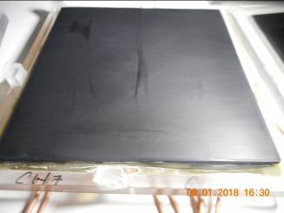
PVdF + carbon nanoparticles
PVdF is a thermoplastic material and has similar chemical and mechanical characteristics as PEEK, but could be melt at a lower temperature (180 °C for PVdF and around 400 °C in the PEEK case) which facilitates its production.
Several loadings (6 to 8%) were tested. Plates of 30 cm × 40 cm of 2 and 3 mm were produced by injection process at the IPC company in France.
Plates with the black-carbon 6% loading were found to have a bulk resistivity of 10¹² Ω⋅cm. Several RPC detectors were produced and successfully tested. Efficiency reaching 96% were measured.
The plates with higher loading (8%) reach lower resistivity values (a few 10¹⁰ Ω⋅cm).

Slide 6
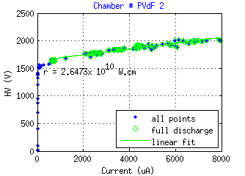
PVdF + carbon nanoparticles
Example of argon test of a PVdF-C chamber
The resistive electrode was composed by two 2.5mm thick plates glued together

Slide 7
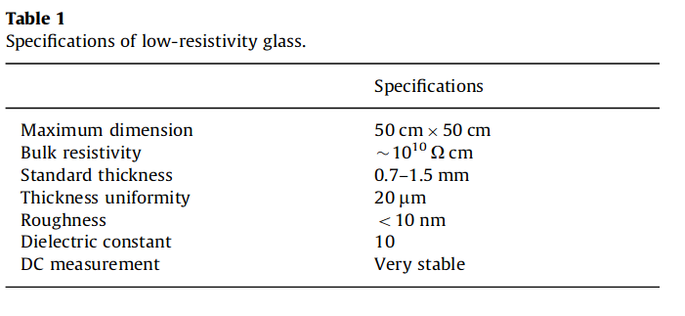
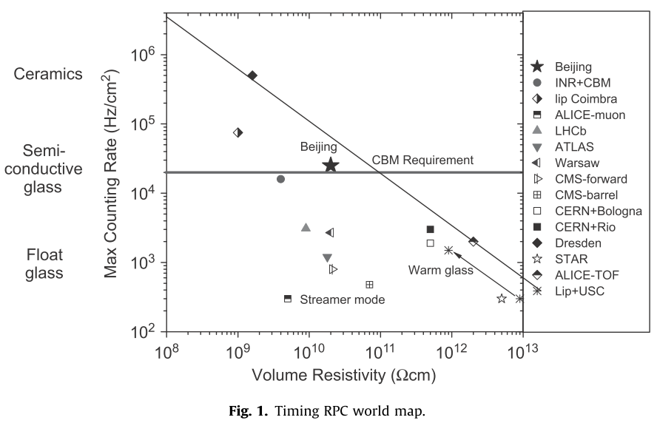
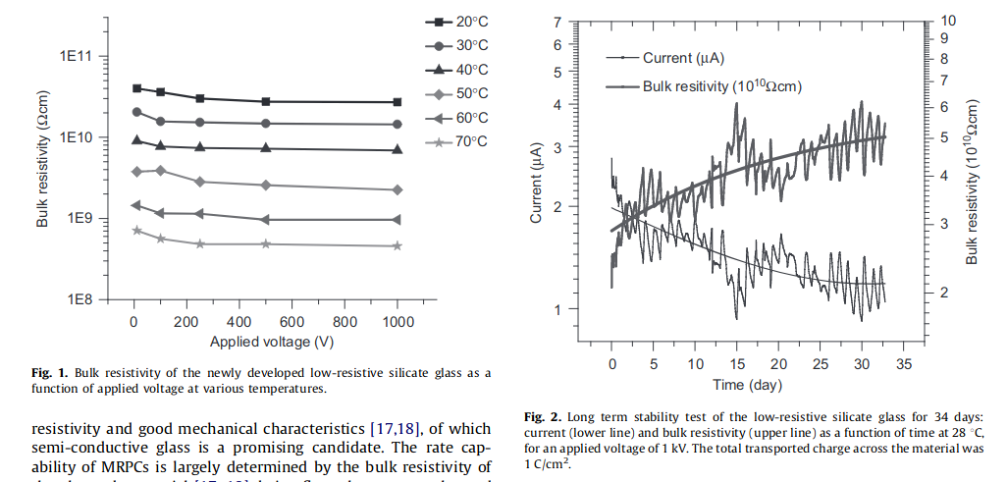
Phosphate glass
Phosphate glass is produced by Tsinghua University for high-rate RPC applications
[Yi Wang et al., 2012]
[Jingbo Wang et al., 2010]

Slide 8
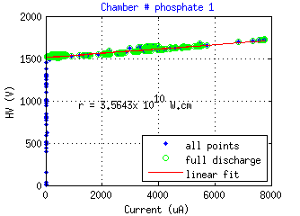
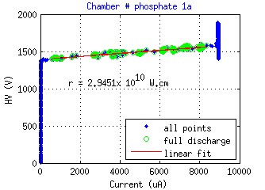
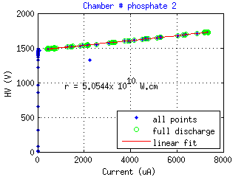
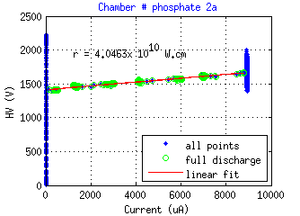
Phosphate glass
Argon tests of the phosphate glass chambers
pre-beam post-beam
No significative changes
The resistive electrode was composed by a single 0.7 mm thick plate

Slide 9
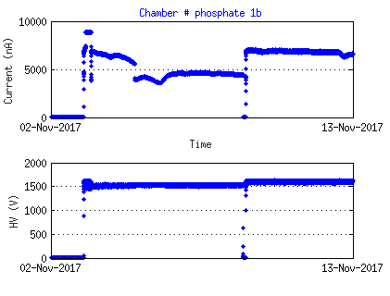
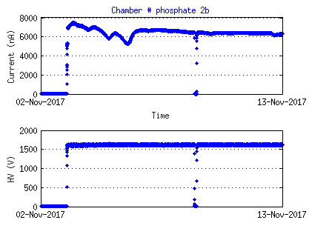
Phosphate glass
Long term argon test to evaluate resistivity stability
The material shows an essentially stable conductivity over time, suggesting a minor ionic contribution to its conductivity.

Slide 10

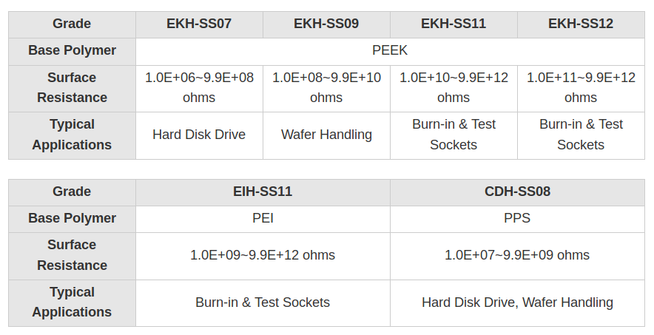
KREFINE
An interesting range of resistivies
Quite expensive (~3k€/m²)

Slide 11
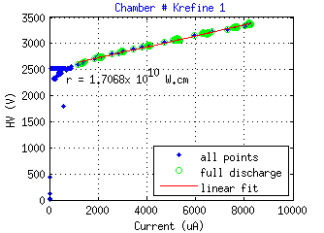
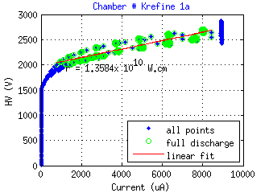
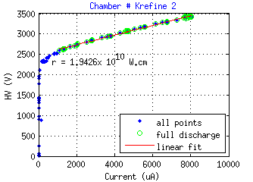
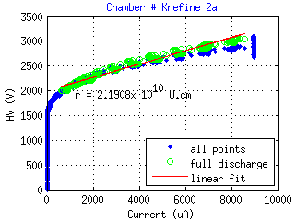
KREFINE
Argon tests of the KREFINE chambers
pre-beam post-beam
No significative changes
The resistive electrode was composed by two 3 mm thick plates

Slide 12
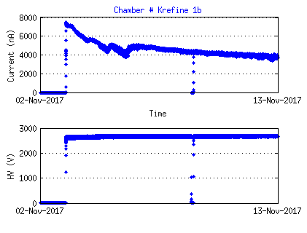
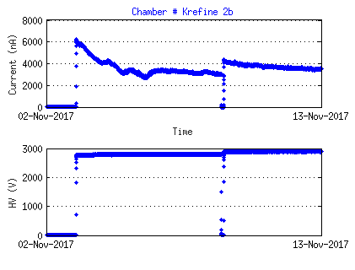
KREFINE
Long term argon test to evaluate resistivity stability
The material shows a conductivity that decreases at a progressively lower rate over time, suggesting a mixed ionic and electronic conductivity.
Nevertheless, the electronic part seems to assure a usable long-term conductivity within a factor 2 of its short-term value.

Slide 13
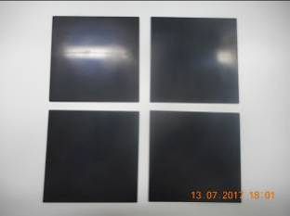
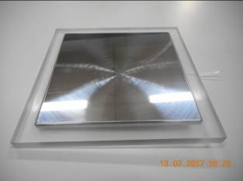
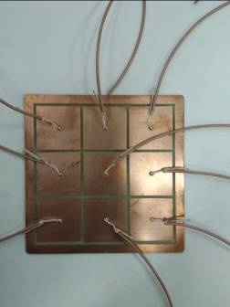
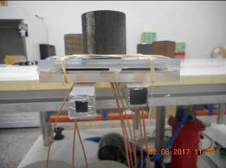
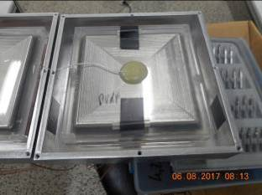
Beam test - hardware
All chambers of identical construction:
1 mm gas gap
1 stainless steel cathode
1 resistive anode
Painted HV layer
No internal spacers
Resistive anode
(PVdF in this case)
Stainless steel cathode
(100 cm²)
9 readout pads
Spacerless construction
Shielding box
Fig. 7 – Left hand: in the spacerless construction the gap between the electrodes is defined by a glue pillar outside the active area. Right hand: RPC inside its shielding box.

Slide 14
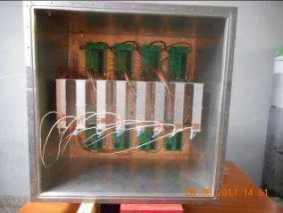
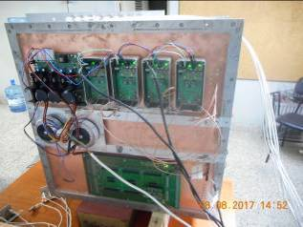
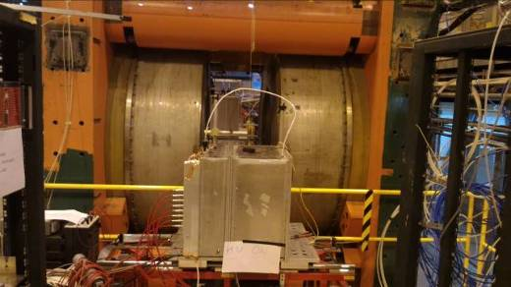
Beam test - hardware
Inner view
Outer view w/out shielding
Beam line view
Both charge and time could be read on each pad
(not at same time)

Slide 15
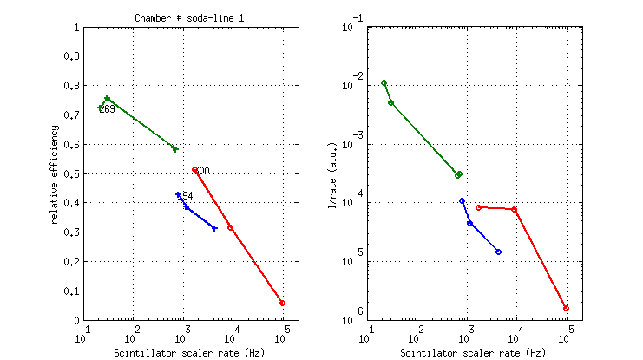
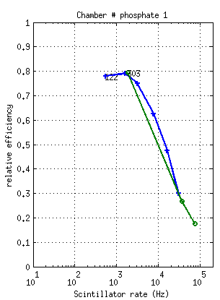
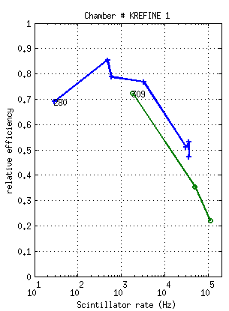
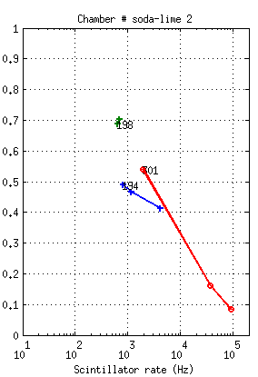
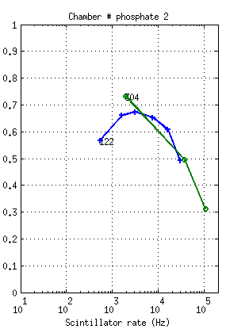
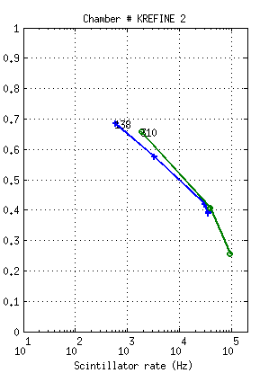
Beam test – relative rate capability
As expected,
phosphate glass
and KREFINE
allow at least two orders of magnitude larger rate capability than thin soda-lime glass

Slide 16
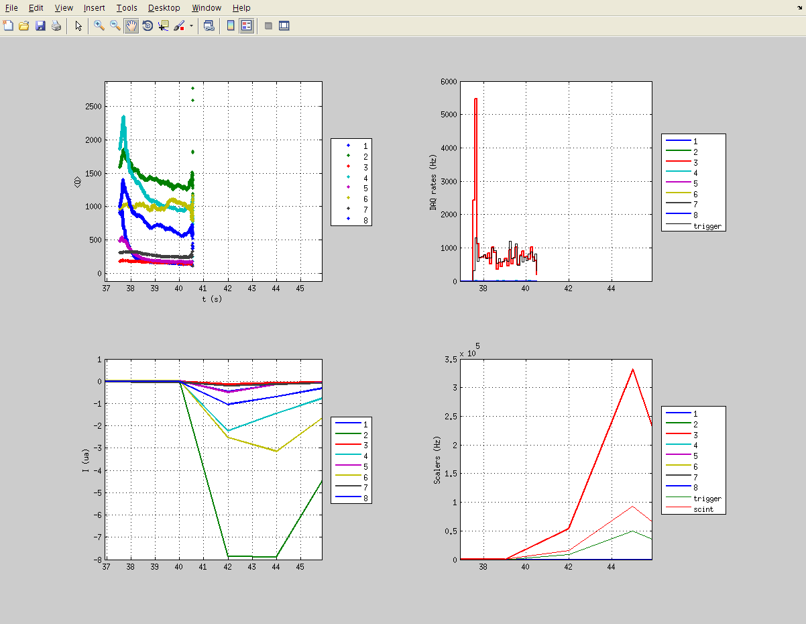
Beam test – relative rate capability
Single spill @ intense beam
phosphate
KREFINE
soda-lime
PVdF

Slide 17
Aging – resistivity
Long term argon-discharge test to evaluate resistivity stability
Small or tolerable effects

Slide 18
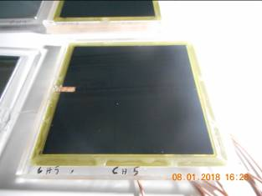
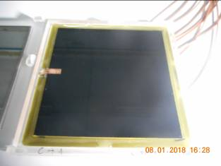
Aging – soda-lime
Post-beam examination
No alterations

Slide 19
Aging – PVdF
Post-beam examination
No alterations

Slide 20
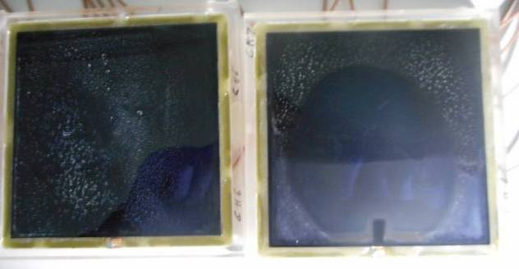
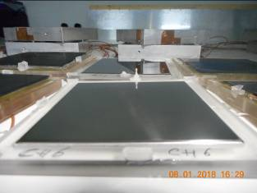
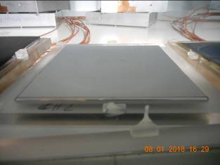
Aging – Phosphate
Post-beam examination
Clean regions!
Maybe by the argon discharge.
This deposit could be wiped clean with alcool.
Clear cathodes
Alterations visible on the glass, but not on the SS. Both chambers worked normally.

Slide 21
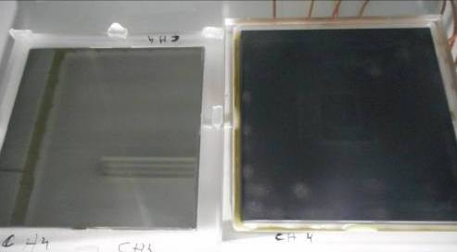
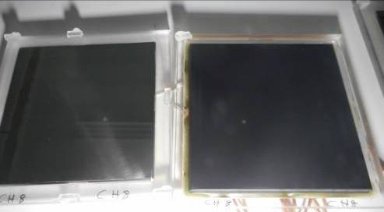
Aging – KREFINE
Post-beam examination
Some stains.
Looks like erosion.
Little hole + transfer of material to the cathode
Stains on the plastic, some transferred to the SS. Both chambers worked normally.

Slide 22
Conclusion
Three different new resistive materials for high rate RPCs were identified or developed and extensively tested.
Eight RPCs were made, two of each kind of new material, plus two made out of standard soda-lime glass, for reference. In these chambers the cathodes were made out of stainless-steel plates and there were no internal spacers, to isolate as possible the materials’ behavior from the constructive details.
The resistivity of the materials was measured in the chambers themselves by the argon-discharge method, both before and after irradiation.
A beam test was performed on the set of eight chambers, confirming their different rate capability.
After-beam observations revealed that the resistivity of the materials was not changed, but that some signs of surface alterations were visible on some of the materials. Despite such alterations the chambers continued to operate normally.
Future work should include similar tests with the resistive electrodes also performing as cathodes and longer irradiations.

