Slide 1
Development of fast-timing large RPCs
Prototypes of large, high-rate RPCs are designed, built and tested as well as a dedicated readout for time response optimisation. The concept is validated by exposing large RPC prototypes to test-beams and accessing their performance, namely their high-rate capabilities and their fast-timing properties.
D13.2 High-rate characterisation of large-size RPC prototypes (qualification at high intensity beam lines of large-size prototypes of optimised RPCs optimised for the rate response and the fine time) M44
1st year | Conception and construction of large RPC/MRPC, Test of PETIROC, TDC
2d year | Design of optimized PCB for RPC/MRPC, integration of TDC into PETIROC (in collaboration with WP4)
3d year | Realization of a prototype, development of DAQ system ( in collaboration with WP5&WP14)
4th year | Beam test and validation & final report

Slide 2
High rate fast timing RPC
-A high rate RPC (> 1 kHz/cm²) has been developed both with Bakelite and low resistivity glass as electrode.
-Excellent timing FEE (PETIROC) is developed and being upgraded
The following scheme is proposed for the CMS RPC upgrade
L
t₂
Principle:
To use the 2D readout with good timing FEE (PETIROC)
Motivation
Better Y determination
Y= L/2-v*(t₂-t₁)/2 → σ(Y) = v* σ(T₂-T₁)/2
2) Less channels (2/eta rather than 5)
3) In addition, with 2-gap RP*C of 1.4 mm gas gap 0.5 ns absolute time resolution could be achieved → noise reduction and better Muon and HSCP trigger performance
t₁
Y

Slide 3
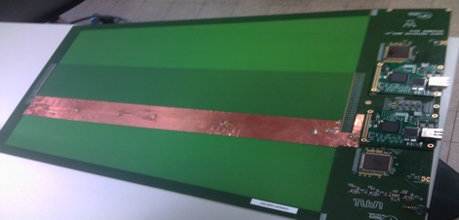
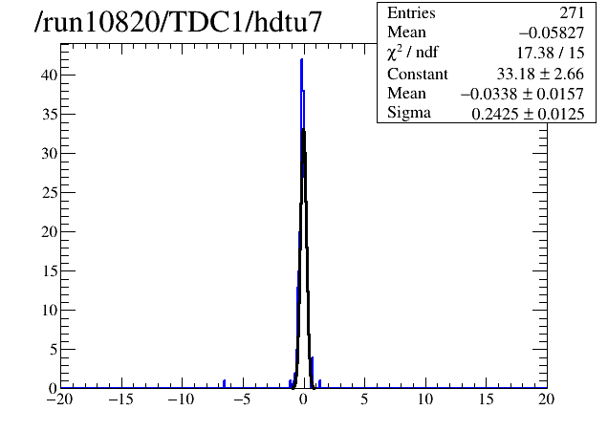
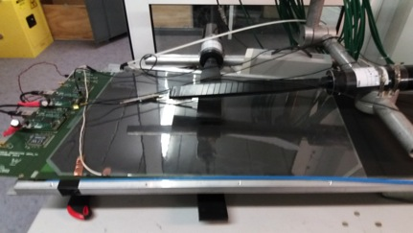
CMS RPC Electronics
First demonstrator : 32 on-detector strips with 3.5 mm pitch
and 32 off-detector return strips 1 mm pitch
64 channels = 2 PETIROC + 2 TDC (Delay Line TDC on FPGA
, 10 ps of LSB)
By charge injection on the strips
50 cm
Using cosmic rays
On detector
σ = 250 ps
- Only one detector
Scintillator resolution correction not included
Cluster size correction improvement not included

Slide 4
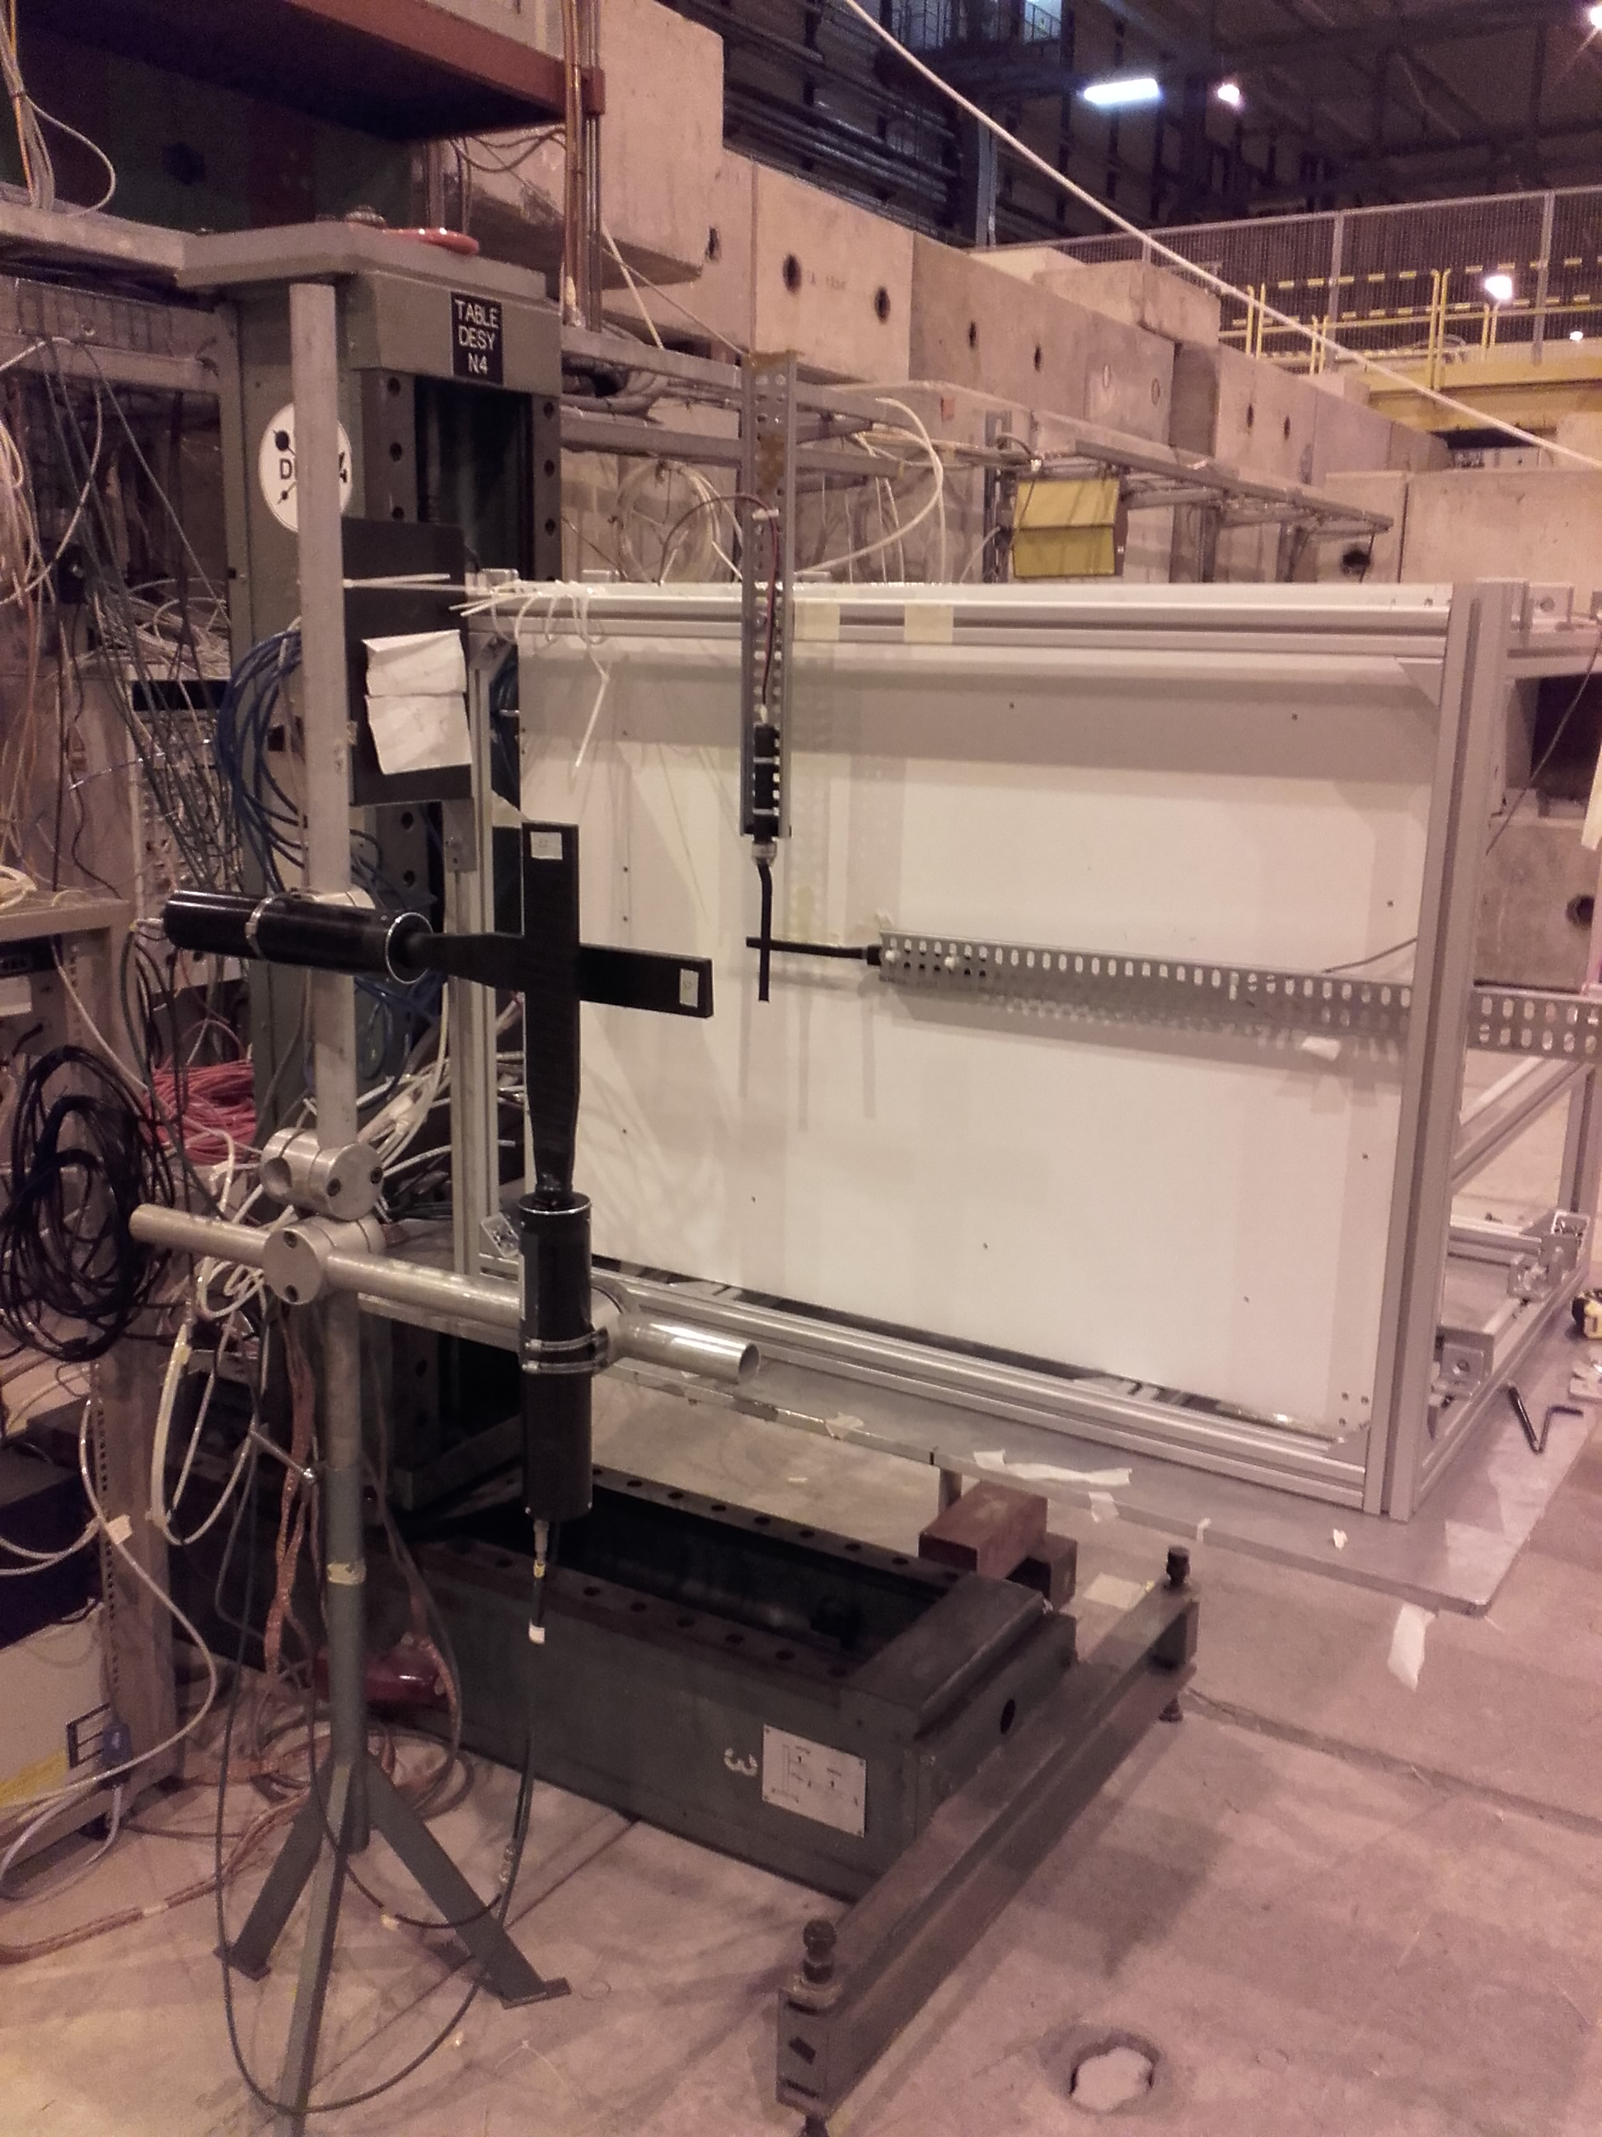
The readout electronics was then tested on iRPC detectors in TB:
-2 iRPC chambers :1.4/1.4mm and 1.6/1.6 mm
-Scan studies were performed using moving tables (< 1mm resolution)
-A DAQ system using external trigger built with small scintillators (few cm width) was used
PCB
iRPC
in progress
in progress
σ = 1.8 (cm)

Slide 5
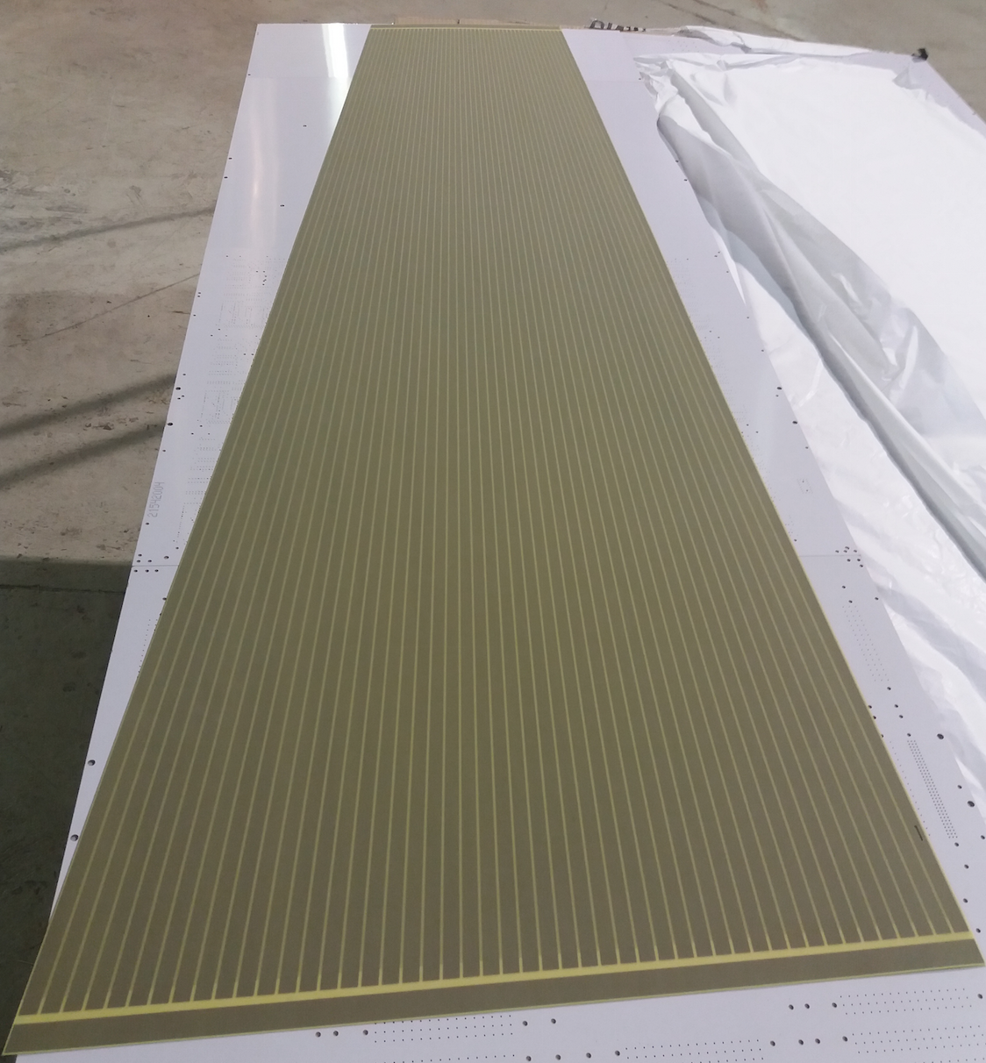
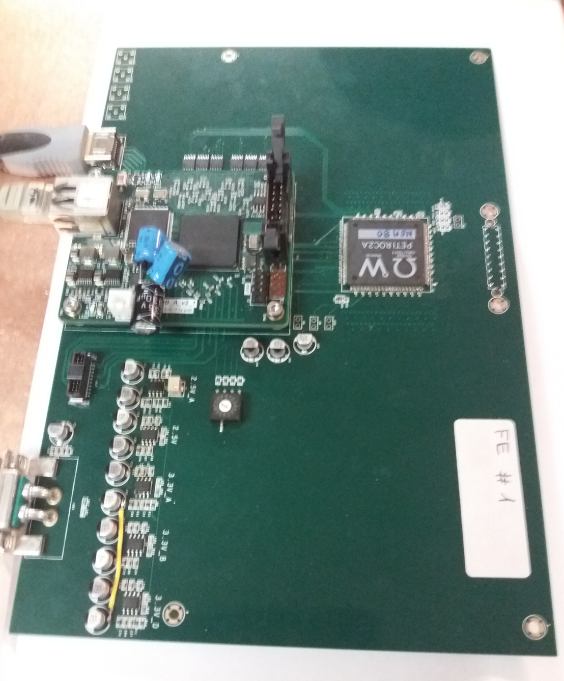
To read out CMS RE3/1 and RE4/1 RPC, long PCBs (160 cm) are needed.
No possibility to have 6-layer PCB of large size. Two solutions are proposed:
First solution :One layer PCB with strips. Return-strips are replaced with coaxial cables with the same impedance (company found : ELVIA).
GND
Two large PCB are needed
for the readout of one RPC
chamber
strips
GND
6 petiroc of 32 ch are needed
adapt. board
adapt. board
coax
FE
coax
GND
strip
This solution is equivalent to the one already tested but simpler and cheaper.
Still, we will produce a large PCB with return strips on the edges to compare the two schemes

Slide 6
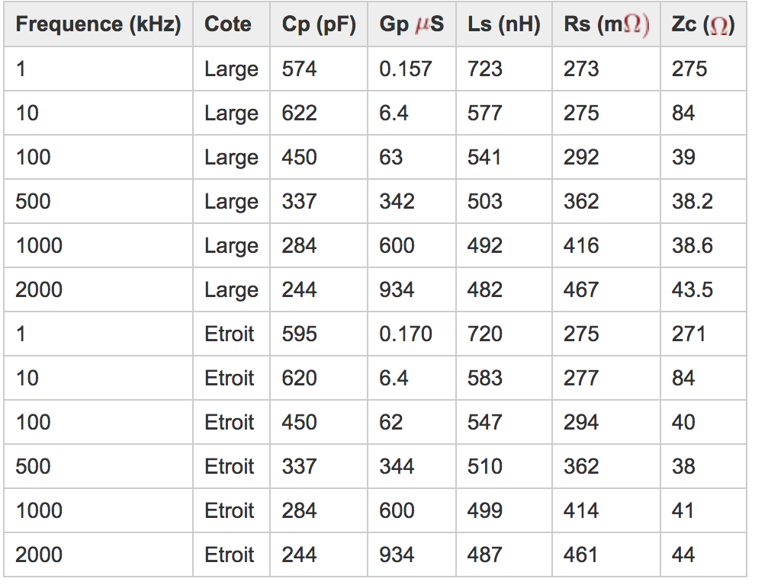
To estimate the strip impedance, several methods were used.
Varying a termination resistor, TDR, RLC meter
At high frequency (fast RPC signal) the impedance value is around 42 Ω,
Using 50 Ω coaxial cables is a cheap solution. Modifying the strips width or producing 42 Ω coaxial cables could be envisaged.

Slide 7
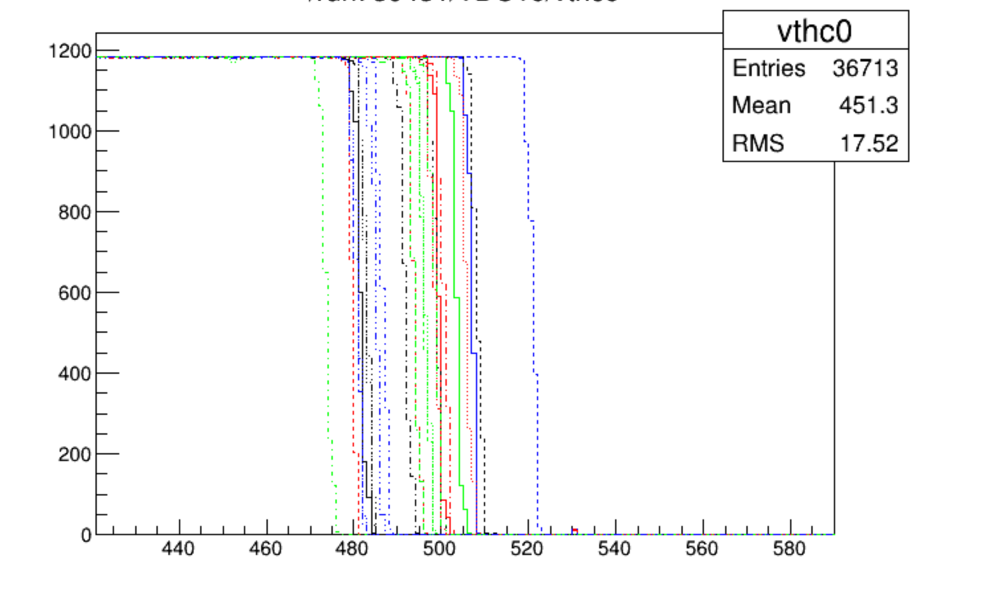
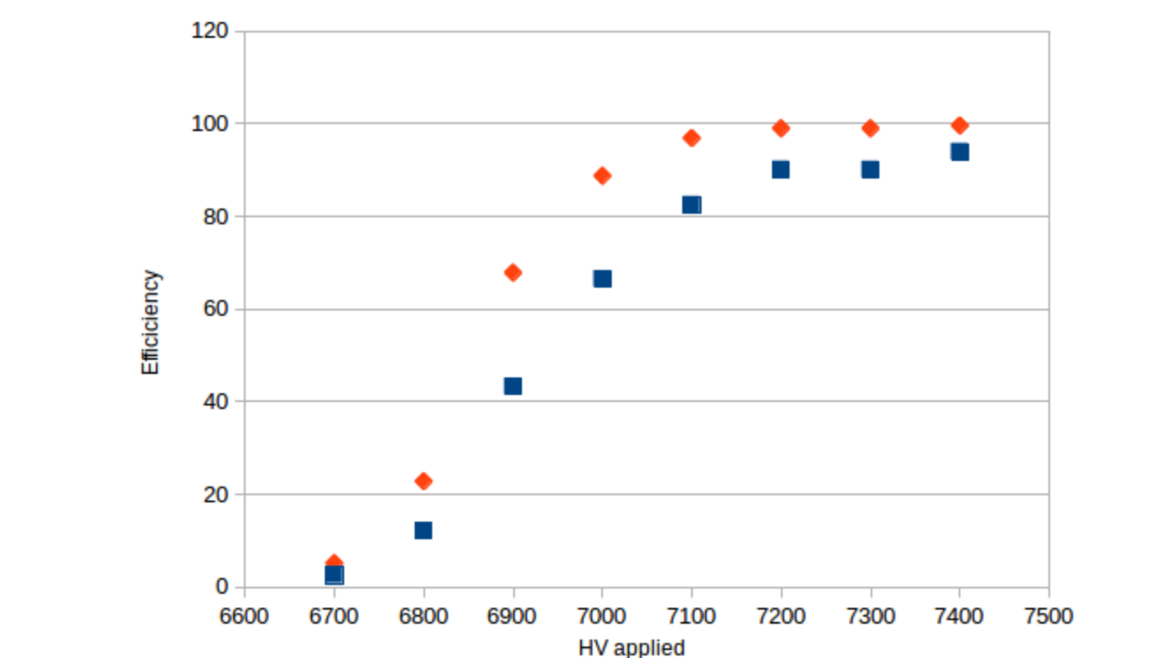
Electronics board equipped with PETIROC and delay-line based TDC were conceived and produced.
PETIROC ASICs were calibrated by changing the 8-bit DAC value of each channel to:
adjust the pedestals
adjust the S-curve
A dedicated DAQ (LyDAQ) system was developed. It allows the readout the TDC channels and associate their content them to the trigger signal ( this is injected in one of the TDC channels)
Preliminary results on detector are encouraging
Work in progress
Red: efficiency of at least one of the two channels associated to one strip
Blue efficiency of having two channels associated to one strip

Slide 8
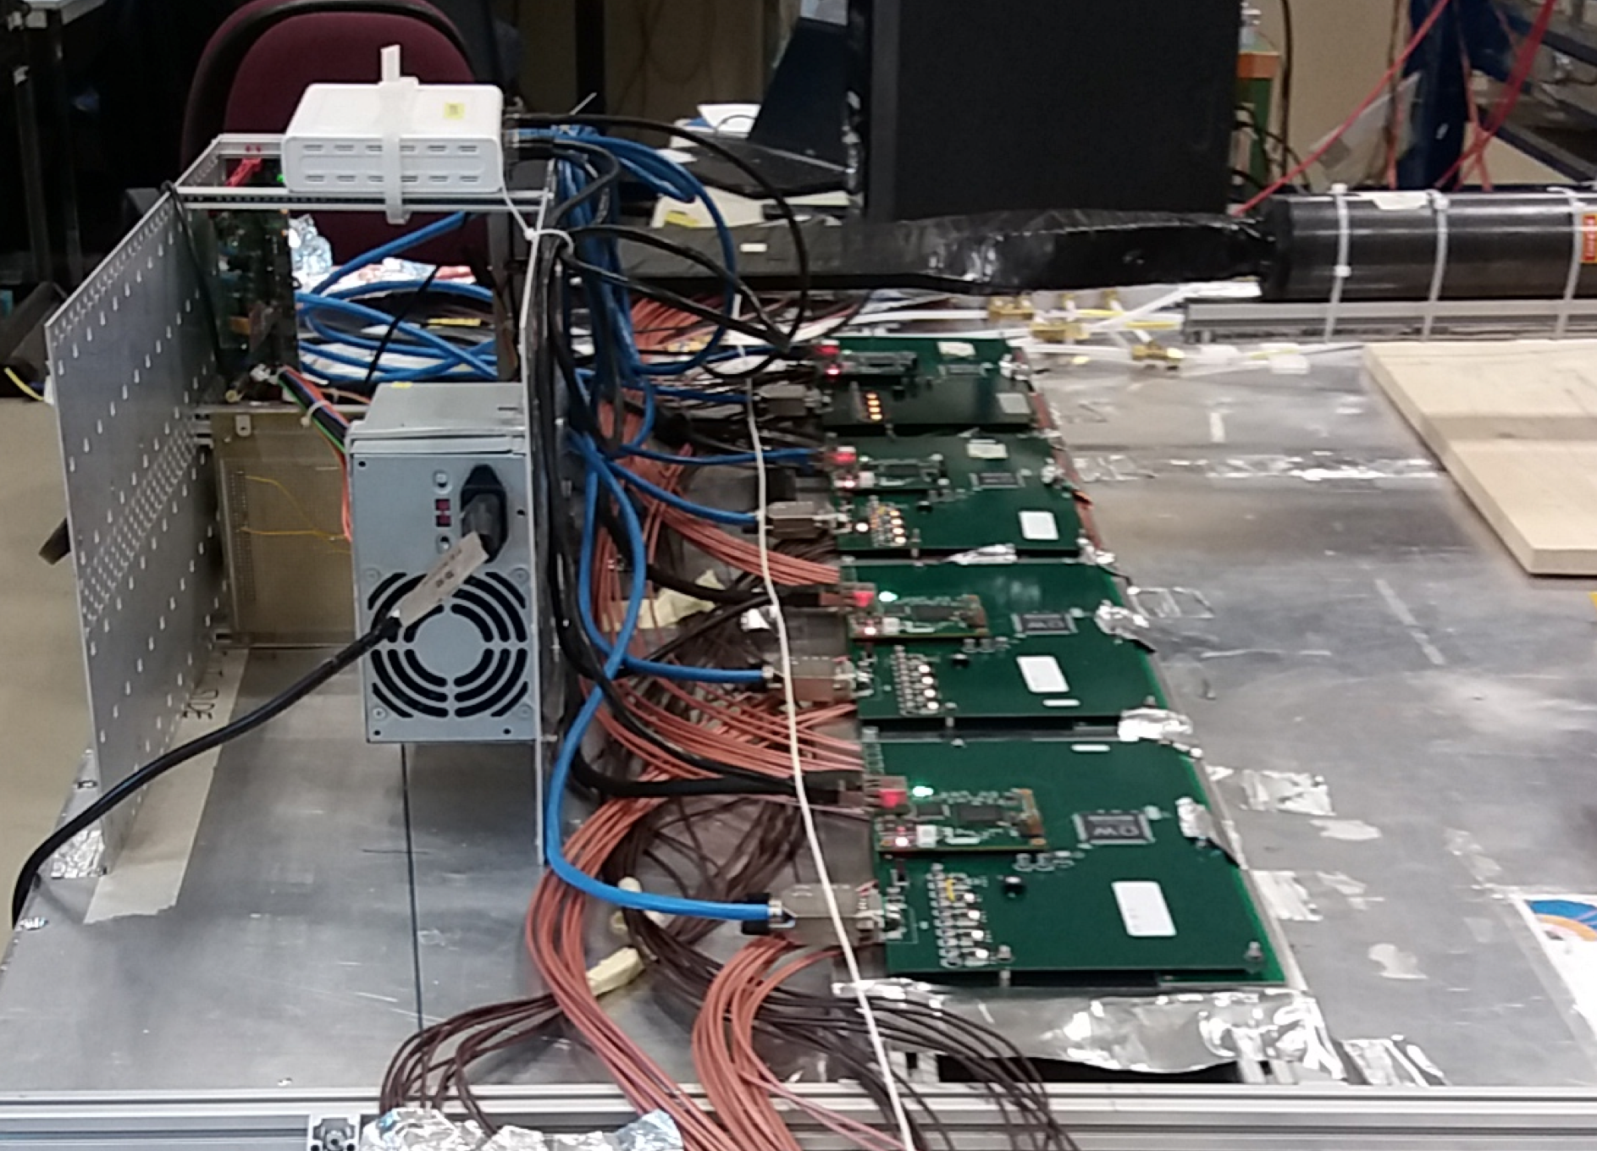
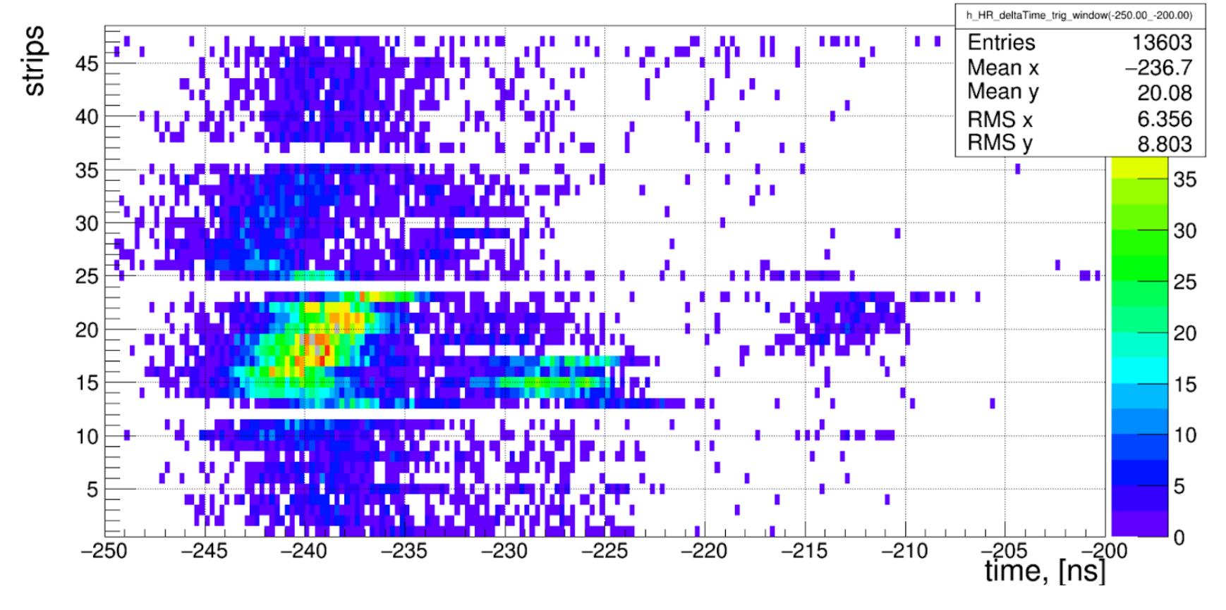
Readout system is being tested in cosmic bench on RE3/1 chamber.
First results showing good efficiency (>90%) with average time resolution of 200-300 ps
leading to 2-3 cm spatial resolution
Work in progress
Mis-matching channels
Missing channels

Slide 9
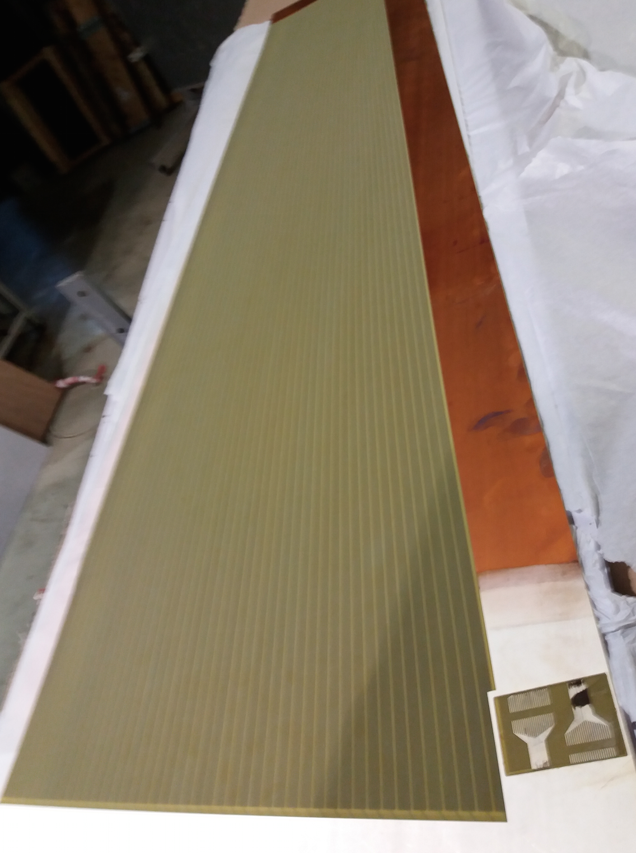
To read out RE3/1 and RE4/1 RPC long PCB (160 cm) are needed.
No possibility to have 6-layer PCB of large size. Two solutions are proposed:
Second solution : “3”-layer PCB with strips and return-strips are replaced with the same impedance. Same as for small PCB but without the readout electronics.
GND
Two large PCB are needed
for the readout of one RPC
chamber
Connectors
strips
GND
Flex will transmit the siganl from the two ends of strips to the FEBs
This solution is as simple as the previous one and provides well controlled impedance

Slide 10
-To completely validate the readout electronics on large RPC CMS chamber using a few FB boards in TB ( this week)
TDC with new FPGA with more resources to allow the TOT exploitation is being developed. Time resolution of 17 ps is obtained for rising/falling signal measurement and 20 ps for TOT with a dead time of 2 ns.
-In parallel TDC chip is being developed in collaboration with WP4
(see M. Dahoumane’s talk) aiming for better performance while reducing power consumption.
Next steps
Assemble the FE boards in one hosting the Petirocs
in addition to the Master FPGA to communicate with the CMS DAQ/Trigger system.
Upgrade the Petiroc from 32 to 64 channels (for compactness,
not a technological challenge) and go for TSMC 130 nm ( in
synergy with the HGCAL ROC) for better radiation hardness even
though the expected rate where the FE board is to be fixed is not
high (fluence of a few 10 e12)

Slide 12
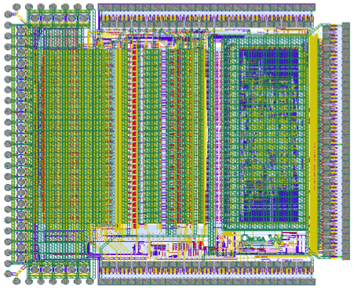
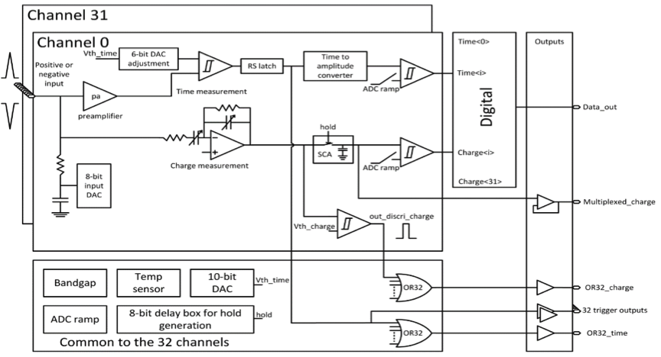
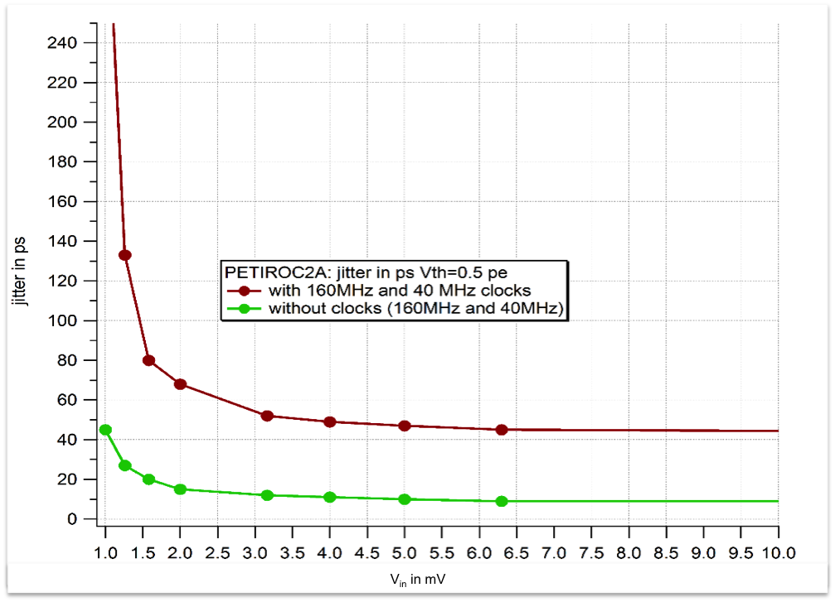
PETIROC ASIC, 32ch, SiGe 350 nm technology
Petiroc scheme : only the preamplifier output will be used
Petiroc S-Curves :
1 DAC unit corresponds to about 3.5 fC
Time resolution as a function of the injected charge
1 mV corresponds to about 55 fC

Slide 13
Backup

