Slide 1
LMQXF Bus and Expansion Loop Status
R. Bossert Nov. 1, 2017

Slide 2
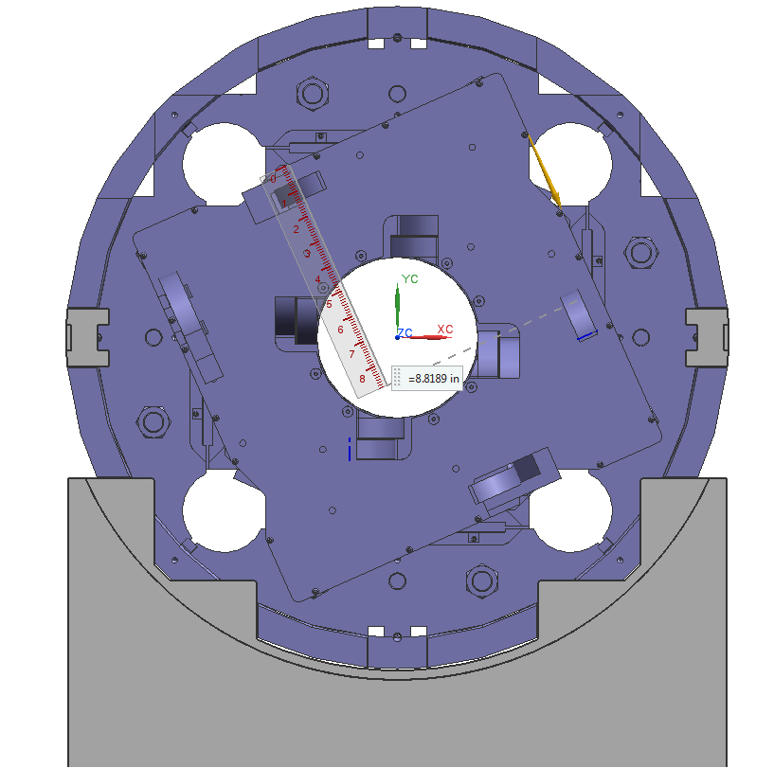
Conceptual design of expansion loops and bus configuration was completed and is shown below.
Since the bus port is not placed symmetrically with respect to the cold mass, there will be two different bus loop configurations on the face of the cold mass.
Q1a/Q3a
Q1b/Q3b
Instrumentation port position
Instrumentation port position
CLIQ
Leads
CLIQ
Leads
CLIQ
CLIQ
Bus port
Bus port

Slide 3
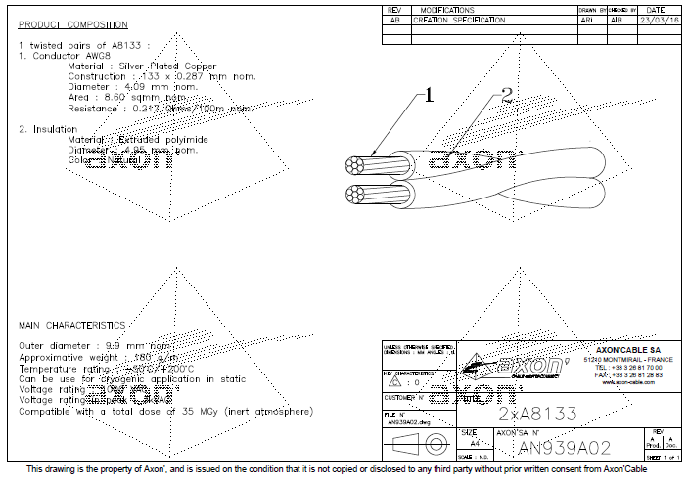
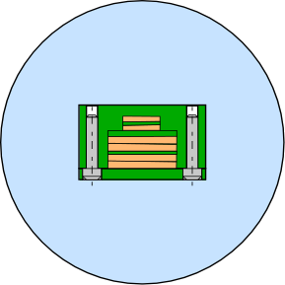
Current bus housing conceptual configuration includes a previous design of the CLIQ leads. New CLIQ lead configuration will take up more space and will consequently result in a larger bus housing, taking more space in the bus port.
LMQXF Bus Housing Configuration
G-11 bus housing
CLIQ Leads
3 mm screws
20 mm
Bus Port
76 mm diameter
34 mm
Magnet Leads

Slide 4
Assembly of a mockup, which will include both bus loop configurations and a through-bus, is beginning.
Space has been allocated in Industrial Building 3, and a dedicated technician has been assigned.
Models have been obtained (from Mike Solis) of all the magnet end and splice connection box assemblies.
Cable for power leads has been obtained.
Drawings of connection box and end plate assemblies for mockup have been completed.
Still need to:
Receive mockup parts.
Obtain end dome model and add this to the mockup.
Order through-bus port for mockup.
Design through bus after confirmation of CLIQ lead configuration.
Obtain CLIQ leads for mockup.
Build mockup.
Form power leads and CLIQ leads
Insert through bus port on mockup and short model.
Assess results

Slide 5
LMQXF Splice and Bus Mockup Schedule

