Slide 1




ALEGRO 2018 workshop at Oxford
Positron Acceleration in Plasma
Introduction, Status and Objectives
Sébastien Corde and Spencer Gessner
WG8 coordinators
March 26, 2018

Slide 2
Outline
Introduction of the scientific context for positron acceleration in plasma
    Motivation and relationship with LWFA-PWFA WG4 and 5
    Difficulties for positron acceleration in plasma
    No self-consistent scheme for simultaneously achieving high efficiency, low preserved emittance and transverse instability mitigation
Paths identified so far (all have major problems for linear colliders)
  Quasi-linear plasma wakefield
  Nonlinear plasma wakefield
  Hollow plasma channels
WG8 Status and Objectives
          WG8 CERN mini-workshop
          WG8 sessions at ALEGRO 2018 workshop
          Identify path forward, potential issues, and R&D priorities

Slide 3
Introduction to Positron acceleration in Plasma

Slide 4
Plasmas are asymmetric accelerators
Plasma acceleration schemes (both LWFA and PWFA) are promising candidates for an advanced linear collider. But plasmas are asymmetric accelerators: there are profound difference between electron and positron acceleration in plasmas.
e⁻
e⁺
m_{i} >> m_{e}
Exception
The plasma electrons are mobile but the ions are not.
The symmetry of the accelerating mechanism is broken.
Linear plasma waves are symmetrical.

Slide 5
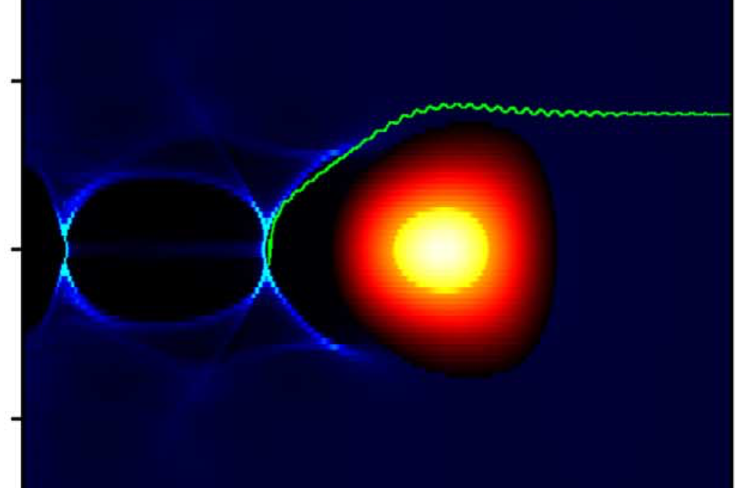
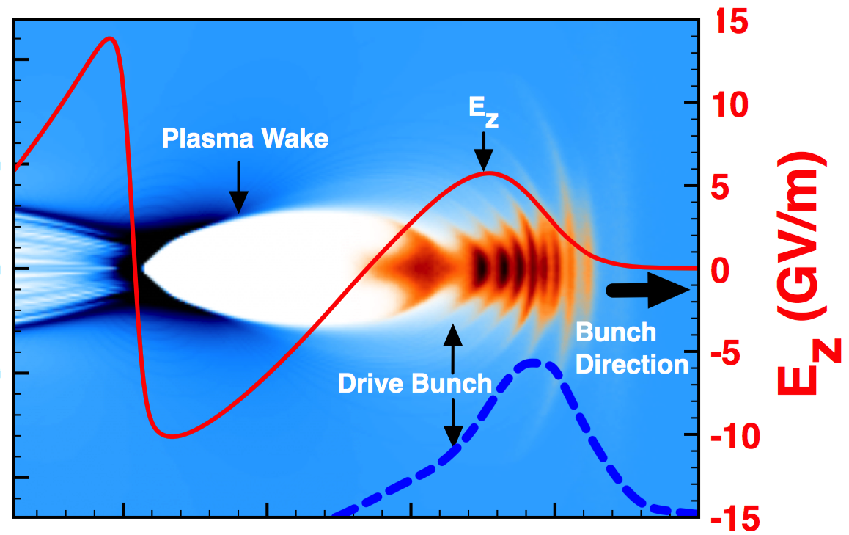
Plasmas are asymmetric accelerators
Laser Direction
LWFA
laser driver
PWFA
particle beam driver
Positron acceleration has very similar difficulties in both LWFA and PWFA. It would be beneficial to tackle the problem across the fields of LWFA and PWFA.
WG8 Positron acceleration is a joint sub-WG to LWFA-PWFA WG4 and 5

Slide 6
Plasmas are asymmetric accelerators
Electron-driven or laser-driven nonlinear blowout wakes:
Where can positrons be accelerated and focused in a non-linear plasma wakefield?
But the field is defocusing in this region.
The field is accelerating behind the pinch in the first bubble.

Slide 7
Plasmas are asymmetric accelerators
Electron-driven or laser-driven nonlinear blowout wakes:
Tiny volume for positrons
Tiny volume where it’s simultaneously accelerating and focusing. But E_{z} varies rapidly in this volume, both transversely and longitudinally.

Slide 8
Plasmas are asymmetric accelerators
Electron-driven or laser-driven nonlinear blowout wakes:
Tiny volume for positrons
Transverse force is highly nonlinear in r
→ emittance growth

Slide 9
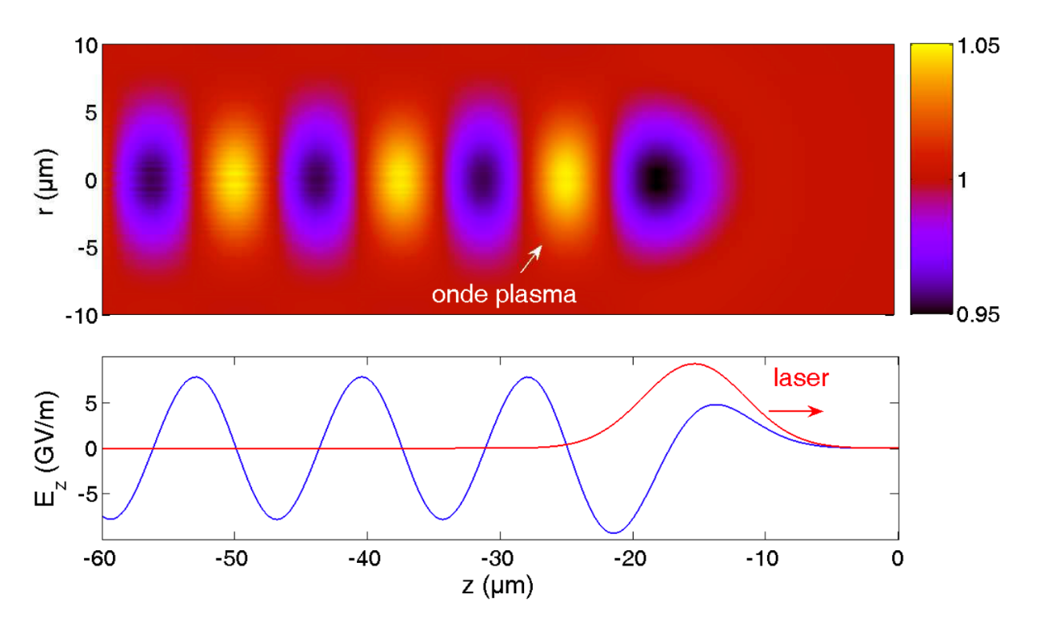

Challenges of Positron acceleration in Plasma
Linear plasma wakes (any driver):
Major problems:
Efficiency is low
Stable propagation of a witness positron bunch requires either high emittance or very low charge; otherwise it collapses and drives nonlinear wakefield.
Driver

Slide 10
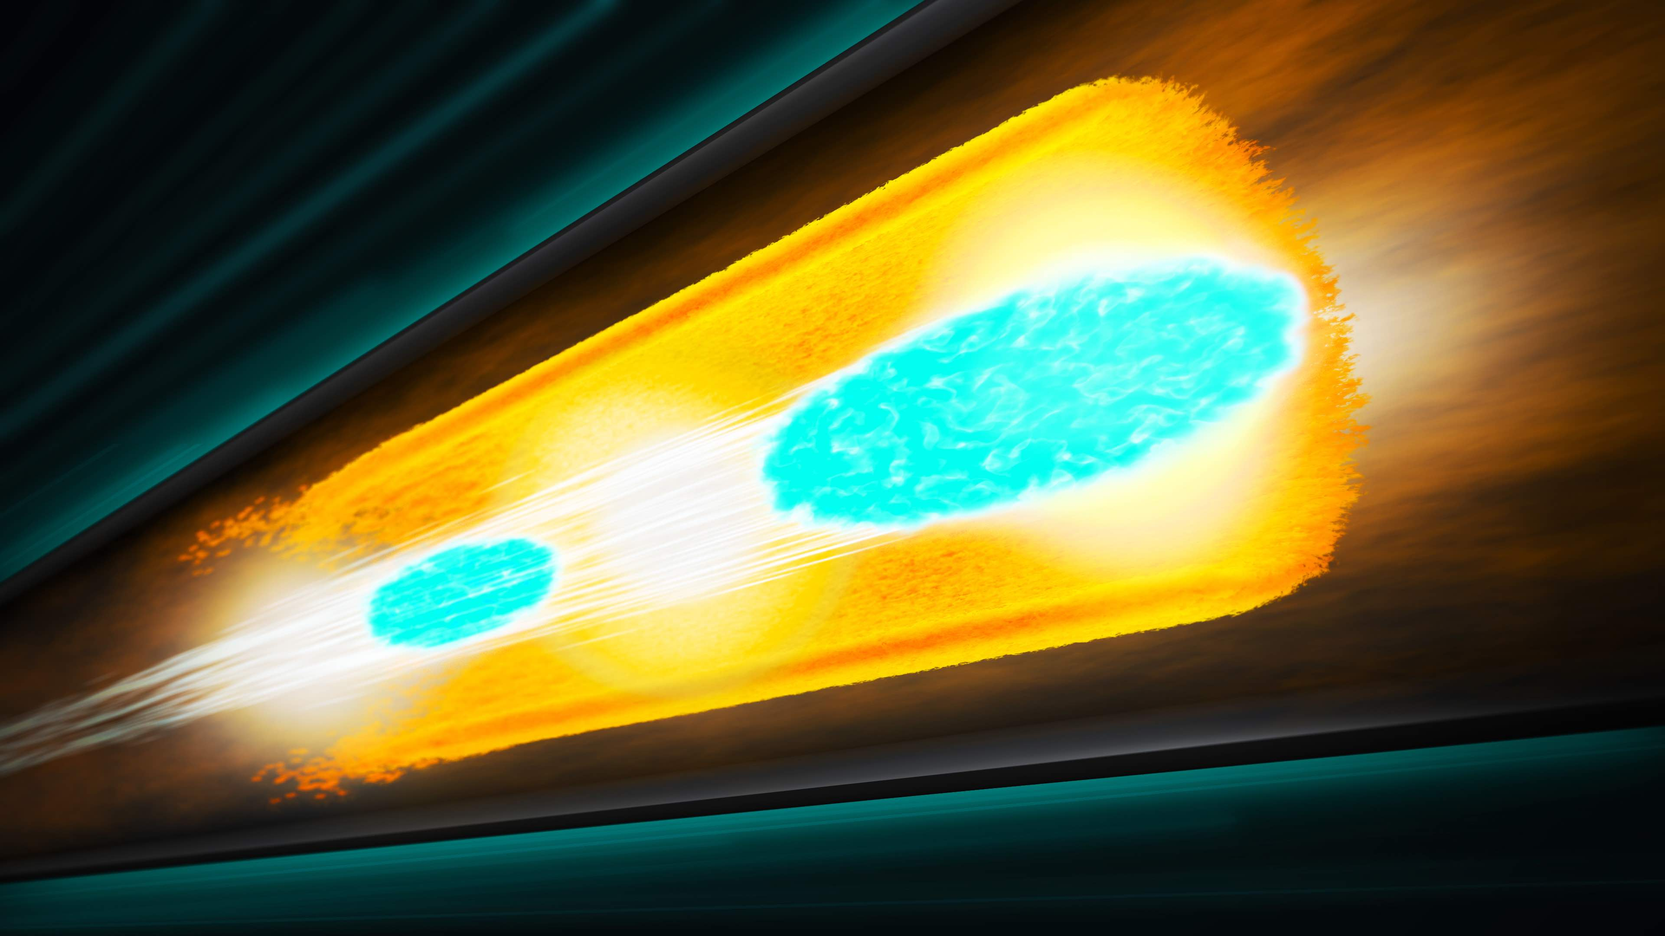
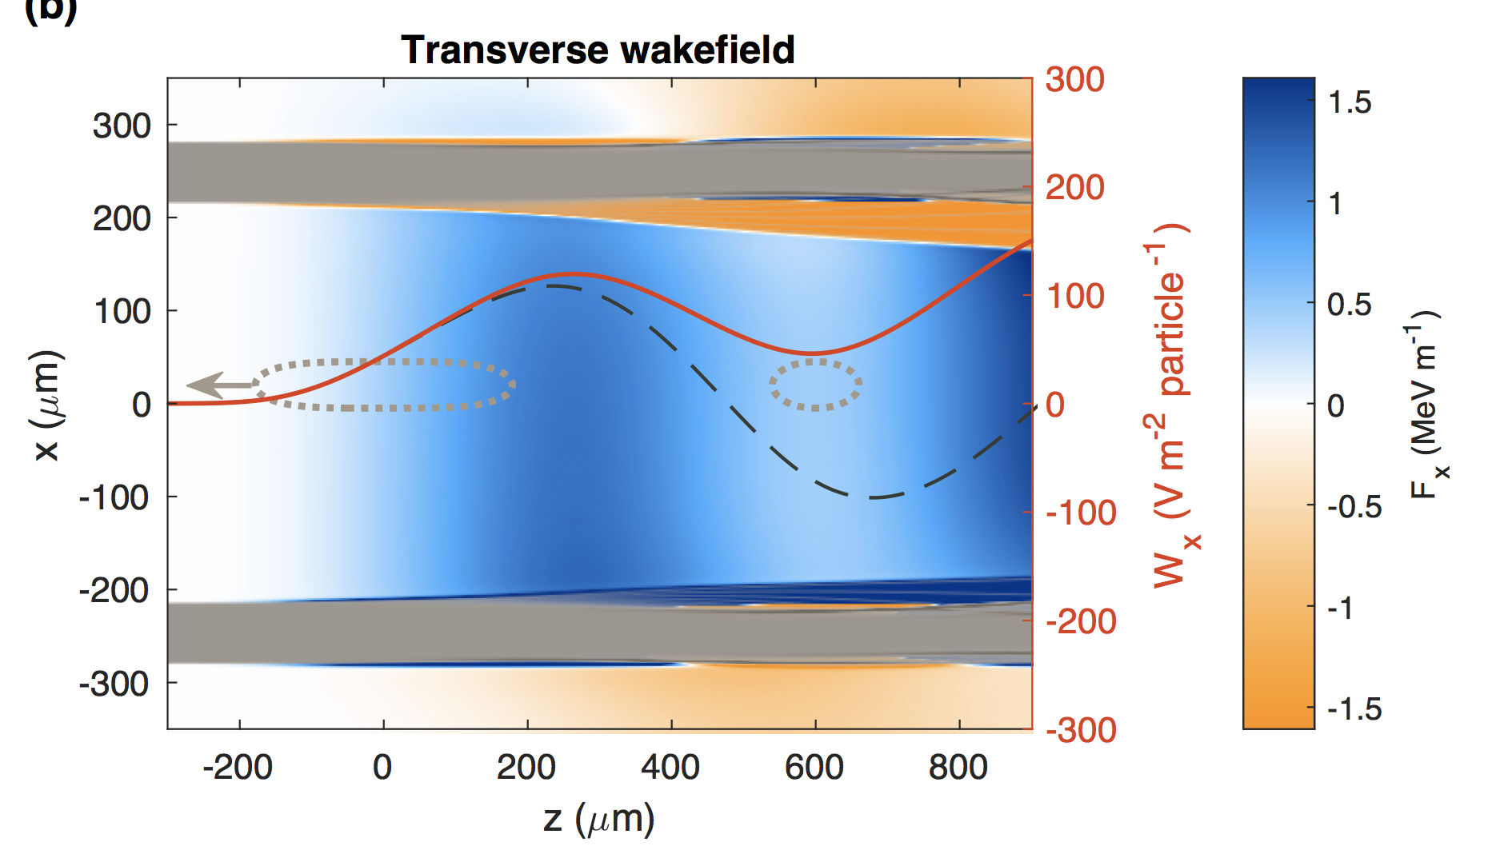
Challenges of Positron acceleration in Plasma
Hollow plasma channels:
Major problem:
Transverse instability

Slide 11
Challenges of Positron acceleration in Plasma
Plasma acceleration is being considered for an advanced linear collider, where positrons are strongly desired.
Positron is half the equation we have to deal with!
Yet very little research on how to accelerate positrons in plasmas.
Mostly due to the lack of facilities delivering positrons for plasma acceleration research.
« The most outstanding problem is the acceleration of positrons with bunch brightness, required for a linear collider » [Lebedev et al., World Sci. (2016)].

Slide 12
Challenges of Positron acceleration in Plasma
As of now, no self-consistent scheme for accelerating positrons in plasma that can simultaneously provide:
    High energy efficiency
    Extremely low preserved emittance
    Mitigation of transverse instabilities
Plasma-based particle accelerators face a major challenge:
The positron problem
Deserve serious attention
It’s all about beam quality and efficiency

Slide 13
Identified paths for positron acceleration in plasma

Slide 14
Nonlinear plasma wakefield

Slide 15
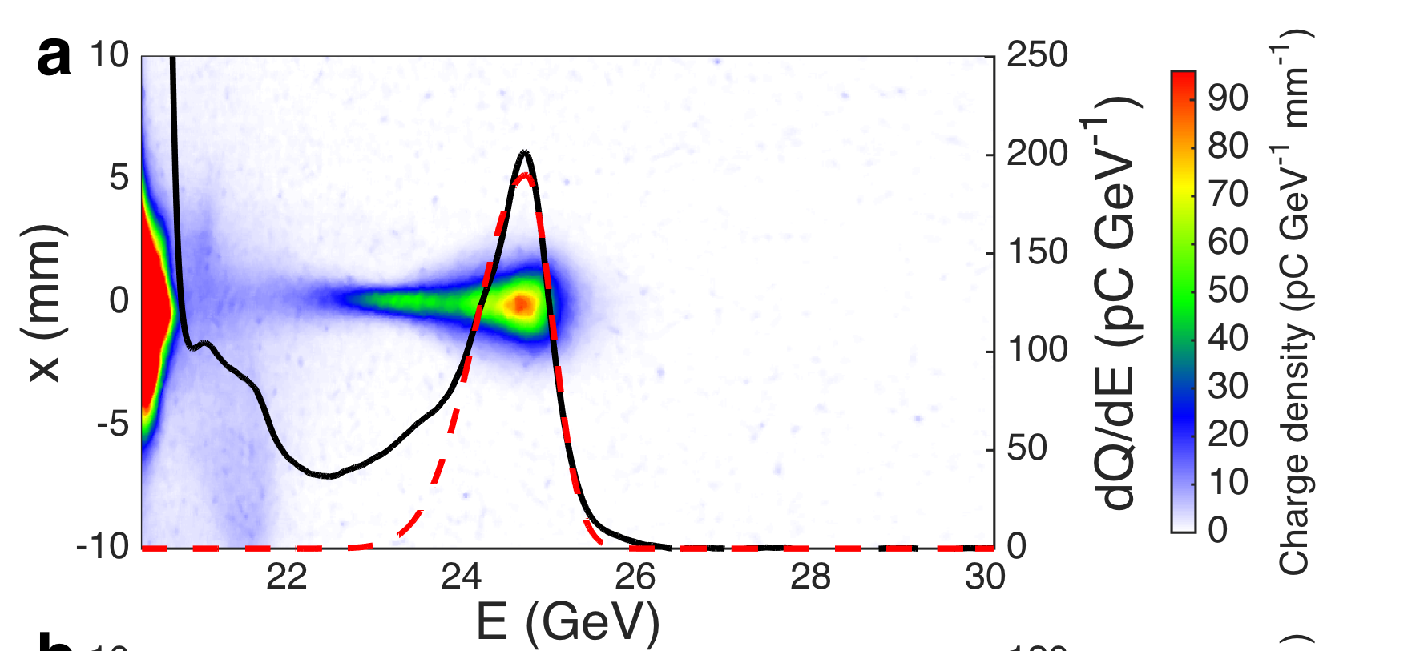
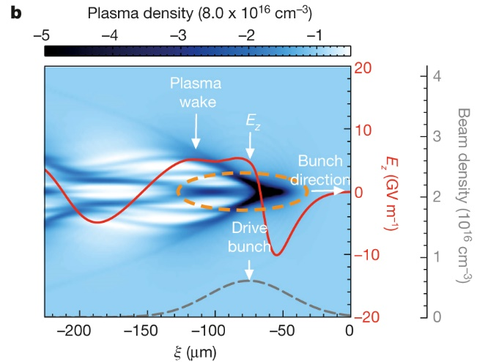
Nonlinear plasma wakefield
Experimental results in 1.3 m plasma
Positron acceleration in nonlinear plasma wakefield:
  Unexpected result: a large number of positrons are accelerated. Not just a tiny volume being accelerating and focusing for positrons.
  Accelerated positrons form a spectrally-distinct peak with an energy gain of 5 GeV.
  Energy spread can be as low as 1.8% (r.m.s.).
  Energy extraction efficiency of about 30% is deduced.
S. Corde et al., Nature 524, 442 (2015)

Slide 16

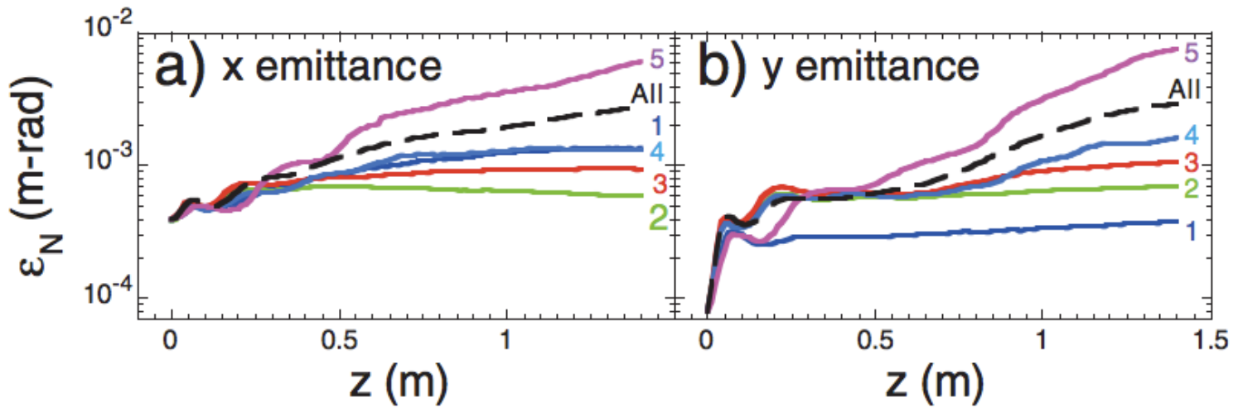
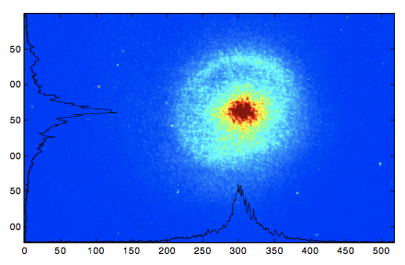
Nonlinear plasma wakefield
Transverse force is nonlinear in r, and is slice dependent.
→ emittance growth
Halo formation
P. Muggli et al., Phys. Rev. Lett 101, 055001 (2008)
P. Muggli | ALEGRO Positron Acceleration in Plasma Mini-Workshop, CERN | February 9 2018

Slide 17
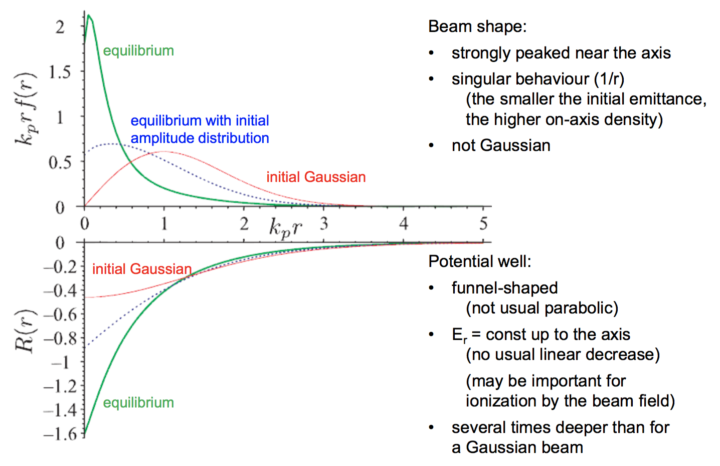
Nonlinear plasma wakefield
“Weird” bunch shape for radial equilibrium
→ no emittance growth
If initially Gaussian, the bunch evolves with emittance growth until equilibrium (quasi-steady state) is reached, after which emittance is preserved.
Single-stage plasma accelerator to avoid emittance growth in multiple stages
K. Lotov, Phys. Plasmas 24, 023119 (2017)
K. Lotov | ALEGRO Positron Acceleration in Plasma Mini-Workshop, CERN | February 9 2018

Slide 18
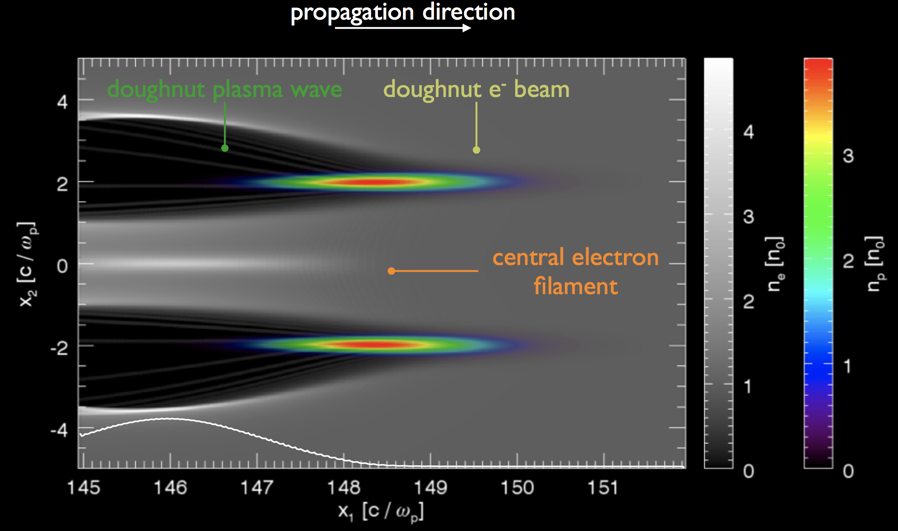
Nonlinear plasma wakefield
Plasma wake shaping using e.g. doughnut-shaped drivers
→ linear focusing force
Potential for high efficiency and preserved emittance in nonlinear plasma wakefield
J. Vieira et al Proceedings of AAC (2014); N. Jain et al arXiv (2015)
Jorge Vieira | ALEGRO Positron Acceleration in Plasma Mini-Workshop, CERN | February 9 2018

Slide 19
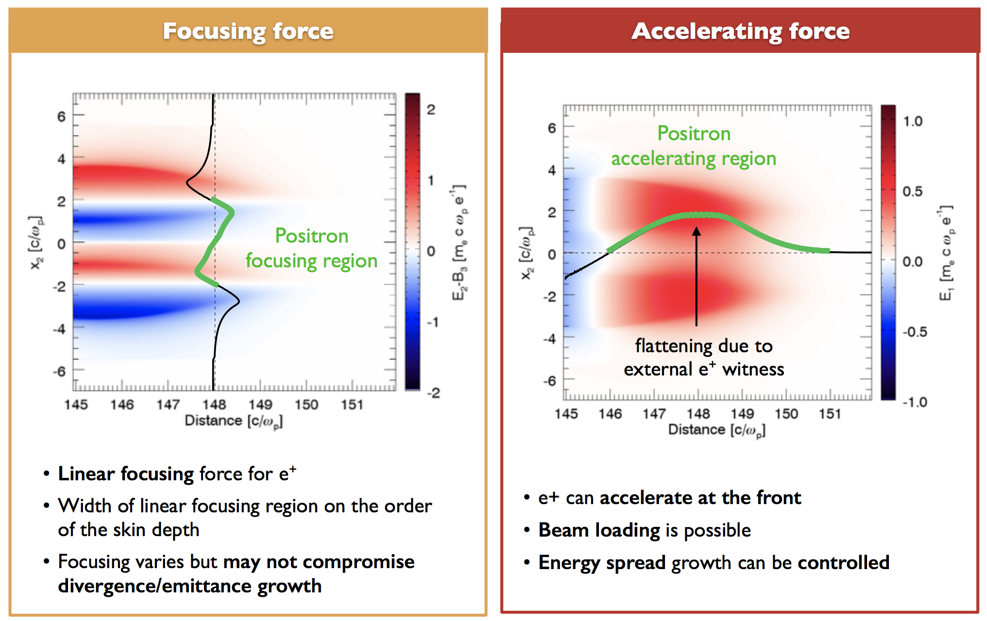
Nonlinear plasma wakefield
Plasma wake shaping using e.g. doughnut-shaped drivers
→ linear focusing force
Potential for high efficiency and preserved emittance in nonlinear plasma wakefield
J. Vieira et al Proceedings of AAC (2014); N. Jain et al arXiv (2015)
Jorge Vieira | ALEGRO Positron Acceleration in Plasma Mini-Workshop, CERN | February 9 2018

Slide 20
Quasi-linear plasma wakefield

Slide 21
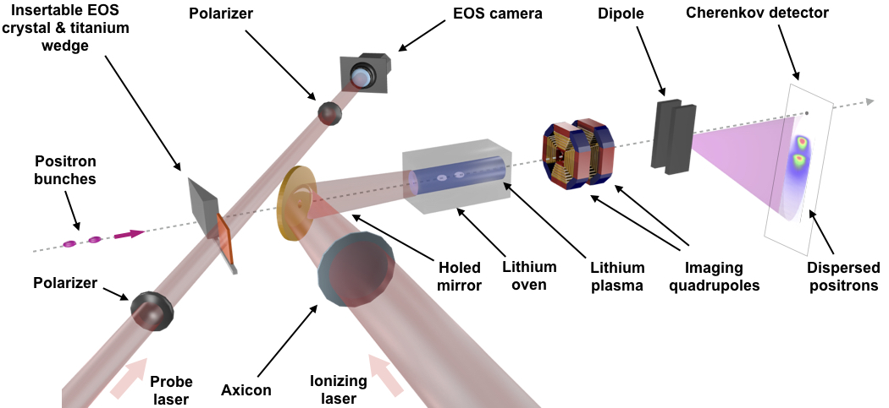
Quasi-linear plasma wakefield
1.65 m upstream of the plasma entrance
Drive charge: 460 pC
Trailing charge: 260 pC
Plasma density: 1 × 10¹⁶ cm⁻³
Emittance without Ti: 100 um x 10 um
With Ti 300 um : 270 um x 60 um
A. Doche et al., Scientific Reports 7, 14180 (2017)

Slide 22
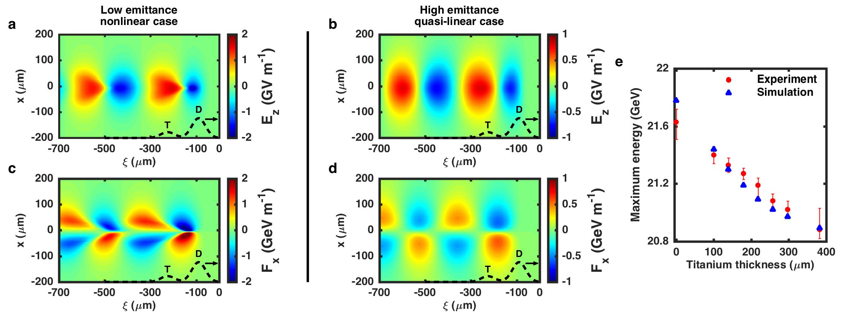
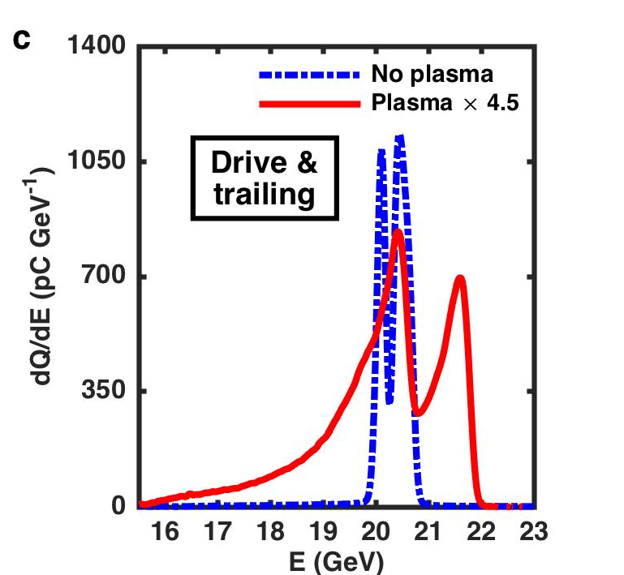
Quasi-linear plasma wakefield
Acceleration of a distinct positron bunch in a plasma
By varying incoming emittance, experiment spans nonlinear to quasi-linear regime
A. Doche et al., Scientific Reports 7, 14180 (2017)

Slide 23
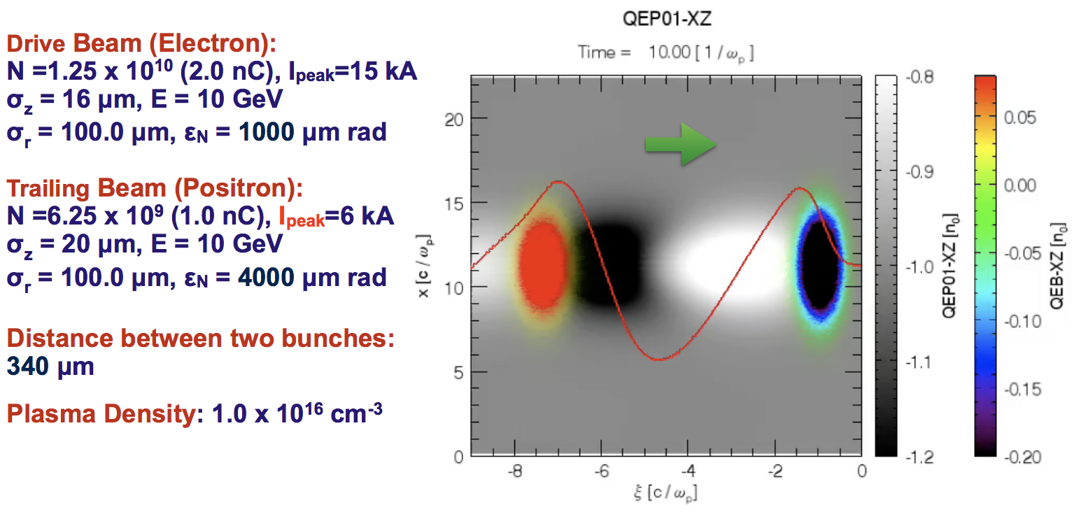
Quasi-linear plasma wakefield
Stable propagation for trailing positron bunch requires high emittance or low charge.
Without stable propagation, the trailing positron bunch collapses and a nonlinear wavefield is generated
→ same problems as discussed for nonlinear plasma wakefield
Weiming An | ALEGRO Positron Acceleration in Plasma Mini-Workshop, CERN | February 9 2018

Slide 24
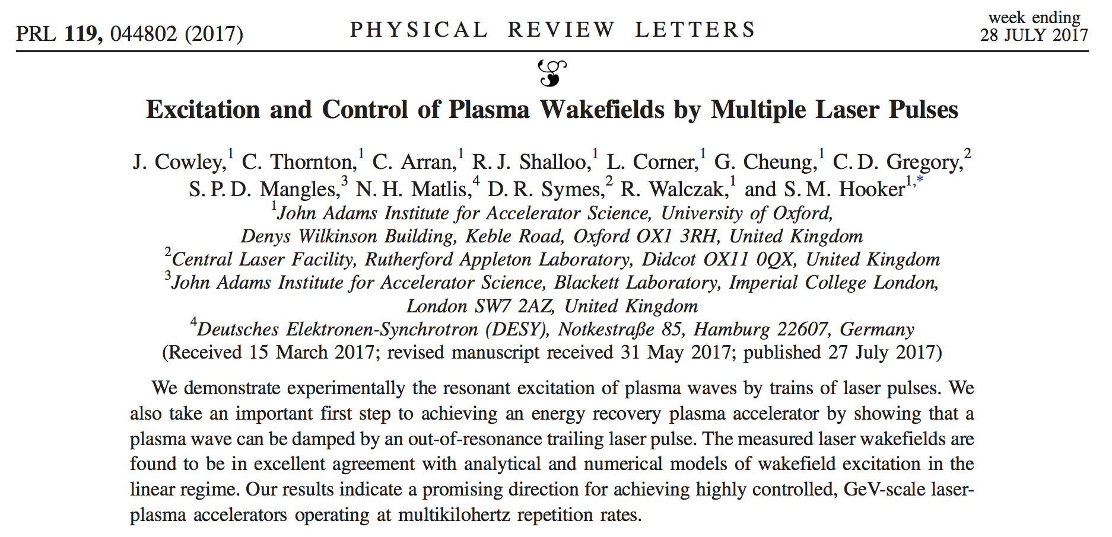
Quasi-linear plasma wakefield
Low emittance implies low charge, and therefore low efficiency per bunch.
“True” quasi-linear regime therefore requires multi-pulse/multi-bunch and/or energy recovery, to accommodate for the low efficiency per bunch and to reach good overall efficiency.
S. Hooker et al., J. Phys. B: At. Mol. Opt. Phys. 47, 234003 (2014); J. Cowley et al., Phys. Rev. Lett. 119, 044802 (2017)

Slide 25
Hollow plasma channels

Slide 26
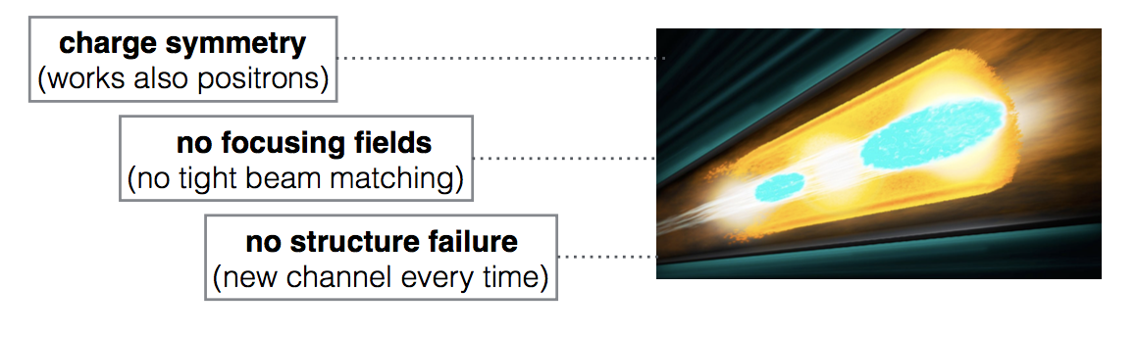
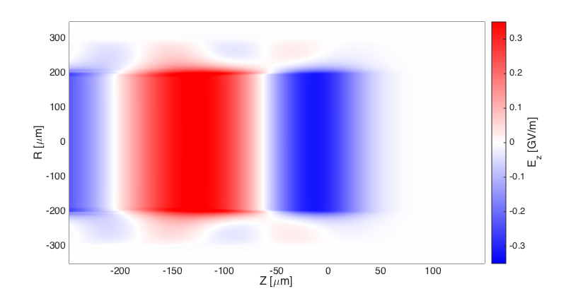
Hollow plasma channels
  The Hollow Plasma Channel is a structure that symmetrizes the response of the plasma to electron and positron beams. There is no plasma on-axis, and therefore no focusing/defocusing force from plasma ions.
Plasma Wall
Plasma Wall

Slide 27
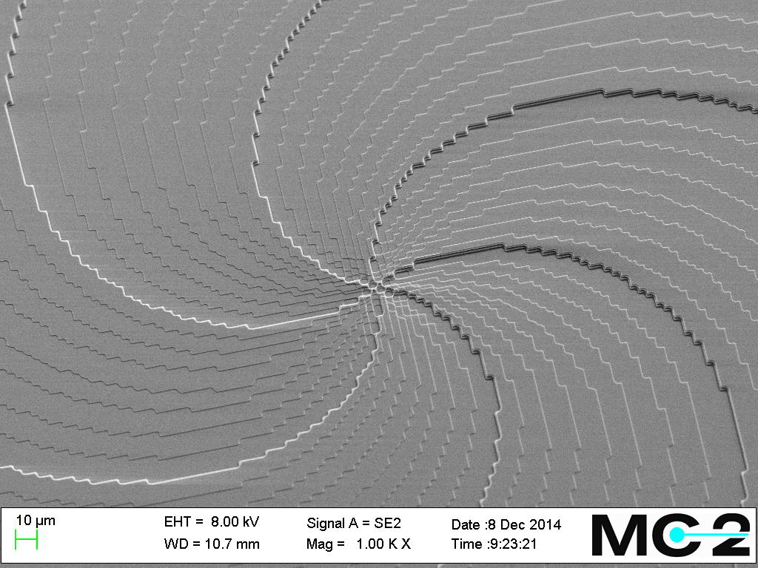
Hollow plasma channels

Slide 28
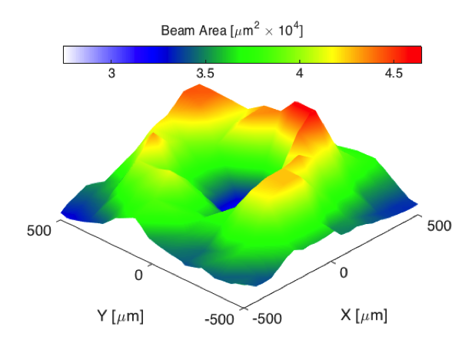
Hollow plasma channels
We measure changes to the beam as the beam is translated in the transverse directions x and y. The beam size increases when the beam interacts with the plasma channel.
Both the Kick Map and Beam Area Measurement (Volcano Plot) are consistent with an annular plasma channel.
S. Gessner et al., Nat. Commun. 7, 11785 (2016)

Slide 29
Hollow plasma channels
Hollow plasma channel with two beams:
At a bunch separation of 400 microns, the trailing bunch gains about 20 MeV on average, while the drive beam loses about 11 MeV.

Slide 30
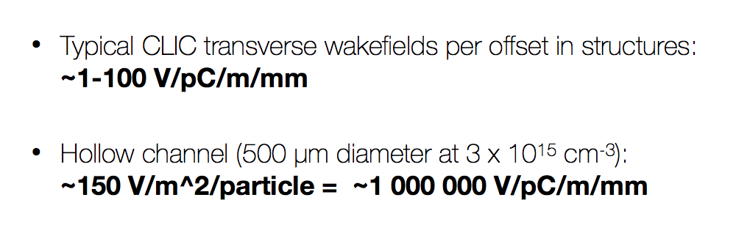
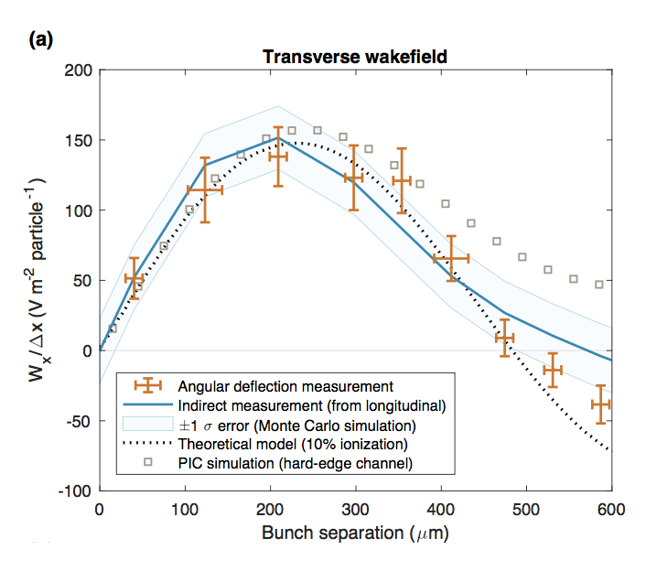
Hollow plasma channels
Experimental measurement [C. Lindstrøm et al., 2018] of transverse wakefield in hollow plasma channel largely agrees with theoretical model [C. Schroeder et al., Phys. Rev. Lett. 82, 1177 (1999)].
Need mitigation mechanisms for transverse instability in hollow plasma channels.
C. Lindstrøm et al., Phys. Rev. Lett 120, 124802 (2018)

Slide 31
WG8 Status and Objectives

Slide 32
Working Group 8 sessions
ALEGRO WG8 mini-workshop at CERN (February 9, 2018)
Talks:
  Review results from previous experiments
  Get a common understanding of the challenges and proposed solutions
  Look ahead to future experiments
Discussion:
  What are the major obstacles to accelerating high-quality positron beams in plasma?
  There are many proposed solutions. What are their advantages and drawbacks?
  There aren’t many facilities of positron PWFA/LWFA research. Is there anything we can do about it?
  What about novel sources of positron beams for plasma acceleration experiments?

Slide 33

Working Group 8 sessions
WG8 session on novel positron sources: Tuesday @10:30
There is only one facility that produces positron beams for plasma acceleration experiments.
Increasing access to positron beams will accelerate positron PWFA/LWFA research.
In this session we examine existing and novel technologies for producing positron beams in the context of a PWFA/LWFA research facility.
Looking ahead, the LC community would benefit from compact, low-emittance positron sources if they can replace expensive damping ring complexes.

Slide 34
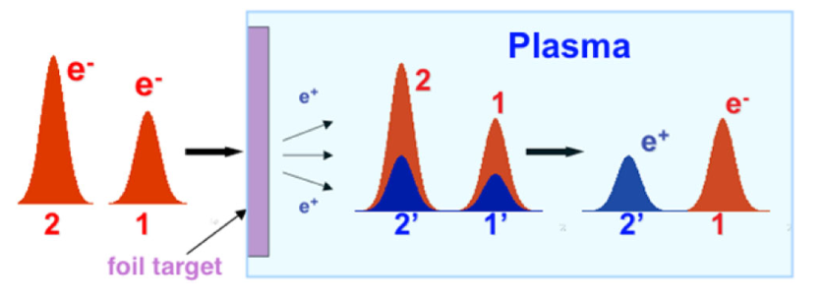
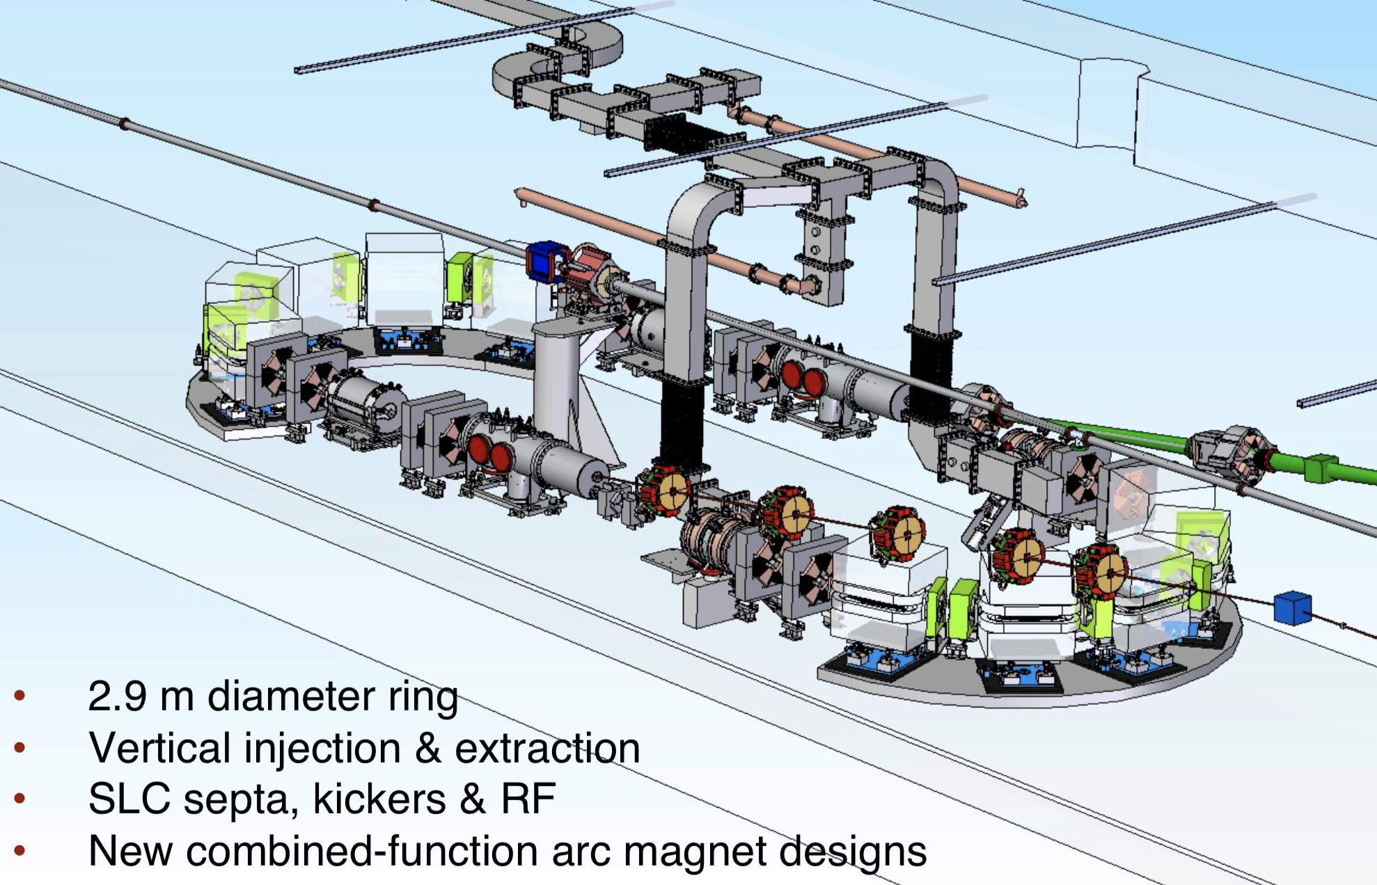
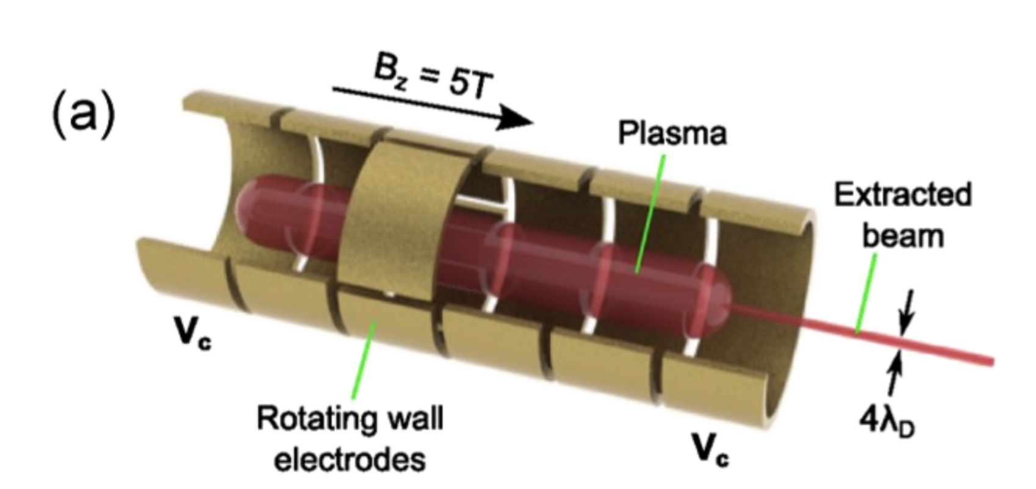
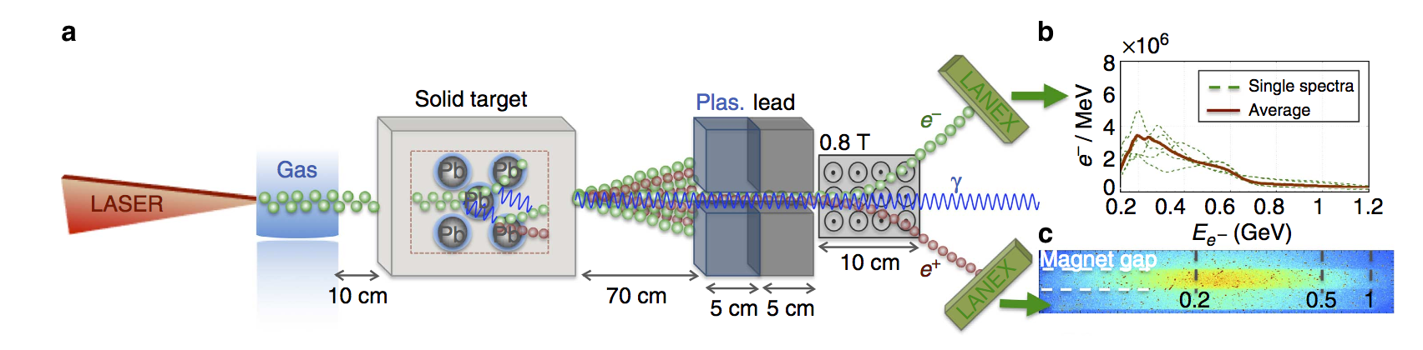
Working Group 8 sessions
Positron Source Topics
Compact Damping Rings
V. Yakimenko, FACET-II TDR, SLAC-R-1072
In-Situ Positron Generation
X. Wang, PRL 101, 124801 (2008)
Positron Beams from Electro-static Traps
J. Danielson, Rev. Mod. Phys., Vol. 87, 2015
Laser Generated Positron Beams
G. Sarri, Nat. Comm., 6747, 2015

Slide 35
Working Group 8 sessions
WG8 joint session with LWFA WG4: Tuesday @15:30
Detailed report on ALEGRO WG8 mini-workshop at CERN
Hollow channels for positron acceleration in LWFAs
Discussion on positron acceleration in LWFA schemes
WG8 joint session with PWFA WG5: Wednesday @10:30
Prospects and challenges for positron acceleration in the quasi-linear regime
Transverse wakefields in hollow plasma channels
Discussion on most viable paths moving forward for positron acceleration

Slide 36
Objectives
Our goals
Survey existing work in LWFA/PWFA positron acceleration
Provide input by identifying most promising path and highlighting their potential limitations
Prioritize R&D on solving the most important problems and on exploring new promising ideas
Emphasize need for facilities for positron LWFA/PWFA research
Quasi-linear plasma wakefield
Hollow plasma channels
Nonlinear plasma wakefield
How to accelerate low emittance beams with high efficiency?
How to mitigate transverse instabilities?
How to preserve emittance?
Doughnut-shaped wakes, weird trailing bunch shaping, single-stage accelerator.
Multi-pulse, energy recovery.
Position trailing bunch at zero-crossing of transverse wakefield, look for damping mechanisms.
It’s all about beam quality and efficiency
Positron problem deserves serious attention

