Slide 1

WG2 (Collider Design) summary for Thu morning discussion
Daniel Schulte and Andrei Seryi
29 March 2018

Slide 2
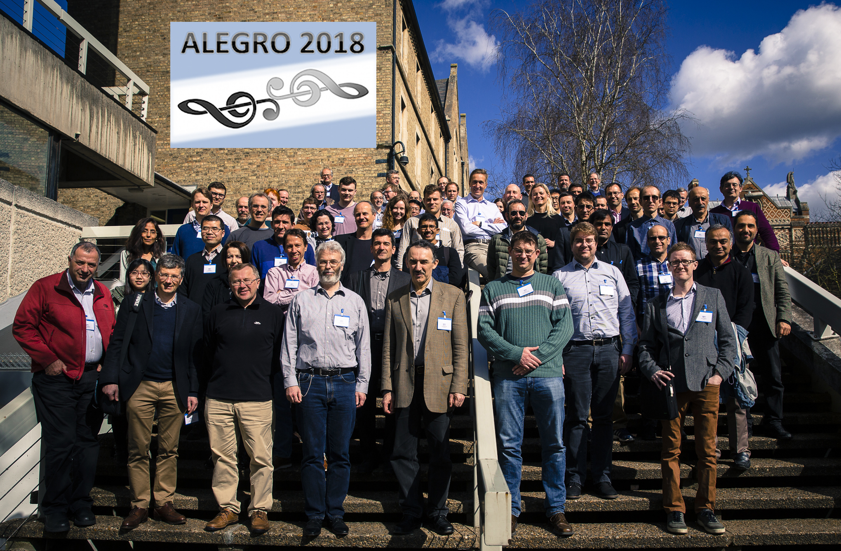

Slide 3
10x your thinking –take moonshots
Why try for 10x versus 10%?
  When you shoot for 10x improvement you approach the problem in a radically different fashion.
  When you attack a problem as though it were solvable, even if you don’t know how to solve it, you’ll be shocked with what you come up with.
  10x vs 10% improvement is 100 times more worth it…but, it’s never 100 times harder.
  Finally, having a moonshot focuses and motivates your team, attracts the best talent in the world, and critically, allows you to solve interim problems and create interim products/services along the way.
How to Disrupt Yourself With Moonshot Thinking…
Peter H. Diamandis, SingularityHub

Slide 4
“Imagination is more important than knowledge. For knowledge is limited to all we now know and understand, while imagination embraces the entire world and all there ever will be to know and understand” – Einstein

Slide 5
Main points
Motivations
  Long term, mid term, near term
Status of technologies
Structure of WG for future ALEGRO
  Mechanisms for encouraging common efforts of design work

Slide 6
Motivations
Long term
  30 TeV e+e- or gg collider
Mid term
  Stand-alone advanced collider
  Upgrade of ILC or CLIC
Near term
  Plasma Electron Proton Ion Collider

Slide 7
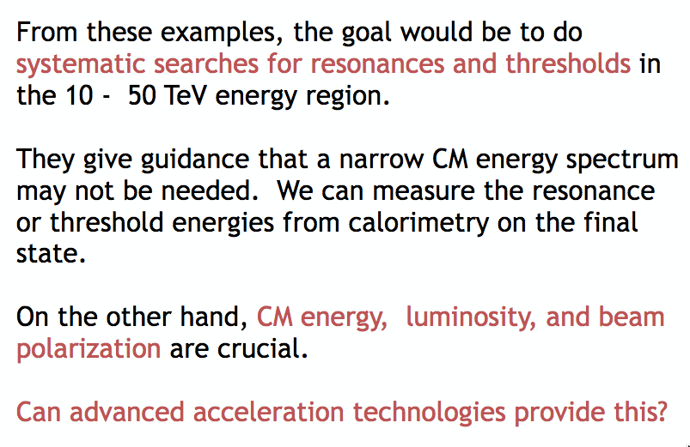

Motivations – long term
30 TeV e+e- or gg collider

Slide 8
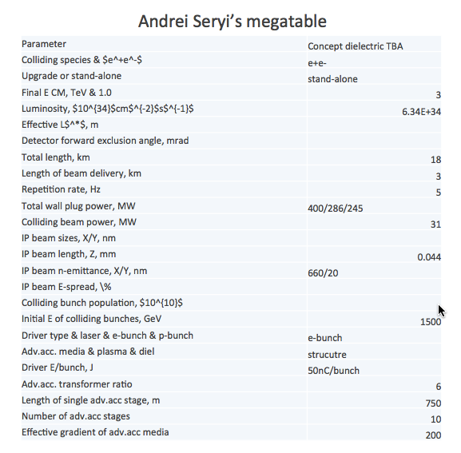
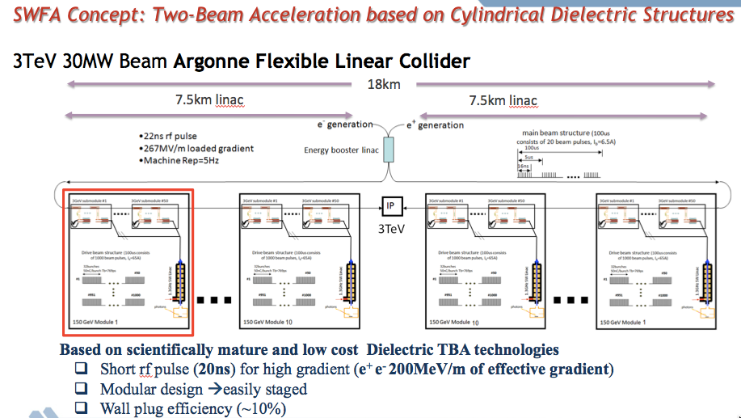
Motivations – mid-term
Stand-alone advanced collider – example
John Power, ANL

Slide 9
Motivations – mid-term
Upgrade of ILC or CLIC
  Example – upgrade of ILC to ~TeV CM
D
IP
p
A
B
p
P
P
e⁻
C
e⁺
Concept of ILC 250 GeV CM Higgs Factory upgrade to ~2 TeV CM using plasma acceleration driven by proton beam

Slide 10
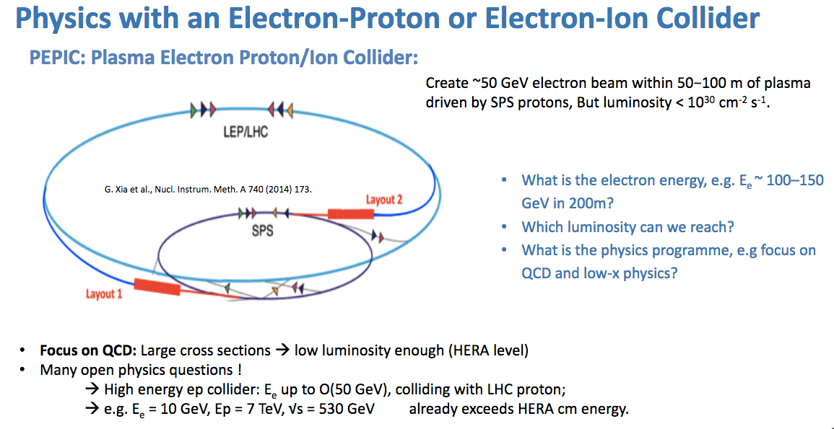
Motivations – near-term
Plasma Electron Proton Ion Collider
Edda Gschwendtner, CERN

Slide 11
Status of technologies
Gradient established for plasmas
…
Beam quality, efficiency, project integration => …

Slide 12
Structure of WGs for future
WGs should be structured according to systems of collider (for near term future)
  WG Physics Case
  WG Acceleration (plasma, swfa, etc)
  WG Power Sources (drive beam, laser, etc)
  WG Luminosity Delivery (beam sources, beam cooling, tolerances, stabilization, focusing)
    May need to be split to several groups eventually
  WG Detector (Machine Detector Interface)

