Slide 1


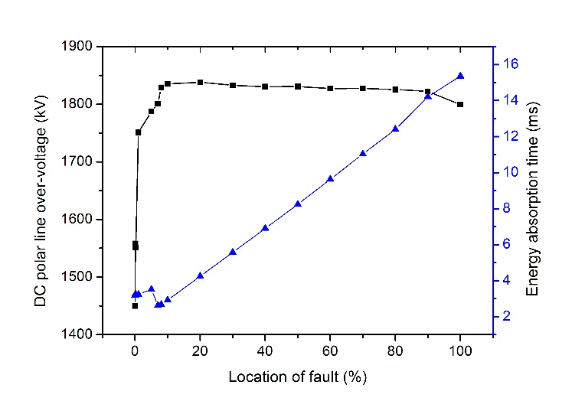
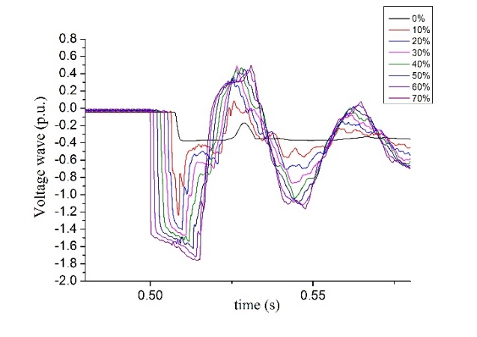
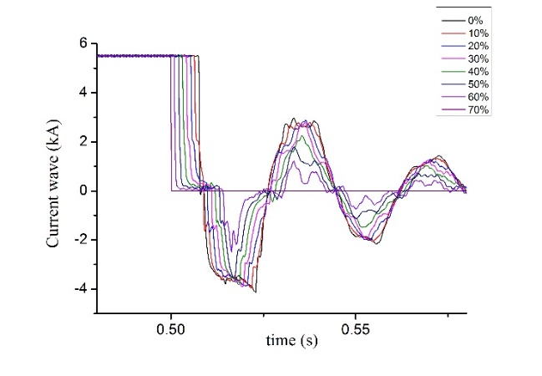
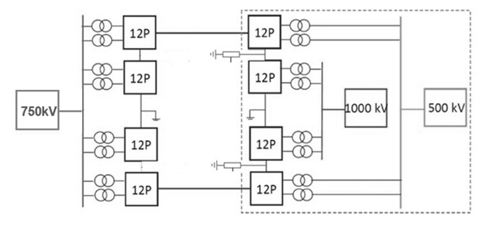
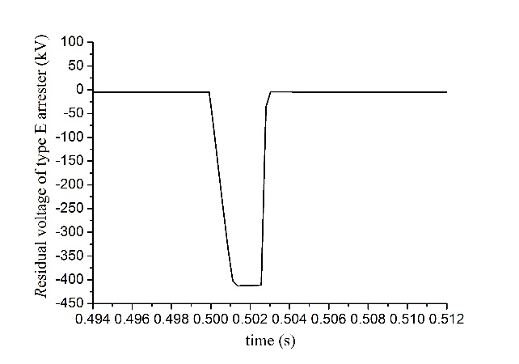
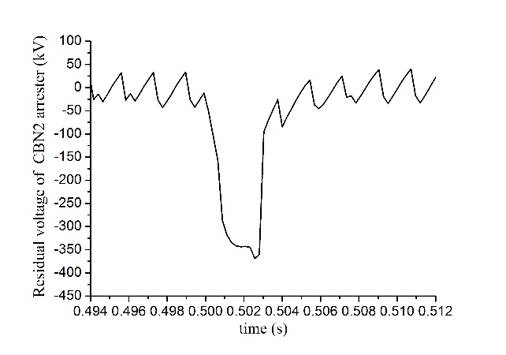
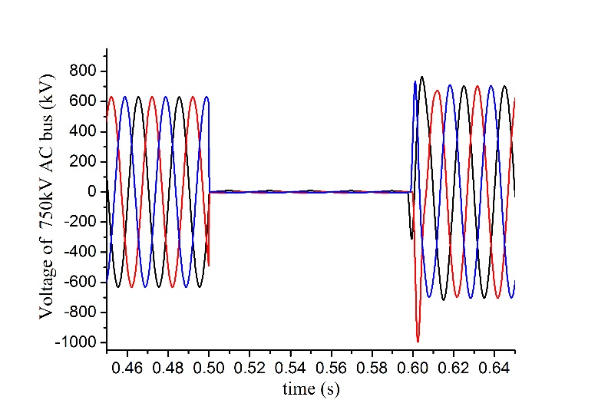
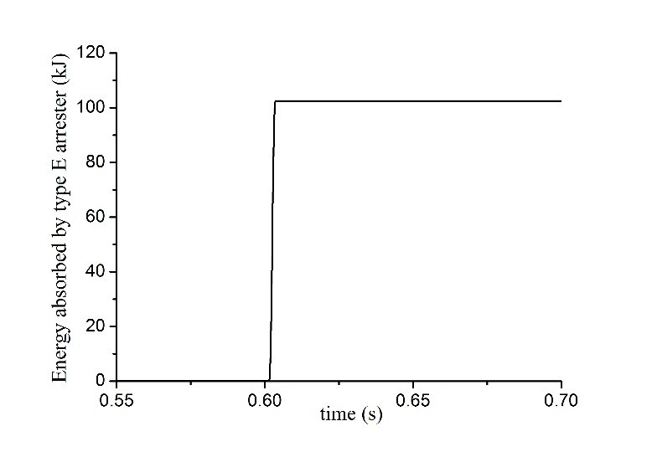
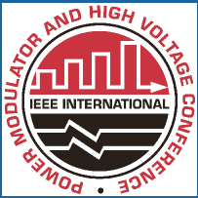
#64
Simulation study on switching over-voltage of UHVDC transmission system under hierarchical connection mode caused by typical faults
Ziyuan REN*, Jiangtao LI¹, Jiaxin HE¹, Yuhao LIU¹, Yi SUN¹, Xin FENG¹, Yifeng WANG¹
School of Electrical Engineering, Xi’an Jiaotong University
Xi’an, 710049, China
I. INTRODUCTION
Open circuit fault of neutral line
Under the bipolar full voltage operation mode
There is no grounding electrode after the neutral bus breaker of converter station occurs open circuit fault. The voltage of neutral line increases, which makes type E arrester act.
Fig. 5. Residual voltage waveforms of type E and type CBN2 arresters
The energy absorption of arresters in rectifier station and inverter station are similar in the same protection delay, both reach their energy absorption limit when NBGS closing time is 2.8ms.
When fault occurs at rectifier station, a negative residual voltage is produced on neutral bus, system voltage is slightly reduced. When fault occurs at inverter station, on the contrary, system voltage is slightly uplifting, which cause the action of ML and CBL2 arrester.
Under monopole-earth operation mode
After the fault occurs, the system current flows from the earth into system through the arrester, and a negative (positive) residual voltage is formed on the arrester.
TABLE I. THE RESIDUAL VOLTAGE AND ENERGY ABSORPTION OF ARRESTERS
The residual voltage of CBN2 is lower than E, mainly due to the neutral line smoothing reactor induces certain voltage.
When NBGS is grounded 2.79ms after the fault, the energy absorbed by E arrester approaches its allowable limit of 3.1MJ.
UHVDC transmission system with hierarchical connection mode is a new trend. In this mode, the inverter station adopts the way of layered access to 1000 kV and 500 kV AC power grid, which can realize the optimization of UHVDC power transmission, improve the voltage support ability of the receiving end AC system and guide the reasonable distribution of power flow.
Basing on the EMTDC/PSCAD simulation platform, this paper studies the mechanism and distribution of switching over-voltage caused by typical faults. Different influential factor of switching over-voltage is simulated and the over-voltage suppression measures are proposed according to simulation results obtained.
When the open circuit fault occurs at the point 20% away from rectifier station, the DC polar line over-voltage is more serious.
The type E arrester can ensure safety if NBGS is effectively grounded within 2.9ms.
Fig.5. Results of over-voltage and arrester energy absorption
II. SIMULATION MODELS
Under the hierarchical connection mode, the high-end and low-end converters of inverter station are connected separately to two different AC grids which have different voltage levels.
The configuration of DC arresters: V1, V2, V3 are valve arresters; ML, MH are six-pulse-bridge arresters of twelve-pulse converter unit; CBN1, CBN2, E, EL, EM are neutral bus arrester; A is AC bus arrester.
Fig.6. Voltage wave and current wave along the metallic return line
Fig.1. Topology structure of hierarchical connection mode
Fig.2. DC arrester configuration of converter station
Ⅲ. SIMULATION OF OVER-VOLTAGE UNDER TYPICAL FAULTS
AC bus grounding fault
The calculation assumes that the converter station has been blocked during and after the fault. The fault moment is evenly distributed in a frequency period.
The maximum over-voltage fault condition is three-phase grounding fault in rectifier station, reaches 1.57p.u..
AC bus grounding fault will cause the action of valve arresters and AC bus arresters, and the energy absorption of them does not exceed their allowable single discharge energy consumption.
The over-voltage of 1000kV AC bus is smaller than 500kV AC bus. The voltage support capability of 1000kV AC system is stronger.
Open circuit fault of metallic return line
Under the monopolar metallic return line operating mode, if the metallic return line occurs open circuit fault, the DC current loop is disconnected, the energy stored on the line that connected to the rectifier station will be released through the type E arrester of rectifier side. There are slight differences in over-voltage when open circuit faults occur at different locations.
Arrester | Rectifier station fault |  | Inverter station fault
 | Residual voltage (kV) | Energy (MJ) | Residual voltage (kV) | Energy (MJ)
E | -412.7 | 3.09 | 339.9 | 3.03
CBN2 | -369.0 | 0.093 | 336.1 | 4.3*10-4
Fig.3. Over-voltage of three-phase grounding fault in rectifier station
Fig.4. DC arrester configuration of converter station
Ⅳ. CONCLUSION
Under AC grounding fault condition, the highest over-voltage of AC bus is 1.57p.u.. The energy absorption of type A and type V arresters does not exceed their allowable limit of 3.1MJ.
When an open circuit fault occurs on the neutral line or metallic return line, the system will form a loop through the neutral bus type E arrester. it is required to quickly close neutral grounding switch NBGS within 2.8ms to avoid the energy absorbed by the type E arrester over its allowable maximum limit.
2018 IEEE International Power Modulator and High Voltage Conference
3-7 June 2018, Jackson Lake Lodge

