Slide 1
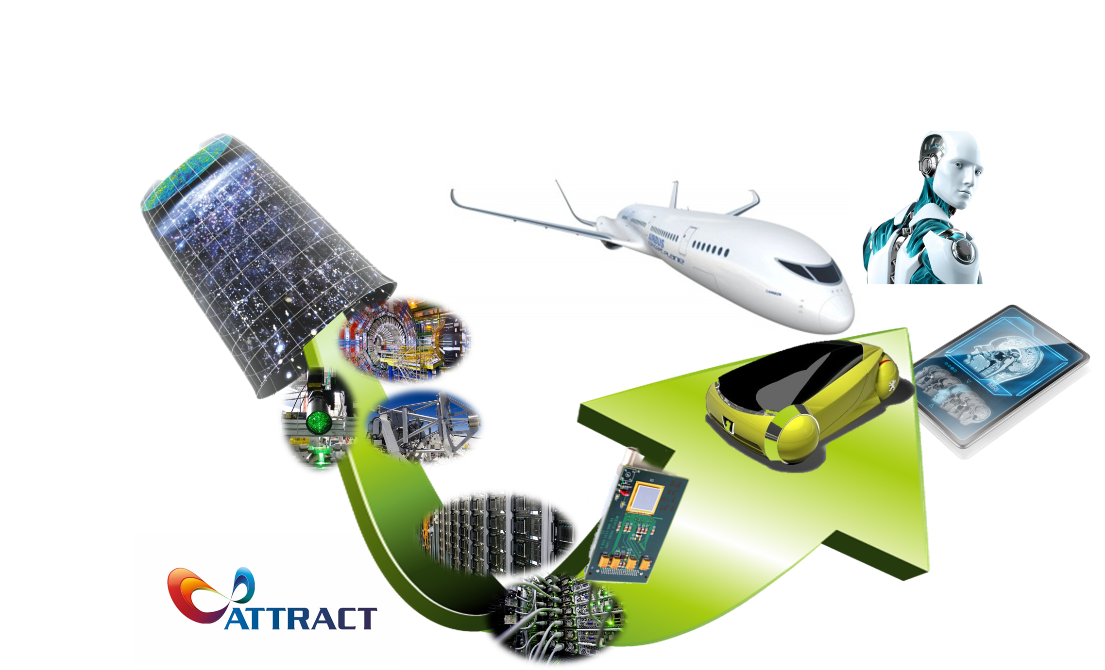

The ATTRACT initiative

Slide 2
Overview
ATTRACT
    Political Context
    A New Innovation Ecosystem
    Philosophy
      Pro-active Response
    Main Strategic Actors
    Why Research Infrastructures, Industry and Business and Innovation specialists together?
                Paradigm
            Technology Focus
            Business Angle
            Young Talent
                The long term vision: 2021 and beyond
            Conclusion

Slide 3
ATTRACT: From Open Science to Open Innovation
European RIs have succeeded in establishing the paradigm of Open Science, establishing an extended ecosystem, where the research communities are fostering a culture of mutual trust, balancing competition and collaboration.
Their potential to generate innovation is largely untapped, due to the lack of a corresponding ecosystem at the European scale, which needs to include also the private sector (industry, investors, entrepreneurs).
The lack of such an eco-system impairs the development of policies of adequate scale, and it is one of the main causes of the declining competitiveness of Europe in innovation.

Slide 4
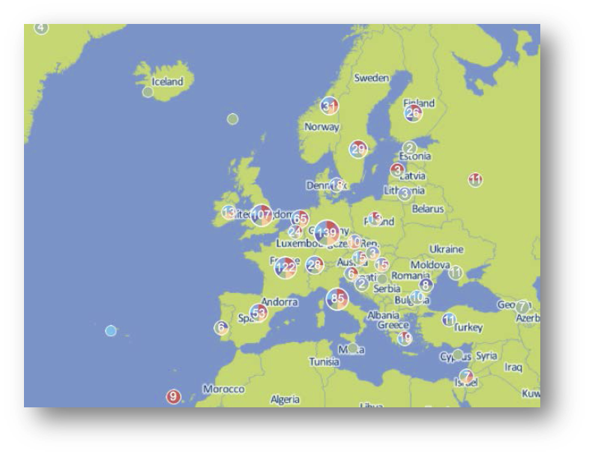
ATTRACT: Political Context
The EC is increasingly emphasizing the role that European Research Infrastructures (RIs) need to play as innovation engines.
Pan-European and National RIs represent an enormous potential as well as investment in people and resources.
Key question: Is it used optimally?
Could RIs work together to make it work better?

Slide 5
ATTRACT: A New Innovation Ecosystem
A pan-European ecosystem of opportunities:
For serving the RIs and their R&D communities in their mission, while…
… better extracting industrial and societal value out of fundamental science and …
… stimulating the talent of young professionals.

Slide 6
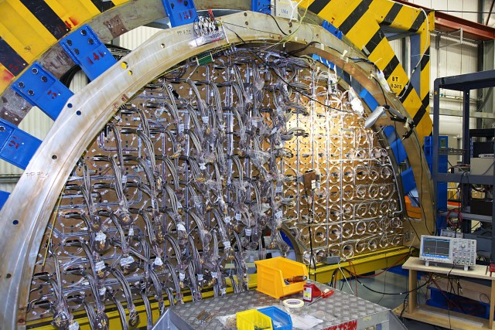
ATTRACT: Philosophy
Pursuing the limits of Fundamental Science generates breakthrough technologies.
Within the right ecosystem these technologies can systematically generate innovations capable of transforming our society and responding to societal challenges.
These transformations increase our social wealth as citizens.

Slide 7
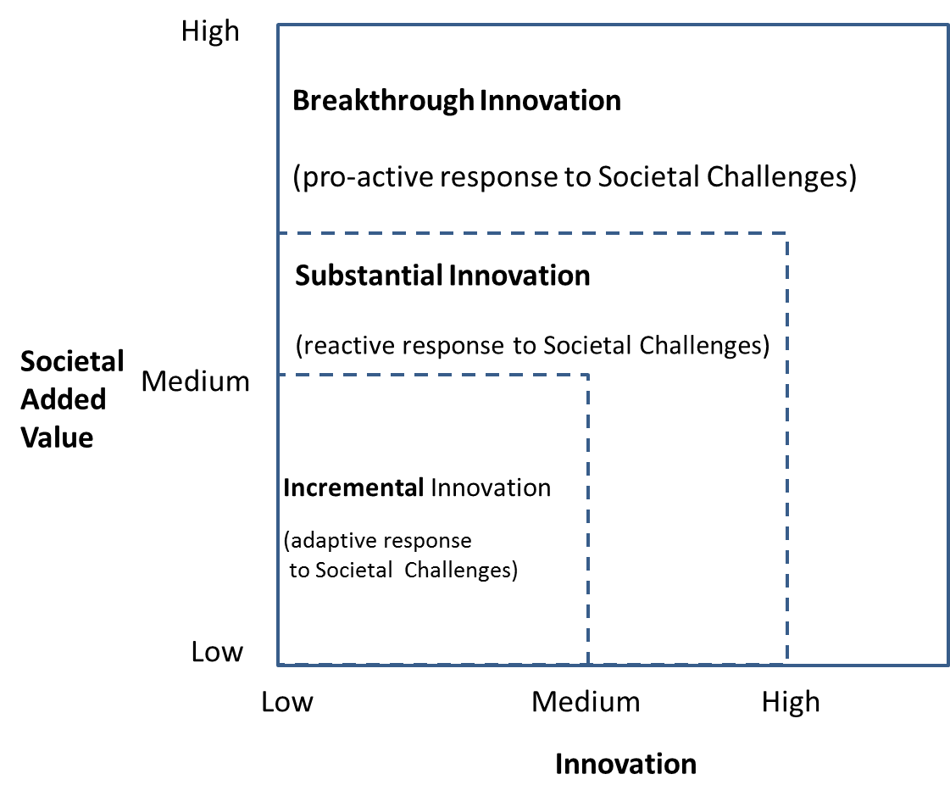
ATTRACT: Pro-active Response
Breakthrough innovation anticipates future societal needs.
ATTRACT

Slide 8
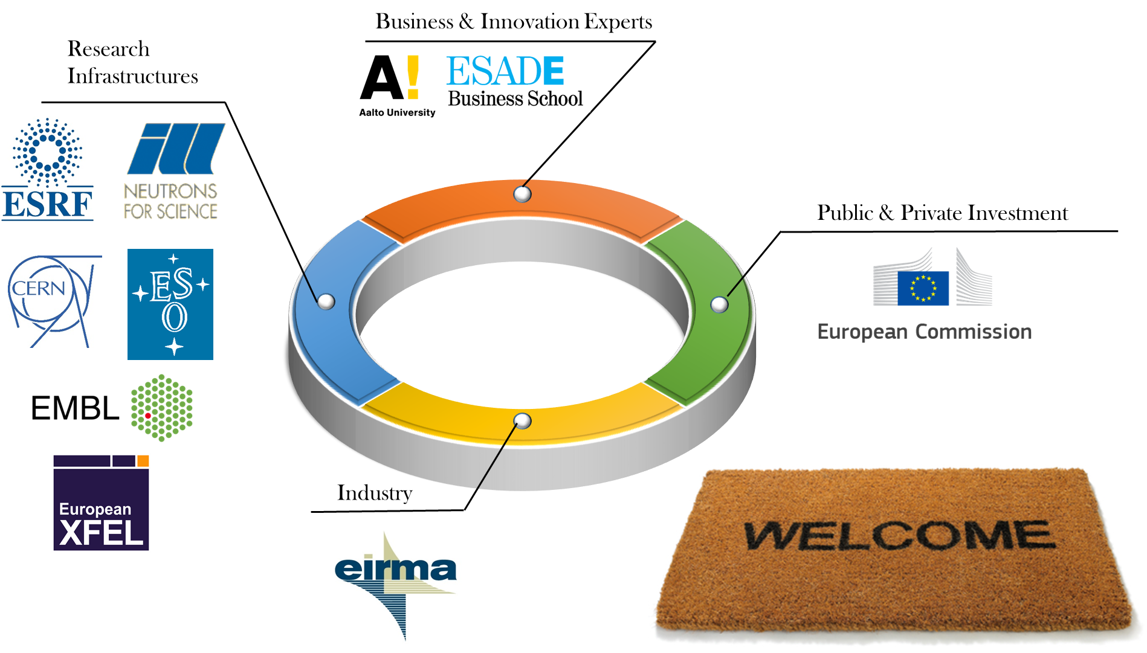
ATTRACT: Main Strategic Actors
Value Extractors
Risk absorption
Value Generators
The success of ATTRACT will not be possible without EC support specially in its ramp-up phase.
Value Captors

Slide 9

ATTRACT: Why Research Infrastructures, Industry and Business and Innovation specialists together?
Pure Basic Research
User-inspired
Basic Research
High
ATTRACT’s quadrant
co-innovation paradigm
scientific research that both seeks fundamental
understanding of scientific
problems, and, at the same
time, benefits to society.
Quest for
fundamental
understanding
Bohr Quadrant
Pasteur Quadrant
Applied Research
Low
Edison Quadrant
Low
High
Use-inspired
Research
Sources: Donald E. Stokes, Pasteur's Quadrant – Basic Science and Technological Innovation, Brookings Institution Press, 1997.

Slide 10

ATTRACT: Paradigm
Balancing collaboration and competition
ATTRACT aims for facilitating the transition from Open Science (RIs) to Open Innovation (Industry).
Proposes a new co-innovation paradigm between Industry and RIs.
Co-innovation breaks with the traditional procurer-buyer model and proposes a strong cooperation from the beginning of the innovation value chain on identified win-win technology and business opportunities.

Slide 11
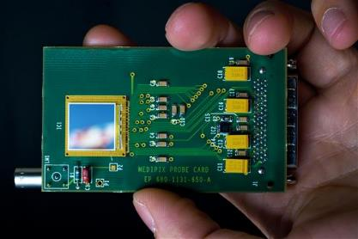
ATTRACT: Technology Focus
Focus on detection and imaging technologies
They are the backbone for European RIs and their R&D communities.
They are the core of future industrial developments, applications and business.
Detection and imaging technologies allow for the emergence of fast innovators especially SMEs.

Slide 12
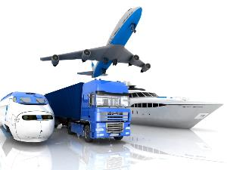
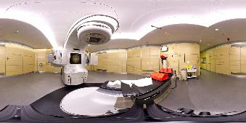

ATTRACT: Technology Focus
Detection and imaging technologies will be critical for the future of European competitiveness and jobs.
Key European industrial players will leverage on them to gain a crucial competitive advantage.
They will enable profound social transformations.

Slide 13



ATTRACT: Business Angle
Fostering entrepreneurship
ATTRACT is not an initiative with an exclusive focus on technology development.
ATTRACT aims to create new paradigms for innovation with the contribution of innovation experts.
Business Schools, Innovation hubs and entrepreneurship experts are key and together with RIs and industry on the driving seat from start.

Slide 14
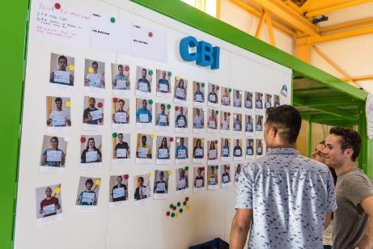
ATTRACT: Young Talent
An instrument for the young talent
ATTRACT aims to create a new pathway to favour innovation linked to entrepreneurship and “out of the box” thinking.
This philosophy will be specially oriented to young talent in Europe.
CERN (IdeaSquare), Aalto (Design Factory), ESADE (Creapolis) among many other ATTRACT supporters already have dedicated pilot experiences.

Slide 15
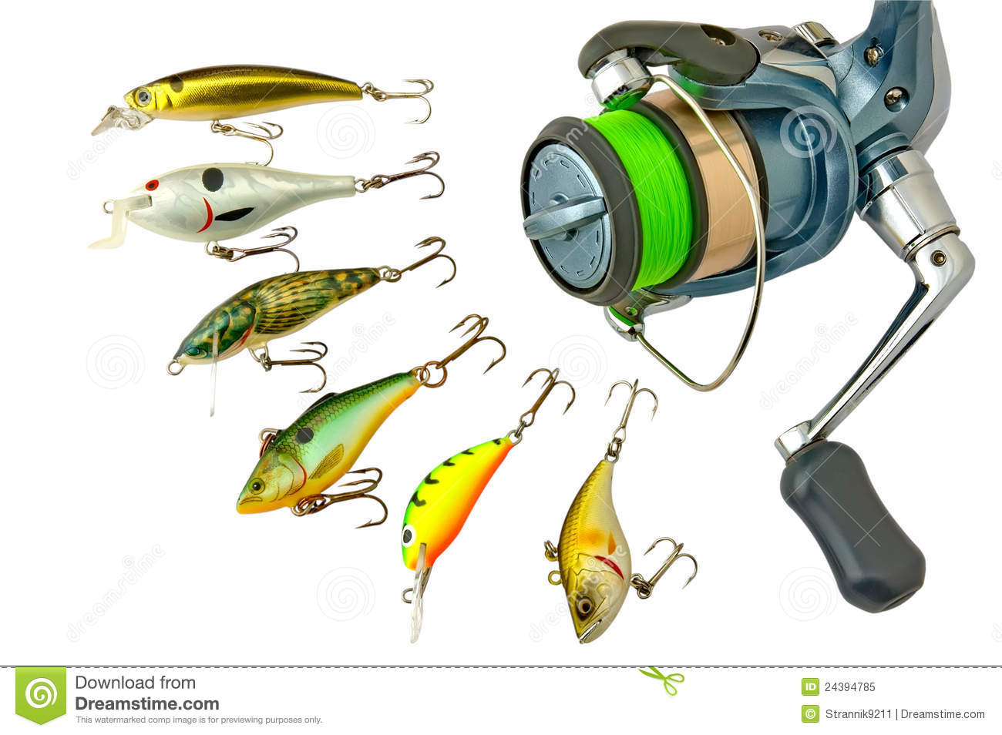
ATTRACT long term vision: Value for Many
“ATTRACT makes possible the best fishing rod…
…and then each one chooses what to fish (and how)…”

Slide 16

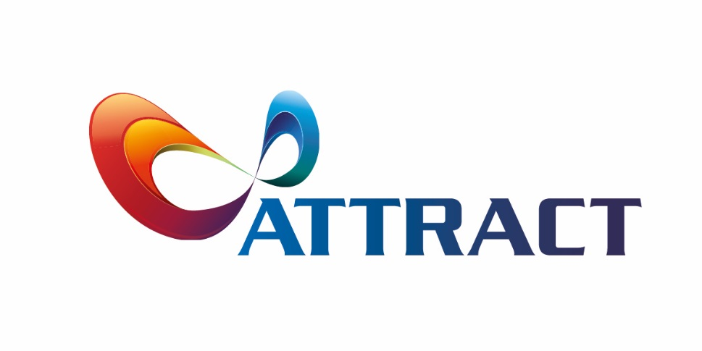
An Ecosystem of sharing based on trust
Technologies
from ATTRACT
projects (public funding)
From
Open Science
Technologies
privately developed
(private funding)
iStore
to
Open Innovation

Slide 17
The “ATTRACT Store of Innovation” (iStore)
Repository for ATTRACT-funded technologies.
Loose IP governing regulation (i.e. open source regime).
Available of course to the ATTRACT community but open to others, too…
  Whoever takes something…must give something back…
  “Free riders” are detected by the user community.
Possibility to further develop “in-house” technologies outside the iStore and protect them.
Open source platforms have demonstrated to be generators of new business opportunities.
Aligned with the EC Policy of openness for public funding.
Technologies constantly improved by the user community.
iStore

Slide 18
ATTRACT: Conclusions
ATTRACT represents an opportunity to place RIs at the forefront of innovation in Europe together with industry and business and innovation specialists.
It nurtures win-win projects enabled by National and pan-European RIs and industry by balancing collaboration and competition (co-innovation).
Aligns with and implements the new political paradigm “From Open Science to Open Innovation and Open to the World”.
Creates opportunities for young innovators in Europe.

Slide 19
Thank you for your attention
Any questions?
Our website: http://www.attract-eu.org/

