Slide 1
Future trends of radiation detector technologies

Slide 2
Introduction
Helsinki Detector Laboratory
Types of radiation detectors
Applications of radiation detectors
Trends in radiation detecting
Science
Health
Safety, Security & Safeguards
Outline
CERN Idealab 1.11.2017
Eija Tuominen & co / Helsinki Detector Laboratory

Slide 3
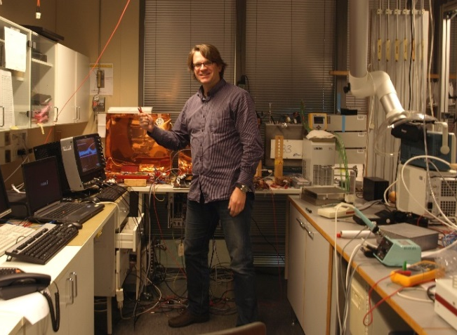
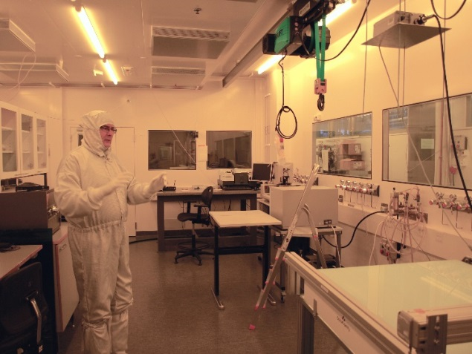
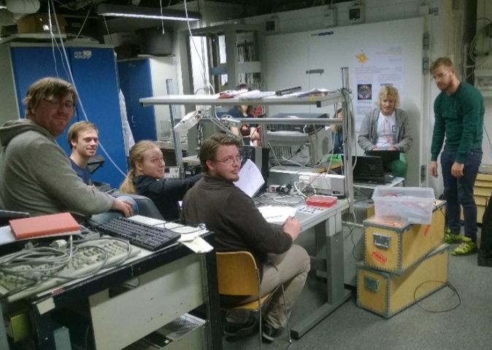
Helsinki Detector Laboratory
Permanent infrastructure with premises, equipment and personnel for detector development, prototyping, assembly and quality assurance;
Common Infrastructure of Helsinki Institute of Physics (HIP) and University of Helsinki / Department of Physics;
Center for instrumentation of Finnish CERN and FAIR activities;
Cooperation with universities, research institutes and companies (e.g. Micronova, JYFL, LUT, CERN);
Education and outreach.
Si
GEM
QA

Slide 4
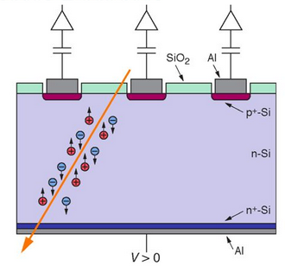
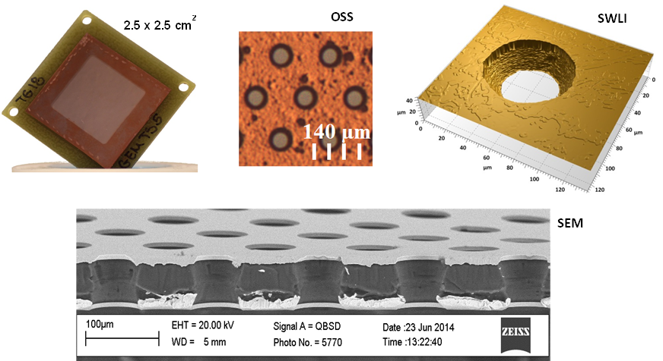
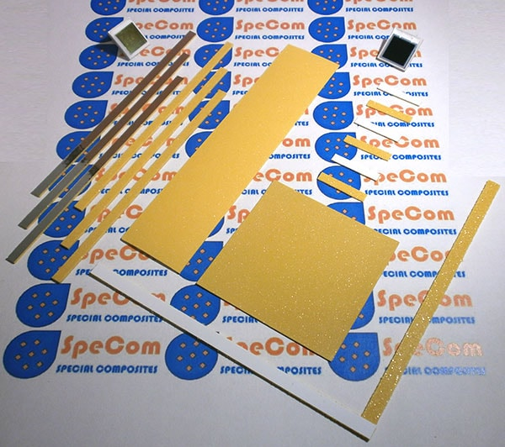
Types of radiation detectors
Semiconductor detectors, eg. Si, Ge, GaAs, CdTe;
Gaseous detectors, eg. propotional counters, Gas Electron Multiplier (GEM) detectors;
Scintillators, e.g. metamaterials (SMM).
© OAW / HEPHY
Si
GEM
QA
© HIP
CERN Idealab 1.11.2017
Eija Tuominen / Helsinki Detector Laboratory
© HIP
© Specom Oy

Slide 5
Applications of radiation detectors
Science
  particle physics (e.g. CERN)
  nuclear physics (e.g. FAIR)
  material physics (e.g. ESRF, XFEL)
  astrophysics (e.g. satellites, ESO, ESA)
  dating, archeology (e.g.C-14)
Health
  medical imaging (e.g. CT, PET, MRI)
  nuclear medicine
Safety, security and safeguards
Industry (e.g. food preservation, imaging)
GEM
CERN Idealab 1.11.2017
Eija Tuominen & co / Helsinki Detector Laboratory

Slide 6
Challenges in science
Increased radiation hardness, due to increased luminosity;
Decreased physical dimensions of detector segmentation, i.e. increased granularity;
Custom-made detector solutions;
Demands for cheaper prizes, longer lifetime, consistent detectors and less maintenance (cost-effectiveness);
Consecutive demands for read-out electronics, data acquisition, interconnection technologies, and quality assurance;
Long project timelines:
  projects and upgrades typically appear in 5-10 year cycles;
  thus, no steady cash flow industrial partners;
  and, gained expertise does not accumulate (brain drain).
CERN Idealab 1.11.2017
Eija Tuominen & co / Helsinki Detector Laboratory

Slide 7
Trends in science / semiconductor detectors
Detector technologies foreseen to improve radiation hardness:
  from n-type detectors to p-type detectors (μ_{e}>μ_{h}, no SCSI);
  availability of p-type Magnetic Czochralski silicon (p-MCz Si);
  p-MCz Si is radiation hard due to high oxygen concentration;
Technologies foreseen provide finer segmentation:
  deep submicron Atomic Layer Deposition (ALD) technology provides very high densities of capacitance and resistance;
  in addition, ALD helps to resolve the accumulation of positive oxide charge in Si-oxide interface in p-type detectors;
Ultra-fast silicon detectors with timing resolution, based on the concept of Low Gain Avalanche Detector (LGAD).
CERN Idealab 1.11.2017
Eija Tuominen & co / Helsinki Detector Laboratory

Slide 8
Trends in science / gaseous detectors
Picosecond Micro Patterned Gas Detectors (MPGDs):
  i.e. hybrid detectors combining micro-pattern gaseous detectors with Cherenkov light detection via a photocathode;
  objective is large surface detectors capable of timing resolution of few tens of picoseconds;
Time Projection Chambers (TPC);
Large area detectors for muon detection;
R&D ongoing to better understand the physics of gaseous detectors and to develop new exotic detectors for rare events (e.g. dark photons).
CERN Idealab 1.11.2017
Eija Tuominen & co / Helsinki Detector Laboratory

Slide 9
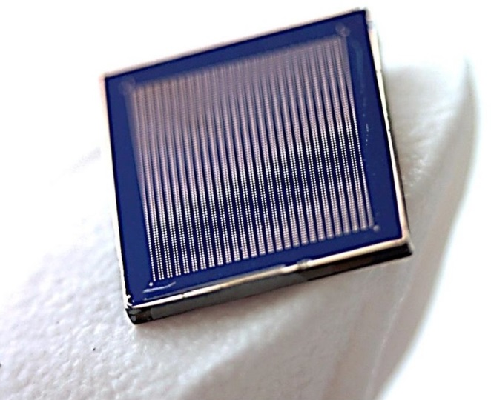
Trends in medical imaging
  Requirement for increased accuracy and decreased radiation dose;
  Direct detection of X-rays (i.e. without scintillator) -> significant improvement in cancer diagnostics and treatment (Spectral/Color imaging);
  Silicon NOT suitable for direct x-ray detection (limited stopping power);
  CdTe still with challenges in crystal growth (commercialization requires significant R&D from scientific community);
  GaAs, especially for the increased need of mammography, still with challenges in semiconductor manufacturing process;
  Commercialization of CdTe and GaAs still requires significant R&D from scientific community.
CERN Idealab 1.11.2017
Eija Tuominen & co / Helsinki Detector Laboratory

Slide 10
Trends in safety, security and safeguards
  2D/3D imaging;
  User-free sensing:
  non-attended operations (safeguards);
  remote sensing (security);
  automated analysis;
  Increased amount of sensing:
  hidden sensors;
  diffused networks;
  Muon imaging:
  penetrating radiation;
  e.g. loaded nuclear fuel casks, cargo containers, train cars.
CERN Idealab 1.11.2017
Eija Tuominen & co / Helsinki Detector Laboratory

Slide 11
Trends in quality assurance (QA)
  Reliable quality assurance (optical and electrical) prior to installation is essential to guarantee reliable performance of detectors, interconnections and electronics;
  Increased detector granularity calls for increased granularity in QA;
Trends in the future:
  traceable nanometrology with novel measurement techniques and standards (ref. EURAMET / MIKES);
  super-resolution technologies with e.g. super-resolution microscopy and image processing (ref. Nobel Prize in Chemistry 2014);
  neural networks to process vast amount of data.
CERN Idealab 1.11.2017
Eija Tuominen & co / Helsinki Detector Laboratory

Slide 12
Summary
Detector technologies developed for particle and nuclear physics are widely applied in:
  medical imaging;
  safety, security and safeguards;
Trends in radiation detectors:
  improved radiation hardness;
  decreased physical dimensions;
  semiconductor materials p-MCz Si, GaAs, CdTe.
Consecutively, decrease in physical dimensions sets demands for:
  read-out electronics & data acquisition;
  interconnection technologies;
  QA (nanometrology, super-resolution, neural networks).
CERN Idealab 1.11.2017
Eija Tuominen & co / Helsinki Detector Laboratory

