Slide 1

New research strongly indicates the elimination of transverse beam impedance
by making beam equipment in the shape of higher order multipoles

Slide 2
Horizontal mirror symmetry gives Z1X=0, Z2B=0 & Z2C=0
The beam impedance is invariant when the drive and test particles are mirrored in the x-axis: Z||[xd, xt, yd, yt] = Z||[-xd, -xt, yd, yt]
2 Z1X (xd+xt) + 2 Z2B (xd yd+xt yt) + 2 Z2C (xd yt +xt yd) =0
[Z||[xd, xt, yd, yt] = Z0 +Z1X(xd+xt) + Z1Y (yd+yt) + Z2A (xd²+xt²-yd²- yt²)
+ Z2B (xd yd+xt yt) + Z2C (xd yt +xt yd) + Z2D xd xt + Z2E yd yt ]

Slide 3
Vertical mirror symmetry gives Z1Y=0, Z2B=0 & Z2C=0
The beam impedance is invariant when the drive and test particles are mirrored in the x-axis: Z||[xd, xt, yd, yt] = Z||[xd, xt, -yd, -yt]
2 Z1Y (yd+yt) + 2 Z2B (xd yd+xt yt) + 2 Z2C (xd yt +xt yd) =0
[Z||[xd, xt, yd, yt] = Z0 +Z1X(xd+xt) + Z1Y (yd+yt) + Z2A (xd²+xt²-yd²- yt²)
+ Z2B (xd yd+xt yt) + Z2C (xd yt +xt yd) + Z2D xd xt + Z2E yd yt ]

Slide 4
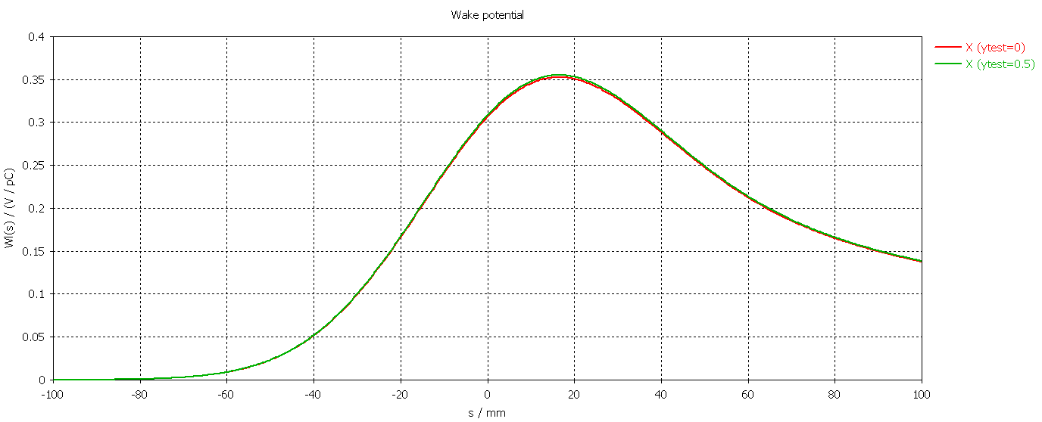
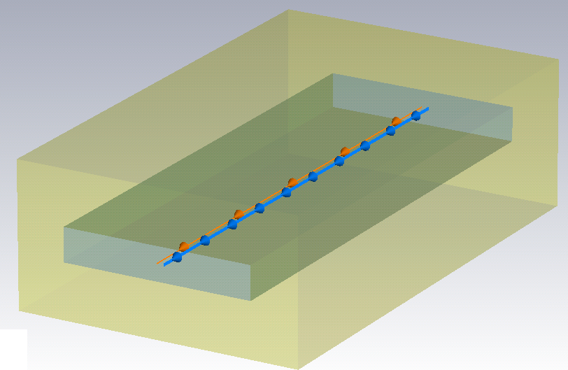

Up/down symmetry leads to Z2B=0
$$X_{⊥}\left(ω\right)=\frac{βc}{ω}∙\left(Z1X+Z2B⋅yt+Z2C⋅yd+Z2D⋅xd+2⋅Z2A⋅xt\right)$$
yt = 0 mm
yt = 0.5 mm
$${W_{x}}_{⊥}\left(s\right)$$

Slide 5
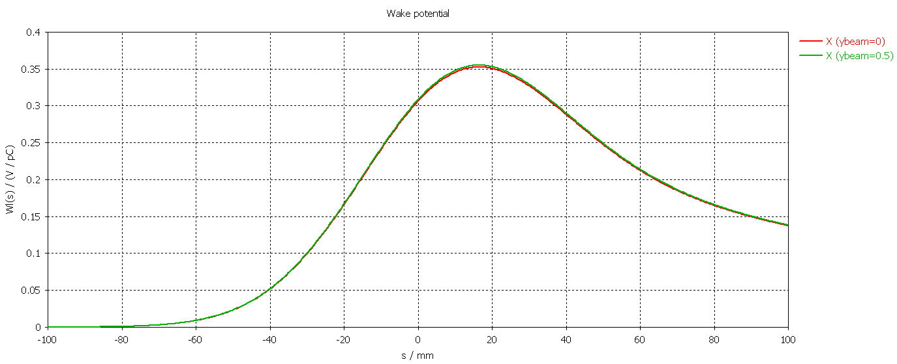
Up/down symmetry leads to Z2C=0
$$X_{⊥}\left(ω\right)=\frac{βc}{ω}∙\left(Z1X+Z2B⋅yt+Z2C⋅yd+Z2D⋅xd+2⋅Z2A⋅xt\right)$$
yd = 0 mm
yd = 0.5 mm
$${W_{x}}_{⊥}\left(s\right)$$

Slide 6
90 deg sym. ⇒ Z1X=Z1Y=0, Z2A=0, Z2B=0, Z2C=0, Z2D=Z2E
For a 90 degree symmetric structure, the beam impedance is invariant when the drive and test particles are rotated by 90 degrees:
Z||[xd, xt, yd, yt] = Z||[xdR, xtR, ydR, ytR]
(-Z1X+Z1Y) (xd+xt)+(-Z1X-Z1Y) (yd+yt) -2 Z2A (xd²+xt²-yd²- yt²)
-2 Z2B (xd yd+xt yt) - 2 Z2C (xd yt +xt yd) +yd yt (Z2D-Z2E)+xd xt (-Z2D+Z2E) =0
[ Z||[xd, xt, yd, yt] = Z0 + Z1X (xd+xt) + Z1Y (yd+yt) + Z2A (xd²+xt²-yd²- yt²)
+ Z2B (xd yd+xt yt) + Z2C (xd yt +xt yd) + Z2D xd xt + Z2E yd yt
xdR = xd *Cos[Θ] - yd*Sin[Θ] xtR = xt*Cos[Θ]- yt *Sin[Θ]
ydR = xd *Sin[Θ] + yd*Cos[Θ] ytR = xt*Sin[Θ]+ yt *Cos[Θ] ]

Slide 7
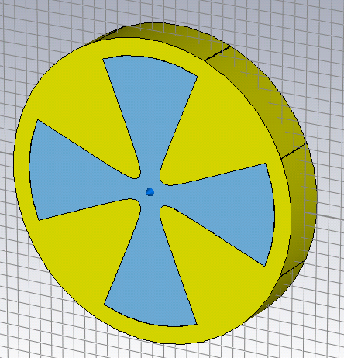
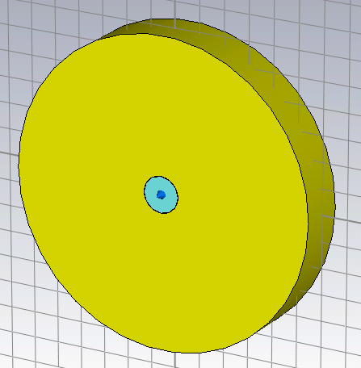
Comparison of a 4-pole and a round structure
In terms of impedance (up to second order), these two structures are identical in that they have only dipolar impedance. Their only difference is the value of the dipolar impedance.
In the 4-pole structure, as the beam moves away from center and goes to the right, it is attracted more and more to the poles. The force on the beam must therefore point to the right. However, when the beam have past the most narrow point between the poles, the force on the beam must be to the left (i.e. attracted to the poles). There must be a point – close to the poles – where the force on the beam is zero and therefore the dipolar impedance is zero at this point. This effect is reflected in the simulation on the next slide.
In general it is easy to see that the forces on the beam will be stronger in the circular structure, leading to a larger dipole impedance. This is reflected in the simulations on the next slide.

Slide 8
Comparison of a 4-pole and a round structure
Wakefield DIPOLAR impedance
NB! The DIPOLAR impedance decreases as the beam gets between the poles
NB! The DIPOLAR impedance increases as the beam gets closer to the wall

Slide 9
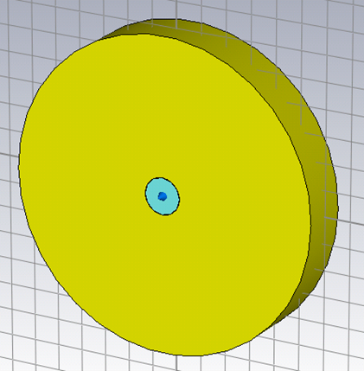
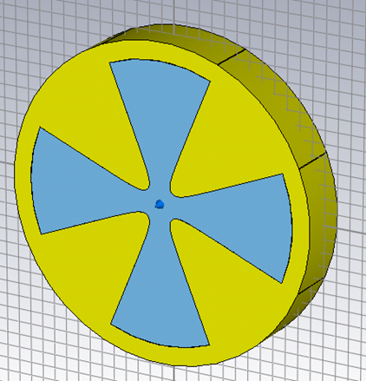
The 4-pole structure have significantly less impedance
Theoretical impedance for circular structure

Slide 10
Concluding remarks
The symmetry analysis show very interesting properties of 90 degree symmetric structures. A counter intuitive property is that these structures have only dipolar impedance
The 4-pole structure has a significantly lower dipolar impedance than the round structure
The calculations still needs more sensitivity tests (dependence on number of meshcells, port versus open boundary, comparison with HFSS, etc. )
Feed-down calculations and even higher multipolar structures still needs to be investigated. Higher multipolar structures might very well have even lower dipolar impedance.

Slide 11
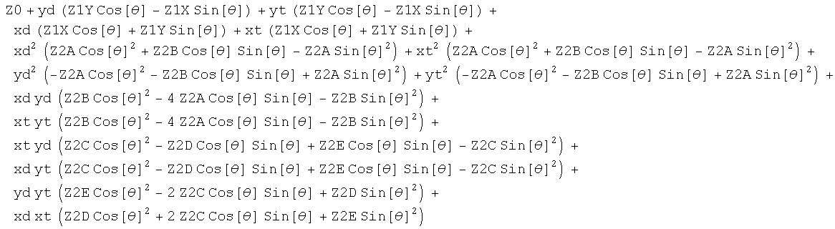
90 deg sym. ⇒ The dipolar impedance is the same in all directions
Z||[xdR, xtR, ydR, ytR]=
[ Z||[xd, xt, yd, yt] = Z0 + Z1X (xd+xt) + Z1Y (yd+yt) + Z2A (xd²+xt²-yd²- yt²)
+ Z2B (xd yd+xt yt) + Z2C (xd yt +xt yd) + Z2D xd xt + Z2E yd yt
xdR = xd *Cos[Θ] - yd*Sin[Θ] xtR = xt*Cos[Θ]- yt *Sin[Θ]
ydR = xd *Sin[Θ] + yd*Cos[Θ] ytR = xt*Sin[Θ]+ yt *Cos[Θ] ]
The dipolar impedance is constant in all directions
(NB! For 90 symmetry: Z2C=0 & Z2D=Z2E)

Slide 12
90 deg. Symmetry => dipolar imp independent of direction
Under investigation, looks too perfect!

