Slide 1
11T Trim Power Converter Connection to Leads
Samer Yammine
TE-EPC Technical Discussion – 2017-11-01

Slide 2
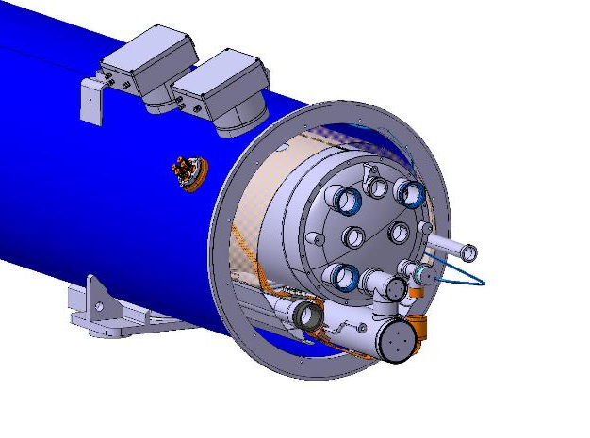
Background
A demand from WP6a to connect the 11T trim PC to 2 leads/polarity
Rationale: To use the LHC conduction cooled 120 A leads
Flange
LHC Conduction Cooled Leads
Current Lead Integration
11T Trim Current Profile for 7 TeV Operation

Slide 3
Requirements
Ensure Protection of leads (voltage threshold): 4 vs 2 in LHC
Ensure current equilibrium in operation
Ensure that the current does not surpass 125 A per lead
If not, discharge the trim circuit under 10s
Flange
LHC Conduction Cooled Leads
Current Lead Integration
11T Trim Current Profile for 7 TeV Operation

Slide 4
Solution Proposal
2x70mm² DC cables per polarity for current equilibrium during operation.
New radiation-tolerant card + 4 current sensors (1 per DC cable) to generate a slow power abort signal to the PC in case of ΔI > 5A or I > 125A.
Extension of already existing card that monitors the CLs voltage from 2 inputs to 4.

Slide 5
Slow Power Abort
The 11T power converter is in parallel to a cold diode
dI/dt < 5V/0.132H – 20 % margin < 30 A/s
SPA of 11T: ramp from - 250 A to 0 A with 30 A/s → 8.33 s

Slide 6
Thanks for your attention

