Slide 1


FCC RF Coordination Meeting
#16
November 22, 2017

Slide 2
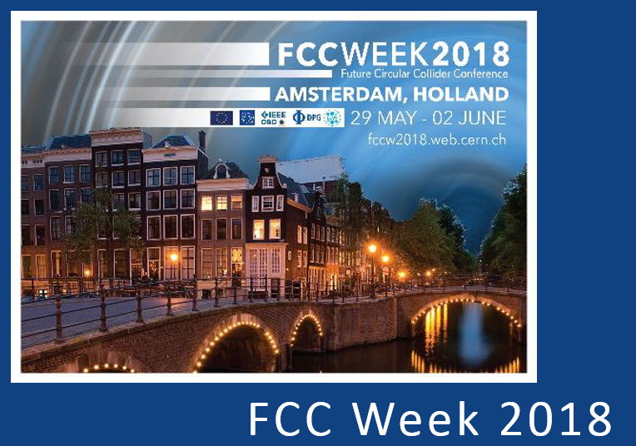
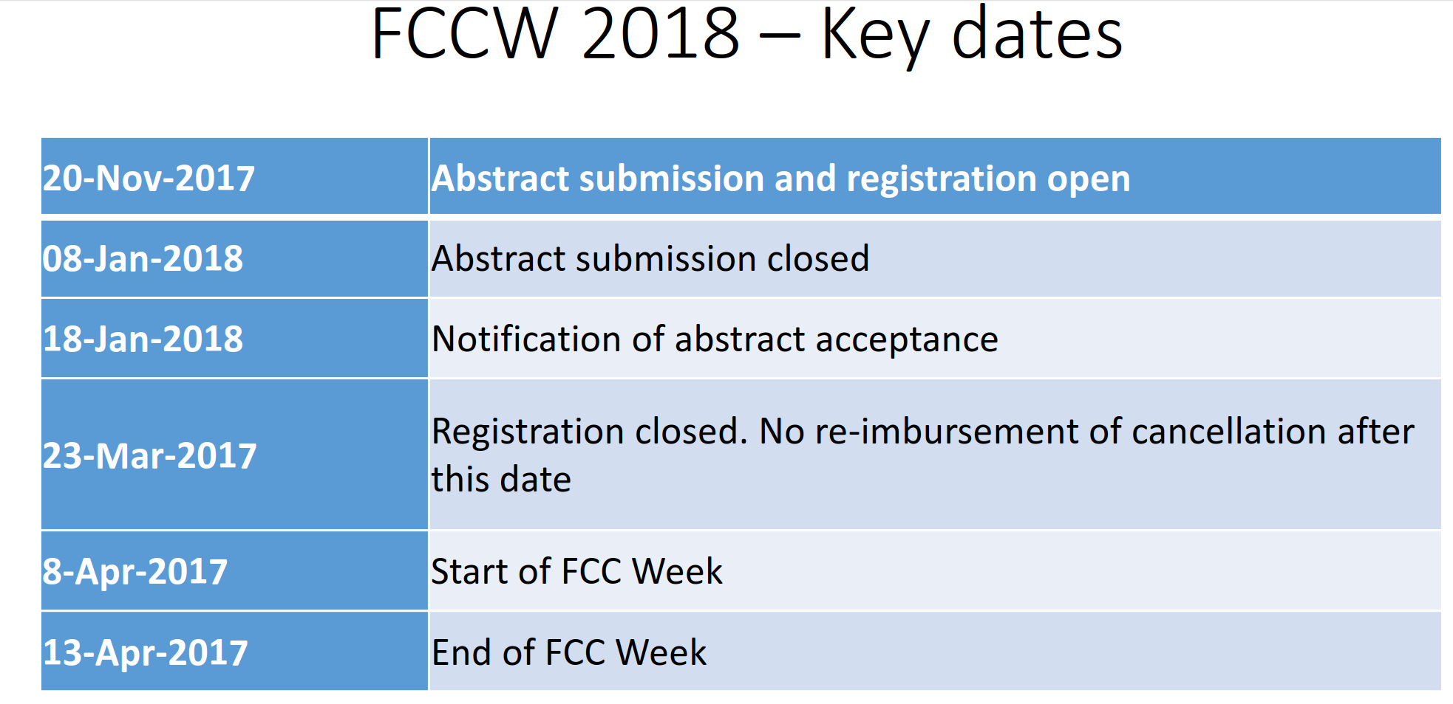

Slide 3
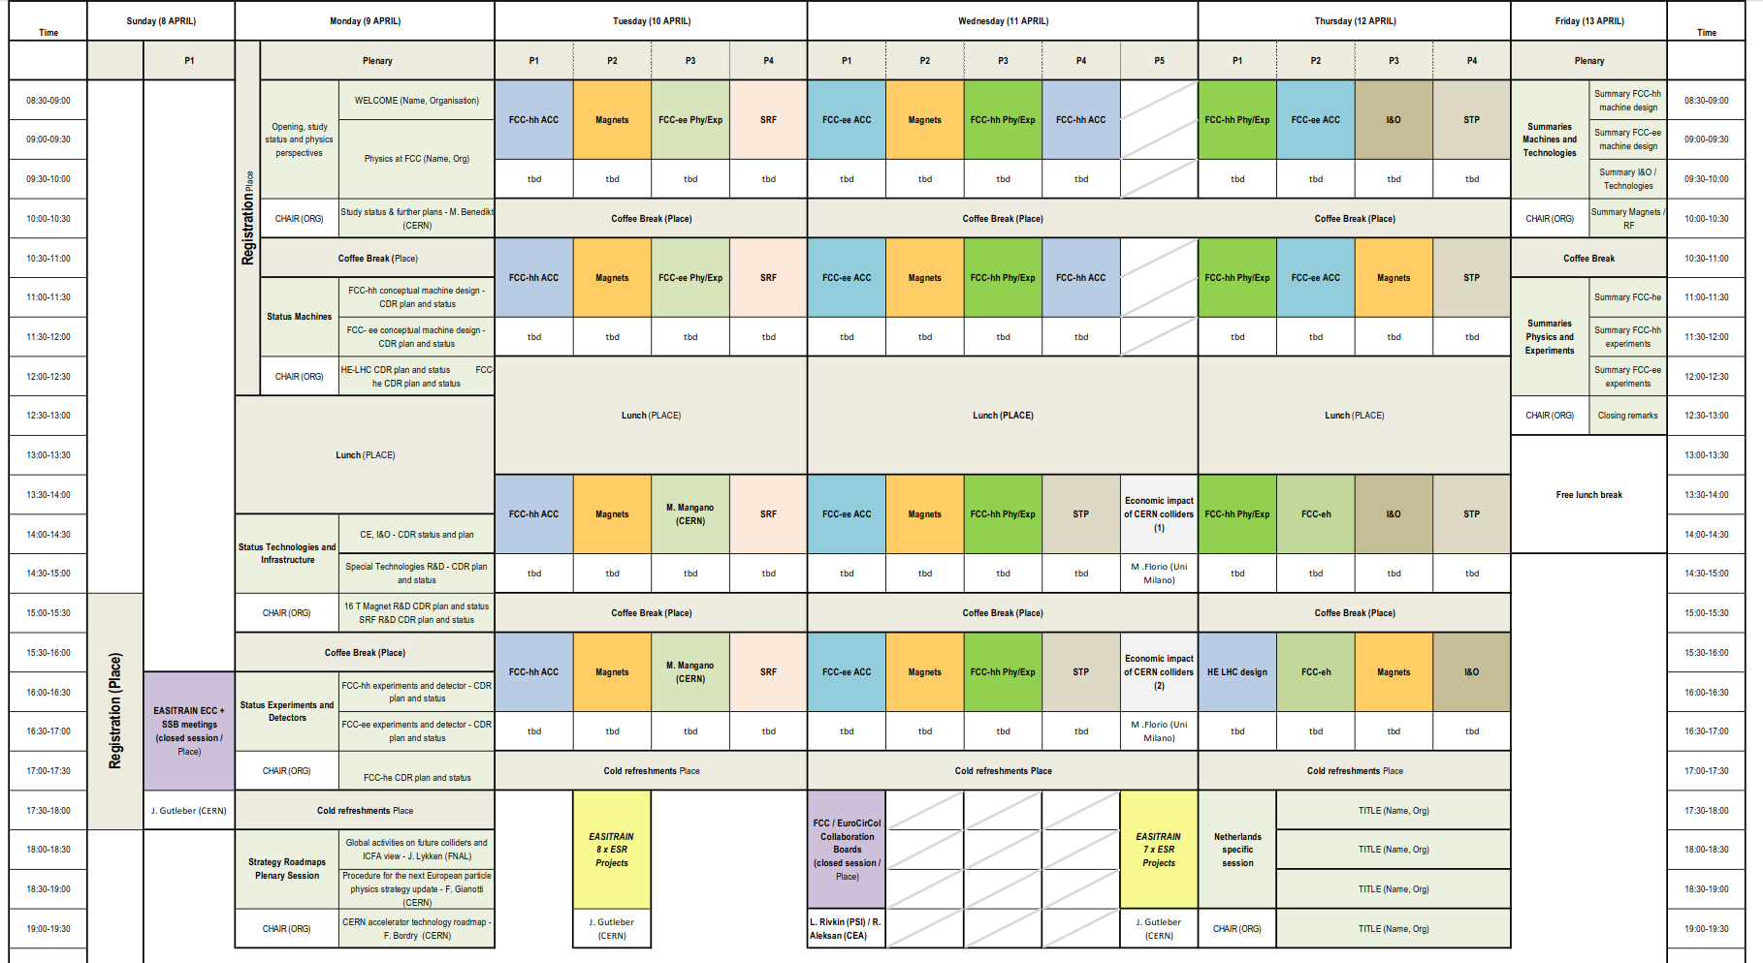

Slide 4
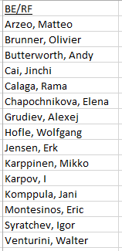
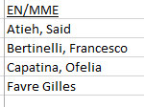
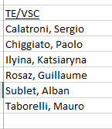
Participant list - preliminary
Draft agenda:
3 sessions enough? (eventually transfer on session to STP)
Status talks:
1 talk LNL (Enzo?)
1-2 talks FNAL (collaboration on N-doping / CM design?)
1-2 talks JLab
1-2 talk Rostock Univ (Shahnam + evt. HOM simulation tool? )
1 talk Frankfurt Univ (if something done!)
1 talk per FCC fellow (Marco, Carolina, Ivan, Jani)
1 talk high efficiency klystron (Jinchi)
1 talk FPC
Future program (i.e. for 2020 -> 2014):
1 talk per hot subject (Beam dynamics, LLRF, coating studies, etc)
D. Valuch
Carolina
Romain (STP)
Alexander?
Please send comment/request/ideas!

Slide 5
FCC study 2020 - 2023
Please send comment/request/ideas!

Slide 6
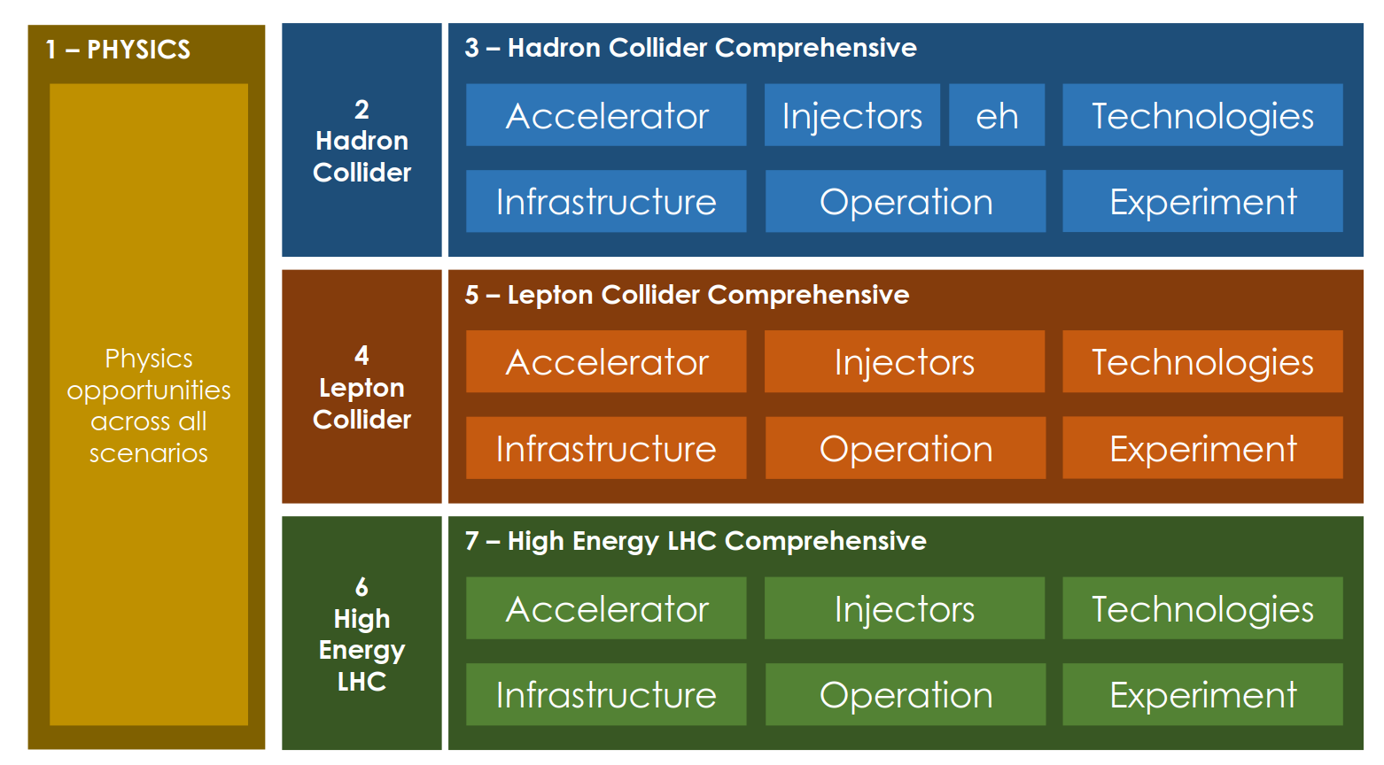
CDR preparation

Slide 7
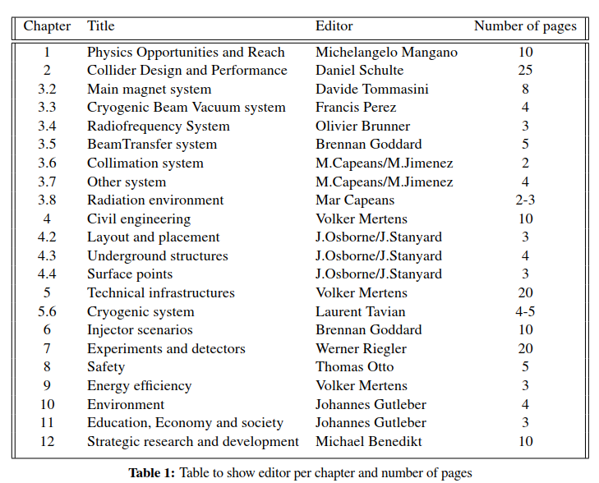
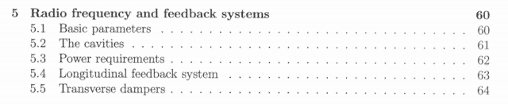
CDR FCC_hh
LHC CDR
1. Define table of content
2. Need input and contribution from Andy, Elena, Wolfgang, Philippe

Slide 8
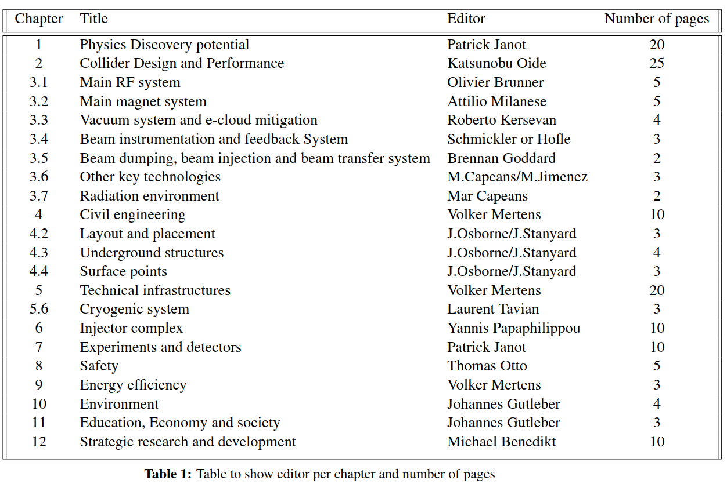
CDR FCC_ee
Define table of content
- Introduction
- Operation model
- RF configuration
- Cavity material options (Walter)
- Beam cavity interaction/ beam dynamic issues (Andy, Ivan, Elena)
- Other R&D challenges (?)
- Installation and staging plan
??

