Slide 1

Overview of the
European Spallation Source (ESS)
Roger Ruber
FREIA Laboratory
Dept. of Physics and Astronomy
Uppsala University
30 October 2018

Slide 2
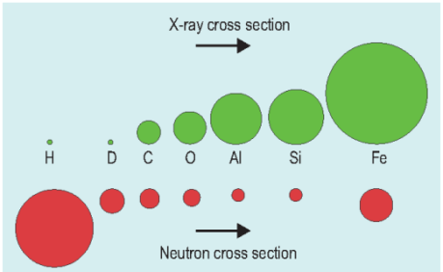
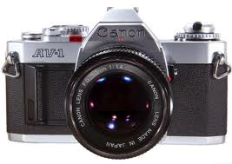
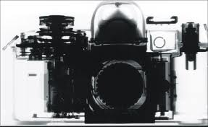
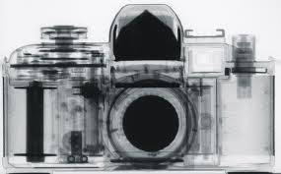
Why to use neutrons?
Neutral charge
  deeply penetrating except for some isotopes
Nuclear interaction:
  cross section depending on isotope (not Z),
  sensitive to light elements.
Spin S = 1/2
  probing magnetism
  unstable n → p + e + νe with
  life time τ ~ 900s , I = I0 e^{- t/τ}
Thermal energies result in non-relativistic velocities
  mass: n ~p; E = 293 K = 25 meV, v = 2196 m/s , λ = 1.8 Å
Light
X-rays
Neutrons
Light
X-rays
Neutrons

Slide 3
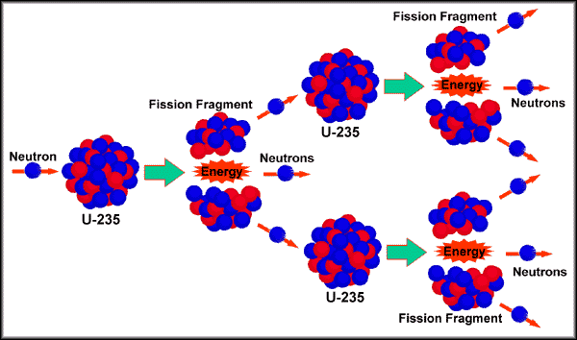
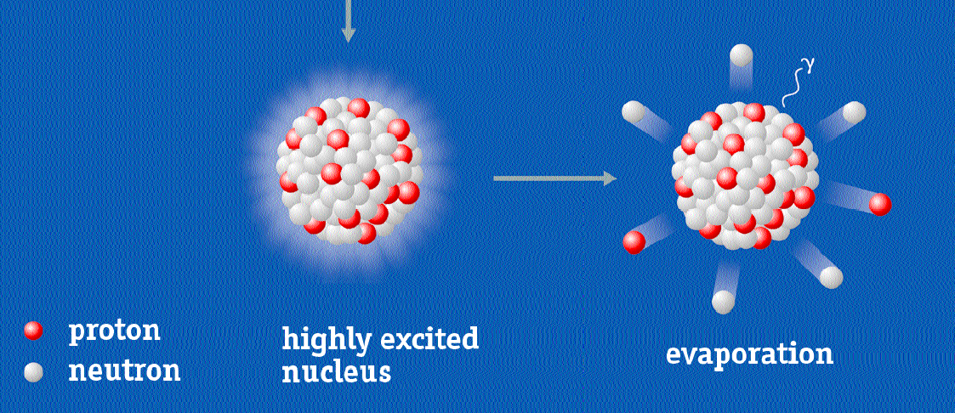


How to produce neutrons
Nuclear Spallation
→ accelerator
Nuclear Fission
→ reactor

Slide 4
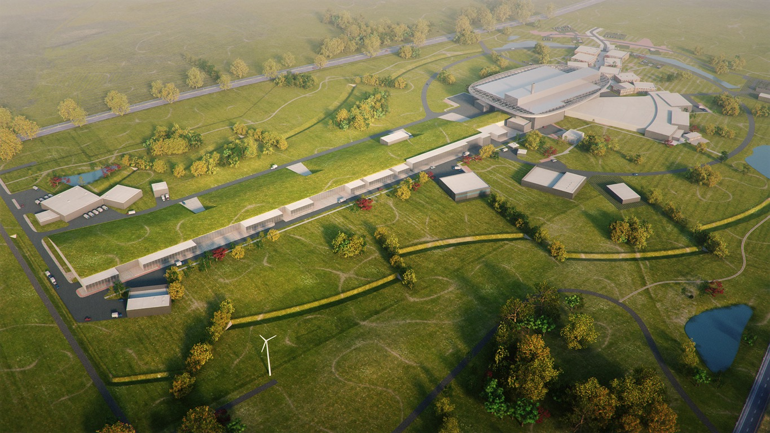
ESS Basic Design Principles
High Power Accelerator
Ultimate energy: 2 GeV
Repetition rate: 14 Hz
Pulse length: 2.89 ms
Peak power: 125 MW
Target Station
Ultimate power: 5 MW
He-gas cooled
Rotating W-target
42 Beam ports
Instruments
15-22 Instruments in construction budget
(depending on scenario)
Ion Source
Protons
Current: 62.5 mA

Slide 5
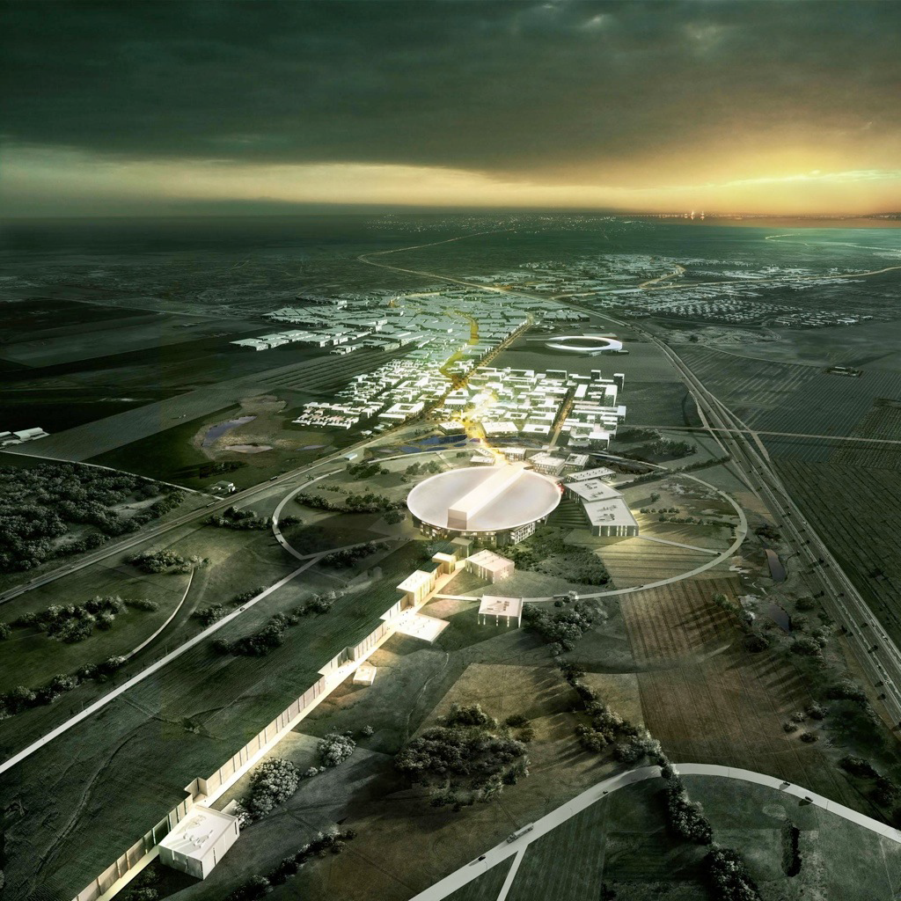
European Spallation Source (ESS)
2025
Construction complete
2023
Start of user program
2020
First beam on target
First neutrons
2014
Construction starts
2012
Design update completed
2009
Decision that ESS will be build in Lund
30 years !
2003
First European design effort completed
1993
Proposal for a European spallation source

Slide 6
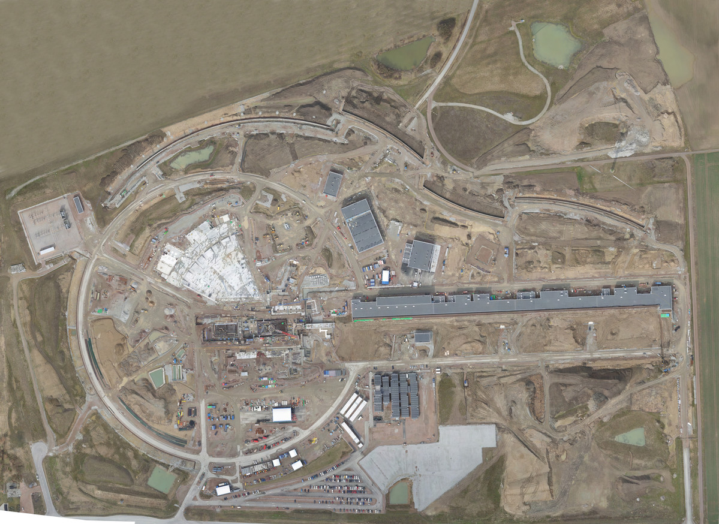
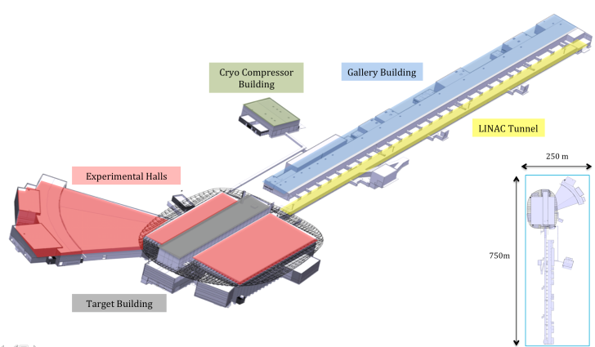
Distribution
Substation
Primary
Substation
Central Utility
Building
April 2017
Exp. Hall
E01
Cryo Compressor
Building
Klystron Gallery
Front End
Building
Active
Cells
Target
Monolith
High Energy
Loading Bay

Slide 7
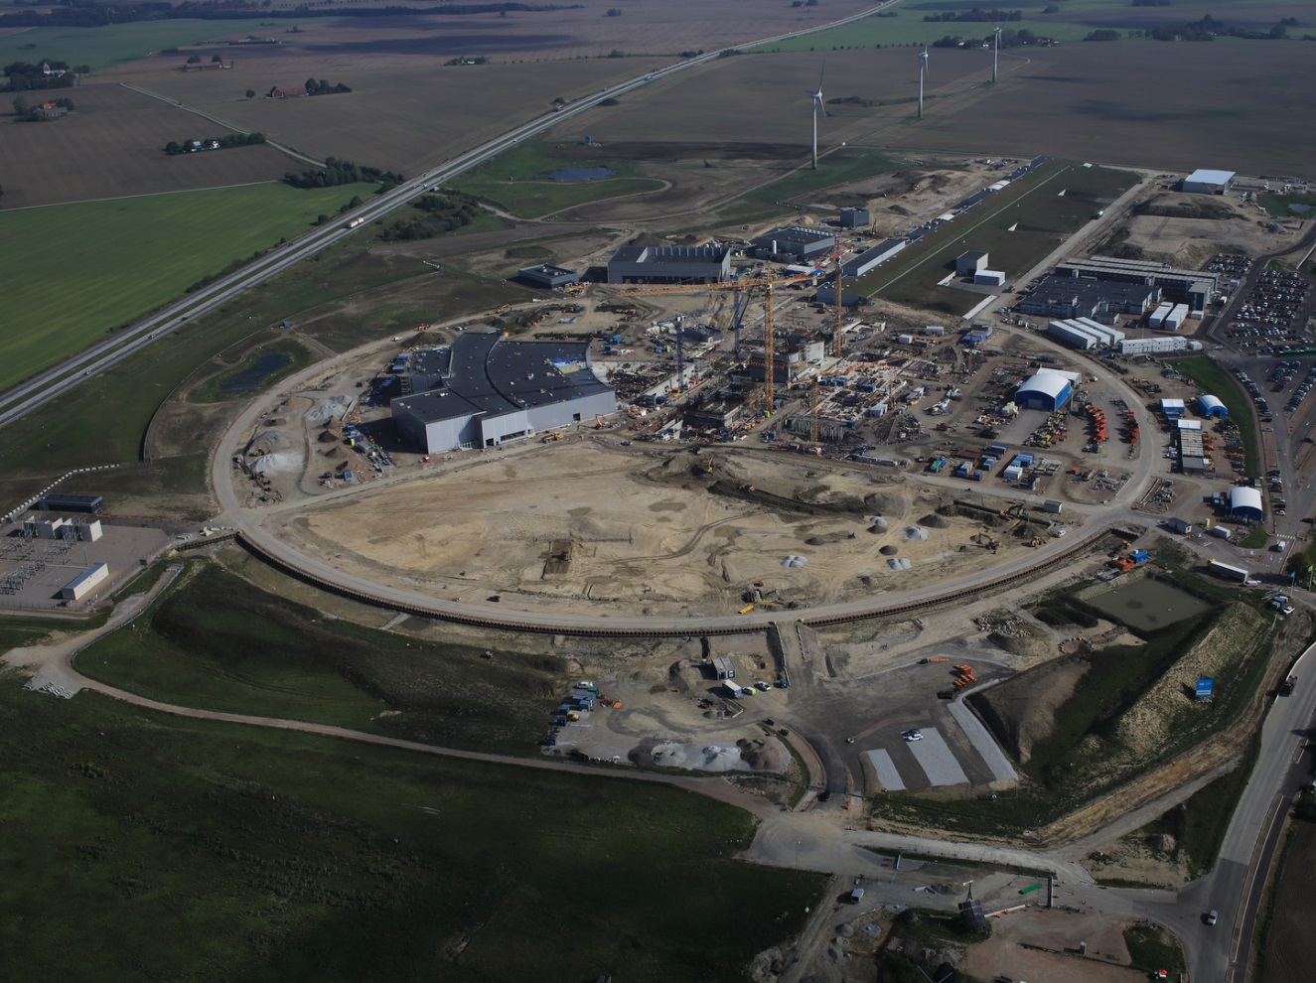
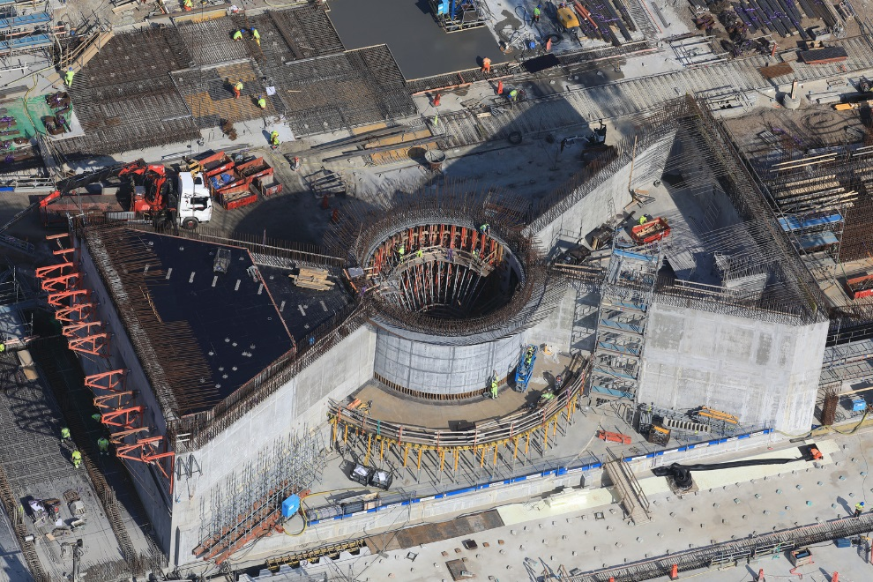
September 2018

Slide 8

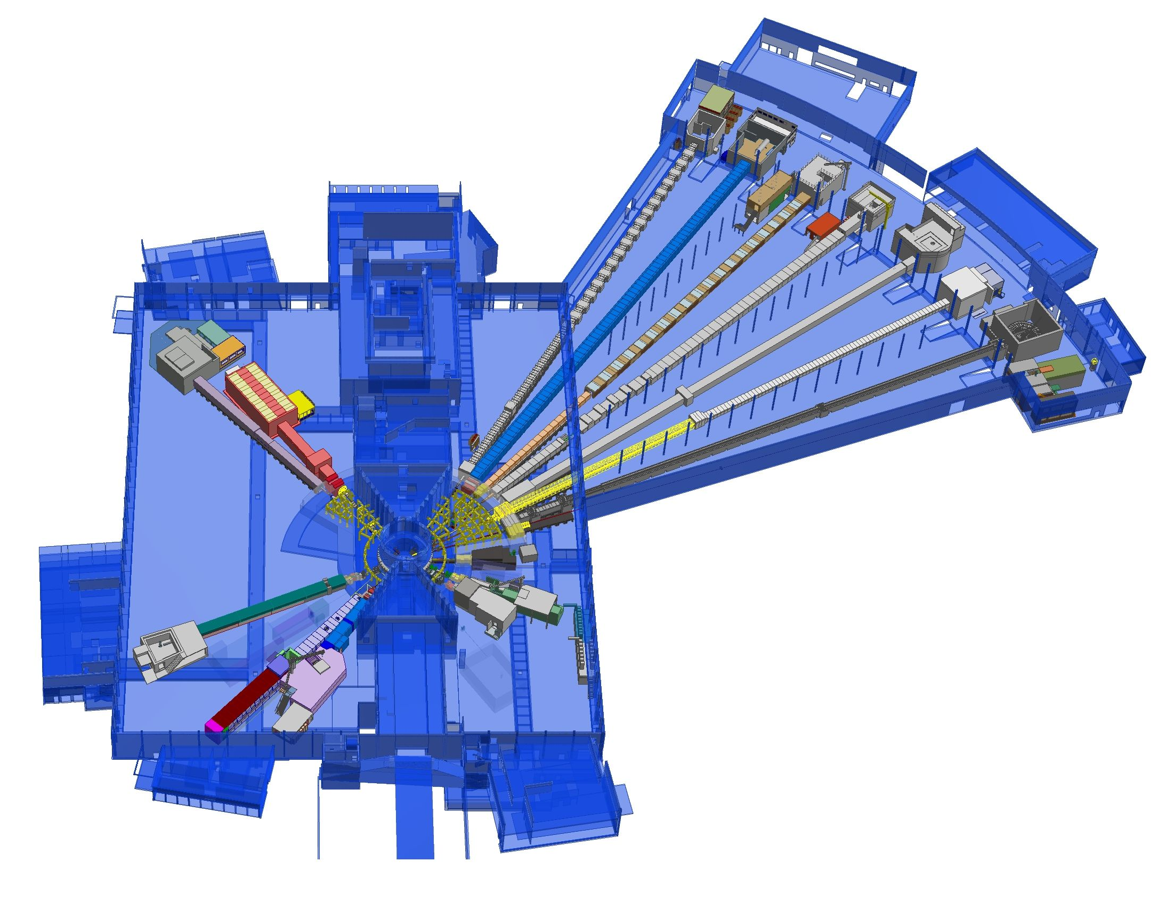











First 15 Neutron Science Instruments
Neutron beam extraction
Offers 42 neutron beam ports
Allows instruments to view either
upper or lower moderator position
+
Nuclear Physics Institute
NMX
+
BEER
Monolith
C-SPEC
BIFROST
MIRACLES
MAGIC
ODIN
T-REX
DREAM
HEIMDAL
Test Beam Line
VESPA
LOKI
FREIA
SKADI
ESTIA
ESS In-Kind Partners also collaborate on sample environment, data management systems etc.
+
ESS Instrument Layout (September 2017)

Slide 9
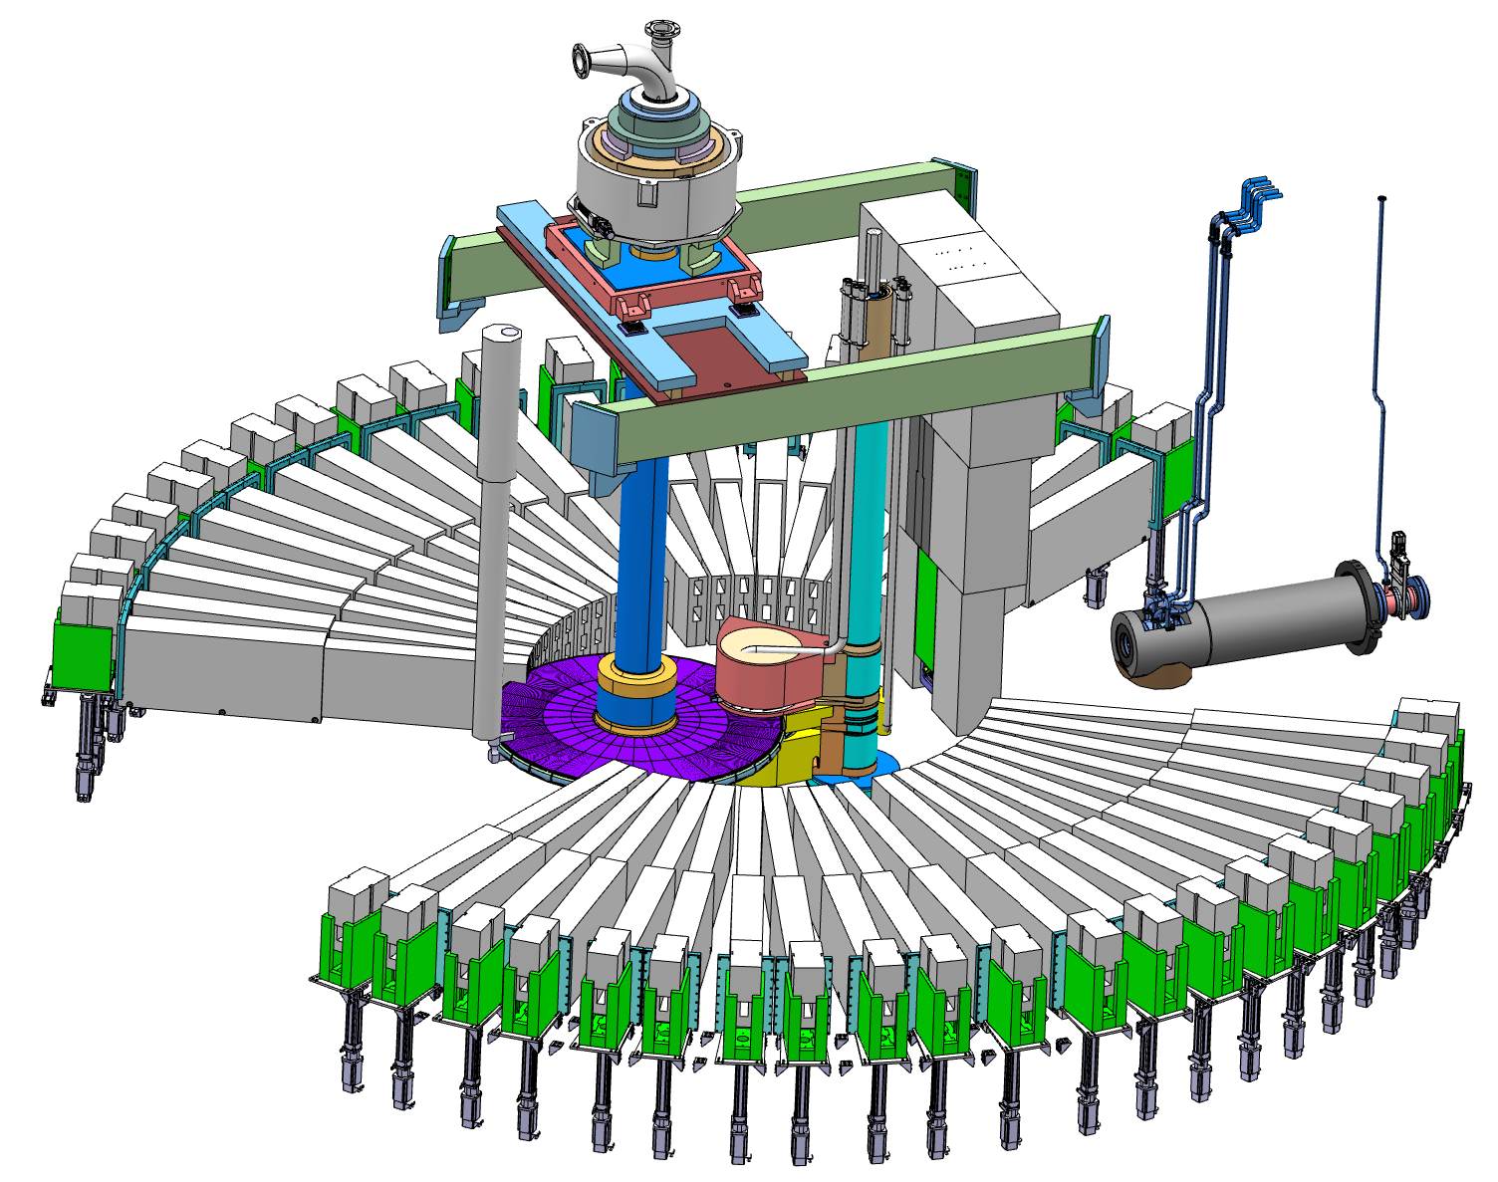
The ESS Target
Moderator and reflector plugs
Proton beam window
Target wheel

Slide 10
The ESS Accelerator
Key parameters:
2.86 ms pulses
    2 GeV
    62.5 mA peak
    14 Hz
    Protons (H+)
    Low losses
    Minimize energy use
    Flexible design for mitigation and future upgrades
Design Drivers:
High Average Beam Power
  5 MW
High Peak Beam Power
  125 MW
High Availability
352.21 MHz
704.42 MHz
2.4 m
4.6 m
3.8 m
39 m
56 m
77 m
179 m
Target
Source
LEBT
RFQ
MEBT
DTL
Spokes
Medium β
High β
HEBT & Contingency
75 keV
3.6 MeV
90 MeV
216 MeV
571 MeV
2000 MeV
First beam at 571 MeV in June 2019
5 MW capacity for 2023
RF sources for HB part is the scope contingency for accelerator

Slide 11
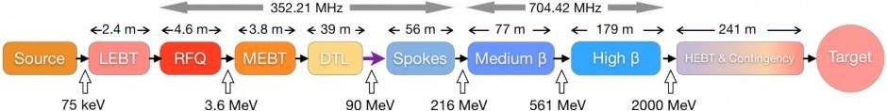
The ESS Accelerator
 | Length [m] | No. Cavities | β | No. Magnets | No. Steerers | No. Sections | Power [kW]
LEBT | 2.38 |  |  | 2 Solenoid | 2 x 2 | 1
RFQ | 4.6 | 1 |  |  |  | 1 | 1600
MEBT | 3.83 | 3 |  | 11 Quad | 10 x 2 | 1 | 15
DTL | 38.9 | 5 |  | PM-Quads | 15 x 2 | 5 | 2200
LEBT + Spoke | 55.9 | 26 | 0.50 | 26 Quad | 26 | 13 | 330
Medium Beta | 76.7 | 36 | 0.67 | 18 Quad | 18 | 9 | 870
High Beta | 178.9 | 84 | 0.86 | 42 Quad | 42 | 21 | 1100
HEBT | 130.4 |  | (0.86) | 32 Quad | 32 | 15
DogLeg | 66.2 |  |  | 12 Quad + 2D | 14
A2T | 46.4 |  |  | 6 Quad + 8 Raster
 | 604.21 | 155

Slide 12

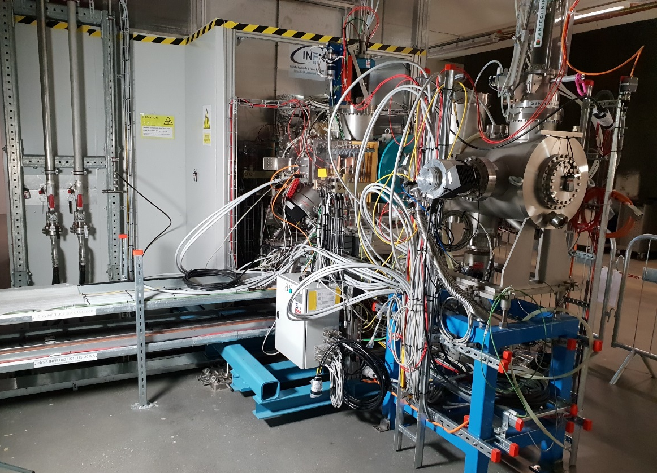
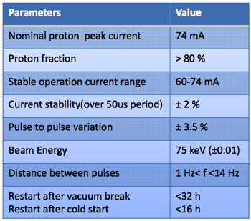
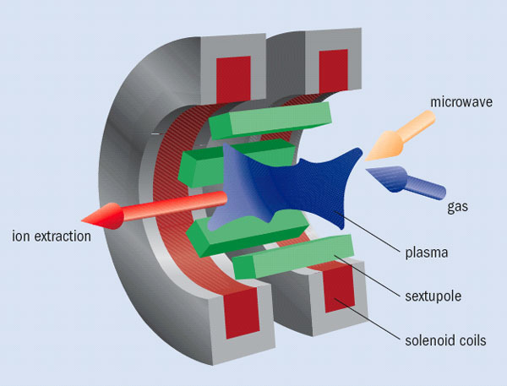
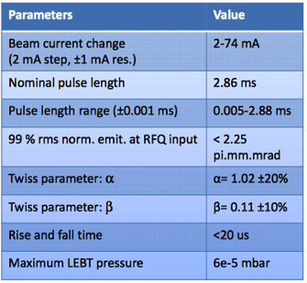
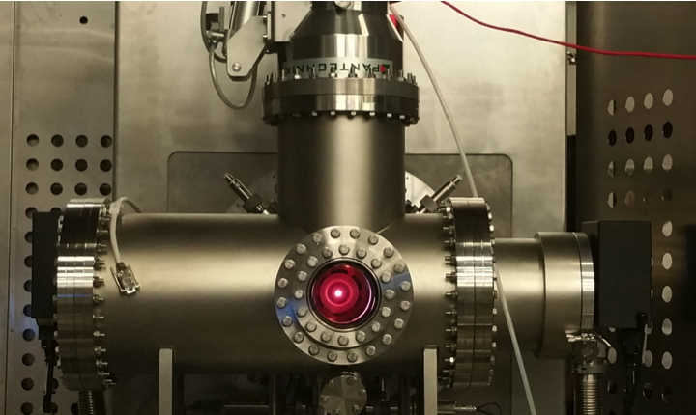
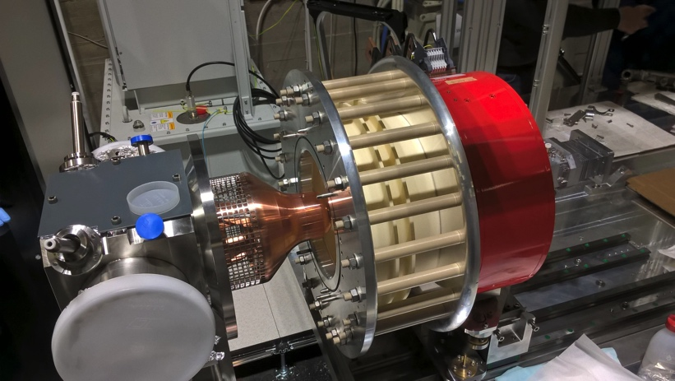
Ion Source & Low Energy Beam Transport
Beam commissioning ongoing.
First Plasma from the ESS Ion Source
M. Lindroos, TAC 14, Oct. 2016
CERN Courier, May 2006
ESS Ion Source
M. Lindroos, TAC 14, Oct. 2016

Slide 13
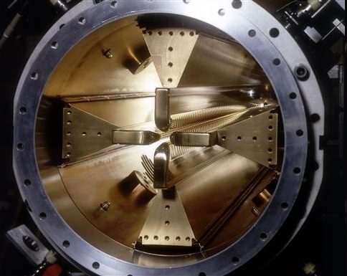
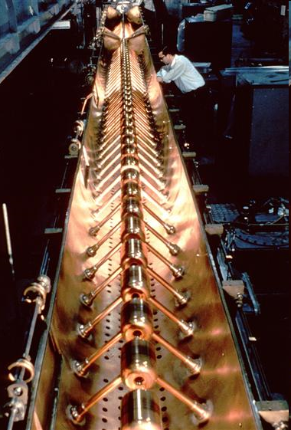
Normal Conducting Linac
RF Quadrupole (RFQ)
  electric quadrupole mode with high field quality
  RF electric field concentrated near the vane tips,
  hence strong transverse focusing
  acceleration through longitudinal modulation pattern,
  hence effective array of accelerating cells
Drift Tube Linac (DTL)
  drift tube shields particle while field direction is reversed
  drift tube length adapted to particle velocity
  permanent magnet included for focusing
© CERN CDS 8303511
© CERN CDS 6808042

Slide 14
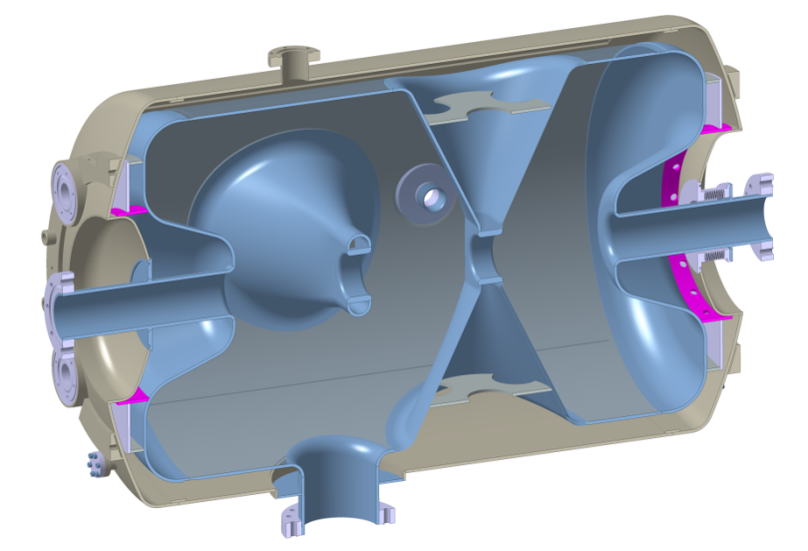
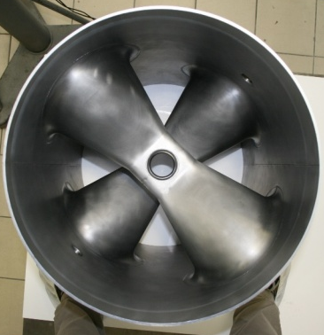
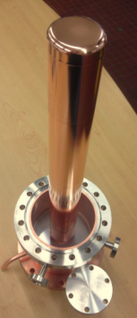
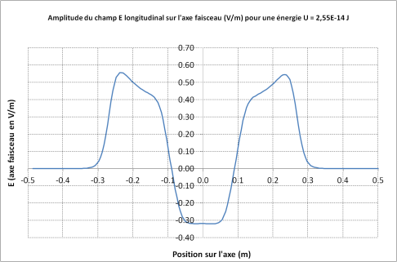
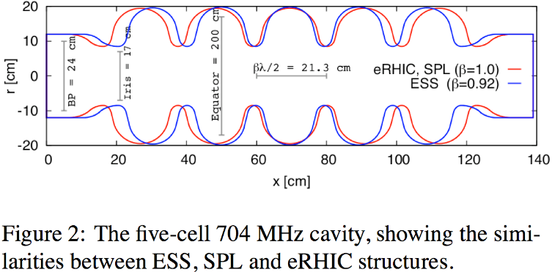
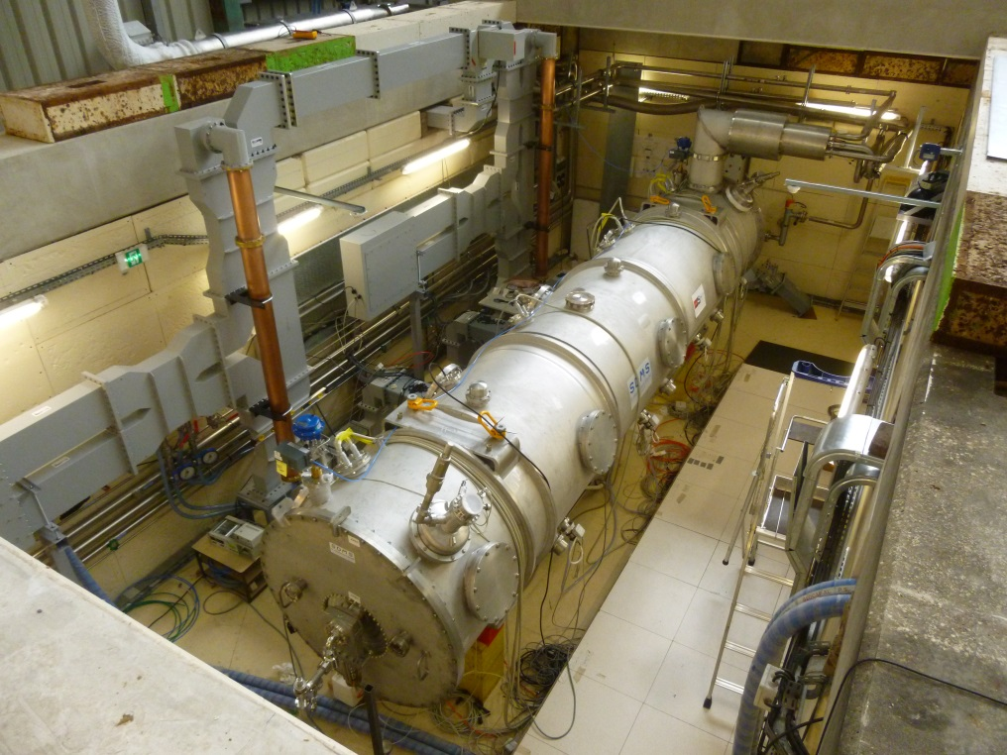
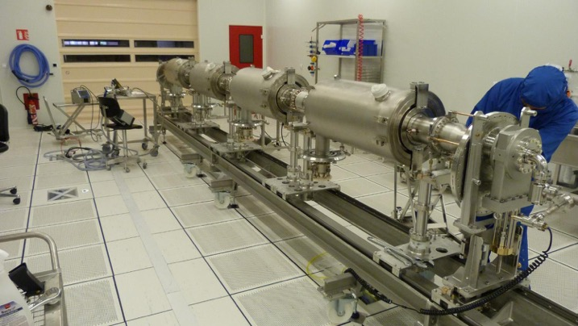
Superconducting Linac
Double spoke resonators
  β = 0.50 (3 gaps)
  E_{acc} = 9 MV/m
Elliptical resonators
  β = 0.67 (6 cells) / 0.86 (5 cells)
  E_{acc} = 16.7 / 19.9 MV/m
Prototype cryomodule with 4 medium β 6 cell elliptical sc cavities in CEA (Saclay) test place
March 2017

Slide 15

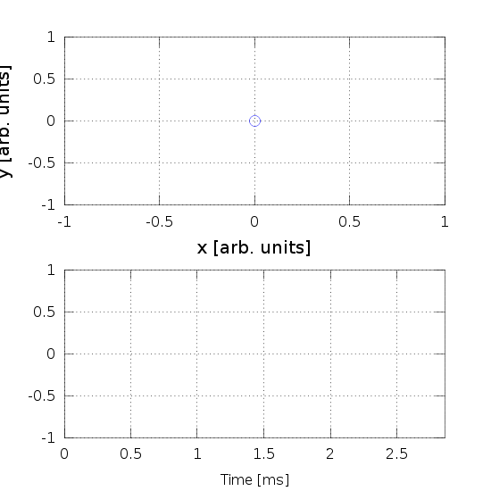
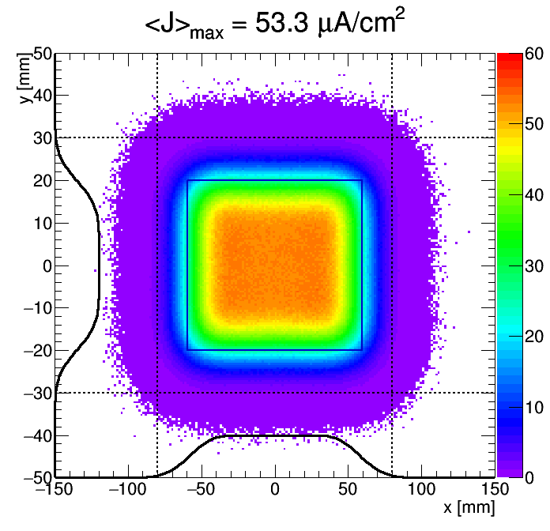
Beam Raster Scanning on Target
Raster system sweeping beam in 2D pattern @ target
8 colinear magnets, individually powered
Crosshatch pattern (f_{x}/f_{y}, ϕ_{xy}, a_{x}, a_{y}) within 2.86 ms pulse
5:4 pattern

Slide 16
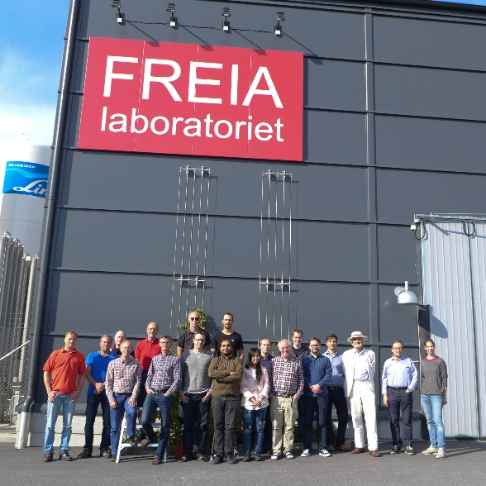
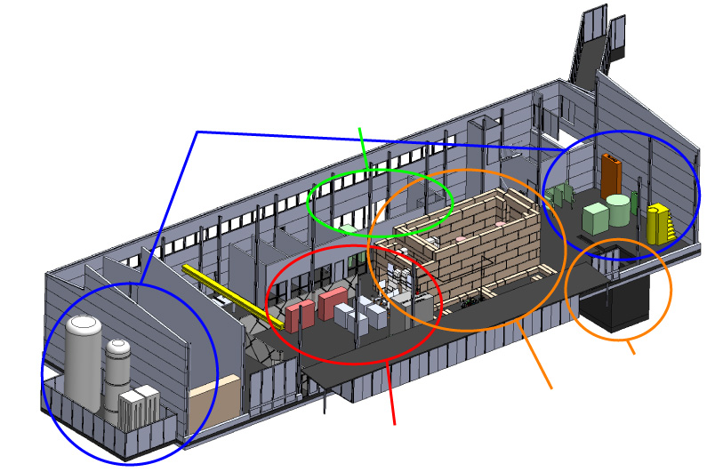
FREIA Laboratory: Test Facility in Uppsala
Facility for Research Instrumentation and Accelerator Development
State-of-the-art Equipment
cryogenics
- liquid helium
- liquid nitrogen
control room
- equipment controls
- data acquisition
Competent and motivated staff
collaboration of physics (IFA)
and engineering (Teknikum).
Funded by
KAWS, Government, Uppsala Univ.
vertical cryostat
3 bunkers
with test stands
horizontal cryostat
radio-frequency (RF) power sources

Slide 17
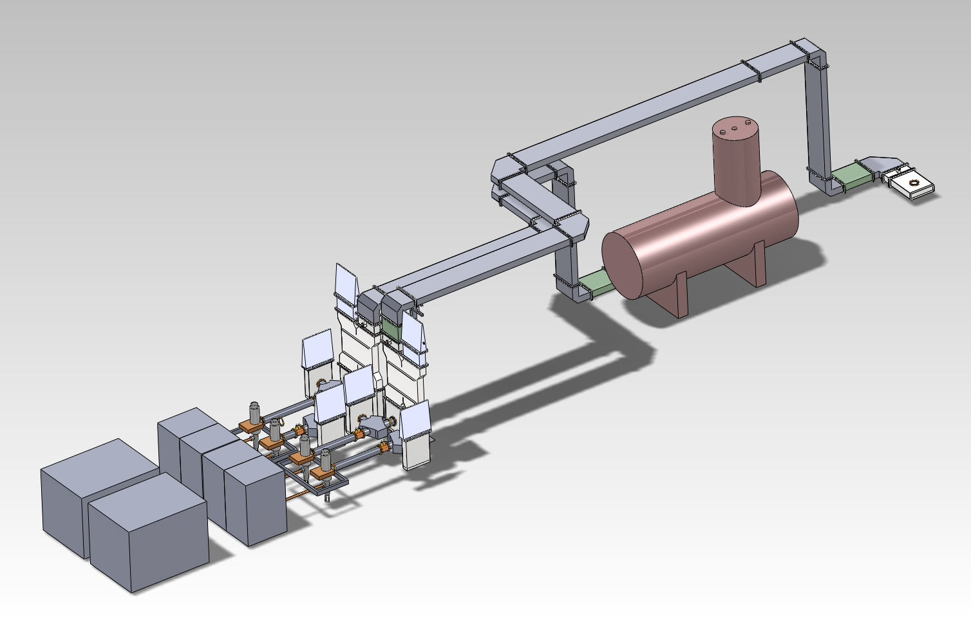
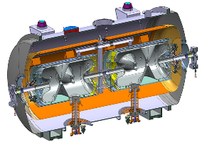
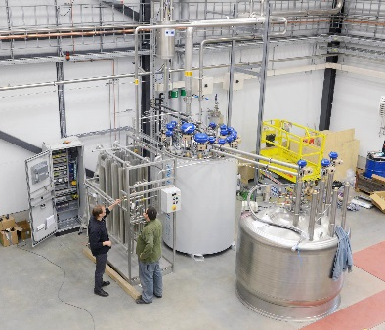
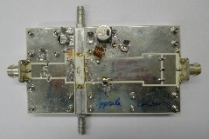
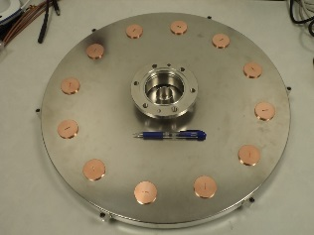
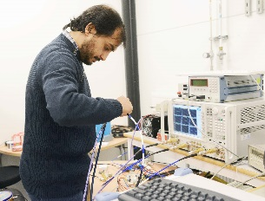
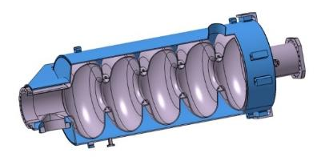
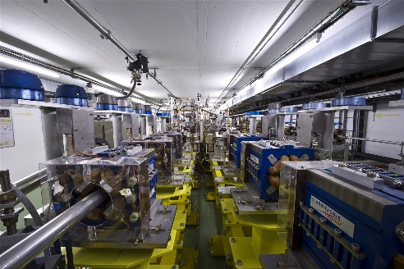
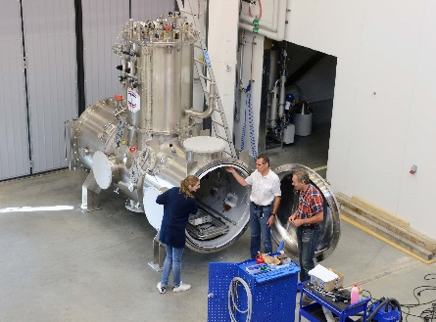
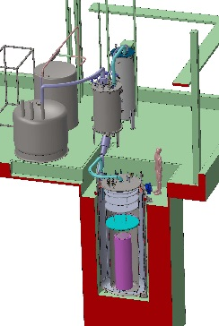
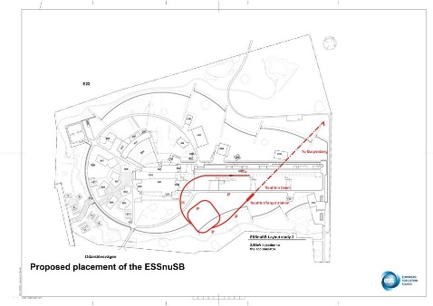
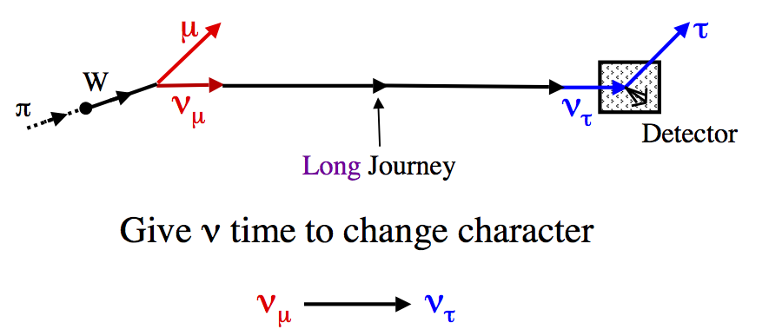
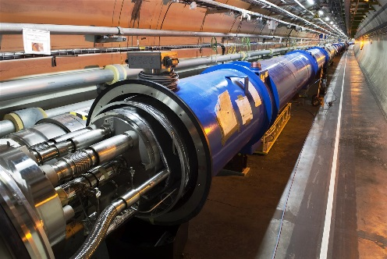
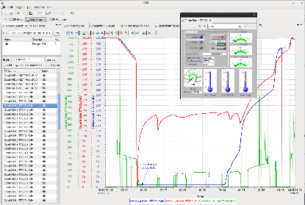
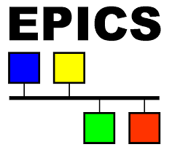
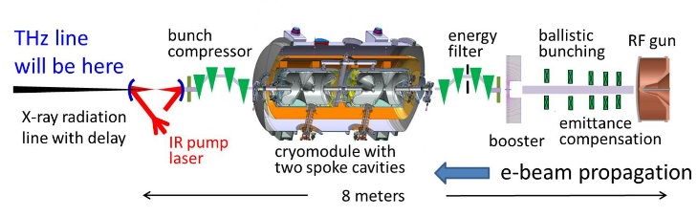

FREIA Laboratory Overview of Activities
ESS SRF Linac
Cryo Distribution
High Power RF
CLIC / CTF3
Cryo Test Stands
ESS Neutrino Super-beam
HiLumi LHC
Controls & Data Acquisition
THz Coherent Light Source
RF = Radio Frequency
SRF = Superconducting RF

Slide 18
Summary and Info

Slide 19
Acknowledgements
With material from many colleagues
Pierre Bosland, Sebastien Bousson, Erk Jensen, Roland Garoby,
Mats Lindroos, Frank Peauger, Guillaume Olry and Volker Ziemann
For details, see
  https://indico.esss.lu.se/event/528
  https://indico.esss.lu.se/event/987
Some illustrations and photos courtesy
Aarhus University, CERN, CEA, ESS, IPNO and KEK

