Slide 1
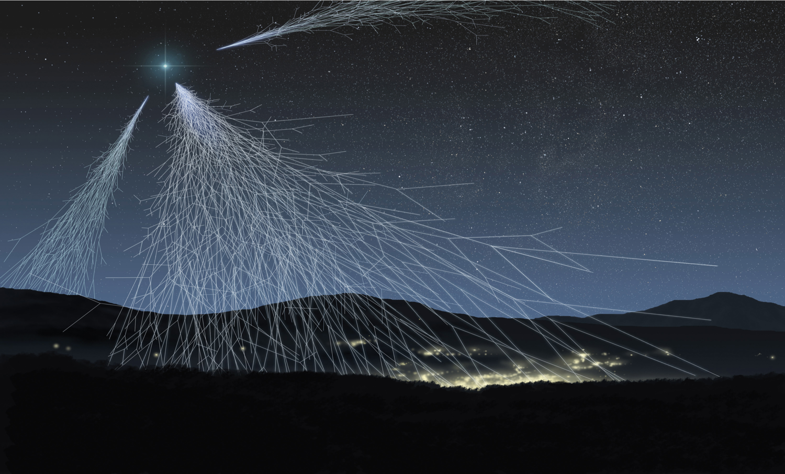

The Extreme Energy Events project
Science in the Schools
Despina Hatzifotiadou
INFN Bologna, and EP Department – CERN
Swedish Teachers Programme – CERN – 30.10.2018

Slide 2



The EEE project is
A scientific experiment for research in cosmic ray physics
An educational / outreach project
with the aim to stimulate the interest of high-school students in science through their involvement in all stages of the project (detector construction, installation, comissioning, data-taking, analysis)
A strategic project of
Centro Fermi – Roma Museo Storico della Fisica e Centro Studi e Ricerche "Enrico Fermi”
In collaboration with
INFN Istituto Nazionale di Fisica Nucleare
MIUR Ministero dell’ Istruzione, dell’ Università e della Ricerca
CERN European Organization for Nuclear Research

Slide 3
The project

Slide 4
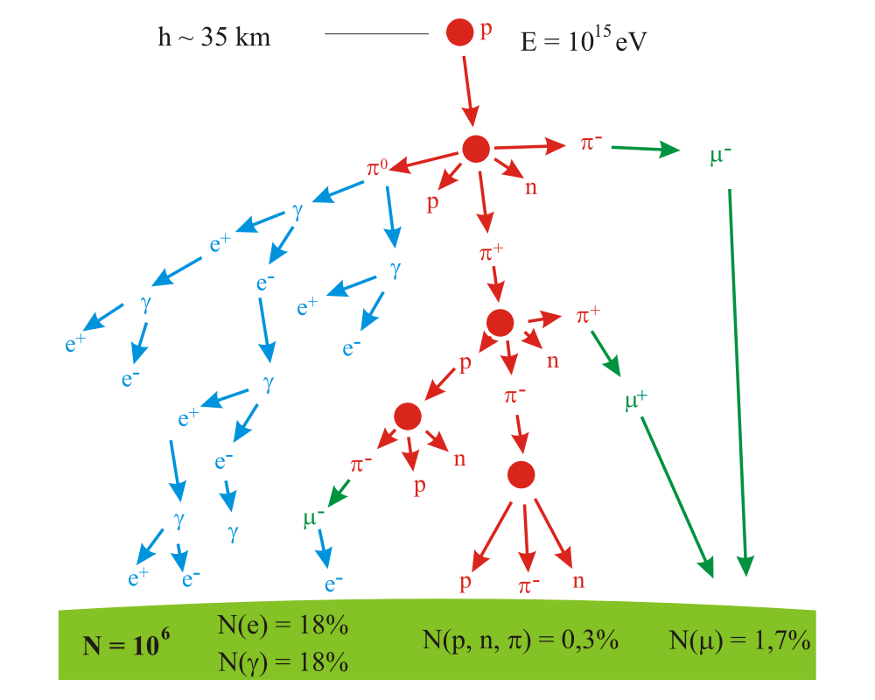
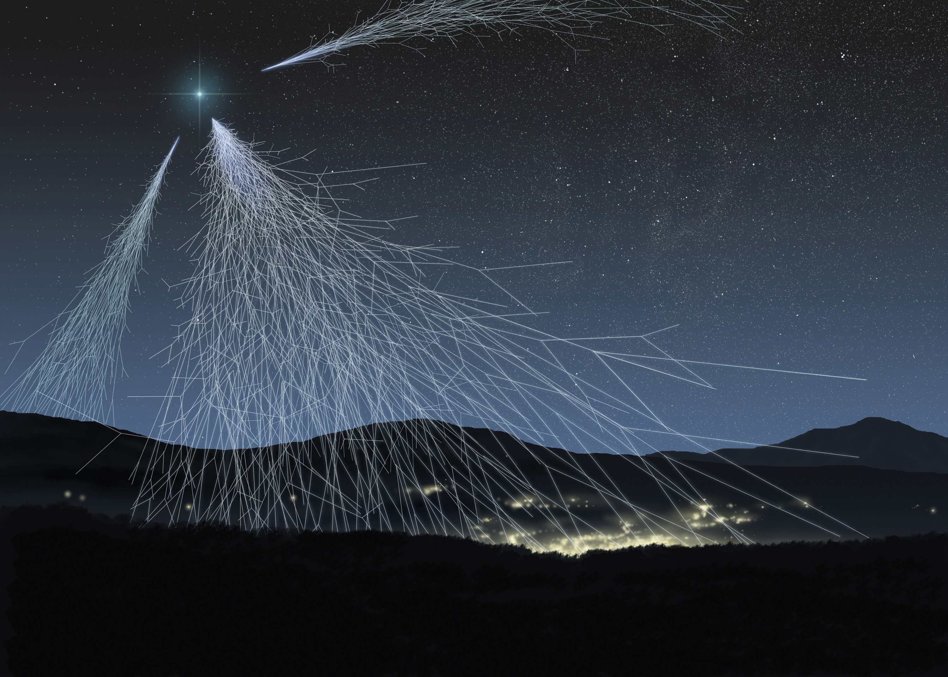
Scientific goal of the EEE project
Look for extended air showers and extreme energy events
By detecting the muon component of the shower
Footprint of air shower at ground level depends on the energy of the primary (proton or heavier particle)

Slide 5
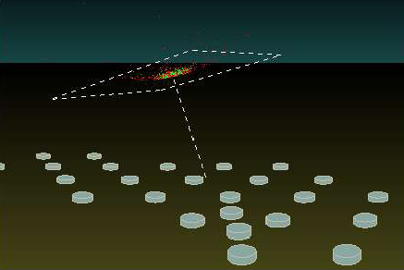
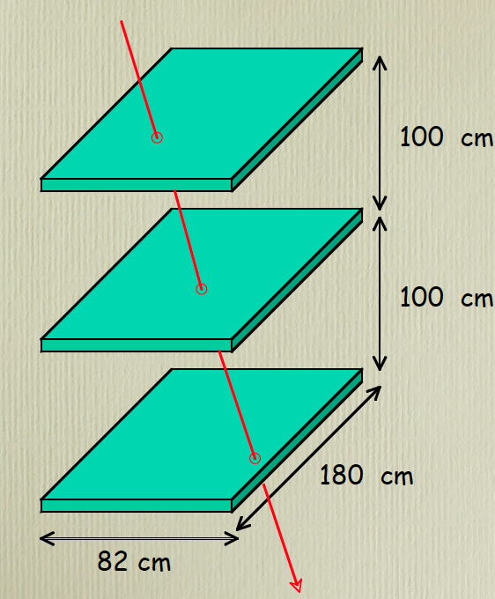
Place telescopes all over Italy
in Italian High Schools
Look for coincidences between telescopes
Key ingredients :
define direction of muon - so that we can point back to interaction point in atmosphere
Measure universal time of detected muon

Slide 6
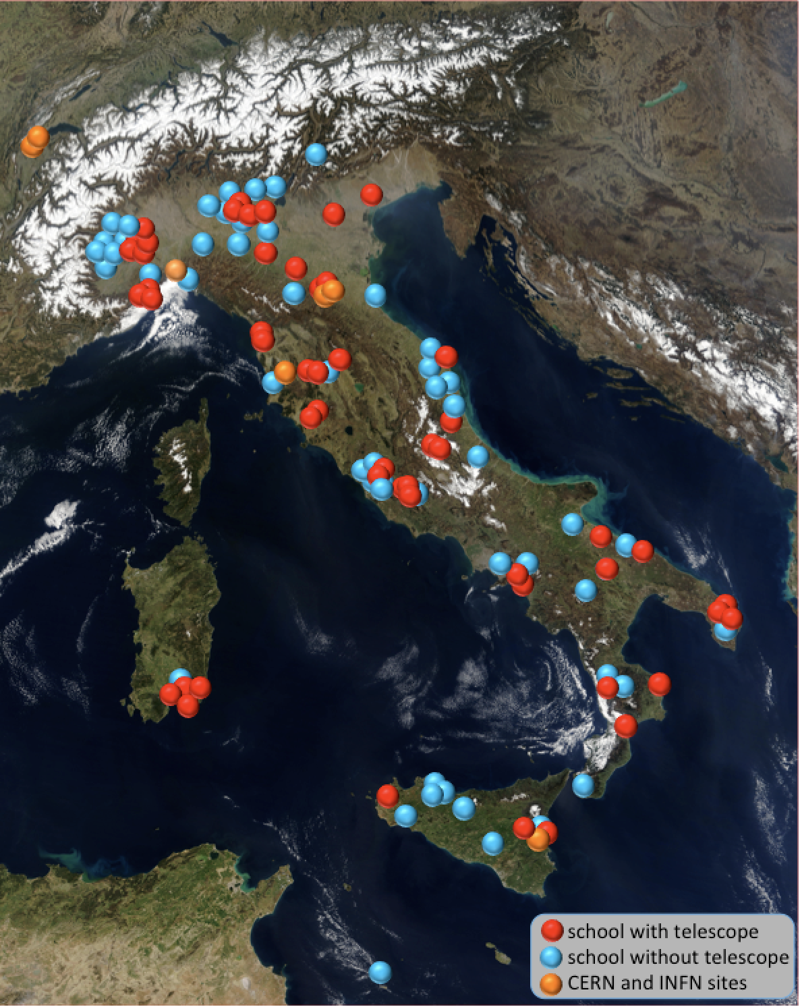
An array of muon telescopes
At present
~50 in Italian High Schools
Mostly distributed in
clusters in the whole Italian territory
+ 2 telescopes at CERN
+ 4 in INFN Units or Universities
~45 schools on the waiting list

Slide 7
The experimental aparatus

Slide 8
The detector : 3 Multigap Resistive Plate Chambers (MRPC)
6 gas gaps of 300 microns each
dimensions : 82 cm x 180 cm
Operated with a mixture of 98 % C₂H₂F₄ – 2% SF₆
Requirements : reliable (long-term); easy to use; not expensive
Design based on the MRPCs of the ALICE Time Of Flight (TOF )

Slide 9
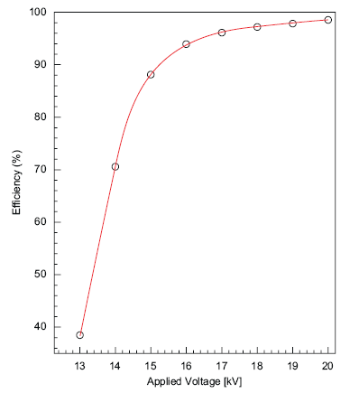
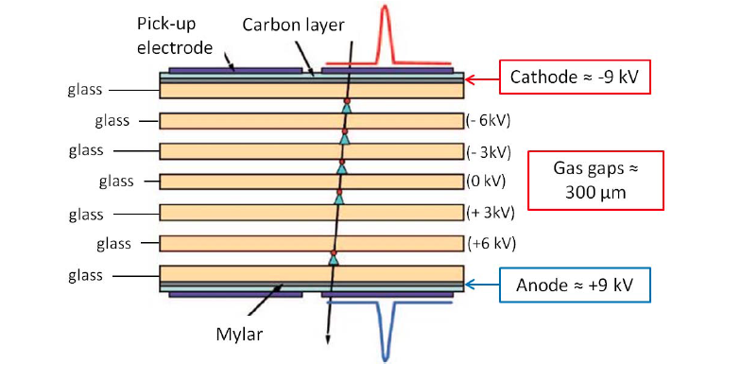
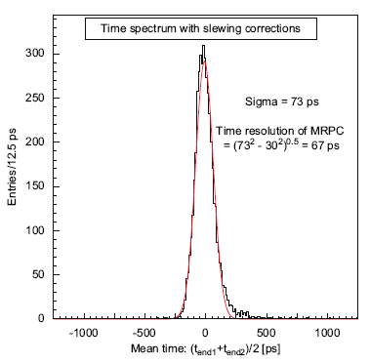
The EEE MRPC
Efficiency
(in dedicated beam tests)
Time resolution
(in dedicated beam tests)
Operated with a mixture of 98 % C₂H₂F₄ – 2% SF₆

Slide 10
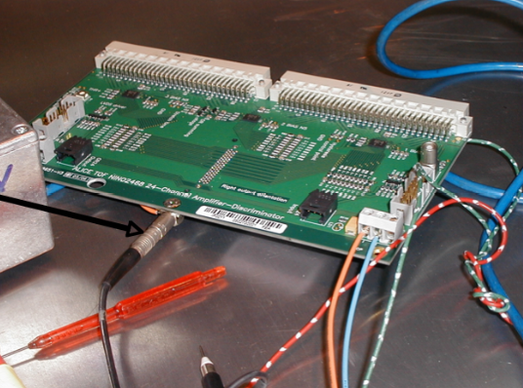
Signal readout
FEA card
3 NINO asics / 24 channels
Amplification
Discrimination
Stretching of pulse
OR of 24 signals
2 FEAs per MRPC
24 strips read out at both ends
time difference : position of hit along the strip
Anode & cathode readout plane : differential signal
adhesive copper tape on vetronite sheet
strip width : 2.5 cm; distance between strips : 0.7 cm
Space resolution in x and y : ~ 1 cm

Slide 11
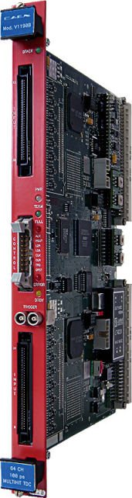
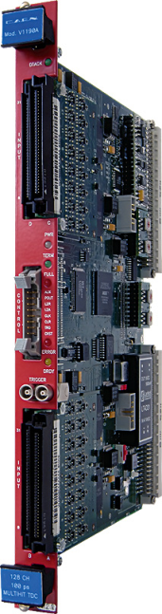

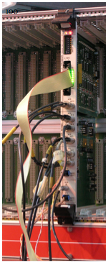
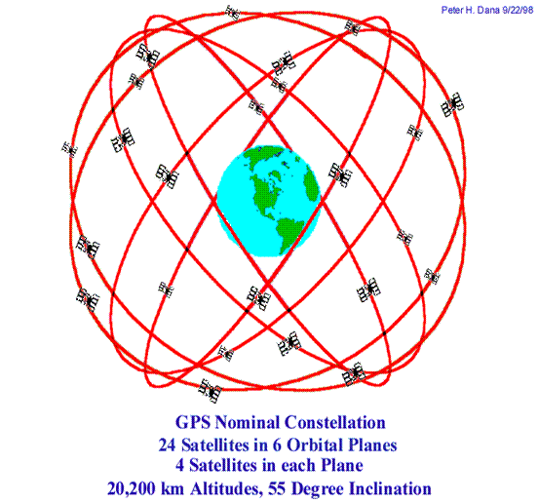
Electronics
TDC TDC VME Bridge
144 channels TDC
Trigger unit
GPS Unit
VME crate
USB connection to PC
VME Bridge
Data Acquisition and monitoring based on Labview
CAEN CAEN CAEN
V1190A V1190B V1718
Weather station to record
temperature and pressure
Trigger card
6-fold
coincidence
GPS generates time stamps and synchronizes stations at different locations

Slide 12
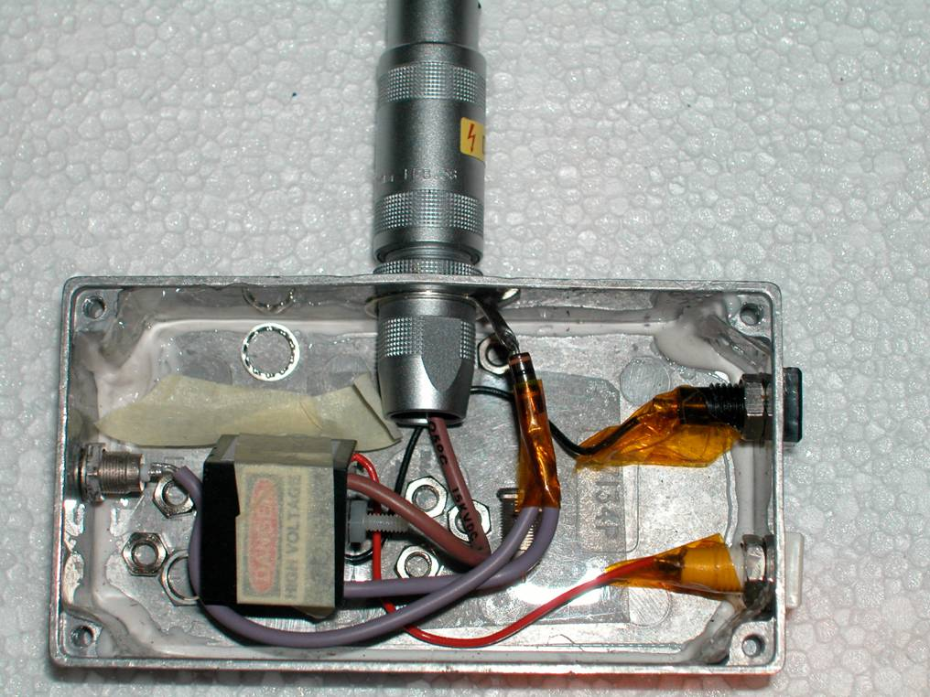
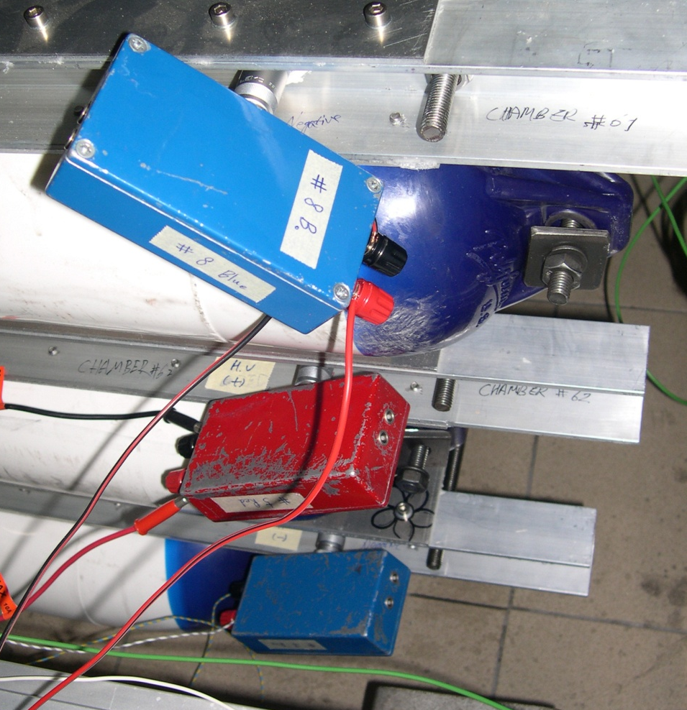
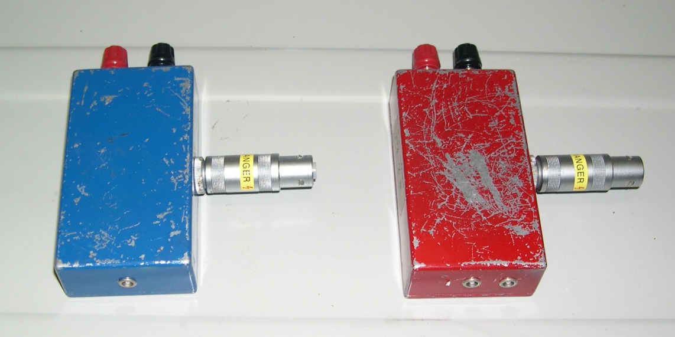
High Voltage
Working voltage for MRPCs : 18 - 20 kV
DC-DC converters inside small boxes
EMCO Q series converters providing an output voltage up to ±10 kV for 0-5 V input
-HV
+HV

Slide 13
The students’ involvement

Slide 14
Construction of muon detectors (MRPCs)
Done by high-school students and teachers at CERN supervised by researchers
Each school sends 4-6 students accompanied by 1-2 teachers
During their week-long stay at CERN they build 3 chambers
    2005 7 schools (pilot)
    2006 14 schools
    2009 10 schools
    2012 3 schools
    2014 6 schools
    2015 6 schools
    2017 6 schools
    2018 5 schools
Total : 57 schools 300-350 students 60-90 teachers

Slide 15
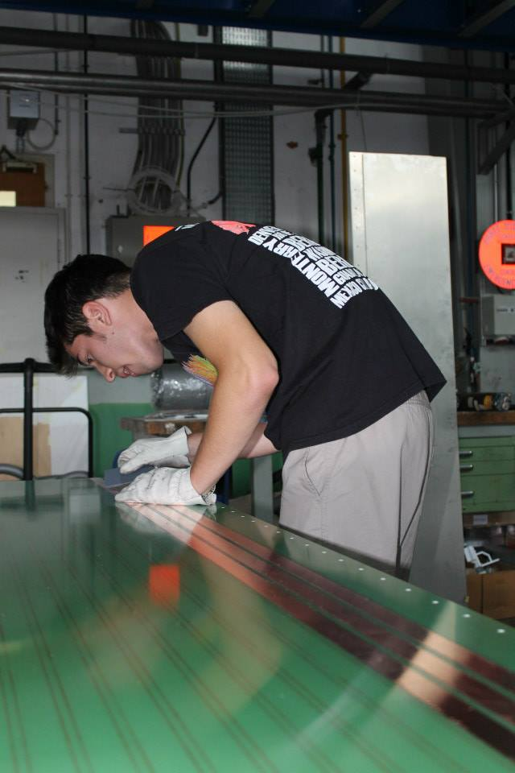
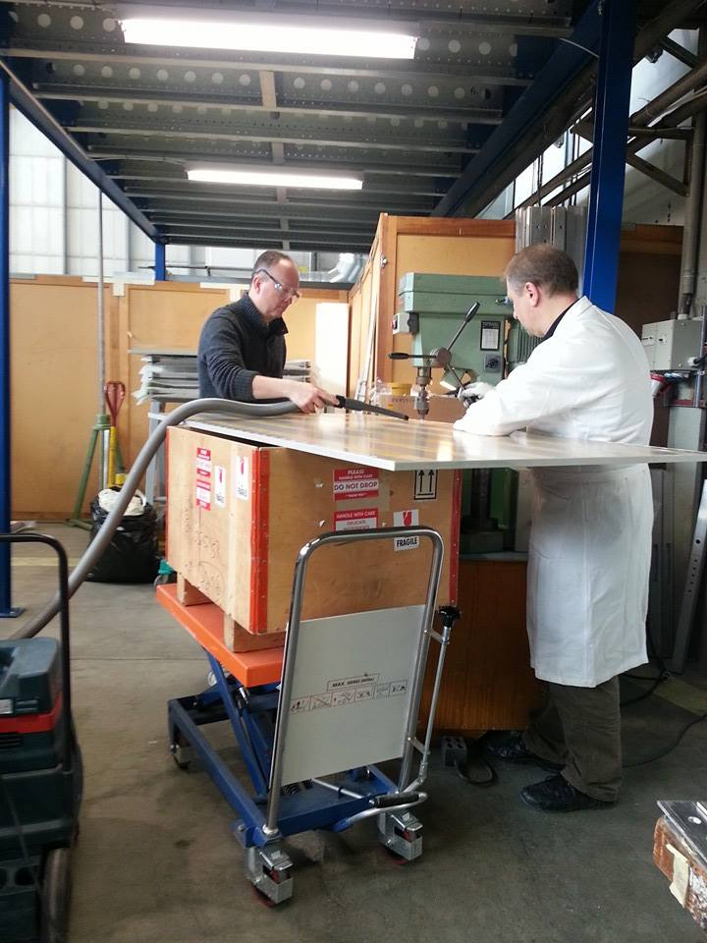
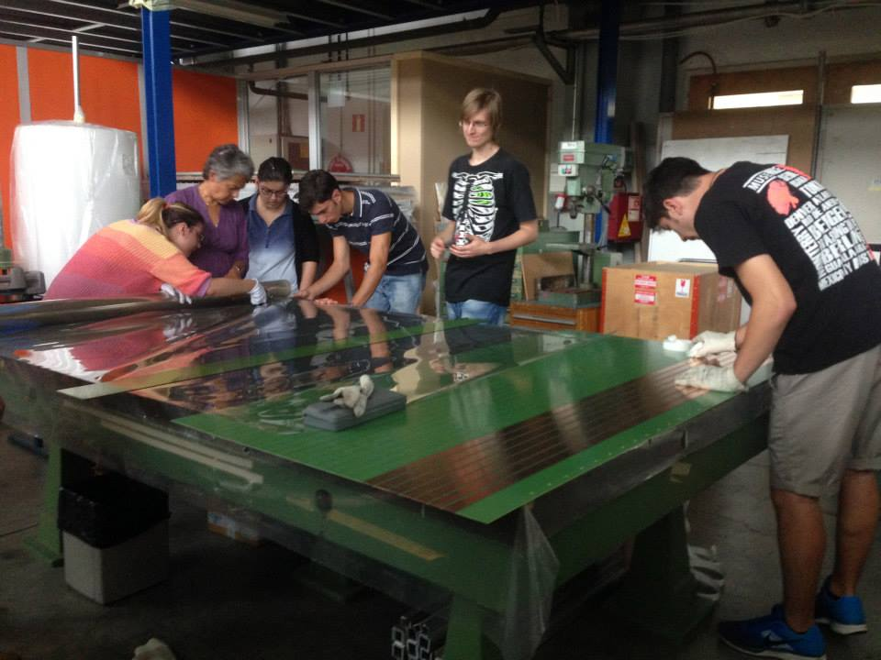
preparation of readout copper strips
preparation of honeycomb panels
Notes:
roman facendo fori sul pannello a nido d'ape
gli studenti non sono autorizzati ad utilizzare il trapano a causa di problemi di sicurezza

Slide 16
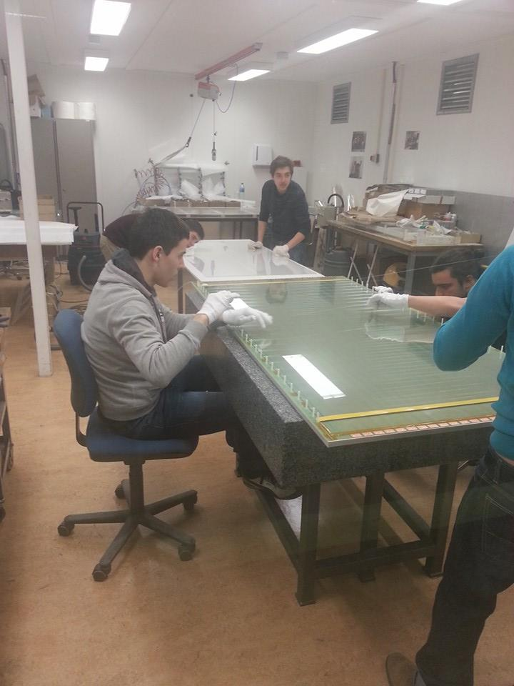
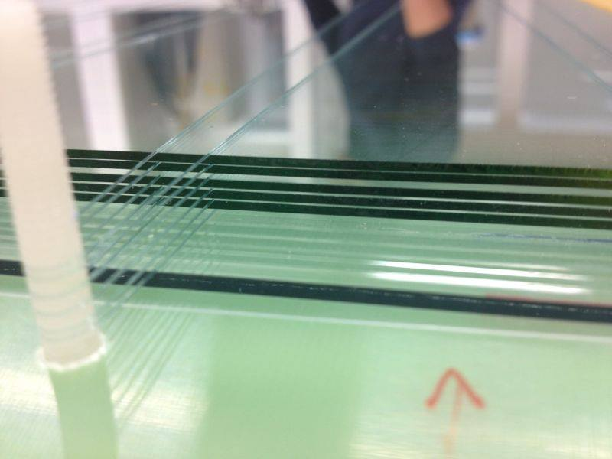
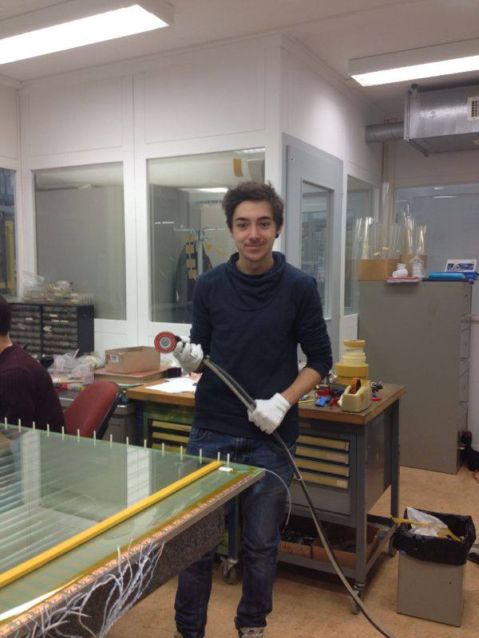
Fishing-line spacers

Slide 17
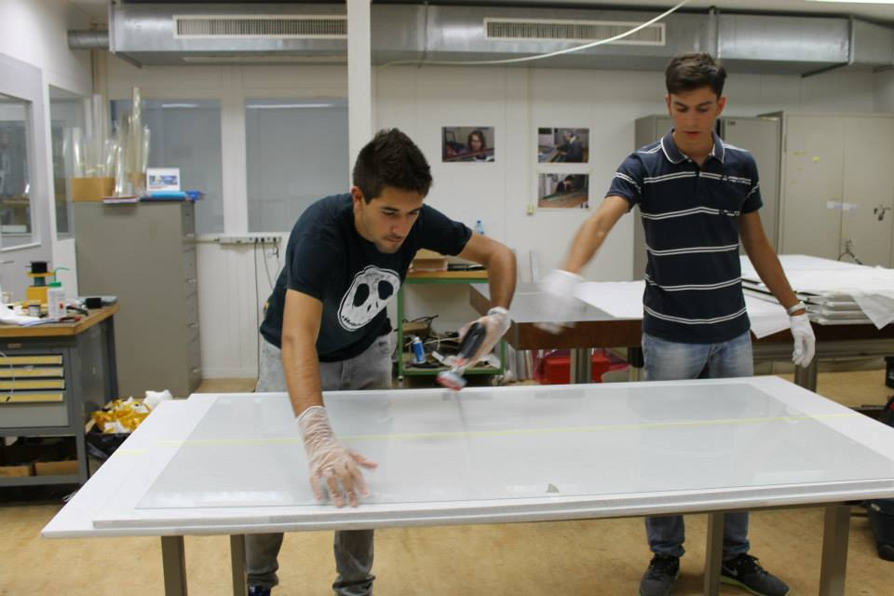
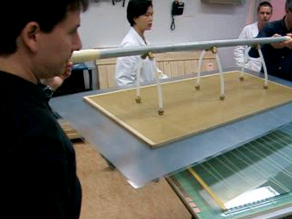
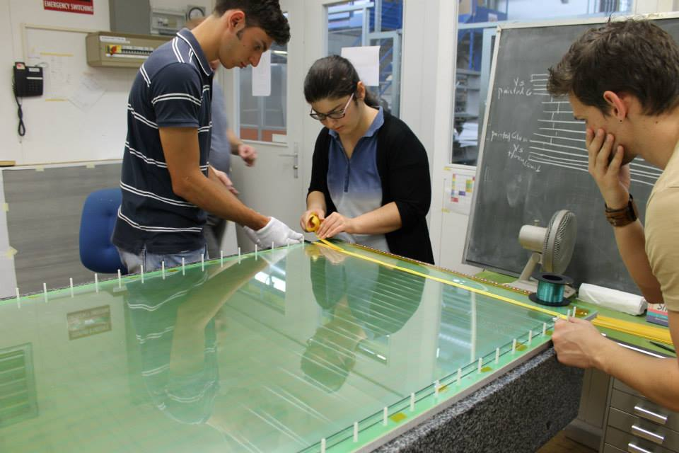
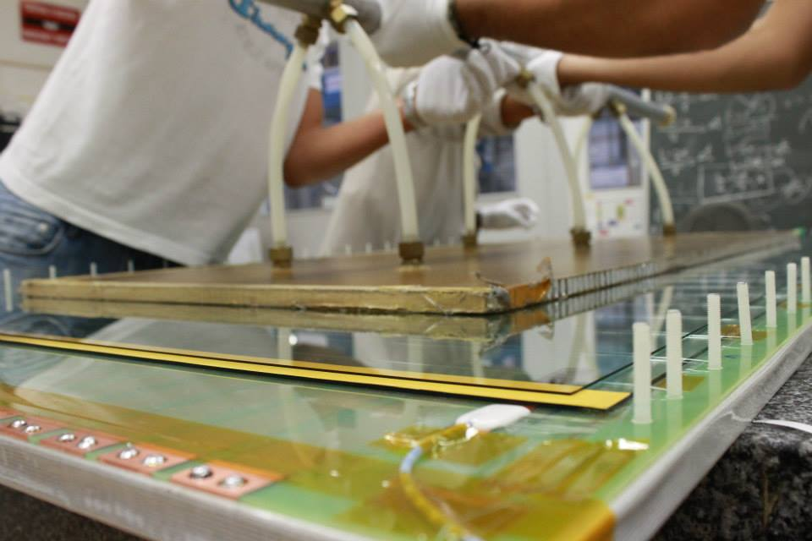
Cleaning glass panels
Lifting glass panels

Slide 18
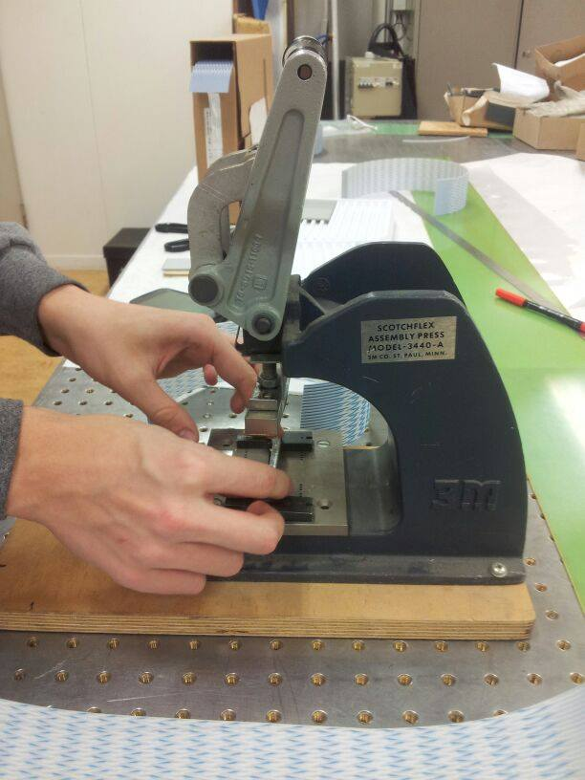
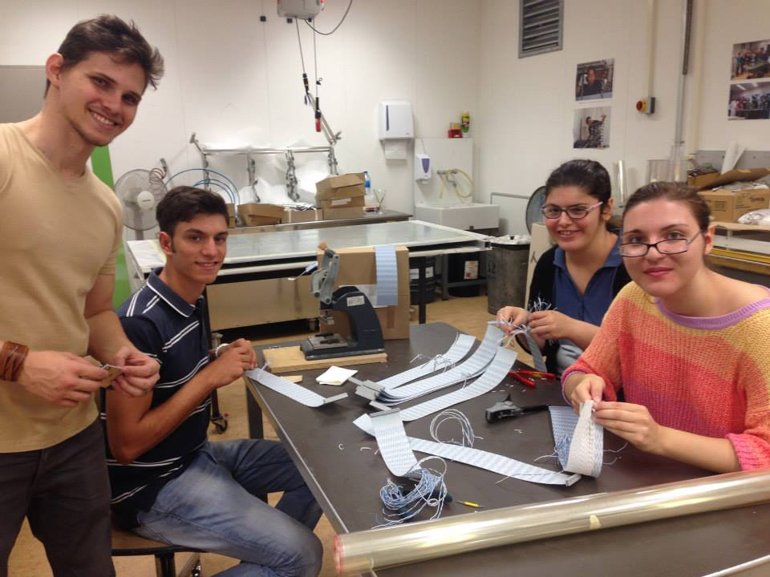
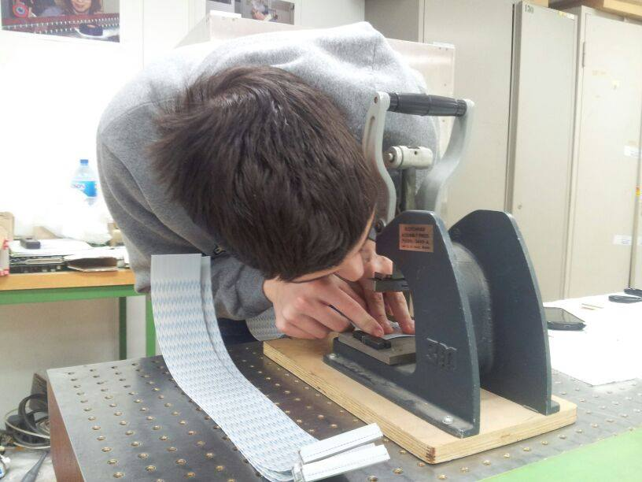
preparation of signal cables

Slide 19
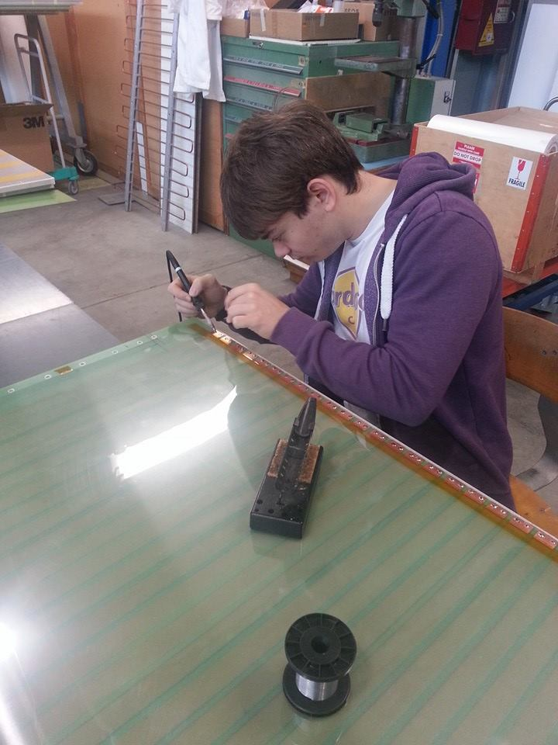
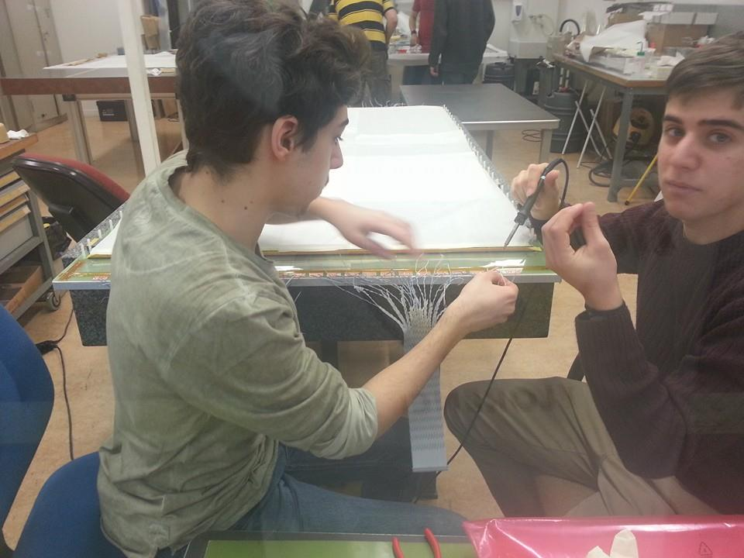
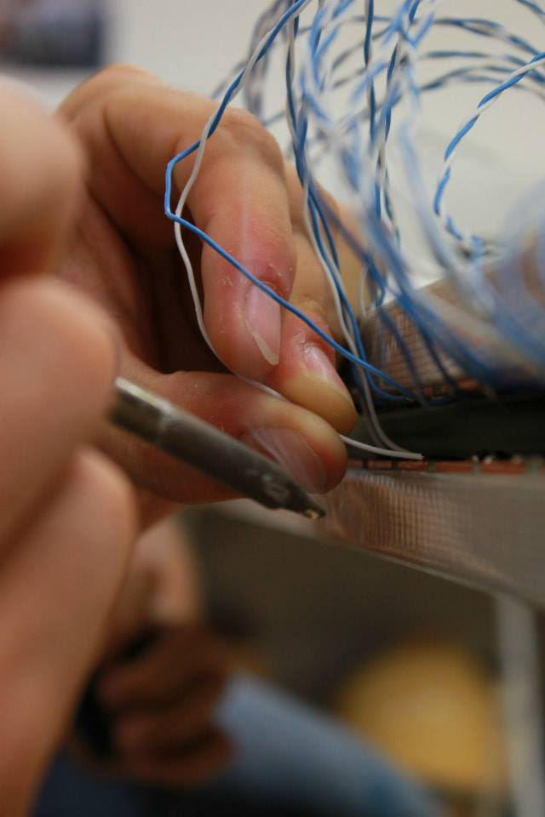
Soldering signal cables

Slide 20
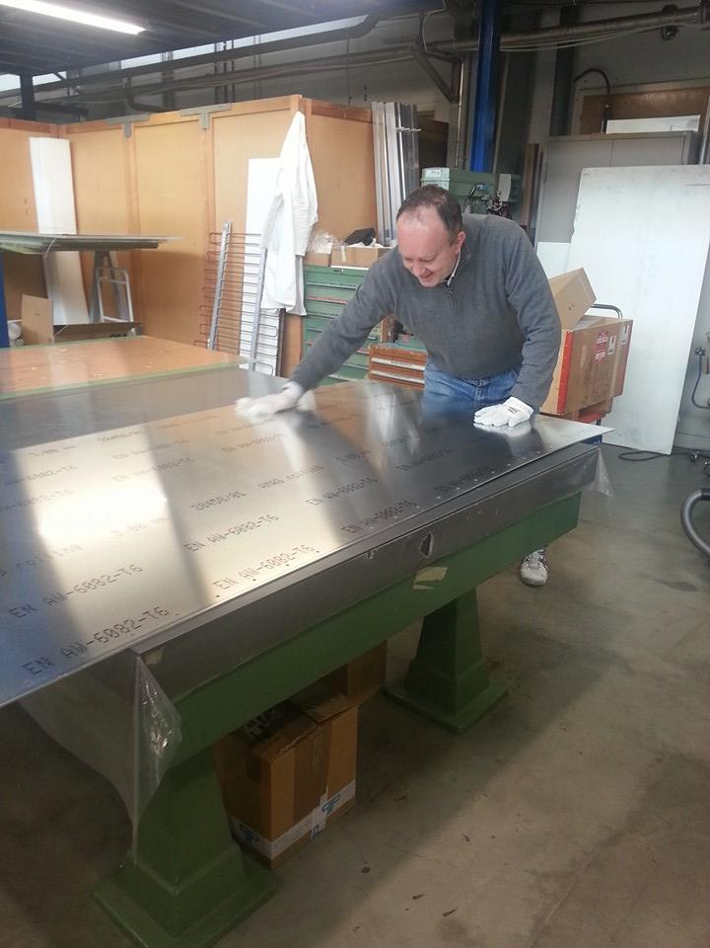
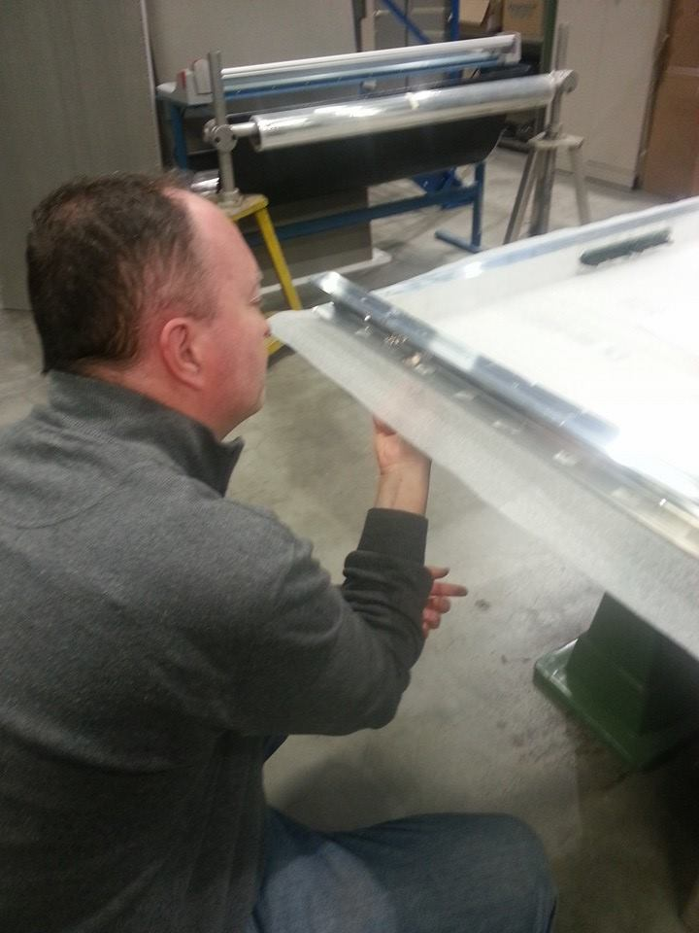
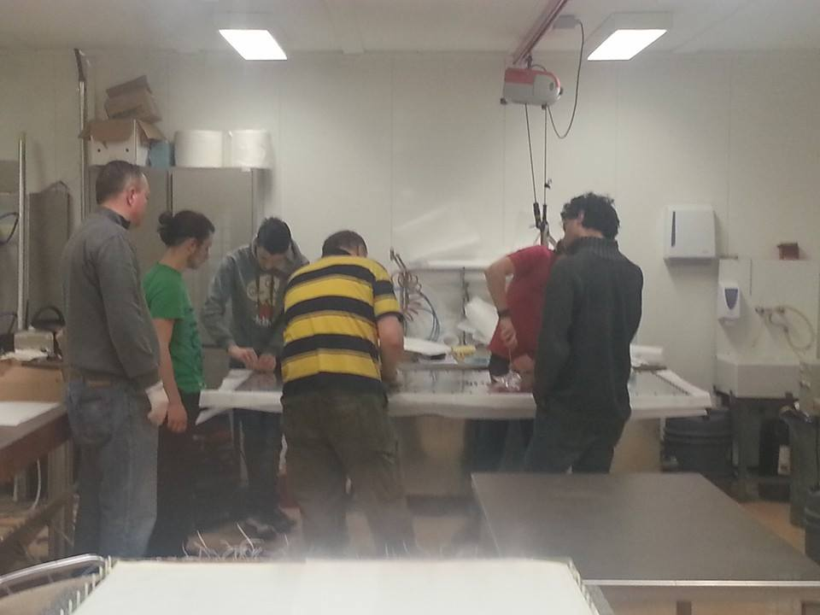
Closing the gas box with the MRPC

Slide 21
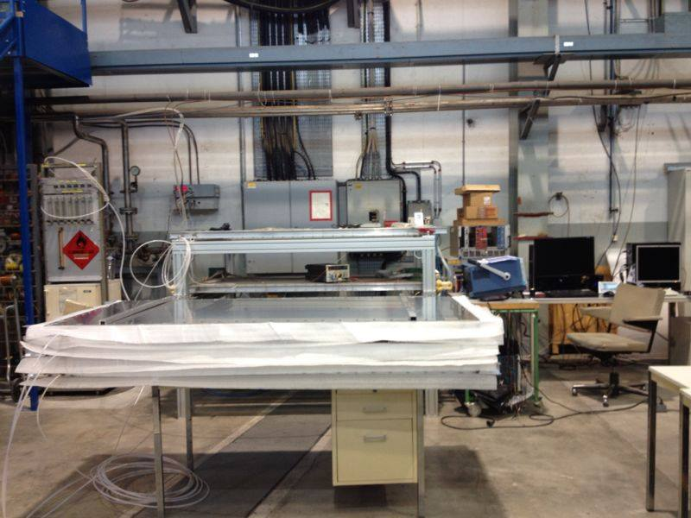
Chambers under gas flow to test for leaks
Notes:
le 3 camere collegate al flusso di gas, al fine di cercare possibili perdite di gas

Slide 22
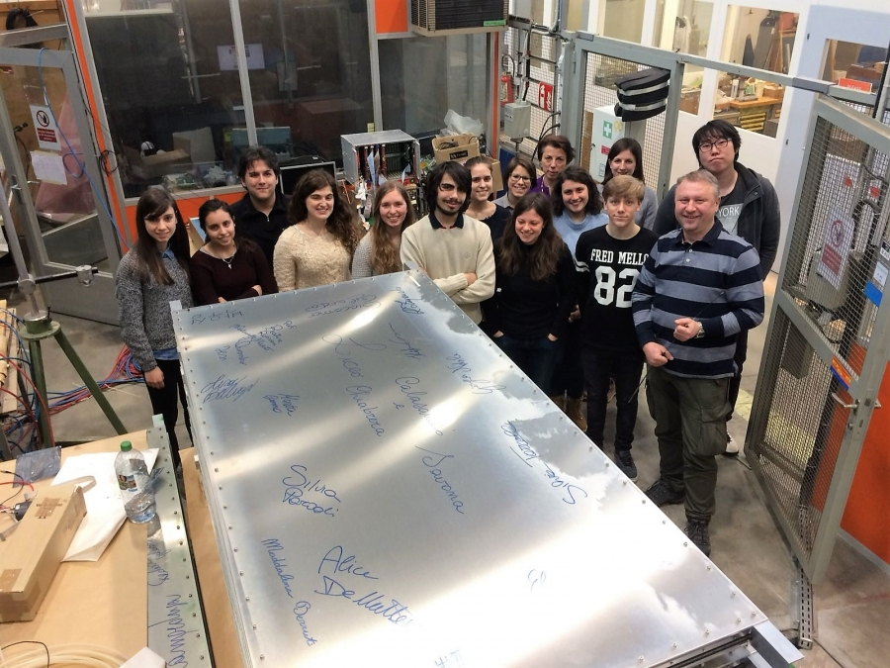

Slide 23
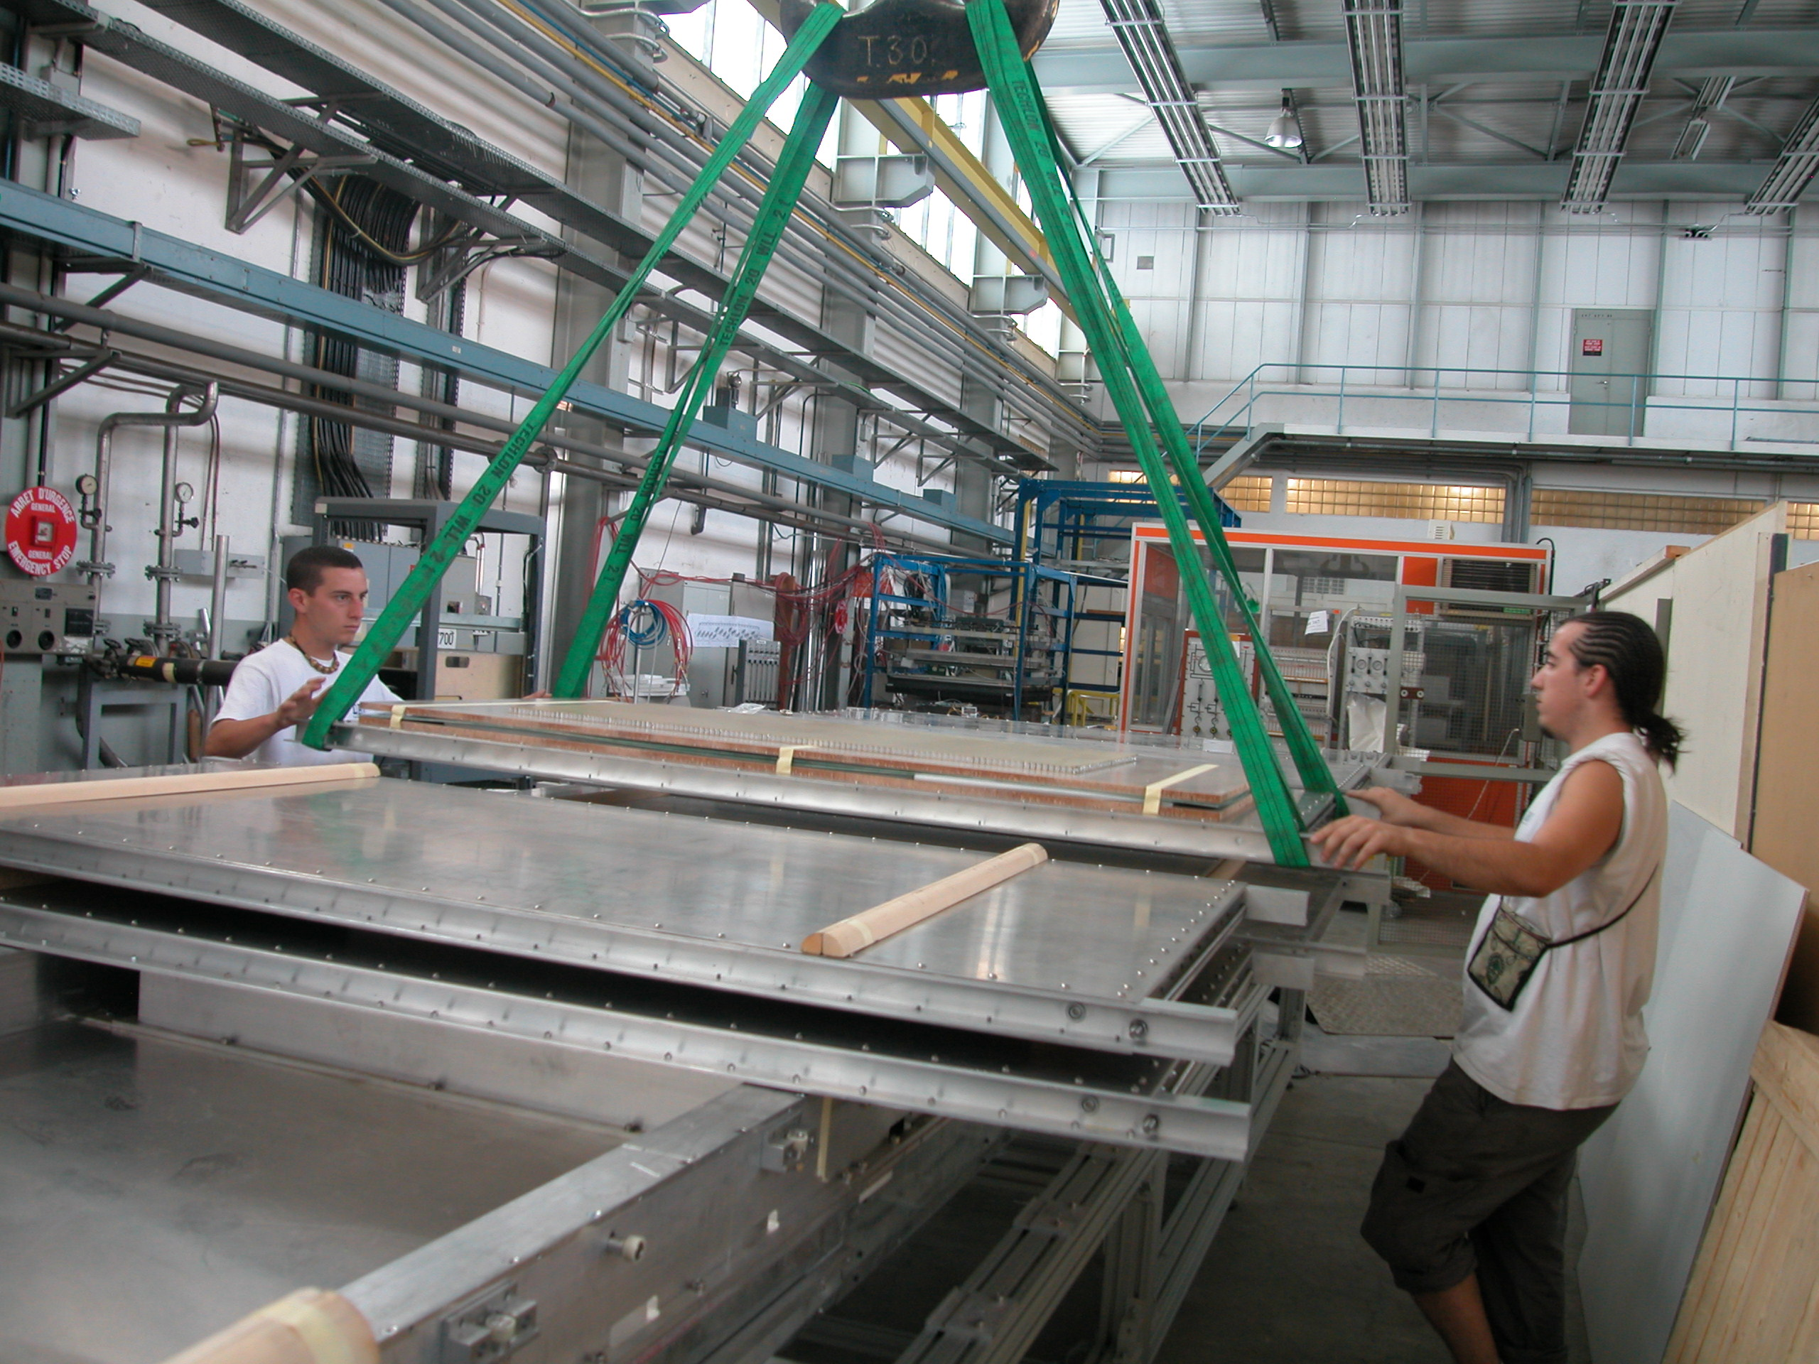
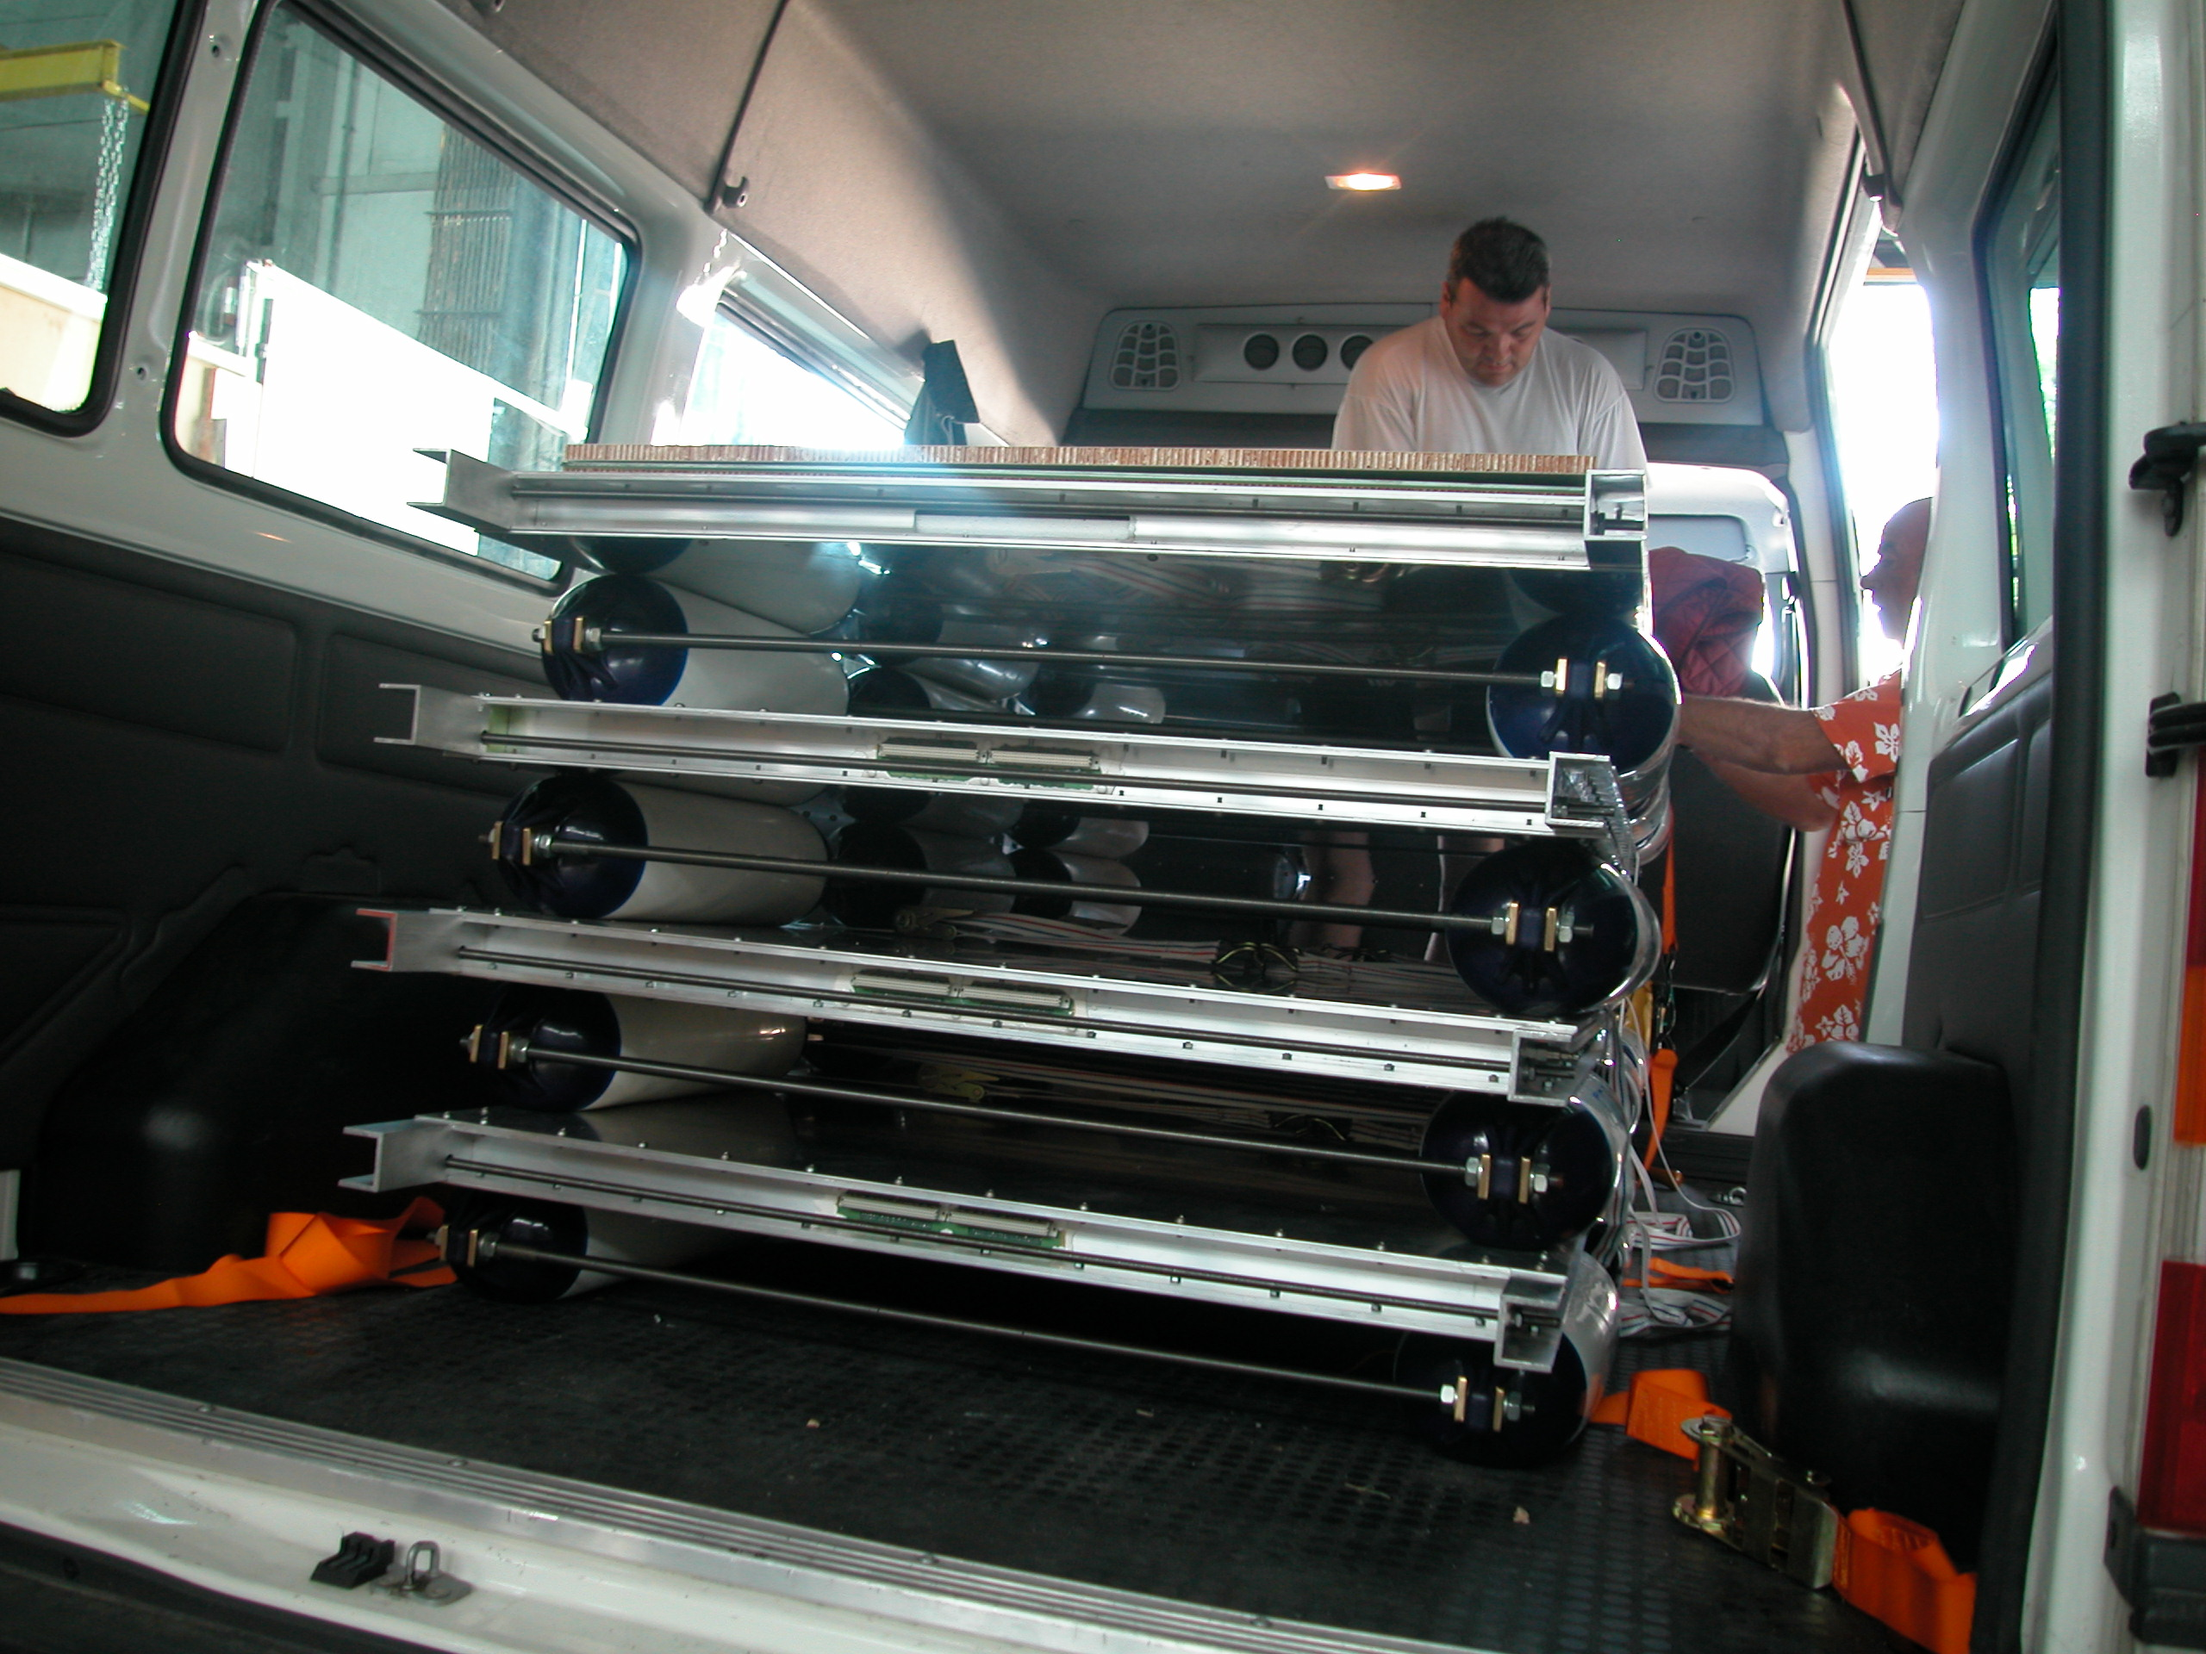
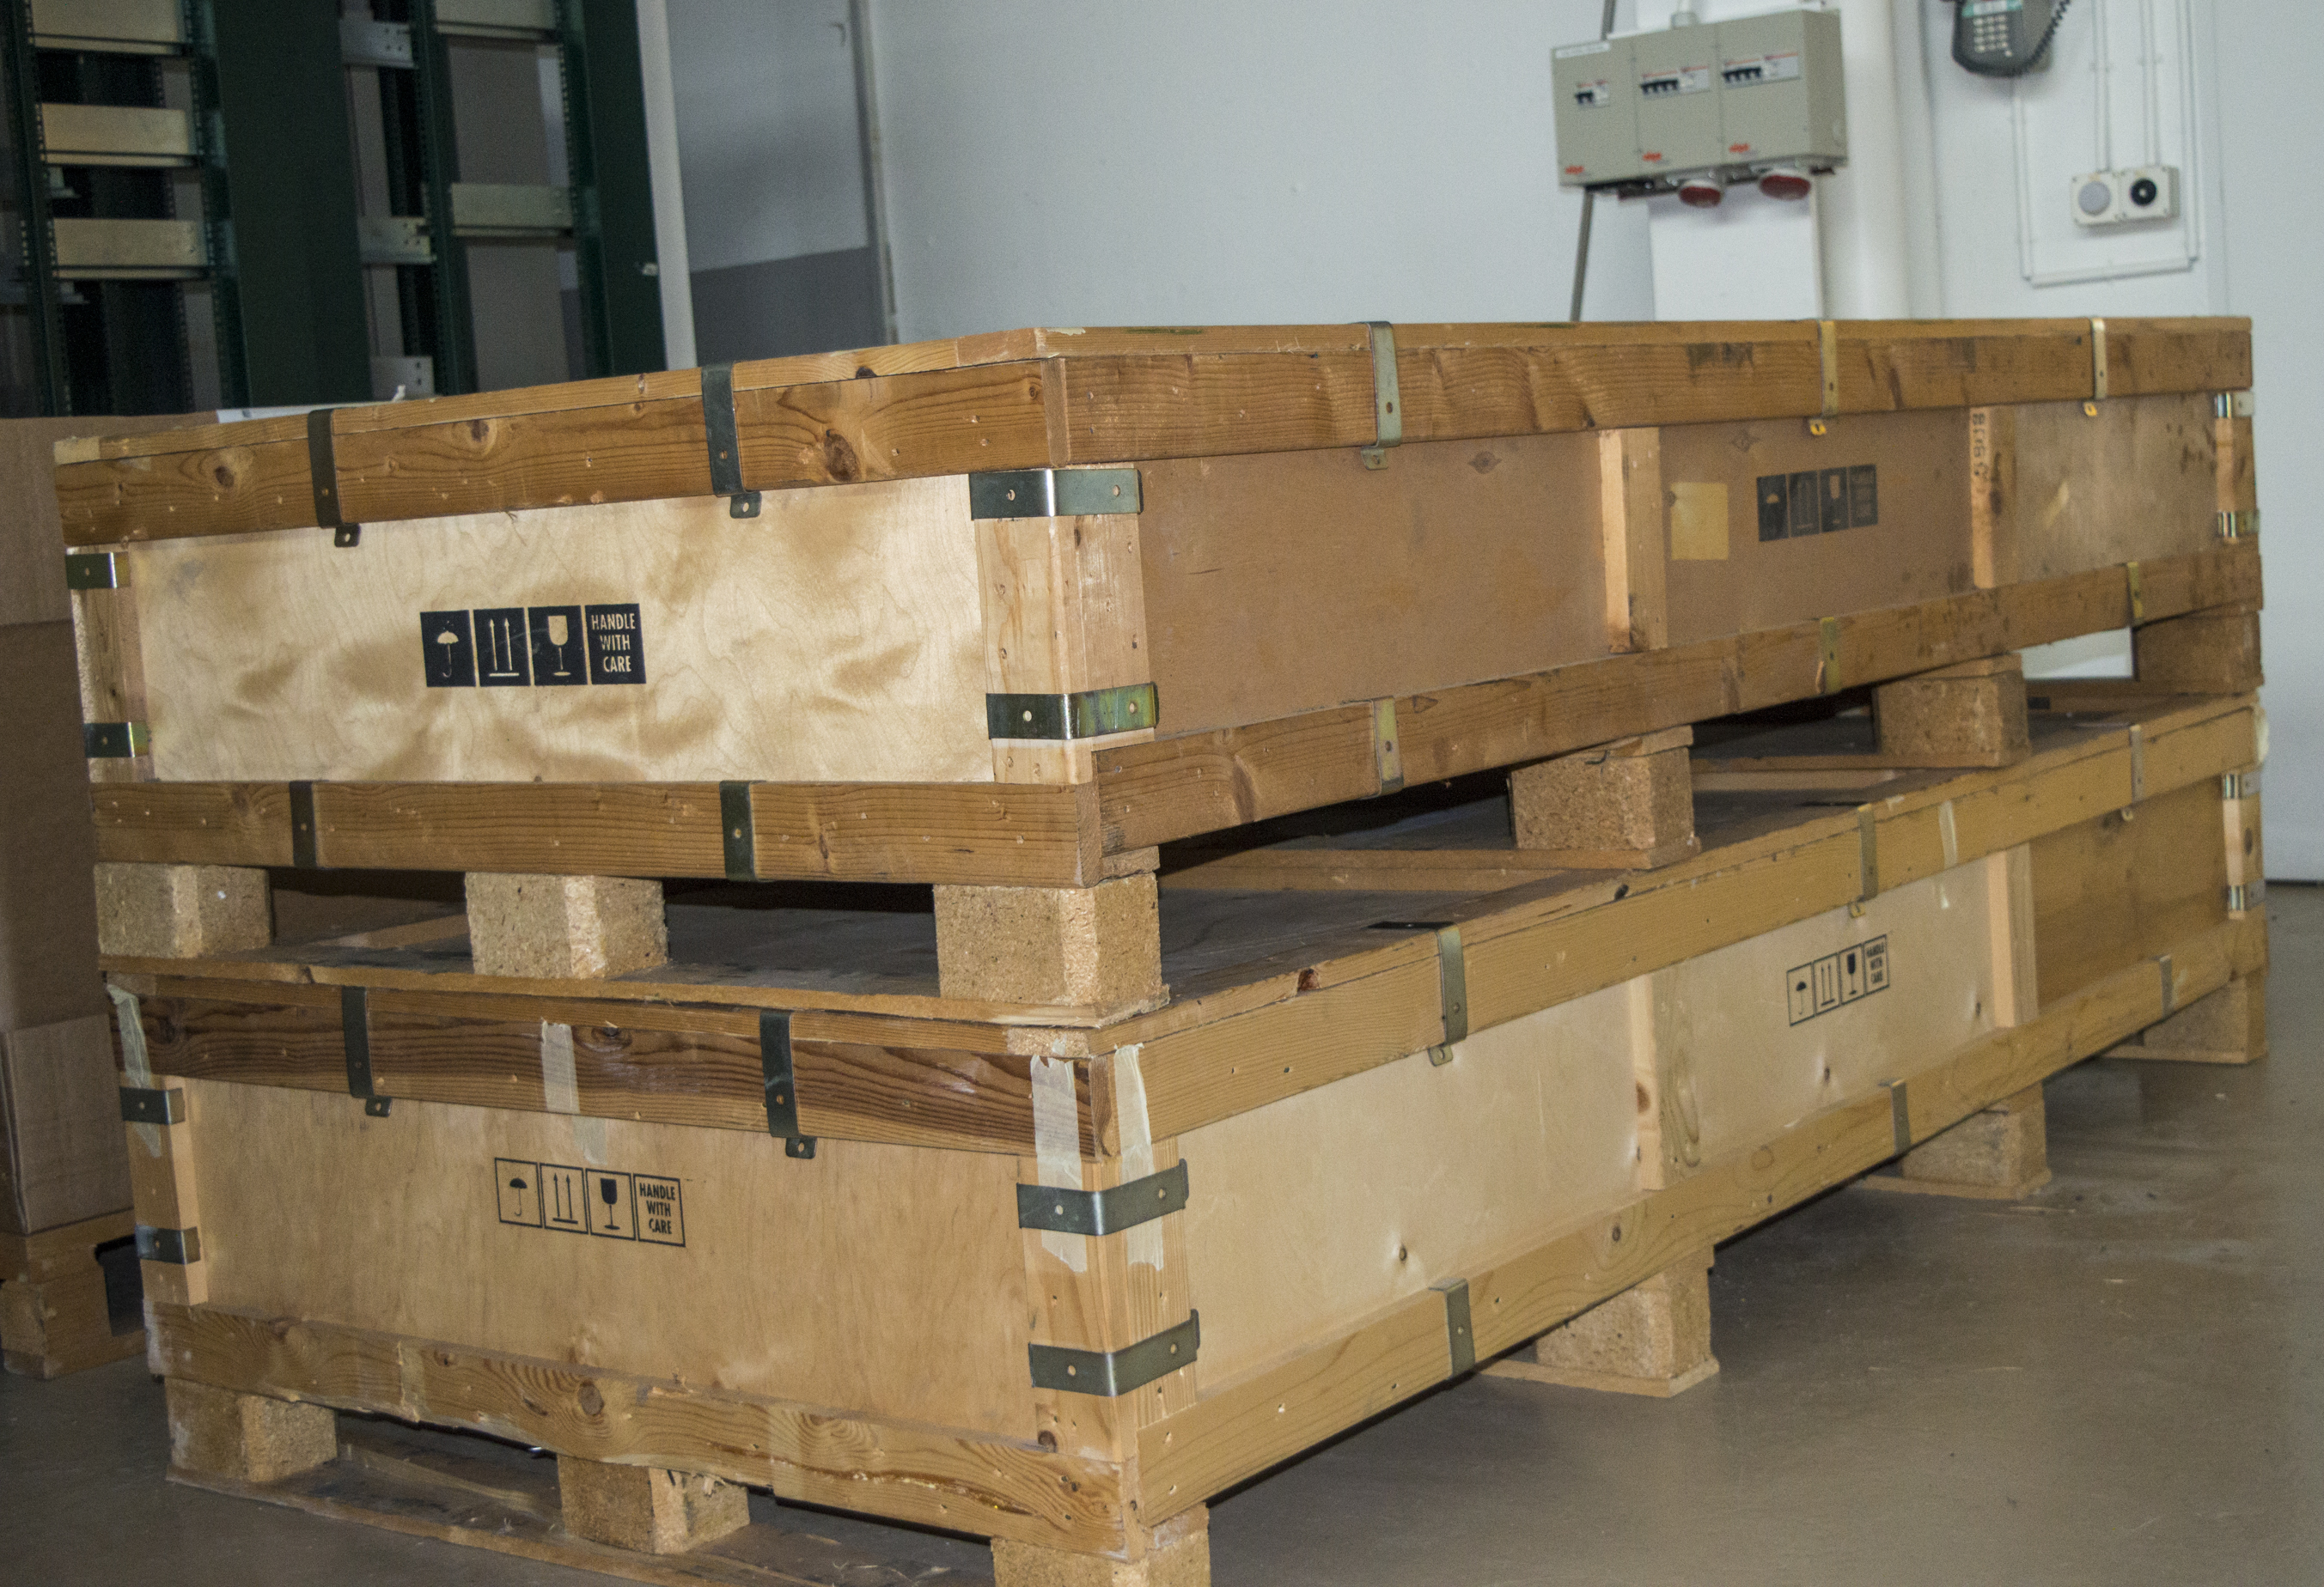
Chambers are shipped to Italy

Slide 24
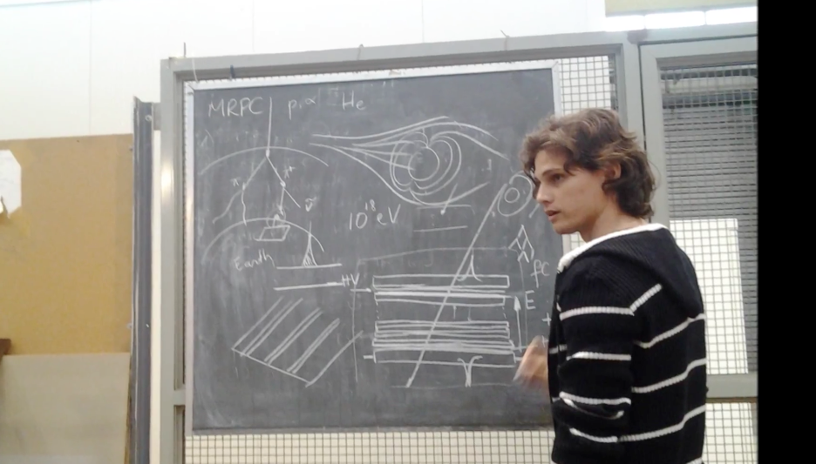
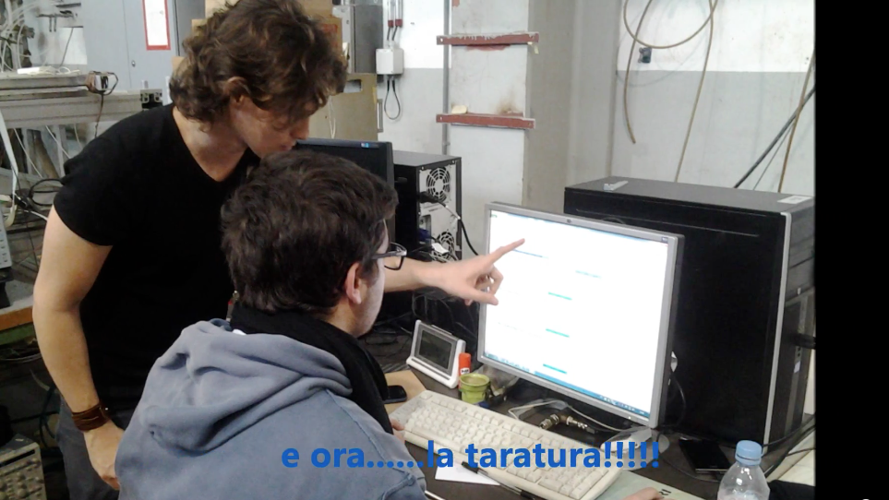
“lesson” on the physics
and operation of Multigap Resistive Plate Chambers
“lesson” on
electronics
readout
data acquisition

Slide 25
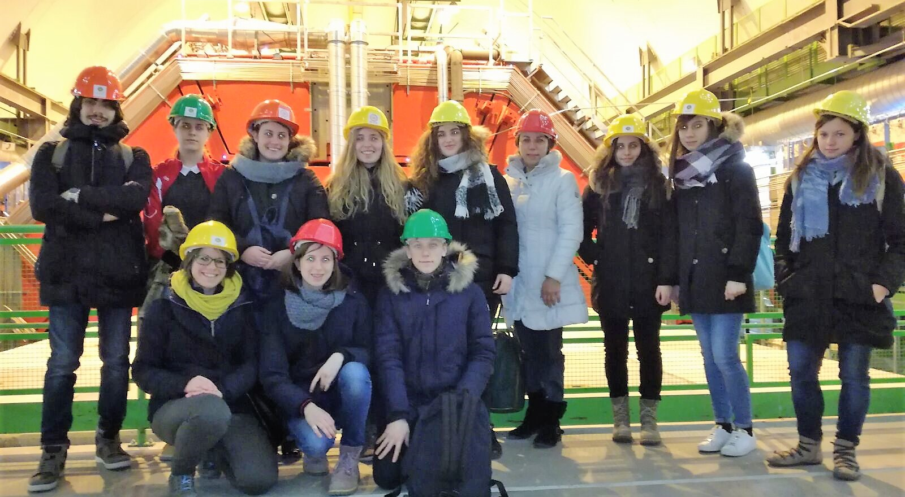
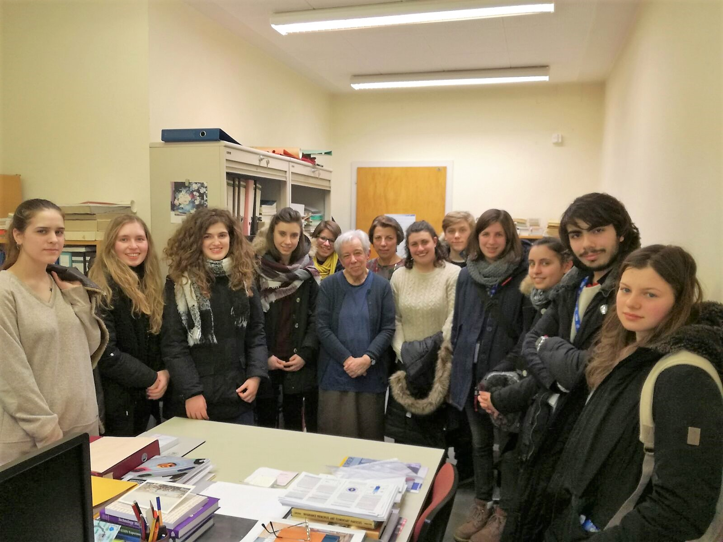
Visit of ALICE
Interview with Maria Fidecaro

Slide 26
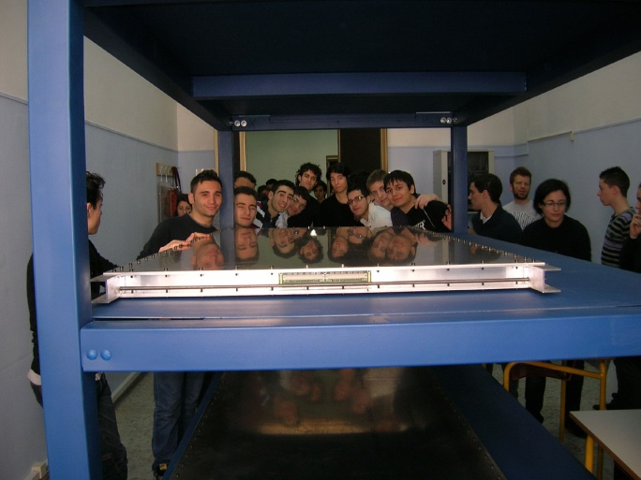
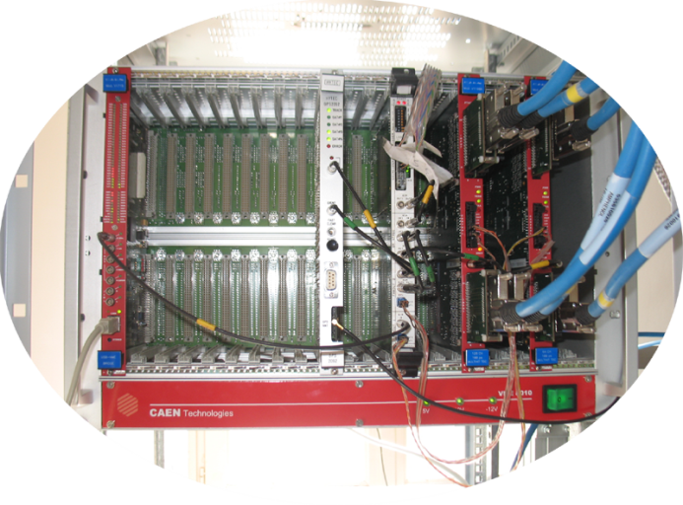
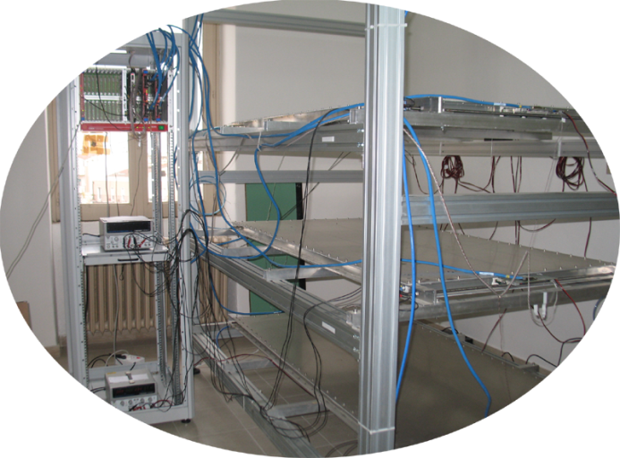
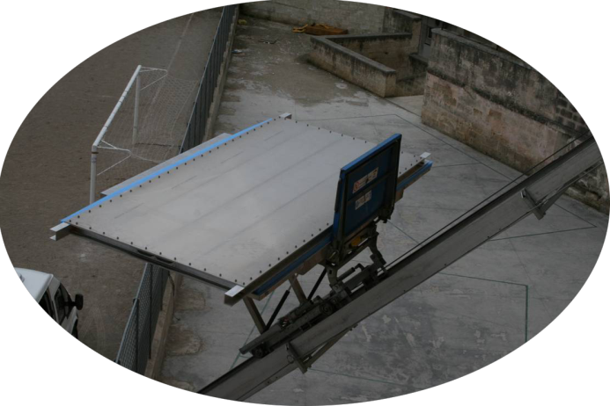
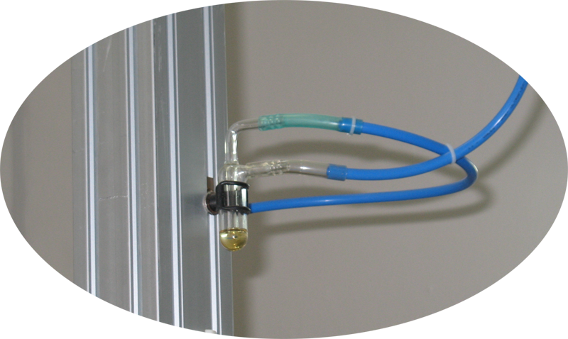




Assembling the muon telescope
readout and DAQ
The telescope assembled
Gas system
Chamber arrival

Slide 27




Data-taking and monitoring
(empty bottle?)
Check DAQ is ON
Check GAS flow
Check chamber hit distributions

Slide 28

Data-taking
2014: centralised, coordinated data-taking; data transfered and stored at CNAF-Bologna
Pilot run : 27 October-14 November 2014 (23 – half of the EEE telescopes)
Run 1 : February 2015 – April 2015 (two third, 35 of the EEE telescopes)
Run 2 : November 2015 - May 2016 (almost all EEE telescopes)
Run 3 : October 2016 - May 2017 (almost all EEE telescopes)
Run 4 : October 2017 - May 2018 (almost all EEE telescopes)
~70 billion tracks collected in all 4 Runs

Slide 29

Students’ involvement in coordinated run
Fill the e-logbook on a daily basis

Slide 30


Students’ involvement in coordinated run
Check the CNAF on-line monitoring system

Slide 31

monthly run coordination video-conferences where the students present the status of their telescope / data-taking /analysis

Slide 32



National Conference of the EEE project, Erice, May 2017
How to measure the amount of gas in a bottle by mean of sound frequency
Liceo F. e M. Campana (Osimo)

Slide 33



EEE in Erice 2017
Both measurements will be published in the Giornale di Fisica with students’ signature.
Measurement of the Earth Radius
Measurement of Cosmic rays flux at different altitudes

Slide 34


EEE at International Cosmic Day 2017
47 Schools , 550 students
Liceo Galvani (BO):
data from their telescope

Slide 35


EEE outside Italy
Moscow Chemical Lyceum
Construction at CERN
Student exchanges between schools: Liceo Staffa Trinitapoli (Bari) and Moscow Chemical Lyceum
Themistokli Germenji Lyceum (Korce, Albania)
Istituto de Ciencias Nucleares UNAM (Mexico)
Oslo University (Oslo)
Liceo Galvani (BO):
data from their telescope
French HSSIP 2017, Swedish HSSIP 2018, etc..

Slide 36
Some results

Slide 37
First detection of extensive air showers with the EEE experiment

Slide 38


Coincidences between telescopes

Slide 39





Forbush decreases
rapid variations of the cosmic rays flux over the course of a few hours
associated to solar phenomena such as Coronary Mass Emission (CME) and solar flares
Decrease in muon flux reaching a minimum within hours
Recovery lasts a few days
comparison with Oulu neutron monitor station
February 2011
Extensive Atmospheric Showers (EAS) Detections
The telescopes relative distances are ranging from a few hundred meters for clusters of 2, 3 and 4 telescopes in the same city, to more than 1000 km for the farthest stations. Muons from the same EAS are detected by different stations [6].
Modulation on φ
2
µ
Δφ_{station} - φ
ΔL*
ΔL_{station}
1

Slide 40

Muon decay
upgoing low energy electron
good signature:
delay~2μs
large χ² (due to multiple scattering)
μ⁻→e⁻ν_{e}ν_{μ}
low energy electrons from muon decay are a robust explanation for upward-going particles

Slide 41

https://eee.centrofermi.it/
Web site in Italian and English

Slide 42
Thanks a lot for your attention

Slide 43
backup

Slide 44




  At L’Aquila, closest stations of the experiment
  Angular correlations between “coincidences”
  7.6 events/hour
  Signal/Noise = 2
  Angular cut
  (requiring quasi parallelism) improves S/N
  1.6 events/hour
  Signal/Noise=18
  Time difference between events at the two stations

Slide 45


First coincidences detected
Single track in one school + multiple
tracks in the other school
3.6 events / hour
Signal / Noise = 26.4
Multiple tracks in both schools
0.8 events / hour
Signal / Noise = 76

Slide 46


Coincidences up to 2012…
Number of coincidences per day, as measured by different telescope pairs of the EEE network, versus the relative distance between the two telescopes
Included in the plot: CERN-Geneva (15 m), L’Aquila (180 m), Cagliari (520 m) and Frascati (650 m)
Results consistent with Corsika and Cosmos Monte Carlo simulations
Few months to observe coincidences for distances > 1 km
Corsika Monte Carlo simulations

Slide 47


1.3 x 10⁸ good tracks
7 x 10⁴ TOF<0
β > 0 downward -going
β < 0 upward-going
Identify electrons from muon decays (in the floor or in the bottom chamber): look at Time Difference with respect to the Previous (TDP) events versus velocity
Correlate TDP with velocity of previous
particle : electrons come from decays
of (slow) muons with 0.5<β<0.8
For β~0.65 range of muons in Al / concrete is 2-3 cm
Electrons from μ-decay, E=50 MeV,
range in Al 7 cm
Notes:
Qui i dati ottenuti ad Altamura vengono confrontati con quelli di Catania (sempre telescopio EEE, ma sito presso il dipartimento di fisica)
e quelli di OULU dove c’è un Neutro Monitor.

Slide 48

Upward-going events
About 1 event every 1000 observed goes in an upward direction
Some of them identified as electrons coming from muon decays (in the floor or in the bottom chamber), looking at their Time Difference with respect to the Previous (TDP) events
Event display (in the two projections)
Tagged downward µ + upgoing electron
Notes:
Qui i dati ottenuti ad Altamura vengono confrontati con quelli di Catania (sempre telescopio EEE, ma sito presso il dipartimento di fisica)
e quelli di OULU dove c’è un Neutro Monitor.

