Slide 1
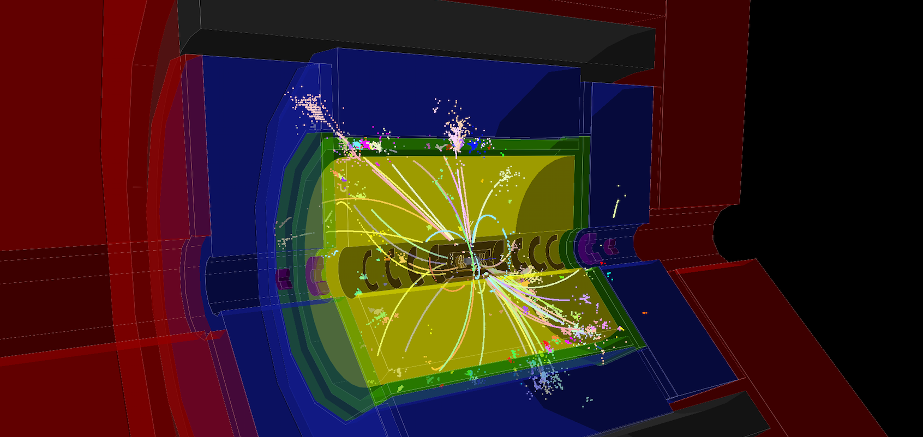
CLICdp intro and general news
-
e⁺e⁻ ➔ tt @ 380 GeV
Lucie Linssen, CERN
CLICdp meeting, November 20th 2017

Slide 2
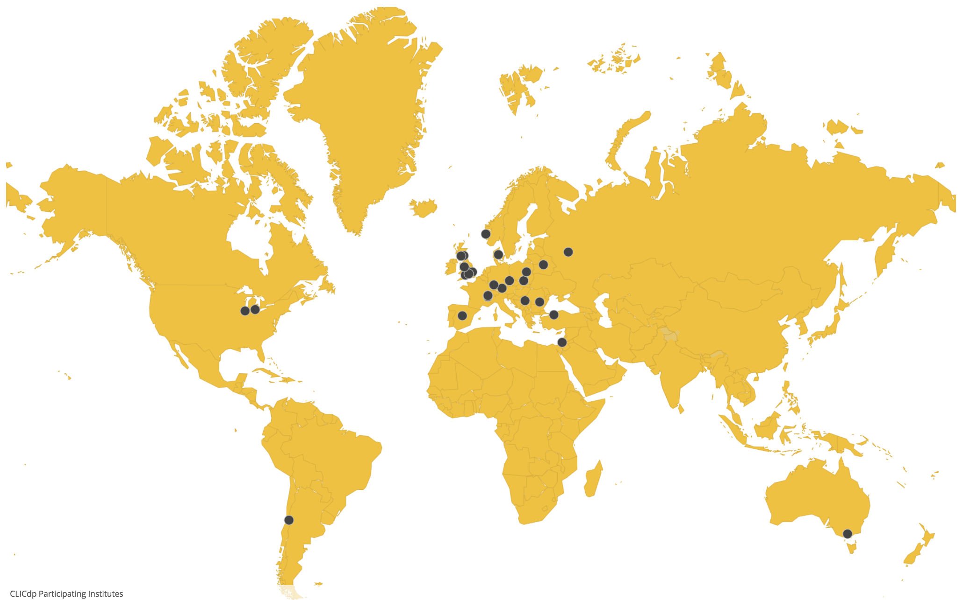
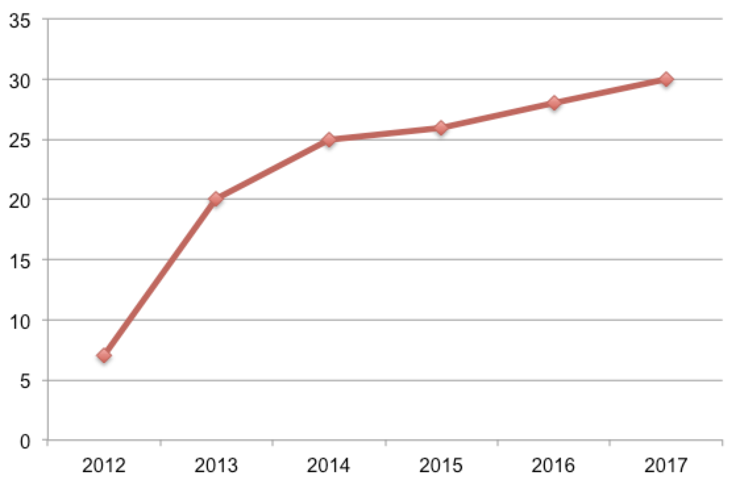
CLICdp institutes
CLICdp currently 29 institutes from 18 countries
http://clicdp.web.cern.ch/
Recent formal request from University of Siegen to join CLICdp (Wolfgang Kilian)
Awaiting approval by CLICdp institute board members and completion of signatures

Slide 3
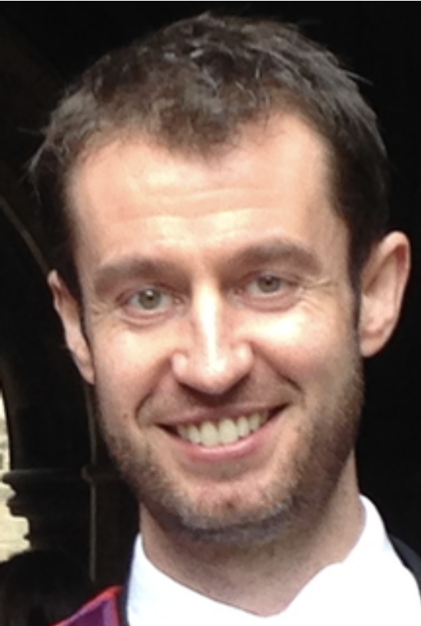
New CLICdp spokesperson
Aidan Robson, University of Glasgow
Recently elected as the new CLICdp spokesperson
2-year term of office, starting January 2018
WELCOME !
Aidan is looking forward to pick up this new role.
He will be based at CERN for 2018, starting at the beginning of January.
Smooth transfer of roles is already ongoing.

Slide 4
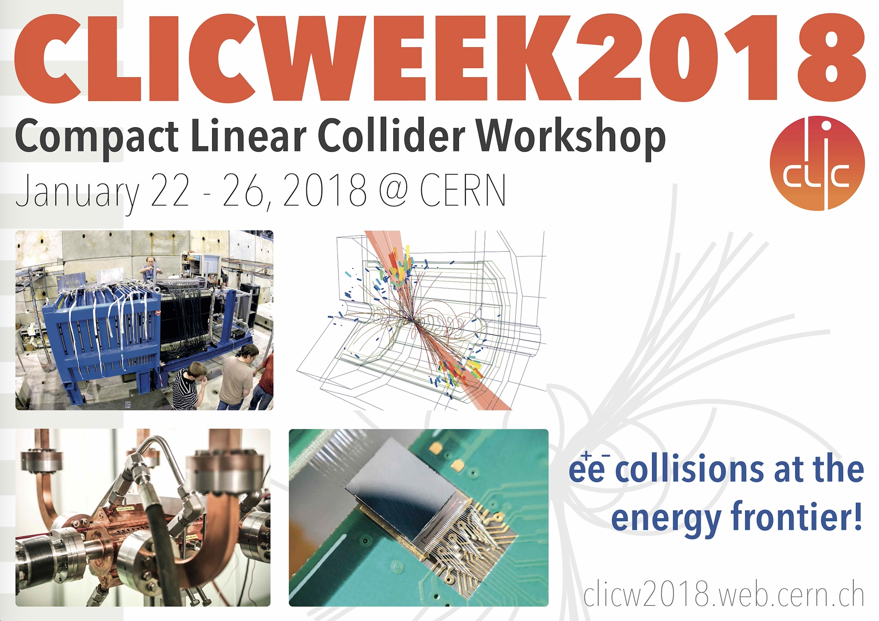
https://indico.cern.ch/event/656356/
CLICdp sessions:
midday Tuesday 23/1 - midday Friday 26/1
CLICdp-related organisers: Aidan Robson, Philipp Roloff, Frank Simon
=> conveners of topical sessions to be announced soon
please register!

Slide 5
CLICdp advisory board
Ongoing preparations towards a review of CLICdp in spring 2018
With support from the CLICdp IB and the CERN management
List of AB members established (by Dave Charlton, Aidan and Lucie)
Name | Institute
Dave Charlton (chair) | Univ. Birmingham
Juan ALCARAZ MAESTRE | CIEMAT, Madrid
Freya BLEKMAN | Vrije Univ. Brussels
Keisuke FUJII | KEK
Christophe GROJEAN | DESY
Matthew McCullough | CERN
Sven MENKE | MPI Munich
Roger RUSACK | Univ. Minnesota, Minneapolis
Peter SCHLEPER | Univ. Hamburg
Joao VARELA | LIP and Univ. Lisbon
Vincenzo VAGNONI | Bologna Univ. and INFN
Pippa WELLS | CERN
CLICdp advisory board (AB) members
Date of the review:
April 17+18 @ CERN
Purpose:
Review of ongoing CLICdp activities
Main focus on the CLIC physics case
Get advice on how to present CLIC physics case at best at the European strategy update

Slide 6
CLICdp documents in preparation for next European Strategy
CLICdp reports serving as ingredients for a CLIC(dp) summary report:
Updated Baseline for a Staged Compact Linear Collider (380 GeV, 1.5 TeV, 3 TeV) ✔
  arXiv:1608.07537, CERN-2016-004
  Higgs Physics at the CLIC Electron-Positron Linear Collider ✔
  arXiv:1608.07538, Eur. Phys. J. C77 (2017) no.7, 475
The new optimised CLIC detector model CLICdet ✔✔
  CLICdp note CLICdp-Note-2017-001 (detector/SW validation in progress)
Overview of CLIC top physics
  CLIC top physics publication => complete draft before the end of 2017
Extended BSM studies
  CLIC BSM overview publication in 2018
CLIC R&D report => with main CLIC technology demonstrators
  Summary publication(s) in 2018
Plan for the period ~2019-2025 in case CLIC would be supported by next strategy
Common CLIC accelerator + CLICdp summary report is under discussion

Slide 7
Status of CLICdet validation and SW tools
Corresponding CLICdp document:
The new optimised CLIC detector model CLICdet ✔✔
Very good progress reported at “Detector Optimisation and Validation WG”, 15/11:
https://indico.cern.ch/event/658821/
In most areas the performance of the reconstruction is already significantly better than software we used so far for CLIC_ILC and CLIC_SiD:
Track reconstruction
Particle flow analysis (now including software compensation)
Flavour tagging
Current plan:
Next “Detector Optimisation and Validation WG” meeting on 12/12
Work towards finalising SW by that time
Submit jobs before Xmas to process a few key physics samples
Validate those in January
Then proceed with physics benchmarking (for new studies) using new SW and CLICdet
New CLICdet note (in addition to CLICdp-Note-2017-001) to include validation results => ✔✔

Slide 8
Paper on CLIC top physics
Aim: Comprehensive paper on top physics at CLIC
Editors team:
Aidan Robson, Philipp Roloff, Frank Simon, Rickard Ström, Andrea Wulzer, Filip Zarnecki
Timescale:
Draft by the end of 2017 (complete text, but not all numbers/figures will be final)
Current status: 38 pages (JHEP style)
Regular meetings (bi-weekly basis from September 21, weekly from November 16)
Note:
Different beam spectra for threshold scan (default and reduced bunch charge)

Slide 9
Outline CLIC top physics paper
Tentative paper title: "Top Physics at the CLIC Electron-Positron Linear Collider”
Introduction
Experimental environment at CLIC (Accelerator, beam conditions, Staging, Detectors)
Theoretical description of top production and decay
Event Generation, Detector Simulation and Reconstruction
Boosted top tagging
Top mass measurements (threshold scan, radiative method, direct reconstruction; at 350/380 GeV)
Top pair production observables (all energies)
Study of ttH production (top Yukawa coupling and analysis extensions: CP properties and ttZ at 1.4 TeV)
FCNC top decays (t->cH, t->c+gamma, t->c+missingE; at 380 GeV)
Phenomenological interpretations (from theorists: EFT analysis of ttbar production, sensitivity for example models)
Summary and Conclusions

Slide 10
“detector technology demonstrators”
CLIC R&D report => with main CLIC technology demonstrators
  Summary publication(s) in 2018
See presentation at this meeting by Mathieu Benoit and Dominik Dannheim
These are “first thoughts”, can be refined in the coming weeks

Slide 11
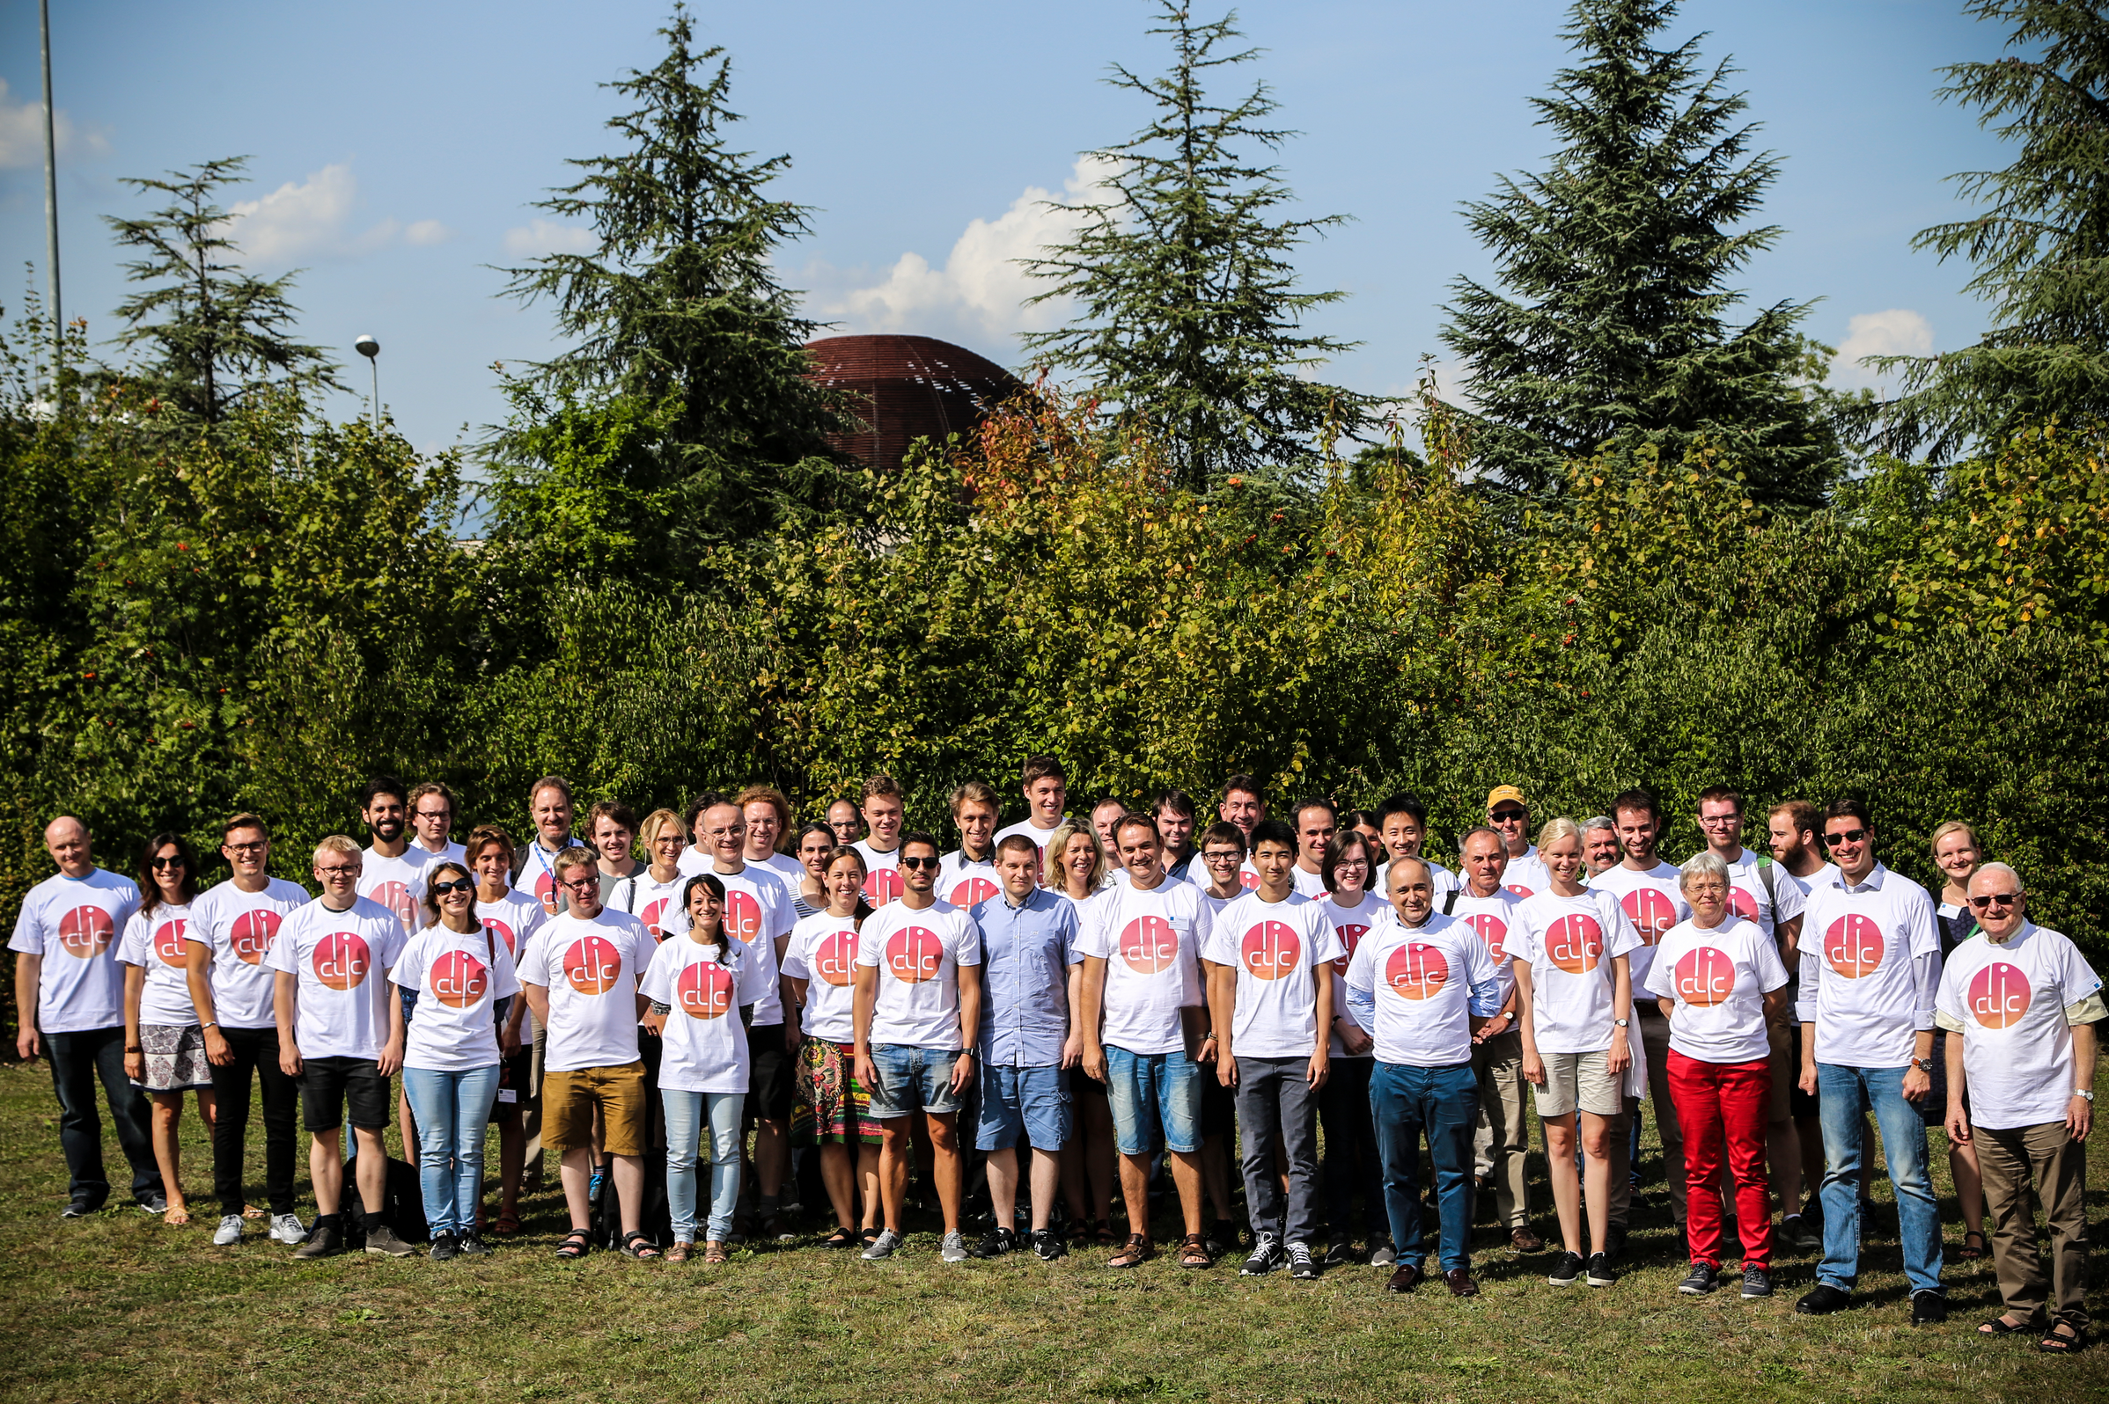
THANK YOU

