Slide 1


Update: Thermal Imaging
William Heidorn
Iowa State University
ISU Weekly Stave QA Meeting
April 4, 2018

Slide 2
Since Last Week…
The Pipe-Foam stave was thermally measured
  200 frames taken at 25 fps with the air off for at least 5 minutes to minimize air effects.
Air Flow Effects
  Stave 6 was measured with fluid at +50C, and -40C
  Thermal videos were taken to see the changes made by the air on the cooling pipes
Stave 6 was thermally measured for the first time…

Slide 3
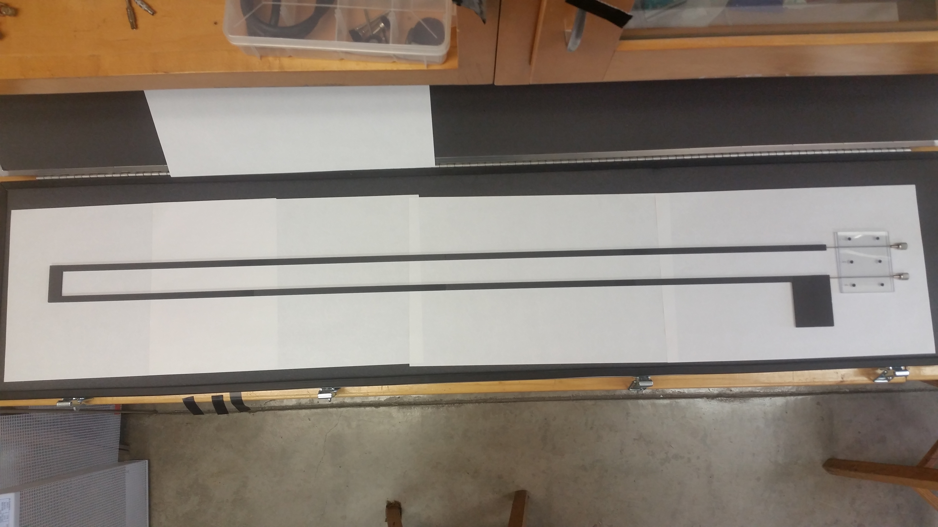
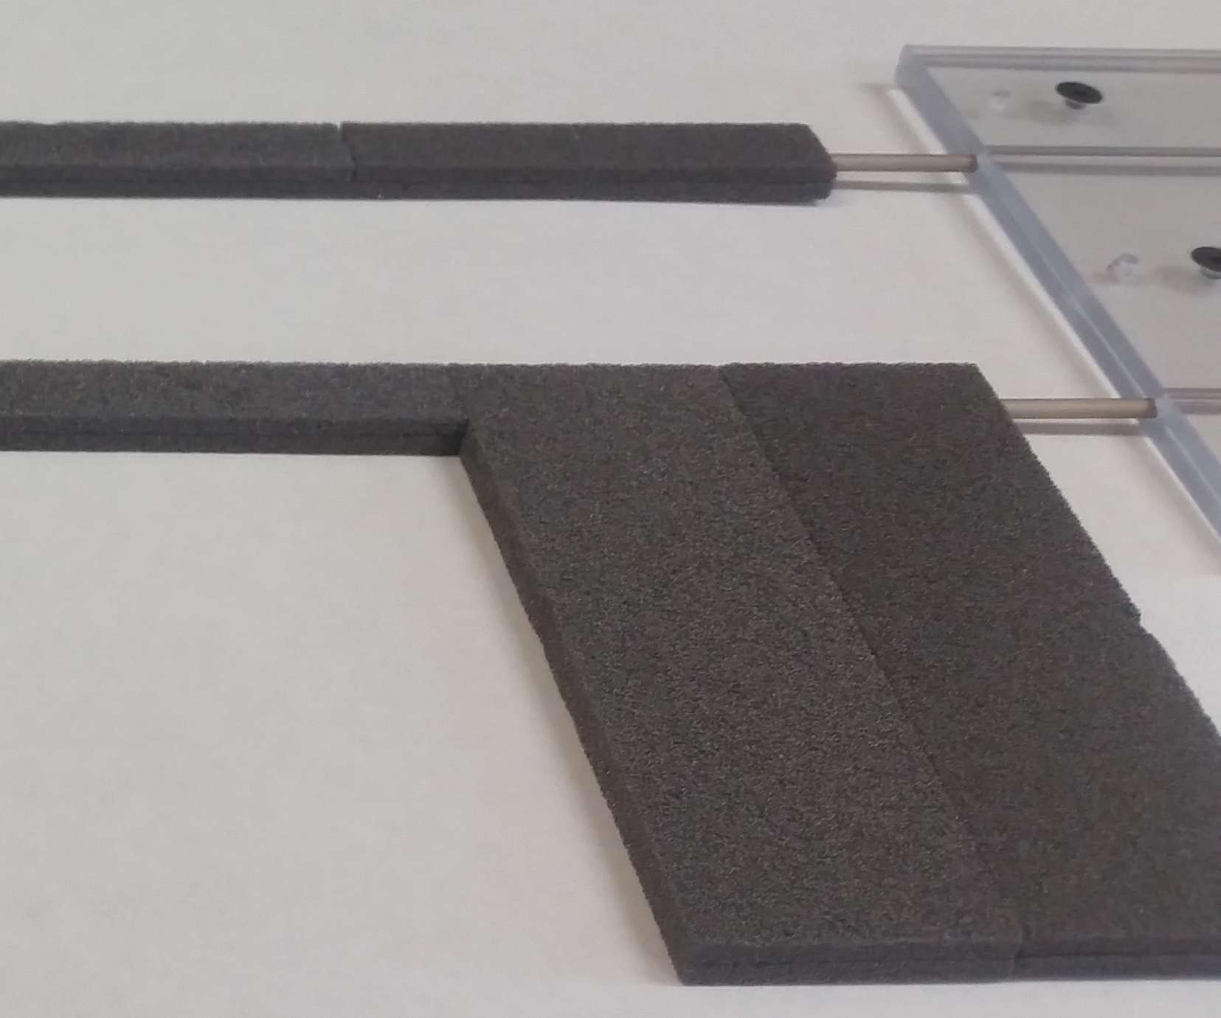
Pipe-Foam Images
The pipe-foam stave is a titanium cooling pipe with the thermal foam put around it.
  The thermal foam is purchased in 1’x1’ squares and is machined into grooved halves that are glued on both sides of the pipe (like a sandwich)
Different gluing techniques may have been used to assemble the structure
Approximate emissivity 0.79

Slide 4
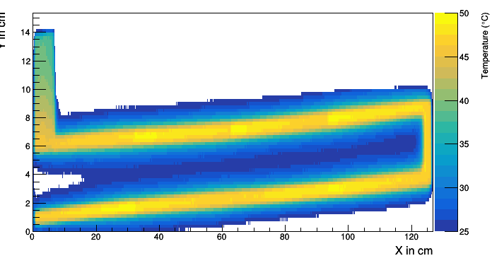
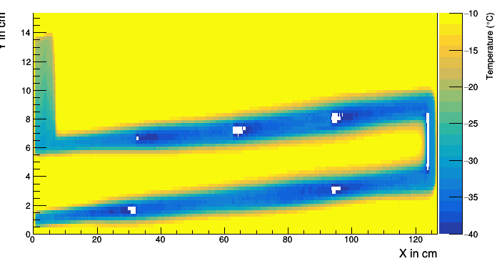
Pipe-Foam Stave J-Side

Slide 5
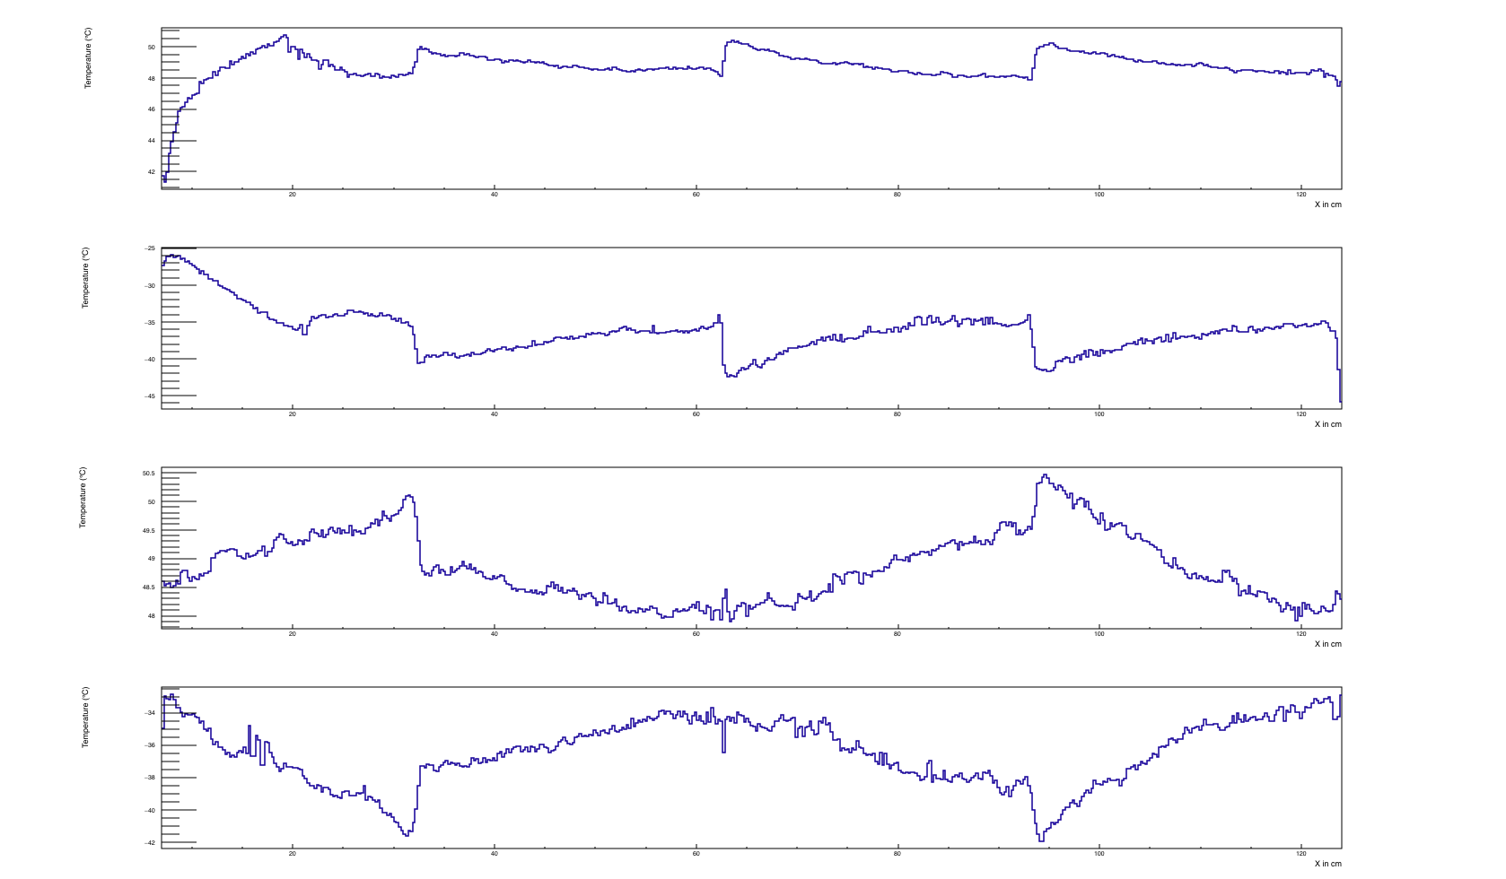
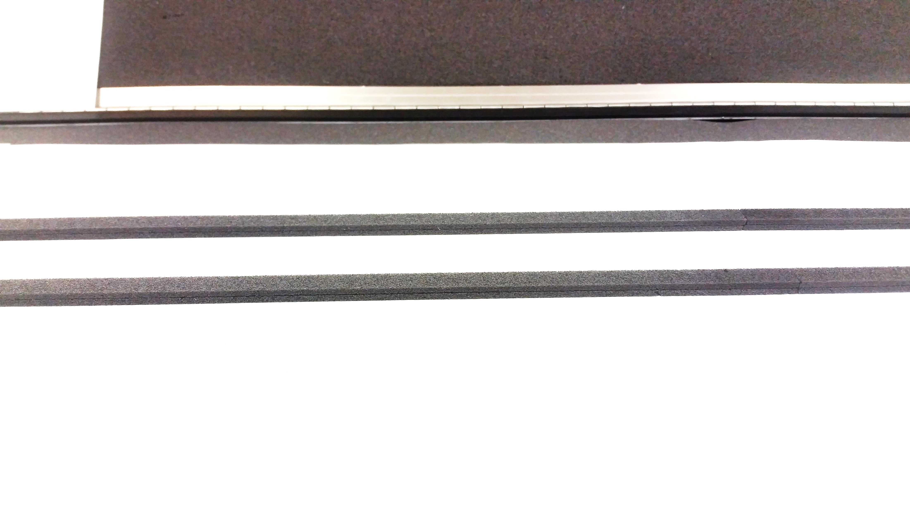
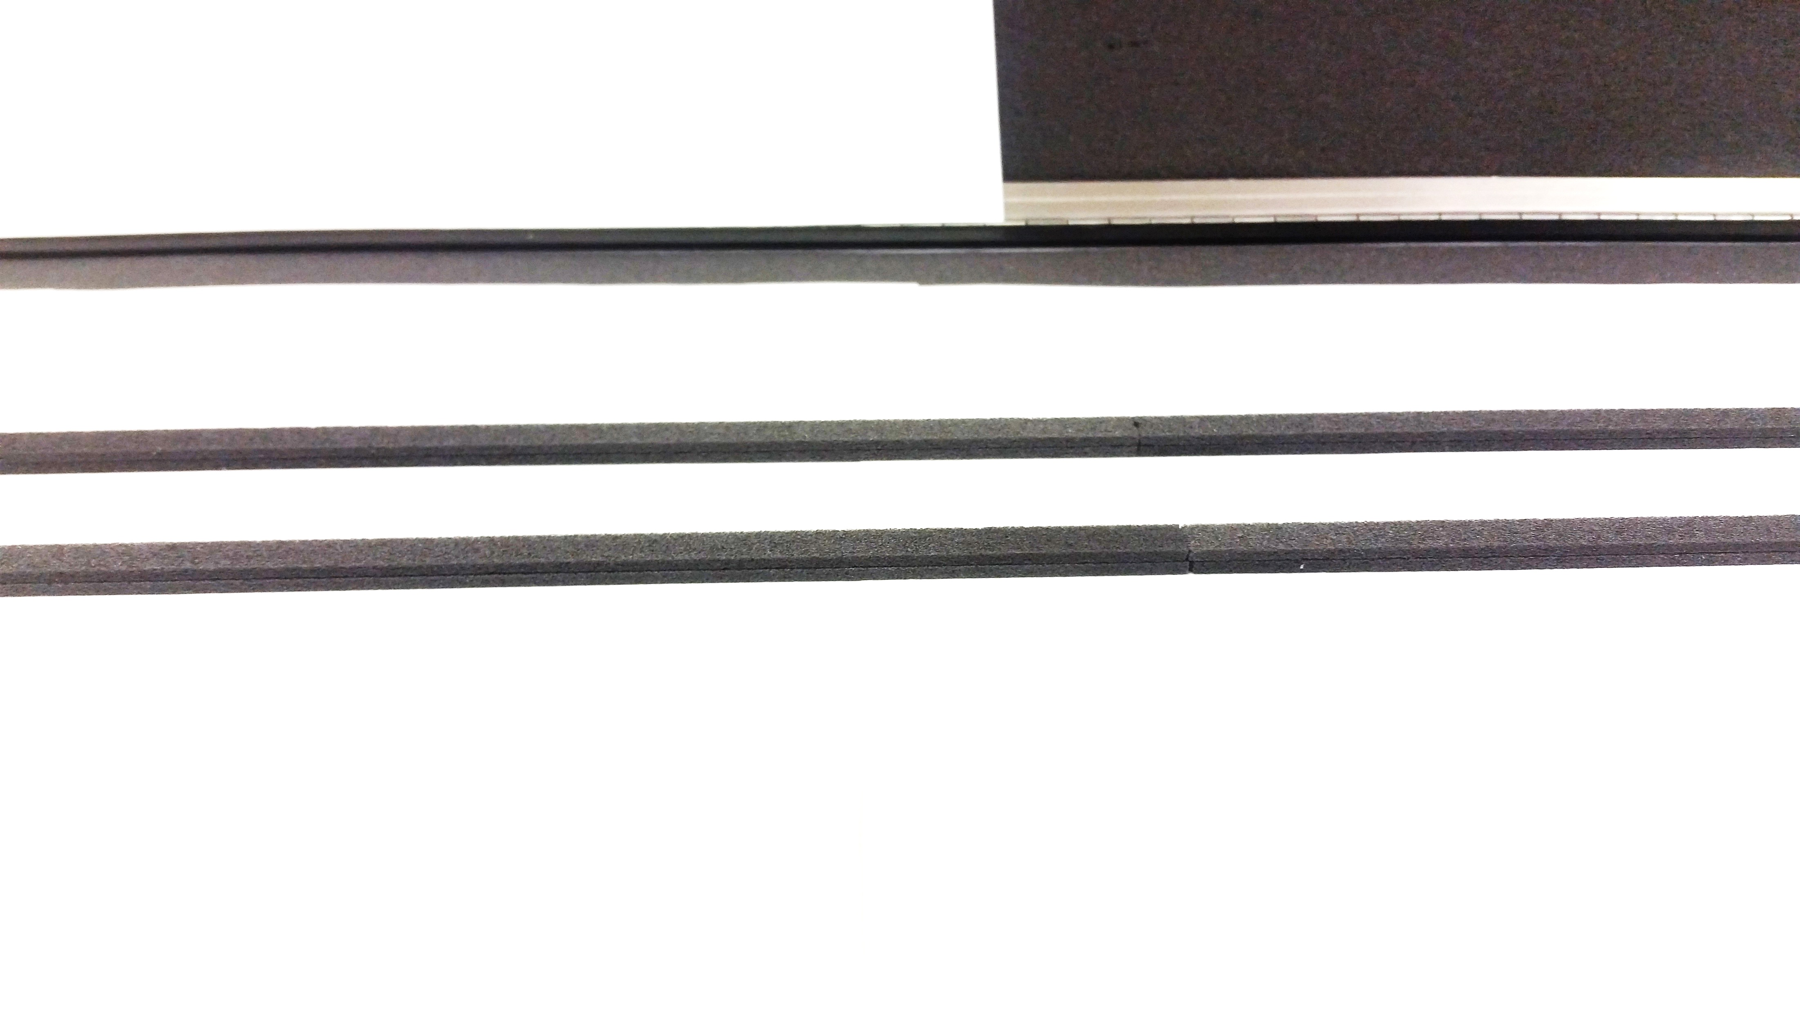
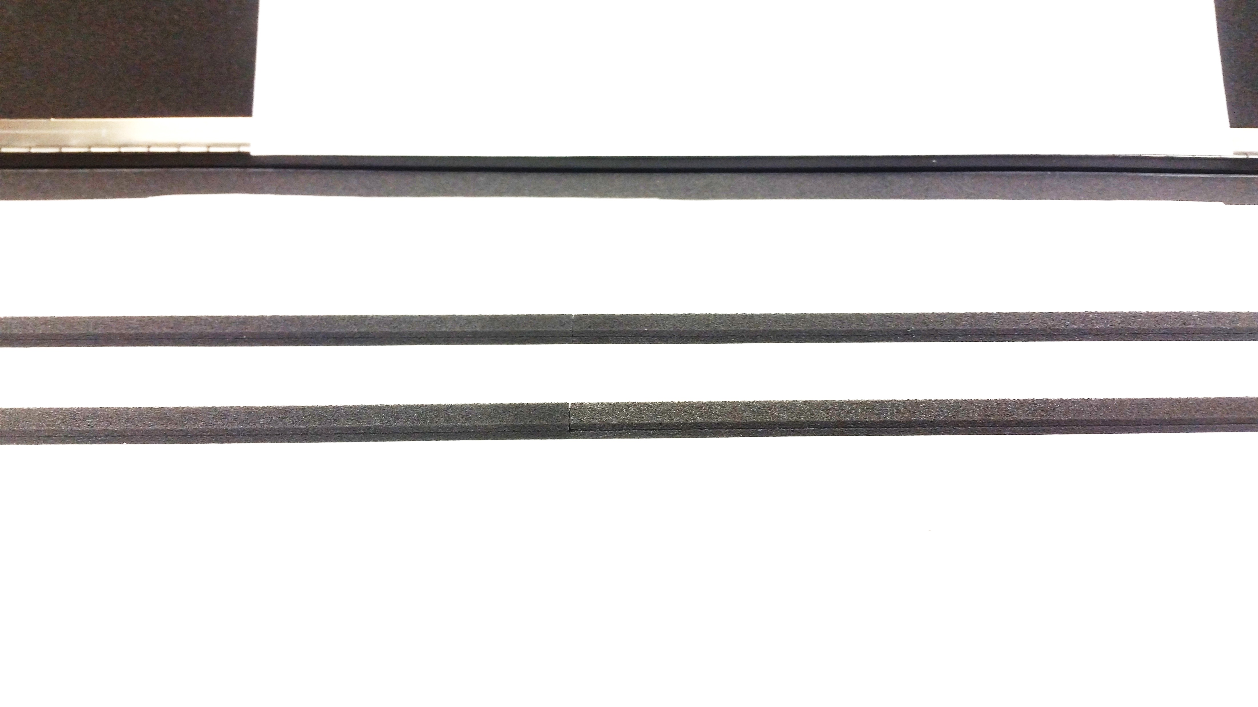
Pipe-Foam Stave J-Side (cont.)
At each intersection between foam pieces a thermal jump can be seen.
Comparing theses peaks to the foam, seems to indicate that the separation between plates may be due to breaks in the connection between chunks
Smoothest transition is seen in well glued area

Slide 6
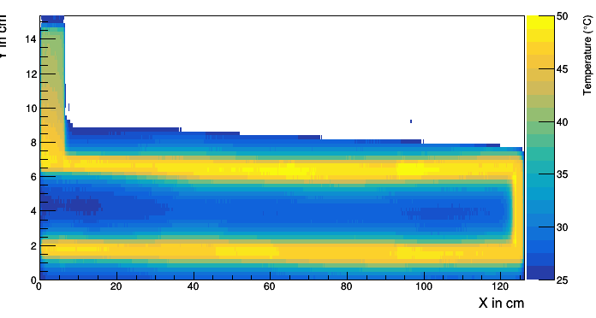
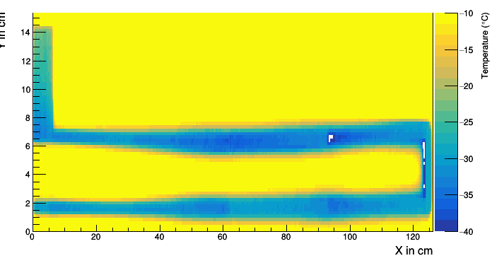
Pipe-Foam Stave L-Side

Slide 7
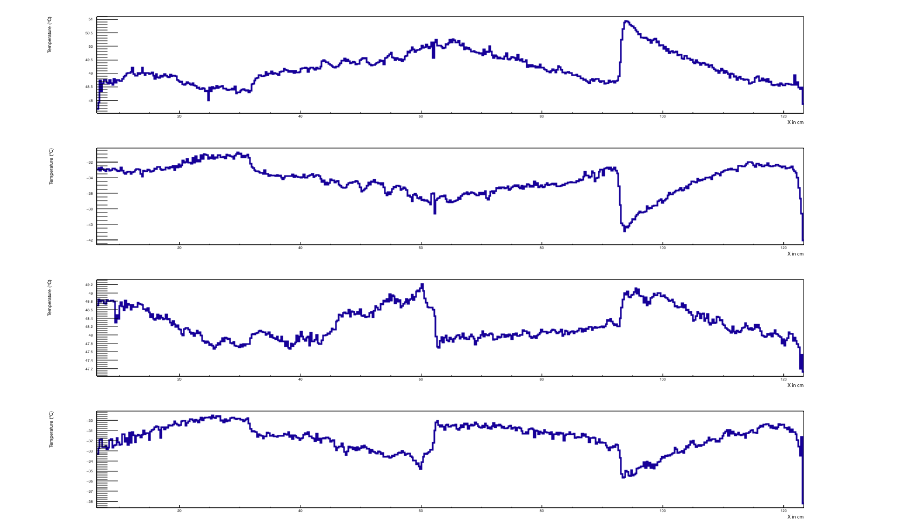
Pipe-Foam Stave L-Side

Slide 8
Once you know about the pipe-foam structure, the basic structure of the cooling pipe profile begins to make a lot more sense…

Slide 9
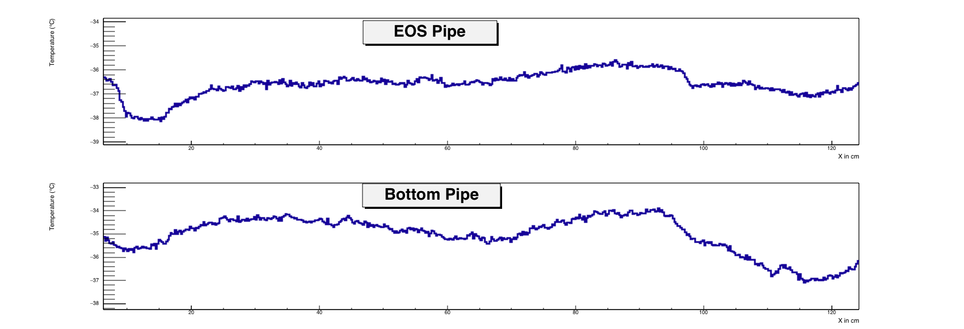
Stave 5-JSide

Slide 10
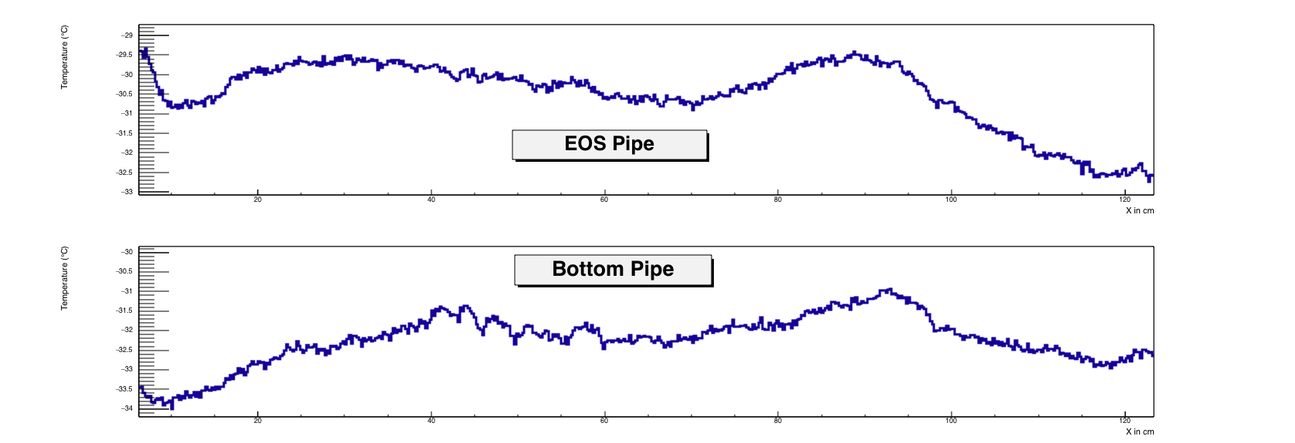
Stave 5-LSide

Slide 11
Pipe-Foam Conclusions
Pipe-Foam thermal structure are the cause of background structures in stave thermal images
Pipe-Foam thermal structure depends on pipe foam connection. If gaps exist between the foam pieces there are step functions that are generated in the thermal profile

Slide 12
Nitrogen flow effects
Dry nitrogen pumped into the enclosure can have an effect on the thermal image of the stave.
Using stave 6 as the backdrop, multiple tests were done filming the nitrogen’s effect to the box’s thermal profile.
  Volume of the box ~300 L
  Flow rate into the box ~ 30L/min @ 10psi
  Flow rate into the box ~ 20L/min @ 5psi

Slide 13
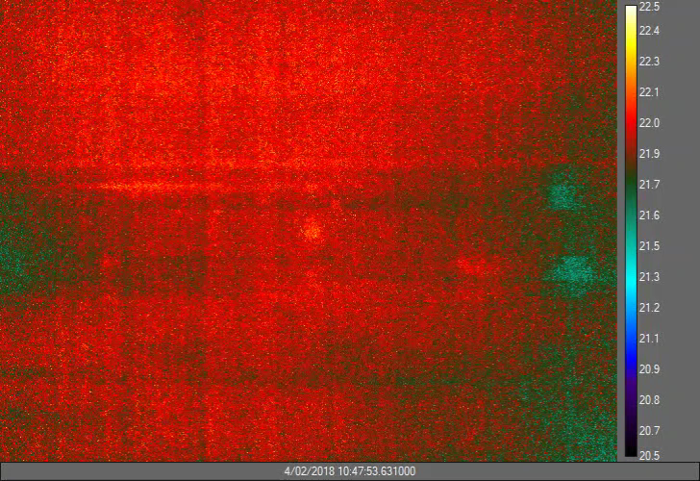
No fluid flow air effects
While the room and box were at ambient temperature, the gas is then turned on at 10 psi and an image is taken every 15s.
The air uniformly cools the box and stave a few degrees over 50 minutes of filming

Slide 14
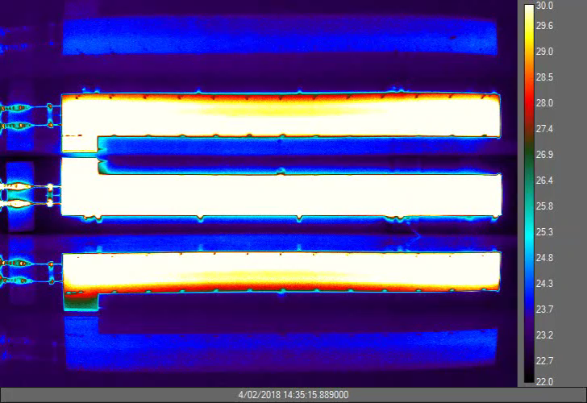
High temp effects
+50C fluid is being pumped through the stave at around 1 l/min.
The nitrogen has been off while the stave was going to +55C. The gas was then turned on at 10psi with the camera taking an image every 15 s
When the airflow begins the box starts heating up. The box temp increases around 5 degrees over 50 mins

Slide 15
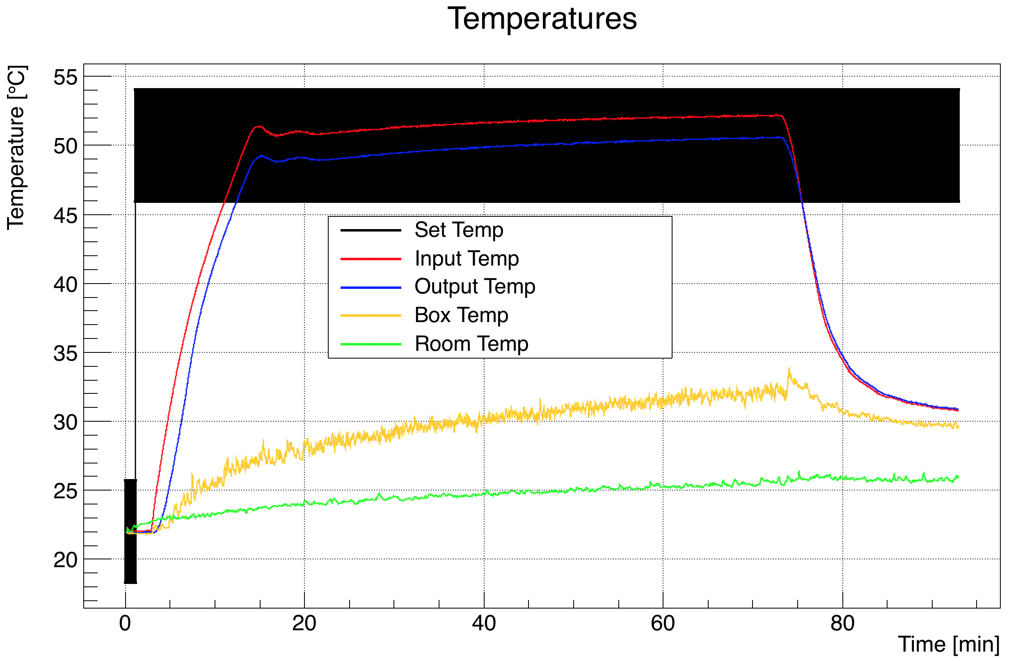
High temp effects cont.
No obvious changes on thermocouple measurements
No changes seen in box temperature measurement
Yellow Line is when nitrogen is turned on and video was taken

Slide 16
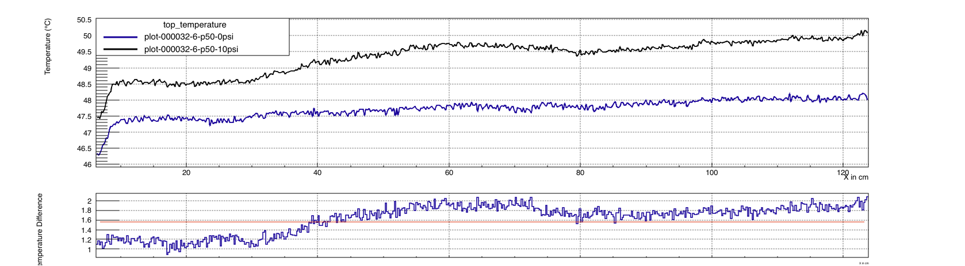
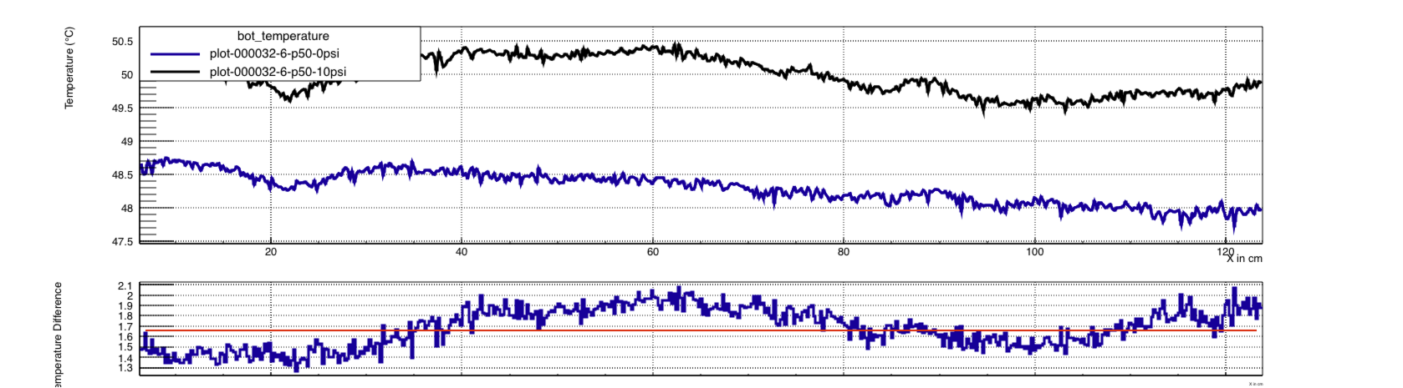

Slide 17
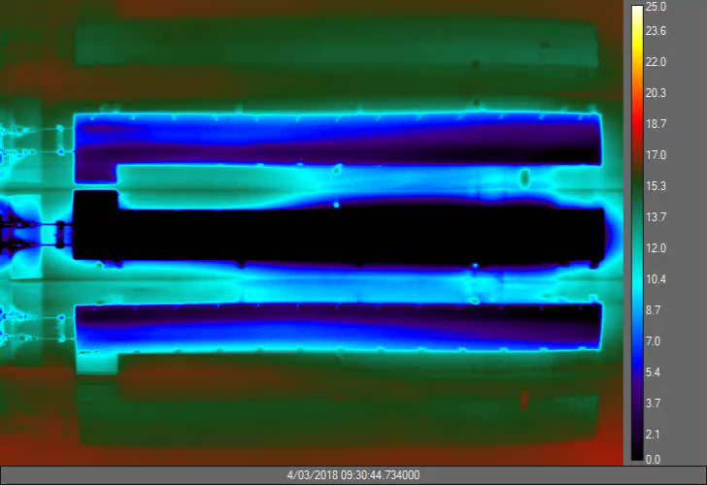
Low temp effects (shutting off air)
-36 C fluid is being pumped into the stave at a rate near 1l/min
The nitrogen has been on while the chiller struggled to get the stave to this temperature… (Had some interesting chiller ctrl problems causing a few restarts)
  Mainly due to the logging process freezing up
An image is taken of the enclosure every 10 seconds for 33 mins. The box warms up during this time
NEXT SLIDE: Temperature difference between beginning and end frame

Slide 18
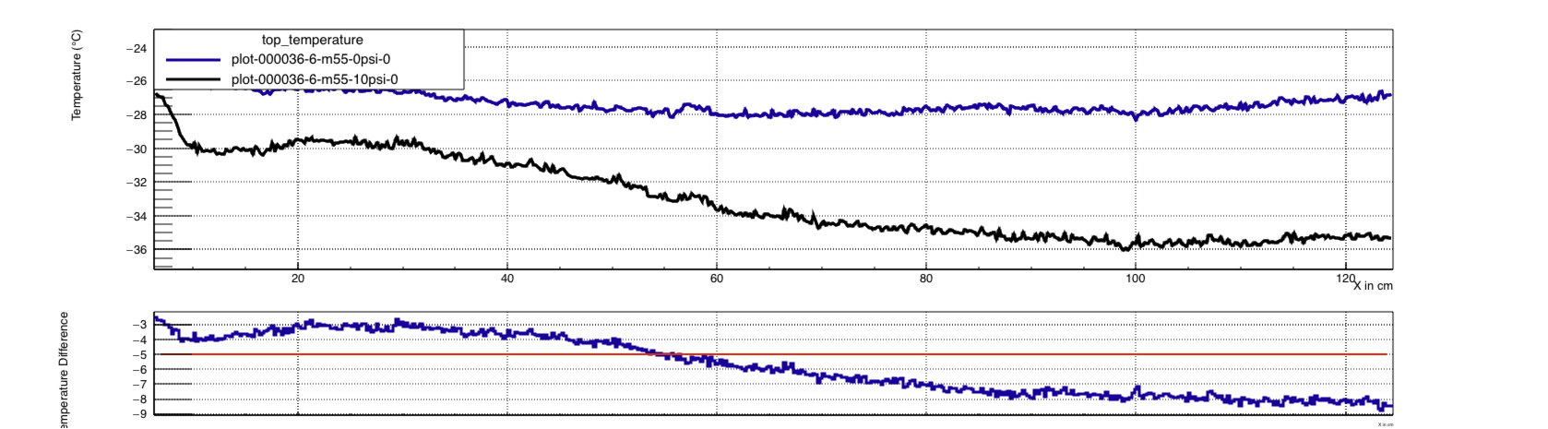
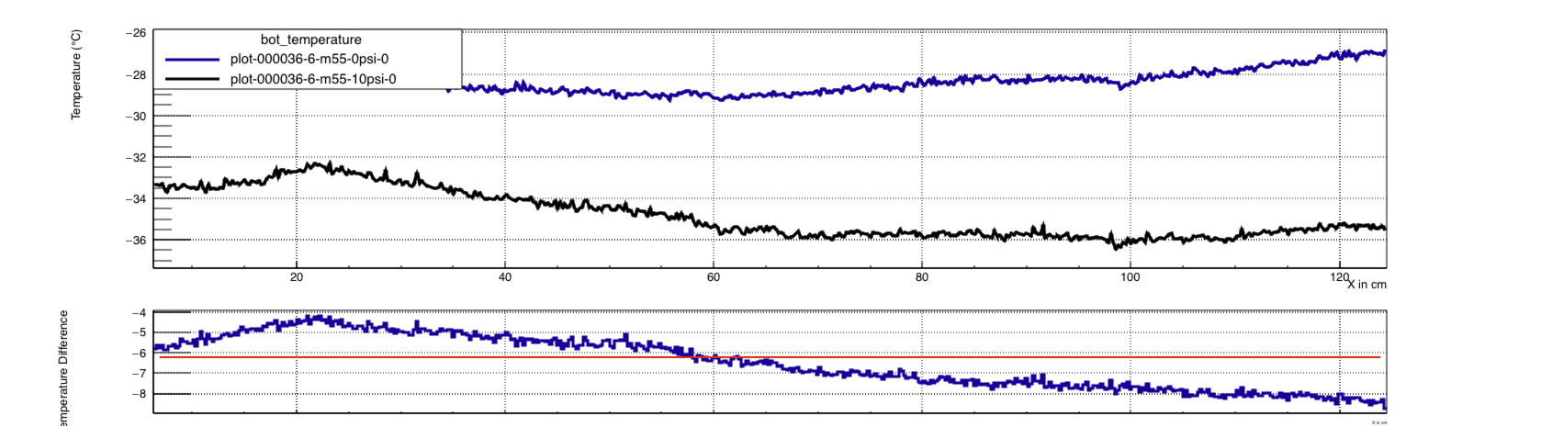
Low temp effects (shutting off air) cont

Slide 19
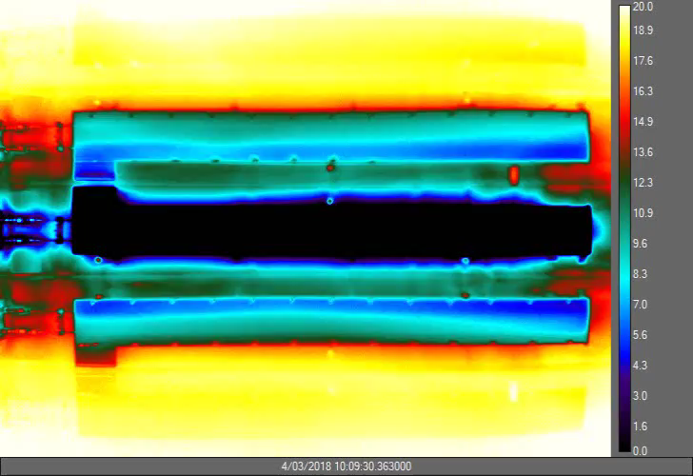
Low temp effects (turning off air)
After the 33 min without air the air is turned back on and a picture is taken every 10 seconds for another 33 min
The temperature of the box slowly begins to cool down over the time.
NEXT SLIDE: Temp diff between beginning and end frames

Slide 20
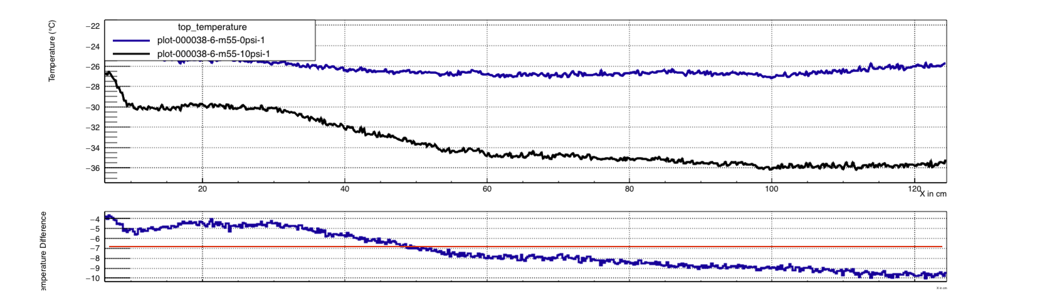
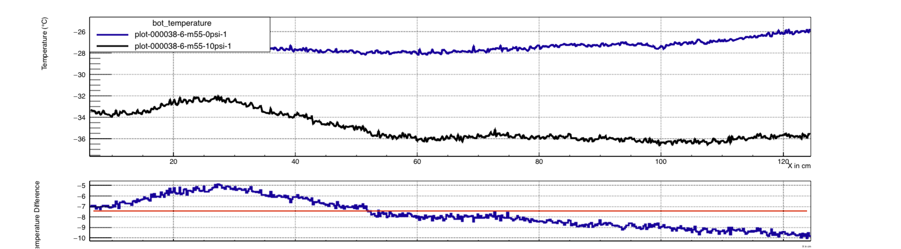

Slide 21
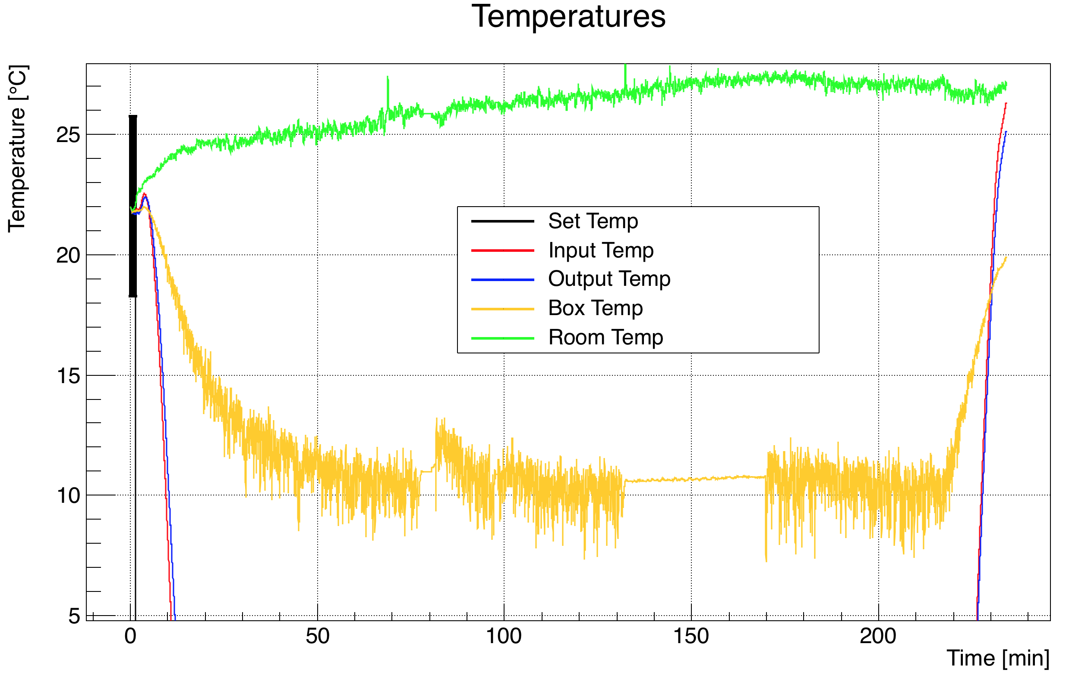
Low temp effects cont.
Shutting off air is black portion
Turning on air is blue portion

Slide 22
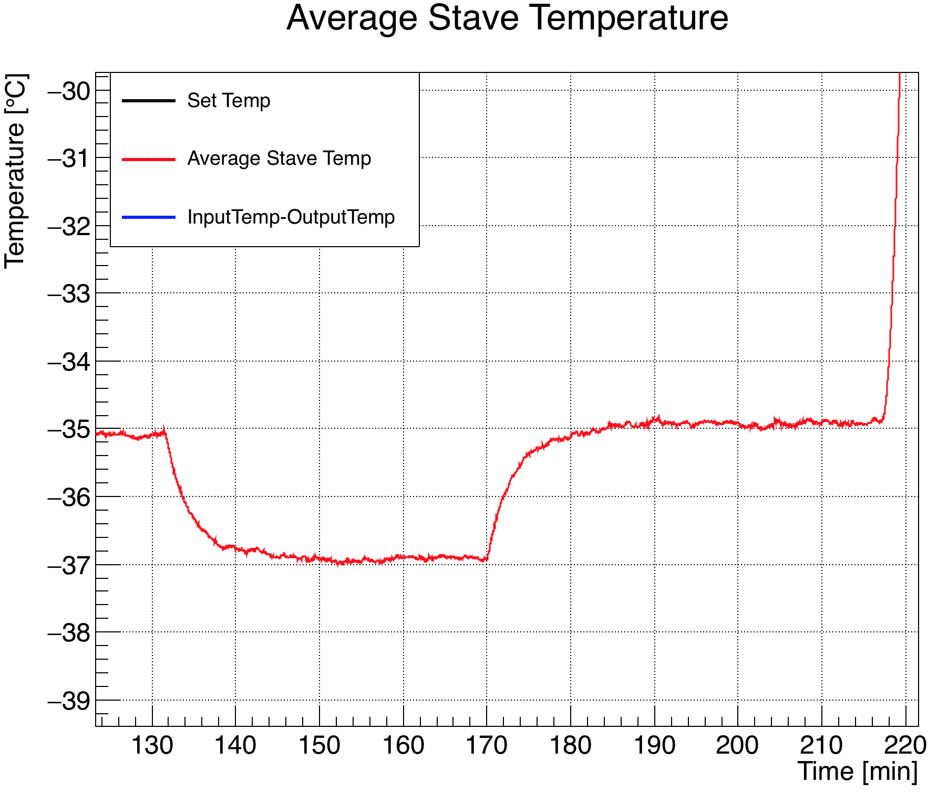
Low temp effects cont.
With the air off the average temperature of the stave inlet and outlet gets lower
It takes about 10 min to reach thermal equilibrium with the nitrogen
NEXT SLIDES: Comparison between both equilibrium plots
Air off
Air on

Slide 23
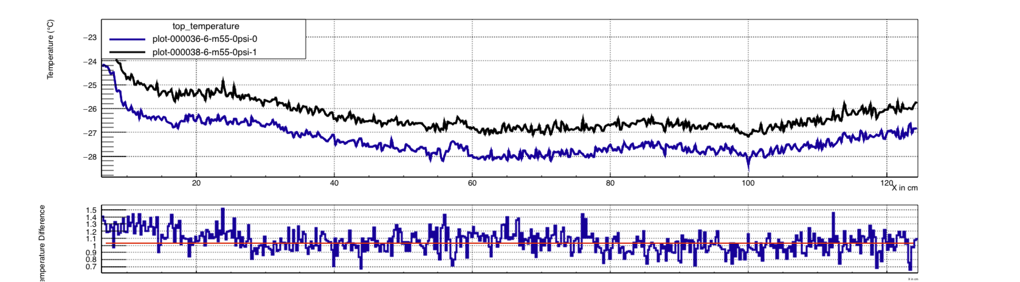
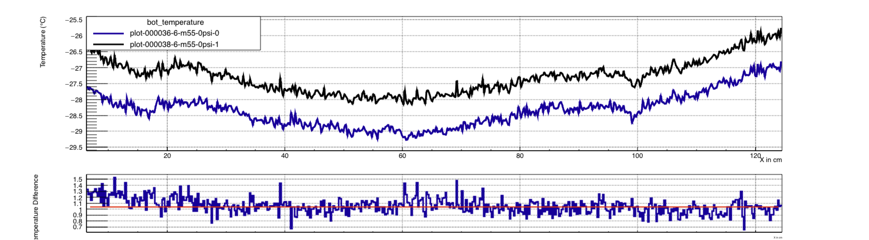

Slide 24
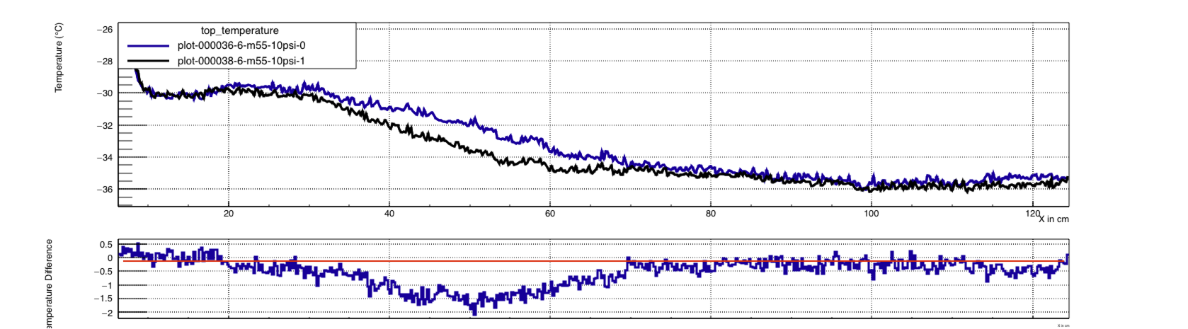
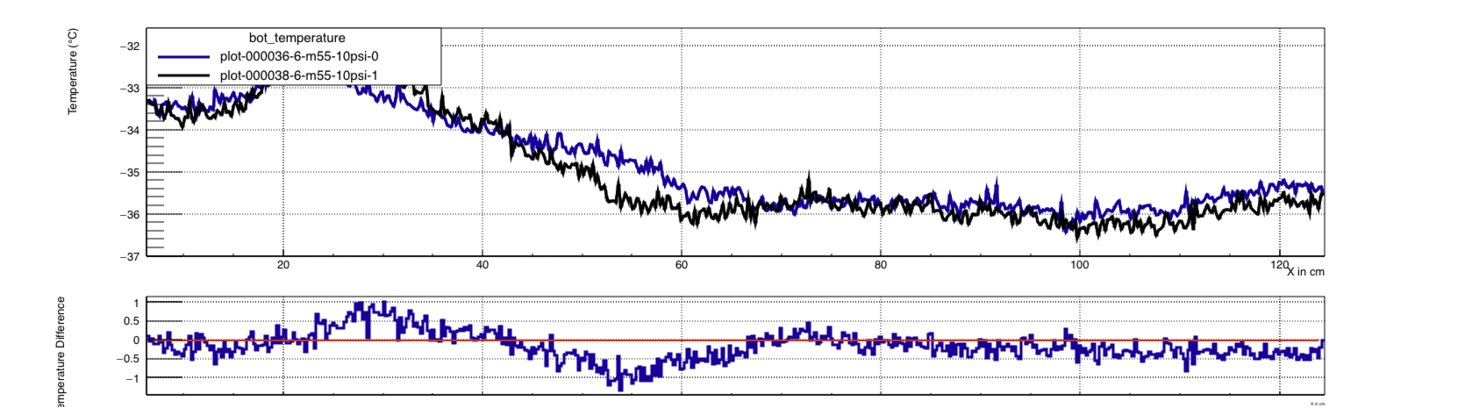

Slide 25
Airflow conclusion
The airflow has distinct effects on the environment of the enclosure.
  Changes the equilibrium temperature of the stave
  Changes the shape of the stave thermal profile
It takes around 10 min for the system to come to equilibrium after changing the airflow rate

Slide 26
Backup Slides
no

