Slide 1


Update: Thermal Imaging
William Heidorn
Iowa State University
ISU Weekly Stave QA Meeting
May 23, 2018

Slide 2
Since Last Time…
Reproducibility Part 3
  In the works, should have a nice set of plots today or tomorrow. I will send them around once they are done.
  Conversion rate of 30 seq files
    327 min for hot : 10.9 min/seq file
    313 min for cold : 10.4 min/seq file
Began reproducing the impedance calculations from Brookhaven for Friday meeting with them. I have a quick image of what I have in comparison as of Friday.
  I have their data as of yesterday to reproduce their exact calculation.
Enclosure renovations
Stave 7 Measurements
  They should be finished today.

Slide 3
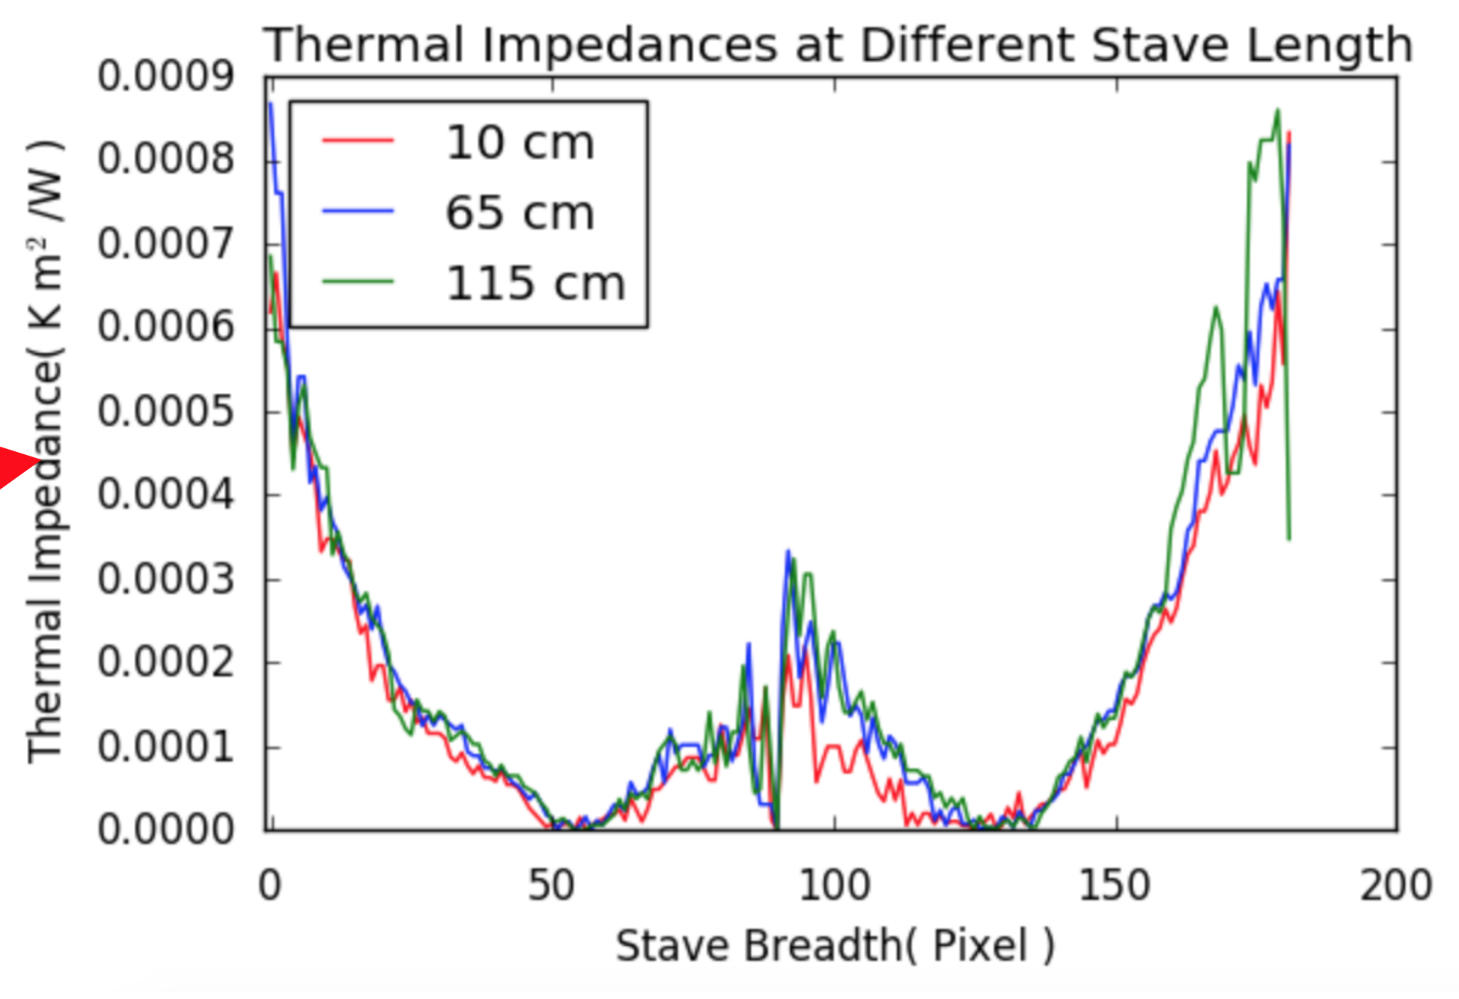
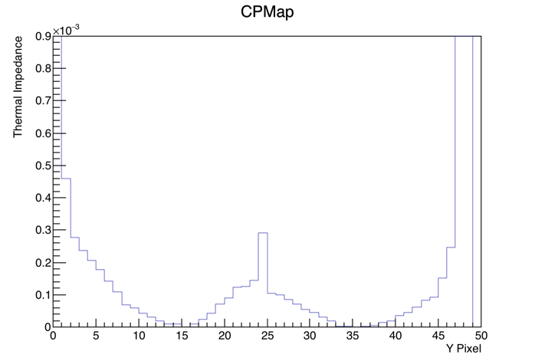
Very Early Comparison

Slide 4
Enclosure Renovations
Moved the support posts for alignment
  No longer get in the way of the stave parts. Could be moved in the future when they update the stave construction
Replaced cradle components
  Pressure gauge: different type that dampens the oscillations
  Quick connects: different type that is always open instead of auto closing when not connected
No leaks have been detected yet. We will have a good measurement on leak rate by next week.

Slide 5
Backup Slides

