Slide 1
Stave 6 Local Flatness
&
Stave 7 Pressure Test
Shuaiyan
2018/05/29

Slide 2
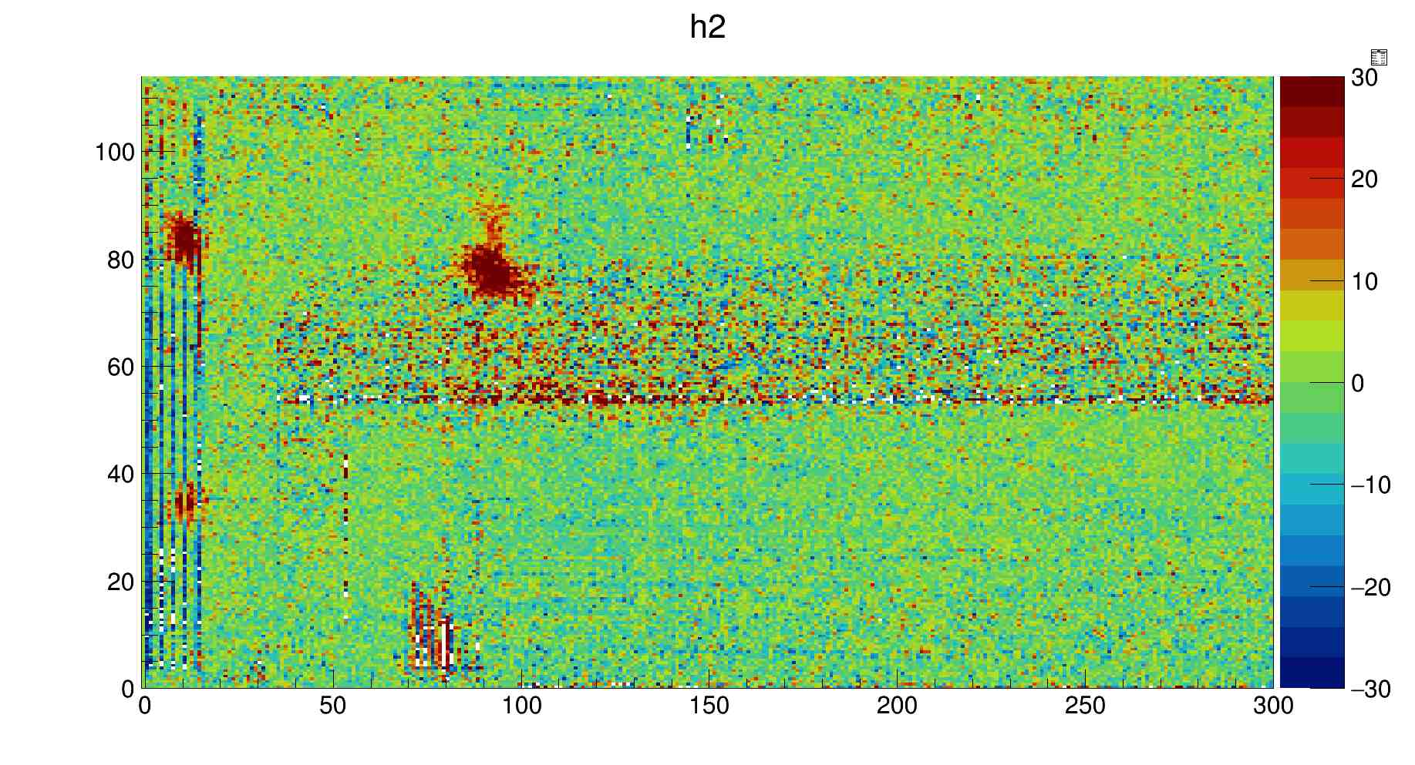
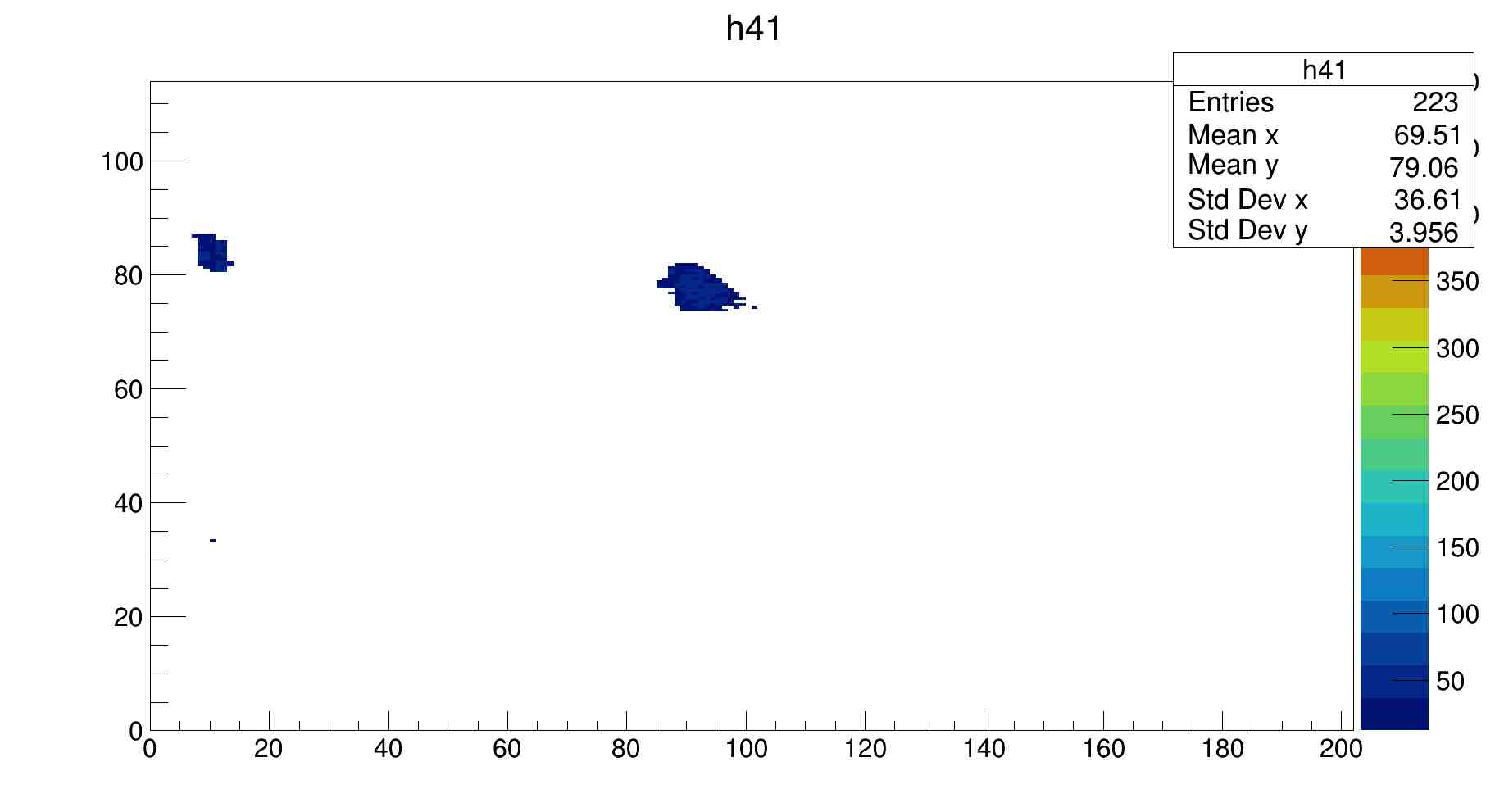
Stave 7 Defects
The defect finder finds three defects(one small) for both sides of stave 7.
1
1
2
2
3
3
L side 5-0 psi (zoomed)
L side defect plot (zoomed)

Slide 3
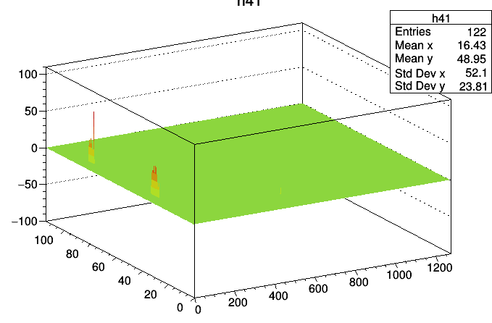
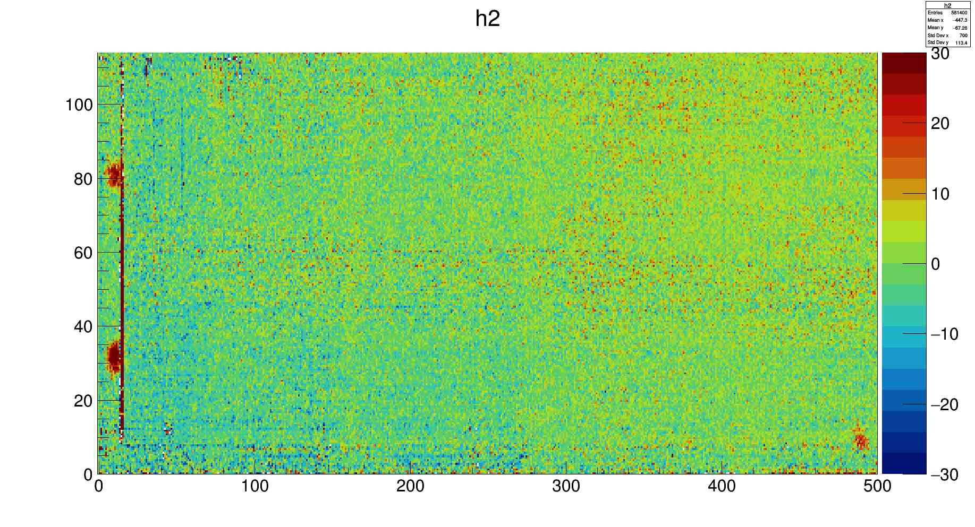
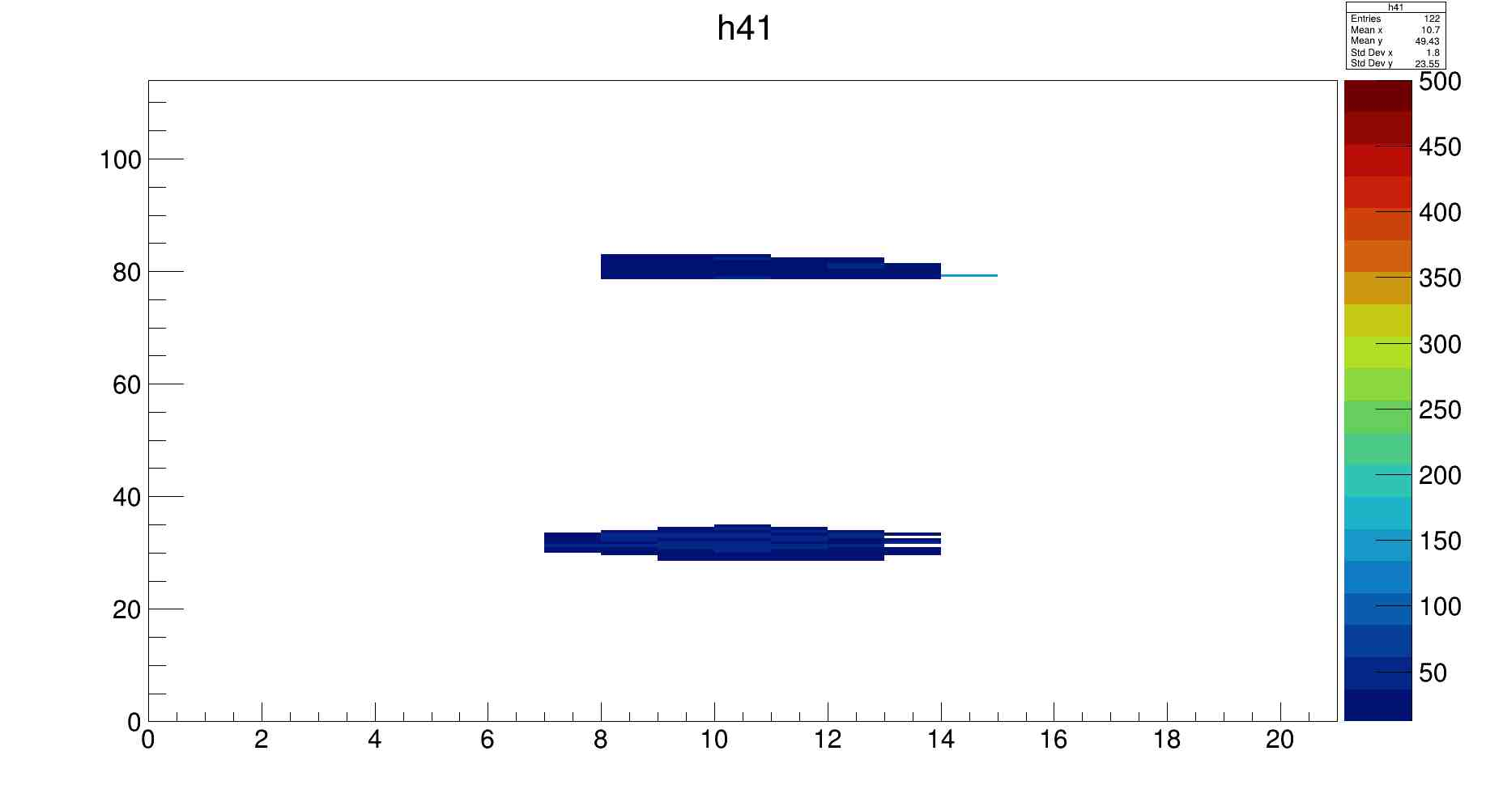
Stave 7 Defects(J side)
1
2
J side 5-0 psi (zoomed)
There is one abnormal pixel causing the
maximum height to be very large(148 um)
The actual maximum height is 43 um.
1
2
J side defect plot (zoomed)

Slide 4
Plot of Maximum Height vs Minimum X, Y defect width
Blue dots represent stave 7 data
Orange dots represent stave 2 & 4 data

Slide 5
Stave 6 Local Flatness
Eliminate the points with rms larger than 15 um
For each module (98*220 points) , dividing them into 5*5 areas
Choose the medium height in each small area,drop the entire area if available points are fewer than 5 (only eliminated 24 5*5 areas for module 1)
Choose three points for generating plane, calculate the height difference

Slide 6
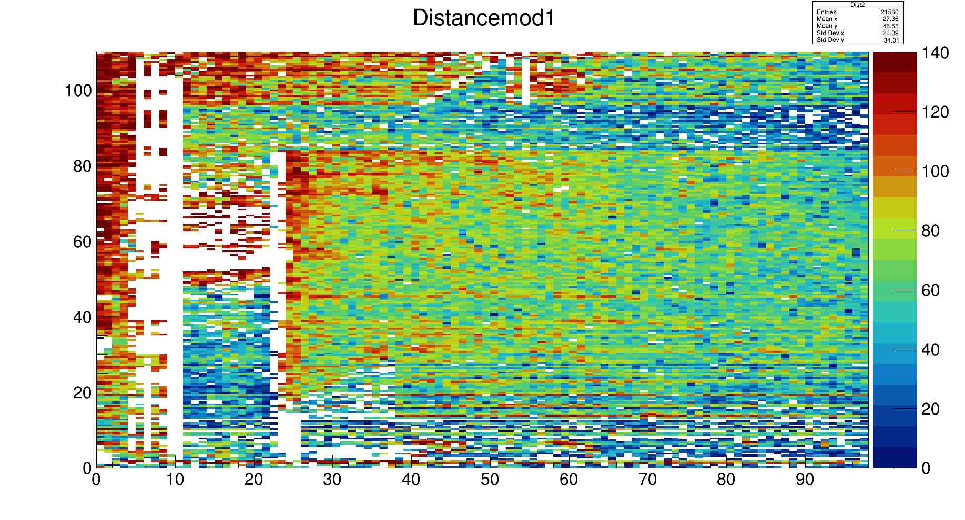
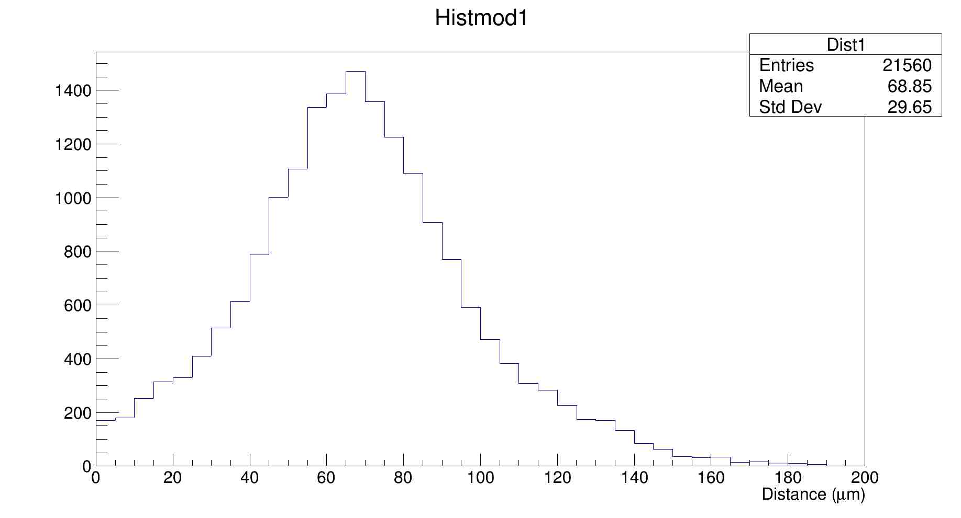
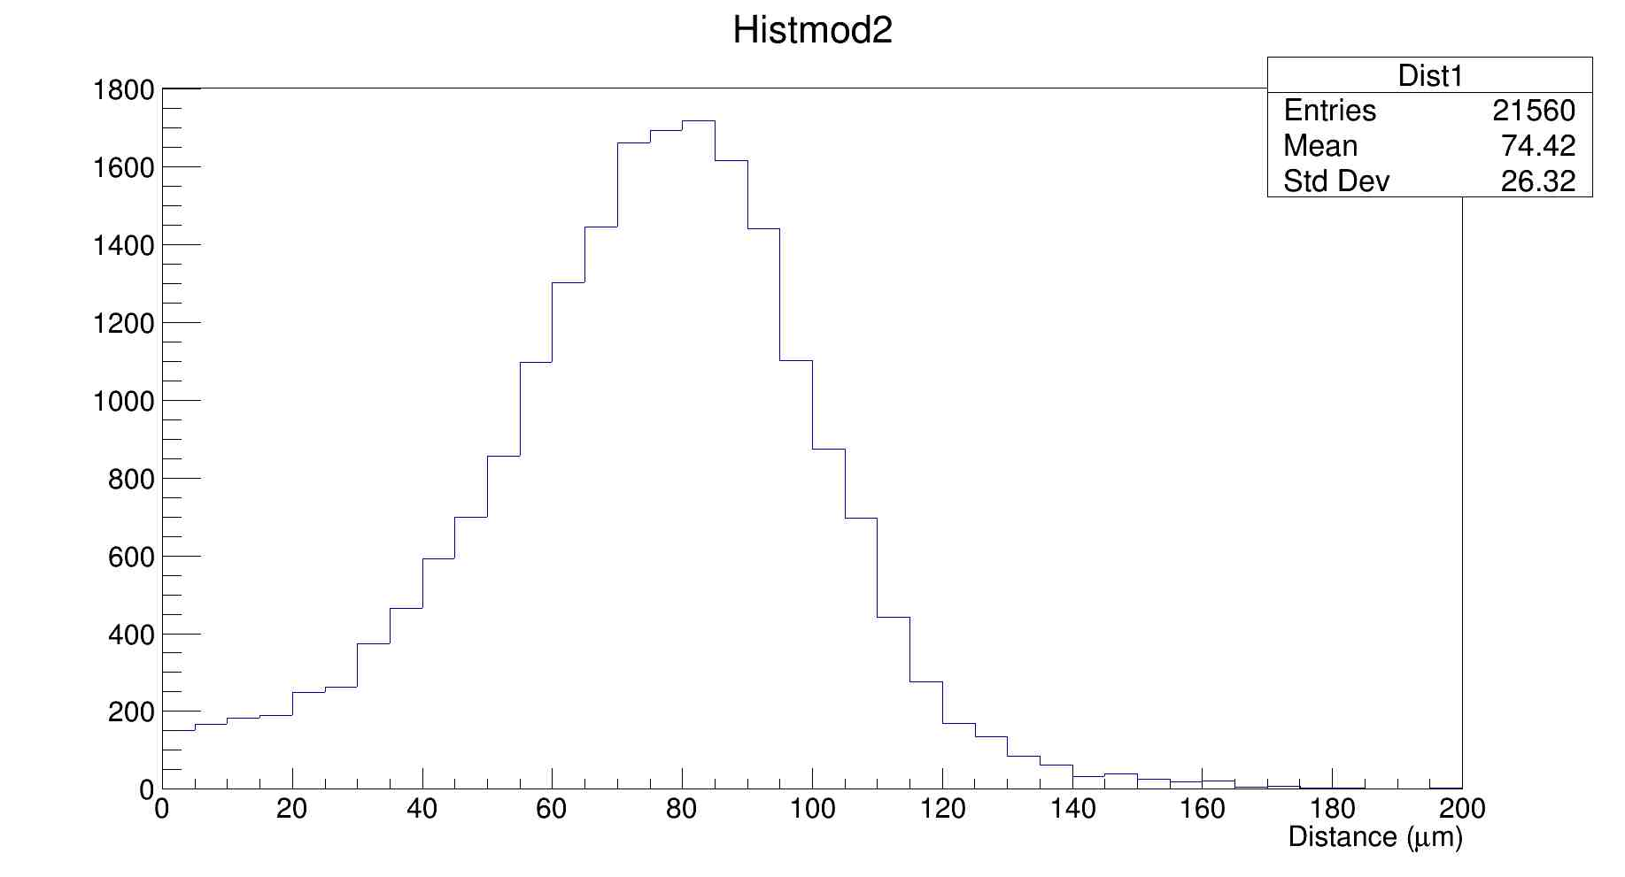
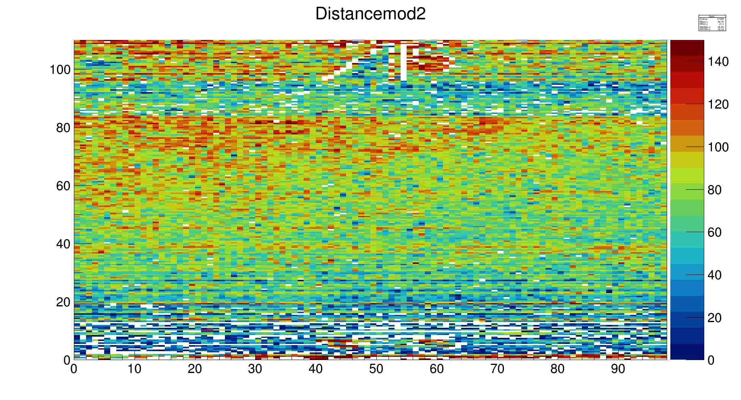

Slide 7
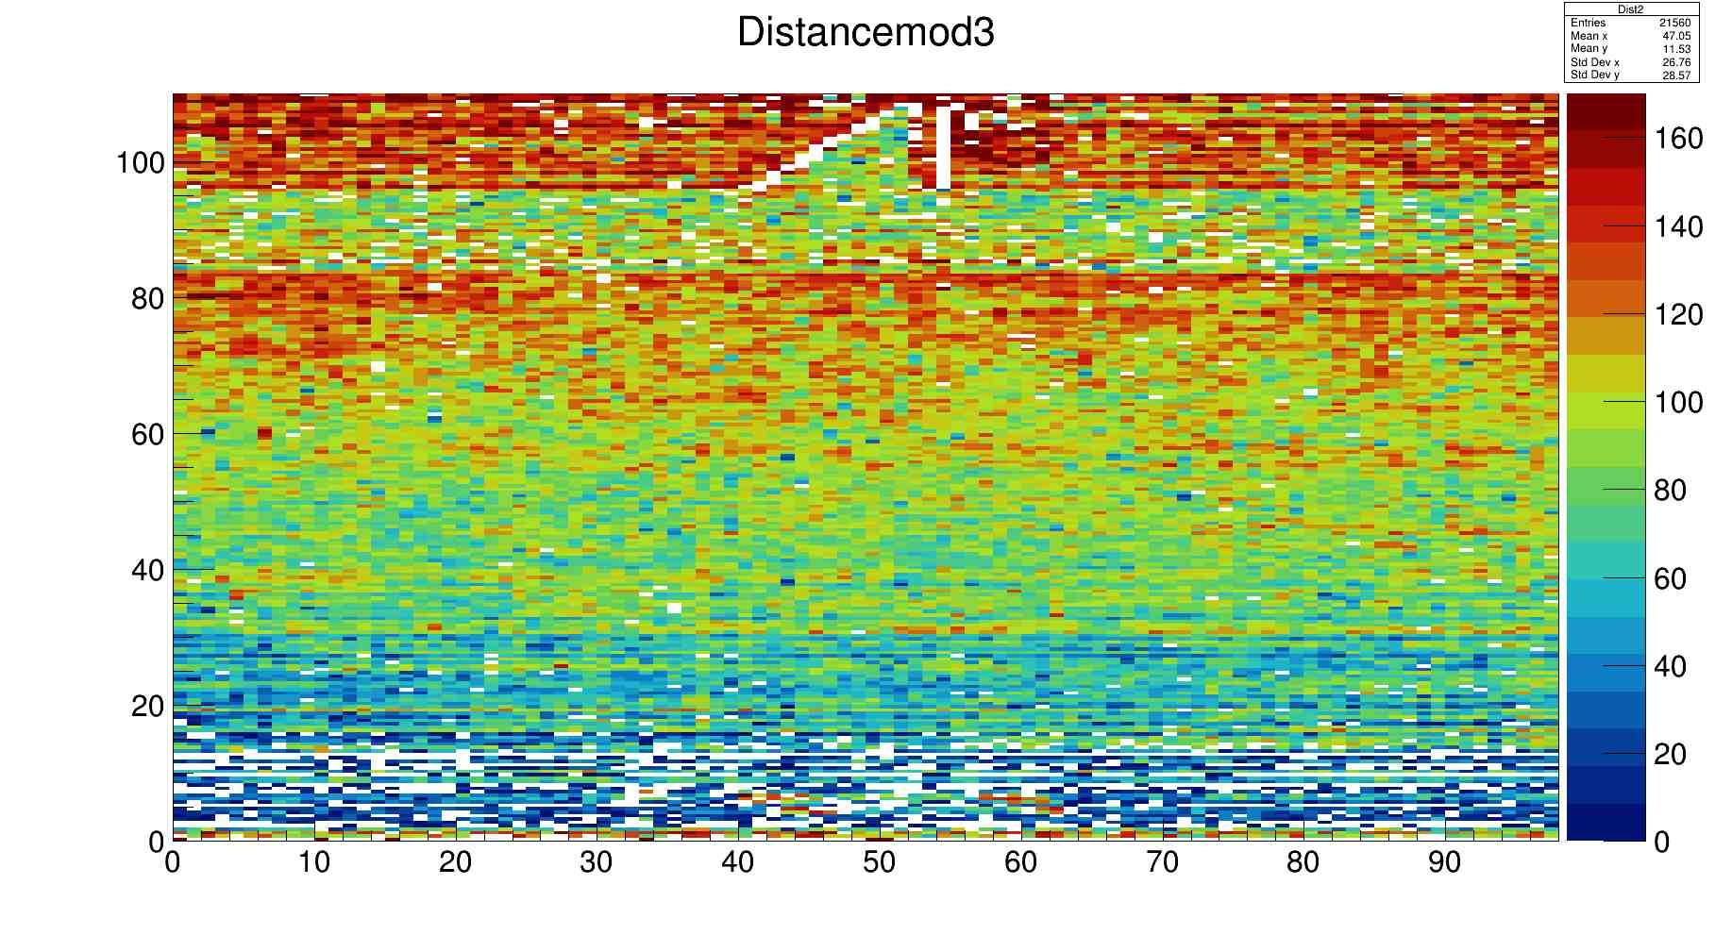
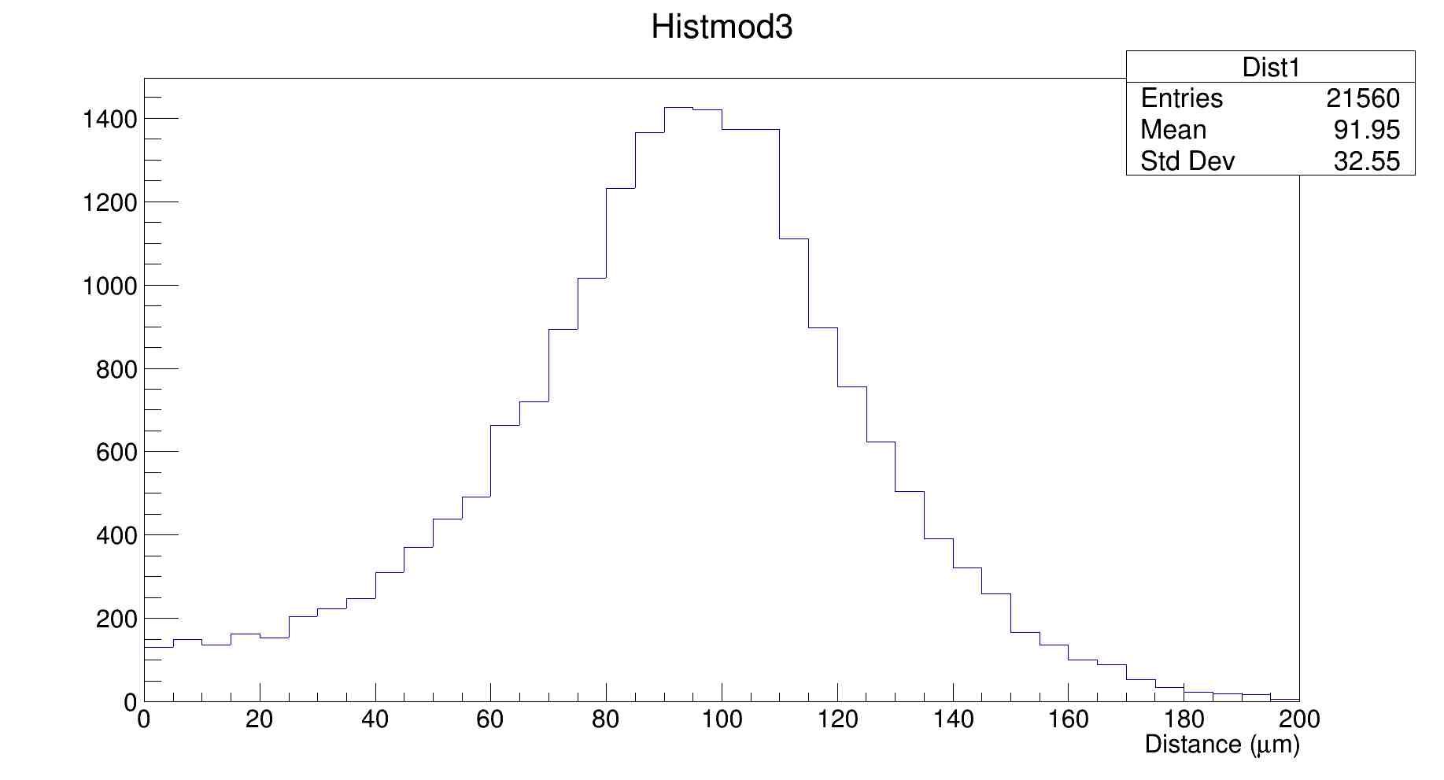

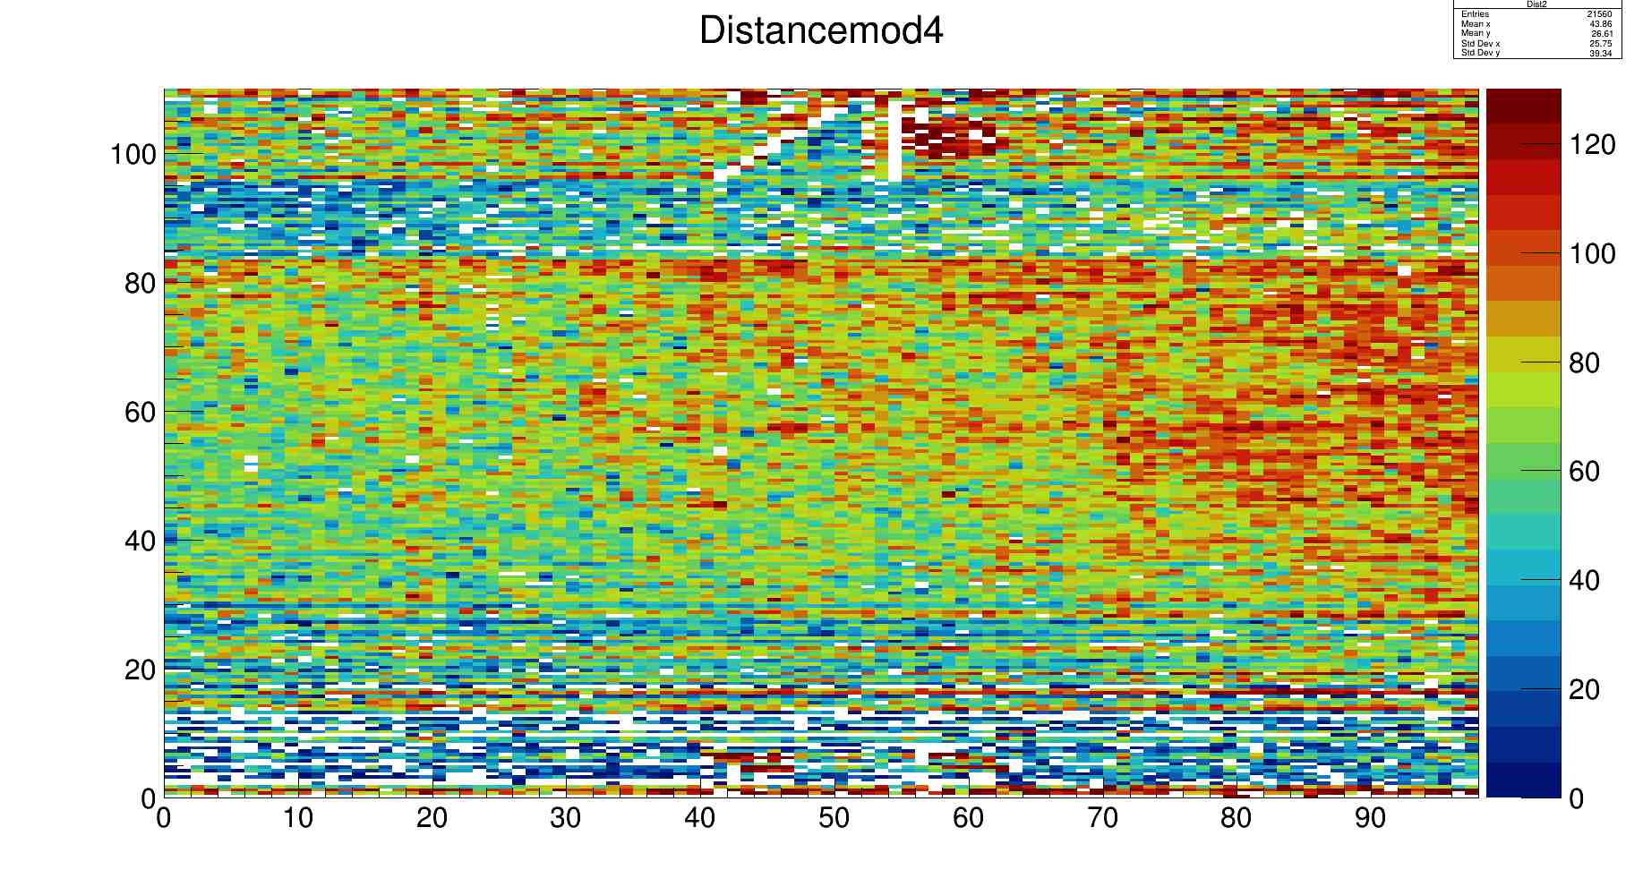

Slide 8
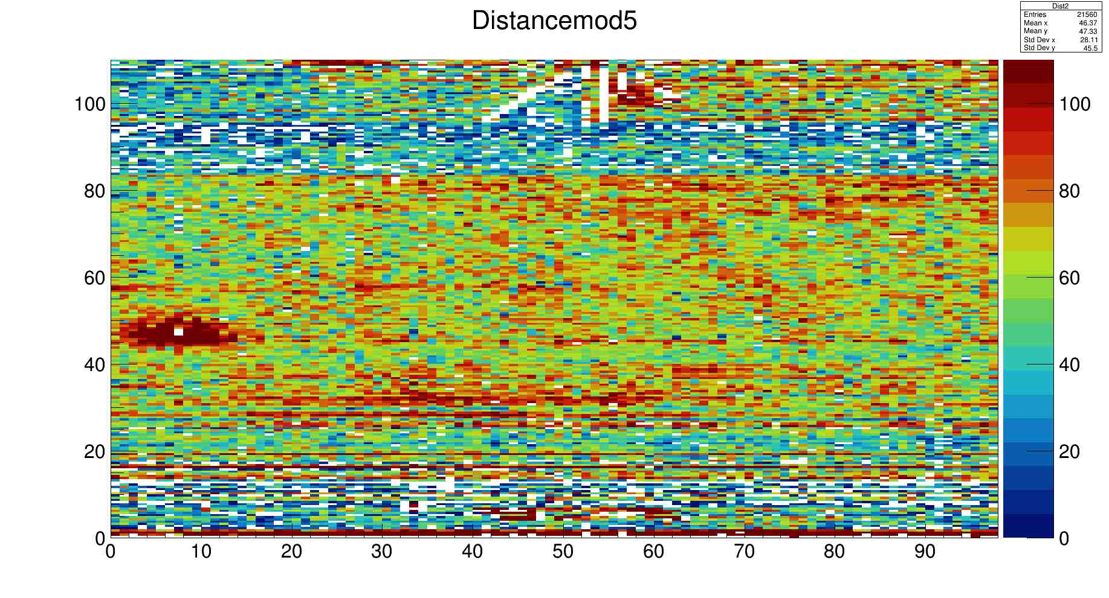
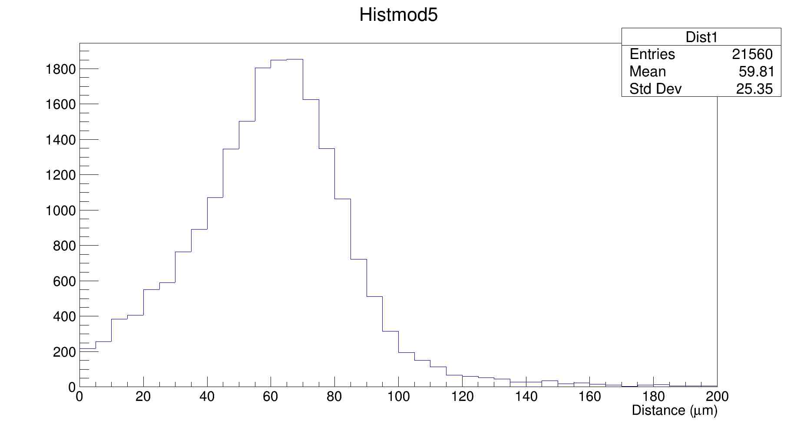

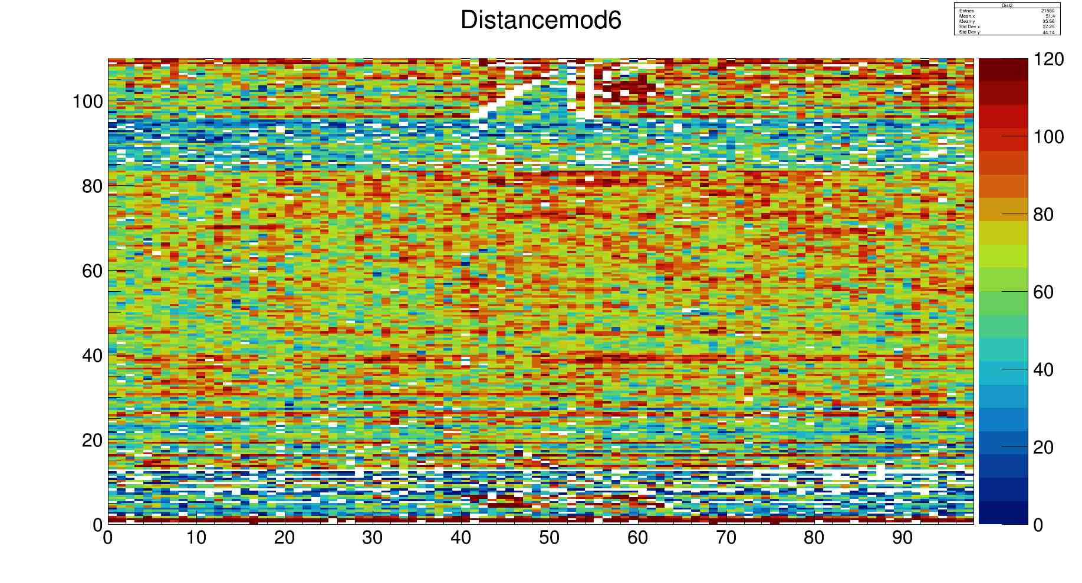

Slide 9
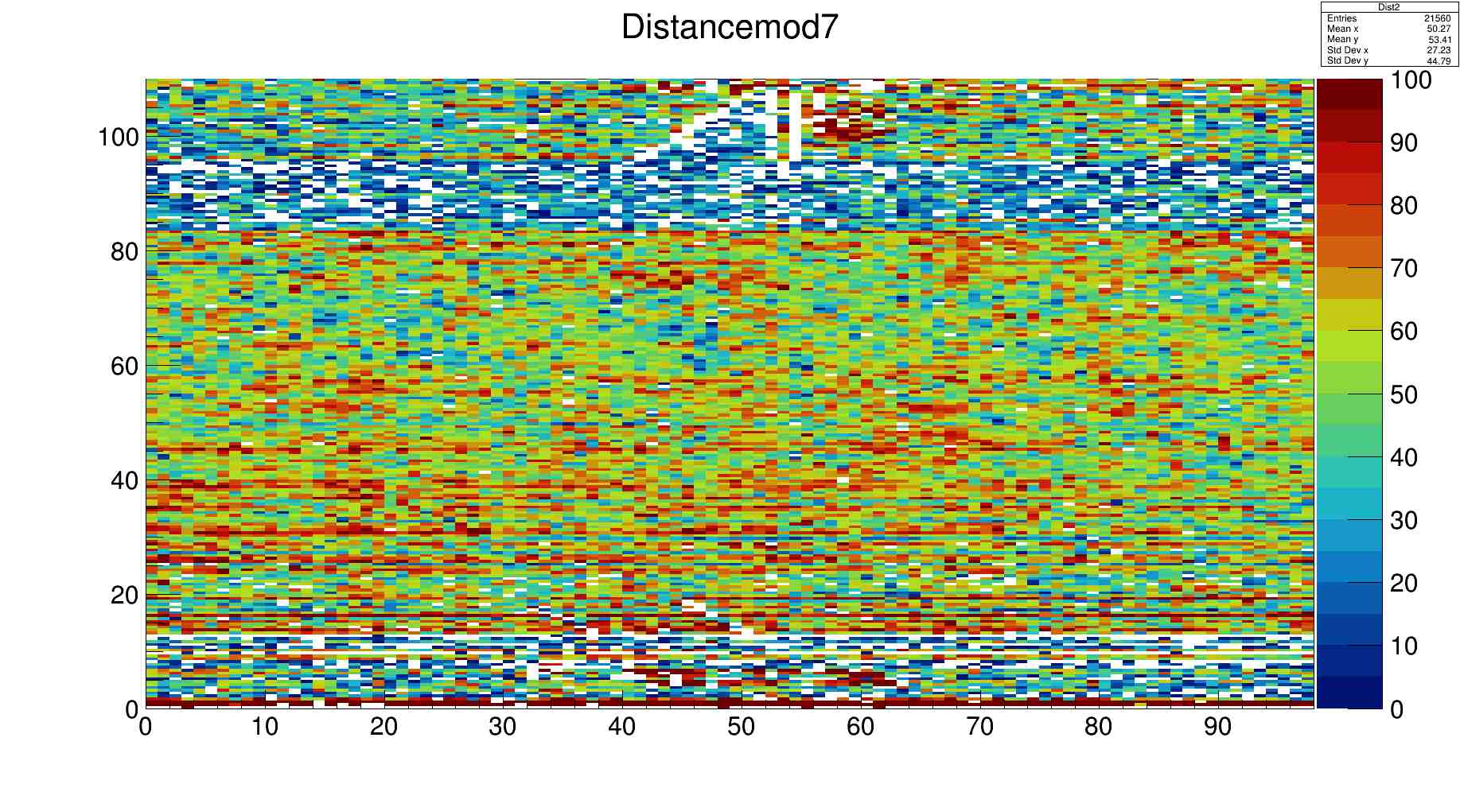

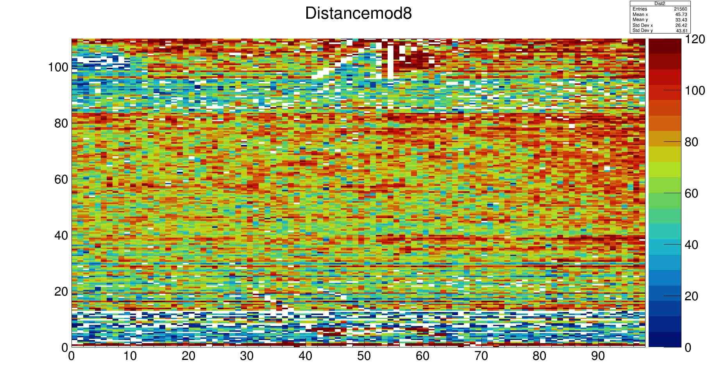
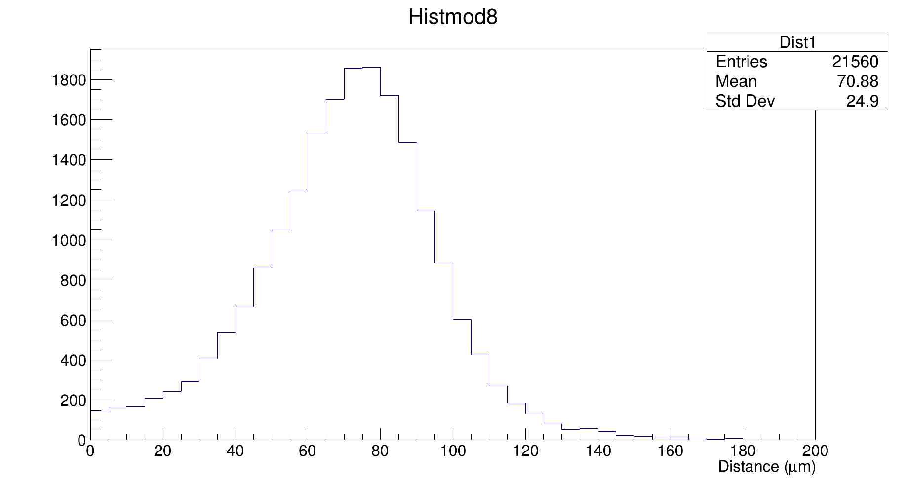

Slide 10
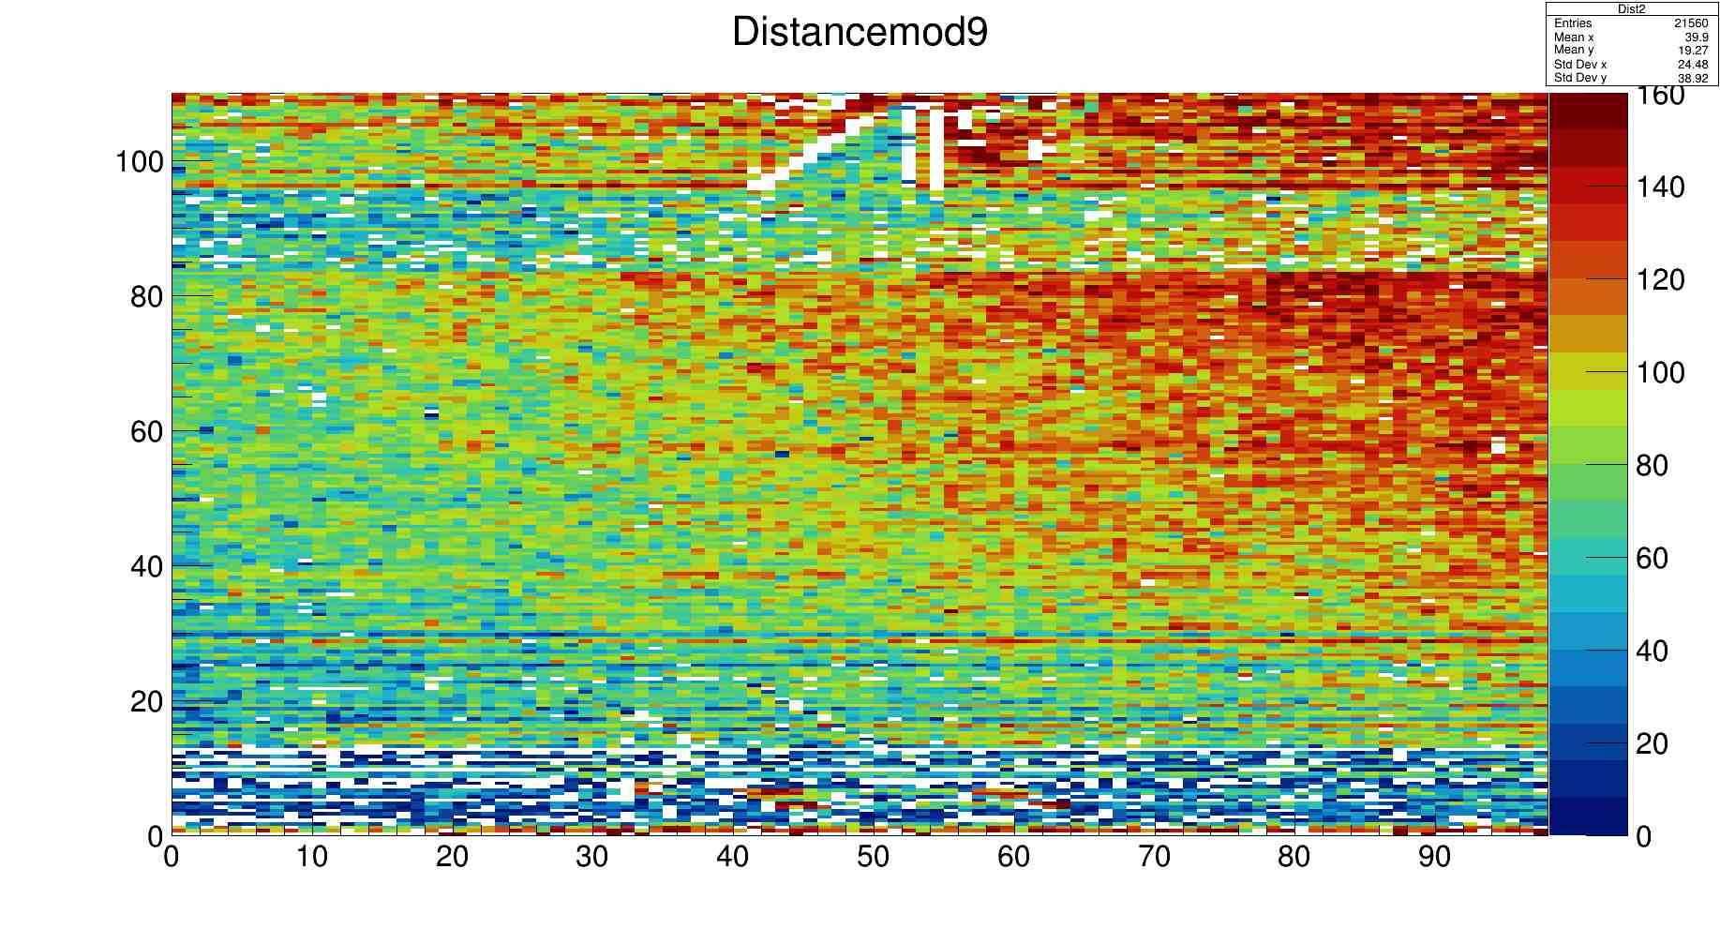

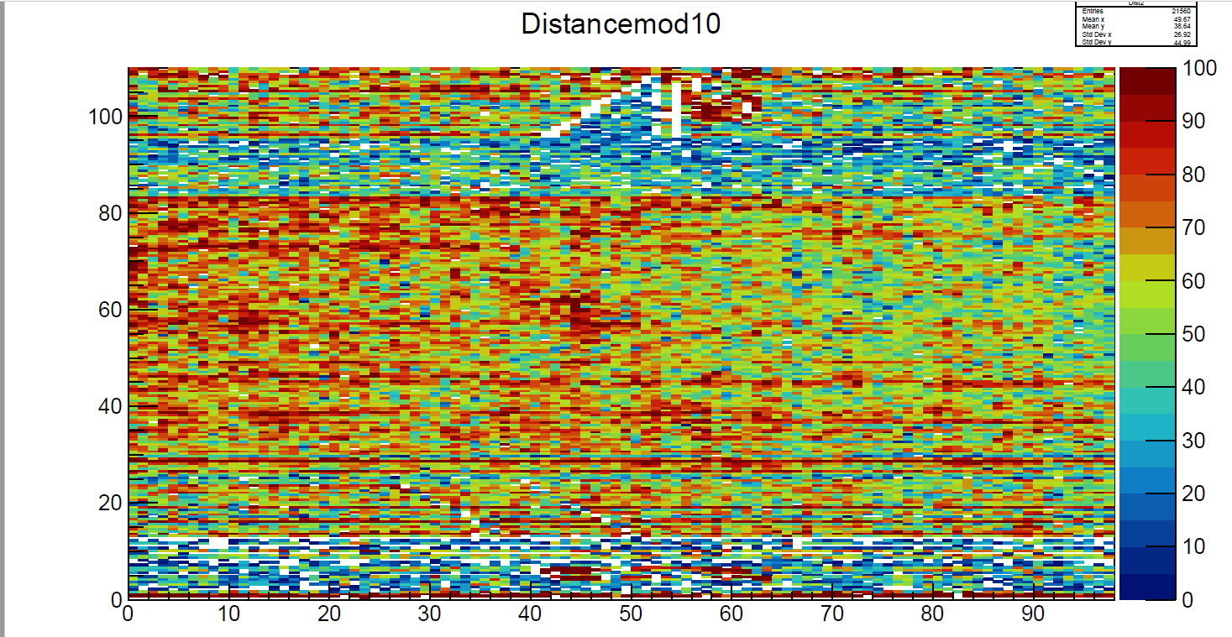
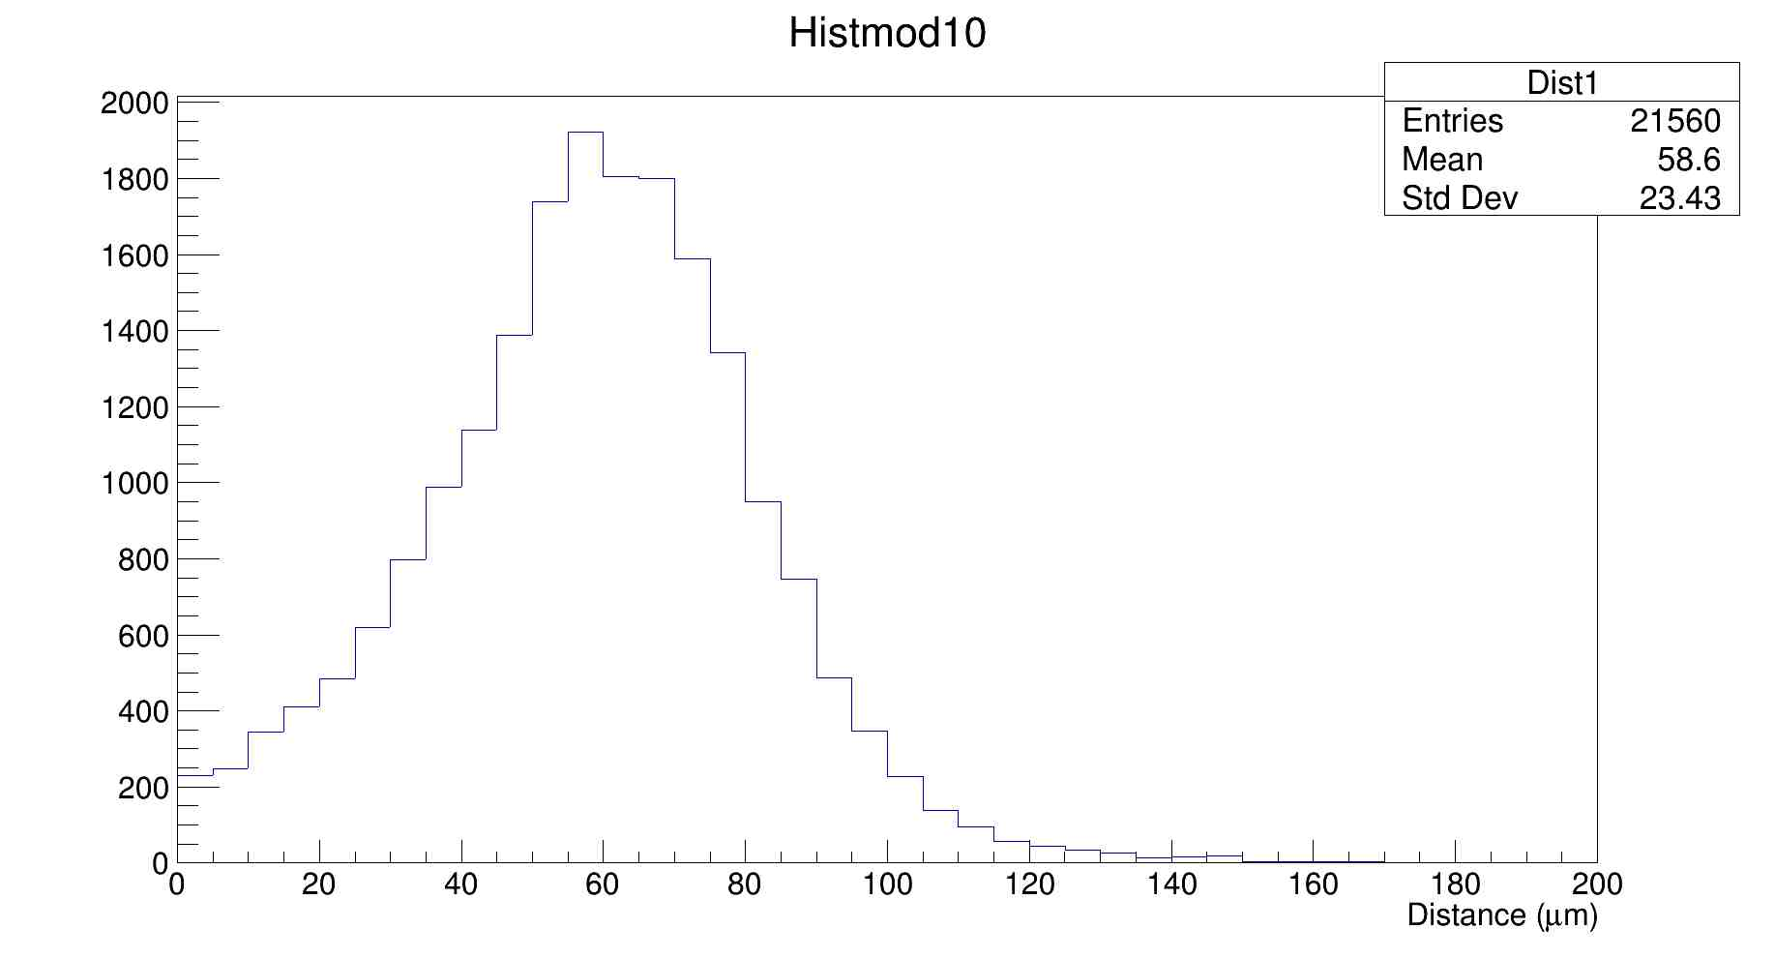

Slide 11
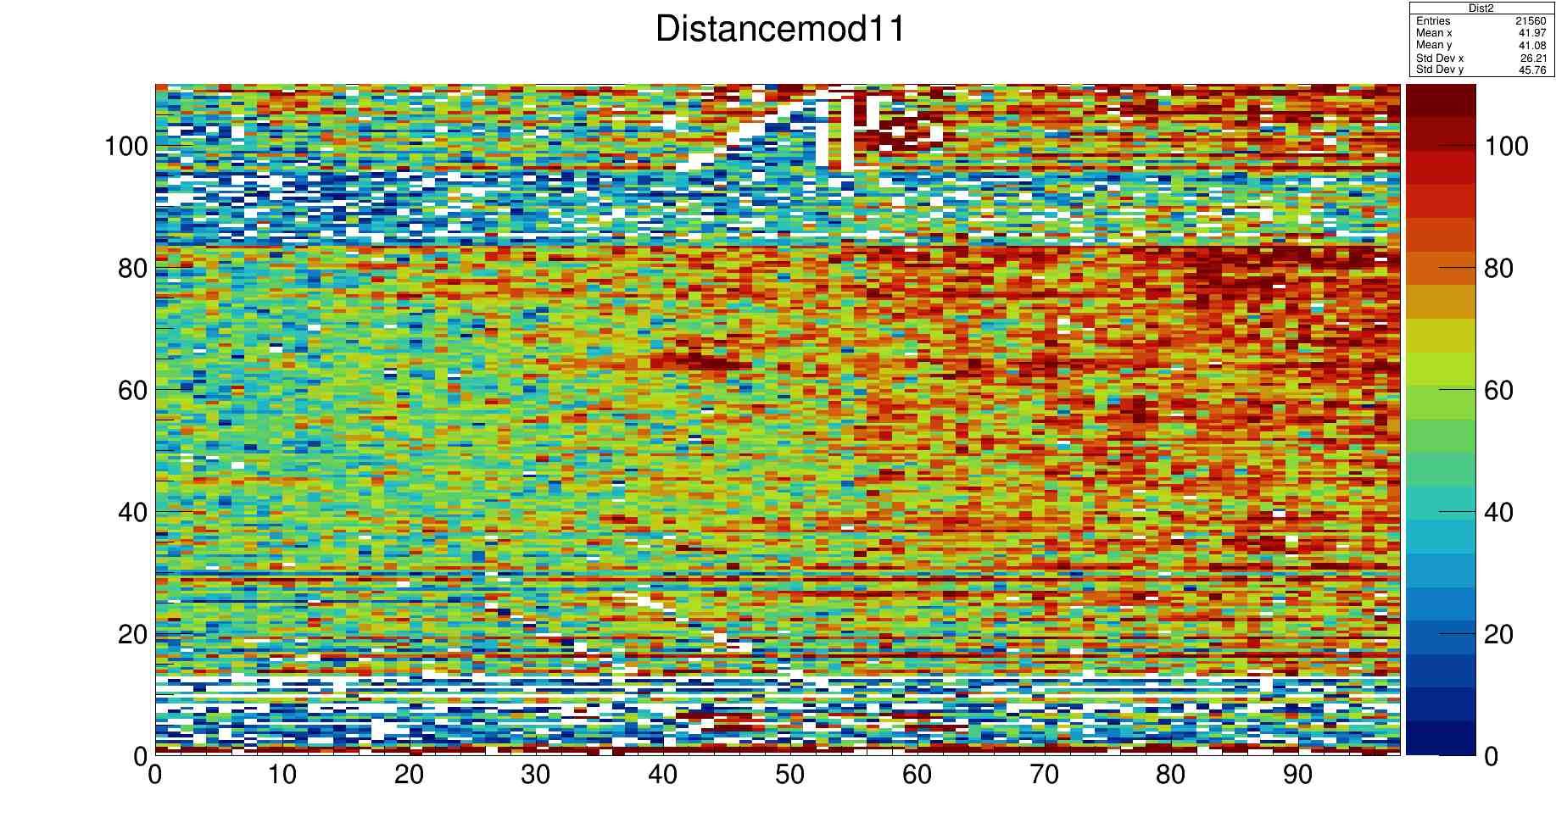

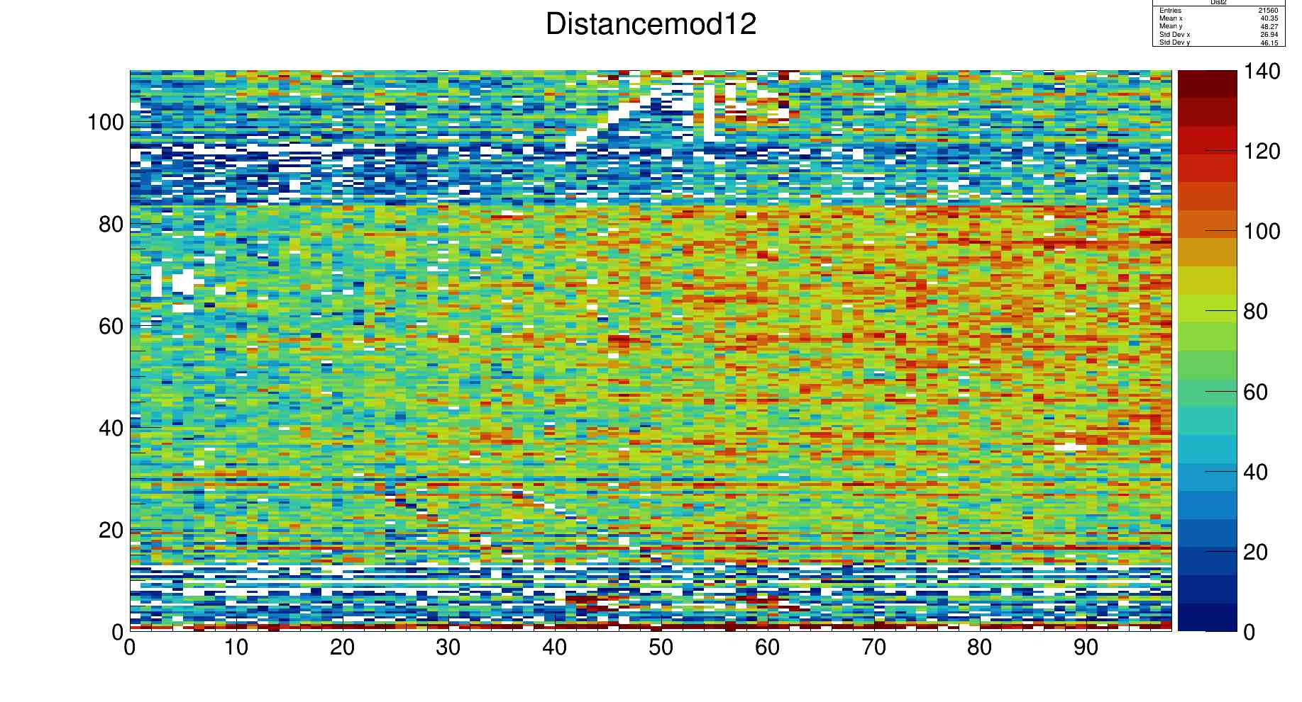


Slide 12
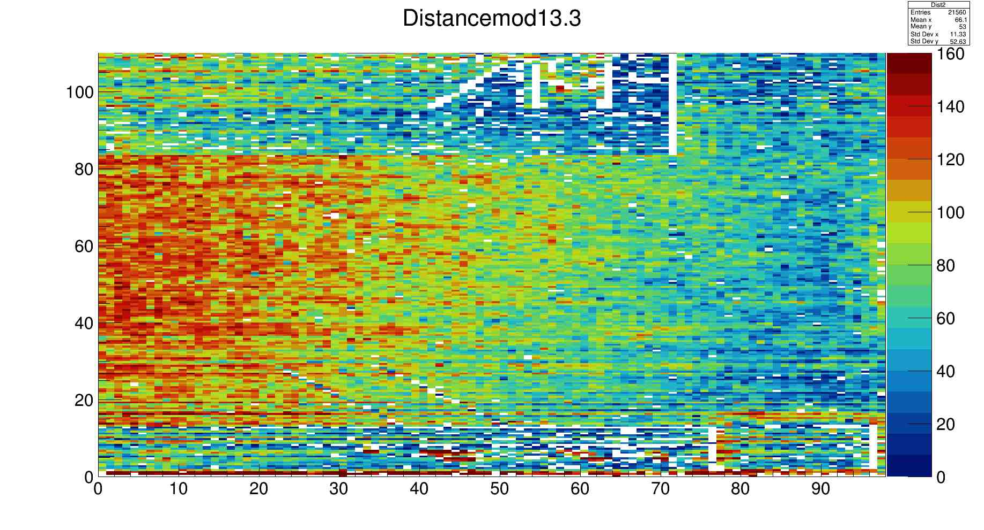
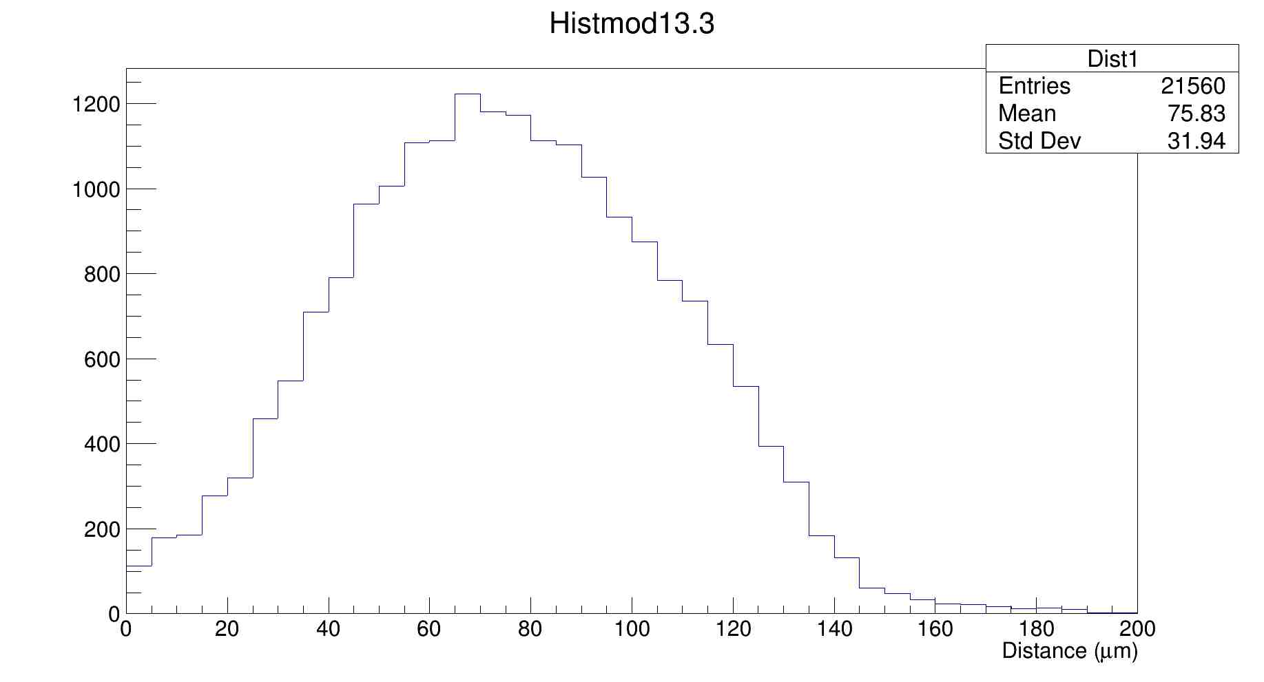

Slide 13
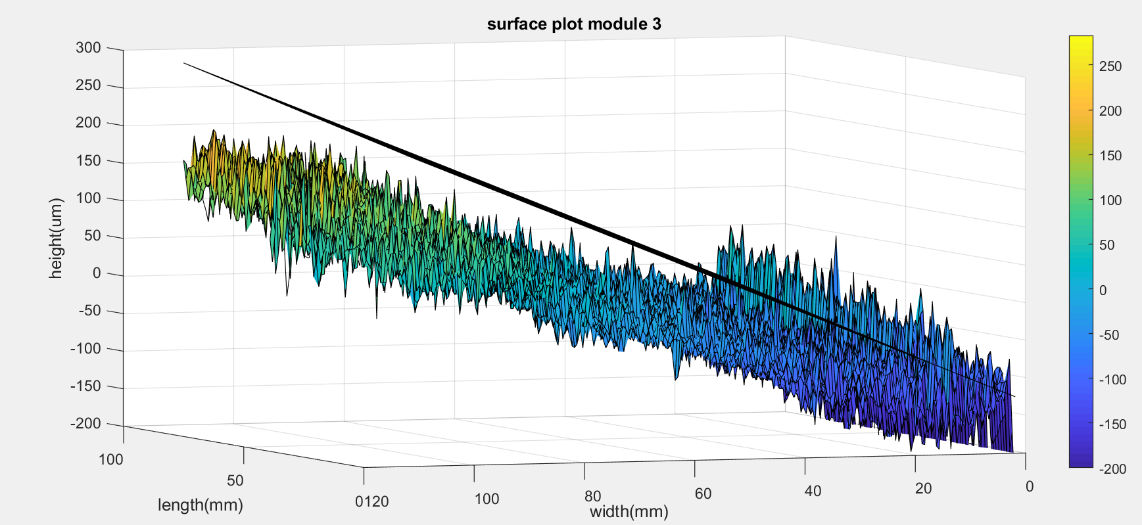
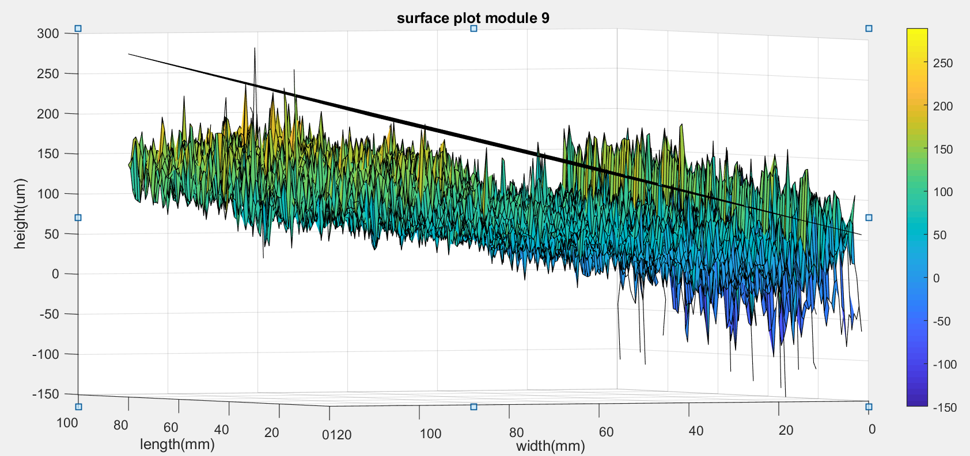
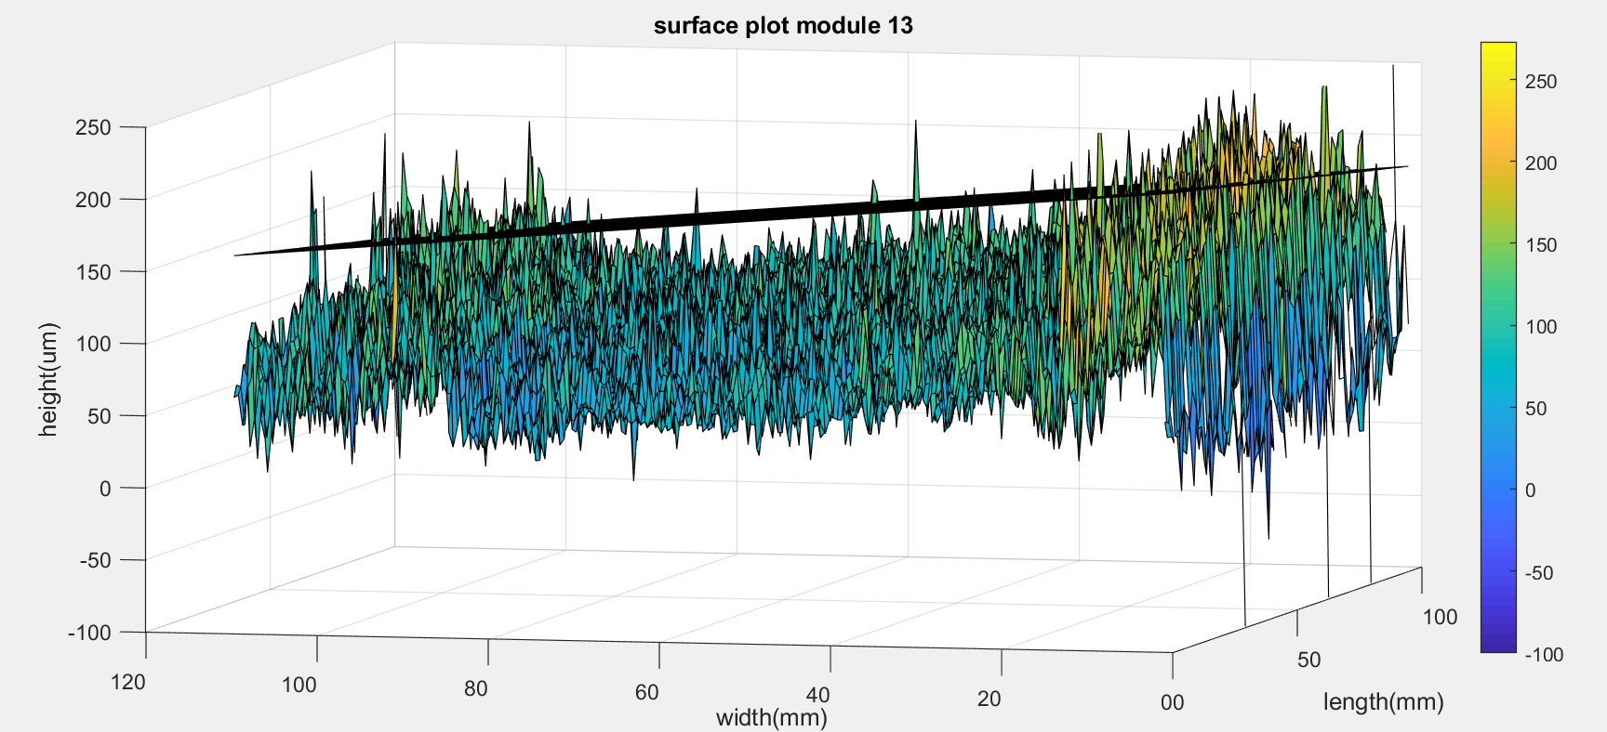
Plot of Potential plane & scanned data

