Slide 1
Summary on 11 T Cable Insulation Scheme
Susana Izquierdo Bermudez, Juan Carlos Perez, Jacky Mazet
10th November 2017
Acknowledgments:
Christian Hannes Loffler and Emelie Nilsson (11 T collaring and mechanical analysis)
Eugenio Cavanna, Jose Ferradas Troitino and Alejandro Carlon Zurita (ten stack measurements)
Patrick Ebermann and Felix Wolf (MATLAB script of reading Fuji)
Davide Tommasini (insisting so much on understanding the issue)

Slide 2
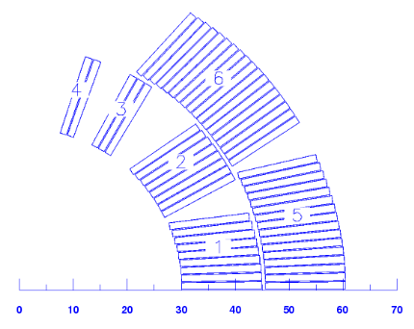
11 T Insulation Design Criteria
56 turns coil
  22 Inner Layer, 34 Outer Layer
Insulation layout: 80-µm-thick C-shaped Mica film and a braided sleeve made of S2-glass fibers
Original target insulation thickness:
  100 µm at 30 MPa pressure
  For the short models coils, the actual insulation thickness was 107 µm – 114 µm at 30 MPa (14x2x34 µm = 0.95 mm of over-thickness in the outer layer!)
  All short model coils produced up to the date and the prototype coils have been done using this insulation layout.
Revised target insulation thickness:
  100 µm at 5 MPa pressure
  Will be implemented in all the future short model coils (and the series magnets)

Slide 3
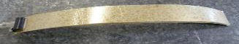
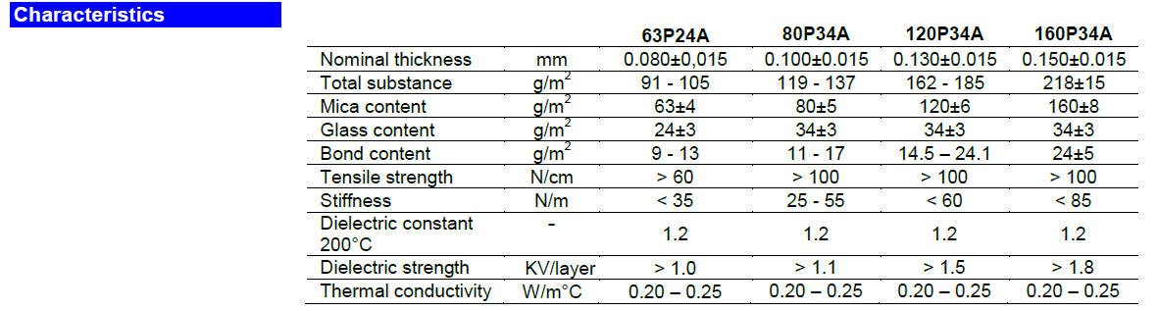
Mica technical characteristics
COGEBI FIROX® P 63P24A, 0.080 mm thick
Actually, the tape is 65 % mica, 25 % glass, 10 % bond (“mica paper bonded to an electrical grade glass cloth as the supporting fabric, impregnated with a specially selected high temperature resistant silicone elastomer”)
Under slight compression, the tape is around 0.050 mm thick (bond and glass quite compressible)
Small change on the type thickness after heat treatment
  8 µm (at 5 MPa) thicker after reaction, but we did the test only once.
http://www.fkaeng.com/userfiles/Firox%20P%20-%20UK%20-%20mv-.pdf

Slide 4
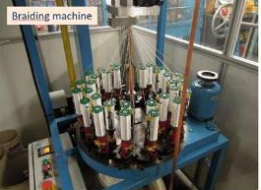

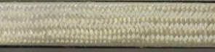
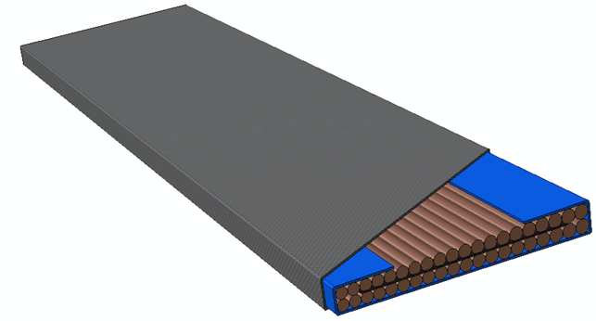
S2-Glass braiding parameters
Basic parameters of the insulation:
# Carriers
# Plies per Strand (or Yarn)
Speed
Picks per cm
Nb₃Sn Cable, Mica insulation, Glass Sleeved
 | Coils 105-107 and 110 | Coil 108-110 and 111-117 | 11 T After Mid-2017
Strand (also called Yarn) | 11 TEX (636) | 11 TEX (636) | 11 TEX (636)
# Carriers | 32 | 32 | 32
Picks per cm | 7 | 6 | 9
Insulation thickness at 5 MPa, µm | 130 | 130 | 100
# Plies/Strand | 9 | 9 | 4

Slide 5
11 T insulation lay-out
Nb₃Sn Cable, Mica insulation, Glass Sleeved
Cavity design assuming 0.1 mm of insulation at 30 MPa.
Even after a small adjustment on the braiding parameters, the insulation thickness was larger than the design value.
  Original braiding: yarn count 14/2 cm (Coil 105-107, 110).
  Updated braiding: yarn count 12/2 cm.
coil | Ins thickness @ 30 Mpa (μm)
105 | 114
106 | 114
107 | 114
108 | 107
109 | 107
110 | 113
111 | 106
112 | 114
113 | 112
114 | 114
115 | 112
116 | 113
117 | 112

Slide 6
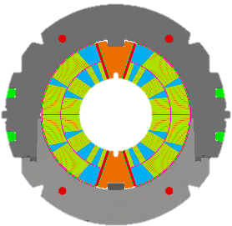
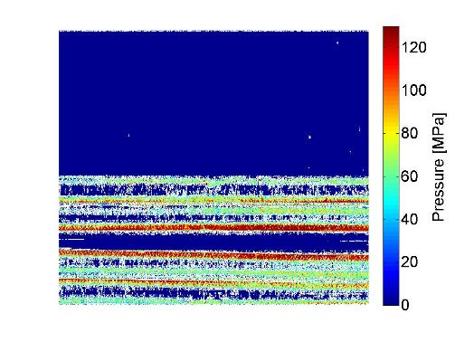

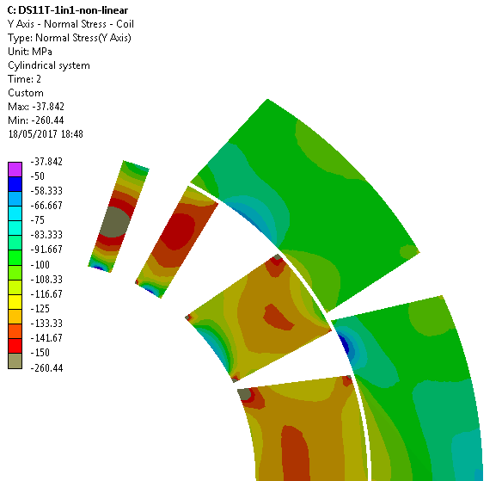
DS11 T – MBHSP105
C. Hannes Loffler, E. Nilsson & N. Bourcey
Lateral shim
Fuji paper tests on the mid-plane of MBHSP105b revealed a very different stress distribution form the one predicted by the FEA models.
Coil size up
Arc length
OL
Coil size bottom
Fuji paper
IL
Collar nose shim
IL
OL
Expected azimuthal stress during collaring in MBHSP105
120 MPa stress gradient on the mid-plane

Slide 7
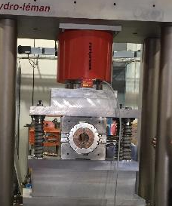
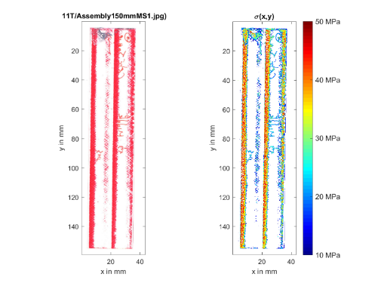
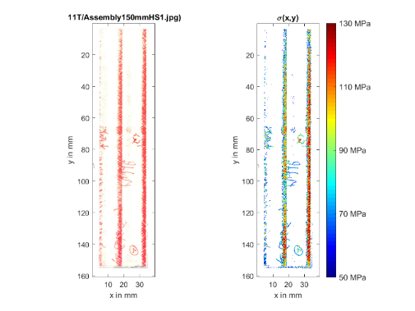
DS11T –
150 mm Assembly Tests
The same effect was observed in the 150 mm assembly test done in the mechanical lab....

Slide 8
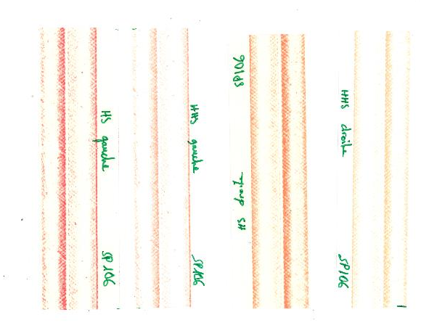
DS11 T – MBHSP106
50 MPa – 130 MPa
130 MPa – 300 MPa
50 MPa – 130 MPa
130 MPa – 300 MPa
In MBHSP106, we did a collaring test with two layers of Mica in the mid-plane
  50-130 MPa, marked on the sides, but we marked this time more the outer layer turn.
  130 – 300 MPa, also marked, but very gently. We think is below 150 MPa.
OL
IL
OL
IL
IL
OL
IL
OL
Further analysis from Felix Wolf: https://indico.cern.ch/event/680375/

Slide 9
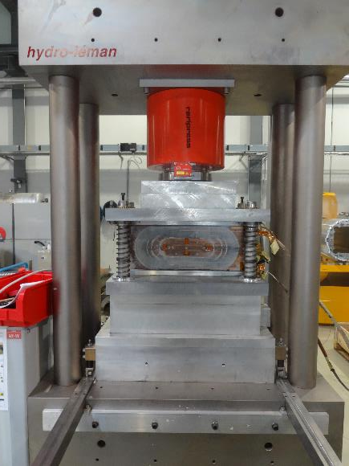
SMC11T
J. C. Perez & N. Bourcey
SMC11T is a good playing tool as:
  The coil is flat, one can press it in a easier and controlled way, removing also the uncertainty on the bending of the coil during collaring.
  The cable is rectangular, so we de-couple the different stiffness of the inner/outer edge with the different stiffness on the edges due to the shape of mica.
  We have a coil available without mica (SMC11T1) and one with mica (SMC11T3a)

Slide 10
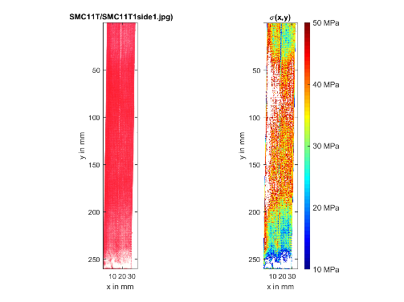
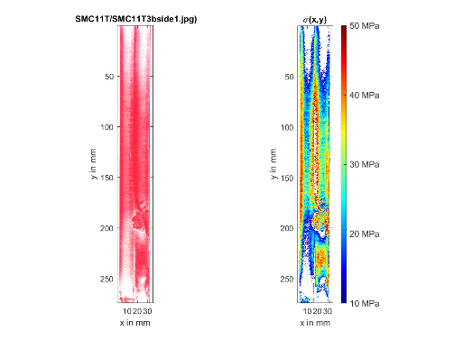
SMC11T
SMC11T-1, side 1 (no mica)
Uniform pressure distribution
SMC11T-3a, side 1 (mica)
Visible trace of the mica

Slide 11

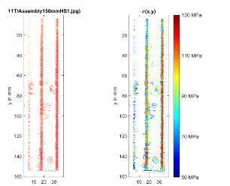
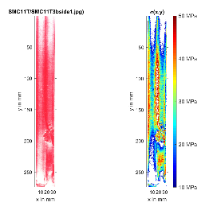
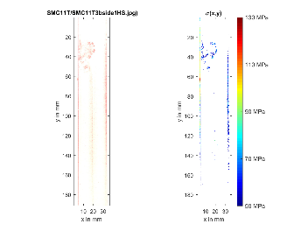
DS11T vs SMC11T
The stress gradient in SMC11T-3b is 2 to 3 times smaller than the one in 11 T:
  The mica seems to contribute to the non-uniformity of the stress distribution on the mid plane.
  The cable keystone and the high compaction of the 11 T coils (the mould is not so tight in SMC11T) is not helping to achieve a uniform stress in the mid-plane.
11T (22/34 turns) : Stress gradient in the order of 100 MPa
10-50 MPa
50-130 MPa
SMC11T-3b (35/35 turns): Stress gradient < 50 MPa
10-50 MPa
50-130 MPa

Slide 12
Gap vs. stress concentration
50 % open
40 % open
30 % open
6.9 mm
7.4 mm
5.4 mm
11T
ERMC – S1
ERMC – S2
 | 11 T | ERMC-Sample1 | ERMC-Sample2
Cable width, mm | 14.7 | 20.90 | 20.9
Cable thickness, mm | 1.25 | 1.82 | 1.82
Mica width, mm | 25 | 38 | 40
Gap, mm | 6.9 | 7.4 | 5.4
Gap/cable width, % | 50 | 40 | 30
Gap/cable thickness,-- | 5.5 | 4 | 3
Total insulation thickness at 5 MPa | 135 | 125 | 128

Slide 13
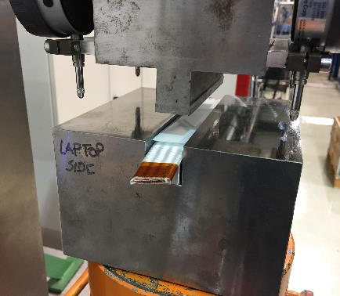
Pressure on single cables
J. Ferradas Troitino & A. Carlon Zurita
Let’s do a quick check:
One single cable, not reacted nor impregnated.
  Very extreme case, we know it is not realistic, but very easy, fast, and gives us the worst case!
Evaluation of the pressure distribution on the two sides of the cables under a control pressure of 5 MPa and 30 Mpa
Two families of samples:
  SMC 11 T: With/without mica
  ERMC: With/Without mica

Slide 14
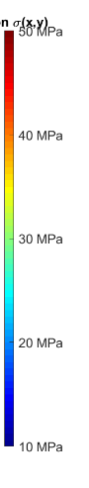
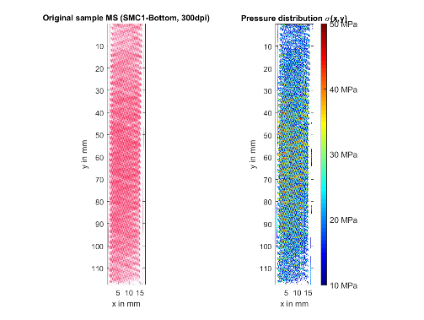
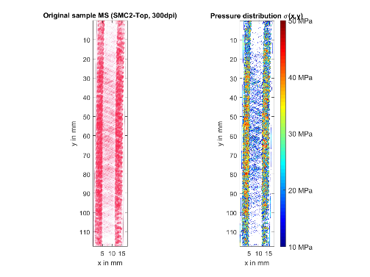
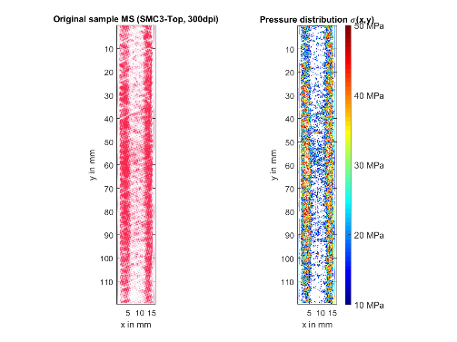
SMC-11T; top face
top
11T
bottom
SMC11T-1
No core, no mica
SMC11T-2
No core, mica
SMC11T-3
core, mica

Slide 15
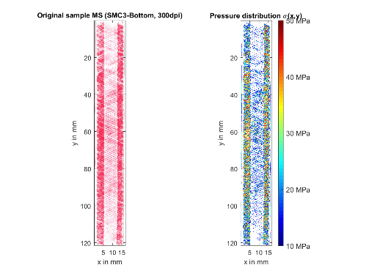
SMC11T-3: cable vs coil
Cable
Coil
As expected, what we see in the coil is partially smoothened from what we see in the non-impregnated cable.

Slide 16
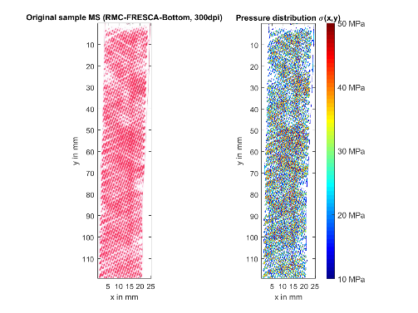
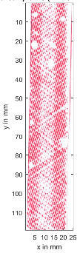
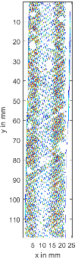
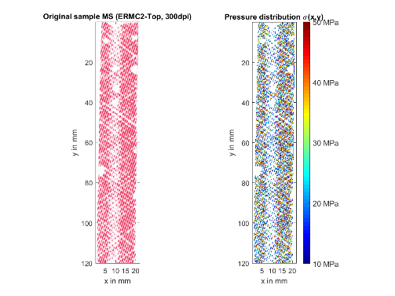
ERMC; top face
top
ERMC
bottom
The increase on the width of the mica from 38 to 40 mm had a significant impact on the pressure distribution
RMC-FRESCA2
No core, no mica
ERMC-S1
core, 38 mm mica
ERMC-S2
core, 40 mm mica

Slide 17
Summary
The observed gradient of pressure distribution on the mid-plane observed on the 11 T is also present on SMC11T-3 (with Mica), but it is 2-3 times smaller.
In absence of mica, the pressure distribution on the SMC11T mid-plane is uniform.
A larger mica coverage can cope with this issue, maybe just to check:
  The impregnation will not be affected.
  What is the impact on the overall coil rigidity. Since the “new” braiding parameters are closer to the target 0.100 mm, future coils will have “more epoxy”.
Available options:
  30 mm tape (1.9 mm gap). (3x500 m, enough for 6 short coils)
  31 mm tape (0.9 mm gap). (3x500 m, enough for 6 short coils)
  In practice, the gap will be 0.5-1 mm larger than the theoretical gap.

Slide 18
Additional slides

Slide 19
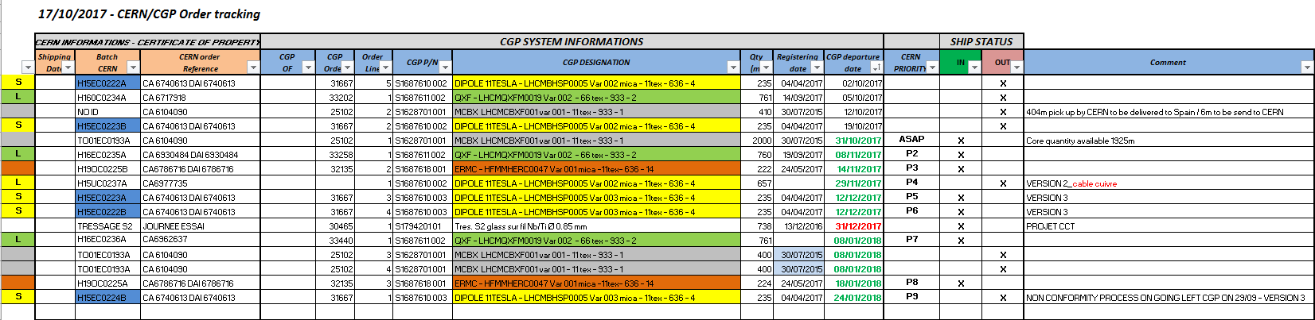
Nous avons en stock cable tissé :
H15EC0222A 235 mètres PIT Tissage nouvelle épaisseur avec mica largeur 25 mm (standard)
H15EC0223B 235 mètres PIT Tissage nouvelle épaisseur avec mica largeur 25 mm (standard)
Nous allons recevoir :
H15EC0223A 235 mètres PIT Tissage nouvelle épaisseur avec mica largeur 31 mm (standard) livraison CERN 12/12/2017
H15EC0222B 235 mètres PIT Tissage nouvelle épaisseur avec mica largeur 31 mm (standard) livraison CERN 12/12/2017
H15EC0224B 235 mètres PIT Tissage nouvelle épaisseur avec mica largeur 31 mm (standard) livraison CERN 24/01/2017
jm

Slide 20
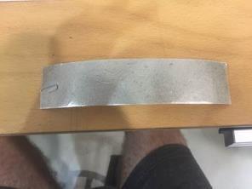
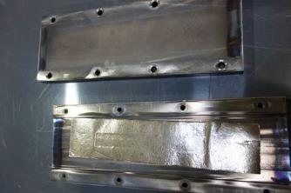
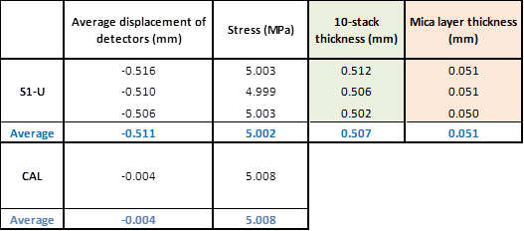
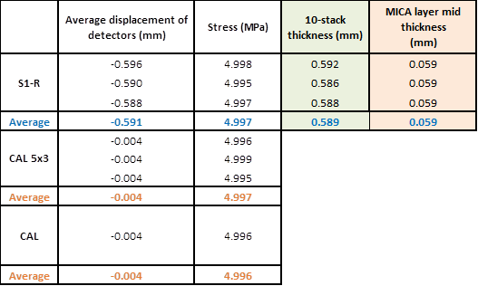
Effect of Heat Treatment on Mica
Before Heat Treatment
After Heat Treatment

Slide 21
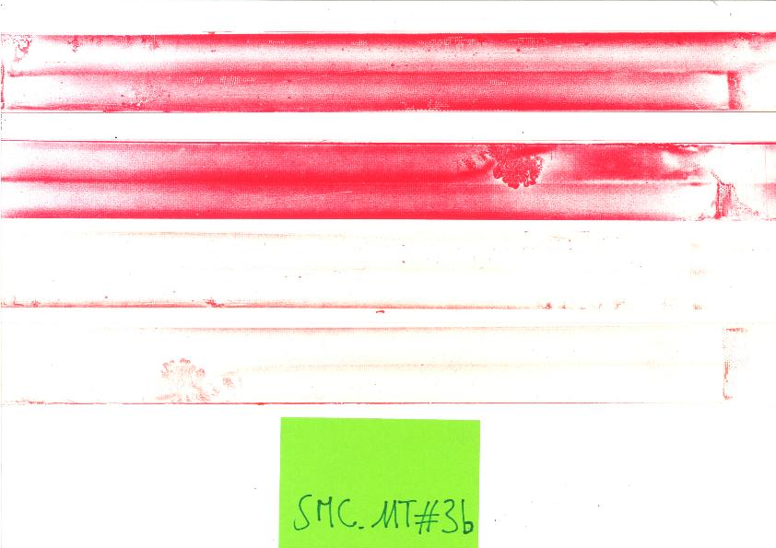

Slide 22
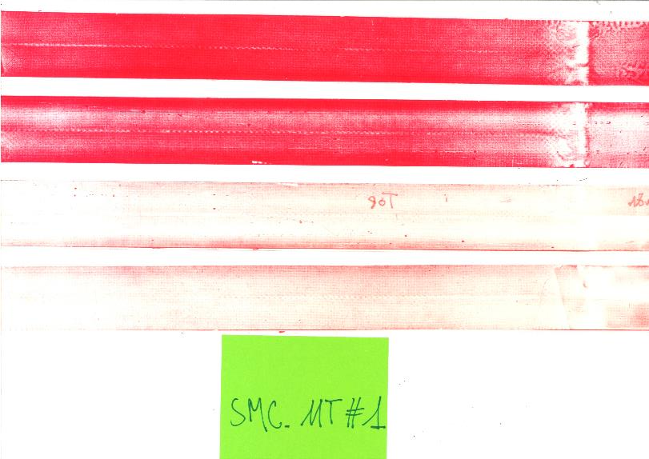

Slide 23
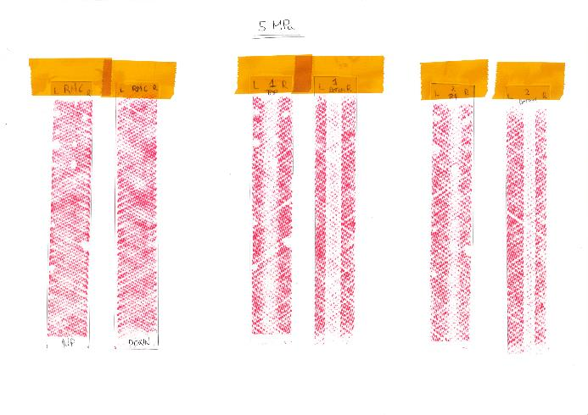
ERMC

Slide 24
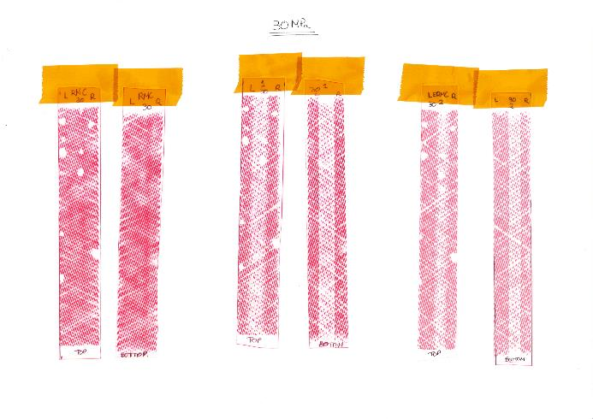
ERMC

Slide 25
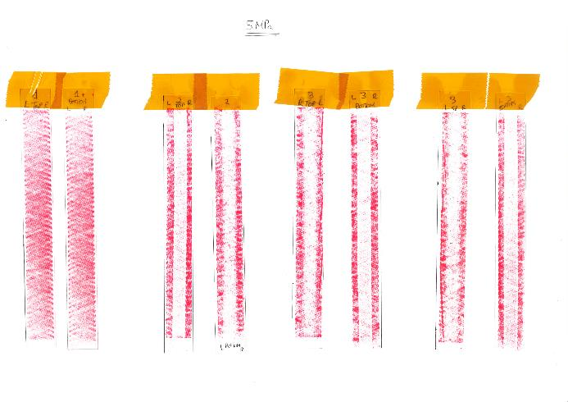
SMC11T

Slide 26
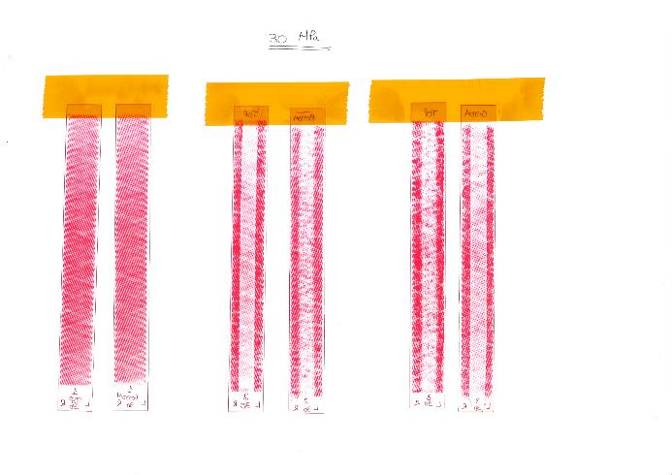
SMC11T

Slide 27
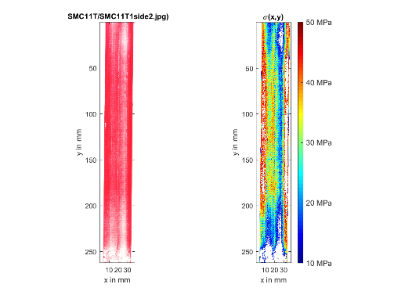
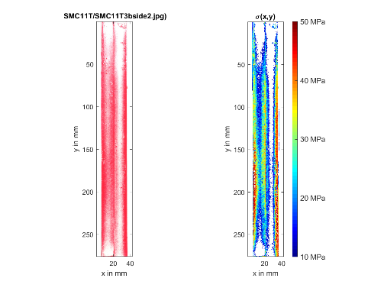
SMC11T
SMC11T-1, side 2 (no mica)
Uniform pressure distribution, although a bit worse than the other side
SMC11T-3b, side 2 (mica)
Visible trace of the mica

Slide 28
Insulations components
Fibres
  S2-Glass (11 TEX, 33 TEX, 66 TEX) 66 TEX means 66 grams per 1000 m
Sizing (on the fibres)
  636 (starch oil sizing)
  493 (compatible with Epoxy
  933 (inorganic sizing)
Our typical combinations:
  11 TEX 636 (☺ only OK for impregnation if it goes through heat treatment)
  33 TEX 493 (☺ darker after reaction than 933)
  66 TEX 933 ☺
Mica
  FIROX ® P 63P24A (Cogebi) for the cable
  FIROX ® P 80P34A (Cogebi) for the interlayer
Ceramic binder (not in flat coils)
  CTD1202
Epoxy
  CTD 101K

Slide 29
MQXF,11 T & FRESCA insulation layout
MQXF:
  Cable (0.15 mm):
    S2 glass 933 66 TEX
  Inter layer:
    S2 glass 933 66 TEX
11T:
  Cable (0.1 mm):
    C-shape 0.080 mm Mica FIROX ® P 63P24A
    S2 glass 636 11 TEX
  Inter layer:
    Version without Quench Heaters:
      S2 glass 933 66 TEX
FRESCA2:
  Cable (0.2 mm):
    S2 glass 933 66 TEX
    Version with Quench Heaters:
      E glass HEXFORCE 120TF970
      FIROX ® P 80P34A

Slide 30
SMC-RMC
 | Cable insulation |  |  |  |  |  | Epoxy impregnation resin
 | Type | Material Fiber | Roving density | Sizing | Material Mica | Ceramic Binder
 | [-] | [-] | [tex] | [-] | [-] | [-] | [-]
SMC_1 Coil #1 | Wrapped tape | S2-Glass | -- | -- | none | none | Mix RAL¹
SMC_1 Coil #2 |  |  | -- | --
SMC_2 Coil #1 |  | CEA Glass + Ceramic | -- | -- |  |  | Ceramic, no impregnation
SMC_2 Coil #2 |  |  | -- | --
SMC_3a Coil#1 | Sleeve | FNAL | -- | -- |  |  | Mix71¹
SMC_3a Coil#2 |  |  | -- | --
SMC_3b Coil#1 |  |  | -- | --
SMC_3b Coil#2 |  |  | -- | --
SMC #4 Coil #201 | Braiding | S2-Glass | 11 TEX | 636 |  |  | CTD-101K
SMC #4 Coil #202
SMC #5 Coil #101
SMC #5 Coil #102
SMC11T_1 Coil 101 |  |  | 66 TEX | 933
SMC11T_2 Coil 102 |  | S2-Glass+Mica | 11 TEX | 636 | Firox ® P 63P24A
SMC_11T_3 Coil 103
SMC_11T_4 Coil 104
RMC FRESCA2 coil 102 |  | S2-Glass | 66 TEX | 933 | none
RMC FRESCA2 coil 202
RMC QXF coil 201
RMC QXF coil 202
1. Astor Stag SER300+Jeffamine D400

Slide 31






FRESCA2 Insulation Lay Out
66 TEX 933
Design thickness: 0.16 mm (at 5 MPa)
S1
0.201 mm
S4
0.194 mm
S2
0.155 mm
S5
0.175 mm
S3
S6
0.140 mm
0.154 mm

Slide 32
What was learnt in FRESCA2
Preparation of six 10stack samples for studying:
The insulation thickness of the cables
The effect of the reaction on the insulation thickness
The effect of the curing on the insulation thickness
The effect of the reaction after curing on the insulation thickness
Measurement► 10stack▼ | 1 | 2 | 3 | 4
1 | U-I | U-B
2 | U-I | R-I | R-B
3 | U-I | C-I | C+R-I
4 | U-I | C-I | C+R-I
5 | U-I | C-I | C-B
6 | U-I | C-I | C+R-I | C+R-B
Acronyms:
U: Unreacted
I: Insulated
B: Bare
R: Reacted
C: Cured
\\CERN\dfs\Workspaces\m\MDT\Magnet_Laboratory\Projects\HFM_Program\FRESCA2\Reference information\Laura

Slide 33
What was learnt in FRESCA2
Laura
Effect of the reaction on the insulated cable thickness and therefore, on the insulation thickness: Negligible
Effect of the curing on the insulated cable thickness and therefore, on the insulation thickness: The insulated-cured cable seems to take the size of the curing cavity
For samples where the cables were cured and reacted, the bare cable has too much insulation residues we couldn’t remove, so these results will be dismissed
  We don’t have curing in flat coils, so we don’t worry much about this.
\\CERN\dfs\Workspaces\m\MDT\Magnet_Laboratory\Projects\HFM_Program\FRESCA2\Reference information\Laura

Slide 34
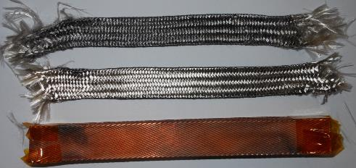
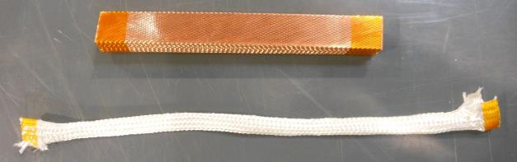
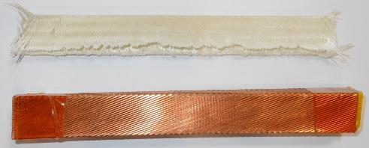
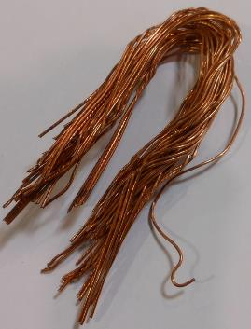
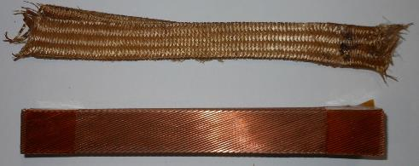
Bare cable and insulation after the different processes
1)
2)
3)
5)
4)
1) Uncured-Unreacted; 2) Uncured-Reacted; 3) Cured-Unreacted;
4) Cured-Reacted; 5) Cable plasticity after curing and reaction

Slide 35
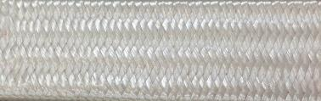
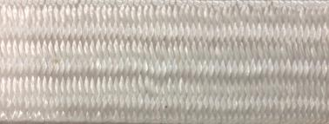
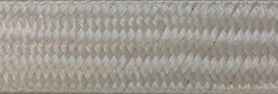



MQXF insulation lay-out
66 TEX 933, aiming at 0.150 mm at 5 MPa
0.191 mm
0.183 mm
0.164 mm
0.158 mm
0.146 mm
0.145 mm

Slide 36

What was learnt in MQXF
Eugenio
Sample 1: not cured and not reacted
Sample 2: cured, not reacted
Sample 3: cured and reacted
Sample 4: reacted but not cured
Lessons:
The insulation thickness grows after curing due to the binder (15 µm), but, after reaction, it comes back to original value
The cable grows of about 2.5% during reaction
Legenda:
U: unreacted
C: cured
R: reacted
I: insulated
B: bare

Slide 37




What was learnt in MQXF
The bradding parameters have an impact on the cable expansion during heat treatment.
  Correlation can be found between change on dimensions during heat treatment and the transverse pressure applied by the insulation on the conductor .
  E. F. Holik, et. al., “Fabrication and Analysis of 150 mm Aperture Nb3Sn MQXF coils”.

Slide 38
11 T insulation lay-out
Nb₃Sn Cable, Mica insulation, Glass Sleeved
Cavity design assuming 0.1 mm of insulation at 30 MPa.
Even after a small adjustment on the braiding parameters, the insulation thickness was larger than the design value.
  Original braiding: yarn count 14/2 cm (Coil 105-107, 110).
  Updated braiding: yarn count 12/2 cm.
coil | Ins thickness @ 30 Mpa (μm)
105 | 114
106 | 114
107 | 114
108 | 107
109 | 107
110 | 113
111 | 106
112 | 114
113 | 112
114 | 114
115 | 112
116 | 113
117 | 112

Slide 39

What was learnt in 11 T
What it is called 0.080 mm of Mica is slightly less, and decreases to 0.050 mm under a slight compression
This is coming from the adhesive that is coming together with the Mica.

Slide 40






What was learnt in 11 T
 | Insulation thickness S2 glass 11 TEX 636
 | [µm]
S2-glass Braiding parameters | # 1 | # 2 | # 3 | # 4 | # 5 | # 5b
 |  |  |  |  |  | (with MICA)
Yarn count/2 cm | 12 | 12 | 12 | 18 | 17-18 | 17-18
No. of brins | 9 | 6 | 5 | 5 | 4 | 4
1st gen. design
2nd gen. design
Very difficult to close the mould → re-definition of insulation parameters for second generation coil design, in order to have 0.1 mm at 5 MPa

Slide 41



Our knowledge on dimensional changes during heat treatment
There is a correlation between the expansion in the cable cross section and the longitudinal coil contraction.
For a braided insulation, cable expands:
  3 % in thickness
  0-0.5 % in width
In HQ, going from sleeve (loose insulation) to braided insulation had a strong impact on the winding relaxation and longitudinal contraction during heat treatment.

Slide 42


Coil size
Coil size of 11 T is considerably worse than MQXF. This could be linked:
  11 T has a tighter mould
  The ways the coils are measured
CERN coils
LARP coils
MQXFS1
MQXFS3
MQXFS5
MBHSP101
MBHSP102
MBHSP103
MBHSP104
MBHSP105

Slide 43


Choices for ERMC
Cavity design assuming 3 % growth in thickness, 1 % in width.
Flexibility in the design to leave up to 6 mm for winding relaxation and longitudinal contraction during heat treatment (we will decide later how much we put).
Aiming at 0.150 mm at 5 MPa, for a insulation lay out with a mica as wide as possible.
  40 mm wide tape selected as the baseline.
5.4 mm
20.9 mm

Slide 44


Slide 45





ERMC insulation tests
11TEX 636 + Firox 63P24A
S1
12 brins
0.125 mm
S4
0.135 mm
S2
12 brins
0.128 mm
S5
0.155 mm
S3
9 brins
0.118 mm

Slide 47
ERMC – Braiding parameters
S1
S4
S2
S5
S3
 | ERMC S1 | ERMC S2 | ERMC S3 | ERMC S4 | ERMC S5 | MQXF-CERN | MQXF-LARP | 11 T 1st Gen. | 11 T 2nd Gen.
TEX | 11 | 11 | 11 | 11 | 11 | 66 | 66 | 11 | 11
# Carriers | 32 | 32 | 32 | 32 | 32 | 32 | 48 | 32 | 32
Picks per cm | 5 | 5 | 6 | 5 | 6 | 7.2 | 8.5 | 12.0 | 17.5
Pitch length (PL), mm | 31.5 | 31.5 | 24.1 | 31.5 | 24.1 | 33.4 | 18.8 | n.a. | n.a.
Pitch angle (PA), deg | 53 | 53 | 60 | 53 | 60 | 49.7 | 64.4 | n.a. | n.a.
Insulation thickness, µm | 125 | 128 | 118 | 135 | 155 | 146 | 143 | 130 | 100
Width of Cable (w), mm | 20.9 | 20.9 | 20.9 | 20.9 | 20.9 | 18.12 | 18.12 | 14.7 | 14.7
Mid-thicknes of cable (t), mm | 1.82 | 1.82 | 1.82 | 1.82 | 1.82 | 1.525 | 1.525 | 1.25 | 1.25
# Plies/Strand | 12 | 12 | 9 | 14 | 14 | 2 | 2 | 9 | 4

Slide 48





ERMC bradding parameters
$$θ$$
$$\frac{Transverse Pressure}{Axial Pressure}\text{= }γ \text{= }\frac{2∙PL∙tan⁡(θ)}{w_{cable}}$$
$$PL$$
 | PL | $$θ$$ | $$γ$$
Sample 1 | 32 | 53 | 4.1
Sample 2 | 32.3 | 53 | 4.1
Sample 3 | 26 | 60 | 4.3
Sample 4 | 32.5 | 53 | 4.1
Sample 5 | 25.5 | 60 | 4.2
ERMC
  E. F. Holik, et. al., “Fabrication and Analysis of 150 mm Aperture Nb3Sn MQXF coils”.

Slide 49
My interpretation of SMC-11 T training based on Hugo’s data and analysis
Susana
SMC_11T_1 | OST RRP108/127 | Braiding 66 tex
SMC_11T_2 | OST RRP108/127 | Braiding 11 tex + Mica
SMC_11T_3 | OST RRP 132/169 + Core | Braiding 11 tex + Mica
SMC_11T_4 | PIT 120 + Core | Braiding 11 tex + Mica
SMC_11T_5 | PIT 120 + Core | Braiding 11 tex + Mica

Slide 50
SMC 11 T-1 has a similar training than SMC 11 T – 3 (close to short sample at 4.3 K but not so stable at 1.9 K, see next slides)
SMC 11T -2 has a very weird training since it went close to short sample at 4.2 K with one quench only, and didn’t increase in current when going to 1.9 K
Training plot from Hugo

Slide 51
SMC 11 T - 3
The increase of pre-load did not improve the picture, but afterwards we realized that the coil was not properly shimmed, so pre-load was affecting mainly the ends and not the straight section
At short sample current at 4.2 K, but not very stable at 1.9 K. Maybe the pre-load is not enough? (similar behavior than SMC11T-1)
150 MPa
180 MPa
210 MPa
Training plot from Hugo

Slide 52
SMC 11 T - 3
When shimming appropriately the coil such that the pre-load was applied uniformly on the coil, we get a more stable behavior at 1.9 K.
Increasing the pre-load up 180 MPa did not break anything (difficult to say if it affects the training or not.
Thermal cycle + increase pre-load by 30 MPa
180 MPa
Permanently degrade when going up to 210 MPa
We loose few percent when going to 4.2 K after training at 1.9 K
150 MPa
180 MPa
When re-assembling at 180 MPa we degrade again (even if in the first loading to 180 MPa there was not visible degradation)
210 MPa
150 MPa
Thermal cycle + decrease pre-load by 30
Thermal cycle + decrease pre-load by 30 MPa
Thermal cycle + increase pre-load by 30 MPa
Training plot from Hugo

Slide 53

SMC 11 T - 4
Thermal cycle + increase pre-load by 20 MPa
93 % Iss
91 % Iss
Stable plateau at the same I/Iss than at 4.2 K
95 % Iss
91 % Iss
89 % Iss
But we loose again another 2-3 % when going to 4.2.
We don’t break when increasing pre-load
Most of the quenches are close to the ends.
Slight degradation of Ic after training at 1.9 K. It seems that we slightly degrade when going to higher current.
Training plot from Hugo

Slide 54


SMC 11 T - 5
Local mechanical permanent degradation in end region at 90 % Iss
10 % degradation of Iss, both at 1.9 K and 4.2 K
90 % Iss
94 % Iss
80 % Iss
Thermal cycle, without changing pre-stress, first time I see we loose (permanently) 5 % due to thermal cycle
All the quenches after this dramatic event happen in the other magnet end!
82 % Iss
70 % Iss
75 % Iss
At 1.9 K we are not reaching the same plateau level than at 4.2 K, this is also not typical in conductor-degraded assemblies
Training plot from Hugo

