Slide 1
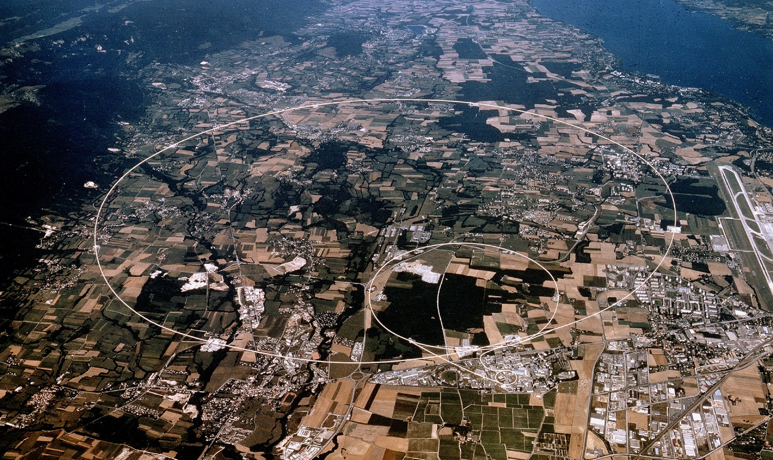

EDMS No. 1369690
Radiological Implication in case of Fire
Doris Forkel-Wirth
CERN, HSE-RP
13th December 2017
Notes:
1

Slide 2
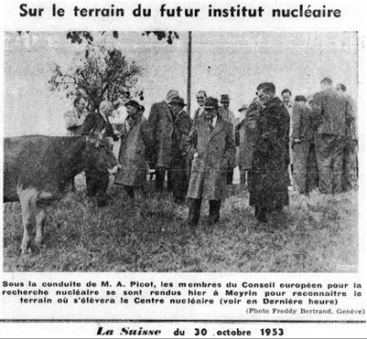
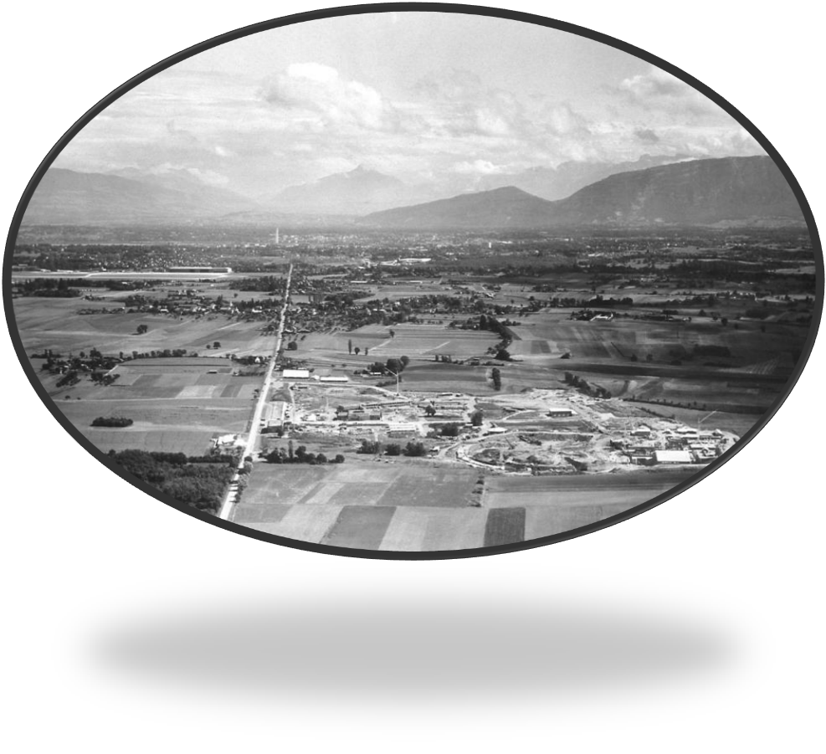
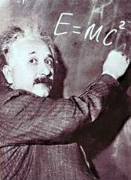
CERN - CONSEIL EUROPÉEN POUR LA RECHERCHE NUCLÉAIRE
EDMS No. 1369690
1954:
Created by 12 European States
First European Organisation
Focus on nuclear physics (“nucleaire”)
Today: Particle Physics

Slide 3
CERN’s Main Accelerator Chain

Slide 4

LHC
LHC - injectors
LHC - collider
27 km circumference
4 experimental caverns
2 proton beams a 7 TeV

Slide 5
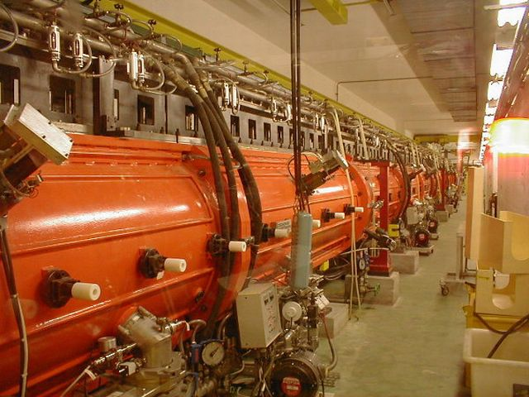
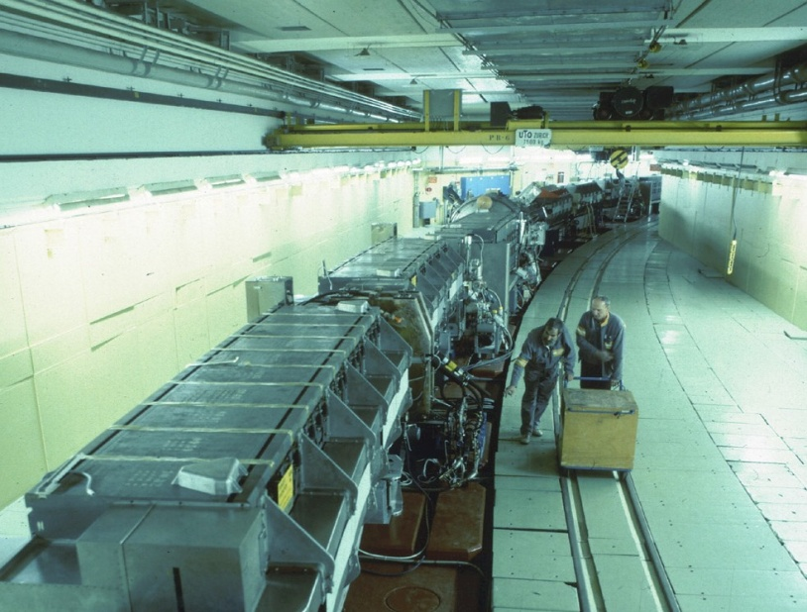
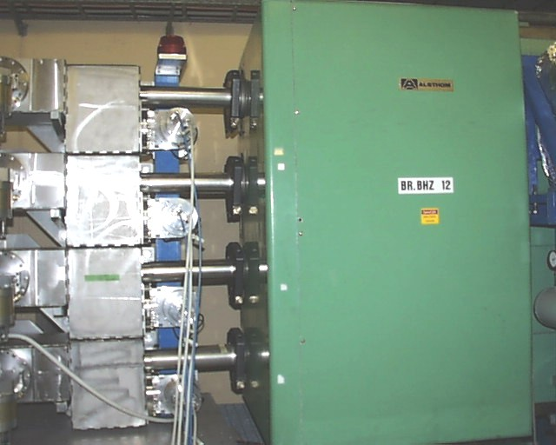
Main accelerator Chain at CERN
(low-energy part)
EDMS No. 1369690
Booster (1.6 GeV)
Proton Synchrotron (26 GeV/c)
LINAC (50 MeV)
200 m

Slide 6
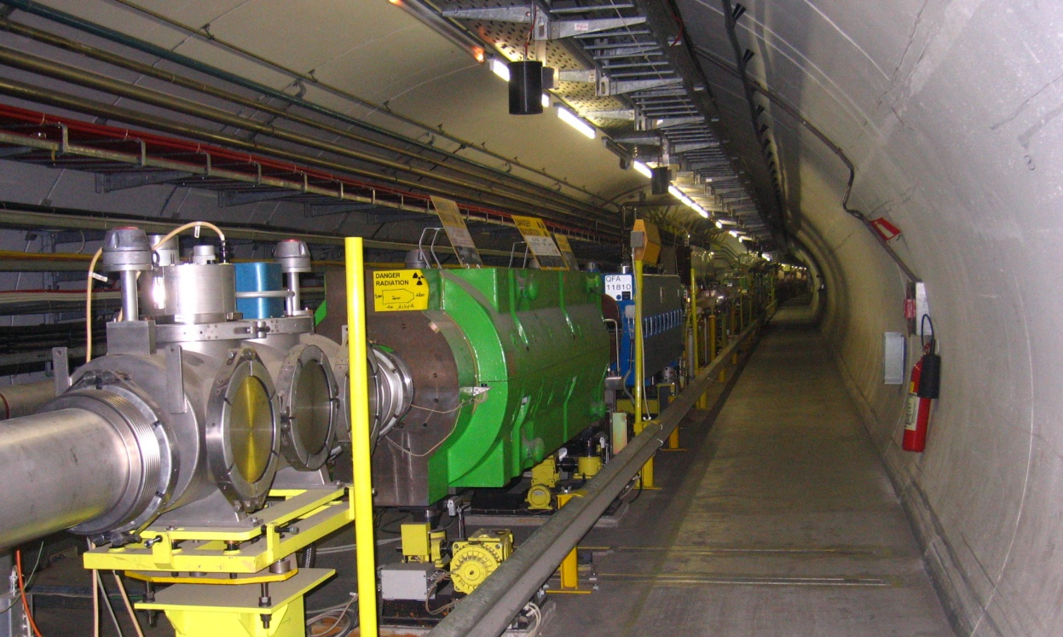
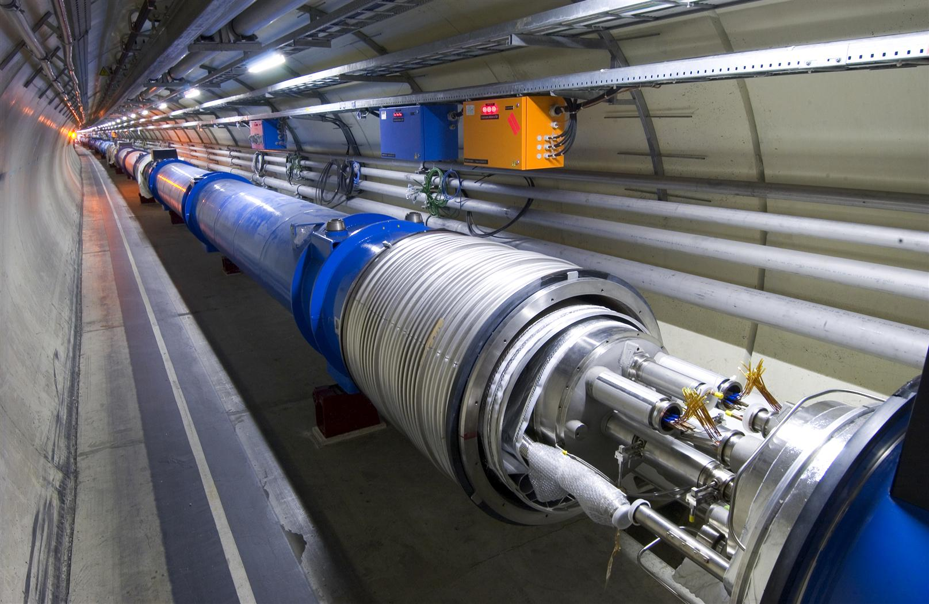
Accelerators at CERN
(high-energy part)
LHC (2 x 7 TeV)
SPS
Circumference: 7 km
SPS beam
FT
Fixed target experiments
Super Proton Synchrotron
(450 GeV/c)
LHC
CNGS
1 km

Slide 7
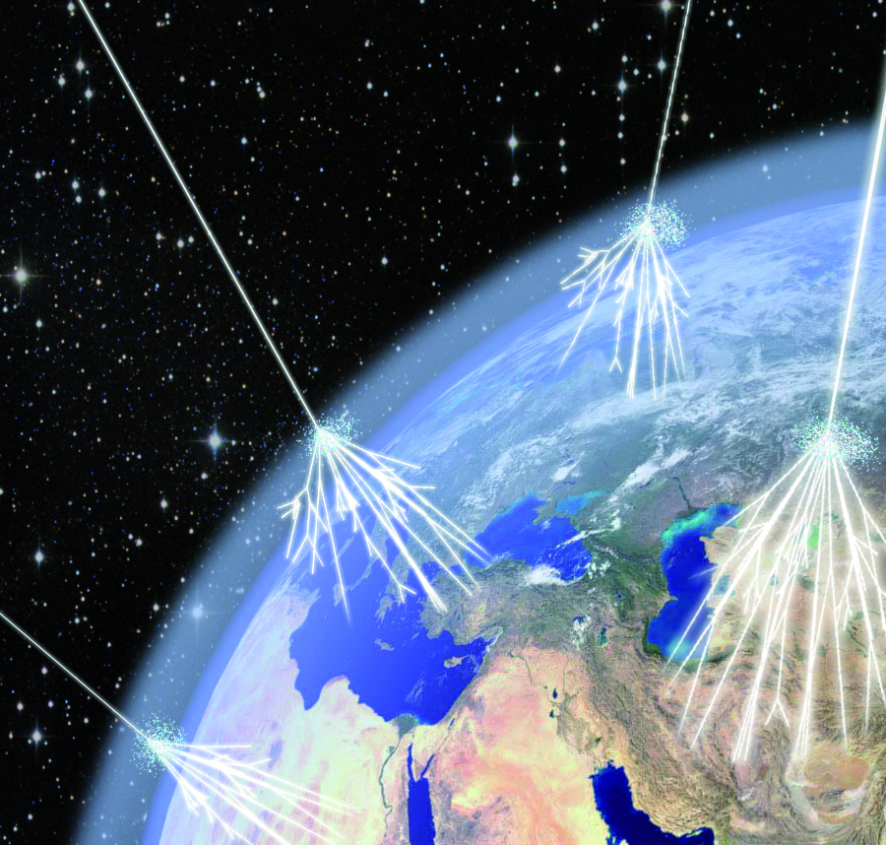
Prompt Ionising Radiation
EDMS No. 1369690
Highest particle energy measured: 3.2×10²⁰ eV
up to 7 TeV
Hadron accelerator
Cosmos
Particle impact creates high-energy mixed radiation fields

Slide 8
Origin of Radiation
beam on
beam off
Beam loss
Radioactive decay in activated material

Slide 9
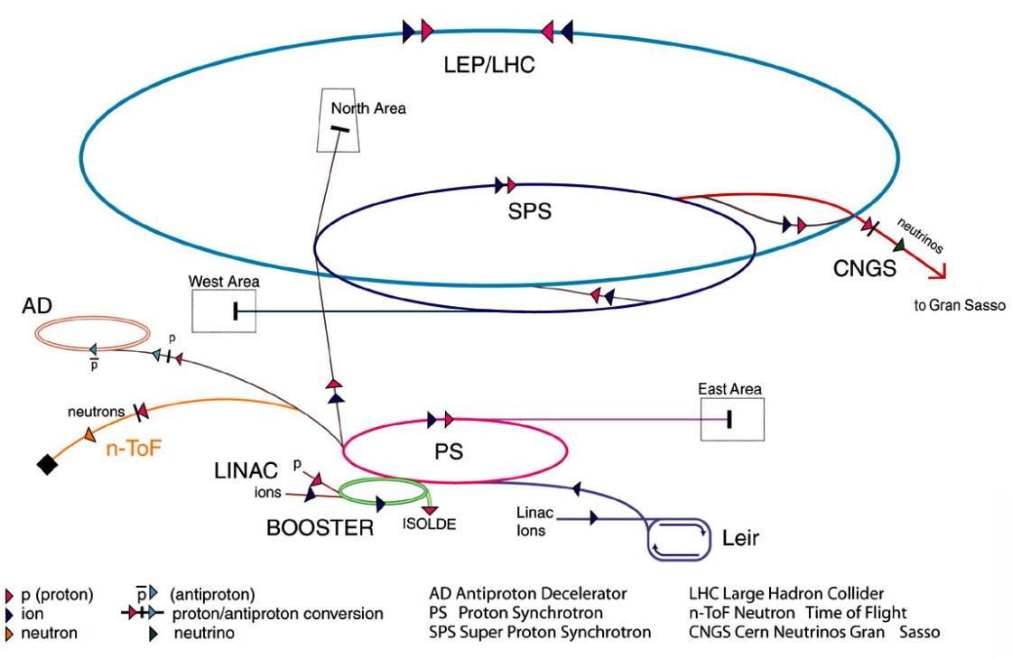
Some Key Figures…
Radiation Areas and Radioactive Laboratories:
~ 50 km accelerator tunnel
Class A, C laboratorites
RIB facility ISOLDE
Spallation source n-TOF
~ 50 - 60 access points
~ 160 experiments
~ 7000 radiation workers
new projects

Slide 10
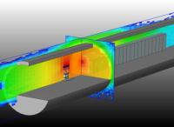
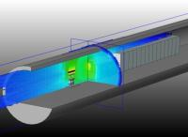
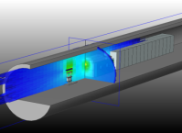
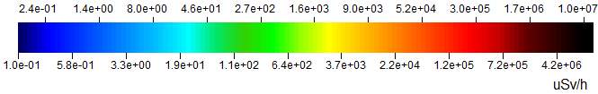
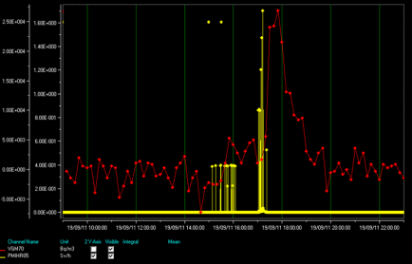
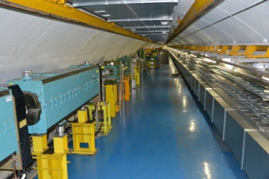
Operational Radiation Protection
EDMS No. 1369690
From design
1 hour
1 week
1 month
to reality
Notes:
HiRADMat
Ramses materials
-yellow inside facility
- Red ventilation outlet

Slide 11
Radiological Accident Scenarios
Each time a new facility has to be designed, the radiological impact in case of an accident has to be assessed
Until today the worst radiological scenarios had been always identified as fire in an area where radioactive material is present (e.g. magnets, cables, targets, shielding…)
Input for fire prevention and CERN’s emergency preparedness

Slide 12
Radiological Impact - Parameter
Radioactive inventory: known (calculated or measured)
Fire parameters:
  Scenarios?
  Temperature profile?
  Duration?
  Percentage of radioactivity released from radioactive components?
  Percentage to radioactivity transported to the outlet?
Dispersion of radioactivity into the environment – known (calculated)
Result: very conservative estimates!
(e.g. all radioactivity is released)

Slide 13
Wishlist
Realistic fire scenarios are required for
  Fire prevention
  Emergency preparedness
  Realistic assessment of radiological impact in case of fire
In addition:
  Pragmatic fire related rules and procedures for non-standard facilities like CERN’s accelerator complex

