Slide 2
Performance-based fire design and safety rules at CERN
13th December 2017
Introduction to fire safety at CERN
S. La Mendola HSE/SEE/XP on behalf of the CERN FSE team

Slide 3



CERN
Funded in 1954
22 member states
~600 universities
Two official languages
16.000+ people (staff, collaborations)
https://cds.cern.ch/record/1295244

Slide 4
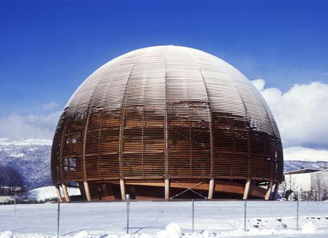
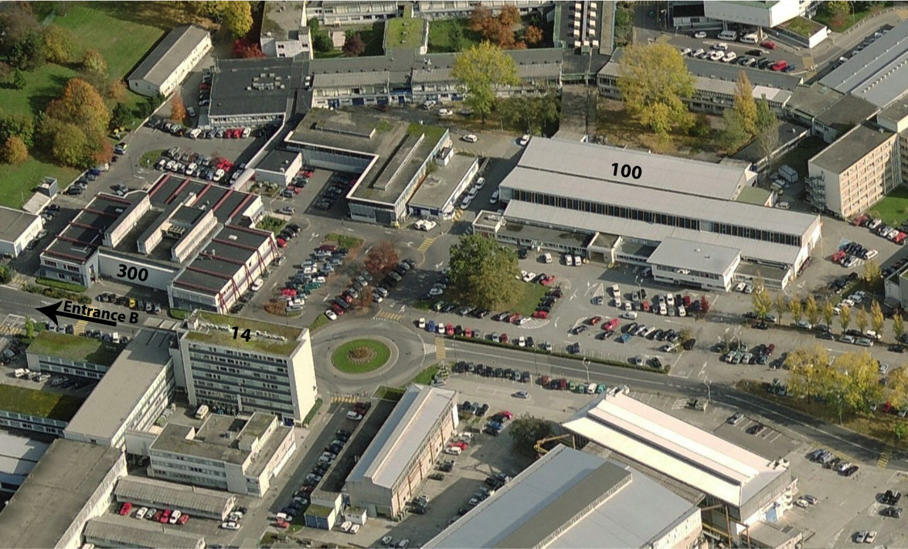
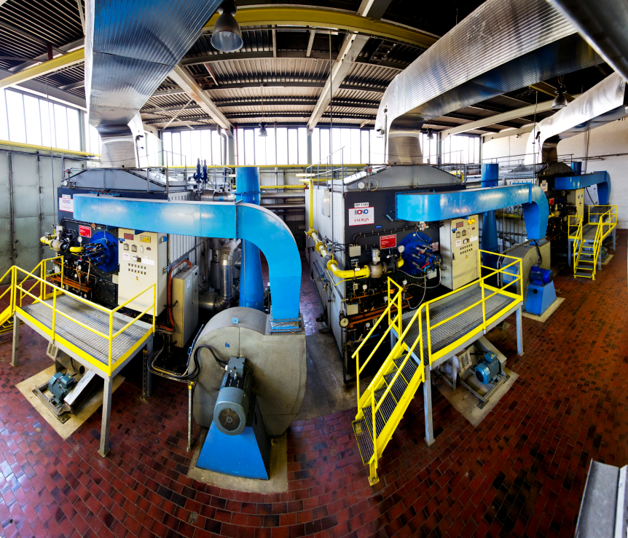
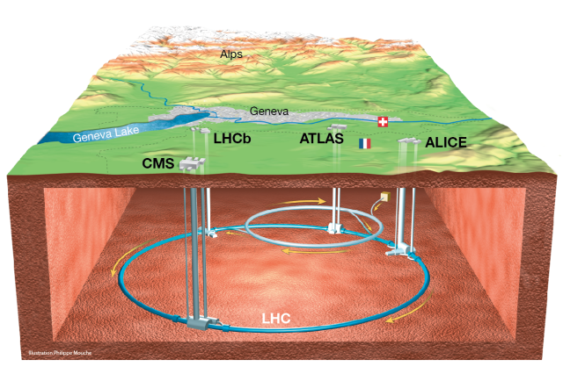


CERN’s facilities
Conventional facilities
Tertiary buildings
Technical facilities
Research facilities

Slide 5
A mission with many allies
Fire Safety
Accelerators Safety
Committees
Building safety Officers (TSO)
Department Safety Officers (DSO)
Physics Experiments Safety (LEXGLIMOS, EXSO)
HSE Unit

Slide 6
The 3 keys of fire safety organization
Delegation of responsibility to the level where the effect is maximized
Responsibilities for all matters of Safety is hierarchically organized down to supervisors of projects and activities (ref. Safety Policy)
Assistance and monitoring made via central structures
HSE:
supports implementation of Fire Safety Policy;
Monitors its application
Grants safety clearance on projects with major Safety implications
Specific regulation
CERN, in accordance with its intergovernmental status, establishes its Safety rules to implement its Safety policy. National laws and regulations shall not be applicable unless explicit.

Slide 7
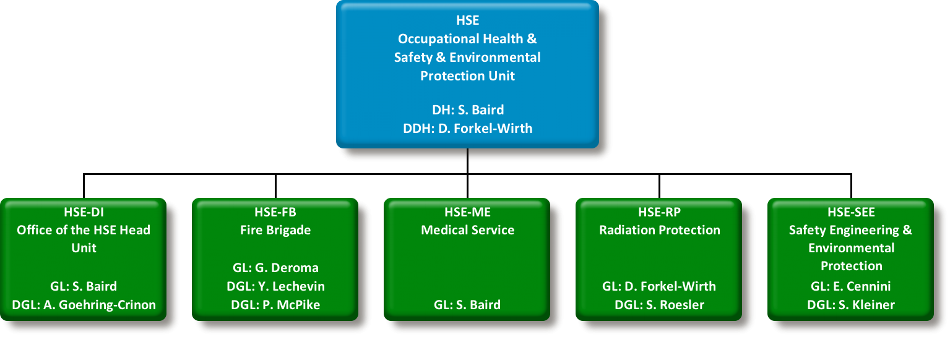
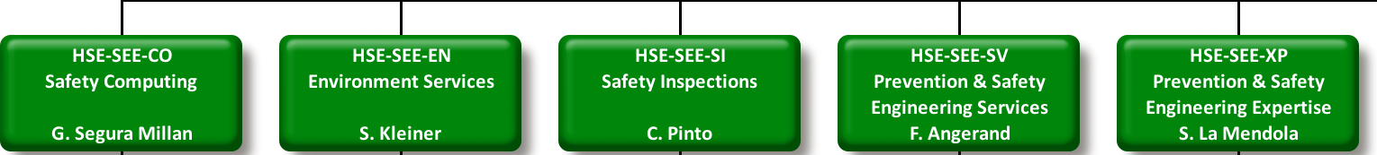

Fire safety with the HSE
Notes:
Fire prevention is mainly covered by the SEE group. Another key actor in fire safety is the CERN fire brigade (See upcoming presentation on fire services by Y. Lechevin). In some cases, where a radiological release can be expected in case of fire, radiation protection group is also involved.

Slide 8

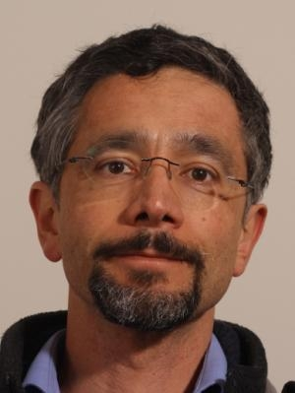

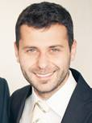
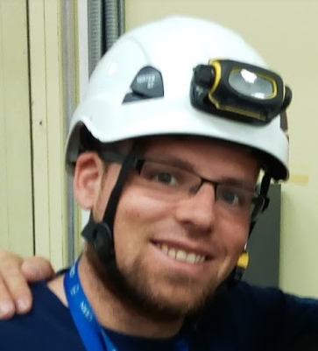

CERN FSE team
Following up on construction/modification projects of standard buildings and/or beam facilities throughout their lifecycle.
Contributing to the writing and maintenance of the cluster of CERN Safety rules.
Carrying out fire risk assessment of existing CERN facilities.
Carrying out fire safety engineering research applicable to CERN facilities.
Participating in activities transversal to the HSE-SEE group or the HSE unit.
Saverio La Mendola
Fabio Corsanego
Art Arnalich
Marco Andreini
Oriol Rios
Tristan Hehnen
Notes:
It is a multidisciplinary team, more info are provided in the upcoming presentation by Oriol

Slide 9


Project & Experiment Safety Support (PESS) activity
Courtesy of A. Henriques HSE/SEE/XP
It supports the Organization in integrating Safety aspects in projects/experiments, as well to share, harmonise and disseminate best practices.
The PESS activity also fulfils the implementation of the HSE mandate, by providing Safety Clearance for projects with major Safety implications (mSi).
Procedure for Projects with
‘major Safety implication’ (mSi)
Beam, Experiments and underground facilities
Industrial installations
namely
Identification of a project as ‘mSi’
List of Safety checks (‘checklist’)
Validation of Safety Checks
Grant HSE Safety Clearance
Example in Fire Safety:
Underground facility
Non-standard layout
Ad-hoc fire models
Fire simulations
PBD-approach,
fire risk analysis
Safety Validation Form
Final inspection
‘Green light’

Slide 10
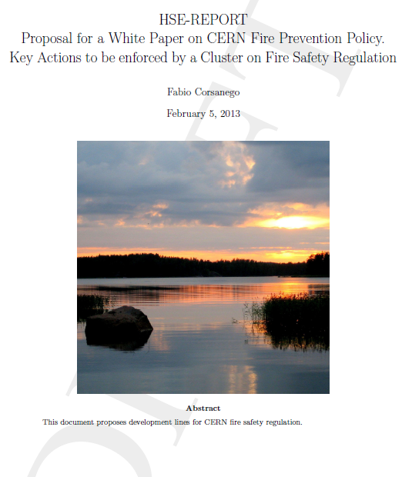
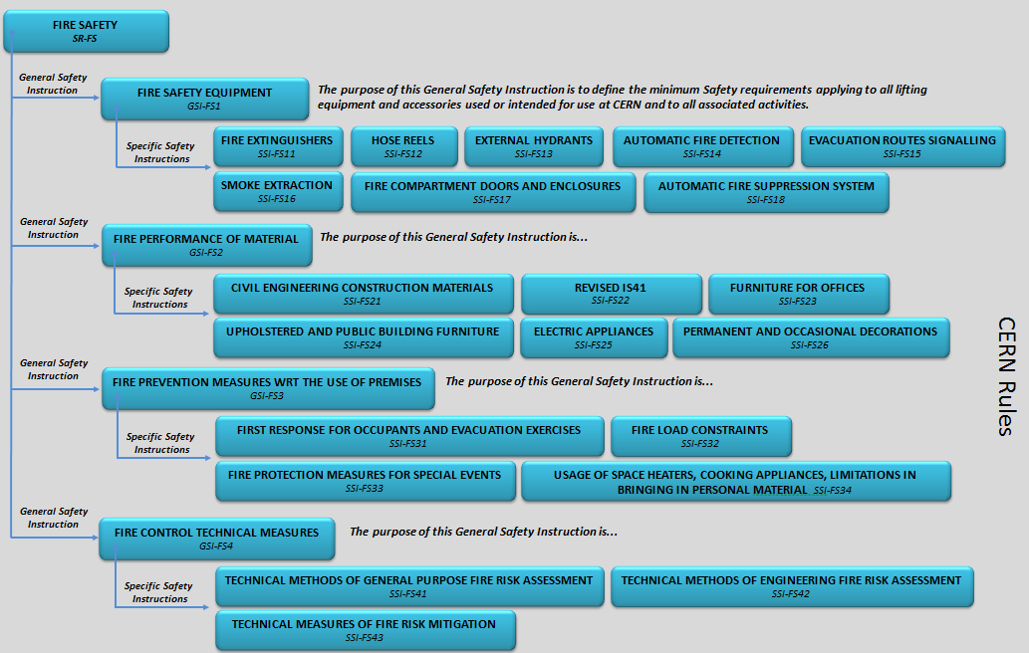
Fire safety rules cluster
A new cluster of fire safety rules is being written based on the strategic “White Paper”
Notes:
More information is provided in the upcoming presentation by F. Corsanego

Slide 11
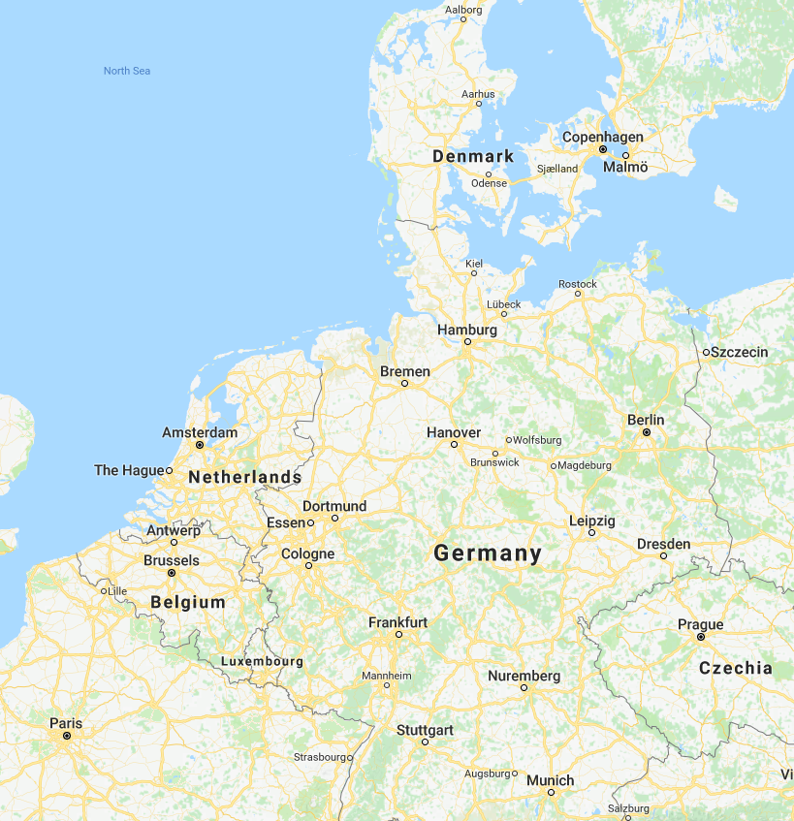







Research collaborations
Framework agreements
Joint doctoral student

Slide 12
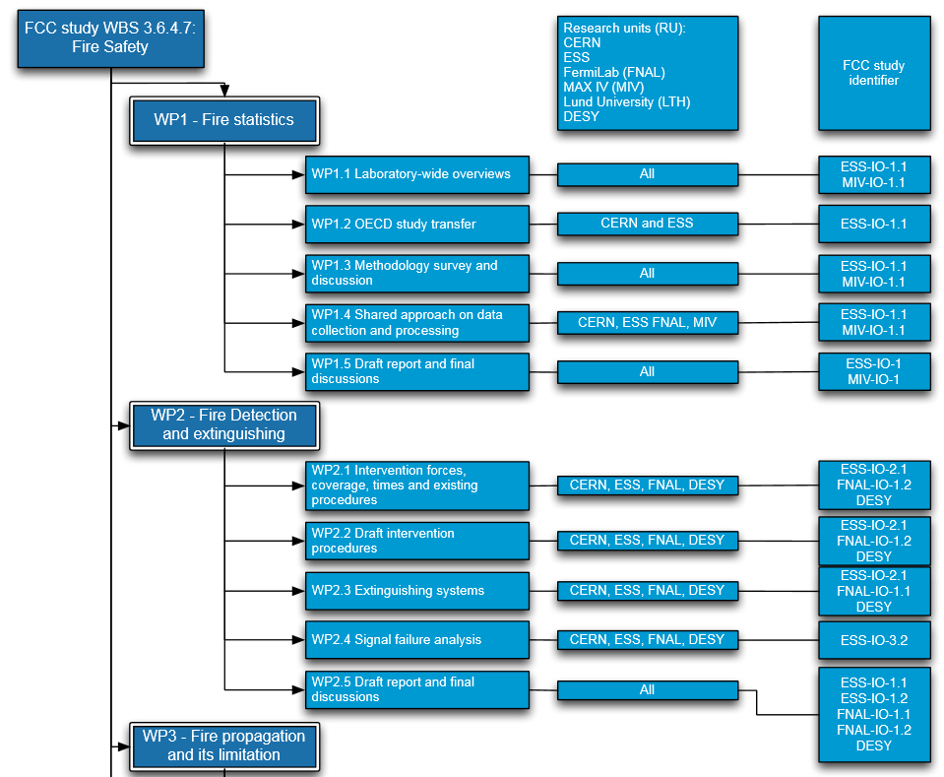






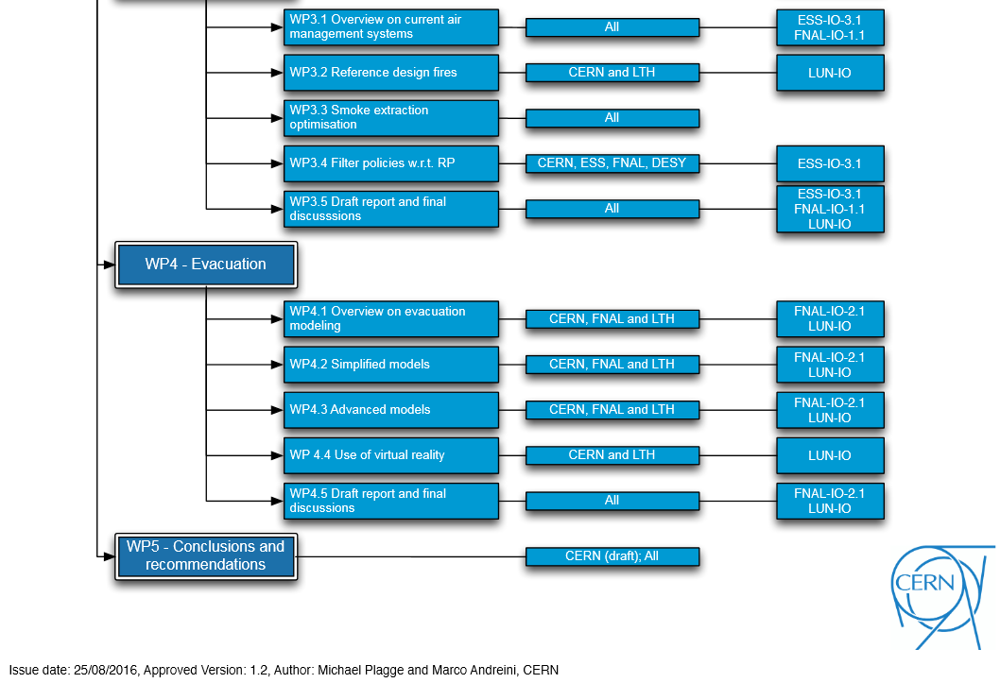
FCC fire safety collaboration
Kick-off workshop @ ESS January 2015
Intermediate workshops every six month
  CERN, October 2015
  ITSF, May 2016 (DESY)
  ESS, November 2016
  ESS, June 2017
  Fermilab, November 2017
4 work packages, 16 sub units providing 10 FCC deliverables

Slide 13
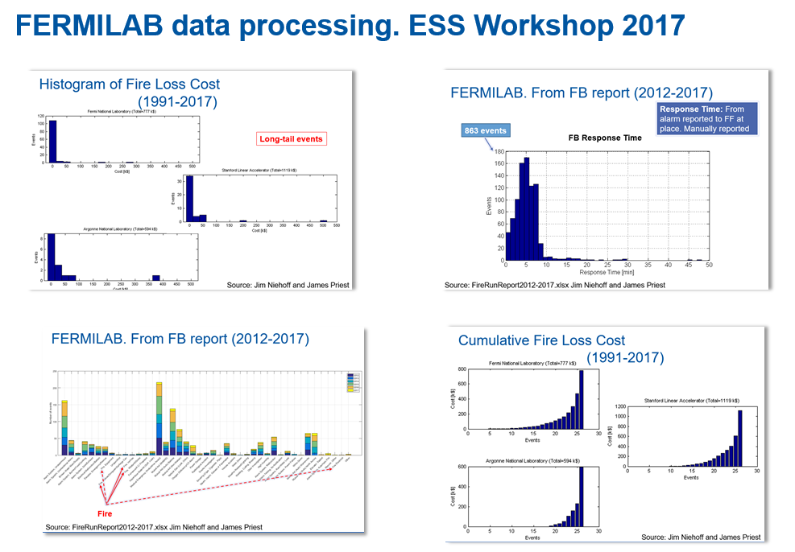
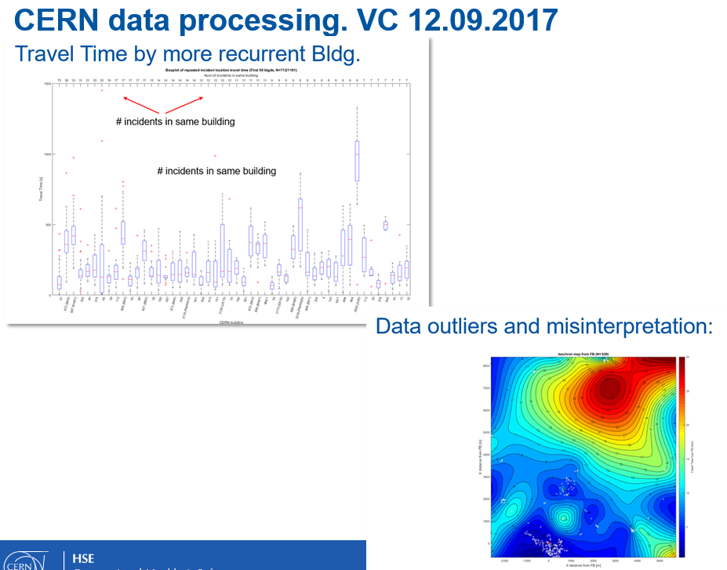
FCC fire safety collaboration - some key deliverables
Courtesy of O. Rios HSE/SEE/XP

Slide 14
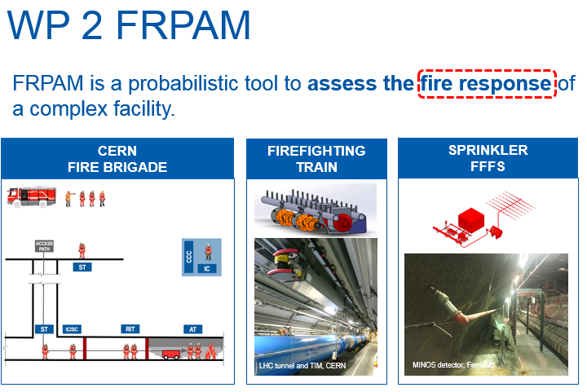
FCC fire safety collaboration - some key deliverables

Slide 15
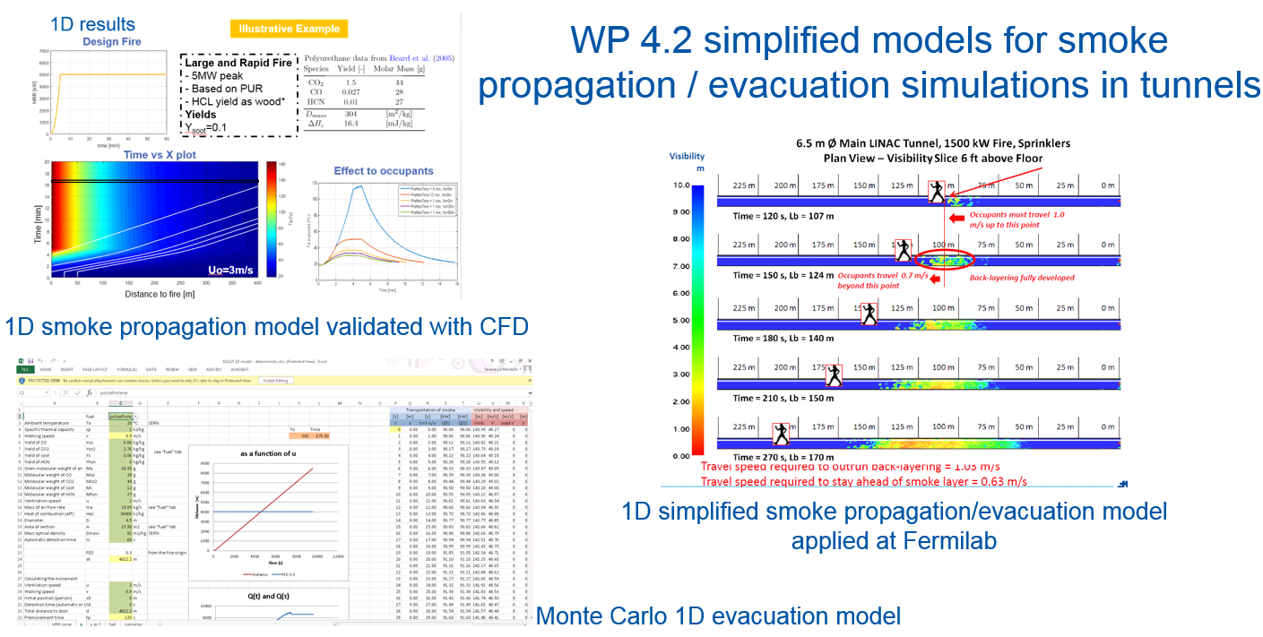
FCC fire safety collaboration - some key deliverables

Slide 16
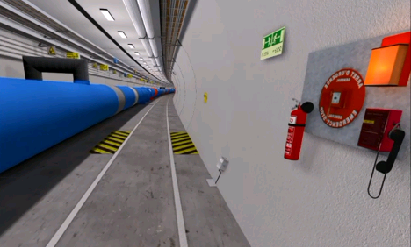
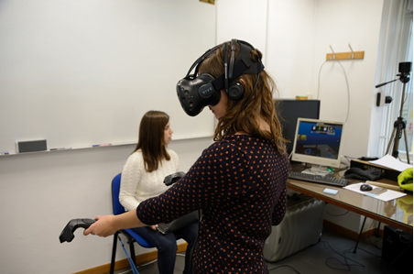
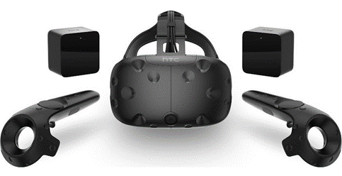
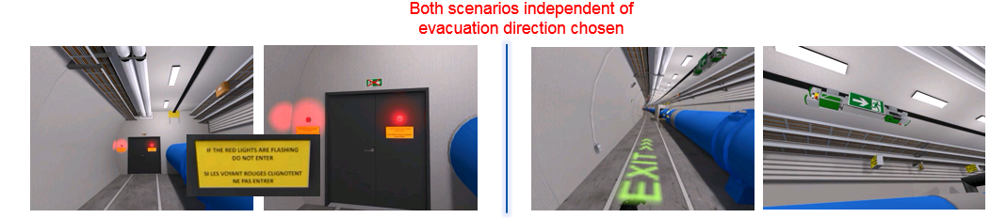
FCC fire safety collaboration - some key deliverables
WP 4: Virtual reality experiments @ CERN in collaboration with Lund University (S. Arias)
About 80 volunteers from CERN
Scenario 1 – Flashing lights
Scenario 2 – Evacuation robot (thanks to EN/STI)

Slide 17
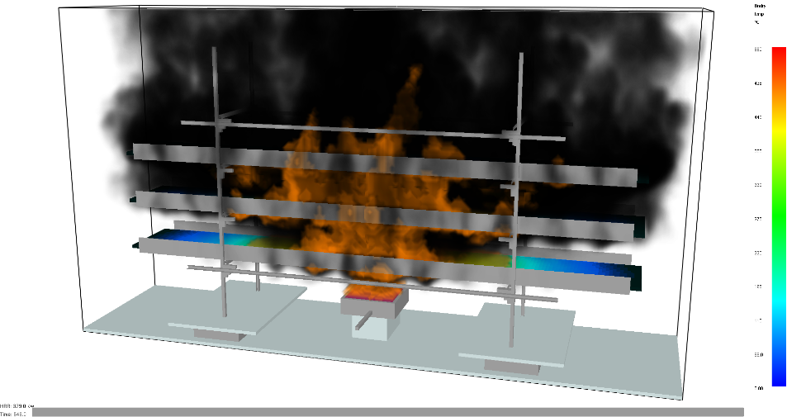
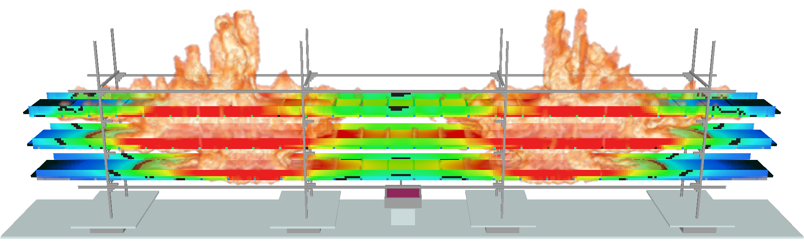
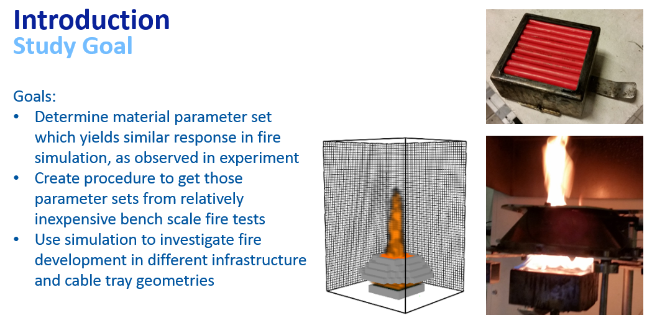
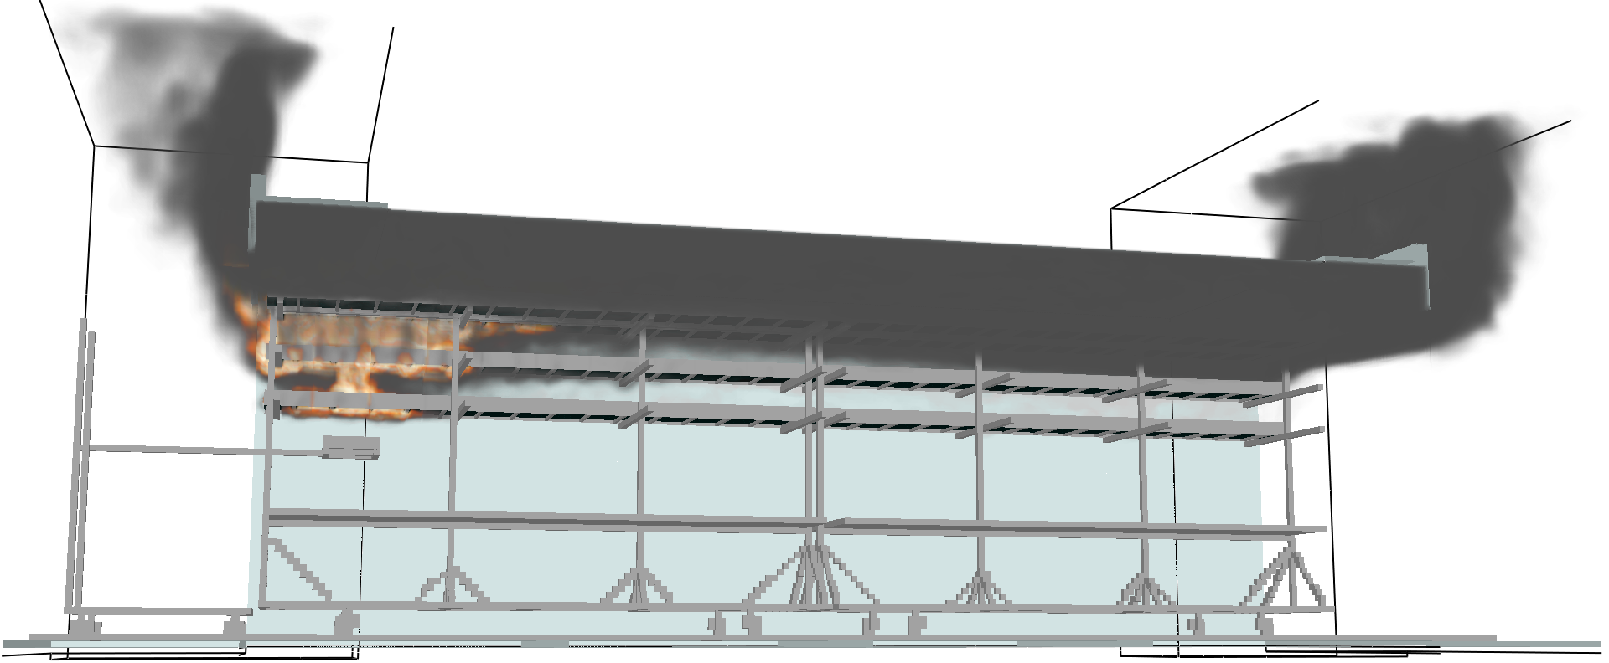
Research on fire simulation of cable trays
Courtesy of T. Hehnen HSE/SEE/XP

Slide 18
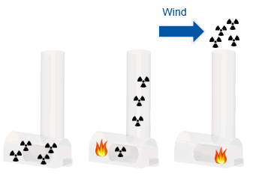
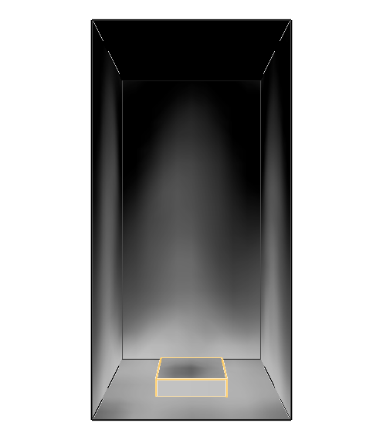
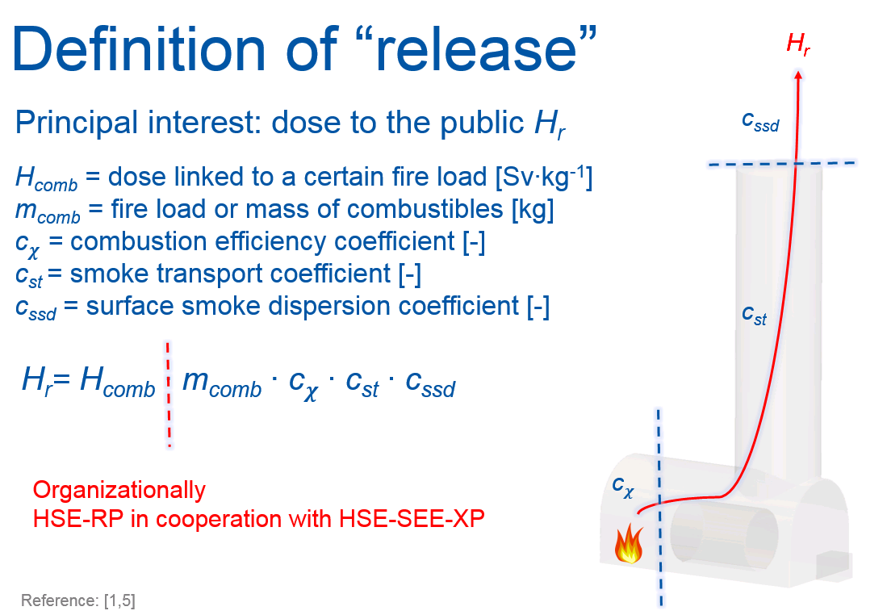
Fire-Induced Radiological Integrated Assessment
(FIRIA) project
Courtesy of M. Plagge
Instead of assuming 100% “release” (too conservative), some coefficient are introduced;
Development and consolidation of an analysis methodology;
Need for a High Performance Computing Cluster;
Some R&D on aerosol production and propagation is needed
Modeled wall soot deposition
originating from a propane flame

Slide 19
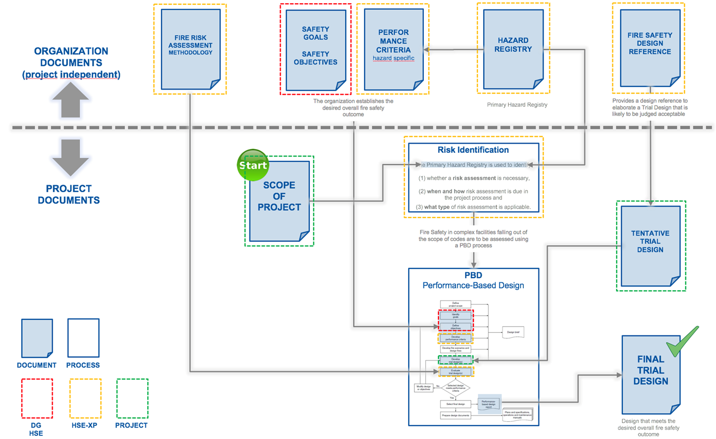
Development of a performance-based fire design approach
Notes:
See upcoming presentation by A. Arnalich

Slide 20
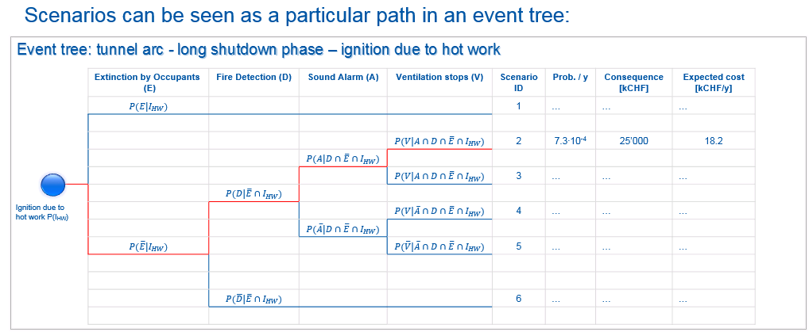
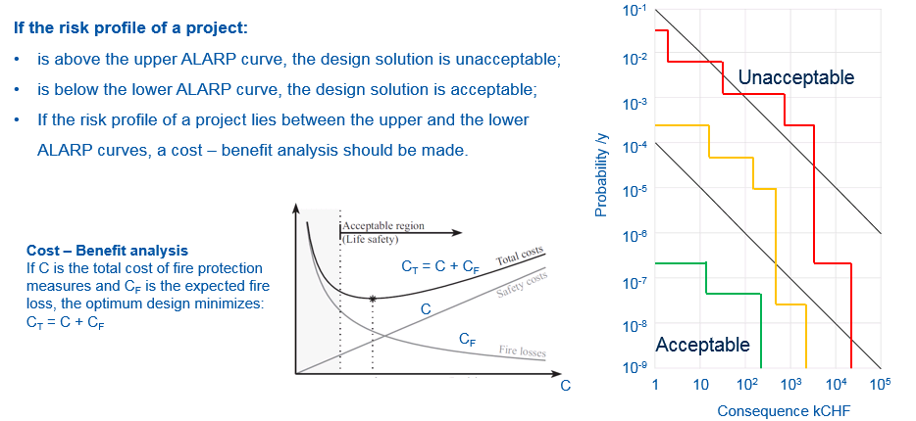
Development of a probabilistic fire risk assessment framework
The total risk is calculated;
Very useful for Cost – Benefit analyses of compensatory measures;
Needs an estimate of probabilities and uncertainties.
Notes:
See upcoming presentation by A. Arnalich

Slide 21
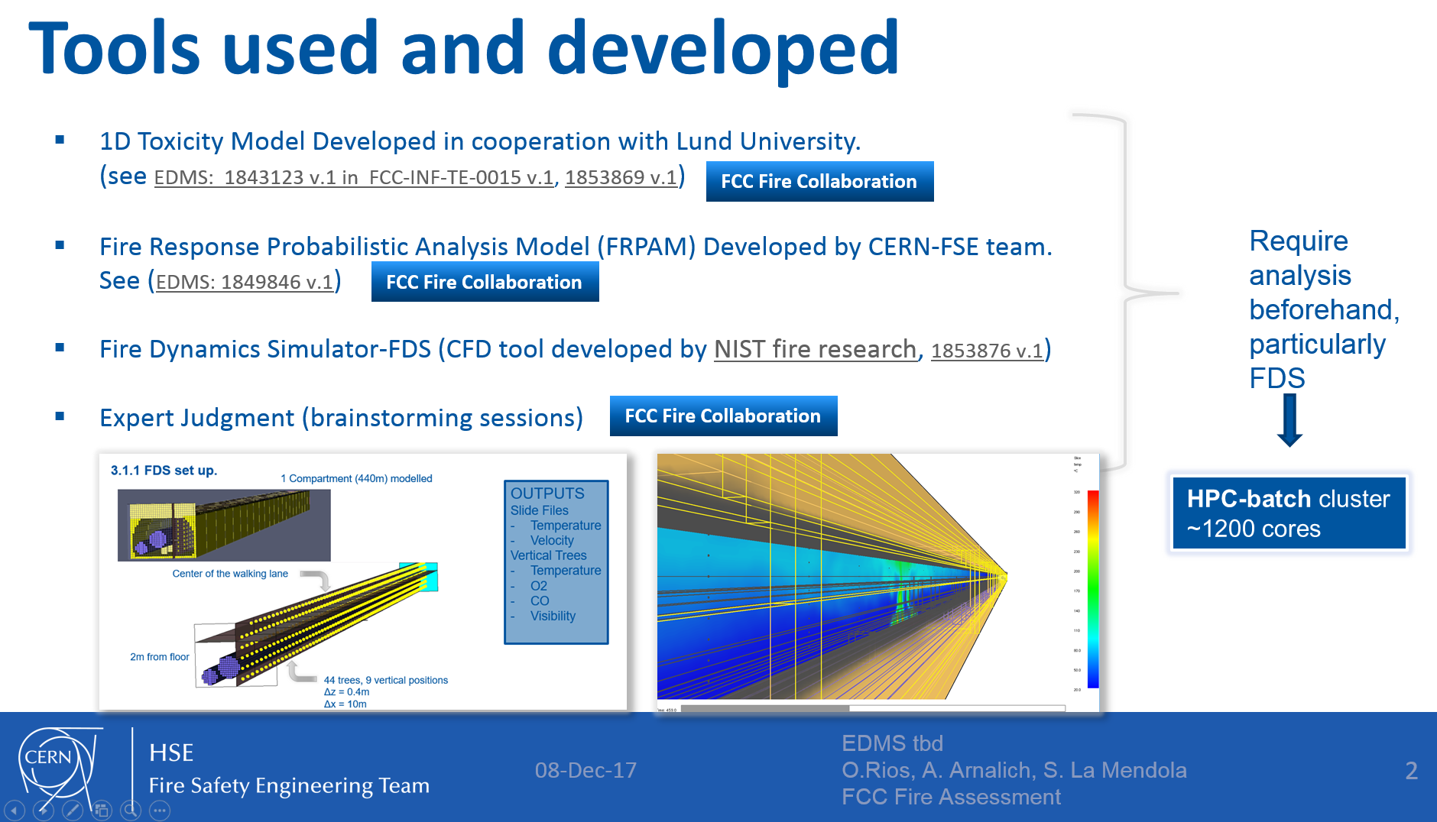
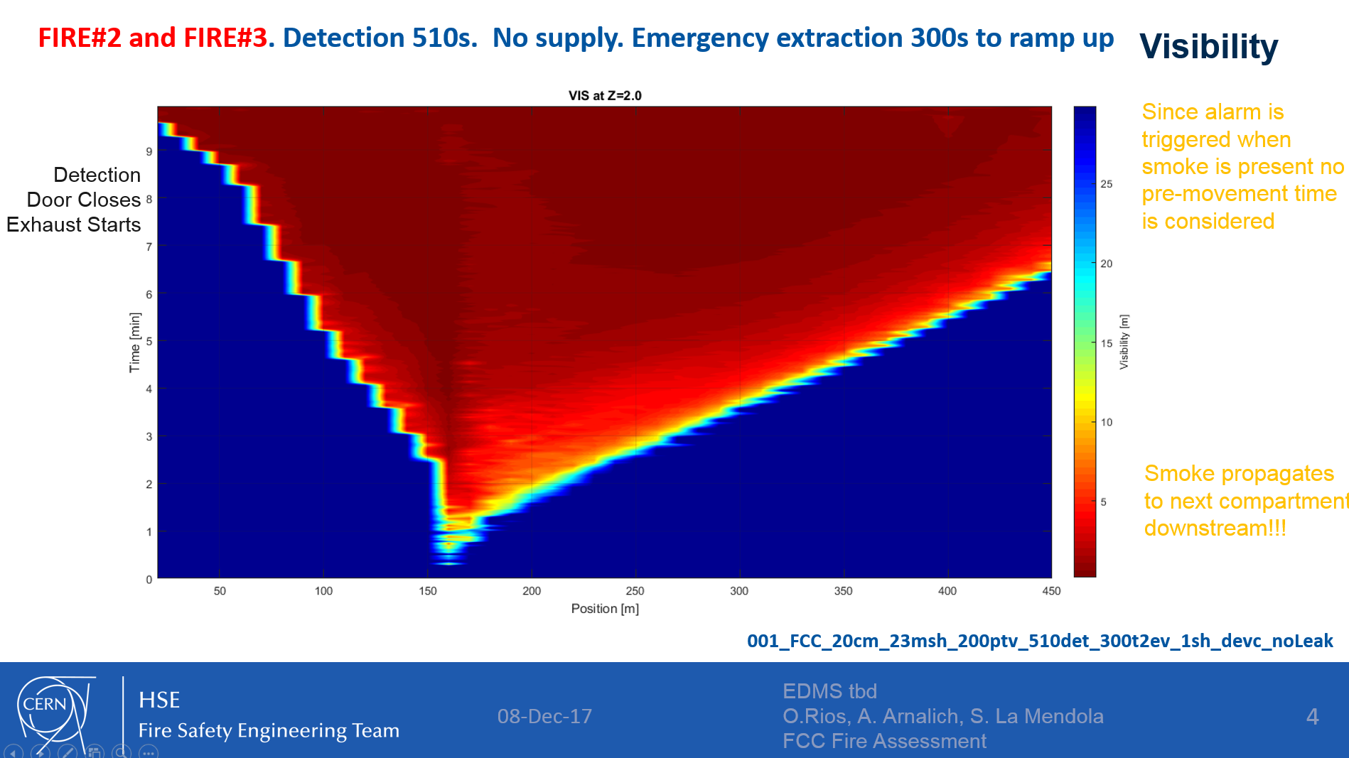
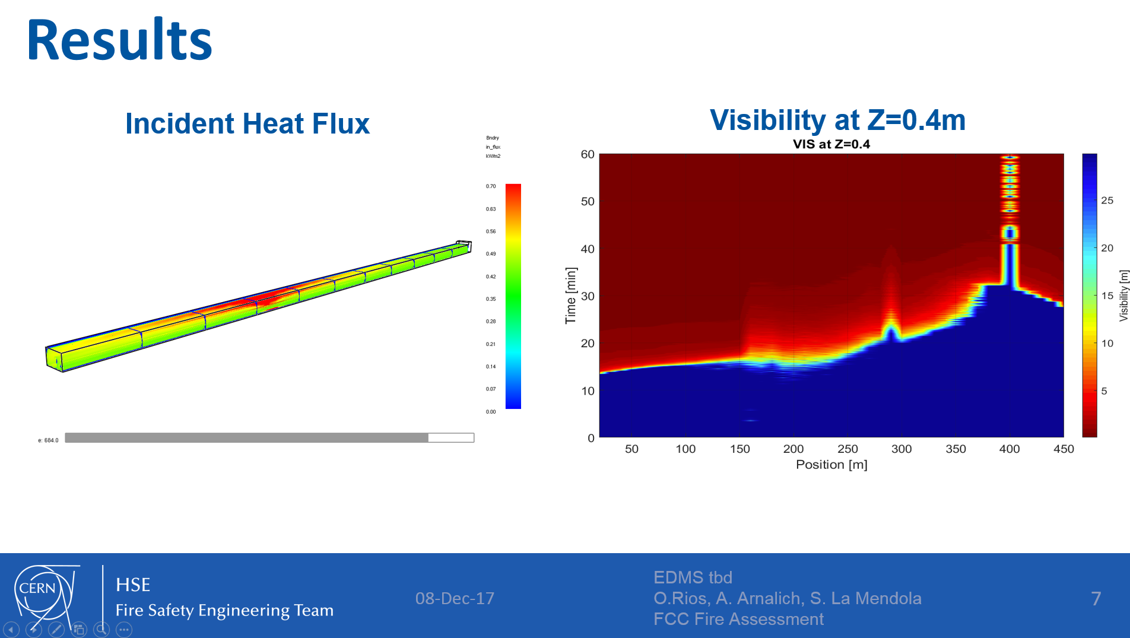
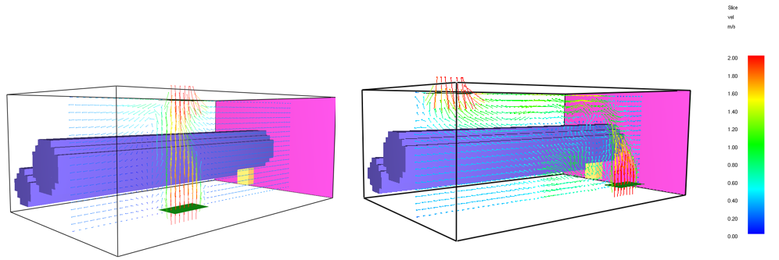
Successful cases - FCC
Courtesy of O. Rios HSE/SEE/XP

Slide 22
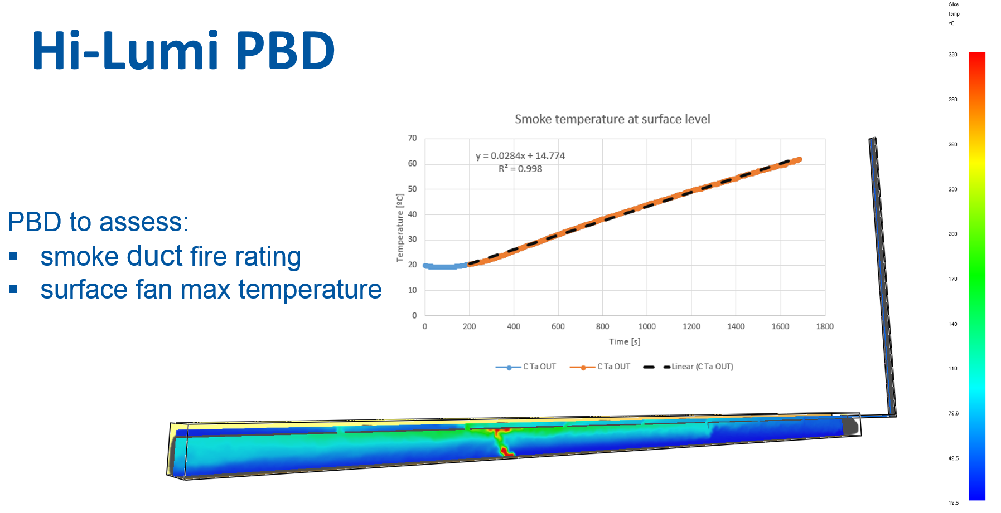
Successful cases – HL-LHC
Courtesy of O. Rios HSE/SEE/XP

Slide 23
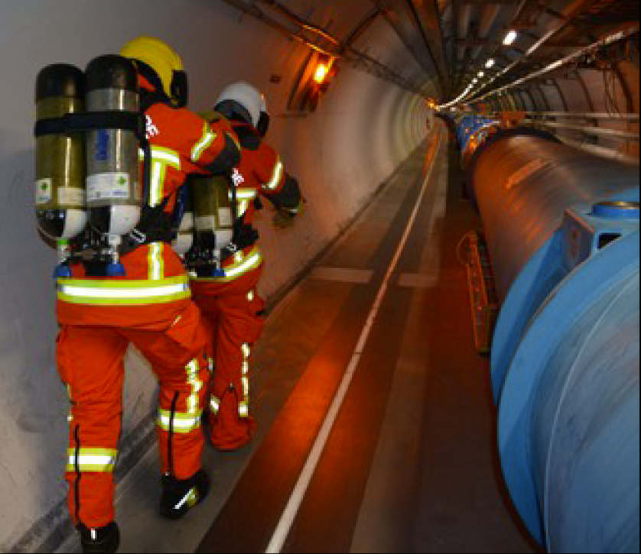
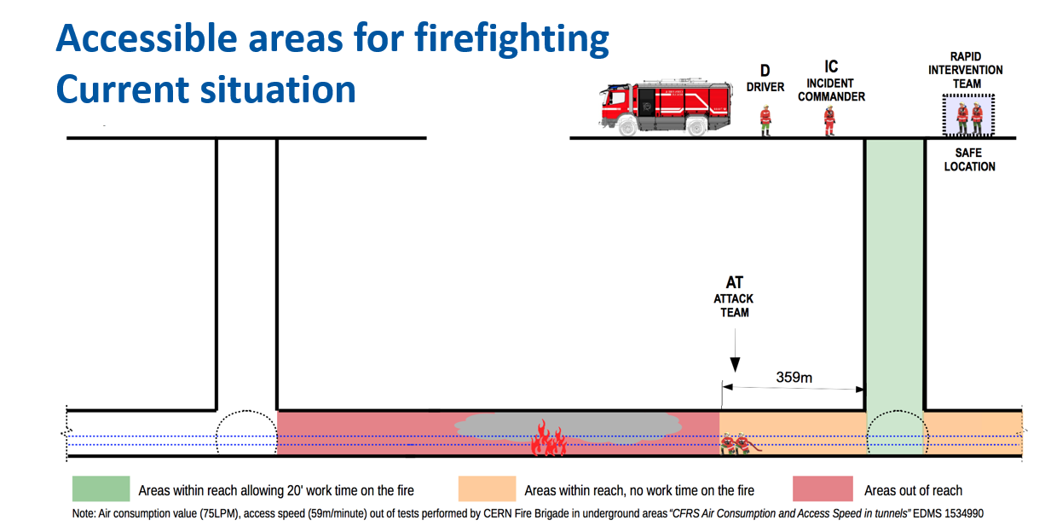
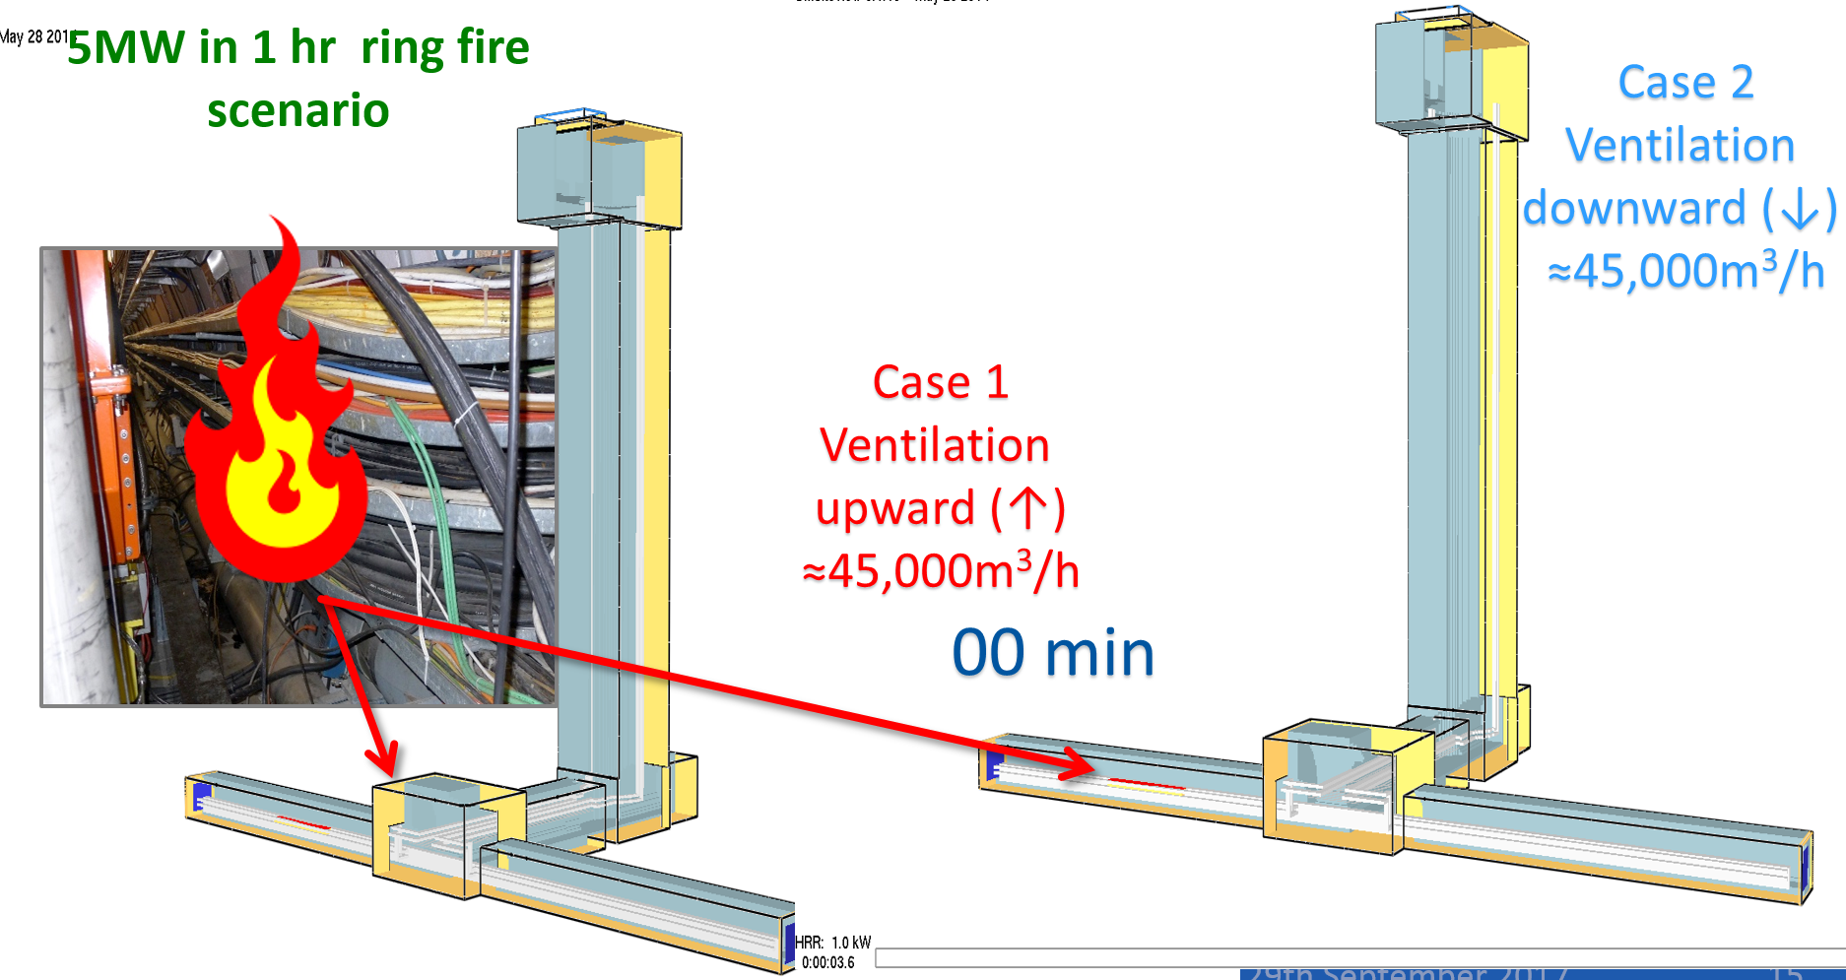
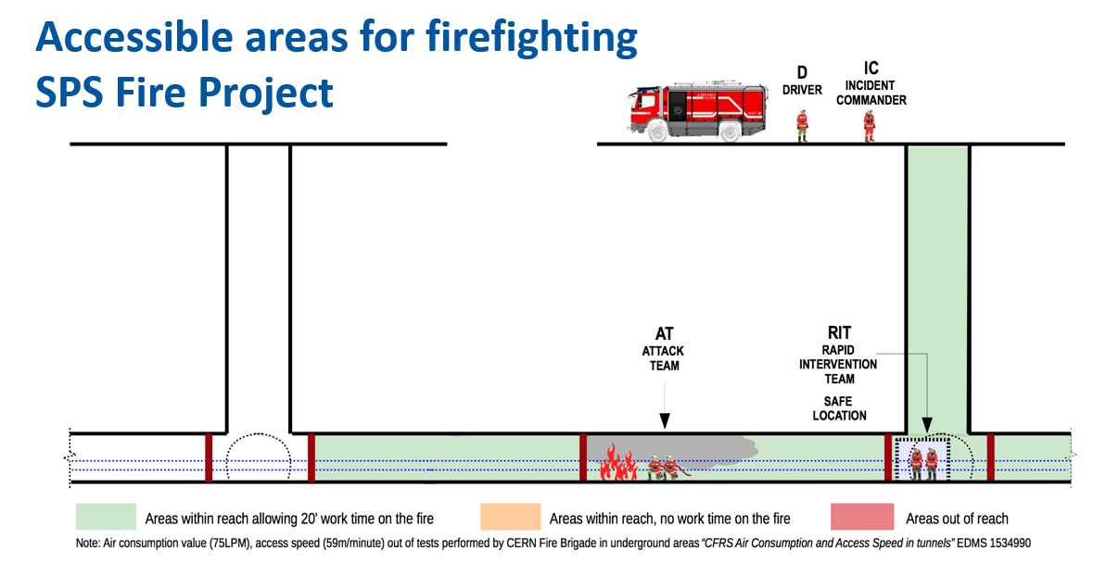
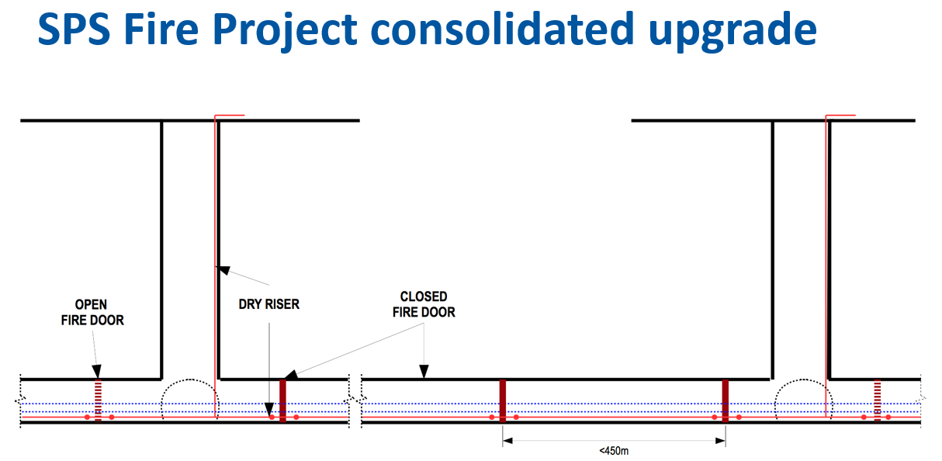
Successful cases – SPS fire consolidation
Courtesy of A. Arnalich and F. Corsanego HSE/SEE/XP

Slide 24
Questions?
Thank you for your attention!

