Slide 1
Enhanced QPS – performance, commissioning at 3.5TeV, outlook towards 5 TeV
R. Denz TE-MPE-CP
on behalf of the (extended) QPS team
Special thanks to Z. Charifoulline, K. Dahlerup-Petersen, R. Flora, F. Formenti and J. Steckert

Slide 2
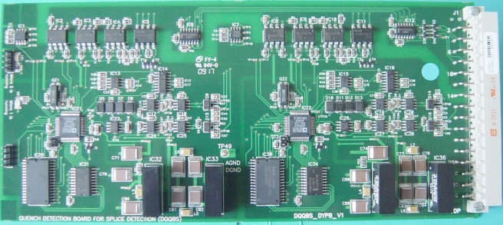
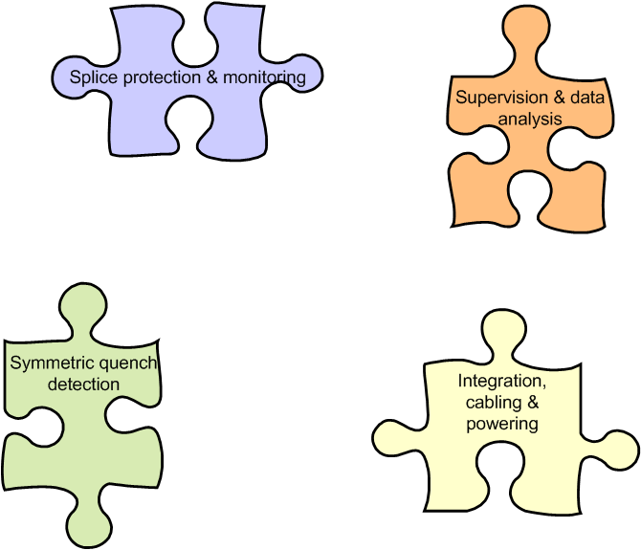
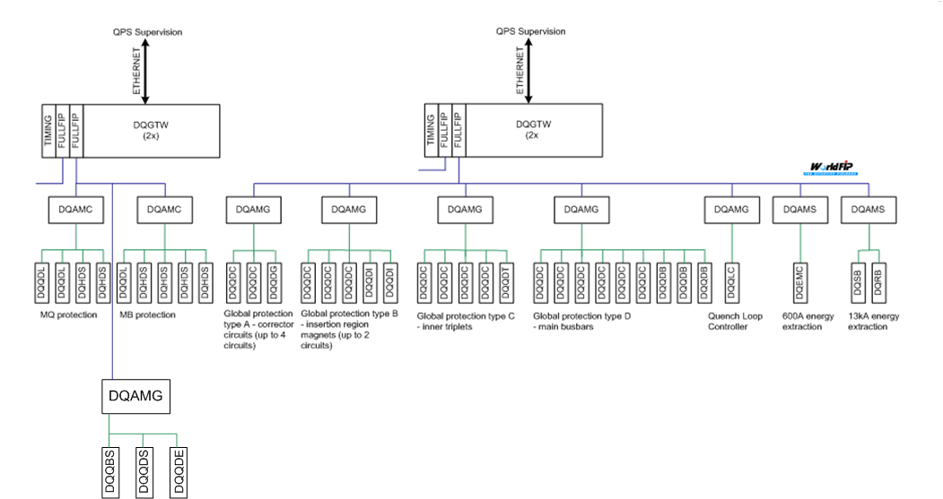
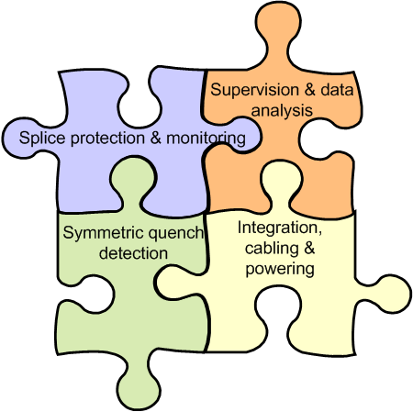
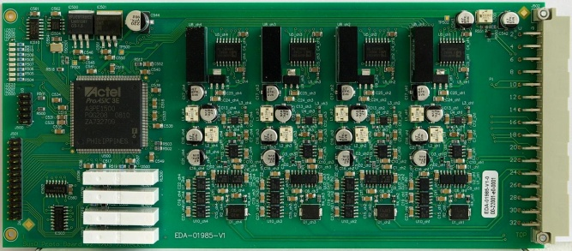
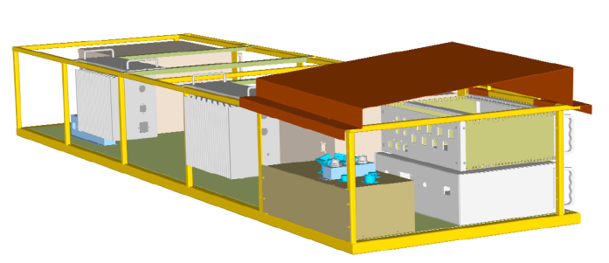
What is enhanced QPS (nQPS)?
436 crates, 3924 detection boards, 872 power packs
~30000 signals
240 km of cables, 7800 connectors

Slide 3
What is the functionality of nQPS?
Splice protection system type DQQBS
  Permanently monitors and interlocks the voltage across the interconnections between LHC main magnets
    Determination of detection threshold based on simulation and tests (→ A. Verweij)
    Required threshold @ I = 12 kA: U_{TH} = 300 μV, 10 s
    For 3.5 TeV operation U_{TH} = 500 μV, 10 s is sufficient
  Provides data for enhanced diagnostics via the QPS supervision
    “Mexican pyramids” → measurement of splice resistance with a resolution of ΔR < 1nΩ
    Evaluation of data recorded during coasting to trace development of splice resistances in time

Slide 4
What is the functionality of nQPS?
Symmetric quench detection system type DQQDS
  Enhances the functionality of the existing protection system in order to detect timely aperture symmetric quenches
    Design threshold U_{TH} = 200 mV, 20 ms
  System is detecting as well “normal” quenches and serves as a back-up of the existing system
    Used for the implementation of the fully redundant UPS AC powering scheme
  System is essential for magnet training up to nominal current
    Significant amount of aperture symmetric quenches due to propagation expected

Slide 5
nQPS commissioning I < 2 kA – splice protection
nQPS can be commissioned and qualified up to I = 2 kA in passive mode e.g. not connected to interlocks and quench heaters
  Protection ensured by standard QPS, respectively self protecting
Verification of signal integrity
  Completeness, wiring errors, noise levels
Adjustment of device parameters
  Threshold and filter settings if applicable
  Splice protection needs to compensate apparent inductive voltage across bus-bar splice during ramp
    Compensation coefficients to be deduced from data acquired during current ramps
    Main contribution from instrumentation wires → different sets for the two redundant protection systems
Splice mapping up to 2 kA
  Identification of potential problems at moderate currents

Slide 6
nQPS commissioning I < 2 kA – symmetric quench detection
Symmetric quench detection system is based on a multichannel evaluation logic supervising 3 magnets
  System is active in all phases of a powering cycle
  Approach ensures a very reliable detection of quenches
  The not so easy task consists in the suppression of false triggers in case of activation of the energy extraction systems
    Risk of multiple quenches
    Steep learning curve during commissioning in 2009
    Use of adaptive filters, which are only active during the transition from ramping/coasting to discharge
    Snubber capacitors for the energy extraction systems needed for operation at higher energies (→ see talk by W. Venturini)
  The check of the immunity of the symmetric quench detection with respect to fast discharges is a mandatory test to be repeated each time the energy is increased

Slide 7
nQPS commissioning I < 2 kA – symmetric quench detection
Signal (magnets → detector) and trigger (detector → quench heaters) mapping to be checked very carefully
  Combined with heater firing test of existing QPS
    Firing of quench heaters of a previously power cycled magnet (typically up to injection current) creates a voltage spike recorded by the symmetric quench detection system
  Heater firing triggered by the symmetric quench detection
    Verification that the system is protecting the right magnet
  Mapping has to be checked only after installation and each major intervention requiring disconnection of nQPS cables
  Heaters and interlocks to be tested once per year

Slide 8
nQPS commissioning I > 2kA
nQPS fully operational once successfully commissioned to 2 kA
  Signal to noise ratio for splice measurements will improve with increasing current → better resolution
  False trigger immunity of symmetric quench detection systems during activation of the energy extraction carefully to be checked (applies as well to existing QPS)
  Installation of snubber capacitors for energy extraction systems required for I > 6000 A
    Delivery to be completed in March 2010
    Installation will require about 2 days per sector
  First tests performed end 2009 in sector 1-2
    Activation of energy extraction systems at 4 kA confirmed immunity of nQPS during fast power abort sequences

Slide 9
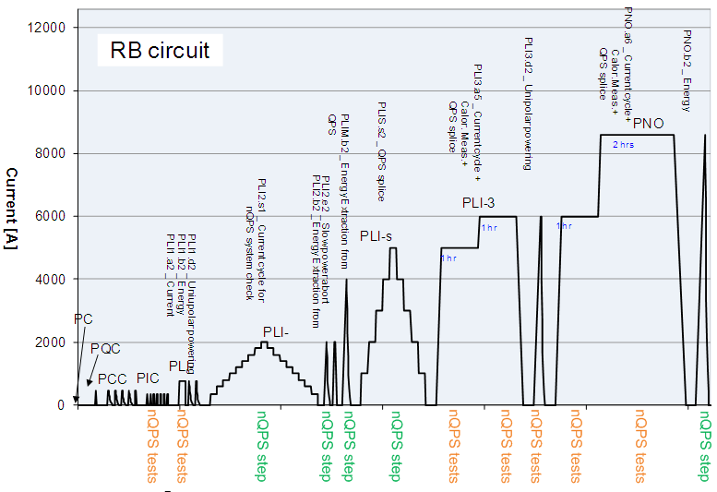
nQPS commissioning & hardware commissioning

Slide 10
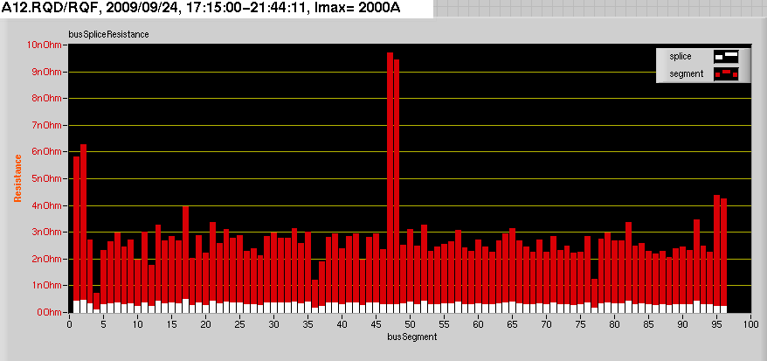
nQPS performance – splice mapping
First splice mapping in LHC
  First real test of splice protection system hardware, nQPS supervision, data transmission, storage and analysis
  Sufficient resolution already at I = 2 kA to qualify splices (~ 400 pΩ)
  High resolution as well due to remarkable precision of power converter

Slide 11
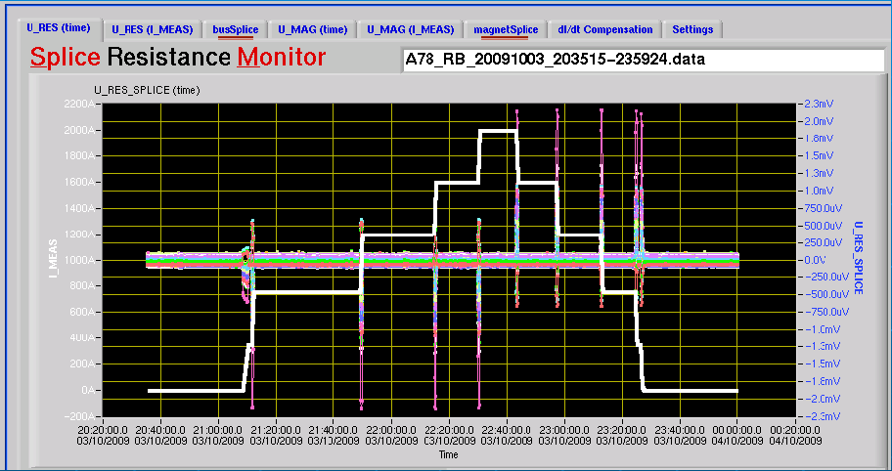
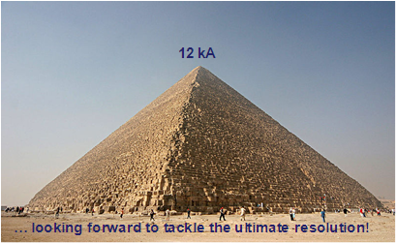
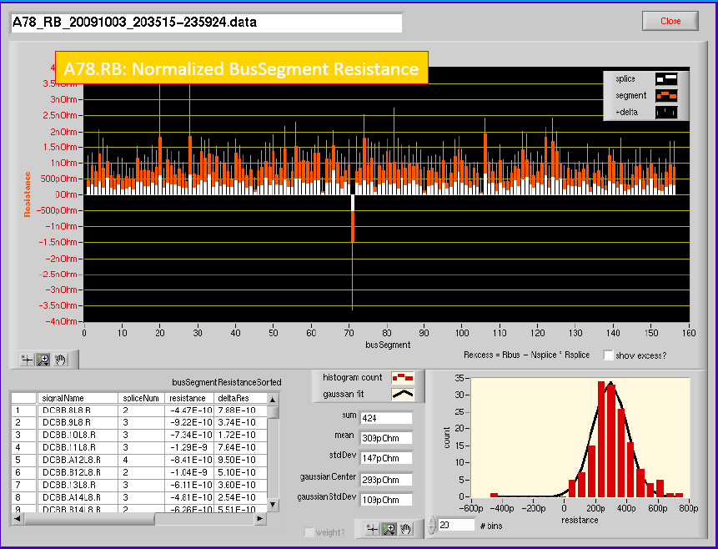
nQPS performance – splice mapping
  Splice mapping up to I= 2 kA; example of a dipole circuit
    10 min per plateau, ~3 hours in total (fully automatic)
  Measurement combined with internal splice mapping of magnets
    Snapshot method using “old” QPS

Slide 12
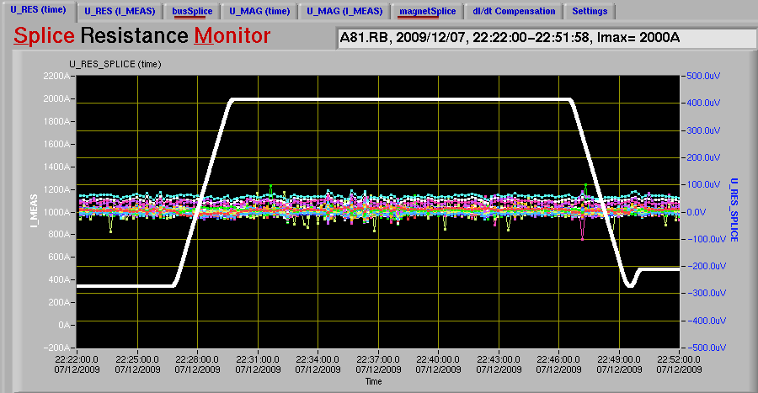
nQPS performance – inductive compensation
Resistive voltage during ramp and coasting after fine tuning of the inductive compensation values in sector 8-1
  Procedure for determination of coefficients and download to device developed and successfully tested

Slide 13
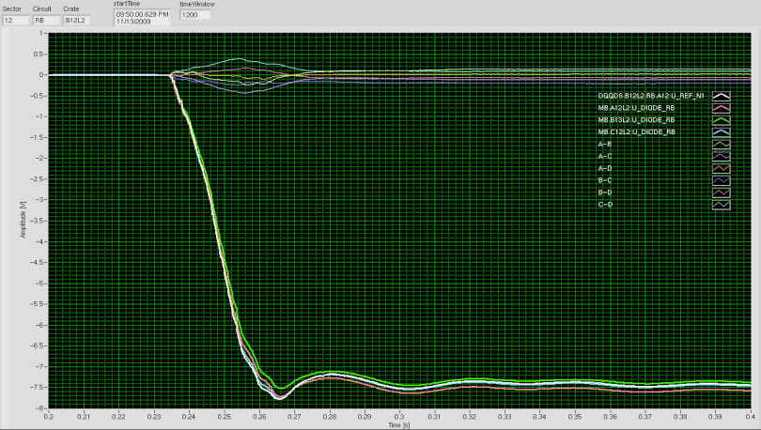
nQPS performance – symmetric quench detection
Differences between magnet voltages
Activation of energy extraction systems at I = 4 kA and data recorded by a symmetric quench detection board (dump of diagnostic buffer)
  System would have triggered without adaptive filtering

Slide 14
nQPS performance – sector 1-2 experience
Sector 1-2 has been the only sector during the 2009 run with nQPS being fully activated and interlocking
  Good stability during LHC operation with beam
    Apart from the transfer line magnets (→ next slide) no interference by other LHC equipment (BLM’s, kickers …) so far observed
    nQPS adds about 500 hardwired interlock channels per sector (total number will increase from 7700 to 11500)
  System fully integrated into QPS supervision – substantial effort by the controls groups to handle the significantly increased data flow
    Enhanced QPS control options (= more knobs) essential for commissioning
  Dedicated tools for nQPS analysis successfully validated
    Splice resistance monitor (Z. Charifoulline)
    Specialist tools for device diagnostics and maintenance
  Very valuable input for final commissioning of nQPS

Slide 15
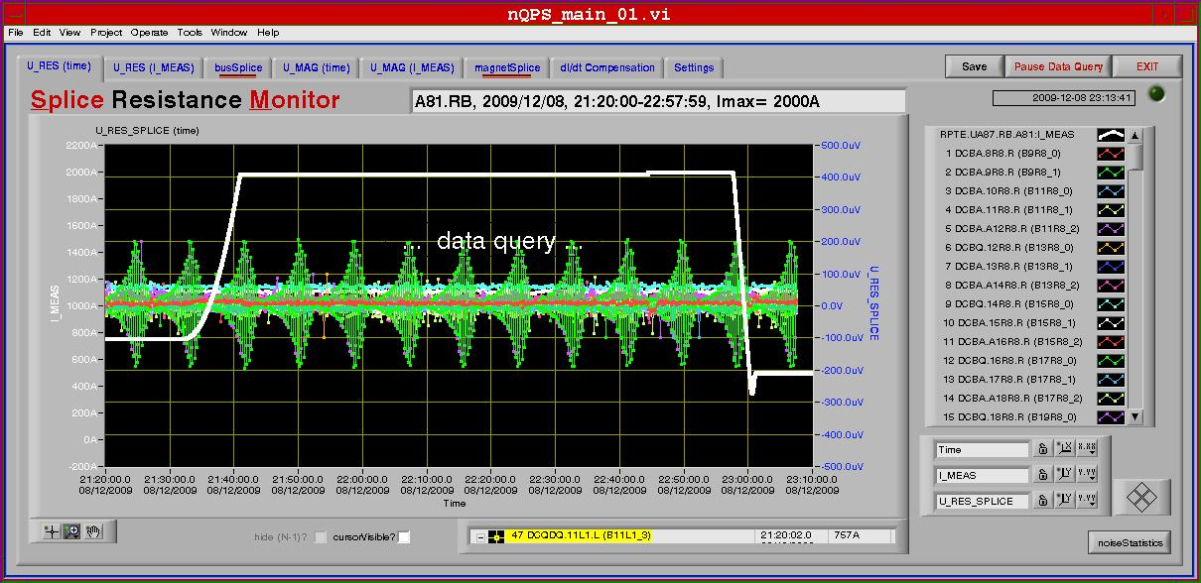
nQPS performance – sector 1-2 experience
nQPS during acceleration cycle
  Crosstalk from transfer lines giving problems to operate with U_{TH} = 300 μV threshold only for a limited number of systems
  Not an issue with U_{TH} = 500 μV, long term solution currently being assessed (source, transfer line settings, nQPS settings)

Slide 16
nQPS roadmap & outlook
Final commissioning up to 3.5 TeV of nQPS in all LHC sectors to be completed in the very near future
  Successfully started in sector 8-1, 1-2 and 2-3 in calendar week 4; other sectors in preparation
  Firmware of symmetric quench detection systems updated taking into account the results from 2009
Commissioning to 5 TeV
  Installation of snubber capacitors for energy extraction systems
  No major commissioning campaign required from 3.5 TeV and 5 TeV

Slide 17
nQPS roadmap & outlook
Extension of nQPS to IPQ, IPD and IT to be prepared
  Upgrades only for diagnostic purposes; circuits are fully protected by the present system (→ see talk by J. P. Tock)
  Necessary additional signal cables already installed
Radiation tolerance
  Several test campaigns in 2009 (PSI and CNGS) confirming design approach
  Potential problem related to radiation weakness of latest version of field-bus chip (MicroFipTM → see talk by J. Serrano)
    Affects only supervision not protection
    Temporary workaround for QPS boards available
    Long term solution required for all QPS systems

Slide 18
Summary
Commissioning of the enhanced QPS in 2009:
  Complete mapping of the interconnection splices in the LHC main circuits for the first time – no bad surprises
  Successful validation of nQPS design
  Re-cabling campaign completed
    Electrical tests by ELQA team completed for 3 sectors
Enhanced QPS exploitation during the LHC run in 2009:
  No showstoppers revealed so far
  The main constraint with respect to the overall dependability (= reliability + availability + safety) of the QPS system is the large equipment number
Full commissioning of the enhanced QPS up to 3.5 TeV after the re-cabling campaign to be completed soon
  System will be ready to be commissioned to 5 TeV once snubber capacitors have been installed
  No major commissioning campaign required from 3.5 TeV → 5 TeV

Slide 19
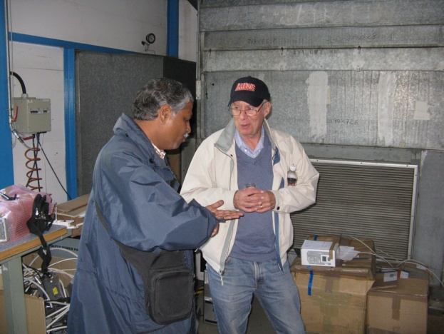
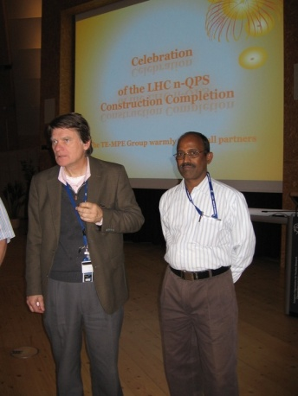
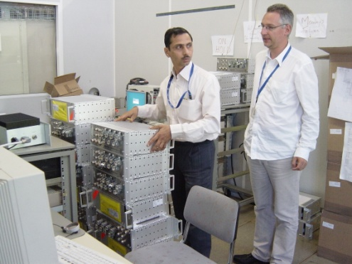

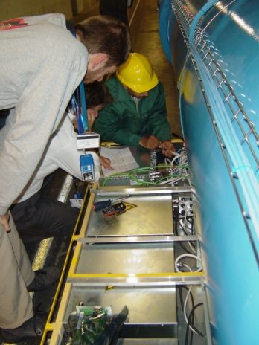
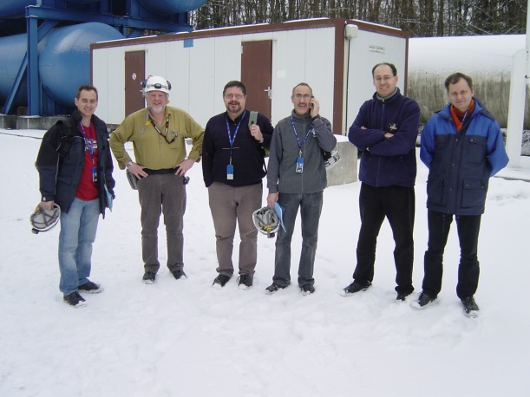

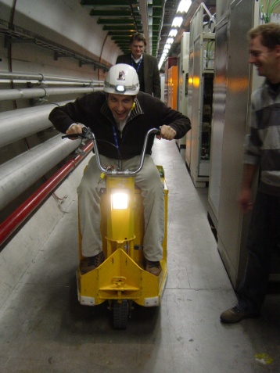
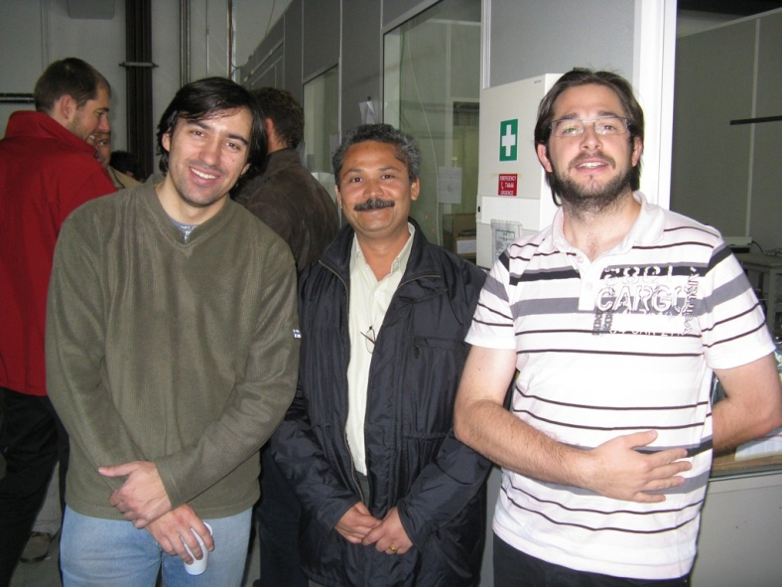
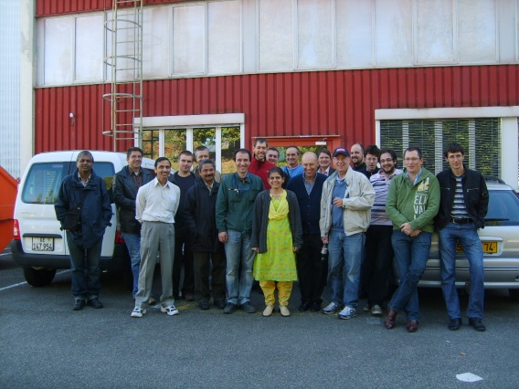
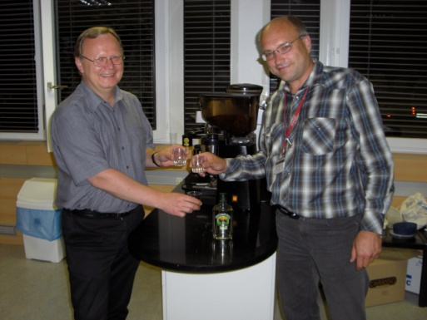
Thanks!

