Slide 1
Linac4 ► PSB ► PS :
Schedule and expected performance
M. Vretenar, with contributions from C. Carli, M. Benedikt, R. Garoby, M. Giovannozzi, S. Hancock, K. Hanke, S. Maury, etc.
Chamonix 2010
Notes:
The goal of this overview is to consider the overall picture of Linac4+PSB and PS.

Slide 2
Contents
Linac4 sub-systems and commissioning plans.
Linac4 schedule “flexibility”.
Linac4 shut-down duration and constraints.
Performance of PS complex with Linac4.
Overall schedule (construction + performance).

Slide 3
Extension of the Linac4 Project
The “Linac4 Project” is composed of 3 parts:
Construction and commissioning of Linac4 (up to Linac4 dump).
Construction of the transfer line, connection to Linac2 line, upgrade of the measurement lines (up to PSB wall, LBE dump).
Modification of PSB injection region for H¯, 160 MeV (commissioning of PSB with Linac4).
PSB injection modifications
transfer line
linac
Notes:
Flexibility of schedule depends on structure of the project

Slide 4
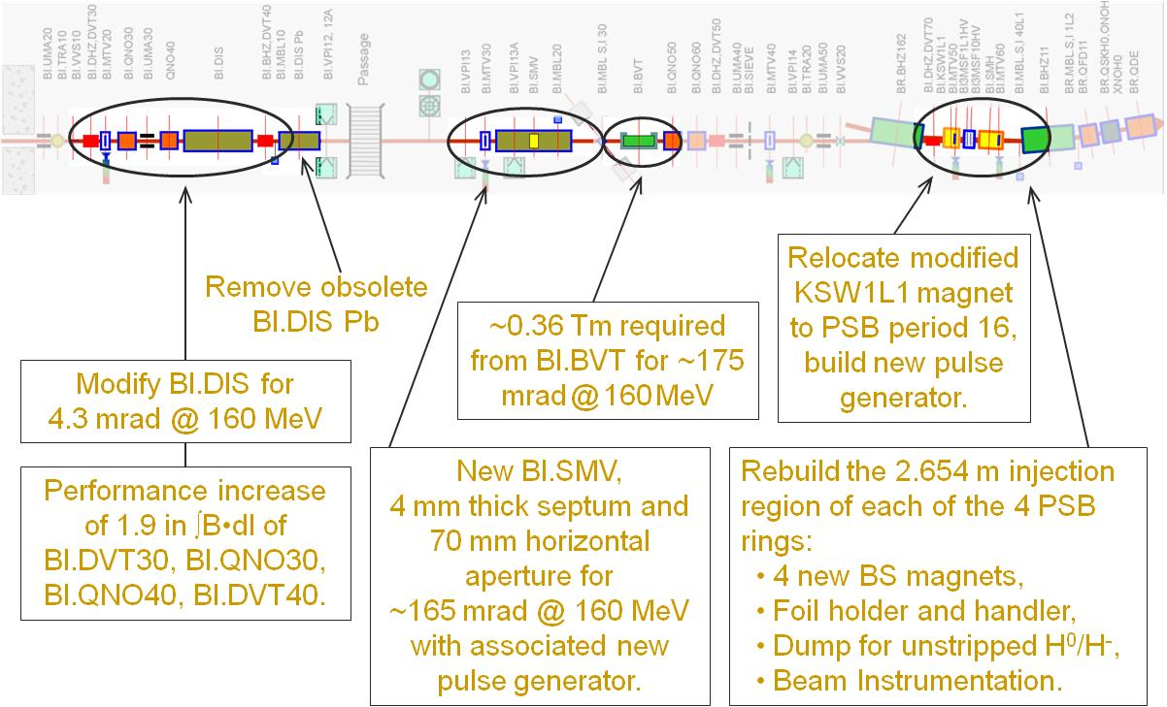
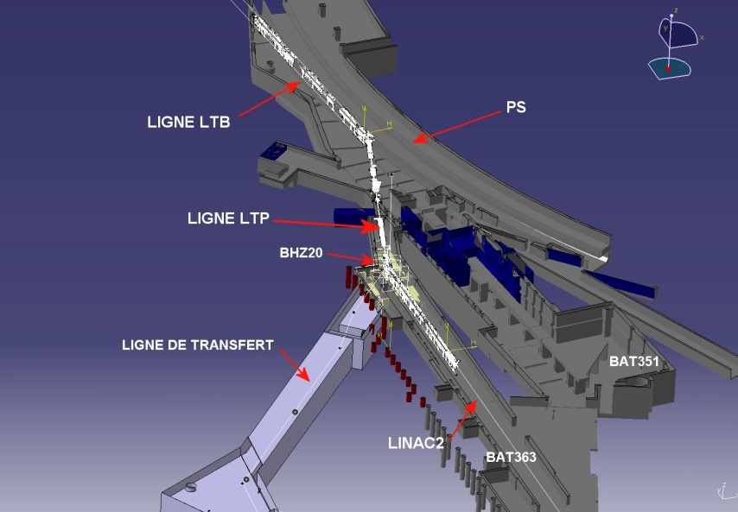
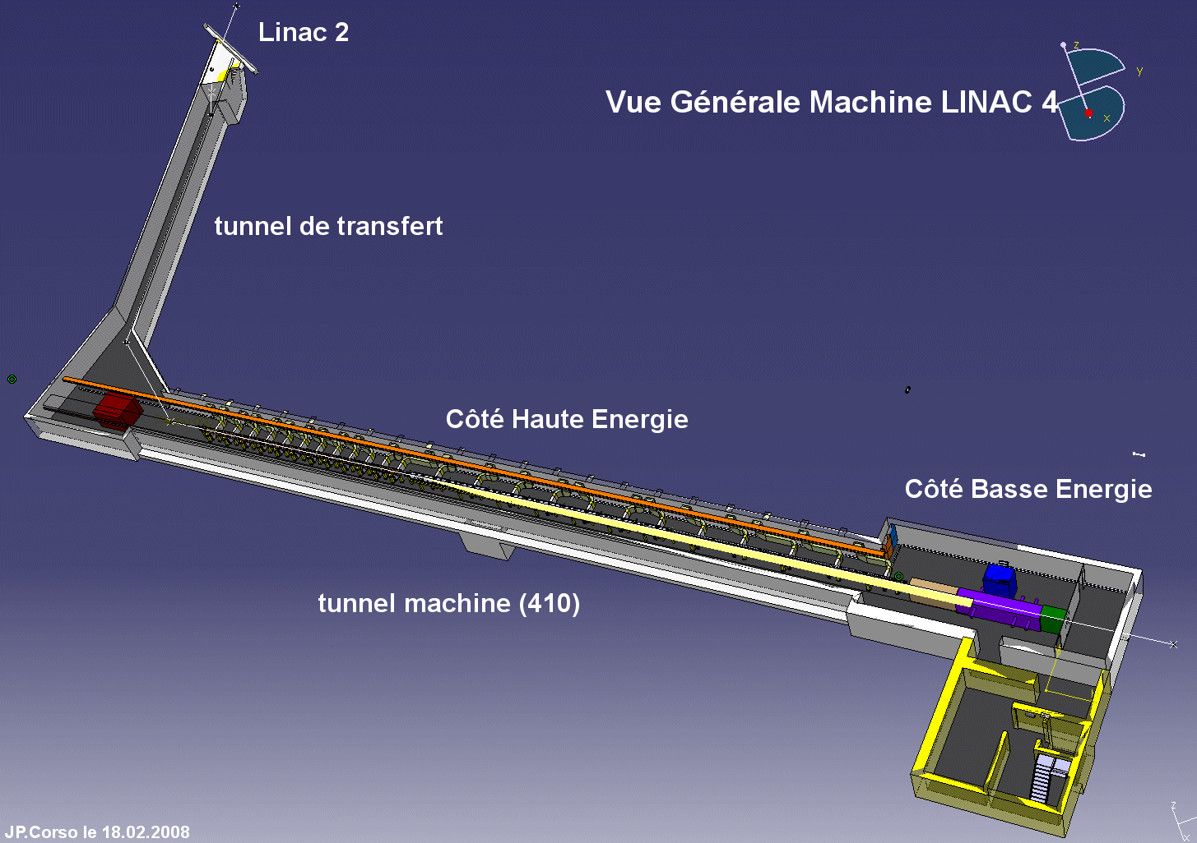
The three project parts
Notes:
PSB modifications 15% of overall machine budget

Slide 5
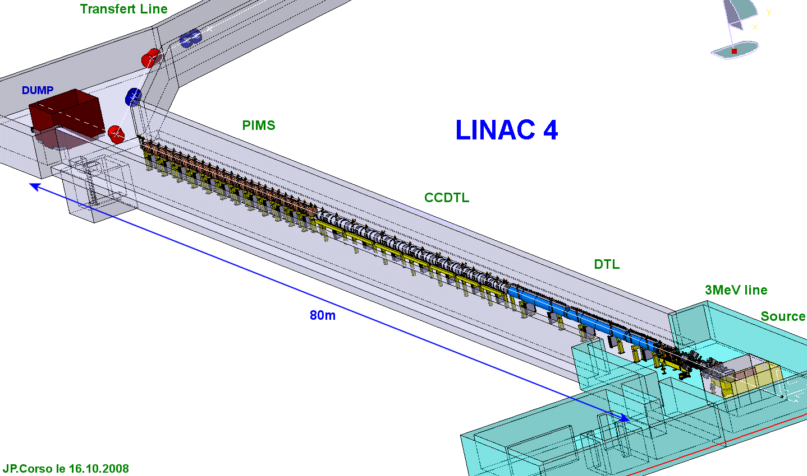
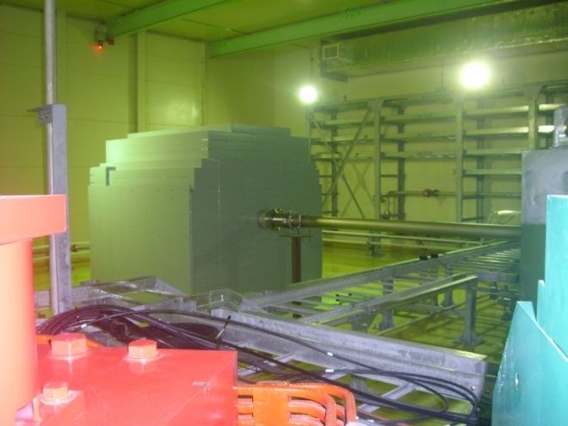
Linac4 Commissioning Plan
Dump at the end of Linac4
Commissioning of 3 MeV injector.
Commissioning of DTL1 (12 MeV).
Commissioning of DTL2 (50 MeV).
Commissioning of CCDTL (100 MeV)
Commissioning of PIMS (160 MeV, to linac dump)
Commissioning of transfer line (to PSB or additional dump)
Will be similar to the JPARC linac dump shown here

Slide 6
Linac4 schedule
Present Master Plan, approved in April 2009
1. Construction
2. Linac installation, commissioning
3. Connection and PSB commissioning
MILESTONE: Linac4 ready for connection to PSB, end 2013

Slide 7
Flexibility in Linac4 schedule
In the schedule we can easily separate 2 parts: a) linac construction and commissioning; b) transfer line connection, PSB modification and PSB commissioning. The commissioning of the linac has no interference with the present machines.
When can Linac4 be ready? The project has been delayed by 1 year in 2009, the new schedule approved in April 2009 foresees end of commissioning in September 2013. So far some minor delays, but project is more or less on schedule.
However, the recent risk analysis has underlined the risk of delays of the order of few months (mainly due to missing manpower resources) and of initial reliability issues.
Conclusion: the connection to PSB can be delayed by 1 year (to 2014/15) if required by general planning, however it would be wise to keep the present linac schedule, and foresee the additional year as spare time, in order to: a) absorb delays, b) sort out potential reliability issues, c) improve performance.
Consequences: 1) the shielding of the linac dump has to be improved, to stand 1 year of testing beams (limits to be checked) and an additional commissioning dump at the end of transfer line can be considered; 2) more manpower will be needed to run in parallel Linac4 and Linac2 in 2014.
In general terms, we can (probably) continue to run test beams in Linac4 until we get the green light for the connection to the PSB.

Slide 8
Duration of “Linac4” shut-down
Shut-down required for the connection of Linac4 to PSB:
1 month for radiation cool-down in PSB injection area.
3 months for PSB hardware modifications.
3 months for PSB commissioning with the new hardware (goal: prepare all the standard beams as before the connection).
1 month (2+2 weeks) for commissioning PS and SPS (standard duration after long shut-down).
Note: there is no interference between the ion complex and the connection of Linac4 → the LHC can run with ions during the “Linac4” shut-down.
Total time required:
8 months of LHC (proton) shut-down, or
6 months of LHC shut-down if a run is terminated with a 2-month ion run (≈ duration of a standard LHC long shut-down)

Slide 9
Schedule for Linac4 connection
Goal: at start-up, reproduce the same beams as with Linac2

Slide 10
Performance with Linac4
BOTTOM LINE:
Linac4 current 40 mA during 400 μs (in ε=0.45 π mm mrad) = 10¹⁴ ppp → plenty of margin in intensity.
160 MeV energy chosen in order to double βγ² and therefore intensity in PSB for same ΔQ (I/ΔQ ~ βγ²) → same performance as now with single batch injection from PSB into PS, increased performance in double batch.

Slide 11
Performance Tables
Limitations are highlighted in yellow; values to be demonstrated are in italic.

Slide 12
After the Linac4 connection
at start-up, nominal performance (on all beams) as before the connection of Linac4.
during 1st year of operation (or first 8 months for a 2-year run): increase PSB performance from “standard” to “ultimate with Linac4”. Can be done in ppm.
PS: the preparation for “ultimate” performance with Linac4 must be done before the connection of Linac4 to the PSB. The PSB can produce already now the density required to explore the PS limitations (longer bunches, for examples) and there is sufficient time to test possible solutions. This can be done in dedicated MDs and in ppm, and can require only minor improvements to PS diagnostics.
If the preparation of the PS is done in advance, the setting up for peak intensity with Linac4 can be done in the “shadow” of the PSB improvements.

Slide 13
Tentative time line
Peak performance out of PS with Linac4

Slide 14
Conclusions
The Linac4 schedule provides enough flexibility to allow the connection to the PSB to take place any time after September 2013.
The LHC shut-down for Linac4 connection must have a duration of 8 months (if no ion run) or of (8 months – duration of the ion run).
It is foreseen that Linac4 will allow reaching the nominal LHC intensity in PS single batch mode and the ultimate intensity out of PS in double batch mode.
The ultimate intensity will be reached ~ 1 year after the connection of Linac4.
But: the limitations of the PS have to be analyzed in a series of MDs well before Linac4 is connected.
Further improvement could come with modifications to the injectors: change of the PS injection scheme or increasing the PSB energy.

