Slide 1
Update on TBL status
CTF3 committee 17.09.2009
Several runs with beam, slowly increasing the current
Arrived at 10 A beam current and 20 MW 12 GHz power extracted
Got experience with beam optics and handling for TBL
Commissioning of instrumentation, BPM’s, BPS’s,
RF-diagnostics for amplitude and phase, movers
Conclusion so far:
12 GHz production in good agreement with theoretical predictions
PETS is well behaved so far, transmission, vacuum
Beam handling rather simple
Some problems with BPM electronics

Slide 2
TBL run with 7 A but long bunches suspected
BPM 150 to predict
BPM 310 to predict

Slide 3
TBL run with 4 A and good agreement
BPS 210 to predict

Slide 4
TBL run 15.9. with 10 A into the PETS
Form factor 0.9
Good transmission but noisy signals from the BPS’s

Slide 5
TBL run 15.9. with 10 A into the PETS
Optimized for peak power, Form factor = 1

Slide 6
Next steps
Commissioning:
Higher current : 20 A, 100 MW (delay loop needed)
Better BPS performance to measure resolution and to play
alignment games with the movers
Finishing TBL:
Finishing the beam line in the next shutdown 21.9 – 16.10
(all Quads, BPS, vacuum system and spectrometer)
Series production of tanks launched
( Two tanks expected to be installed during the winter shutdown )
Norwegian collaborators expected to work on TBL commissioning in 2010

Slide 7
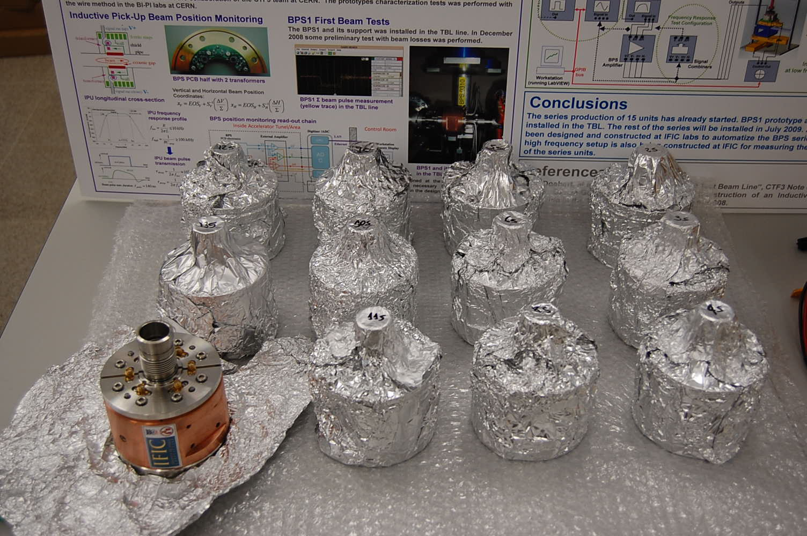
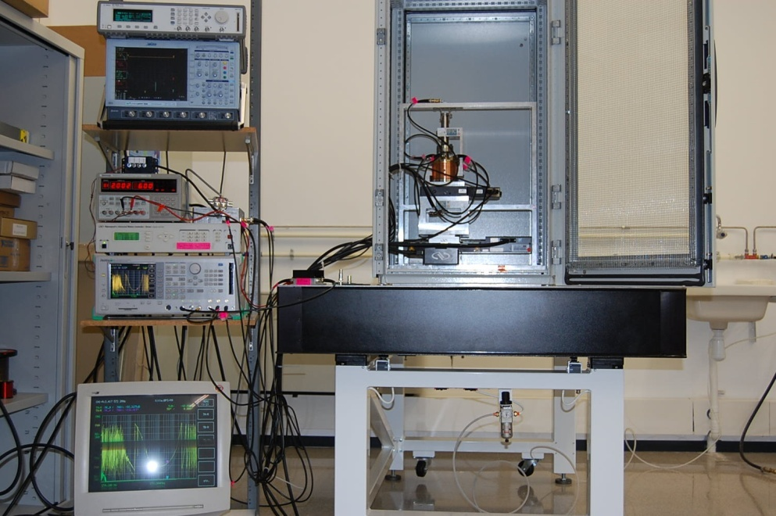
Status on BPS’s from IFIC Valencia
Angeles Faus-Golfe
Status:
BPS finished, calibration measurements ongoing
Electronic droop compensation by Gabriel Montero next week (week 39)
Juanjo will come to CERN week 41 and 42 to help with the installation

