Slide 1
Update on CTF3 Operations and schedule
This time I will try to give a more complete update, not concentrating only on the last month

Slide 2
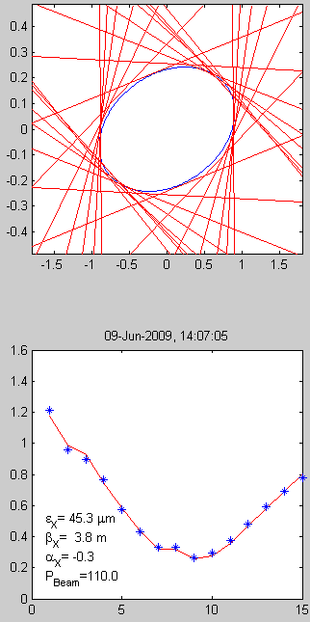
Optics, DL, Ring, measurements
Emittance & Twiss parameters with quad scans: well established & coherent (up to TL2)
Kick measurements, tune and dispersion coherent with model (up to TL2, some recent doubts on DL)
Ring length, closed orbit and combination procedure also well under control
Still work needed for bunch length control and TL2 optics (see later)
Example of quad scans in linac
Emittance 40 to 100 π mm mrad everywhere
Example of dispersion measurement in CR

Slide 3
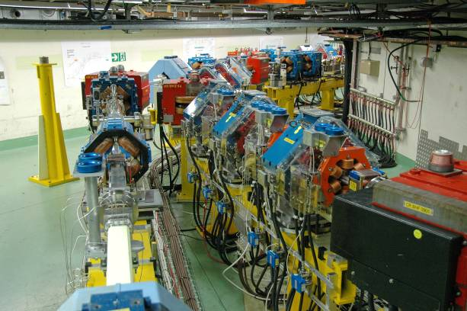
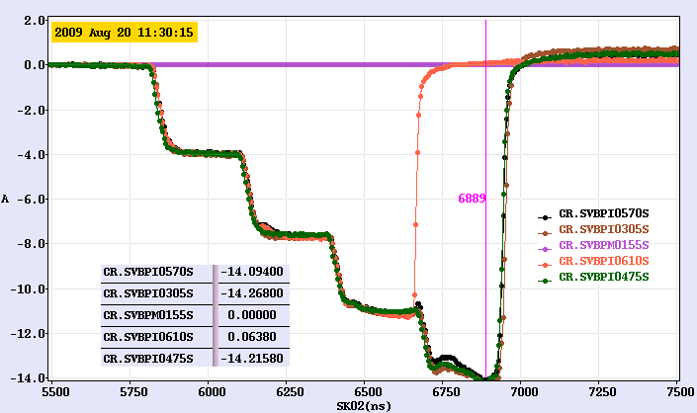
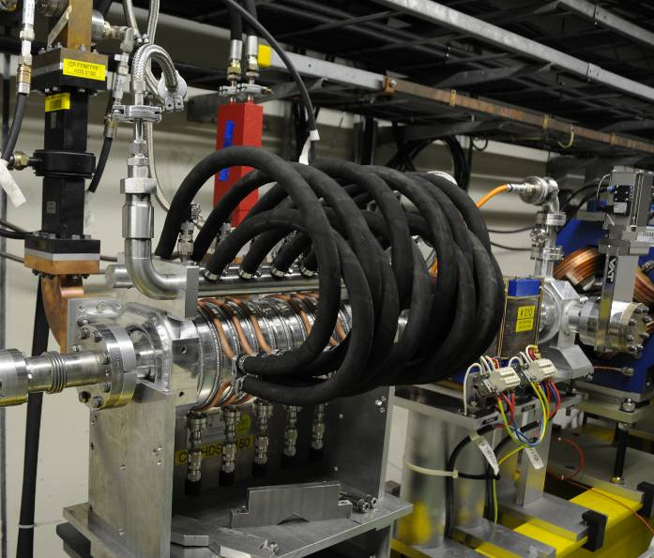
Combination, x 4 in CR
Combination factor four in CR established for both 3 GHz and 1.5 GHz beam
Peak current about 15 A
Routinely obtained above 12 A (from a few minutes to a couple hours set-up)
Still work needed on remaining losses and reproducibility/fluctuations

Slide 4
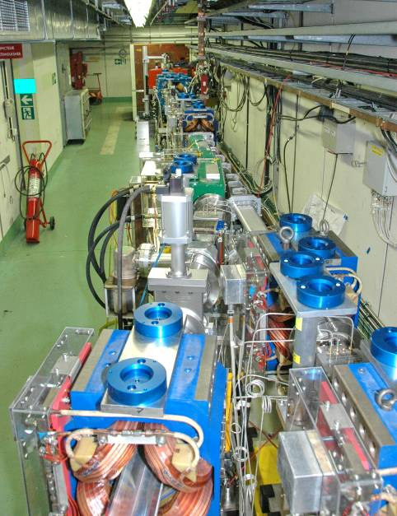
Combination, x 4 in CR

Slide 5
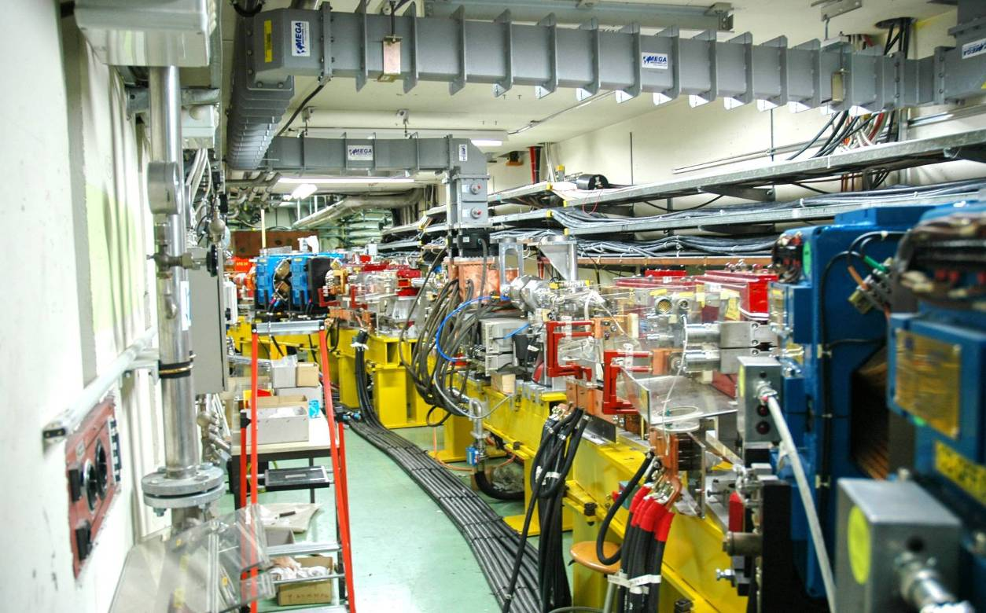
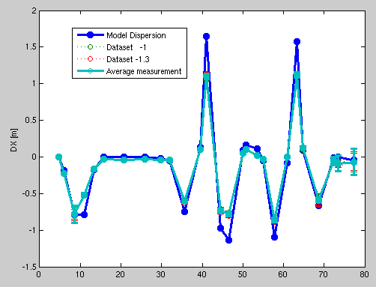
Combination, x 2 in DL
Beam re-established in DL after 2 years
Optics and transport in DL under control – but yesterday…
Problems with extraction - test interrupted due to hardware failures (MKL02 and TWTs)
Residual tail
Beam through by-pass
Beam in DL
Re-combined
beam

Slide 6
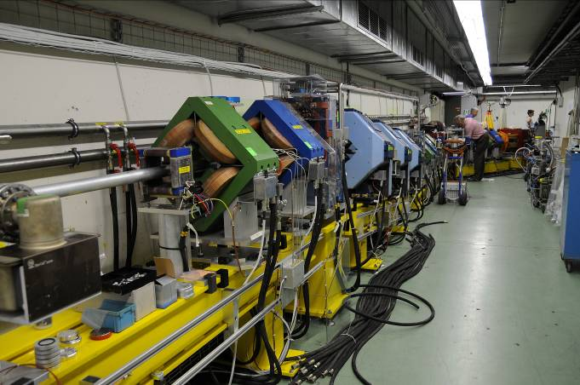
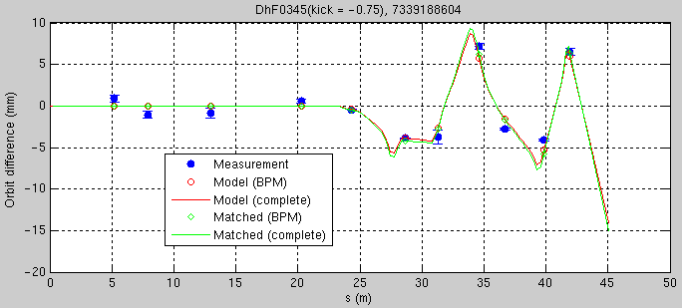
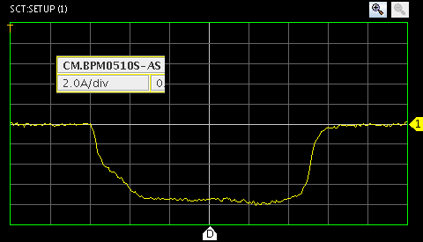
TL2, TL2’, TBTS beamlines
Line optics looks about OK (kick measurements) but difficult matching – recently identified one possible error (20% strength in one quad, under investigation)
Non-combined beam transported to TBTS and through PETS with small losses (less that 10%)
Combined beam transported to TBTS with some losses (from 12 A to about 10 A - no local losses in PETS)
21 Aug
8 Sept

Slide 7
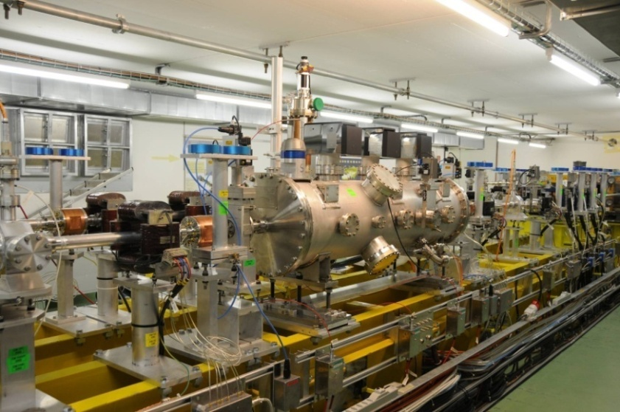
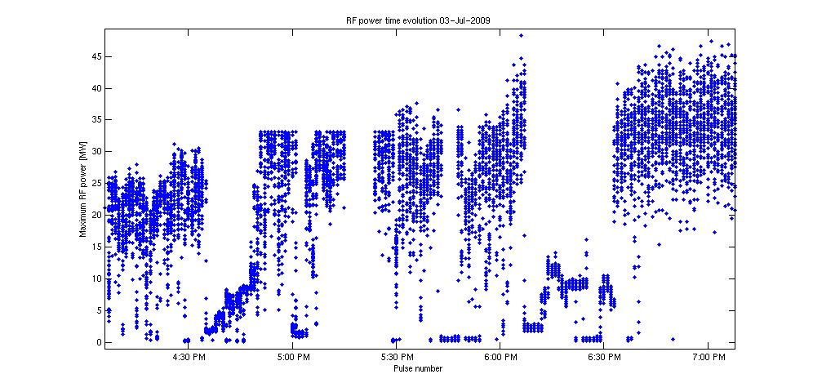
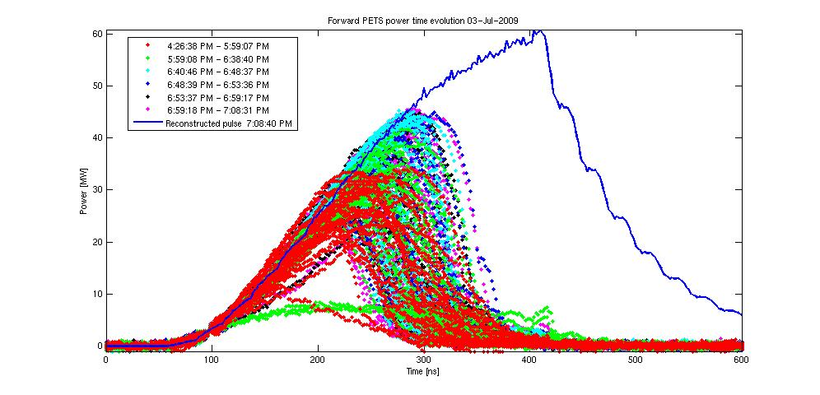
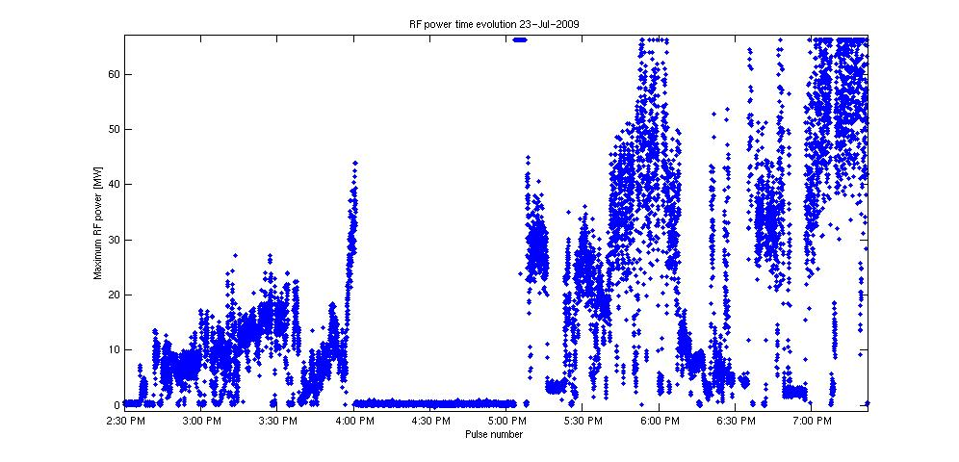
TBTS, PETS conditioning
Lots of breakdowns (pulse shortening) – most likely variable power splitter (outside PETS)
Rapid (if a bit aggressive) conditioning – possibly limited by beam availability & current
3 July
~ 3 hours
3 July
23 July
~ 5 hours

Slide 8
TBTS, PETS conditioning
Max power reached >160 MW (peak) – total pulse length about 200 ns – no flat top
Power decrease – explained by bunch length – later recovered

Slide 10
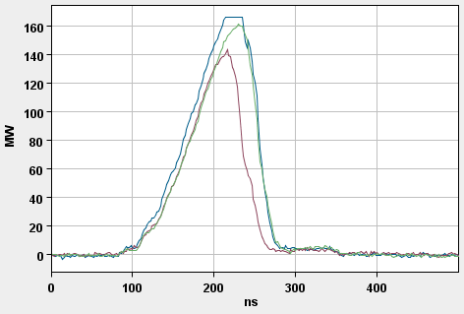
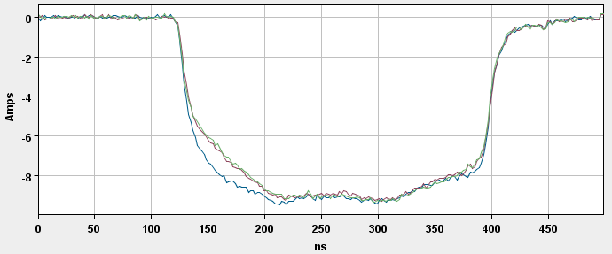

Slide 11
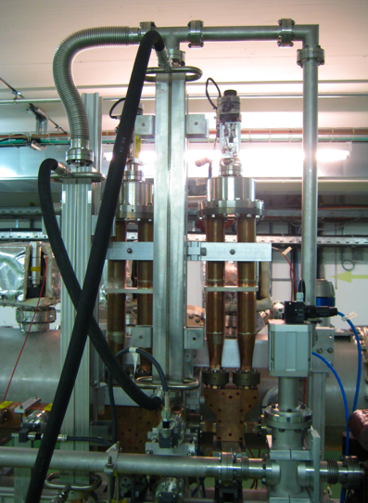
Variable phase shifter
Variable power splitter
Prediction
Measurement

Slide 12
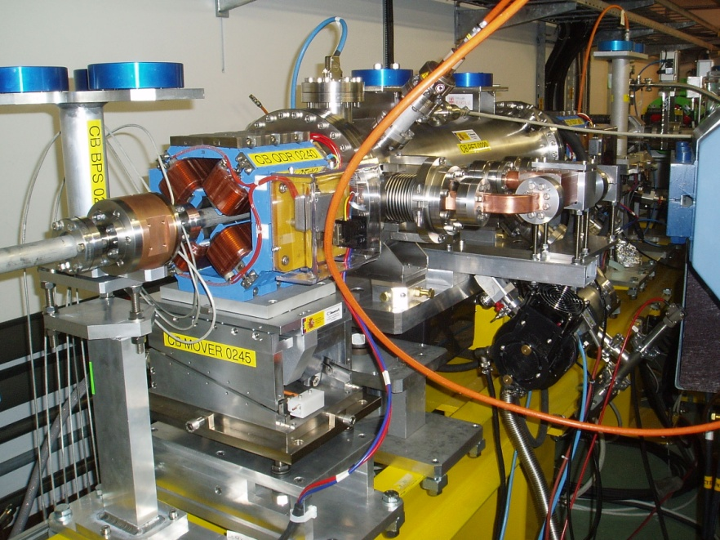
TBL status
A few tests done in the (short) TBL
Initial test (3.5 A to 10 A) good agreement with expectations
Prediction based on BPS 210

Slide 13
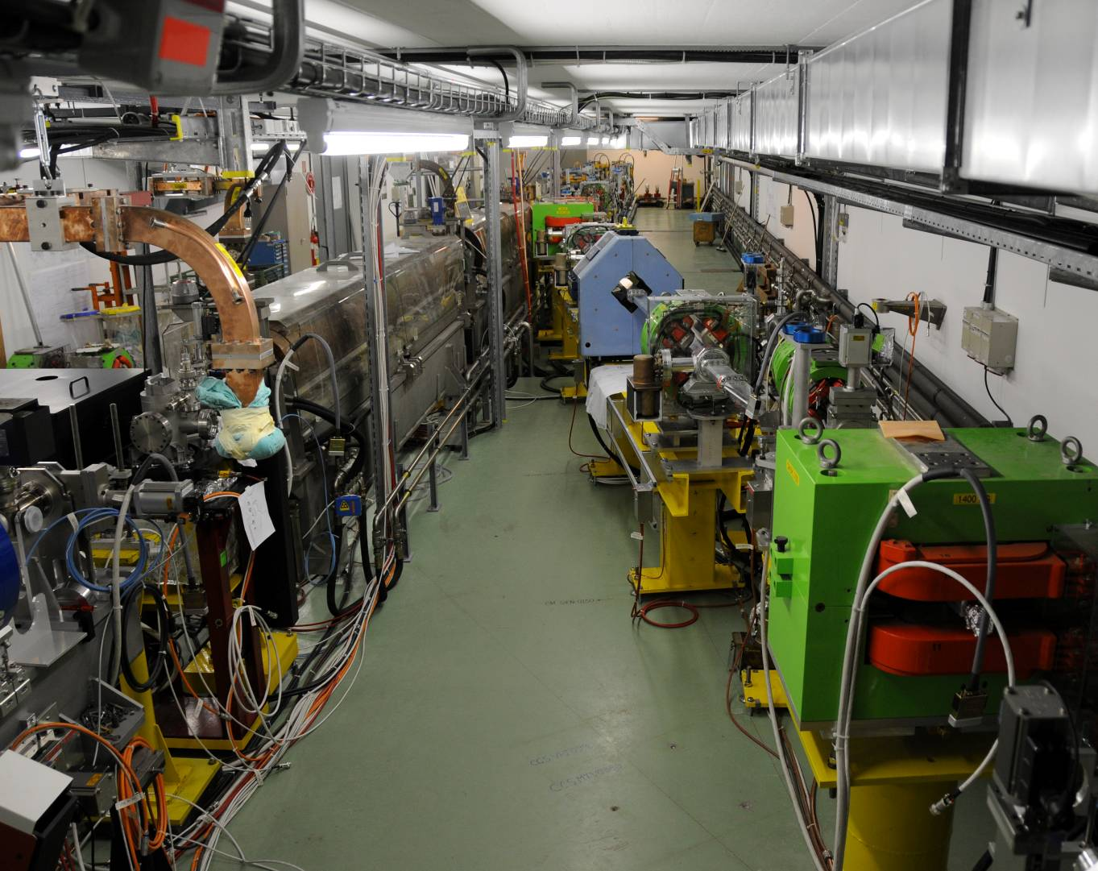
CALIFES status
CALIFES back in operation, beam in the final spectrometer, some moderate losses
First optics checks in TBTS OK
Reached ~ 120 MeV, 0.2 nC / bunch, 100 ns
Beam emittance optimization under way
(Initial measurements @ 90 MeV 120-160 π mm mrad)
Specifications
Energy ~ 200 MeV
Emittance < 20 π.mm.mrad
Charge per bunch : 0.6 nC
Energy spread <2%
Number of bunches : 1 to 226
Bunch length (rms) : 0.75ps
Bunch spacing : 667ps

Slide 14
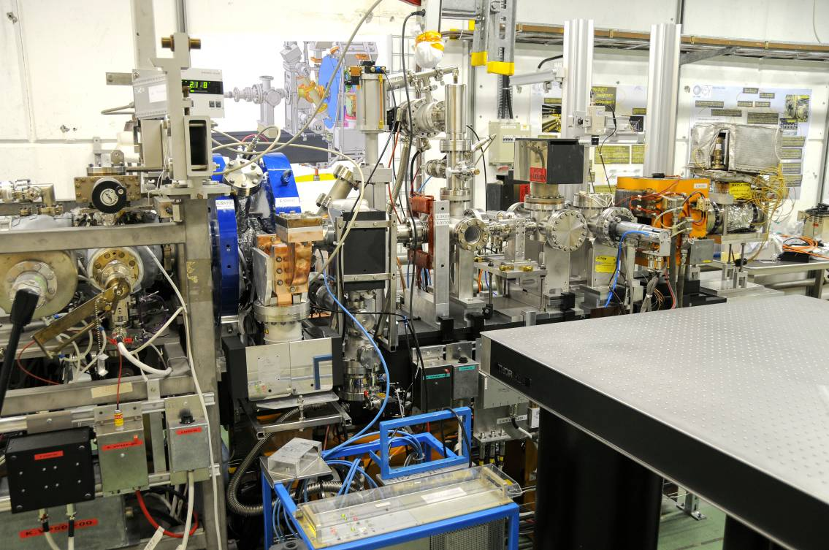
PHIN status
First run in 2009 very successfull
Bunch charge up to 2.5 nC, above nominal
Beam energy ~ 5-6 MeV
Emittance measured ~ 7 π mm mrad
Very good agreement with simulations
Several potential improvements identified, will be implemented for next run
Aims for next run: stability (short and long term)

Slide 15
2009 CTF3 experimental program
Goals
30 GHz: One structure test (TM02) + breakdown studies
PHIN Beam characterization, reach ½ of nominal bunch charge ?
CALIFES Beam characterization, beam to TBTS (most likely still reduced current)
Delay Loop Back in operation, retrieve combination x 2 (~ 7 A)
Combiner Ring Final optics checks, isochronicity, put together with DL (> 24 A)
TL2 Complete commissioning (tail clipper), bunch length control, > 20 A to users
TBTS PETS to nominal power/pulse length (15 A, recirculation)
Beam commissioning of probe beam line
First accelerating structure tests (one structure ? – CLIC G)
Two-beam studies (deceleration/acceleration), initial breakdown kicks studies
TBL PETS validation (100 MW, need > 20 A), beam line studies (2-3 PETS ?)
Others CDR studies in CRM, beam dynamics benchmarking, stability studies, control of beam losses…

Slide 16
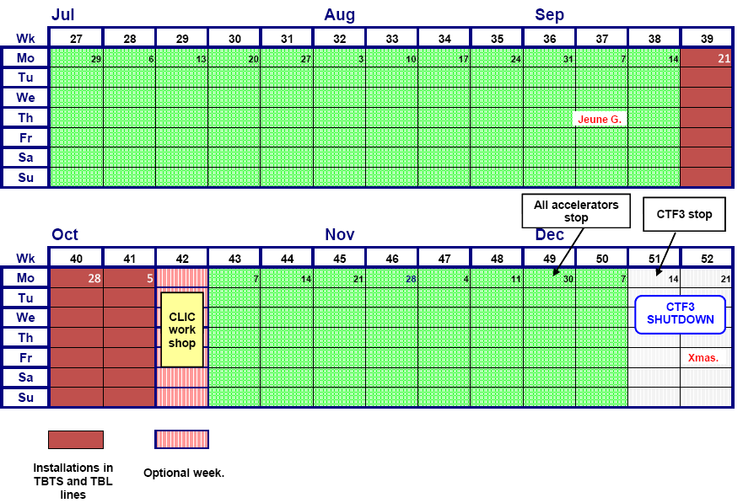
Schedule end 2009
CALIFES
Opt. +TBTS
Today
DL & high current TBTS
DL & CR – full combination ?
High current to TBTS check PETS
DL & CR – further studies
Two beam tests?
Running in TBL line
PHIN, 2nd run
CALIFES
TBTS + struct?
CALIFES opt.
CLEX closed

