Slide 1

CMS Track Trigger or
LHC Physics Under a New Lamppost
Yuri Gershtein
^{mostly based on}
^{arXiv:1705.04321v1 [hep-ph]}

Slide 2
Outline
CMS Track Finding @40 MHz
  Prompt tracks
    Yes, every track (p_{T}>2 GeV) in every LHC collision will be reconstructed with high efficiency
  Displaced tracks and displaced jets
Physics:
  Long-lived particles with ~cm lifetime decaying to jets
    rare higgs decays
    Dark Sector cascades
    Low HT jetty final states
Triggers based on (displaced) track jets
Physics reach & discussion

Slide 3
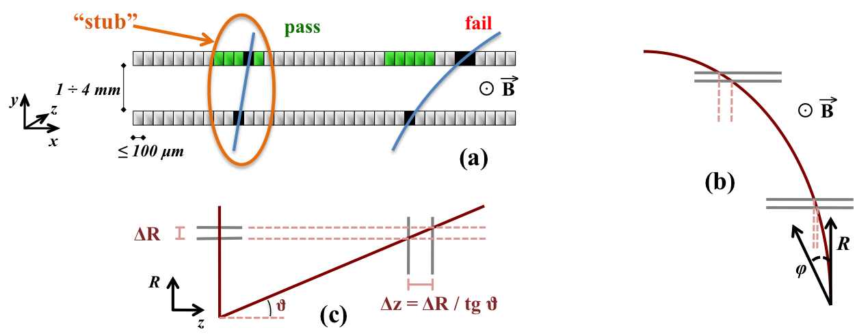
CMS: Track Trigger @40 MHz
Challenge is to read out all the hits – enormous amount of information, can not be done at required latencies
Solution: have the two sensor both run strips along the beam
  The pair of hits measures pT of the track that left them
  The electronics that measures that pT can live on the module – reduce occupancy by a couple orders of magnitude, sufficient to make readout of the high pT hits possible
  CMS demonstrated that it has more then one way to build an FPGA-only track finding with those hits (latency < 4 μs) – for prompt tracks with rapidity less then 2.4 and pT>2-3 GeV
bend

Slide 4
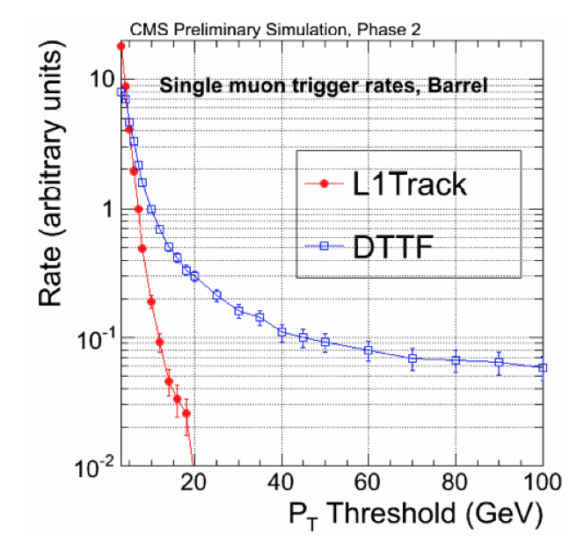
Need for L1 Track Trigger
have to have it to keep a single muon trigger
  but it also helps with taus, jets, etc
Flattening of the rate due to poor momentum resolution

Slide 5
Strawman Trigger Menu
CMS Technical Proposal, LHCC-P-008
Rate w/o L1Tk
huge help for the muons
139
177
for events with at least one jet above ~200 GeV, there is no need for track trigger
52
185
Great help for jets
the lower the pT the greater the help
73

Slide 6
Observations on the jets in that menu
Jets @L1 are started by calorimeter and then “confirmed” by the tracker
  L1 calorimeter resolution + PU -> large uncertainty
  If start with tracks, remove PU ~completely, end up with selection on the jet pT in charged tracks, have better acceptance to low pT jets, lower thresholds.
    Lower sensitivity to fake tracks: only look at ones in jets
    Also, get more useful for analysis jets – the ones that have a lot of tracks to do vertexing with.
Is simulating trigger hard? The CMS tools are very complex
Simple toy simulation (not even DELPHES)
  Fastjet to find jets
    Either on stable particles, or only charged ones to emulate “track jets”
  Noise term to emulate pile-up

Slide 7
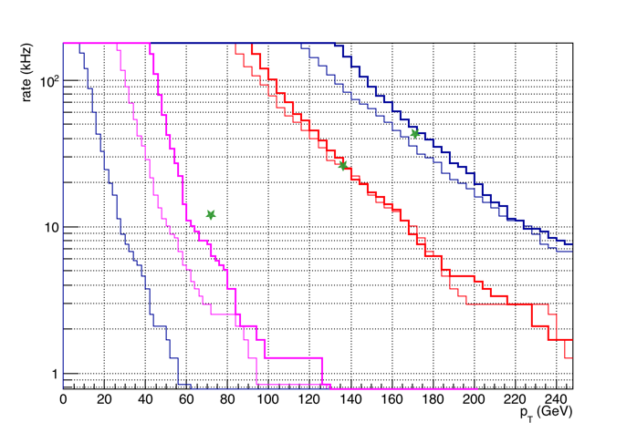
Jet Triggers
Calo Jet pT smearing:
S = 0.9 GeV^{1/2}, N_{PU}=25 GeV
Track Jet pT is sum pT of tracks above 2 GeV, assuming 90% eff
^{arXiv:1705.04321v1 [hep-ph]}
1 Calo Jet
4 Calo Jets
Good to better then a factor of 2!
4 Track Jets
2 Calo Jets
Rates from CMS TP

Slide 8
New Lamppost
The possibility to have for analysis tracker hits from high pT tracks @L1 is a qualitatively new development
  Caveat: FPGA based algorithms, limited resources
Prompt track finding (pT>2-3 GeV) demonstrated
What else is possible?
  displaced (d₀~1cm) track reconstruction
  jet and MET reconstruction with tracks only: PU insensitive
  lots of room for new ideas
What is probably not a good use of L1 resources
  optimizing track efficiency in dense jets (those are likely above 200 GeV)
  optimizing generic jet / MET energy resolution (for L1 we only care about the thresholds)
  Tracks found at L1 indeed can simplify the job for high level trigger
    but why do this FPGA assist with L1 constraints? CERN OpenLab is developing platforms with FPGA-assisted CPUs. LHCb is already using FPGA assists for unpacking, RICH reconstruction, etc.

Slide 9
Outline
CMS Track Finding @40 MHz
  Prompt tracks
    Yes, every track (p_{T}>2 GeV) in every LHC collision will be reconstructed with high efficiency
  Displaced tracks and displaced jets
Physics:
  Long-lived particles with ~cm lifetime decaying to jets
    rare higgs decays
    Dark Sector cascades
    Low HT jetty final states
Triggers based on (displaced) track jets
Physics reach & discussion

Slide 10
Rare Higgs decays
Since we share the vacuum with new physics (i.e. dark matter?), it’s very unlikely to completely not couple to Higgs. It could show up as exotic Higgs decays
  Branching fractions as small as 10⁻⁵⁻⁶
Very well theoretically motivated & studied (arXiv:1312.4992, Curtin, Strassler, et al)
Prompt decays of φ: hopeless, too little H_{T} in the event to pass first level of the trigger, and huge QCD bkg
If φ is long-lived, then if we had events on tape, the background is almost zero
The “plausible” way is to go to associated production with leptonically decaying W
  Huge penalty (~200):
    1.4 pb / 44 pb
    Br(μ/e) = 0.2, but single electron trigger will run at high threshold (35 GeV or more)

Slide 11
In HL-LHC stage, LHCb plans to take >100/fb
That’s less then factor of 30 penalty, as opposed to 200, and LHCb is better at finding displaced vertices than ATLAS and CMS

Slide 12
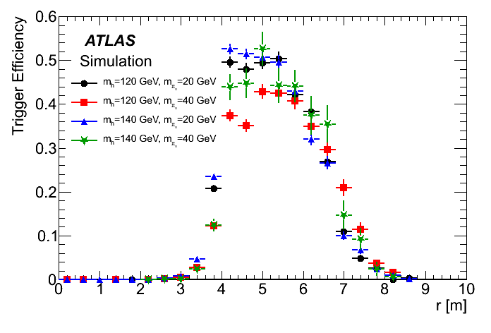
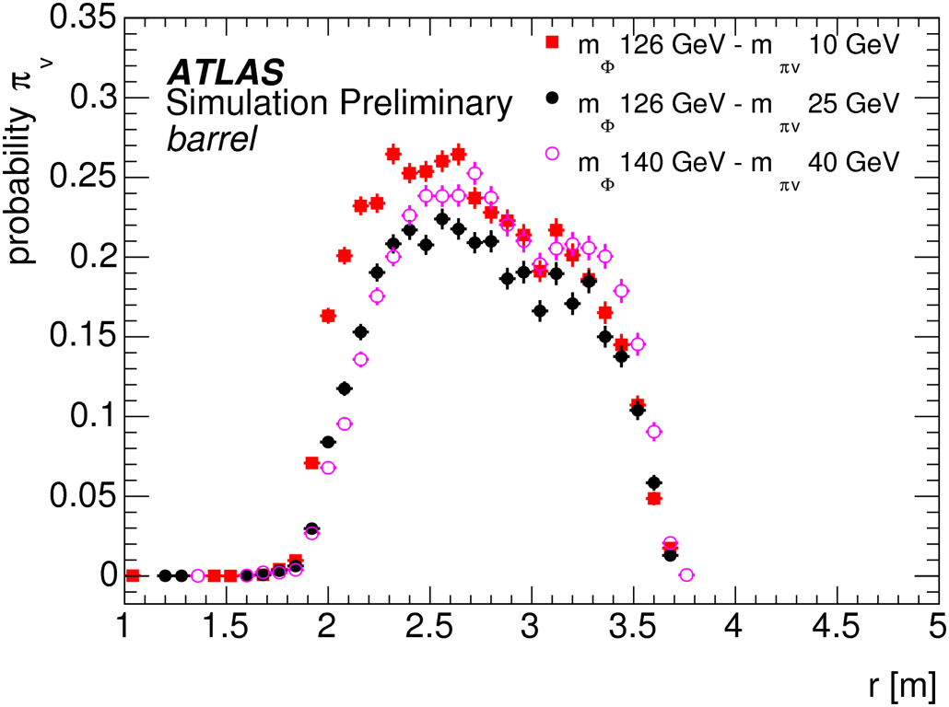
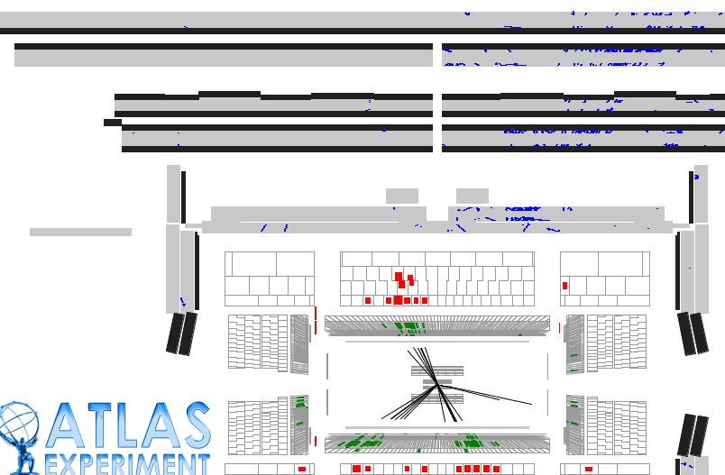
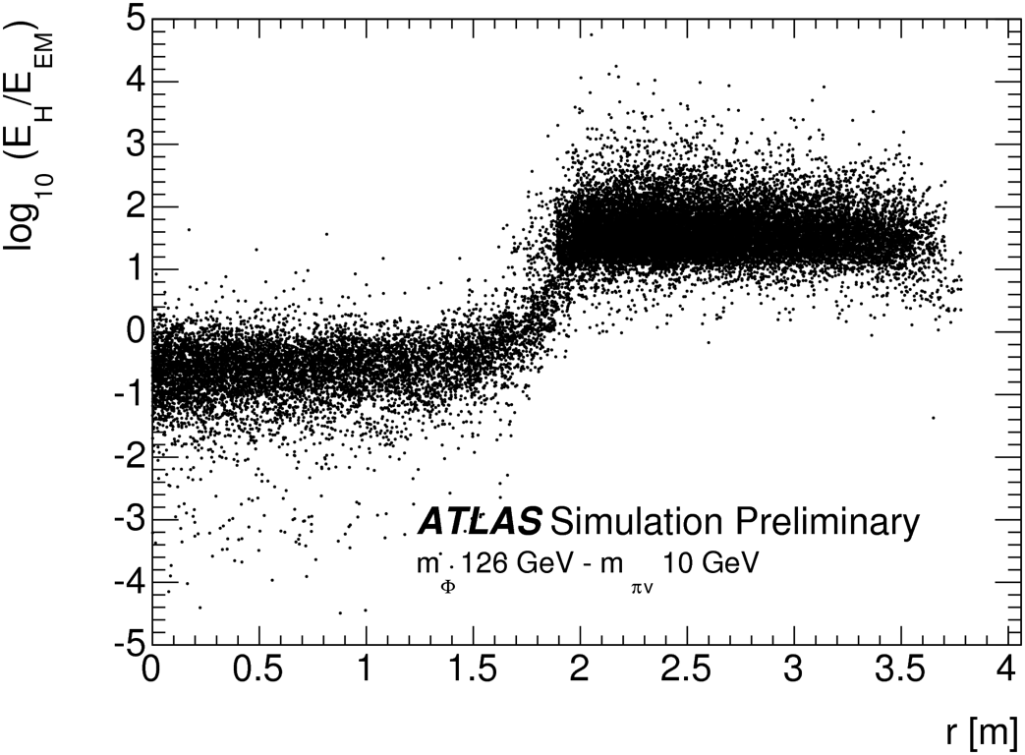
Passing Hardware Trigger: easier for large cτ
ATLAS has focused on utilization of more unusual objects
  decays in HCAL (no signals in ECAL)
  decays outside HCAL (vertex in a muon system)

Slide 13
Even larger lifetimes: MATHUSLA
Detector on the surface next to CMS or ATLAS
Huge hit in acceptance, but can reach below 10⁻⁵
arXiv:1606.06298 [hep-ph] and
Cristiano Alpigiani’s talk this afternoon

Slide 14
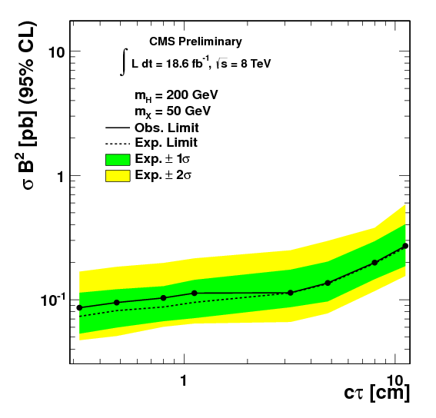
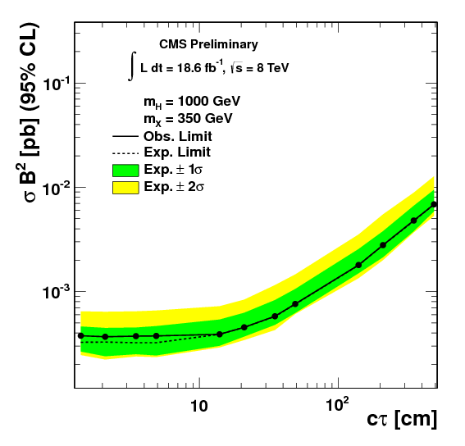
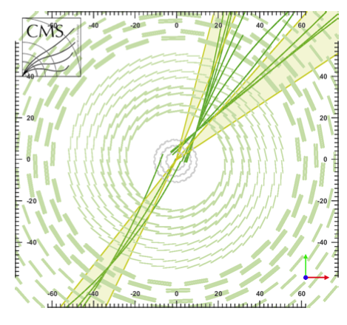
Small lifetimes
The trick at CMS or ATLAS is to find a way to pass through hardware triggers – once full event information is available for the HLT, a displaced jet trigger is possible
  Passing L1 for the h(125) was already a problem in Run 1
EXO-12-038
pp-> H -> XX ->jets

Slide 15
Goal for this study
Making displaced track finding is hard and expensive – need to demonstrate that it is worth it
Compare three ways to trigger on h->φφ
  associated production with W-> lepton
  trackless calorimeter jets (tracks with large IP are not reconstructed), similar to ATLAS’es jets with low EMfraction
  trigger based on displaced track reconsrtruction

Slide 16
Track Trigger with toy MC
Perfectly cylindrical layers
  Radii and stack separation as in real detector
Shoot circular tracks and measure hit positions and bends in layers
  “loose”: track gives >=N stubs (max is 6)
  “tight”: fit the hits to a helix constrained to a beam spot, count hits within 300 um from the fitted position. Reasonable approximation of algorithm with pattern recognition tuned for prompt tracks
Off-pointing track bends are wrong
Inefficiency for displaced tracks, especially in inner layers

Slide 17
5 stubs “loose” track
4 stub “tight” track
bend too large, will not read out
Residuals from circular fit are less then 300um for 4 of the stubs:

Slide 18
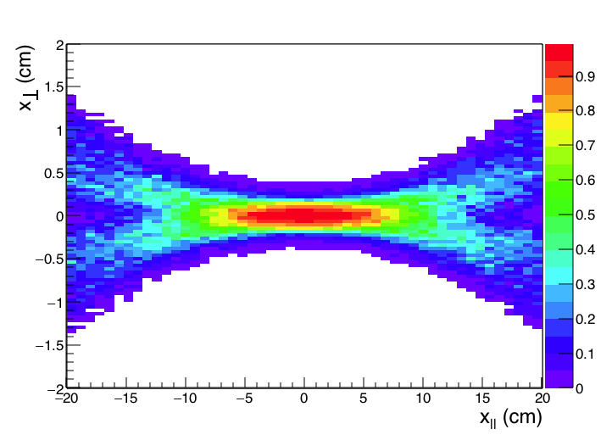
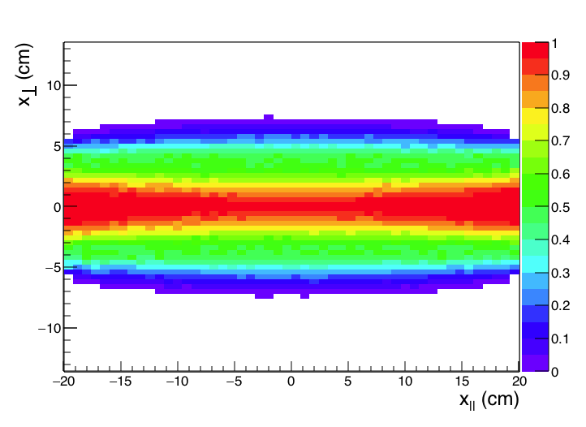
“Tight”, 5 hits
Track reconstruction parameterization
“Loose”, 5 hits
DCA resolution of a trigger track is about 100μm
Tracks of pT above 2 GeV, with pT spectrum form 40-80 GeV jets

Slide 19
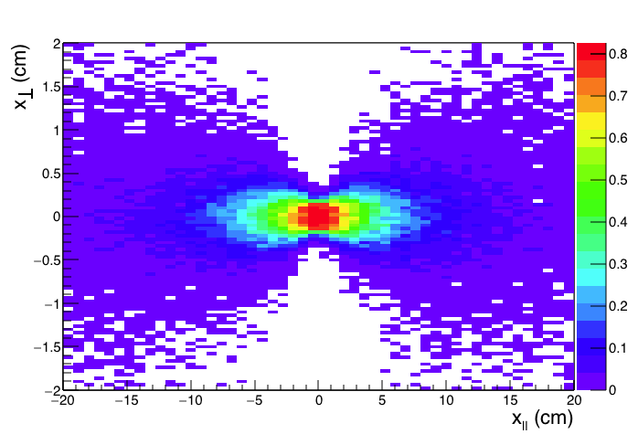
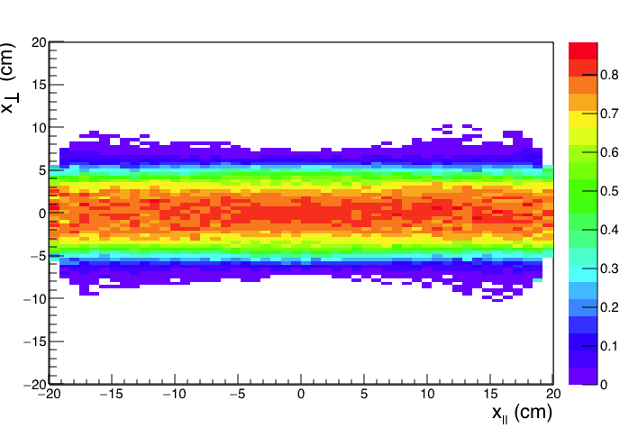
“Tight”
Jet reconstruction parameterization
Efficiency = f(pT, x||, x⏊ )
add flat 90% efficiency per track
>= 3 tracks with >=4 hits
>= 2 tracks with >=5 hits
Sum track pT > 10 GeV
“Loose”
Example plots for 40-80 GeV jets

Slide 20
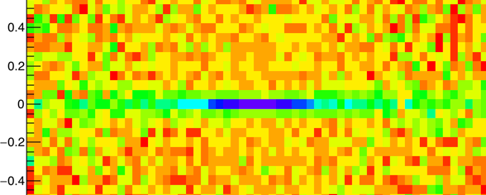
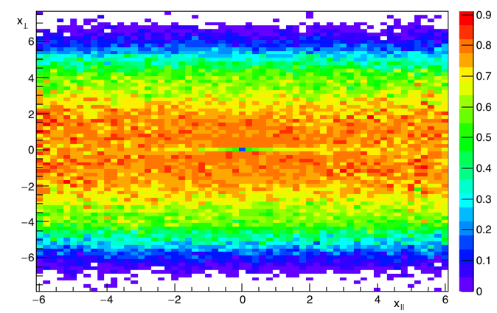
Jets with lifetime tag
Track jets
  require that >= 3 tracks in the jet have impact parameter greater then 300 μm
  Prompt jets are reduced by factor >50
Calo jets
  (if only reconstructing prompt tracks)
  Require no prompt tracks pointing to the jet
  Huge background from PU jets
    Need detailed PU simulation…
“Loose”
X⏊ (cm)
X|| (cm)
Blue: <= 1 track
Magenta: <= 2 tracks
Purple: <= 2 tracks, sum pT < 10 GeV

Slide 21
Recap:
Assume
  “tight” tracks represents what the L1Tk can do ~easily
    Prompt-like pattern recognition, 5-parameter fit
  “loose” tracks is a realistic possibility
    Both pattern recognition and fit allow for slightly non-prompt tracks
  PU effects are small if starting with tracker for quad-jet trigger
  PU effects are not overwhelming for calo jets above 70 GeV
L1 Triggers
  Quad jet (sum tracks per jet > 20 GeV)
  Quad jet with a lifetime tag (sum tracks per jet > 10 GeV)
  Two jets (> 70-100 GeV) without prompt tracks
HLT
  Can reconstruct secondary vertices

Slide 22
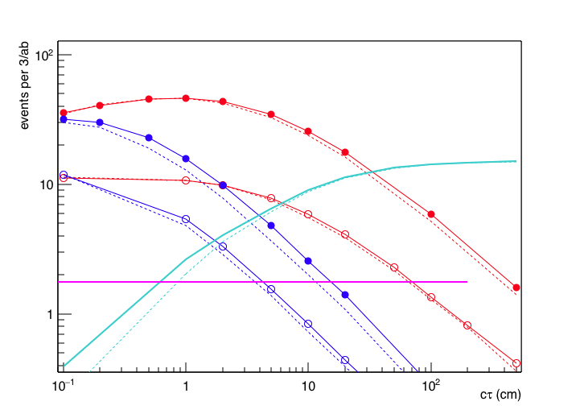
Offline
For ggH assume that track jet reconstruction is easier offline, and we already required 4 displaced jets at L1
For Wh require three track jets above 10 GeV
  (requiring just two jet from the same φ changes efficiency by ~30%)
Br(h->φφ) = 10⁻⁵
Loose, Quad10
2 no-tk-jets 70
Loose, Quad20
Wh
Tight, Quad20
Tight, Quad10

Slide 23
Offline
For ggH assume that track jet reconstruction is easier offline, and we already required 4 displaced jets at L1
For Wh require three track jets above 10 GeV
  (requiring just two jet from the same φ changes efficiency by ~30%)
Br(h->φφ) = 10⁻⁵
Loose, Quad10
LHCb
For LHCb, assume 100/fb total lumi, and require one f with daughters above 5 GeV in 2<|h|<5 range
Probably too optimistic?
Loose, Quad20
Wh
Tight, Quad20
Tight, Quad10

Slide 24
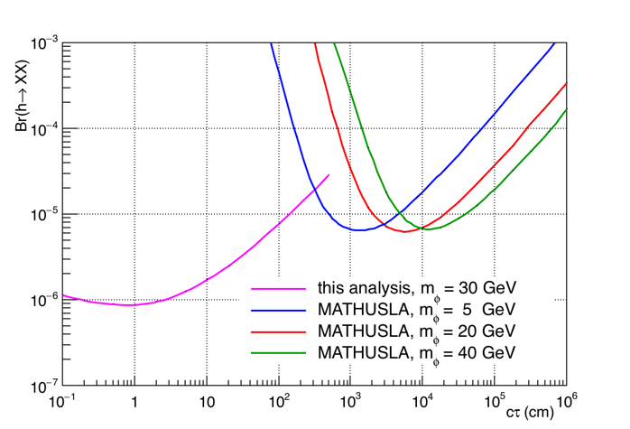
CMS + MATHUSLA
Instead of N events for Br=10⁻⁵, calculate Br that results in 4 events
Very complementary coverage

Slide 25
Beyond h(125)
Recall some of the theoretical setups employed for X(750)
If φ is a pseudo-Goldstone, there should be another massive scalar
  h(125) decays to φφ through mixing with X, which is small
  X decays to φφ with large branching, but production is small
    Had to involve VLQ to explain large X(750) production, but it could be produced through the same mixing with h(125)
Same final states occurs in simplified DM model
  χ₂ and χ₁ are ~close in mass
  χ₁ is invisible
arXiv:1704.06515

Slide 26
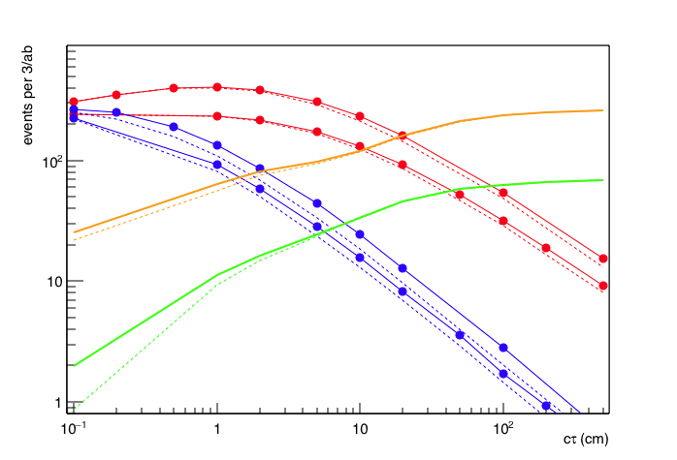
Much easier at higher mass
M(X) = 250 GeV, M(φ) = 60 GeV
Same σ x Br as for h(125) study above, 0.44 fb
Loose, Quad10
2 trackless jets, pT>70
Loose, Quad20
Big potential gains from the “long-lived” track trigger
pT>100
Tight, Quad20

Slide 27
How realistic is this?
Track fake rate is assumed to be small
  only look in jets – fake tracks do not cluster
  From CMS TP, quality cuts (for prompt tracks) reduce fake rate to below important
  Not too bad an assumption
Vertexing
  Right now assume we can still vertex in events with slightly displaced jets – probably true, but breaks above some displacement
Calorimeter jets
  Really need PU simulation here. 70 GeV threshold for “small PU rate” is really just a barely educated guess. However, it is likely to be wildly optimistic (i.e. this trigger will be even less useful)

Slide 28
How realistic is this?
Track fake rate is assumed to be small
  only look in jets – fake tracks do not cluster
  From CMS TP, quality cuts (for prompt tracks) reduce fake rate to below important
  Not too bad an assumption
Vertexing
  Right now assume we can still vertex in events with slightly displaced jets – probably true, but breaks above some displacement
Calorimeter jets
  Really need PU simulation here. 70 GeV threshold for “small PU rate” is really just a barely educated guess. However, it is likely to be wildly optimistic (i.e. this trigger will be even less useful)
No public plots so far that can be shown, but so far it appears that the displaced track reconstruction uses only 50-70% more FPGA resources. Not a trivial sum of money, but peanuts compared to MATHUSLA / SHiP, etc.

Slide 29
Summary (1)
HL-LHC experiments are planning substantial improvements to detectors and trigger systems
  Primary goals of the designs was to preserve detector performance at high PU
  These detectors can do more!
CMS has several demonstrated algorithms to do track finding @40 MHz
  Some technology choices have already been made, but the parameters of the systems will not be fixed for a while longer
  Now is the time to understand what kind of physics CAN be accessible with track trigger. This study shows that one can get jetty signals with pretty low HT to the HLT. The key is to have something in these events that makes offline analysis possible (lifetime tag, soft leptons, low mass resonances…) There must be other applications – the community should make a physics case for them now while the design of the syste, is still somewhat in flux

Slide 30
Summary (2)
Even in the era of trusting GEANT, back of the envelope and simple parameterized MC estimates can guide us to improve physics reach of the only future circular collider that we’ll see before 2040-ies
LHC will run through 2030’es
  new capabilities: L1 tracking, ps timing
  march to N/ab or switch to new strategy after ~1/ab? What is that strategy? What detector and trigger modifications are needed to implement it?

Slide 31
Backup

Slide 32
Physics Benchmarks for L1Tk
L1Tk beyond muons is needed for low H_{T} jetty final states
  good cases should have a feature in the events that makes offline analysis “easy”.
heavy or light flavor, 4 or 2 resolved jets depending on scalar’s mass
  Long lifetime, cτ ~ 1cm to make offline easy / possible
  Tests: off-pointing tracks, track pT thresholds, fake rates
Modifications:
  Heavier H (up to 300 GeV)
  Simplified DM models, Y₀~20-50 GeV, χ₂−χ₁ ~ 50-150 GeV
(i.e. if scalar does not couple to fermions)
  Narrow di-photon mass peak to make offline easy / possible
  Tests: photon track isolation, pT threshold

Slide 33
Physics Benchmarks for L1Tk
“Natural”-ish compressed SUSY (stop and higgsino), small mass splitting, so no tops
  Soft leptons from higgsino make offline possible
  Tests: track pT thresholds, MET, fake rates
Regular compressed SUSY (gluino and may be higgsino)
  If no soft leptons from higgsino, need to understand what H_{T}/MET can be useful offline.
  Tests: track pT thresholds, MET, fake rates

