Slide 1
Update on PS Longitudinal Impedance Model
B. Popovic
09/11/17

Slide 2
PS Impedance Model Updates
Transmission line kickers
  KFA13 & KFA21 models
  Effect of vacuum chamber on impedance simulations
PS Dump
  Model of the dump currently in the machine
  Working with EN-STI on the replacement dump design to reduce its impedance*
*IWG #14 : https://indico.cern.ch/event/671318/

Slide 3
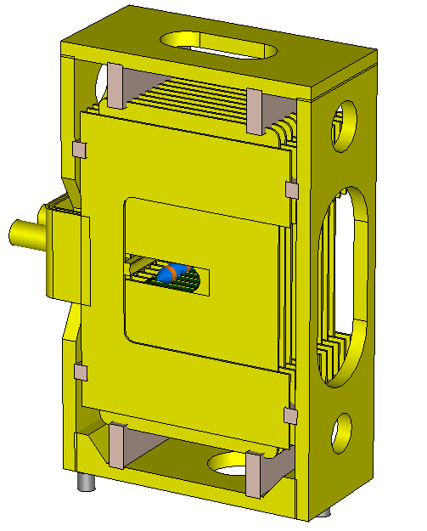
Transmission Line Kickers
CST models built from old drawings and CATIA drawings when available
KFA13, 21, 71 & 79 all contain identical modules
  KFA13 & KFA21 are identical units
Important step would be to measure one module to confirm simulations
8C11 Ferrite
  Using APB provided definition*
Module
*https://impedance.web.cern.ch/impedance/PS.htm

Slide 4
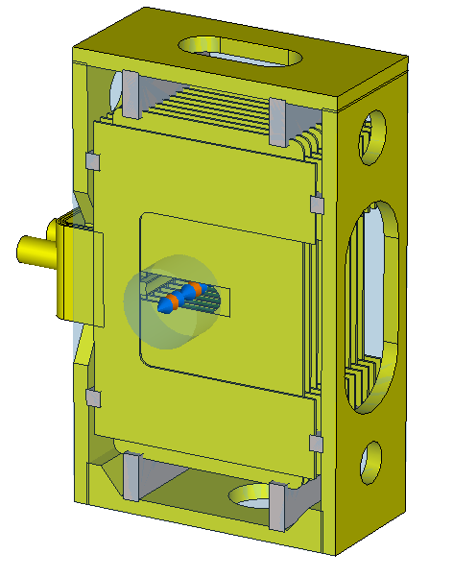
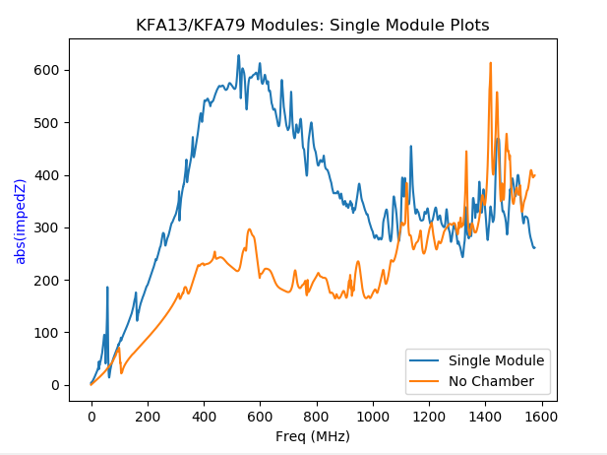
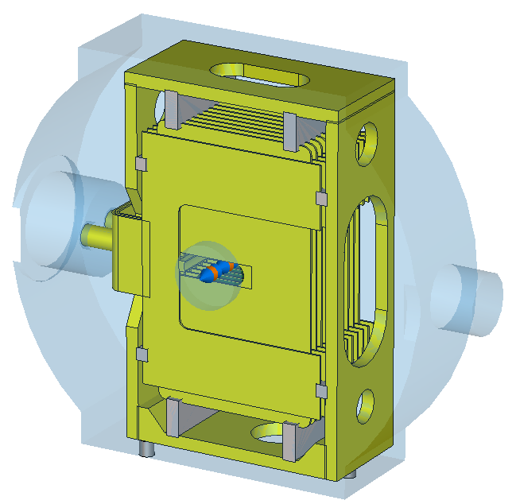
Effect of Vacuum Chamber
Single Module, No Chamber
Including the chamber enlarges the structure
  More resonances at lower frequencies
  Also adds ‘chamber modes’
Single Module
Mode Supported by Chamber

Slide 5
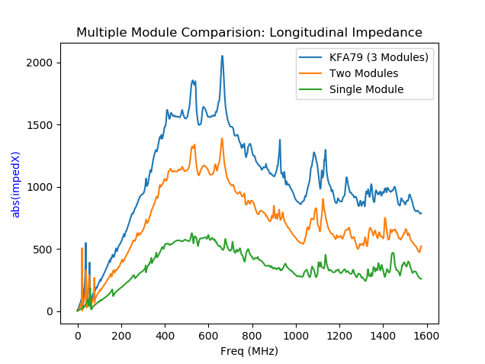
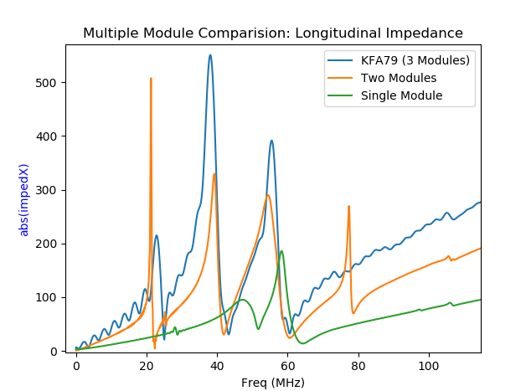
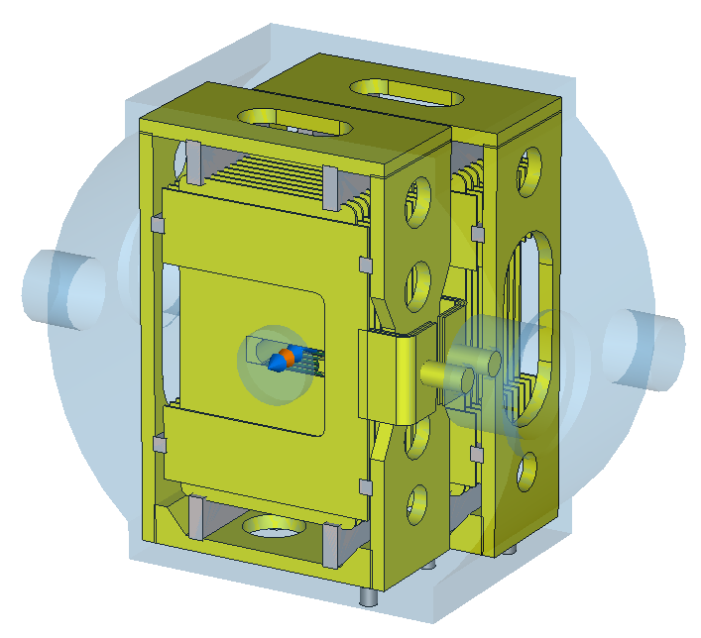
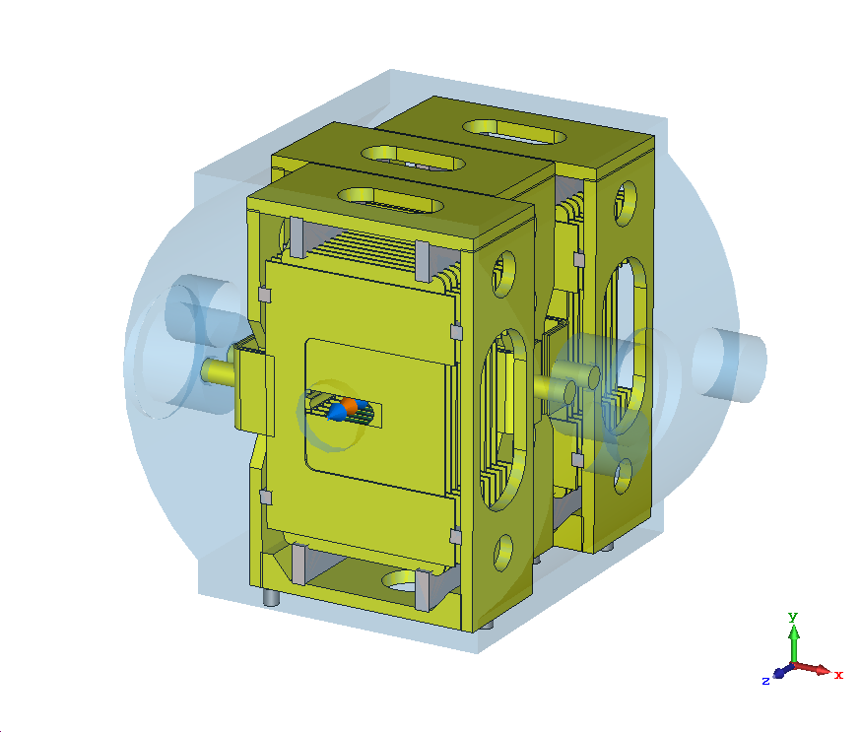
Comparing Multi-Module Simulations
Modes Supported by Chamber Geometry
Abs(imped Z)
Abs(imped Z)
Single Module
Two Modules
KFA79 (3 Modules)
Notes:
Loss mechanisms
Losses due to the ferrite itself (more modules, longer path seeing ferrites => uniform increase in impendence) (1,2,3 module simulation)
No Chamber simulation, a broadband resonance shifted to higher frequency
2) Modes resonating in the structure itself => more modules, larger structure => resonant modes at lower frequencies ( 9 module simulation)

Slide 6
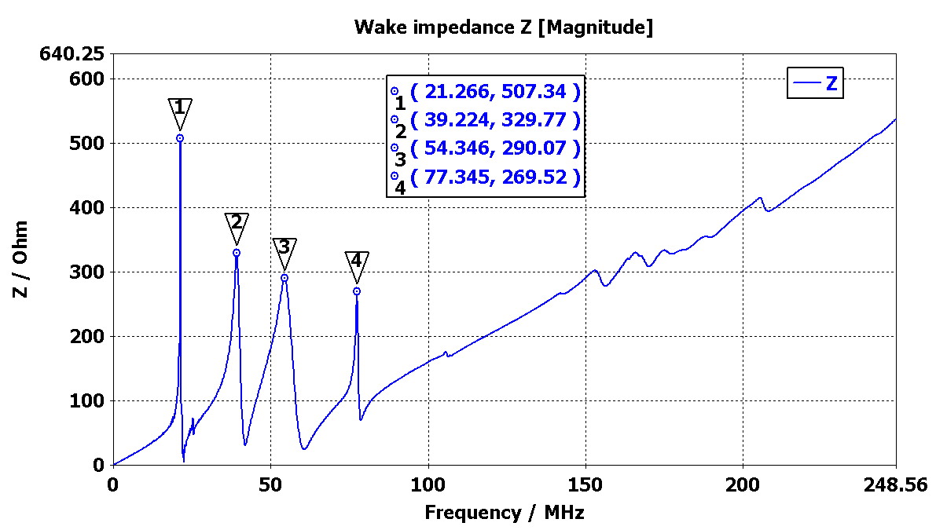
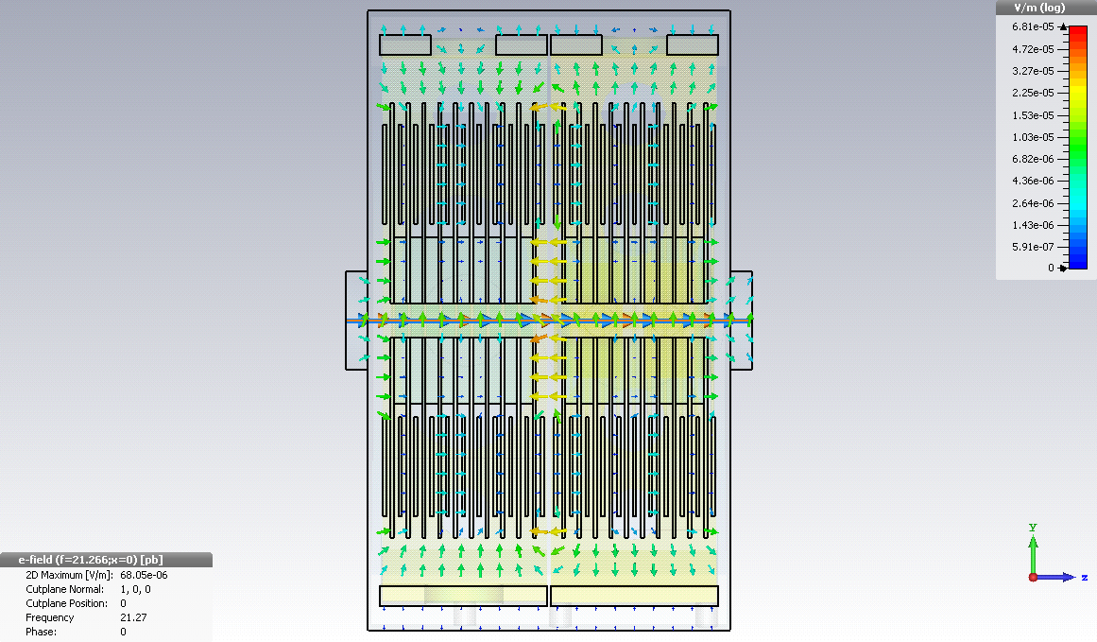
Vacuum Chamber Supported Modes
Two Modules
E-Field Monitor
at 21.27 MHz: Side View
Appendix includes additional mode monitors

Slide 7
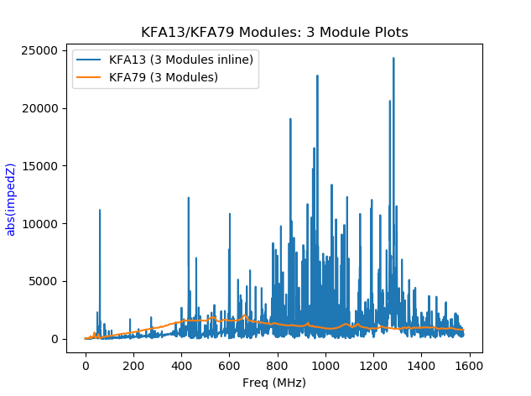
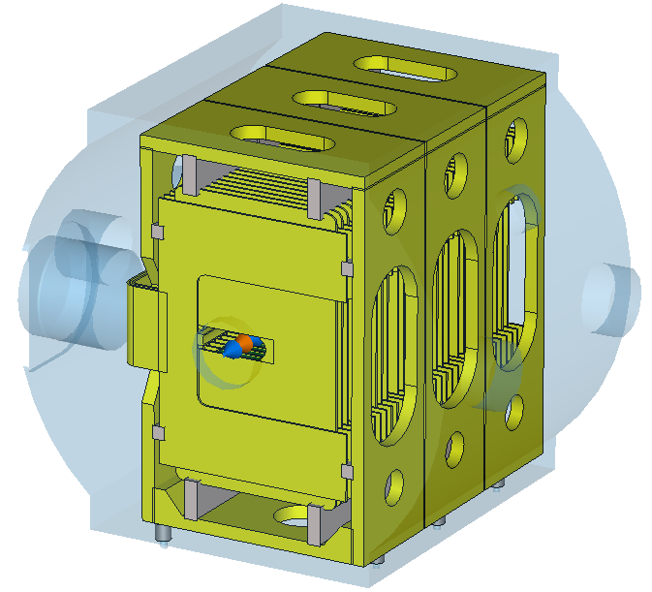
Comparing KFA79 to KFA13
KFA79
Inline modules produce a ‘forest’ of resonances (KFA13)
Inline modules seem to allow additional modes to build up along beam path
  I.E. Higher coupling between modules
KFA13

Slide 8
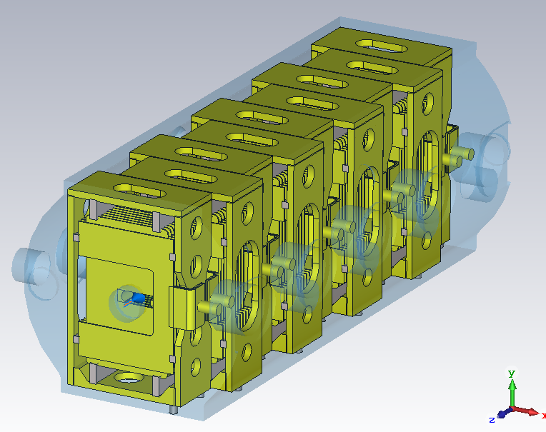
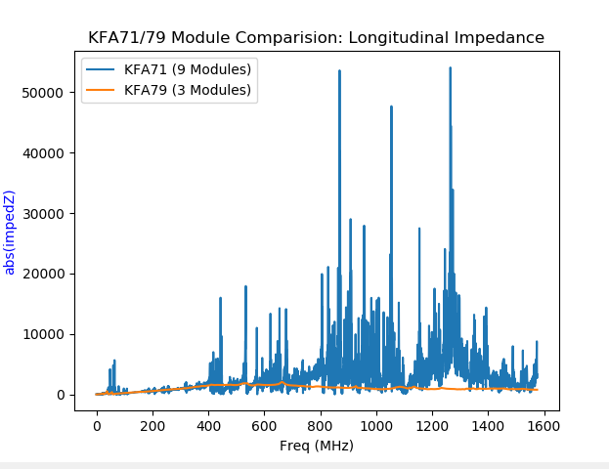
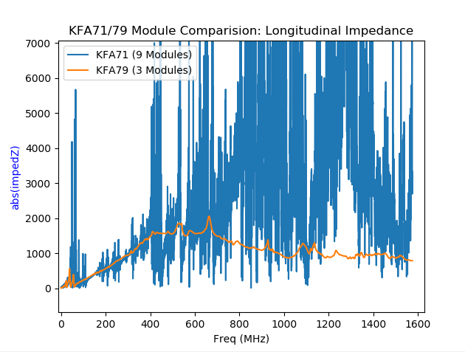
Comparing KFA79 (3 Modules) & KFA71 (9 Modules)
Once again ‘forest’ of modes
  Longer path length seems to result in more modes supported
KFA71 (9 Modules)
Zoomed

Slide 9
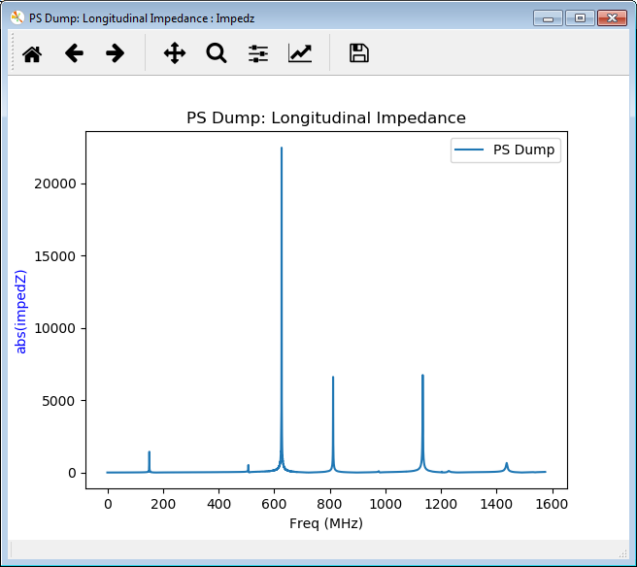
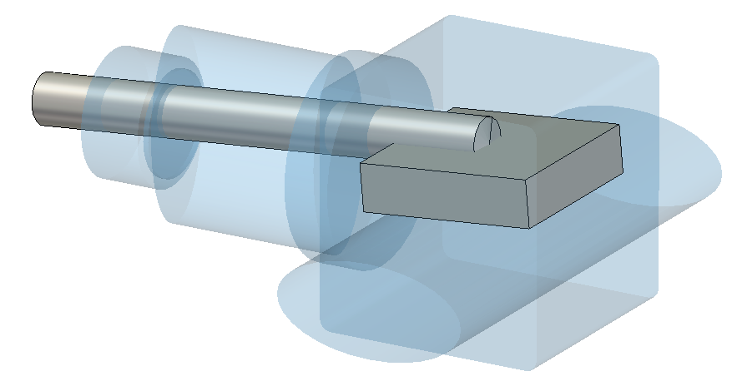
Preliminary PS Dump Model
Installed in straight sections 47 & 48
Main problem modes are ‘Coax Cavity’-like
Simplified moveable dump
Moveable
Dump
Actuator
PS
Beam Pipe

Slide 10
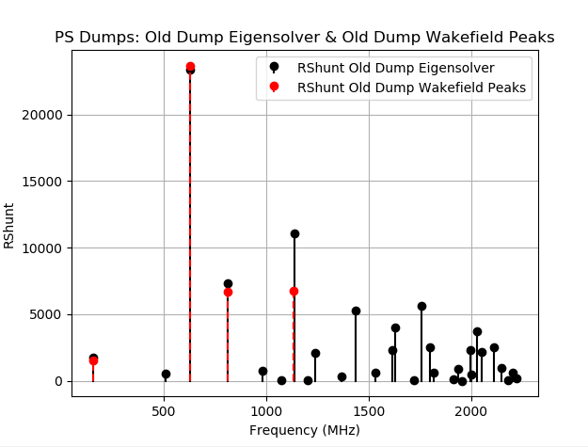
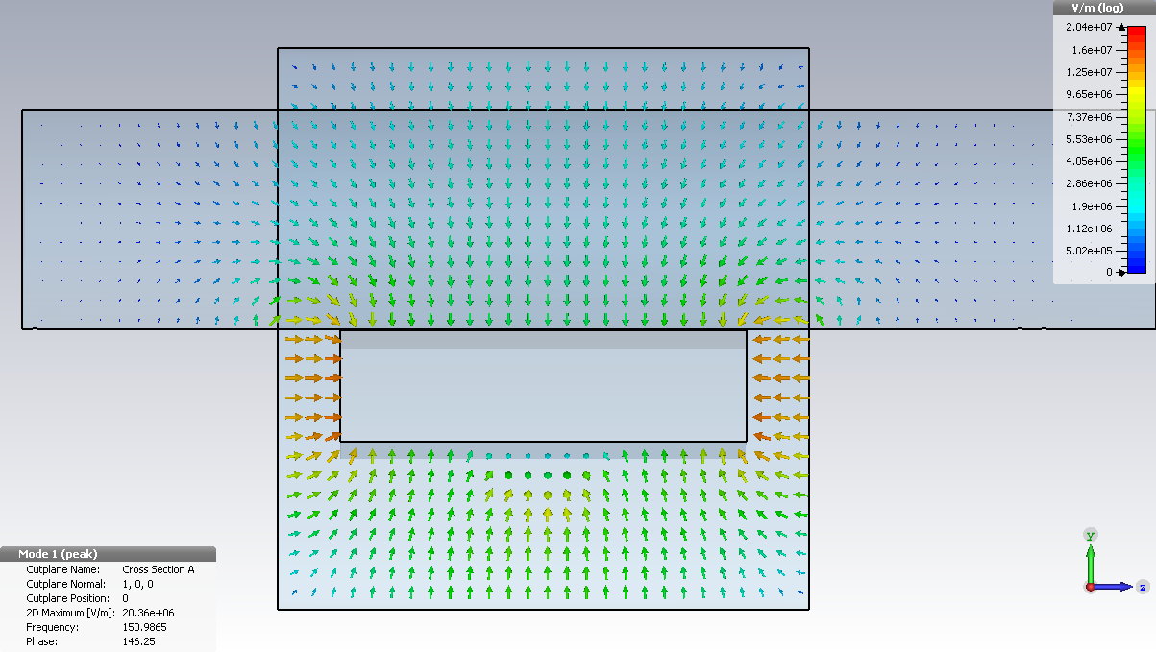
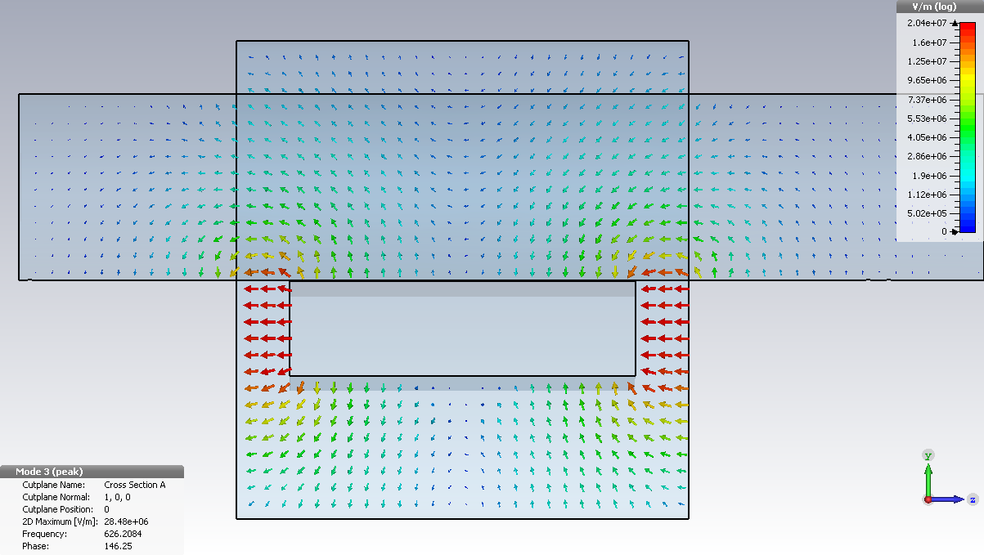
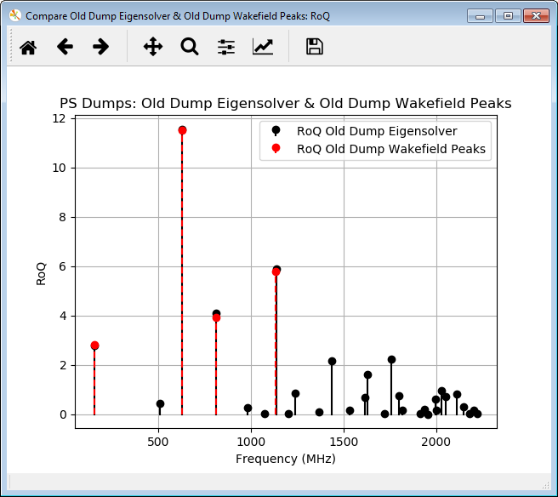
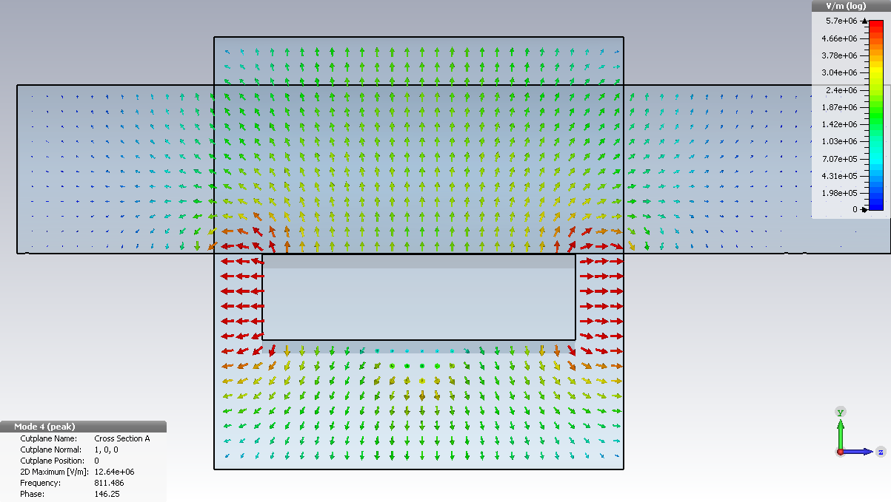
‘Coax Cavity’-like Modes
Eigenmode Solver: Front View
150 MHz
Beam
626 MHz
Beam
811 MHz
Beam

Slide 11
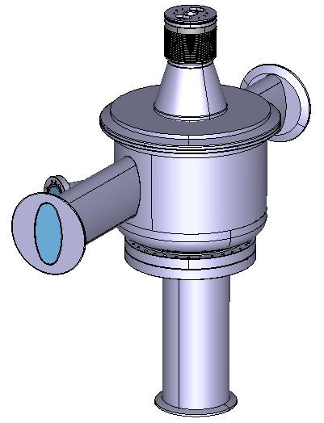
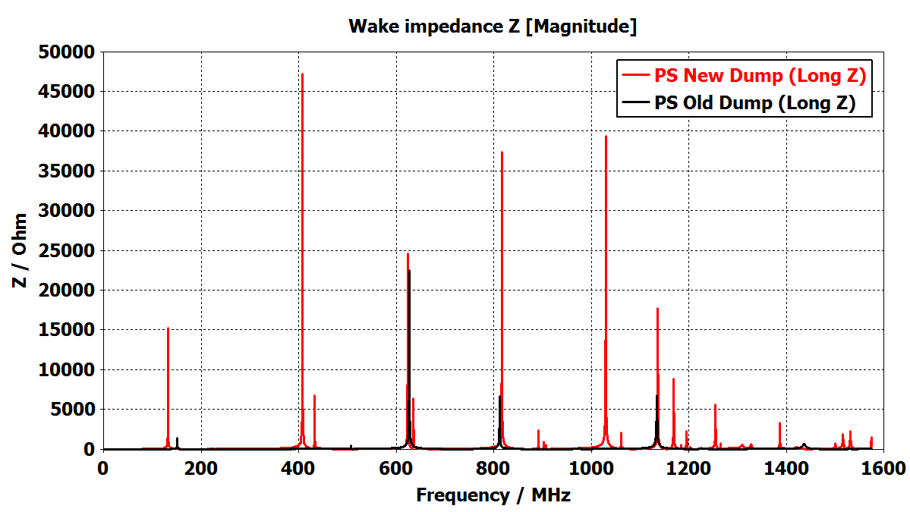
Current Replacement Design
Latest replacement design uses off the shelf cylindrical vacuum vessel
  Could be an impedance problem
Cylinder: Poor performance impedance-wise
  Excess of space: Drives resonance peaks to lower frequencies than necessary
  Supports significantly more modes than the old PS Dump
Actuator
Cylindrical
Vessel
PS
Beam Pipe
To Ion Pump

Slide 12
Path Forward
Kickers
  Measure 8C11 Sample
    Ferrite measurement script underway
      Being benchmarked with known samples (Teflon & other ferrites)
      Need to have 8C11 samples machined
  If available, attempt to measure an individual kicker module
PS Dump
  Add realistic material definitions to the moveable dump
  New PS dump design is in progress
    Impedance reduction necessary
Passive Elements ( Bellows, transitions, etc.)
  Continuing to do a machine survey of the straight and magnet sections
  Begin modelling the most numerous elements

Slide 13
Appendix

Slide 14
Lower Frequency Modes: Two Module Case

Slide 15
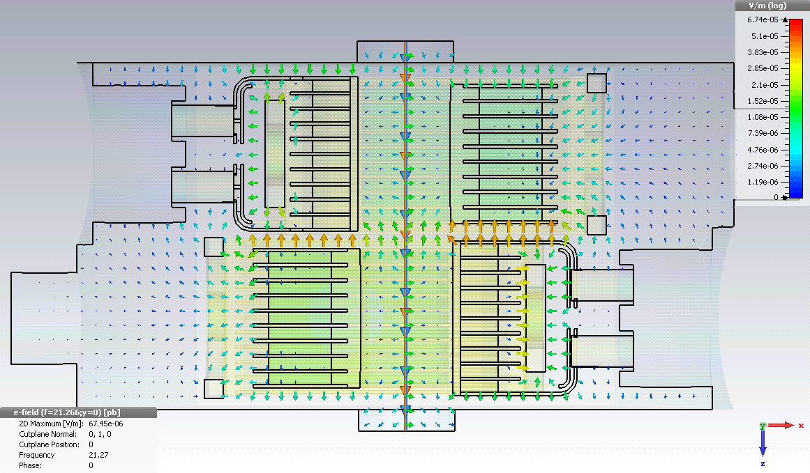
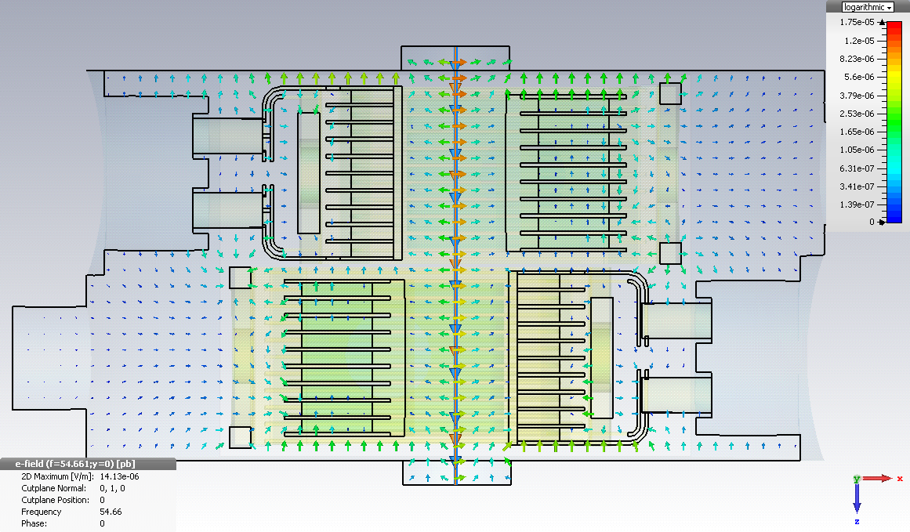
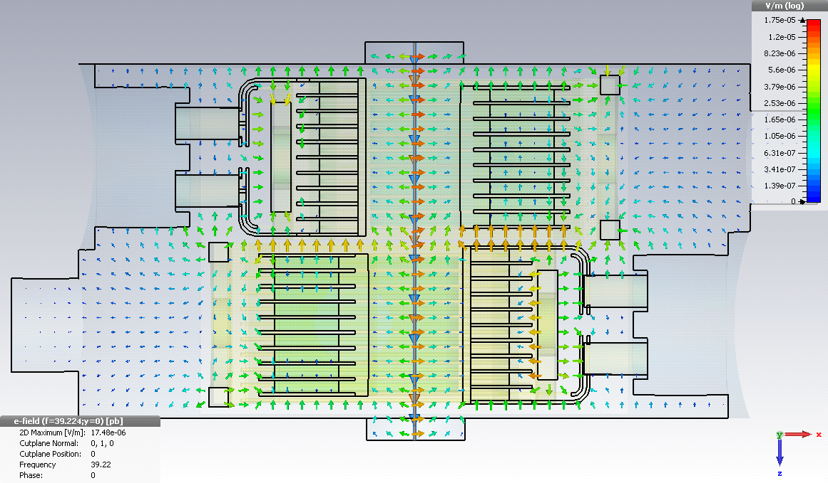
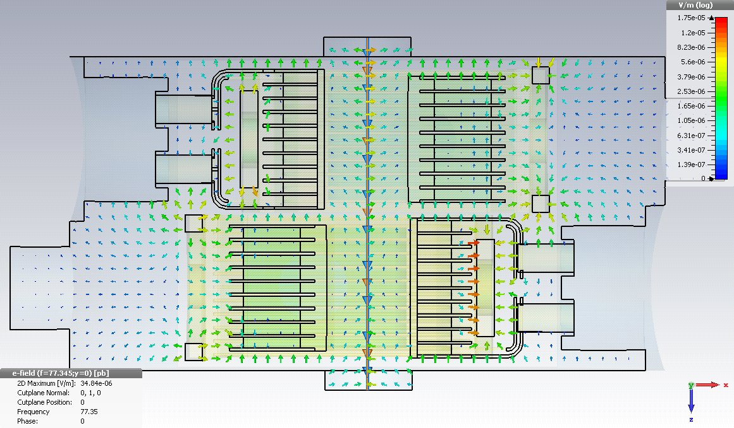
Two Module Case E-Field Monitors: Top View
21.27 MHz
54.66 MHz
39.22 MHz
77.35 MHz

Slide 16
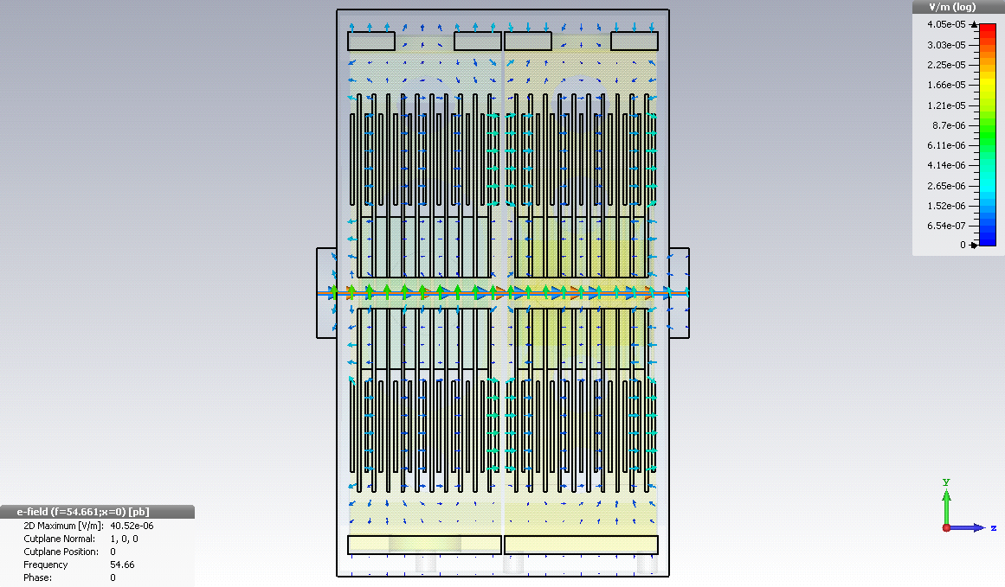
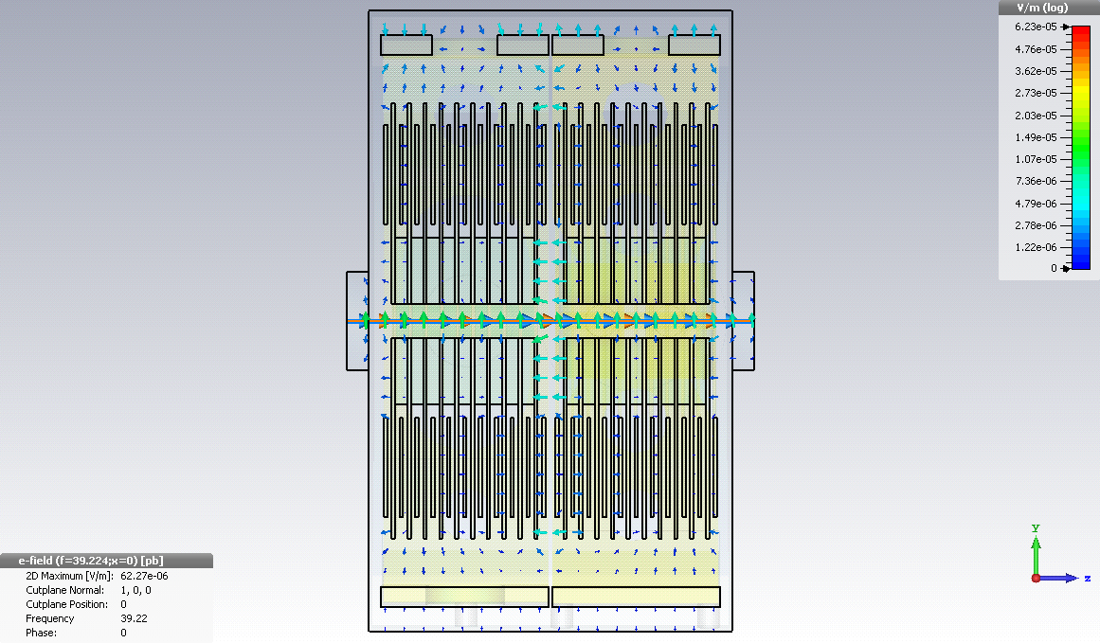
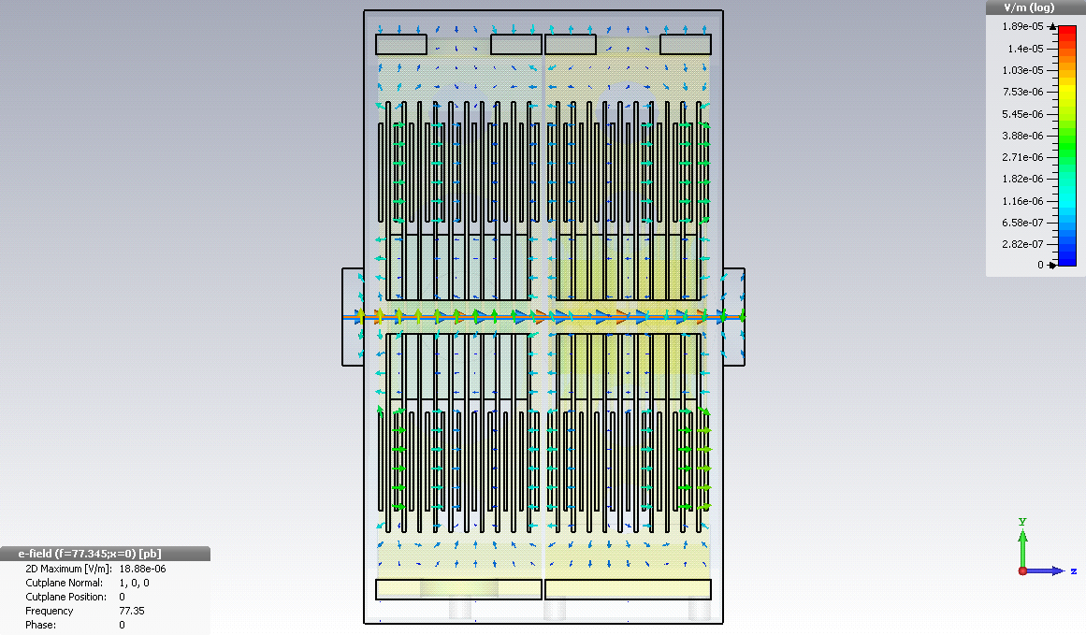
Two Module Case E-Field Monitors: Side View
21.27 MHz
54.66 MHz
39.22 MHz
77.35 MHz

Slide 17
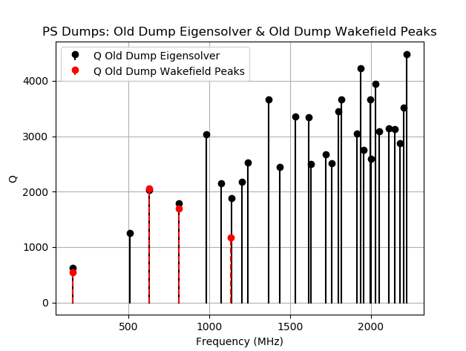
PS Dump Compare : Wakefield & Eigenmode :Q

Slide 18
PS Dump Compare : Wakefield & Eigenmode : R Shunt

Slide 19
PS Dump Compare : Wakefield & Eigenmode : RoQ

