Slide 1
Post acceleration and longitudinal shaving before extraction
s
LIU-PS Beam Dynamics WG – 09/11/2017
A. Lasheen, H. Damerau, M. Schwarz, J. Repond
Acknowledgements: E. Shaposhnikova, D. Cotte, M. Delrieux, CPS and SPS OP crew

Slide 2
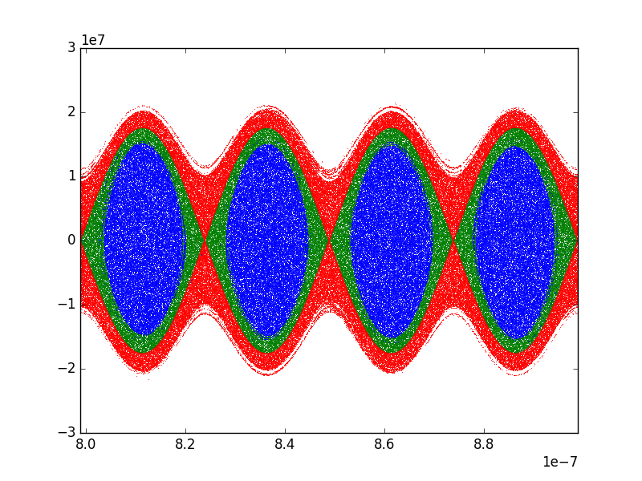
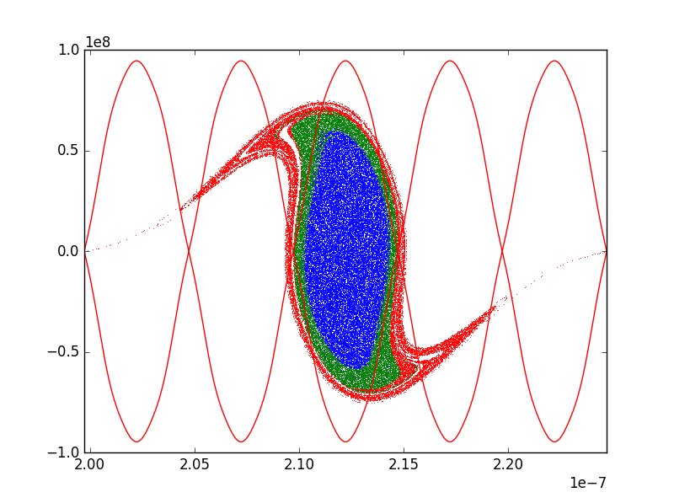
Introduction
PS after 2 x double splitting
SPS at injection after bunch rotation
Injection losses in the SPS are due to the large amplitude particles in phase space, that do not fit in the SPS RF bucket at injection
Losses can come from the core of the bunch (blue), or from the tails/halo (green), or from the uncaptured particles in PS (red). The last two are difficult to measure but are suspected to be the main contributors for the losses (in operation with 2x40 MHz RF cavities).

Slide 3
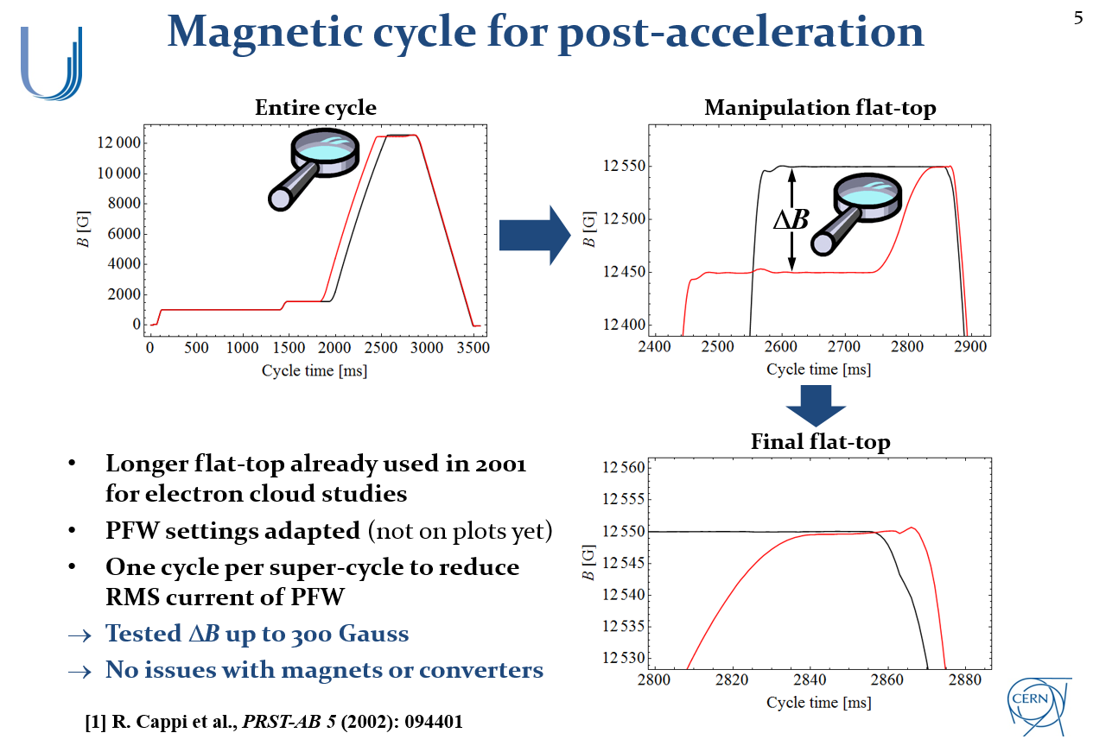
Introduction
An idea to separate the beam from uncaptured particles in the PS is to perform post-acceleration (presented by Heiko last meeting https://indico.cern.ch/event/673990/#1-40-mhz-post-acceleration-in)
Post-acceleration can also be used to shave the longitudinal halo

Slide 4
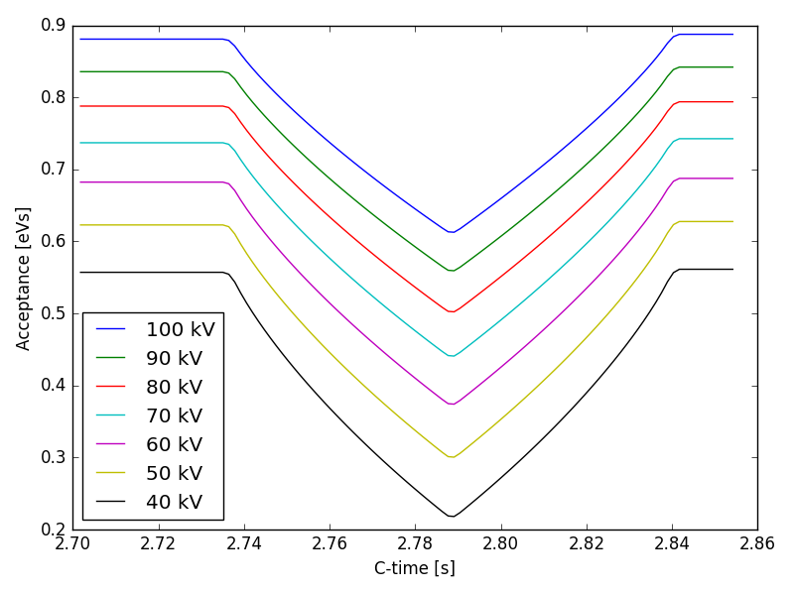
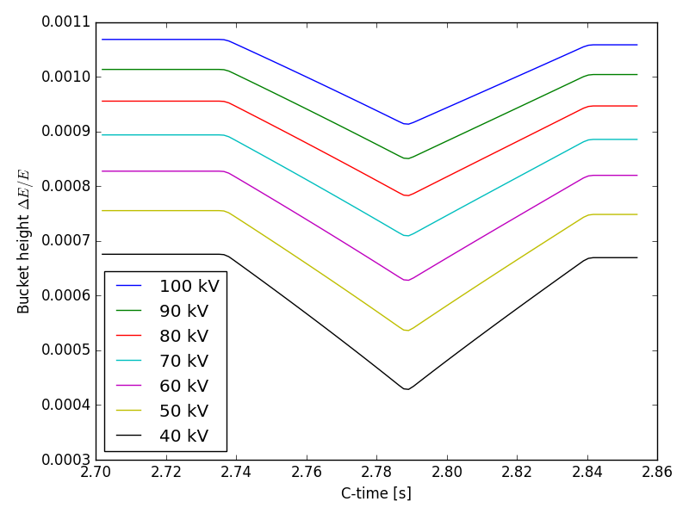
Shaving during post-acceleration (PS)
The shaving is performed by keeping the RF voltage constant during post-acceleration (dip in longitudinal acceptance)
Scanning the value of the RF voltage to find the optimum point where the tails are shaved and not the core of the bunch (longitudinal emittance is ~ 0.35-0.4 eVs, so ~60kV is expected to be the limit)

Slide 5
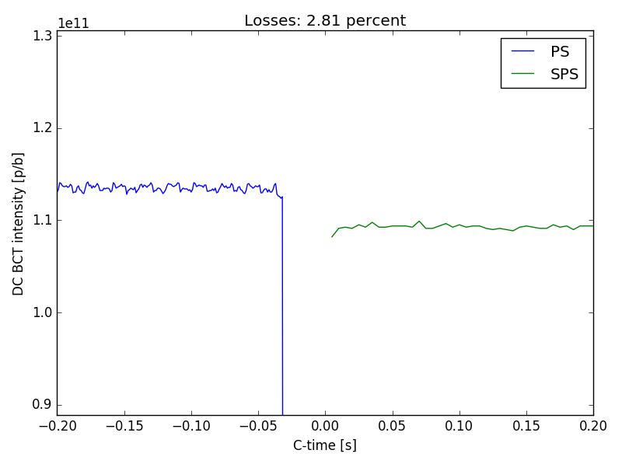
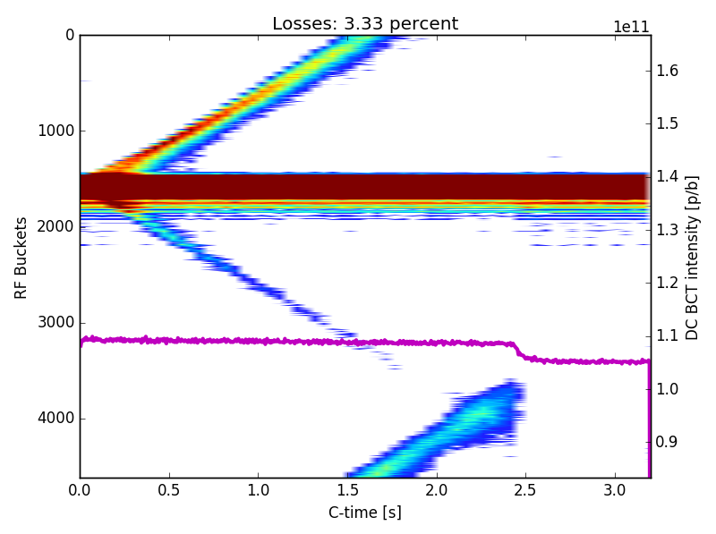
Definition of losses in the PS and SPS
Reference intensity
Uncaptured beam
Main beam
Losses during PS-SPS transfer
Losses during post-acceleration
Acceleration
PS-SPS transfer
Flat bottom in the SPS
Losses measured in the PS during post-acceleration (last ~1ms), and by comparing the measured intensity with the DC BCT in PS and SPS
Losses measured in the SPS from the DC BCT (magenta line) at the beginning of the ramp and with the Fast BCT (coloured 2D plot)
The uncaptured beam in the SPS is lost at the beginning of the ramp

Slide 6
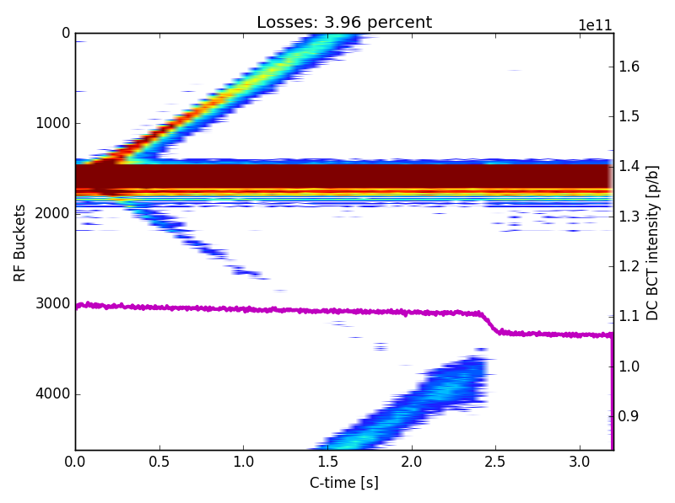
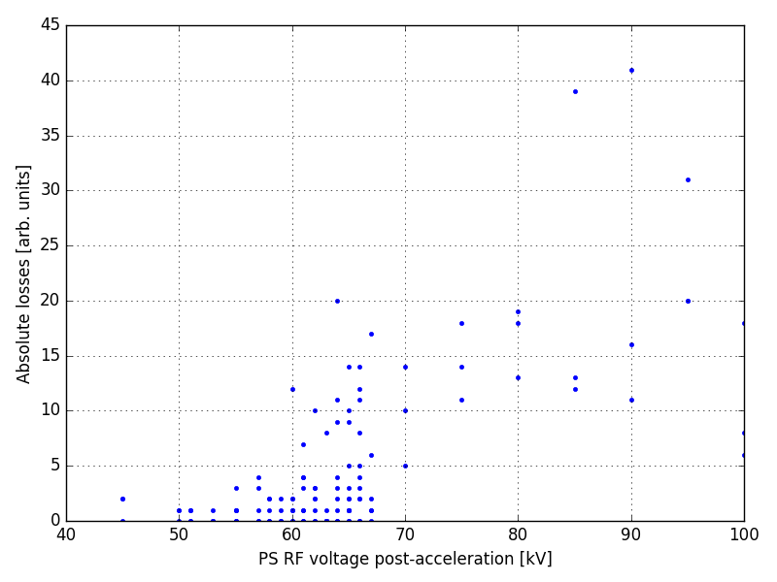
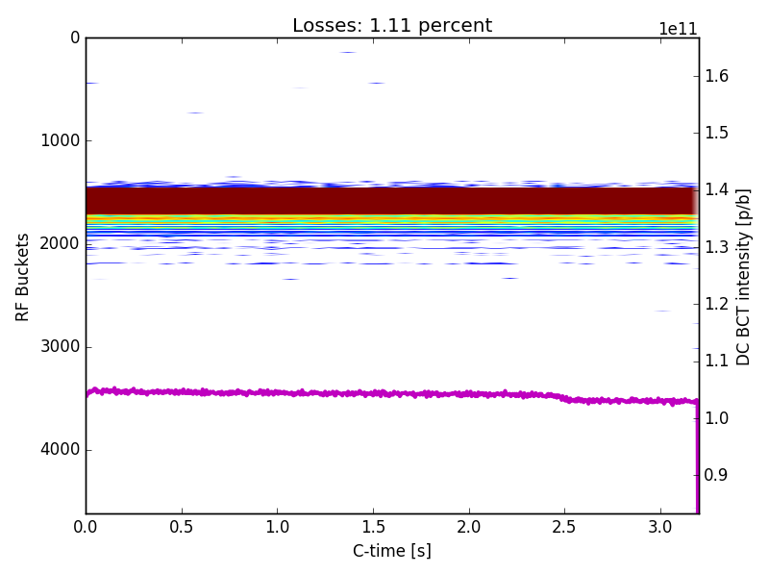
Losses in the Fast BCT (SPS)
No shaving
Losses measured in Fast BCT
Same colour scale
Shaving 60 kV
Below 10, there is no visible uncaptured beam in the Fast BCT (still some losses below the sensitivity of the device ?)

Slide 7
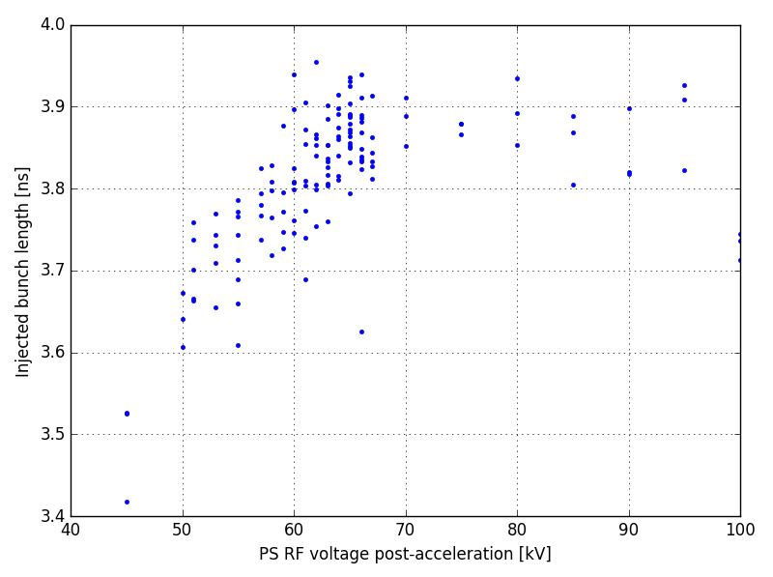
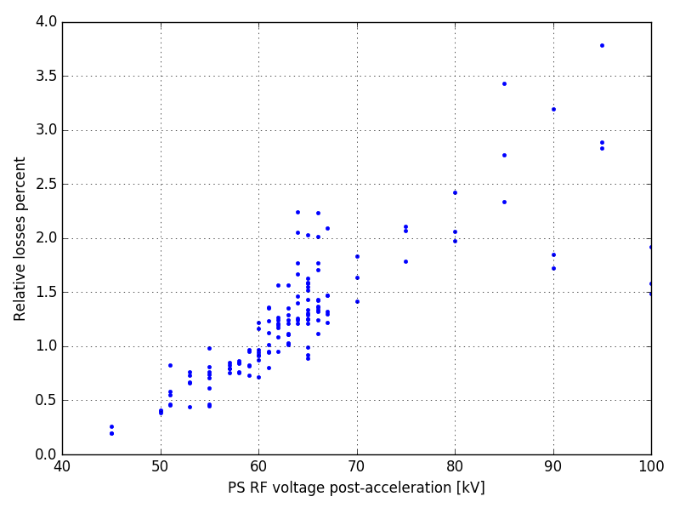
Injected bunch length and losses during ramp (SPS)
Losses during SPS acceleration
Injected bunch length
For 60 kV, although there is no visible loss in the FBCT anymore, still some losses in the SPS at the beginning of the ramp (~1%)
Large oscillations at injection and filamentation, those losses might be the captured in the RF buckets but with too large amplitude
NB: Without shaving, large spread in the losses that is maybe correlated to the variability of the injection phase (> +-10 °)

Slide 8
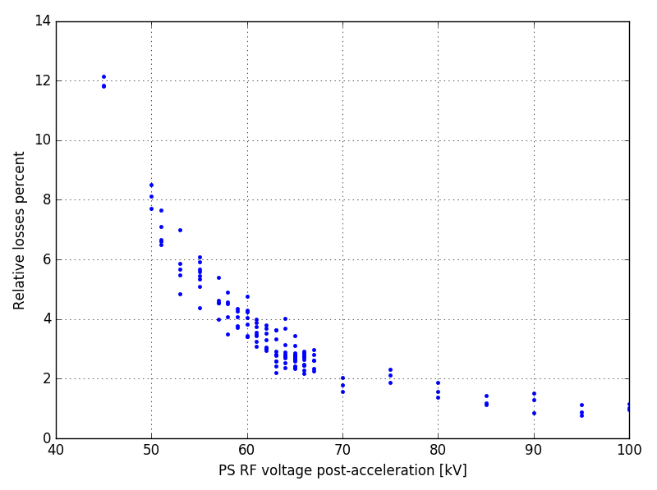
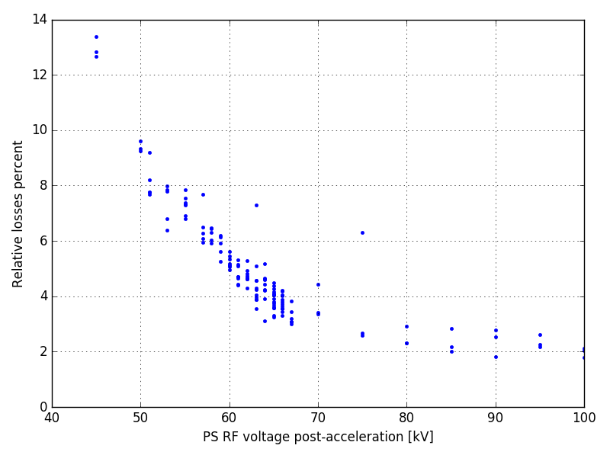
Losses during post-acceleration and transfer (PS-SPS)
Losses during post-acceleration
Losses during PS-SPS transfer
The shaving increases the losses during PS-SPS transfer
-> expected since the shaved particles are lost in the PS instead of the SPS
The shaving also increases the losses during post-acceleration, meaning that part of the shaved beam is already lost in the PS

Slide 9
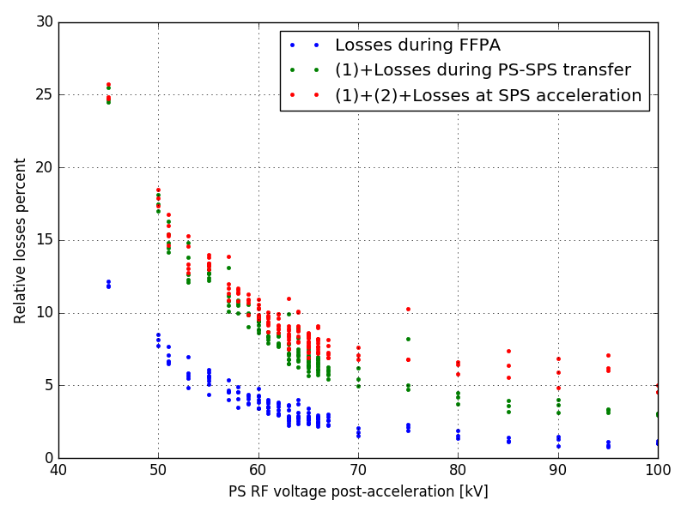
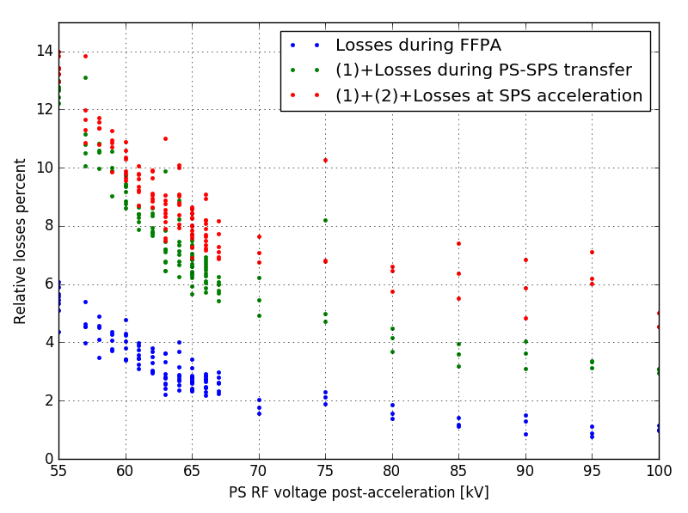
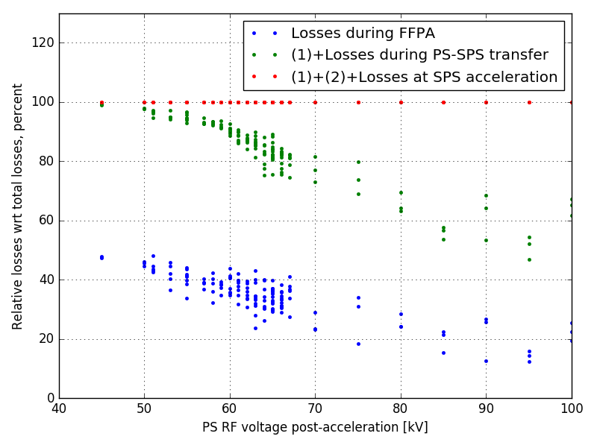
Overall contributions to total losses (PS-SPS)
The shaving reduces the losses in the SPS, but increases the overall losses including all steps
Very strong shaving is necessary to fully remove the losses in the SPS
The extra losses may come from the mismatch at injection and filamentation

Slide 10
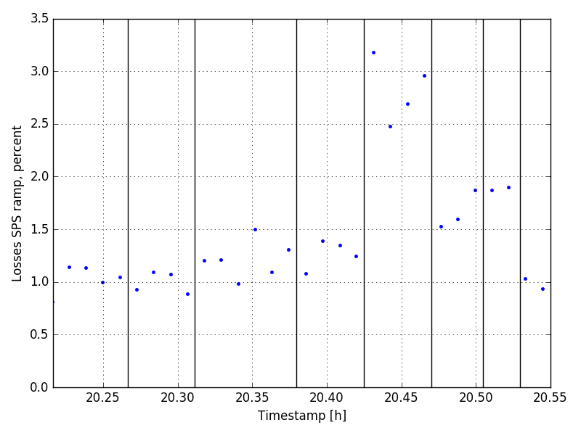
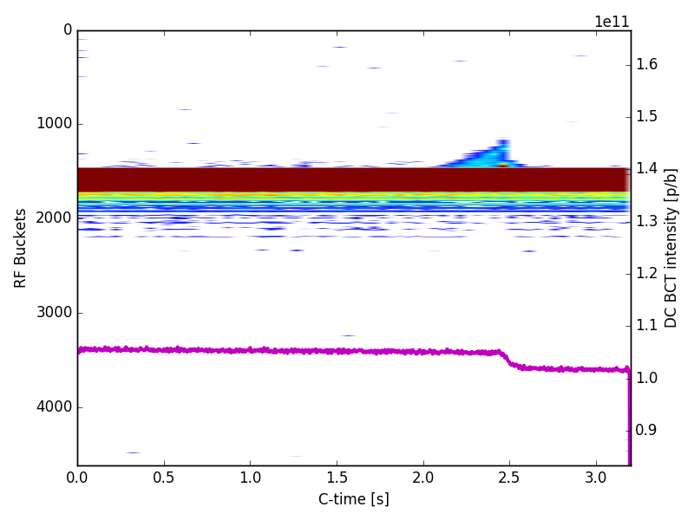
Shaving at start of SPS ramp
Bucket area reduced to 0.5 eVs
Ramp
0.6 eVs
0.65 eVs
0.7 eVs
0.75 eVs
0.5 eVs
0.7 eVs
0.75 eVs
0.6 eVs
To test the idea that the RF bucket in the SPS is full after filamentation, the bucket area at the beginning of the SPS ramp was reduced to 0.5 eVs (with shaving in the PS, longitudinal emittance should be <0.35 eVs)
Despite the shaving applied in the PS, we can see that we shave particles in the SPS even before the ramp
However, increasing the RF bucket to 0.75 eVs does not solve the problem, probably due to aperture limitation in the SPS

Slide 11
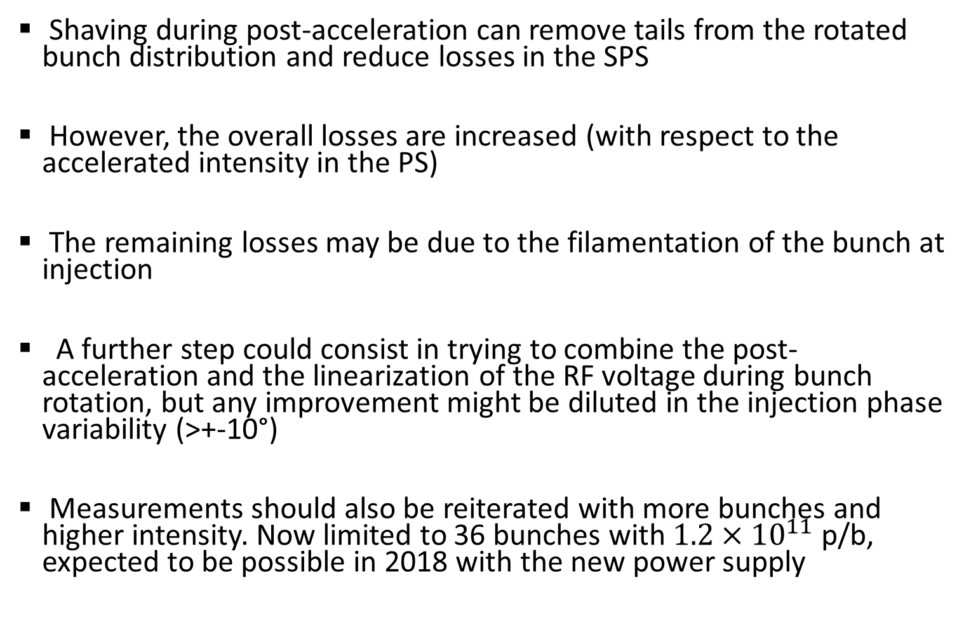
Conclusions and next steps
Shaving during post-acceleration can remove tails from the rotated bunch distribution and reduce losses in the SPS
However, the overall losses are increased (with respect to the accelerated intensity in the PS)
The remaining losses may be due to the filamentation of the bunch at injection
A further step could consist in trying to combine the post-acceleration and the linearization of the RF voltage during bunch rotation, but any improvement might be diluted in the injection phase variability (>+-10°)
Measurements should also be reiterated with more bunches and higher intensity. Now limited to 36 bunches with $1.2×{10}^{11}$ p/b, expected to be possible in 2018 with the new power supply

