Slide 1
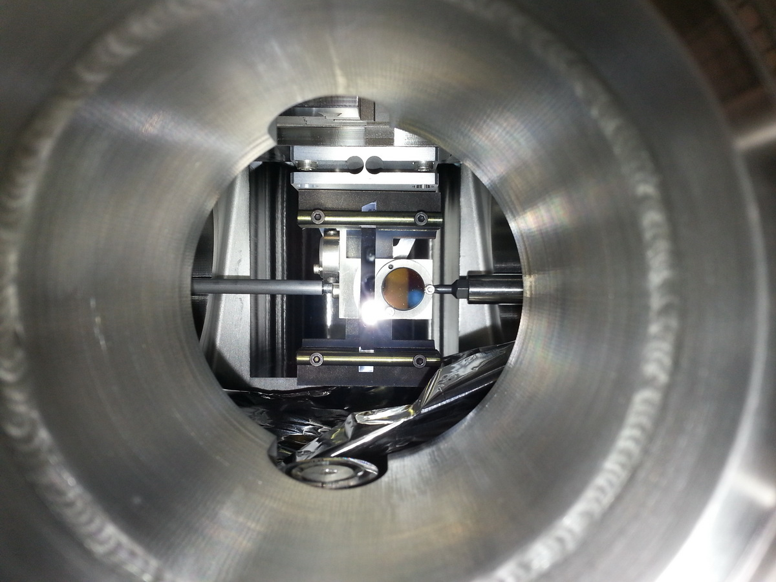

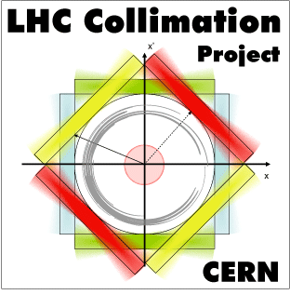
Results from Crystal Collimation MD with Xenon ions in LHC
24/11/2017 – Collimation Upgrade Specification Meeting
Roberto Rossi, Daniele Mirarchi, Stefano Redaelli, N. Fuster Martinez, M. D’Andrea, W. Scandale, S. Montesano, F. Galluccio, A. Masi, G. Valentino, M. Butcher, C. Barreto, P. Serrano Galvez

Slide 2
Outline
Introduction
MD plans
MD results
  Channeling Measurements
  Cleaning Measurements
B1-H crystal discussion

Slide 3
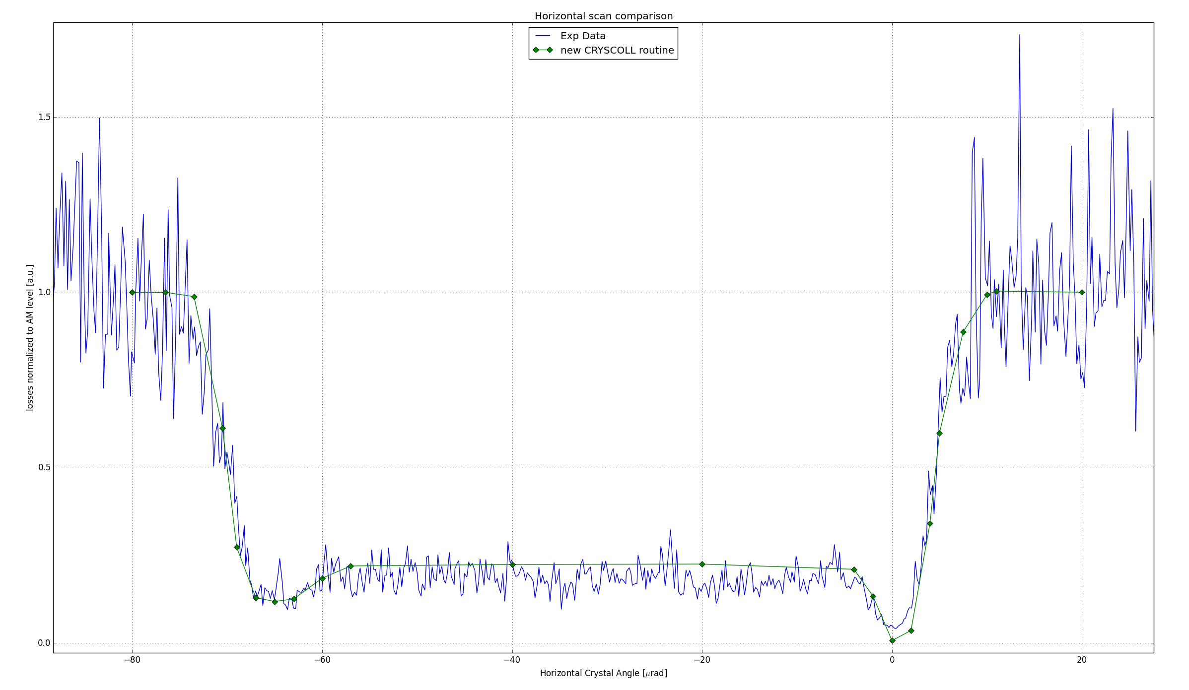
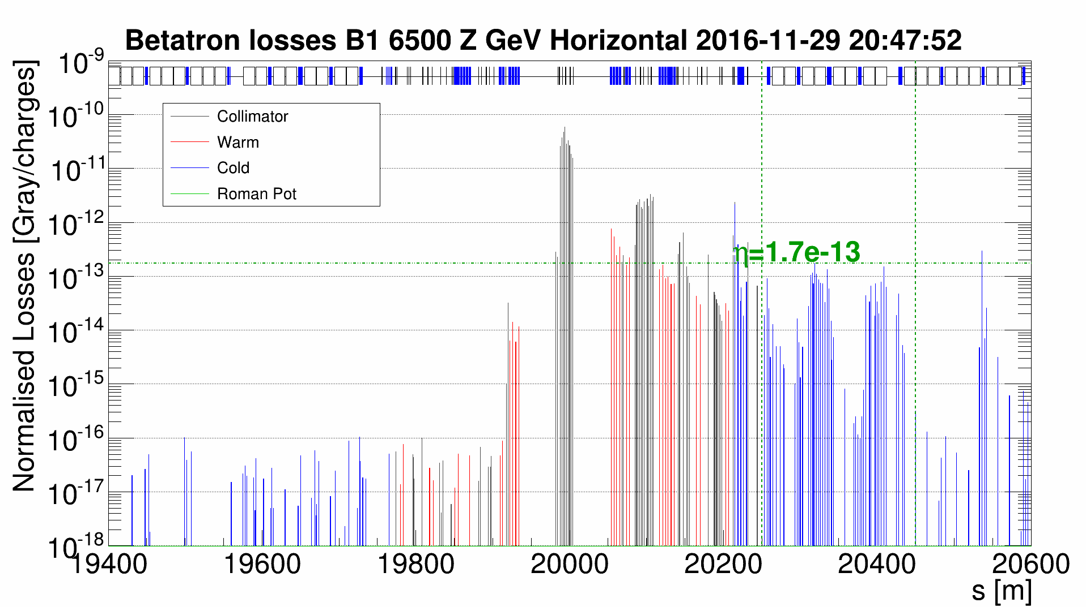
Introduction
During 2015-2017 MD blocks crystal collimation devices on B1 & B2 have been successfully tested.
  Channeling observed with both ion and proton beams at top energy
  Cleaning measurements performed
  Channeling maintained during the proton energy ramp
  New installation on B2 tested – with understanding of new installation features
With lead ion beams no improvement indication of beam cleaning observed in the 2016 tests.
Xe beams tests crucial to understand if crystal collimation can work with heavy ions.

Slide 4

MD Plan
The main goals is to assess the performances of the new hardware
Crystal aligned and set as primary collimator
downstream system at nominal settings
Fast angular scan to find channeling orientation
Characterization measurements
  Injection
    Angular scan to find optimal channeling orientation
    Linear scan with absorber to characterize the channeled beam
  Flat Top
    Angular scan to find optimal channeling orientation
    Linear scan with absorber to characterize the channeled beam
Cleaning measurements of crystal collimation (Loss Maps)
Perform in parallel same tests on B2
Beam
Crystal
Angular Scan
Absorber Scan
Absorber

Slide 5
Crystal Channeling Measurements

Slide 6
Crystal Channeling with Xe
Channeling measurements in agreement with lead ions observation.
In comparison with protons, the reduction factor is about a factor 2 lower.
B1-H
B1-V

Slide 7
Crystal Collimation Measurements

Slide 8
Methods
Usual normalization to TCP losses does not allow direct comparison
To compare the crystal collimation to the standard collimation the leakage of particles in specific region near to the IR7-DS is evaluated by normalizing losses to the beam flux.

Slide 9
Collimation cleaning setup
In lead ion test of last year a small improvement were observed when the first secondary collimator was moved to tighter apertures.
D4L7 @ 7.0 σ
D4L7 @ 7.5 σ
D4L7 @ 8.0 σ
Lead ion leakage ratio to standard coll
With Xe was decided to explore different settings, using also TCLAs to different apertures.
Because of the tighter settings used, also the standard system was tested with such TCSGs & TCLAs positions: no significant difference were observed.

Slide 10
Resume of Results
In general, good performance were observed with almost any configuration (except for Q7 region).
Looking at loss maps along the ring no dangerous peaks with crystal.

Slide 11
Tight Settings Comparison
When standard coll is used with tight settings small difference observed in Q7 (more showers), while large difference observed in crystal collimation

Slide 12
Different TCLAs Aperture
Tighter TCLA’s settings correspond to improvement of leakage at first dispersive peak.
May be caused by off-momentum particles produced by TCSGs.

Slide 13
Different Downstream Coll Aperture
Tighter settings of both TCSG and TCLA improves cleaning in all considered regions.
May be caused by particles leaking from crystal.

Slide 14
Comparison with QM crystals
With QM crystals, with same tight settings, it is not observed the same magnitude of improvement.
Indication on different behaviour of the two technologies, with heavy ion beams.
Still, why there it is not observed the huge improvement observed with B1-H with those crystals?

Slide 15
B1-H Characteristics Discussion

Slide 16
Comparison with Proton Simulations
B1-V Meas
B1-V Sim
Comparing cleaning simulations, a good agreement with data is found in vertical plane, while an important difference (factor ∼3) is observed in the horizontal plane.
In particular Losses in Q8-9 has a facto >10 of difference, when configuration with only TCSG.6R7 is used.
This collimator has >20 μrad angular cut.
B1-H Meas
B1-H Sim

Slide 17
Comparison with Proton Simulations
In collimator scan simulations, it is evident that the dechanneled population at lower deflection angles is higher in B1-H.
The main difference we can found between the two condition is the bending angle of the two crystals
B1-H: θ_{b} =63 μrad, R = 63 m
B1-V: θ_{b} =40 μrad, R = 100 m

Slide 18
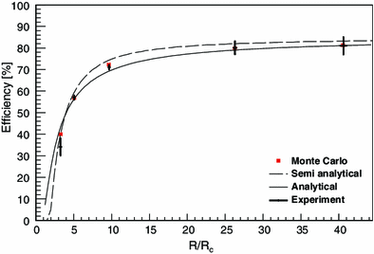
Comparison with Proton Simulations
In measurements is clear how the dechanneled particles increase starting at 30 μrad of deflection.
With 63 μrad deflection and 4 mm of length, the bending radius is 63 m, ∼4 critical radius (∼15.6 m @6.5 TeV)
In this regime nuclear dechanneling is enhanced and there is no analytical description (simulation discrepancies)
E. Bagli et al., Steering efficiency of a ultrarelativistic proton beam in a thin bent crystal, Eur. Phys. J. C, 74 (1) (2014), pp. 1-7

Slide 19
Collimator scan measurements
Rc∼1.1 m @450 GeV The crystals are equivalent in injection measurements
B1-H: θ_{b} = 63 μrad, R = 63 m
B2-V: θ_{b} = 56 μrad, R = 71 m
B1-H: θ_{b} = 40 μrad, R = 100 m
Injection
Flat Top

Slide 20
Collimator scan measurements
This observation is confirmed by all flat top collimator scans made with B1-H
2015 proton
2016 proton
2017 xenon

Slide 21
Conclusion
Channeling established with both new crystals at injection and top energy for the first time with xenon ions
Cleaning measurements performed, tight settings improve the cleaning in the DS and in the machine in general
Indication on different efficiency with heavy ions between QM and strip
Confirmation that crystals within required specifications provide better results
Goals :
Test with Pb ions in 2018 to confirm good results observed with Xe

Slide 22
backup

Slide 23
Xenon Measurements
B1- V FT
B1- H INJ

