Slide 1
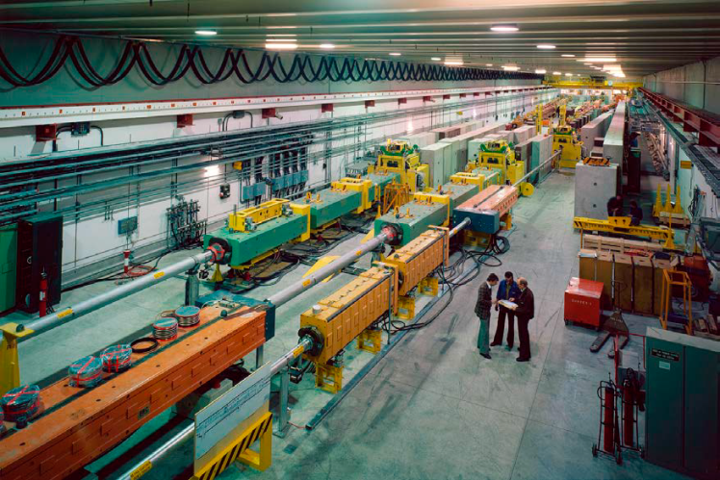

Slide 2
Dose
Activity 1
2 μSv
12 μSv
Activity 2
33 μSv
Activity 3
Activity 4
2 μSv
Time
Time
Time
List of activities
Planning of activities
WORK PLANNING
Planning of activities
WORK AND DOSE PLANNING

Slide 4
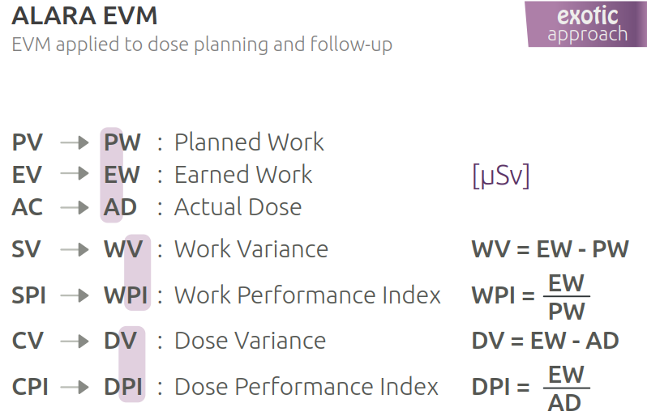
Courtesy of Pierre Bonnal

Slide 5
ALARA Framework and processes
Value and Principles
Change your Mindset !
Inputs
Process driven vs Value Driven
More processes vs Freedom to add value
Processes &tools vs Individuals & interactions
Working beamline vs Exhaustive documentation
Collaboration vs Working in silos
Responding to change vs Execute the plan
Process
Outputs
Increasing :
Effectiveness
Efficiency

Slide 6
KANBAN
LEAN
DSDM
XP
Crystal
Mindset
SRUM
FDD

Slide 7
Flow based method
To do
Work in Progress
Done
done
yesterday
to do today
will do tomorrow

