Slide 2
PS: Start up procedure and desiderata for 2018 as test case for post-LS2
Denis Cotte, Frank Tecker, Alexander Huschauer, Marc Delrieux, O.Hans, H.Damerau and the BE-OP-PS crew

Slide 3
Draft 2018 Injectors schedule - Q1
HW Test
Beam Commissioning
HW test/commissioning + Cold Check-out : tight planning for PS-RF following EN/EL works.
No access in PS-SWY from the 27th March. (detailed planning next slide by O.Hans / M.Delrieux)
First beam expected Friday 9/03/2017 in PS.
Beam Commissioning : Setting up of MTE and LHCINDIV as first beam for SPS on the 16/03.
Check PS-MU realignment (14Gev Orbit) performed during YETS. -> MU73
Beam Commissioning : Setting up of AD, East Area, nTOF beams from the 23rd of March.
Pb in PS from the 30th of April 2017. Pb to SPS on the 4th of June.
Notes:
Fermeture du PS le 16 Fevrier. -> shit 2p no night , no week-end
3 semaines des HW test Cold check-out.

Slide 4
Draft 2018 Injectors schedule - Q1
HW test & Cold Check-out planning by O.Hans

Slide 5
Draft 2018 Injectors schedule - Q1
All 2017 operational cycles will be cloned (2018) with only 1 year of setting history.
Other cycles (ex : no-MHS) will be deleted or archived.
From Week 10: play all cycle that will be used LHCPROBE, LHCINDIV, MTE and also everything that can be done w/o beam.

Slide 6
MAIN YETS17-18 WORKS impacting HW COMMISSIONING
Very special attention on Central Building equipment due to decabling/cabling campaign (all equipment in B353 & B359 can be impacted) .(EN-EL)
BE-BI equipment : new PI.BTVI42(one cable), new FWS54(electronic 09/18), new SemGrid48/52/54(electronic 10/18), SemFil277(repair), BGI82(chip3), exchange of FWS85V(calibrated)
Extraction kicker FESA class upgraded (KFA71) + external condition + SIS interlock
Septum 16,23,42 replacement. (TE-ABT)
Replacement of 16 Magnets (QDN) in TT2.(TE-MSC, TE-VSC)
5 (+1 spare) power converters (C40/C80) will be upgraded to FGC3 – (TE-EPC/BE-RF)
Installation and test of PSC10 400W Driver amplifiers (BE-RF)
Interlock renovation via PLC for 200MHz(+power), 20MHz (BE-RF)

Slide 7
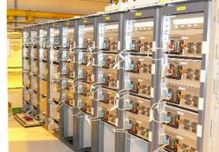
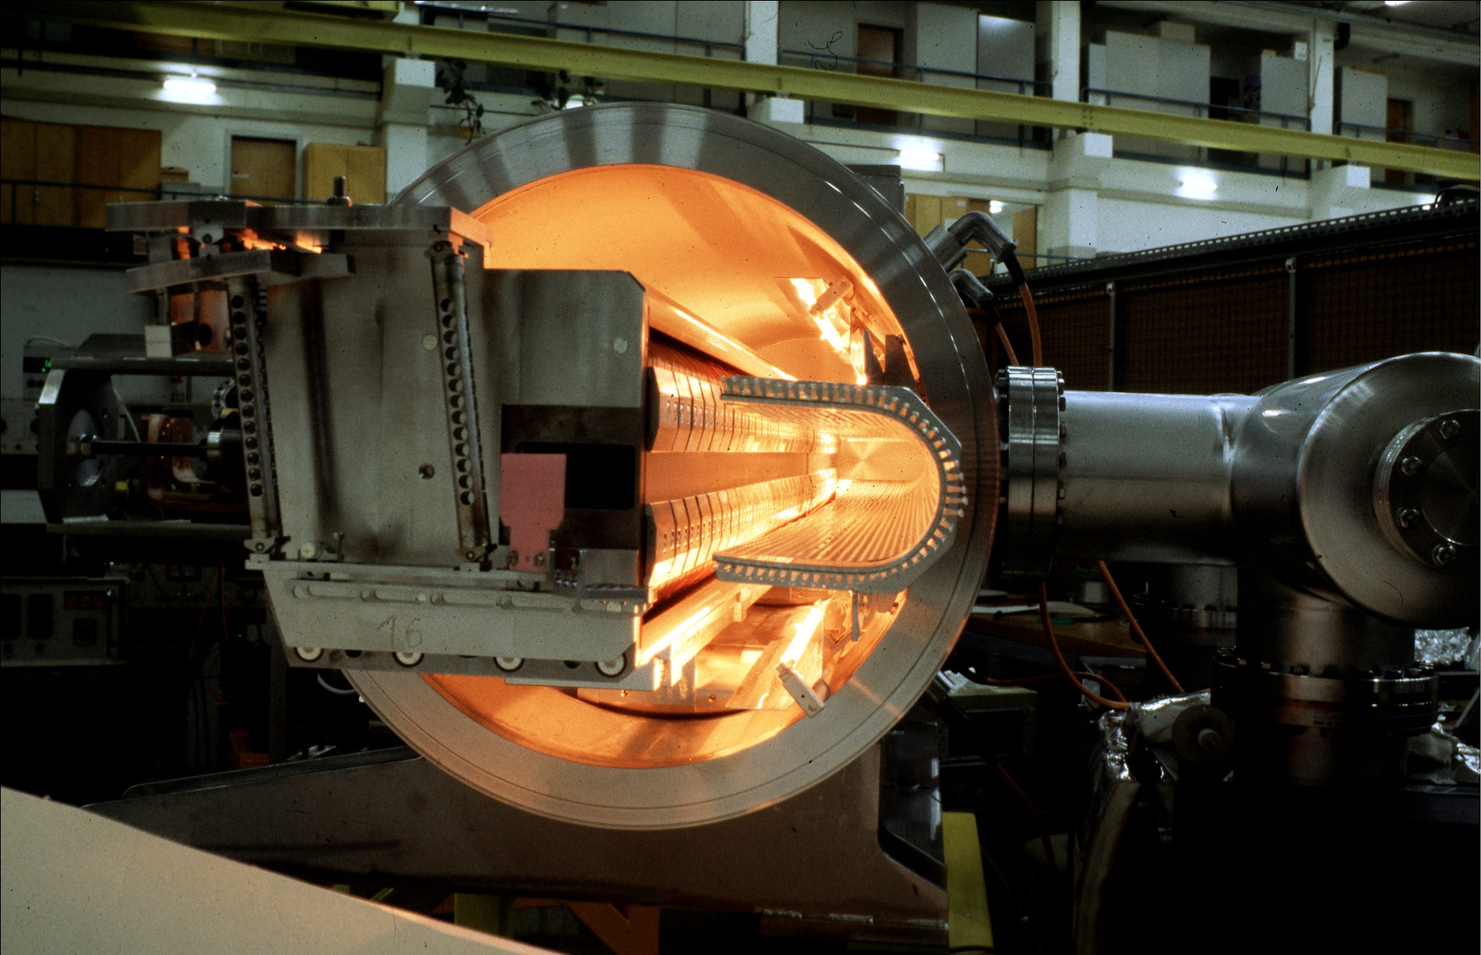
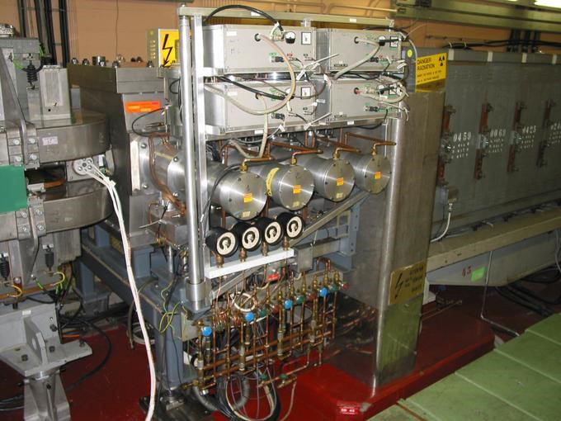


EXISTING HARDWARE
53 power converters in the ring
17 (old) power converters in transfer line
Power converters (mainly POWM1553, FGC53, FGC61) :
  Check control of the devices from CCC: working sets, Knobs, Makerules…
  Check acquisition AQN value, OASIS (+ samplers)
  Check PFW regulation ➔ overshoots, ripples
  Check SIS protection for QFNs, QDNs
  For kickers check timings, fine delays, OASIS
  Check logging
Injection septum ER.SMH11
Septum (STEP-V, ABT_SeptaMotion, Tps15RemMov) :
  Check control of the devices from CCC
  Check acquisition and motion
  Check logging
Kickers inj (KFA45, KFA28), ej(KFA71-79), MTE(KFA4,13,21, BFA9P) :
  Check control of the devices from CCC (spec app or Wset/knobs+Makerules)
  Check acquisition and OASIS
  Check logging

Slide 8
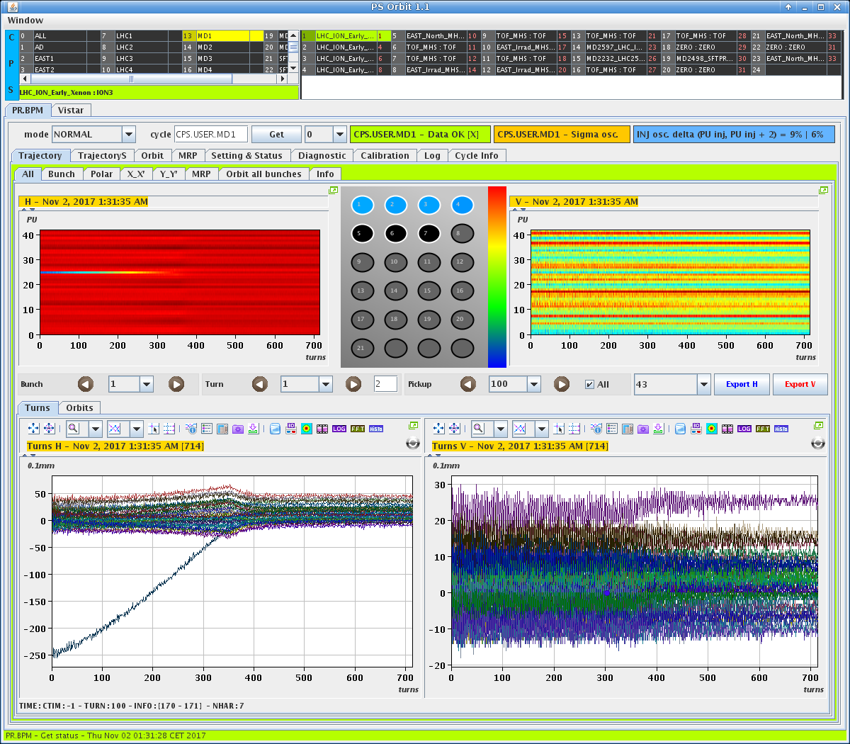
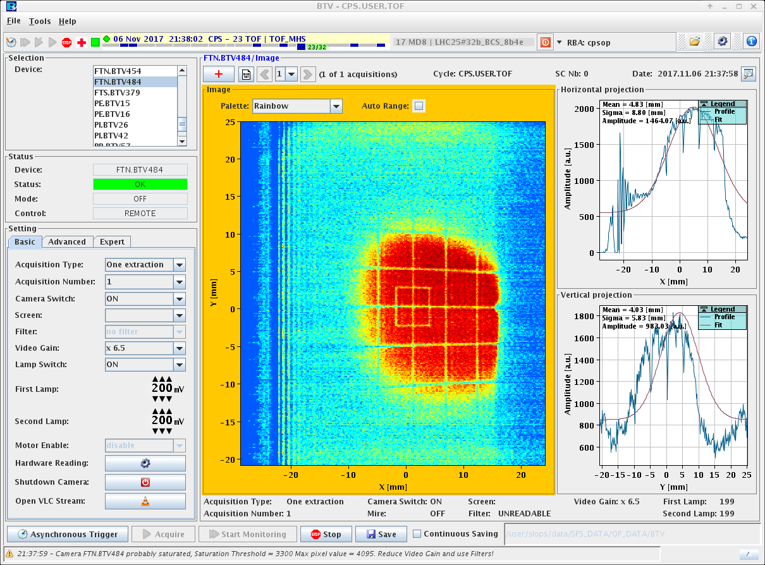
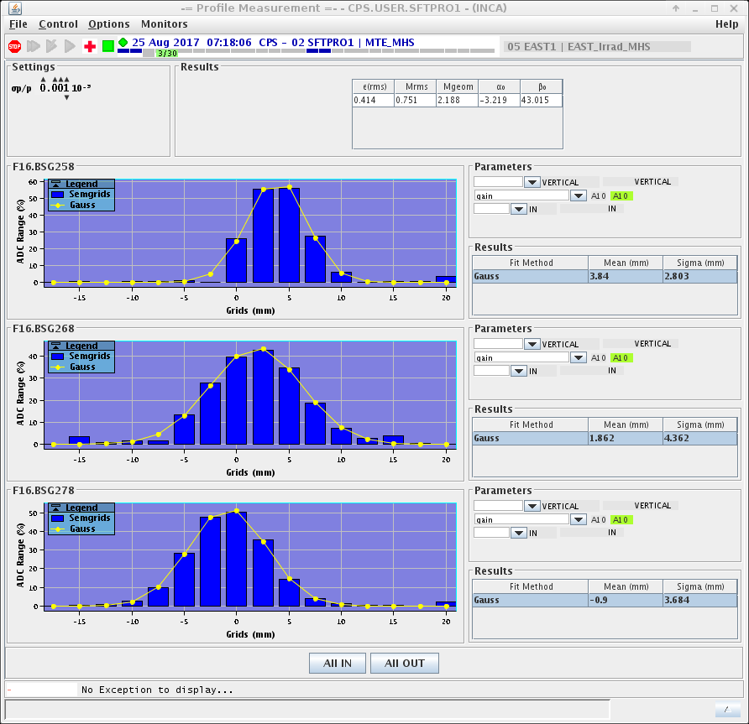
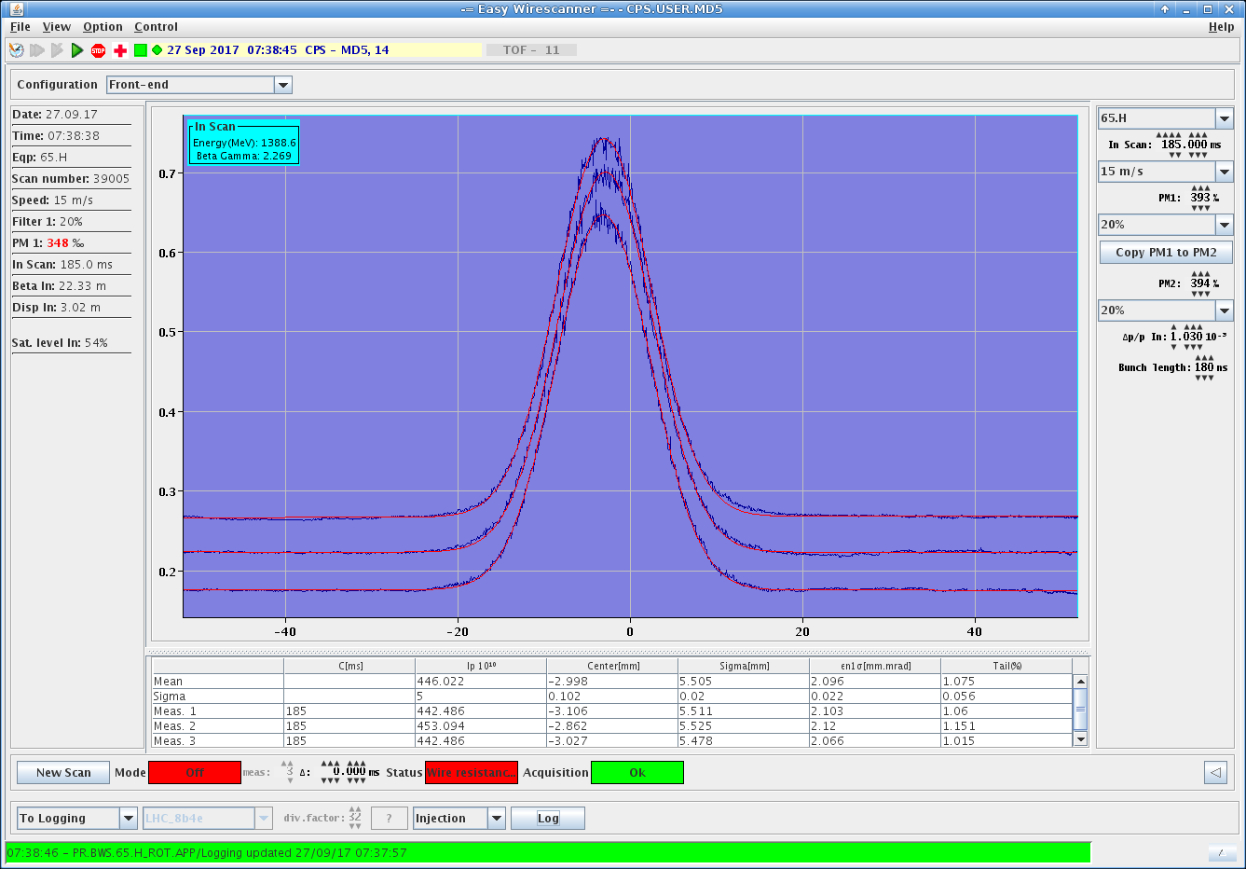
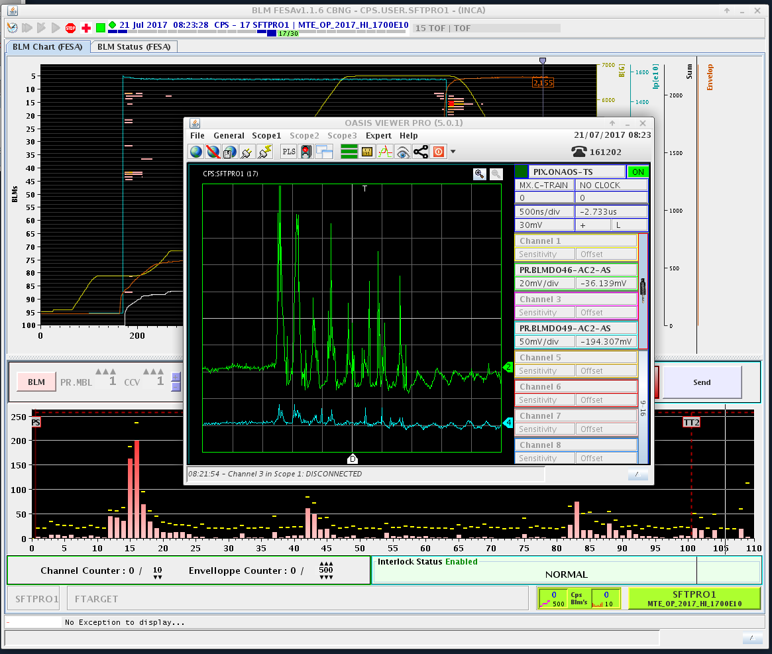
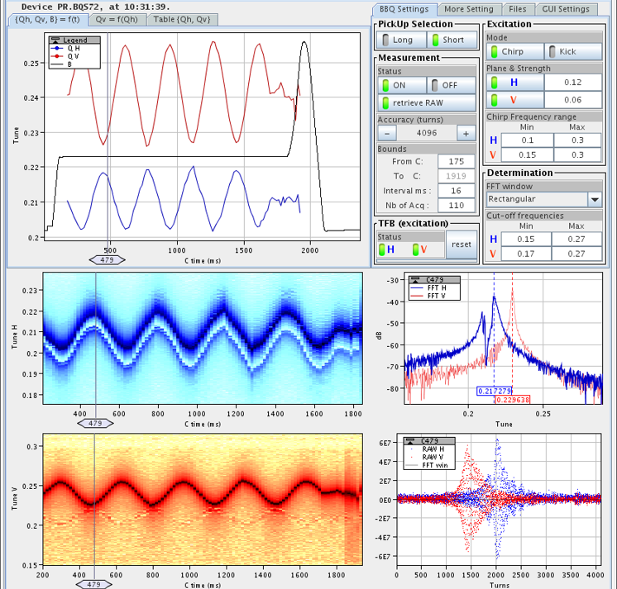
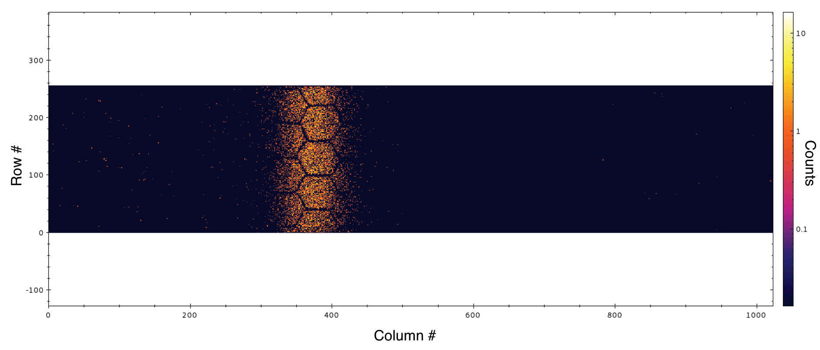
Beam instrumentation: FWS, SemFil, SemGrids, BTV, BCT, BPMPS, BBQ, BSM, BLM (ACEM, IC, DIAMOND), BGI :
  Check control and applications from CCC
  Check logging
  Check OASIS
  Check BGI kick compensation
BPMPS (TMS)
BTV
SemGrids
WireScanners
BLMs + DIAMOND
Q meter
BGI82 H

Slide 9
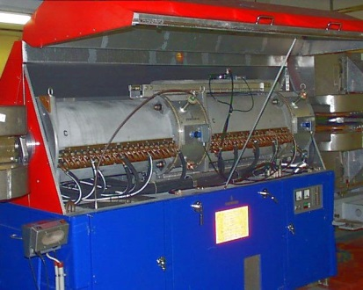
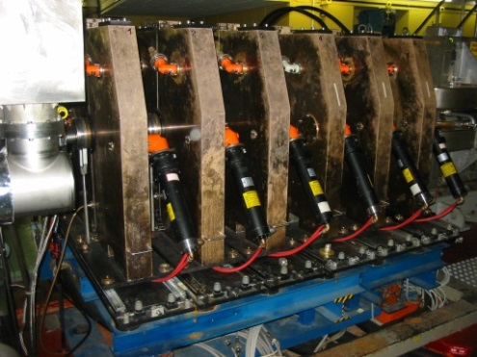
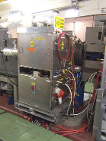
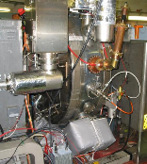
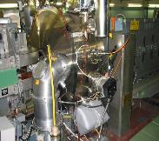
Internal dump TDI47/48:
2.8 – 10 MHz
  Check control from CCC: working sets / Knobs
  Check OASIS
  Check Logging
200 MHz
Acceleration
Longitudinal blow-up
RF system High Level and TFB :
  Check control from CCC: working sets
  Check MakeRules / Samplers
  Check OASIS
Dumping movement
20 MHz
40 MHz
80 MHz
Mechanism
Dump core
RF Manipulations

Slide 10

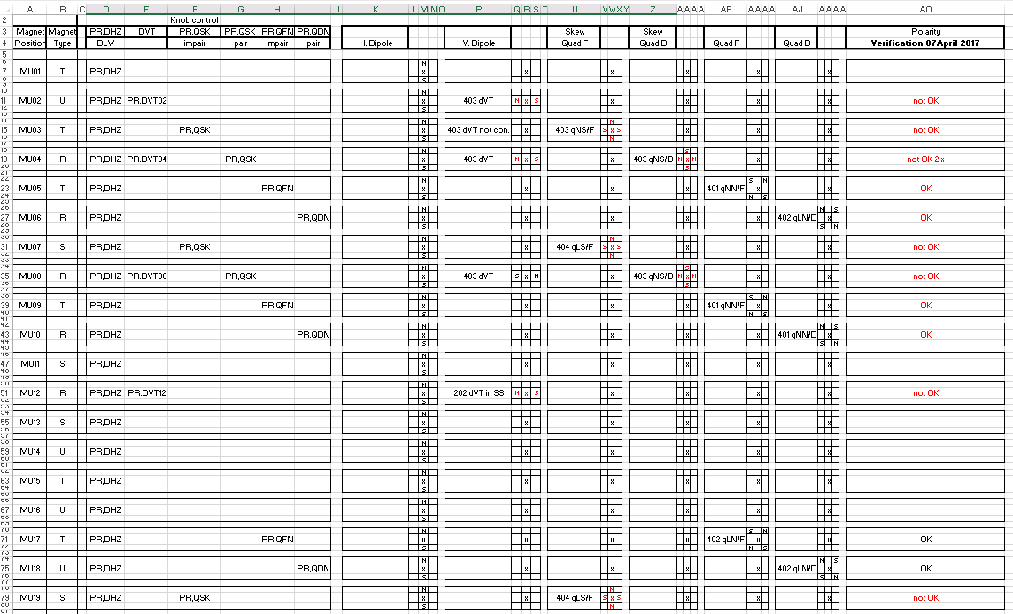
CO systems:
Polarity Tests:
  Check External condition
  Check Trains (B, C, RF, REV)
  Check Synchro
  Check SIS interlocks
  Check Applications:
    MTG Diag
    TGM Video
    CBCM
    TIMDiag
  Check Correctors : 50xPR.DHZ, 20xPR.DVT
  Check Low Energy Quads : 40xPR.QD/QF
    PR.QDW18 reverse polarity
  Check Skew Quads : 40xPR.QSK
  Check Multipoles : 10 circuits
  Check Bumpers/QKE : 15 circuits
  Check Transition DB/TR : 4 circuits
  Check also polarity on OASIS !
INCA/LSA cycle:
  Check Optics
  Check Incorporation Rules
  Check MakeRules
20 MHz
40 MHz
80 MHz
Polarity check list

Slide 11
PS 2018 commissioning part 1
Mar 09, 2018
Mar 16, 2018
Start beam commissioning
Week 11
SFTPRO (MTE) to SPS Ip~200e10 (10us) island + core
Ip~50e10 (2us) core only
LHCINDIV
Week-end: Polarity checks of LEQ and DHZ/DVT with beam
TT2 kick response.
Test C40/80MHz
Mar 12, 2018
Mar 20, 2018
Possible realignment
LHCPROBE (PILOT) to SPS
Mar 09, 2018
Mar 13, 2018
Mar 15, 2018
Mar 16, 2018
TOF-like cycle (or MTE H8)
LHCINDIV(H16Li)
SFTPRO, and LHCINDIV
SFTPRO(MTE)
Ip~1e13
LHCINDIV
Phasing of 40MHz
Phasing of 80MHz
Complete longitudinal setting-up of LHCINDIV
Establish injection, acceleration to 14/20 and 26 Gev, fast extraction
Check all pick-up signals with beam (BPMOPS)
Re-commissioning of H8/H16 Beam Control with MHS-CRS.
Setting up of 2 MTE type beams requested by SPS.
Transverse feedback
needed
LHCINDIV:
Energy matching with PSB
Phasing of 200MHz
Blow-up operational
LHCINDIV:
Recommissioning of MHS-CRS for H16Li Beam control
Mar 14, 2018
Week end 10-11 Mar
Check realignment performed during YEST with MU73. (@14Gev with YASP)
Do we need another iteration ?
Adjust and improve the Shadowing TPS15 - SMH16 with Diamond BLMs & High Energy orbit correctors DHZ_OC

Slide 12
PS 2018 commissioning part 2
Mar 26, 2018
Mar 30, 2018
Apr 30, 2018
June 4, 2018
Mar 09, 2018
LHC25ns standard 12b to SPS
Start of nTOF, EA, physics
Start beam commissioning for Pb
Pb beam to SPS
Start beam commissioning
LHC25ns(multi-bunches)
Phasing of 20MHz cavities
LHC25#12b:
Recommissioning of MHS-CRS for LHC Beam control
Mar 20, 2018
Mar 29, 2018
Apr 30, 2018
Start AD physics
Check new destination LEIRDUMP when we play spare cycles
Mar 19, 2018
AD:
Recommissioning of MHS-CRS for HSWP Beam control
Tuning of one C80MHz cavity for ions.
Mar 23, 2018
Protons to EA, nTOF, AD targets
Mar 17/18 2018
Setting up of EARLY/NOMINAL beams in PS
TOF-EAST-AD cycle
Establish injection, acceleration to 20/24 and 26 Gev
Basic setting-up by OP
Vacuum sublimation start
Setting up of TOF, EAST_Irrad, EAST_North, AD, LHC25ns12b

Slide 13
Milestone or improvement for 2018
New tools coming from Injector settings management WG :
  Cycle Generation : move the generation of PFW basic functions and drive tune and chromaticity directly into LSA. (high level parameter)
  Use the particle type, charge and mass to automatically generate settings dependent on charge to mass ratio; incorporate the Brho in the transfer line beam process type to get the settings automatically generated according to this. (like in SPS and LEIR)
Auto-Q : used in 2017 to stabilize the tune at low energy. -> to be done with PFW for high energy part.
New tools to be tried out together with PSB: injection steering with line optimisation between PSB and PS. (YASP)
LHC Beams : Last turn logging (need an extra WCM), BQM in PS ?, automatic energy matching measurement.
High level parameter showing the successive harmonic changes during the cycle -> then a stable phase calculation.
Framework to measure and store references for power converter. (already available in CTF)

Slide 14
Summary
Tight HW test planning
  Constraint due to late lock-out, which prevents the equipment testing before the HW commissioning. Once the power is back it takes time to get back operational conditions (water, vacuum, etc.,.)
  In future, we must make sure to allocate sufficient time for equipment experts to test their equipment. (same as PSB)
Special attention on Central Building equipment EN/EL Cabling/Decabling campaign
  We will surely find several cables to be repair/pull. This extra work can delay the planning.
Much less migration from POWM1553 to FGC this year compared to 2017 and 2016.
Tight beam commissioning schedule.
  It mainly depends on the need to realign the PS machine.
Many new improvements foreseen in 2018 to facilitate operation, beam commissioning and HW tests.

