Slide 1





X-ray coming

Slide 2
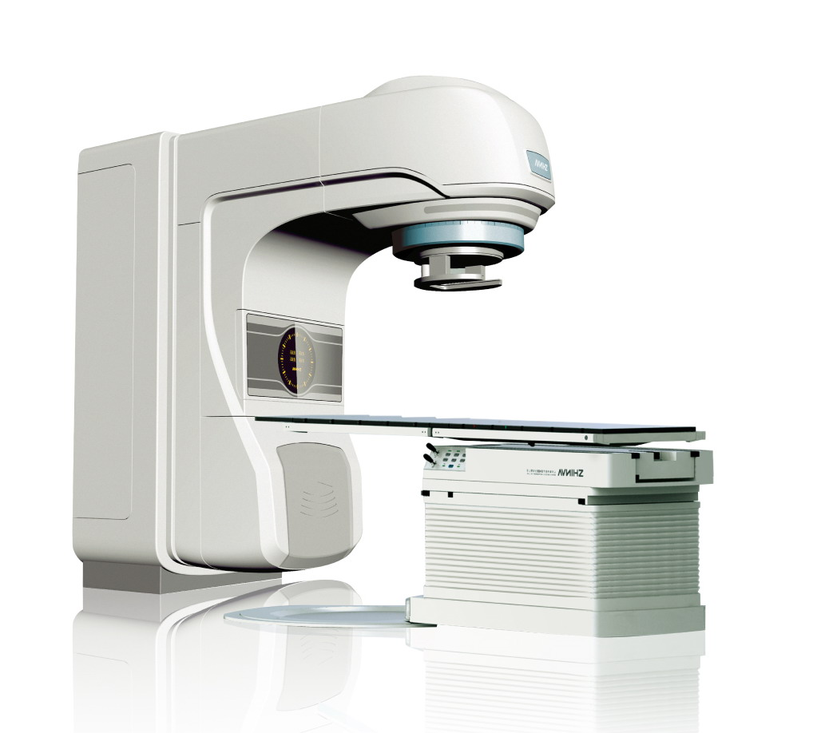
Statistics (in Europe)
Almost 4M cancer cases/y
  Surgery,
  Chemotherapy
  Radiotherapy
    Gamma therapy
    Hadron therapy
    X-ray therapy
2000+ medical accelerator
Over 1M treatments/y

Slide 3
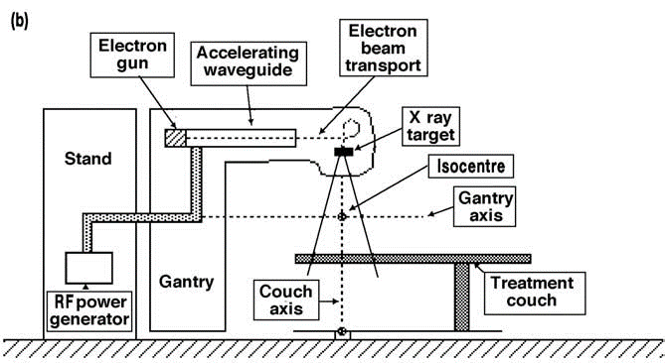
X-ray therapy (in Europe)
Over 1M treatments/y
  1% in beam efficiency means 10k more treatments
  1% beam size reduction (by reducing the side effects) can cause better life for thousands
  RF technology
  Accelerator
  Beam manipulation
  Beam monitoring
  Particle interaction
  Simulations
  …

Slide 4
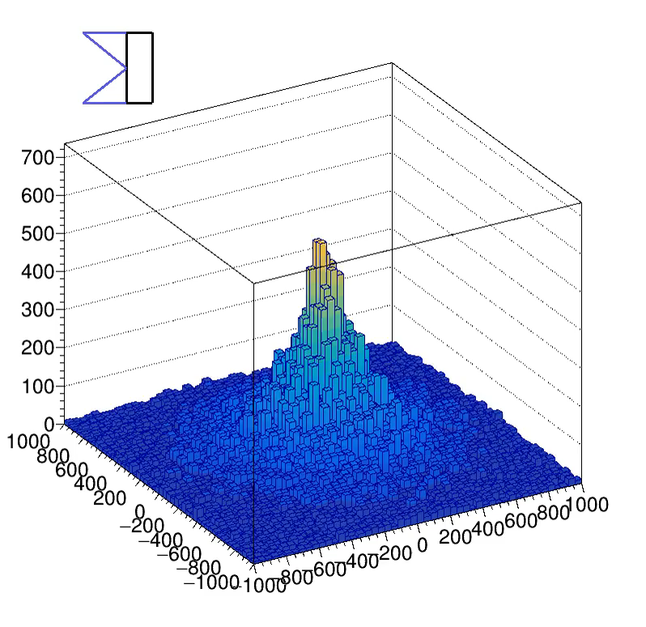
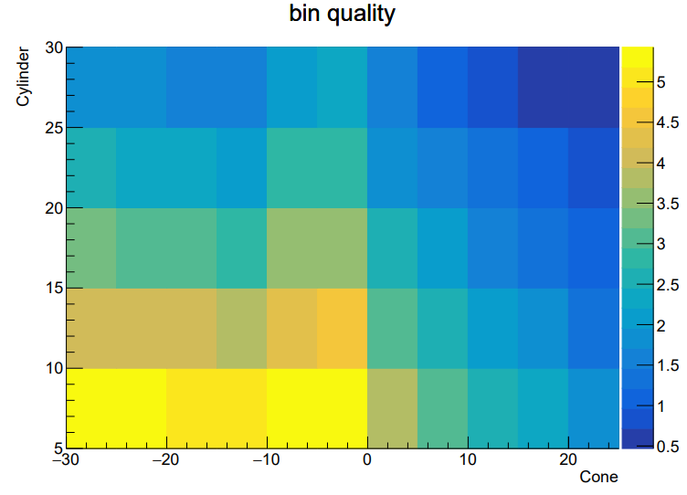
Efficiency, beam quality
GEANT: electron (6MeV) target (cone + cylinder)

Slide 5
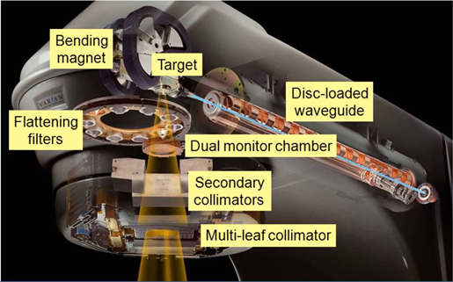
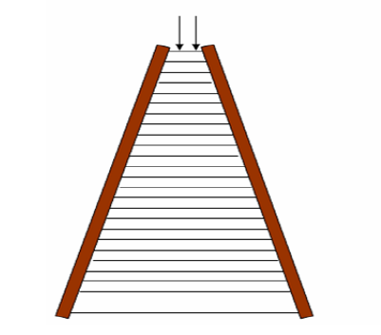
GEANT simulation = find the key parameters
Build up a real device (from drawings/CAD)
Run several simulations with different parameters
Declare what a good beam is (not easy)
Show what parameters are important
Or try new concept
https://arxiv.org/ftp/arxiv/papers/1102/1102.3284.pdf

Slide 6
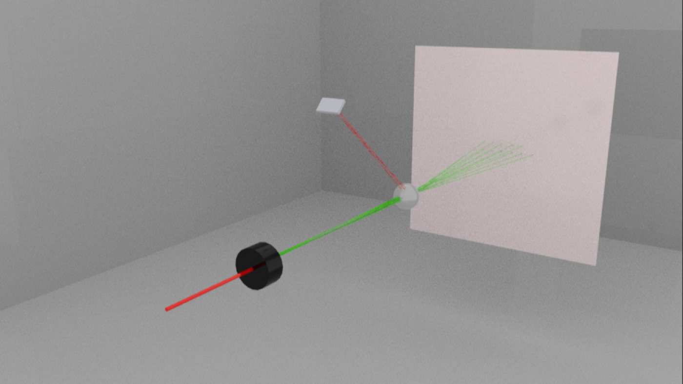
Beam monitoring, QA
At CERN, we trust GEANT result, but…
Show the beam quality by measuring
  Energy spectrum at different position (vs. ionization chamber)

Slide 7
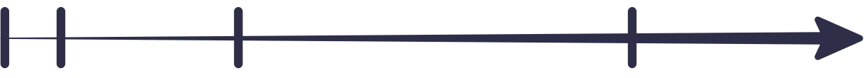

Timeline
NOW
1 WEEK
1 MONTH
1 YEAR
Would be nice to work with
    GEANT experts (GEANT V)
    Timepix experts
Develop the business model and find the key partners
  GEANT runs with real world parameters, analyse the result
  Prototype the QA detector
  Build up a real treatment device in GEANT and give useful answers
  Test new ideas
  Launch the QA detector

Slide 8
Thanks!
Question?

