Slide 1



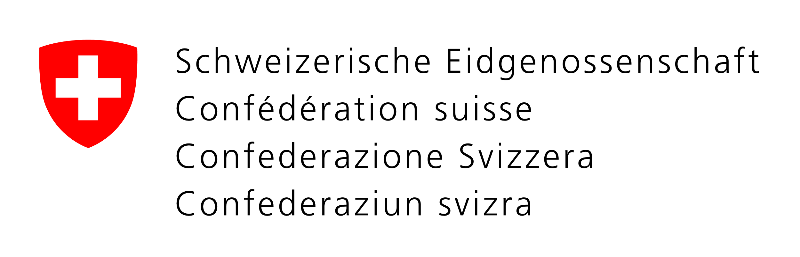




Global Humanitarian Lab (GHL)
Accelerating Innovative Solutions for Efficiency, Impact & Dignity
A partnership program hosted by
And supported by
Notes:
Experience and insight from your work, your methods for measuring impact, your input on recent trends or gaps, your experience in identifying new funding resources.
Olivier Delarue Bio
Bio below for reference:
International jurist by training, serial intrapreneur, innovation passionate, Olivier Delarue is a true UN homebody, having joined UNHCR 23 years ago to tackle large scale and complex challenges. After 3 years in refugee camps in Mauritania, 3 years in Mostar in Bosnia Herzegovina and the Great Lakes region. Olivier joined WFP in Rome from 1998 to 2001 before returning to UNHCR to be the Rep in Switzerland and Liechtenstein. From 2005 to 2012 Olivier lead the development of UNHCR International Corporate and Foundation Partnerships portfolio expanding it from $750,000 to $35m annually. He was responsible for collaboration with global partners such as Google, Facebook, HP, Microsoft/Skype, Nike, UPS, PwC as well as developing the UNHCR private sector corporate engagement in 9 priority countries through a newly developed global corporate partnerships strategy and launching with Nike the ninemillion.org campaign for boosting education, access to technology and sports for refugee children. In his fundraising capacity Olivier has directly generated over $160m from the private sector for refugees and counting. In 2010 Olivier founded the partnership with the IKEA Foundation which has generated over $220 million for refugees. Olivier coordinated the development of the innovative and groundbreaking Better Shelter RHU (Refugee Housing Unit) which UNHCR already purchased 15,000 units installed in UNHCR operations across the world. In 2012, Olivier founded and lead UNHCR Innovation. Olivier also co-founded the UN Innovation Network in 2013 together with UNICEF and WFP which now features more than 18 UN agencies working together in harnessing the power of innovation process. From 2015 to 2016 Olivier participated in the World Humanitarian Summit process as a member of the Pillar Transformation through Innovation and contributed to the creation of the Global Alliance for Humanitarian Innovation (GAHI) and the Global Humanitarian Lab (GHL) which he now leads as its CEO. The GHL is a partnership entity hosted by UNOPS and founded by ICRC, Handicap International, OCHA, Terre des Hommes, UNHCR and WFP.

Slide 2



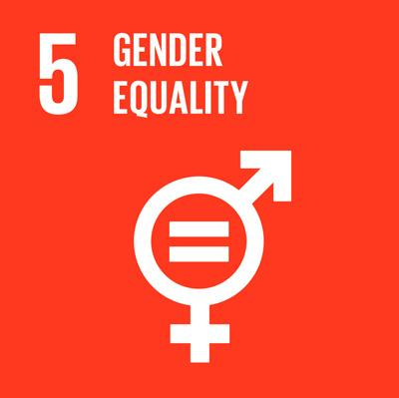
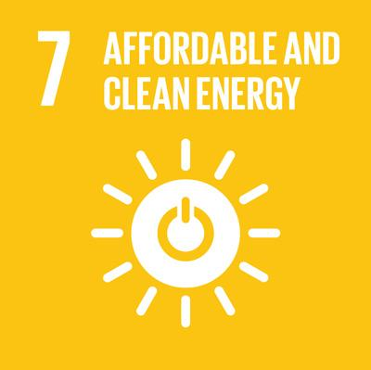
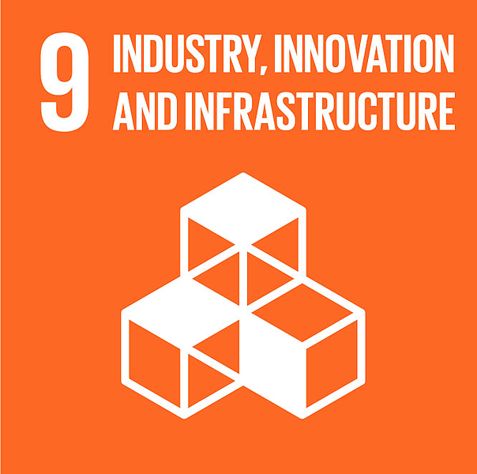
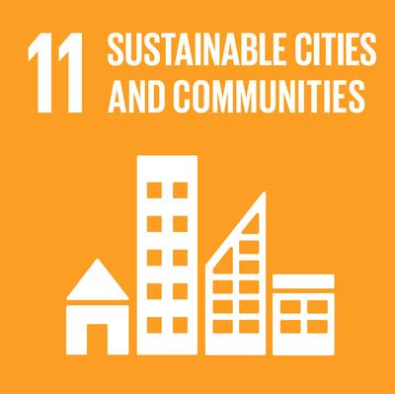
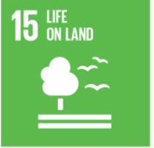
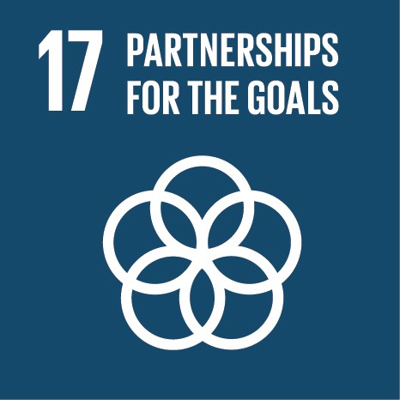
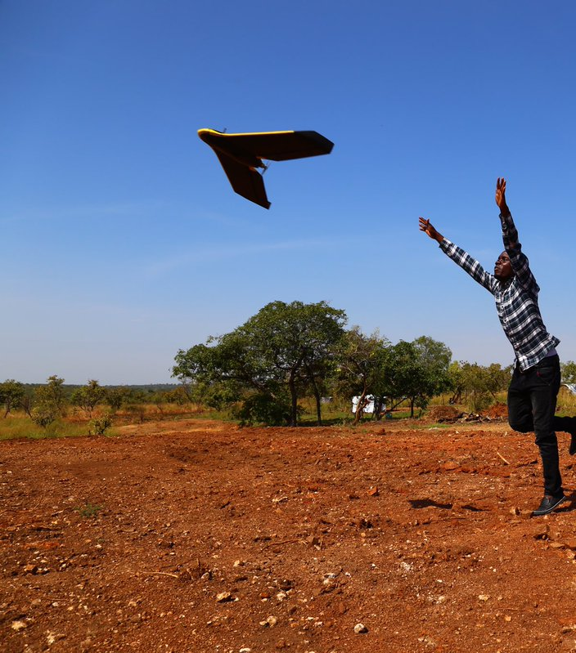
GHL is..
A cross-sector partnership
accelerating humanitarian innovative solutions
to address common challenges with new forms of collaboration, affordable materials and processes
for increasing efficiency, impact and dignity of the affected and fragile communities stroke by disasters.
Notes:
Link to previous slides: from UNHCR set up the GHL.
The GHL’s key function is to support its partners.
The Steering Committee is the engine that drives the GHL. It is represented by the three humanitarian families working together.
All partners are represented on the SC, usually by the Head of Innovation. This is a senior and influential team.
The SC meets on a monthly basis to share ideas, needs, lessons learnt and best practises.
Opportunities (Ideas, Prototypes and Starts-Ups) are presented to SC for ratification and next steps directives.
It is a transparent and challenging environment encouraging healthy debate

Slide 3

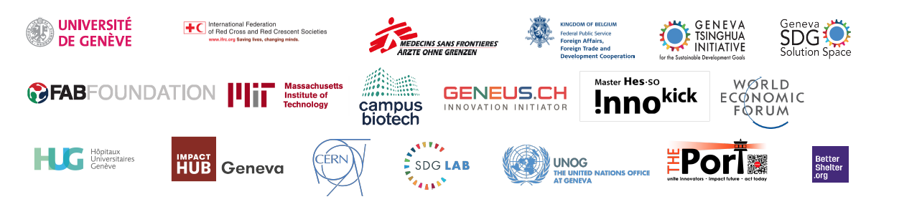
Partners
Funding partners in 2017
Collaboration partners in 2017
Notes:
The GHL’s key function is to support its partners.
The Steering Committee is the engine that drives the GHL. It is represented by the three humanitarian families working together.
All partners are represented on the SC, usually by the Head of Innovation. This is a senior and influential team.
The SC meets on a monthly basis to share ideas, needs, lessons learnt and best practises.
Opportunities (Ideas, Prototypes and Starts-Ups) are presented to SC for ratification and next steps directives.
It is a transparent and challenging environment encouraging healthy debate

Slide 4
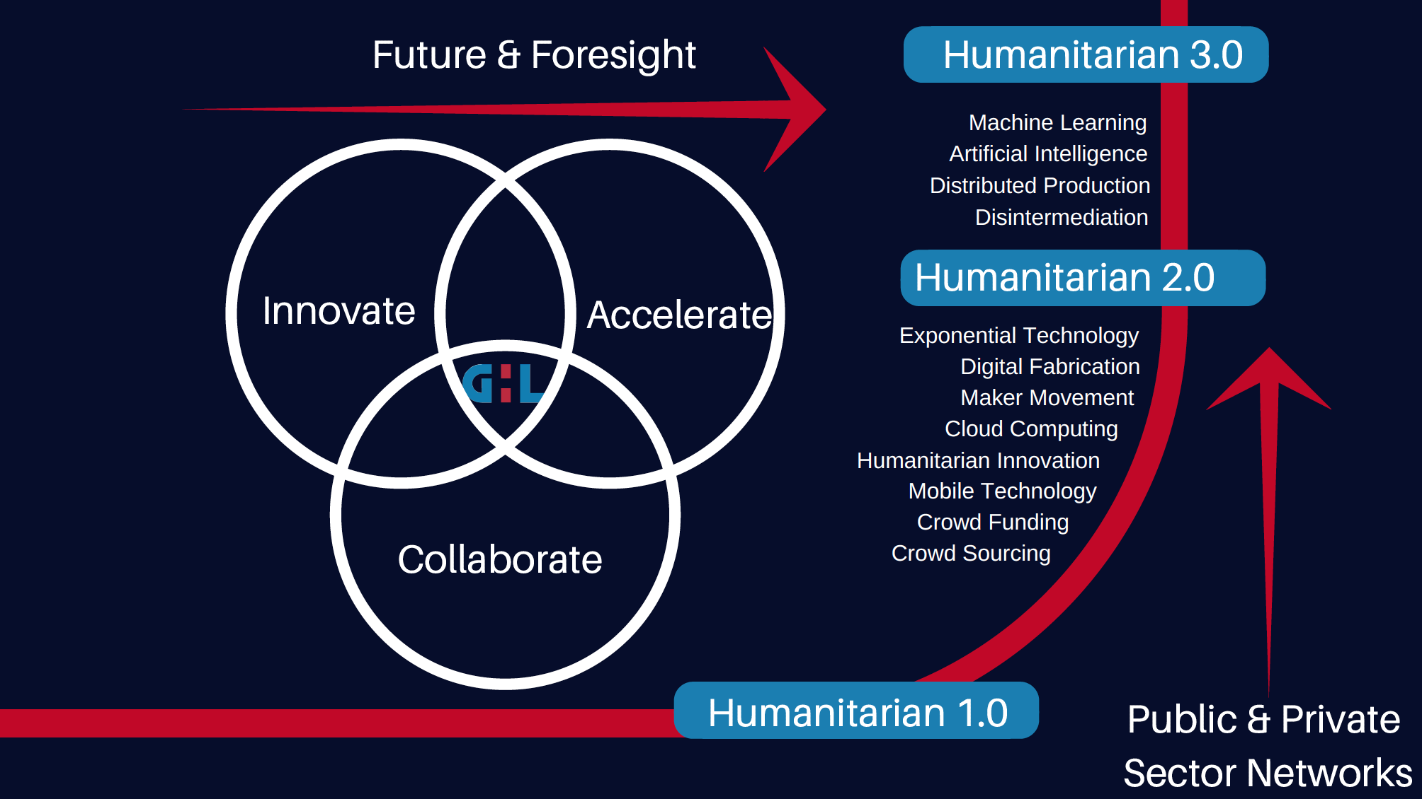
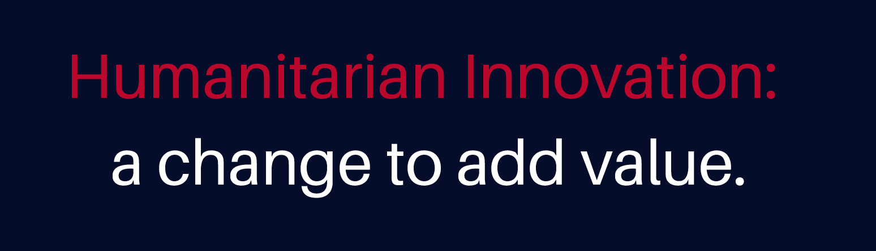

Slide 5
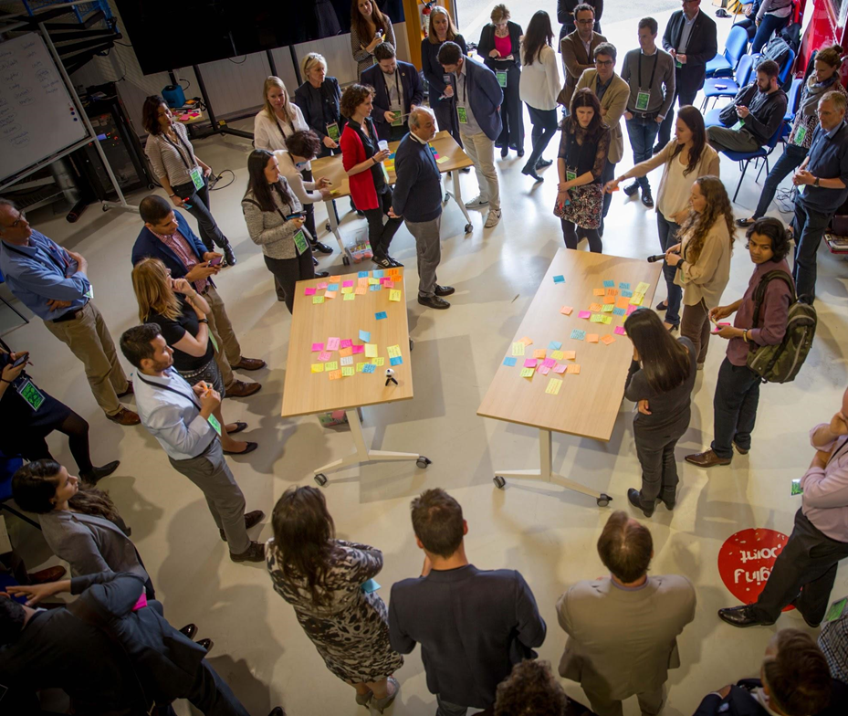







Foresight and Futures
What keeps humanitarians up at night?
How to anticipate instead of react.
Projecting the future for aggregation, anticipation & efficiency
Notes:
15:21 - 15:29 Elisabeth Pfund

Slide 6
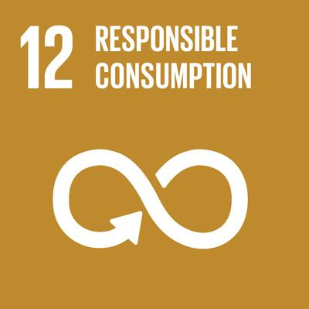
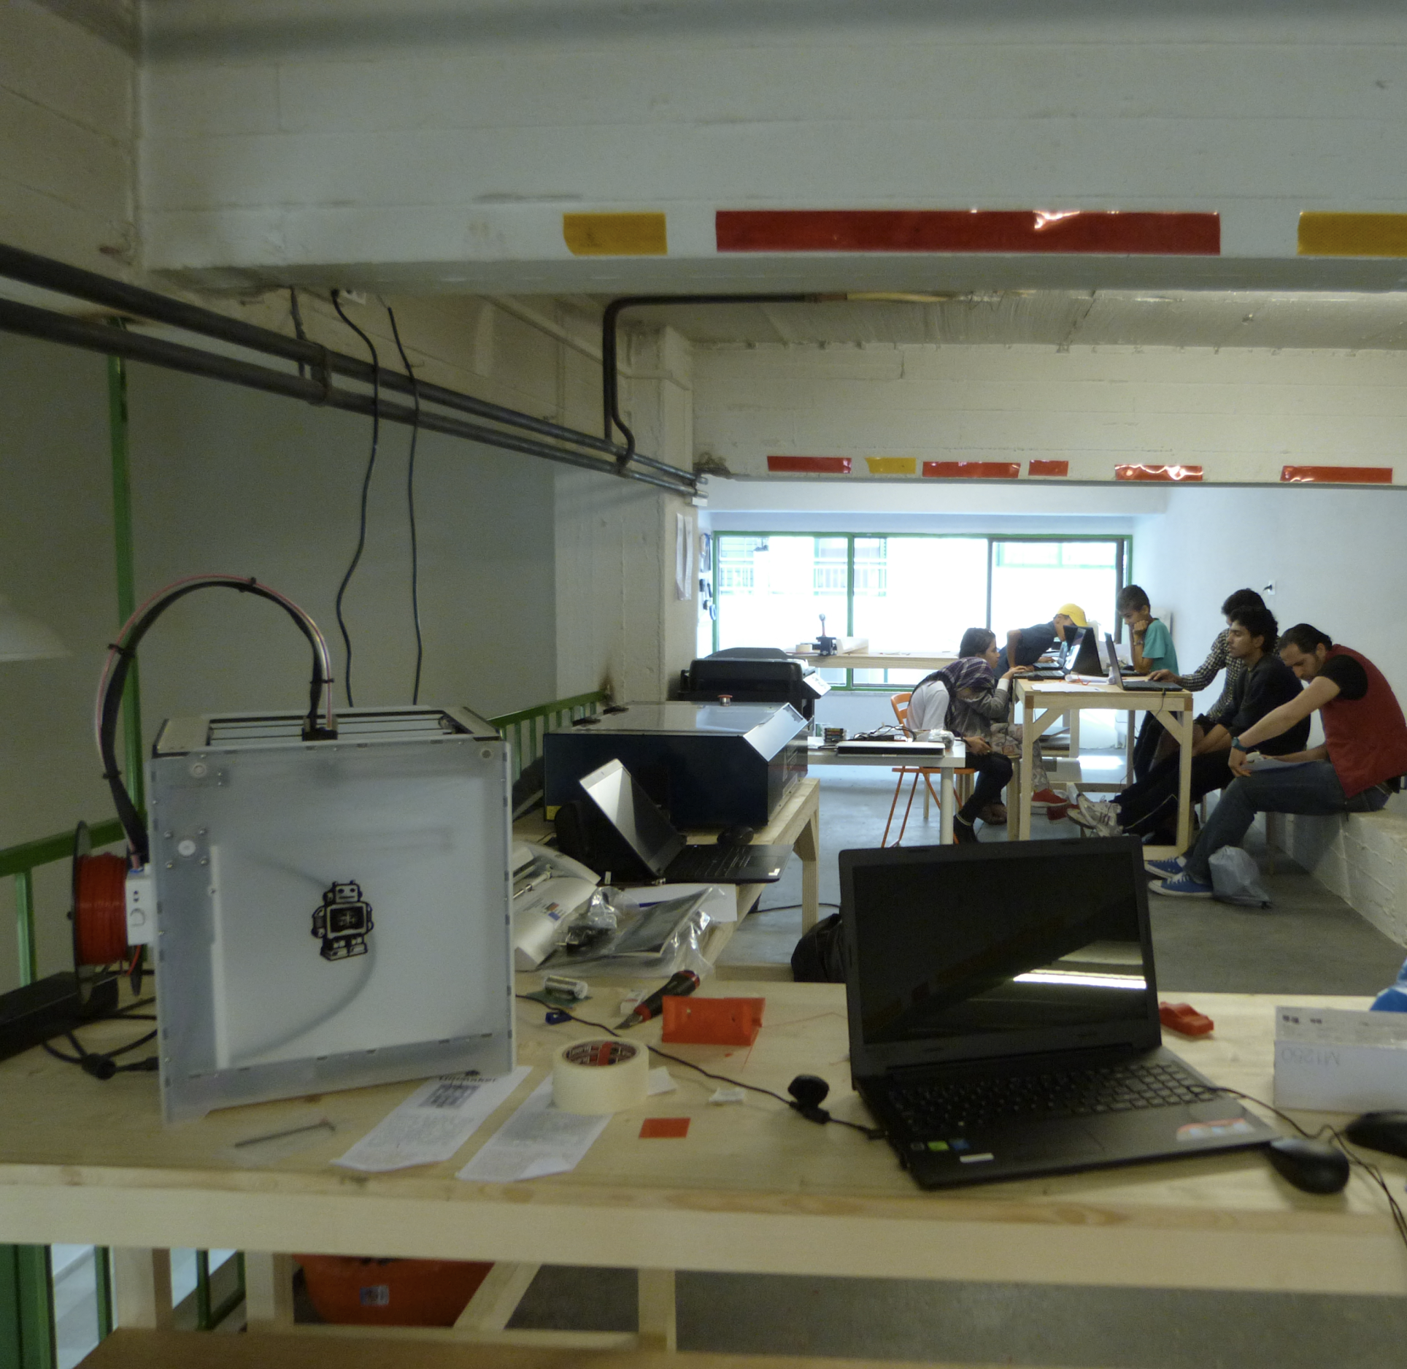



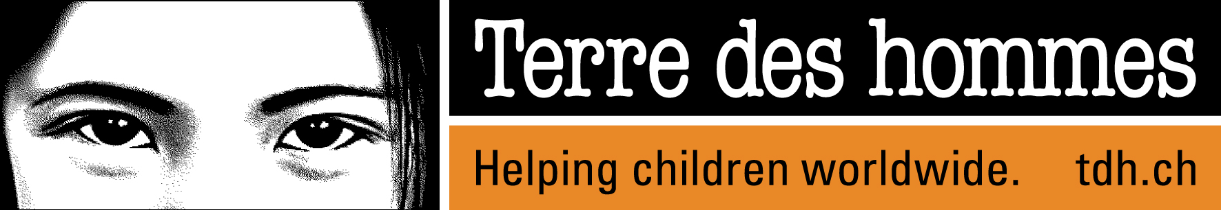

Develop and scale the humanitarian fablab model
Empowering affected communities
The GHL provided the Fab Lab model, initial proof of concepts, link to the Fab Lab network and initial seed funding

Slide 7
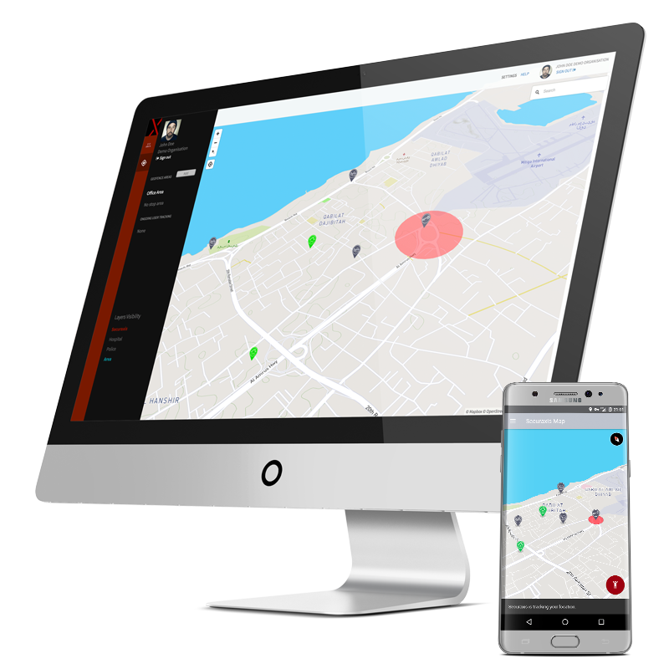

Easy Access for Start-ups and Social Entrepreneurs
SecuraXis quantifies the level of risk for a person in a given context through predictive analysis and provides recommendations to the user via a web interface as well as a mobile application.
The GHL provided risk financing facilitation that enabled Securaxis to raise start-up funds and is hosting Securaxis

Slide 8
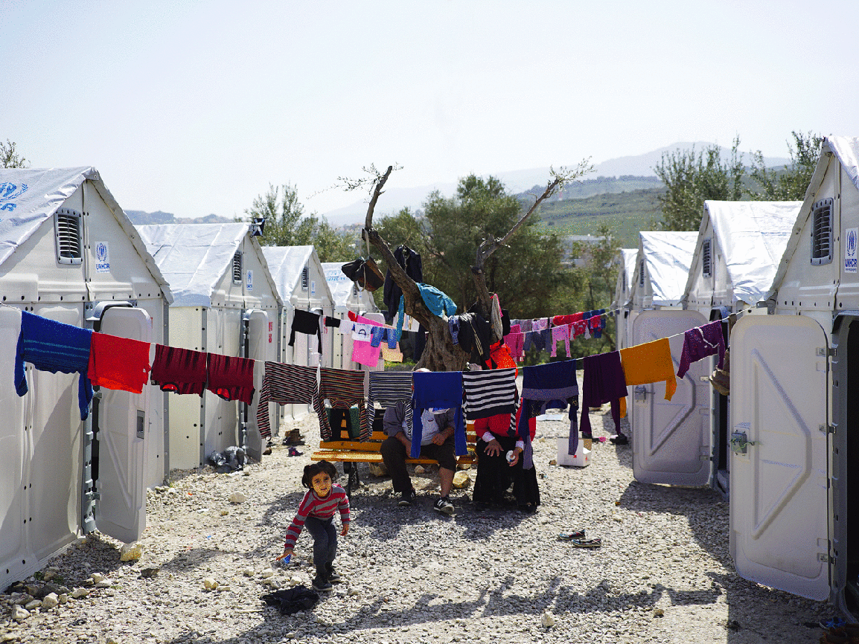
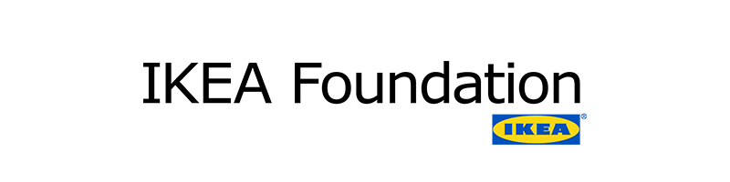

Accelerating innovative solutions
The GHL is helping scaling the Better Shelter solution by:
Aggregating partner demand to lower costs
Outsourcing R&D cost and risk
Exploring non-traditional financing models
Prototyping & tests modularity and thermal features

Slide 9
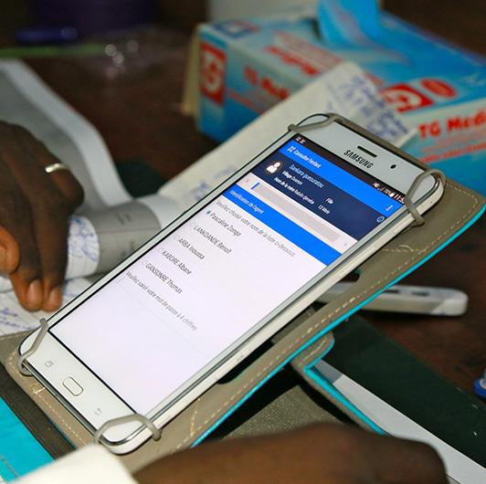

mHealth Diagnostic
Mobile technology to help health workers better diagnose children: 1 million patient records in 2017
Collaboration between ICRC, MSF & Tdh

Slide 10
globalhumanitarianlab.org daniel@globalhumanitarianlab.org
@HScienceAdvisor
Thank you!

Slide 11
