Slide 1
HCAL HF
Summary
FNAL October Upgrade Workshop

Slide 2
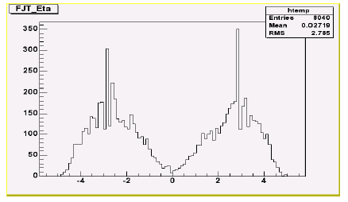
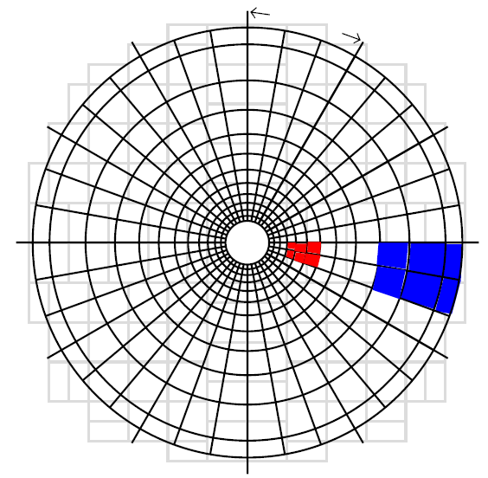
HF Basics
HF covers ~3 < η < 5
  WBF forward partons peak at η ~ 3!
Steel absorber and rad hard quartz fibers
  Cerenkov light collected via phototubes, uniform HCAL readout
36φ and 12η = 432 towers per side
  Δφ=10° and Δη=0.166
Each tower has a long and a short fiber running along z
  Short is in the back ~ “ET_{HAD}”
  Long is front to back ~ “ET_{EM+HAD}”
  Makes 2x432=864 towers per side
Level 1 Trigger and HF
  TPGs are built inside HTRs for HF and transmitted to RCT, passed through to GT
    Combines 2φ x 3η = 6 towers = 1 trigger primitive (TPG)
    Δφ=20° and Δη=0.5
HF

Slide 3
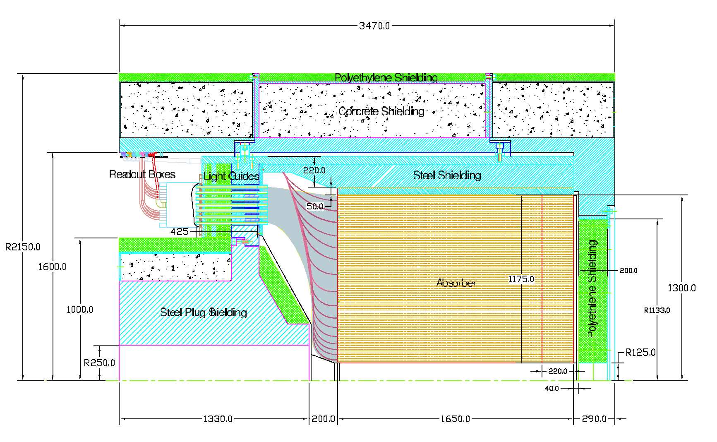
My HF
Shielding
Absorber
IP
PMT/Readout
Light Guides

Slide 4
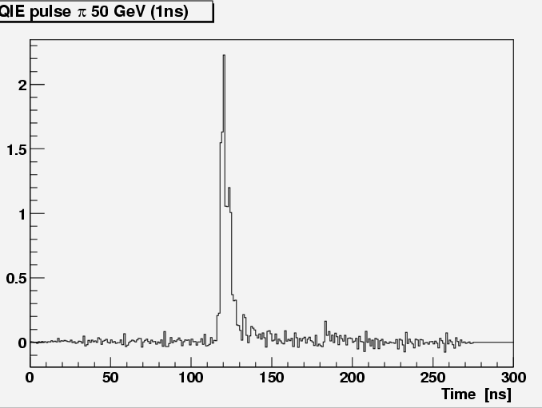
In a Nutshell
HF will withstand Phase 1 with no trouble
  The device is inherently radhard
However, there will be significant pileup
  Note on current HF:
    Quartz fibers produce a pulse that is quite fast with Δt<25ns
    But there is no capability in current HF to measure time of arrival
  At higher luminosities we will be measuring rare processes, and need to have handles on non-bx-related backgrounds
  Therefore we are considering whether we can add a timing capability to HF by piggybacking
  on the HB/HE FE electronics effort.
    Would make for a better device to do physics!

Slide 5
Summary of Phase 1 for HF
If it makes sense to add timing…
…and if the HB/HE FE effort yields electronics,
we can apply this to HF
  We will be therefore have to understand the time profile of what we see in HF

Slide 6
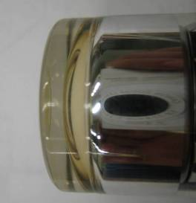
“PMT Window Events”
Cerenkov light from charged particles radiating in the PMT window (aka “PMT window events”) has a lot of attention
Through thin part of PMT glass, ~130 GeV
Through thick part of PMT glass, up to few TeV?

Slide 7
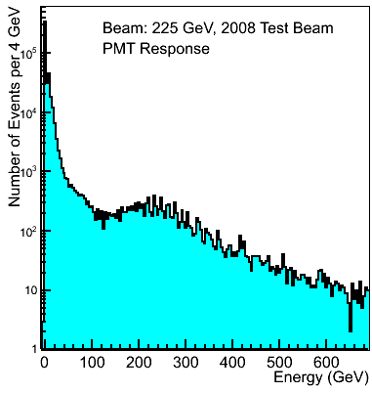
Window Events
There are 2 components
  “Peak” at ~30 γ’s, ~150 GeV in energy, rate ~10⁻²⁻³
    Going through the glass at normal incidence
  Long tail going up to TeV energies, another factor ~10 drop in rate
    Going through thick part? Multiple particles? Charge exchange? TBD
Events in the peak <10 GeV ET outer rings
  But will make MET suffer
Events in the tail ~100GeV or more
  Risk that these will trigger
We might be able to handle some of
this in the HTRs where we make the TPG
TBD…
But we would do well to not have this
exposure, and we need handles

Slide 8
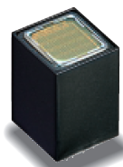
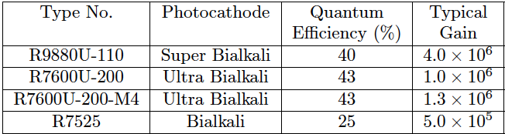
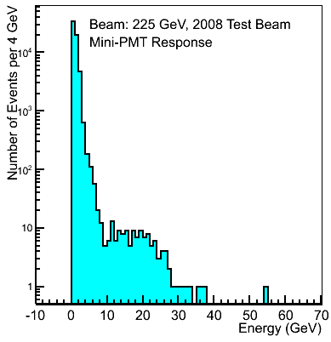
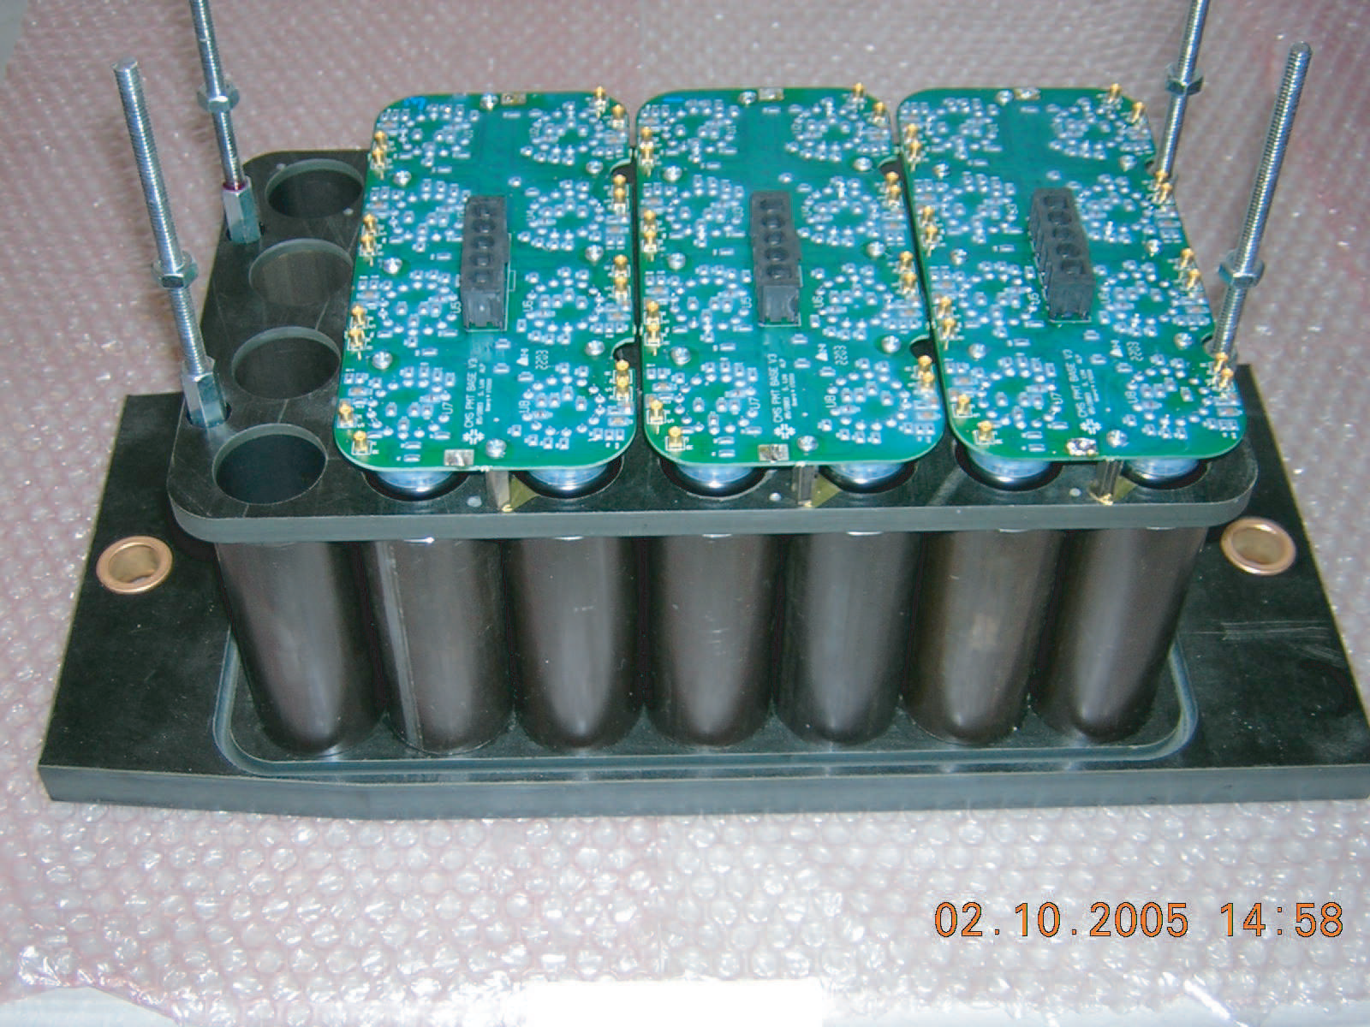
Plan of Attack
Consider new PMTs “MiniPMT”
  Thinner window, metal sides
    This means fewer photons from PMT window photons
  Higher QE (almost x2)
    Less GeV/photon calibration
This solution is under study
We will propose to put some of these new tubes in place in near future to compare to current tubes
  Working on this now…

Slide 9
PMT Window and Phase 1
One of the possible new PMTs with multi-anode readout
  This would allow increased lateral segmentation
  Making use of this segmentation will allow additional firmware/software handles for this particular problem
Necessitates sending x4 more data to USC55
  Fits in nicely with increased transmission capability for HB/HE given SiPM/longitudinal segmentation
Summary:
  Timing considerations, and additional transverse segmentation, might mean upgrading HF front-end with new HB/HE front-end electronics
    With the new 4-anode instead of single-anode PMTs

Slide 10
Phase 2?
HF likely radiation levels:
  1Grad/year at the absorber for inner rings
  100kRad/year at the electronics
Lots of discussion and thinking and proposing on what to do, e.g.
  Replace quartz fibers?
  Replace entire HF?
  Run with a more limited pseudo-rapidity?
Radiation measurements in next few years will be very important
  And verification with computer codes
Luminosity | Ring 1-5 | Ring 6-9 | Ring 10-13
LHC (at 10³⁴) | 1 Mrad/year | 10 Mrad/year | 100 Mrad/year
Phase I (1.5 *10³⁴) | 1.5 Mrad/year | 15 Mrad/year | 150 Mrad/year
Phase II (3 *10³⁴) | 3 Mrad/year | 30 Mrad/year | 300 Mrad/year
SLHC (10³⁵) | 10 Mrad/year | 100 Mrad/year | 1 Grad/year

