Slide 1
Report from Tracker Upgrade Project Office
Mandate of the TUPO
Members
Organization of meetings
Topics discussed so far (brief overview)
Conclusions/Outlook

Slide 2
Mandate of the TUPO
Clear definition in the notes from the last Upgrade Steering Committee from GMB
The Upgrade Project Office has to overview the activities of the working groups, to coordinate the progress on integration issues that involve work from different working groups, and to possibly identify aspects that need attention and that may not be covered directly by any of the working groups.

Slide 3
Mandate of the TUPO
Clear definition in the notes from the last Upgrade Steering Committee from GMB
The Upgrade Project Office has to overview the activities of the working groups, to coordinate the progress on integration issues that involve work from different working groups, and to possibly identify aspects that need attention and that may not be covered directly by any of the working groups.
Coordination, communication, system engineering

Slide 4
Members of the TUPO
Working group conveners
Track trigger task force conveners
Mechanics coordinator, Electronics coordinator, Review Manager
Upgrade coordinators
Tracker Project manager
TUPO conveners
hans-christian.kaestli@psi.ch, Katja.Klein@cern.ch, Gino.Bolla@cern.ch, Alessandro.Marchioro@cern.ch, Marcello.Mannelli@cern.ch, Peter.Sharp@cern.ch, m.raymond@imperial.ac.uk, arndt@physics.purdue.edu, rlschmitt@fnal.gov, geoff.hall@cern.ch, Frank.Hartmann@cern.c, Hans.Postema@cern.ch, jan.troska@cern.ch, Alexander.Dierlamm@cern.ch, anders.ryd@cornell.edu, Simon.Kwan@cern.ch, Roland.Horisberger@cern.ch, Gian.Mario.Bilei@cern.ch, Panja.Luukka@cern.ch, Francois.Vasey@cern.ch, Antti.Onnela@cern.ch, alberto.messineo@pi.infn.it, Duccio.Abbaneo@cern.ch

Slide 5
Organization of meetings
Meetings take place on Wednesday afternoon
  In weeks that do not contain other major meetings
    No TUPOs during TK days, CMS weeks, Upgrade workshops, major conferences
    Effectively ≈ 2 meetings /month on average
Typically the meeting is divided in two sessions: 14:00-16:00 and 16:30-18:30, with one topic per session
  Sometimes there is only the second session
    Preferred because more US-friendly
Try to keep the meeting useful: if the key people cannot be present, rather cancel/postpone
Additional people are explicitly invited depending on the topic
  An EVO session is always booked, with no password
  The agenda (not protected) is available at
    http://indico.cern.ch/categoryDisplay.py?categId=2421
Anybody is always welcome to “spy” on the topics discussed and join the meeting

Slide 6
Choice of topics and documents
Topics are chosen with input from WG conveners
  Input not overwhelming, so far…
Presentations and summary documents attached to the agenda
  Topics appear in the meeting title, to help finding back the info
  Dedicated web site may be needed at some point…
Until now mostly focused on phase II strip upgrade
  Possibly to be evolved

Slide 7
Modelling of outer layers
Study of system aspects for outer layers
  Input from sensors, electronics, powering, mechanics
First model for the integration
  Including electronics, mechanics, cooling
Purposes
  Validate key aspects
  Identify possible weaknesses and correct if needed
  Keep as reference to evaluate alternative options and possible further improvements

Slide 8
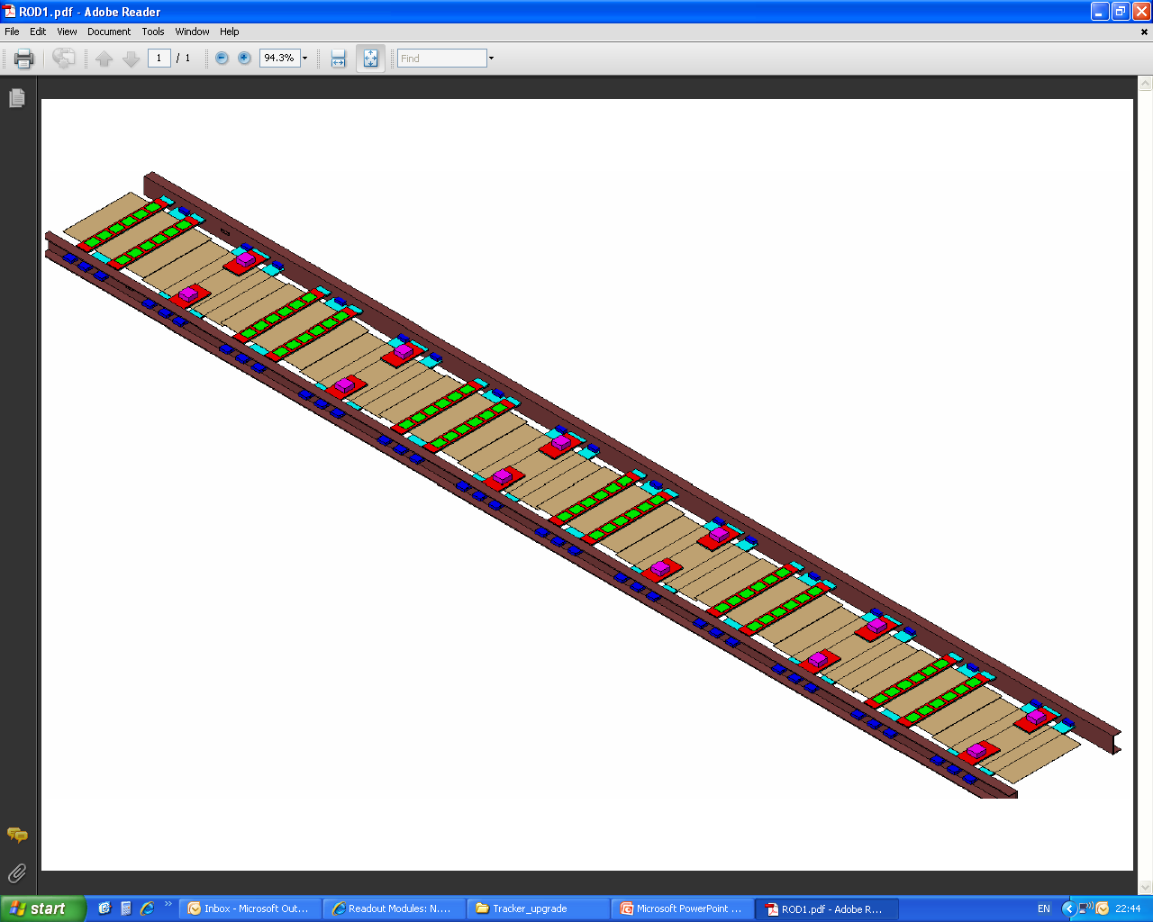
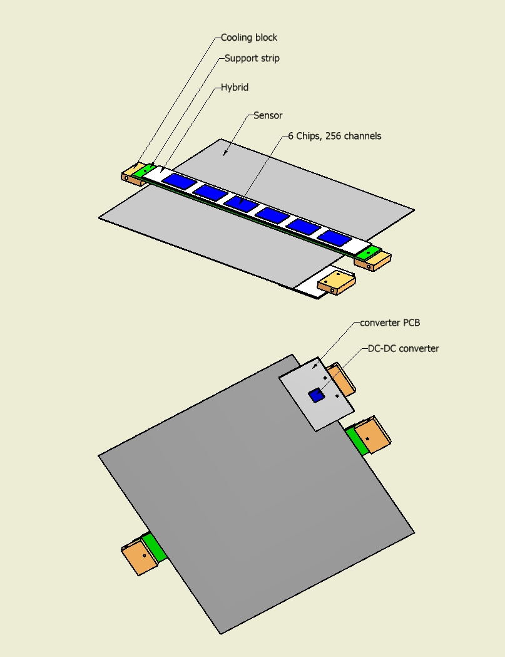
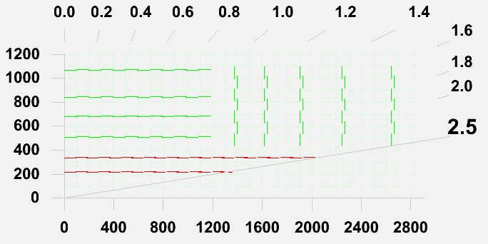
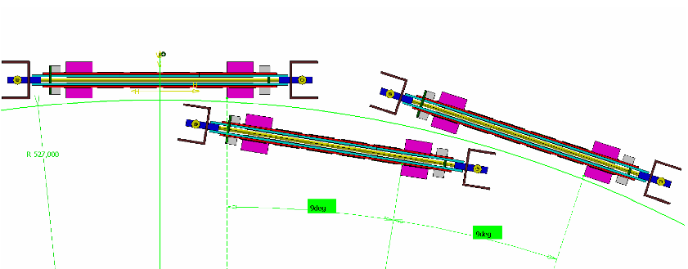
Modelling of Outer Layers (readout only)
Work in progress
  Integration studies @CERN
  Thermal modelling @ UCSB
3D design by Antonio Conde Garcia

Slide 9
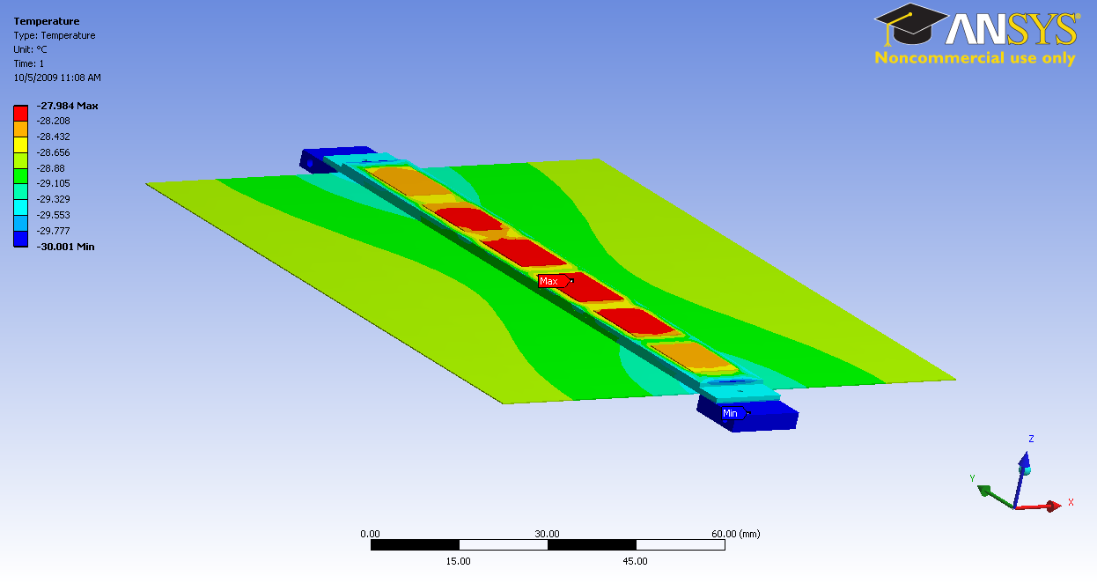
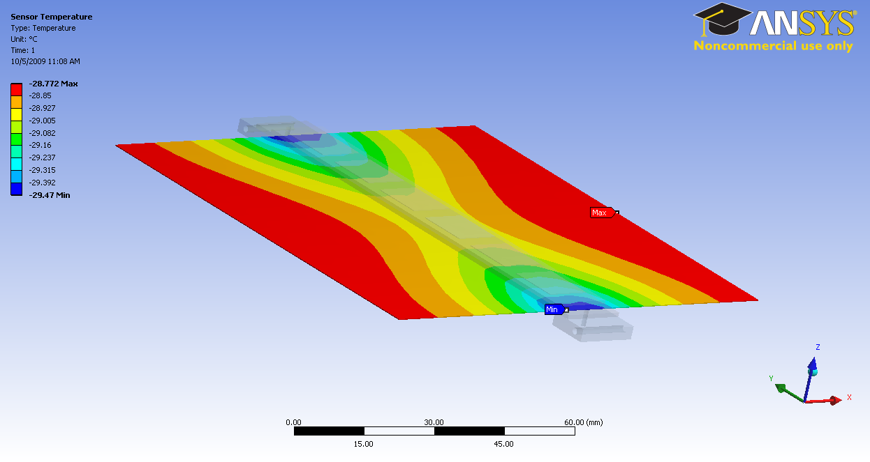
Result of steady state thermal analysis for one of the options
Analysis by
Susanne Kyre Dean White
UCSB
Max. Temperature:
-28.0°C (at center chips)
Max Sensor Temperature:
-28.8°C
ΔT between Cooling block and Sensor: 1.2°C
Model to be evolved – results not yet to be taken at face value
Good indication that a TPG strip can efficiently remove heat from the hybrid (and the sensor)
Now planning prototyping and experimental measurements to validate the model

Slide 10
Outlook for Outer Layers
Refine and complete 3-d model
  Especially connectivity at the rod end
Continue study of thermal performance
  Evolve the model
  Validate with experimental measurements on mechanical prototypes
Implement changes and/or evaluate other options
  Depending on results
Expect contributions from DESY as well

Slide 11
Other topics discussed
Powering, links, sensors
  Useful input for successive system studies
R&D on monolithic pixels
  Decided to postpone study of system aspects to after the first submission
Irradiation facilities, beam telescope
  Information and open issues in view of sensor qualification
Plan for HPK sensor work
  Discussion on organization, management, schedule
  Upcoming on November 24: traceability and database
Integration of P_{T} layers
  Compilation of part list, requirements on connectivity etc…
  Done with all the experts around the table (+EVO)
    Links, electronics, power…
  Will serve as basis for first integration and cooling studies
For each meeting minutes (or relevant document) attached to the agenda

Slide 12
Conclusions and Outlook
Working groups and Upgrade Project Office should (or could) ensure coordination and coherence in hardware R&D activities for the upgrade
  Working groups: activities in the specific domains
  TUPO: coordination among WGs + system engineering
Upgrade Project Office
  Not many meetings so far, good ratio progress/# of meetings
  Good (or even excellent) response from some groups, but in general there is room for improvement
    In the first place need to improve reporting to Working Groups
  Coherence can (and will) be improved to the extent that people are willing to work coherently…
    Looking forward to making more progress and improve communication over the coming months

