Slide 1
What SiPM will get the job done?
Jacob Anderson, Jim Freeman, Sergey Los, Julie Whitmore
Fermilab

Slide 2
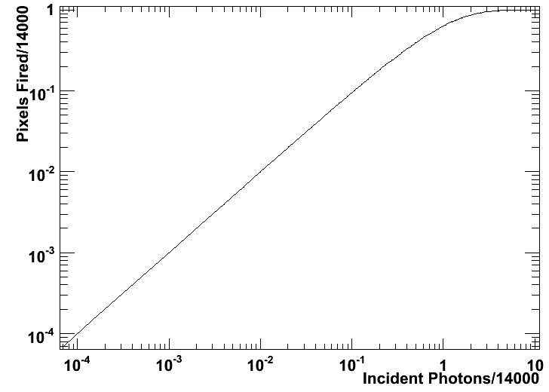
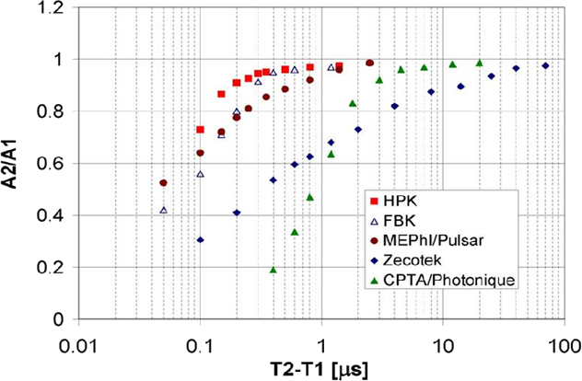
SiPM characteristics
Dynamic range is determined by the pixel count of the device.
A pixel which has fired takes some time to charge back up.

Slide 3
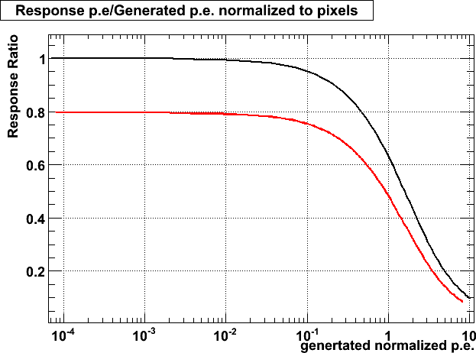
Consequences
If you have too many photons striking a SiPM it will saturate.
25 ns is not long enough for a pixel to recover so history matters.
Other things may matter too, but so far I haven’t studied them.

Slide 4
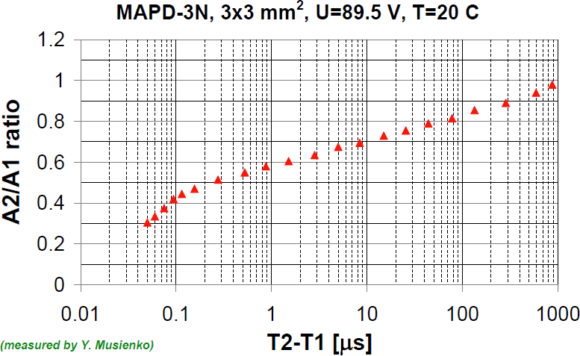
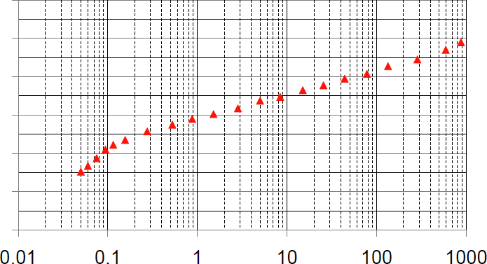
The tale of two SiPMs
Zecotek
Zecotek has 15k or 40k pixels/mm². Excellent dynamic range.
The Zecotek takes 1 ms to charge back up. That is 40k bunch crossings.
What does it mean for the response of the device?

Slide 5
Tale of two SiPMs
Hamamatsu
The Hamamatsu devices have 400, 625, or 1600 pixels/mm².
Their dynamic range is significantly limited compared to the Zecotek
They are very fast in comparison. Taking only 300 ns to charge up fully.
Will the dynamic range be sufficient?

Slide 6
Going back in time
Take minimum bias events generated in CMSSW 3.1.2 with sim hits for every scintillator layer.
Use these hits to make p.e. spectra in 4-eta bins in HB, HE, and HO.
Simulate the last 40–40k bunch crossings using the min. bias spectra to model the needed pile up events.
Simulate the SiPM as an array of pixels each of which keeps track of the percentage it is charged up.
  Use the measured recovery curved to track the charge fraction on each pixel through the history period.

Slide 7
Going back in time
After an appropriate time apply a test based on single pion simulation.
  Take layer by layer p.e. deposits from the tower with the largest sum of sim hit energy.
  Select a test event at random from the sample.
  50k - 500 GeV single pion
  2k - 1 TeV single pion
What is the state of the simulated SiPM, and what size of signal comes from it?

Slide 8
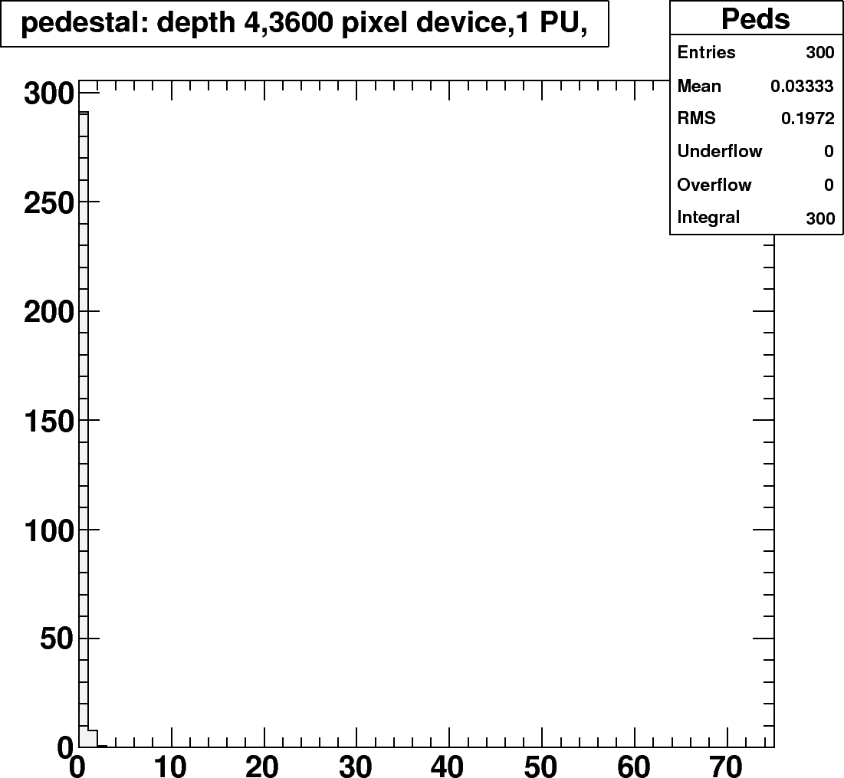
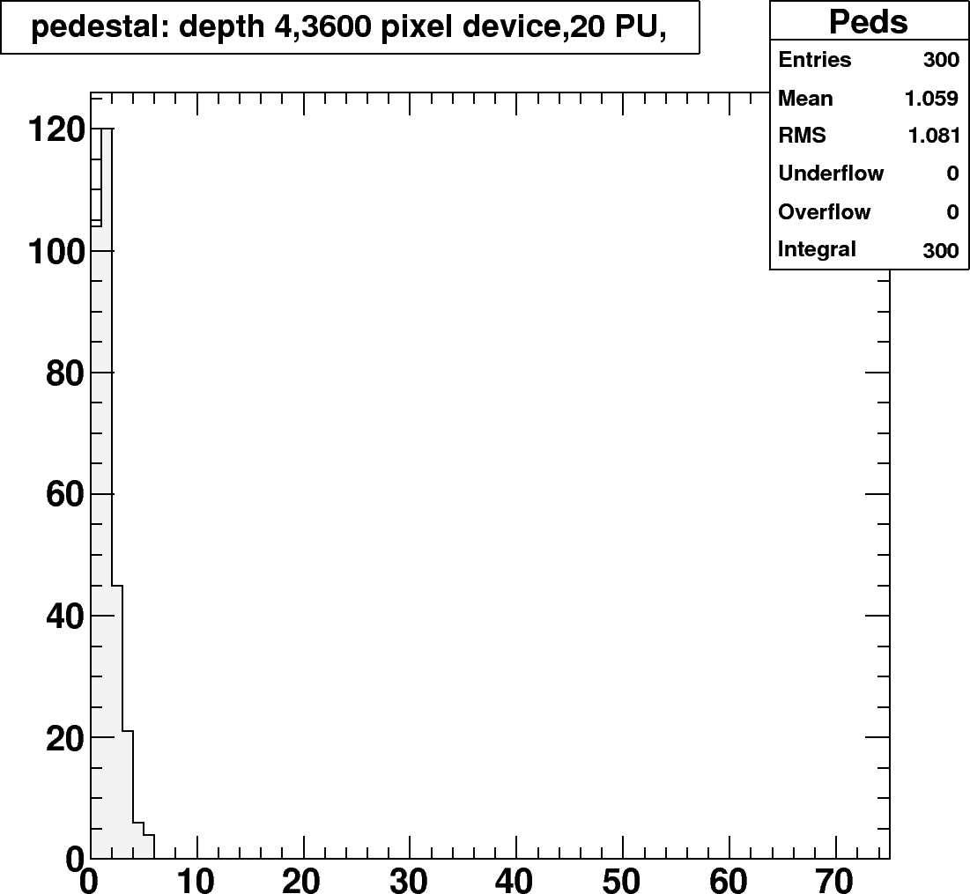
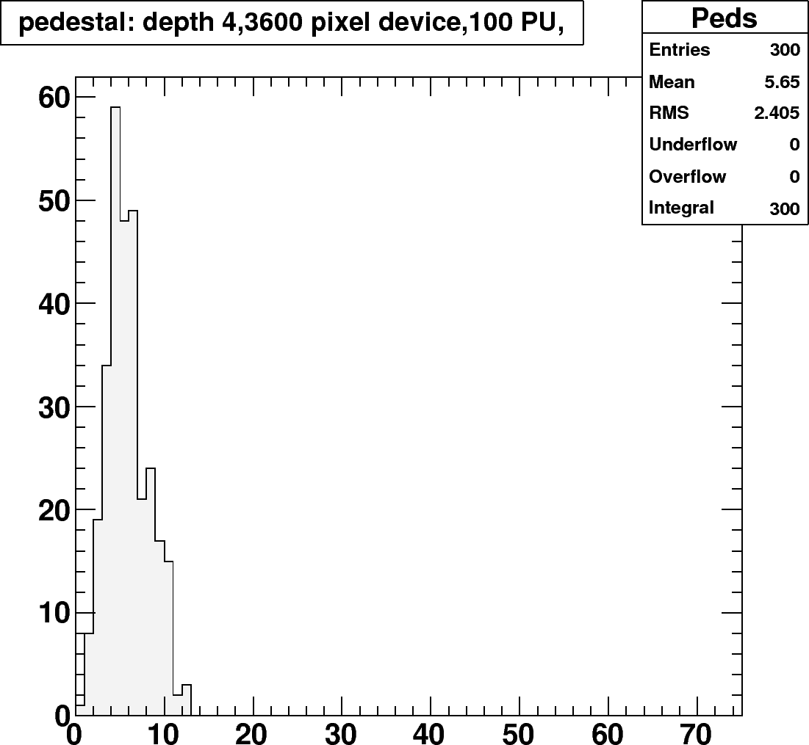
First the HO
~2000 p.e./ms/interaction/layer assuming 18 p.e./mip from min bias interactions.
Saturation is less of a problem.

Slide 9
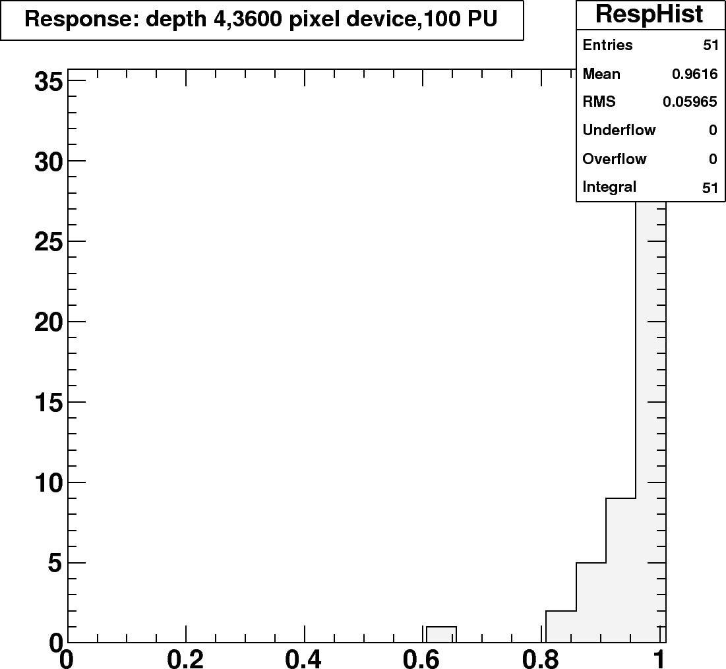
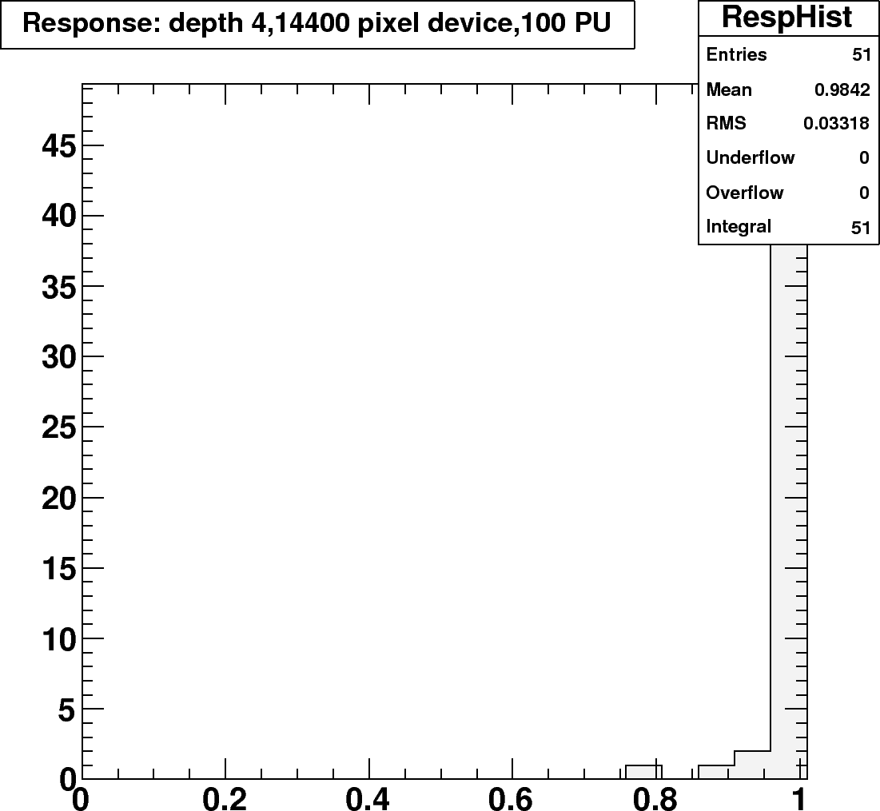
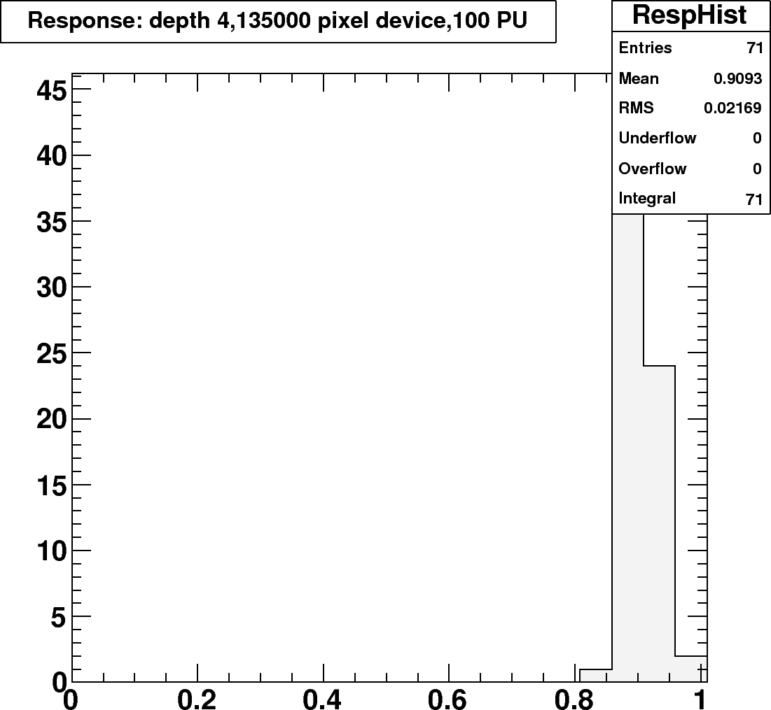
HO Performance
The long history of the Zecotek is visible at high luminosity even out in HO.
Hamamatsu 3x3
Zecotek 3x3
Historical
pile up
Saturation
1 TeV single pion

Slide 10
HB/HE upgrade
In the future we would upgrade the current HPDs with a better photodetector.
We would hopefully gain longitudinal depth segmentation in the barrel.
We need to be able to operate in high luminosity conditions.
Here I look at two options
  With electronic signal summing
  With optical signal summing

Slide 11
HB/HE with an EDU
One potential upgrade would use 1x1 mm SiPMs to read out each layer individually.
The SiPM signal would be electrically summed to form a readout cell allowing longitudinal segmentation of the HB.
How is the signal from each layer affected by the dynamic range and recovery time of the SiPM device used?

Slide 12
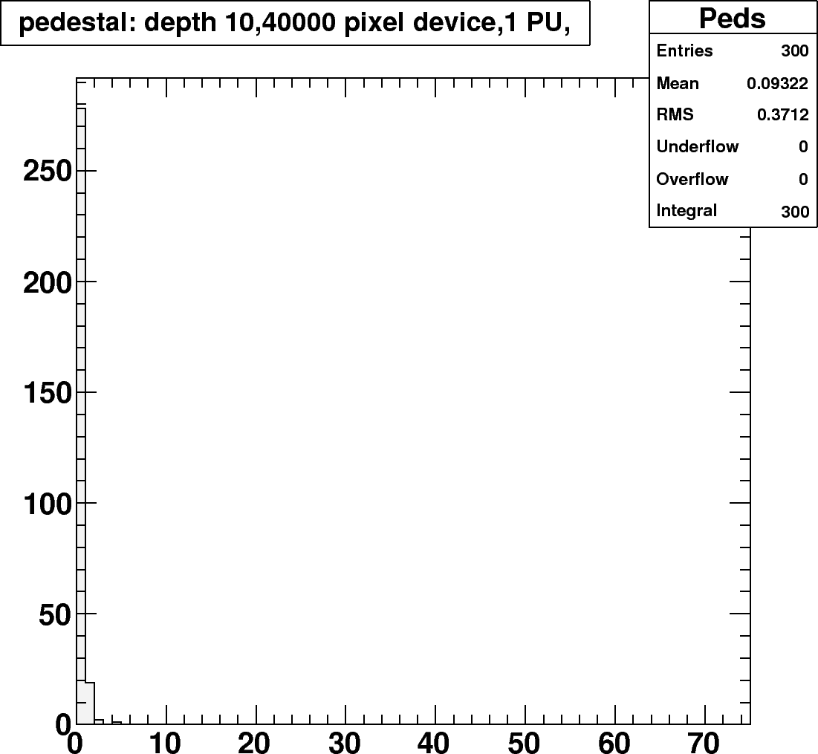
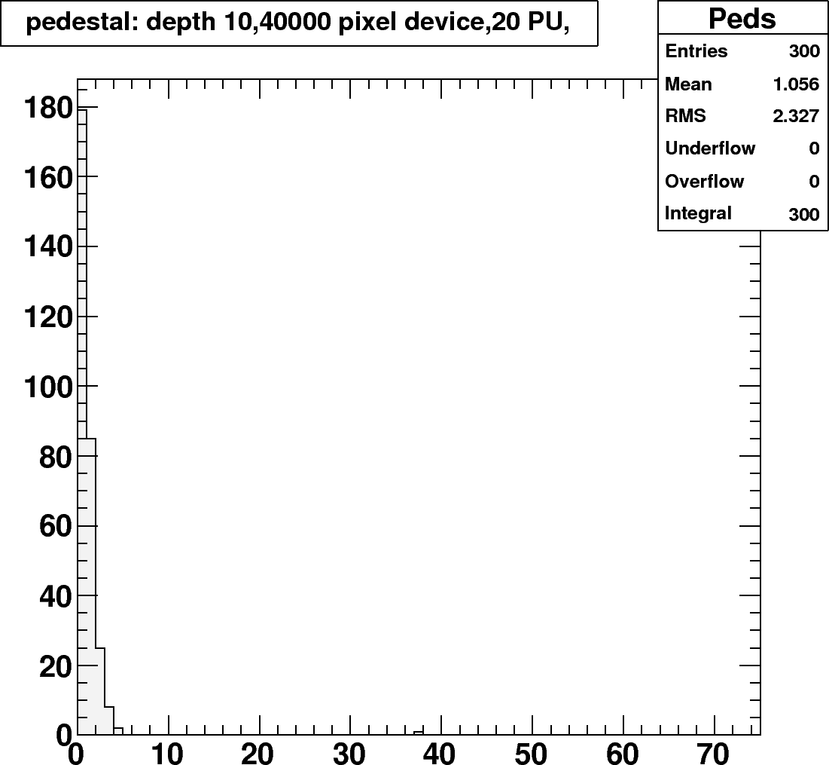
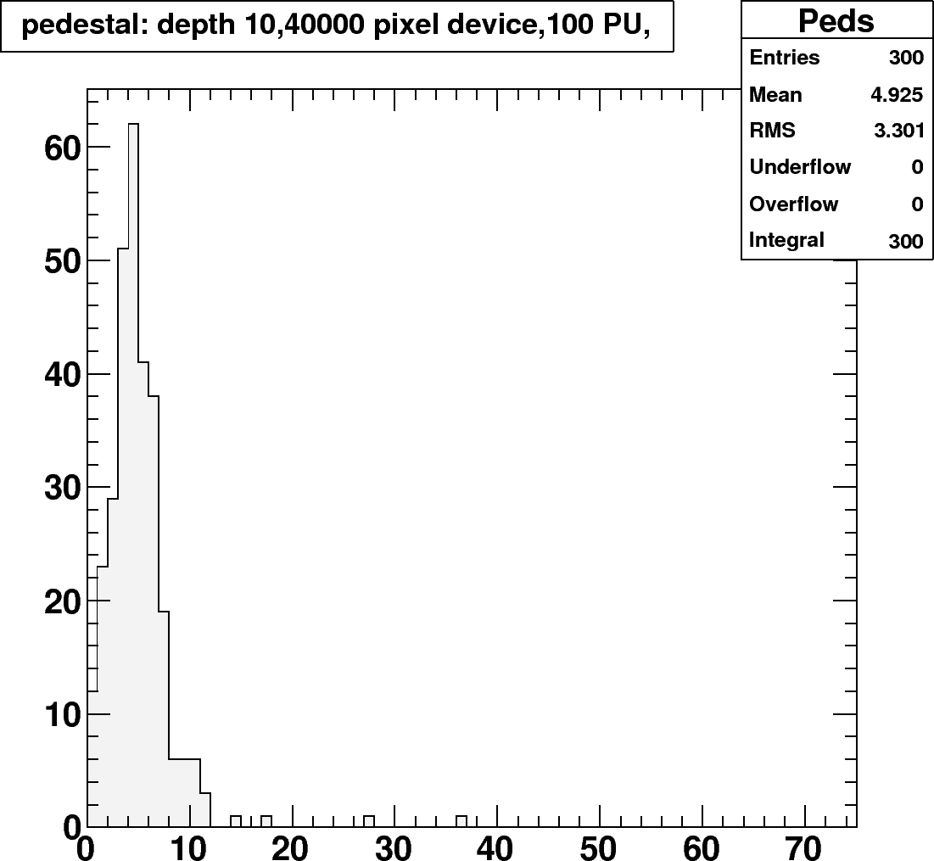
Occupancy
The HB and HE see between 2k and 10k p.e./ms/interaction/layer depending layer and location assuming 30 p.e./GeV.

Slide 13

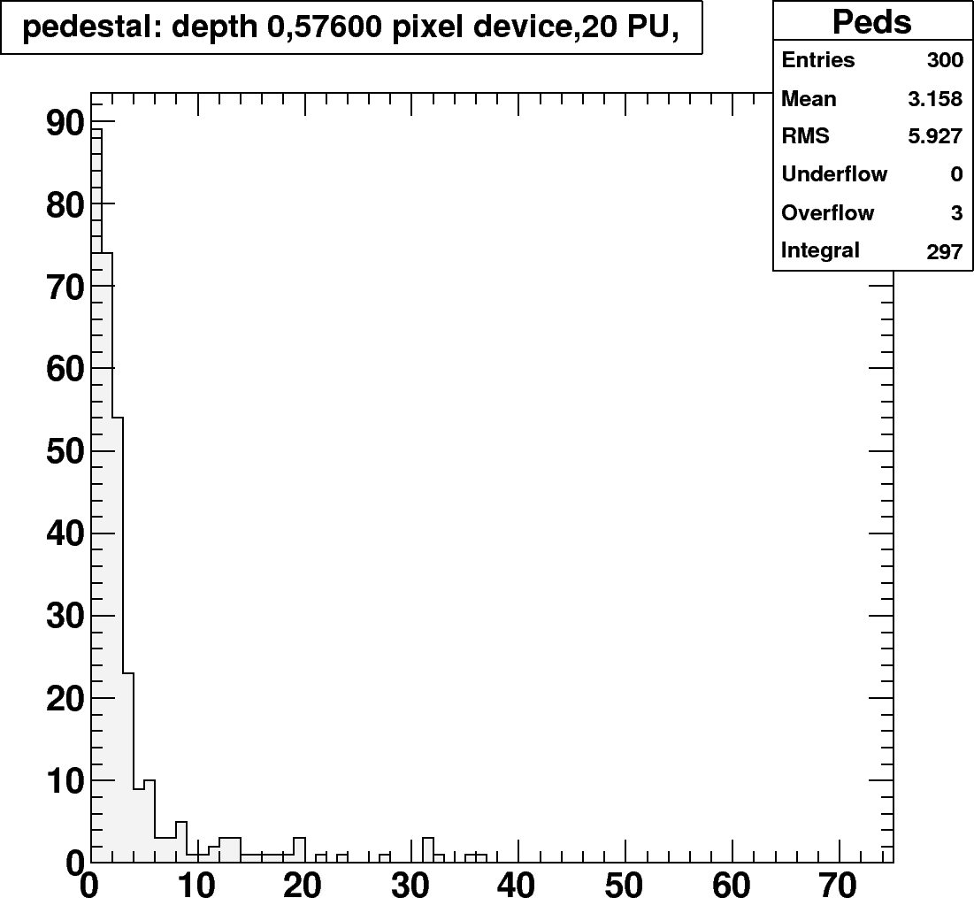
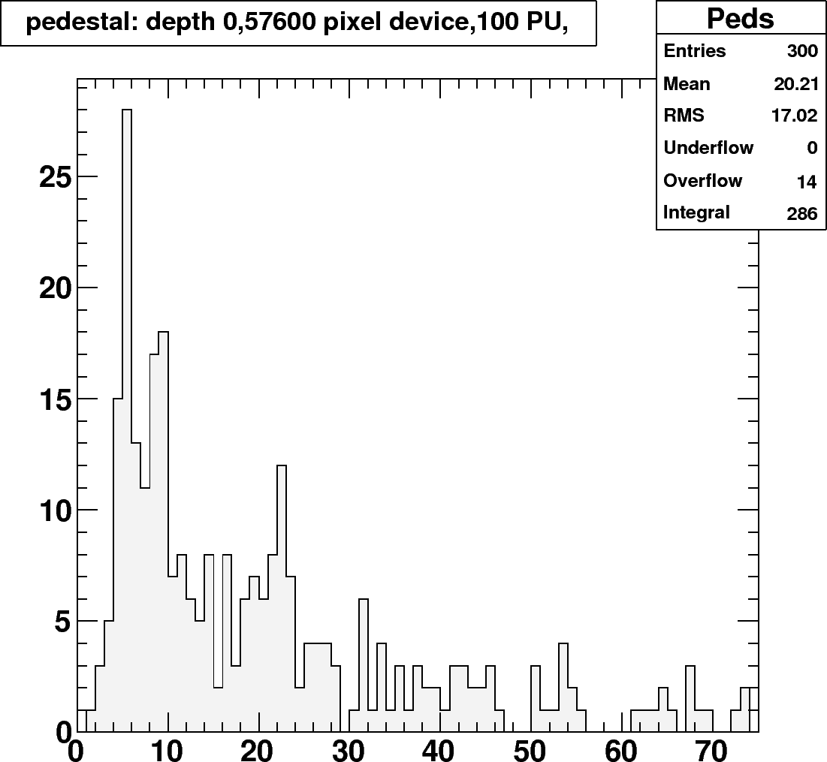
Occupancy challenging layers
Inner layers are more problematic.
Higher rates and more energy. Start to see more ragged average pedestal.

Slide 14
Zecotek 15k
Average fractional response to 1 TeV single pions for 1 PU, 20 PU and 100 PU
Barrel towers 9-12
L0 | L1 | L2 | L3 | L4 | L5 | L6 | L7 | L8 | L9 | L10 | L11 | L12 | L13 | L14 | L15 | L16
0.93 | 0.95 | 0.94 | 0.95 | 0.95 | 0.95 | 0.96 | 0.96 | 0.96 | 0.96 | 0.97 | 0.97 | 0.97 | 0.97 | 0.98 | 0.98 | 0.97
0.80 | 0.83 | 0.82 | 0.83 | 0.84 | 0.84 | 0.84 | 0.85 | 0.85 | 0.86 | 0.86 | 0.86 | 0.87 | 0.87 | 0.87 | 0.87 | 0.86
0.72 | 0.74 | 0.74 | 0.74 | 0.75 | 0.75 | 0.75 | 0.76 | 0.76 | 0.77 | 0.77 | 0.77 | 0.77 | 0.78 | 0.78 | 0.78 | 0.77
The average response degrades as a function of luminosity.
  The primary cause of the loss is the history of dead pixels accumulated over the past ms.
  For the inner layers saturation is also a significant problem

Slide 15
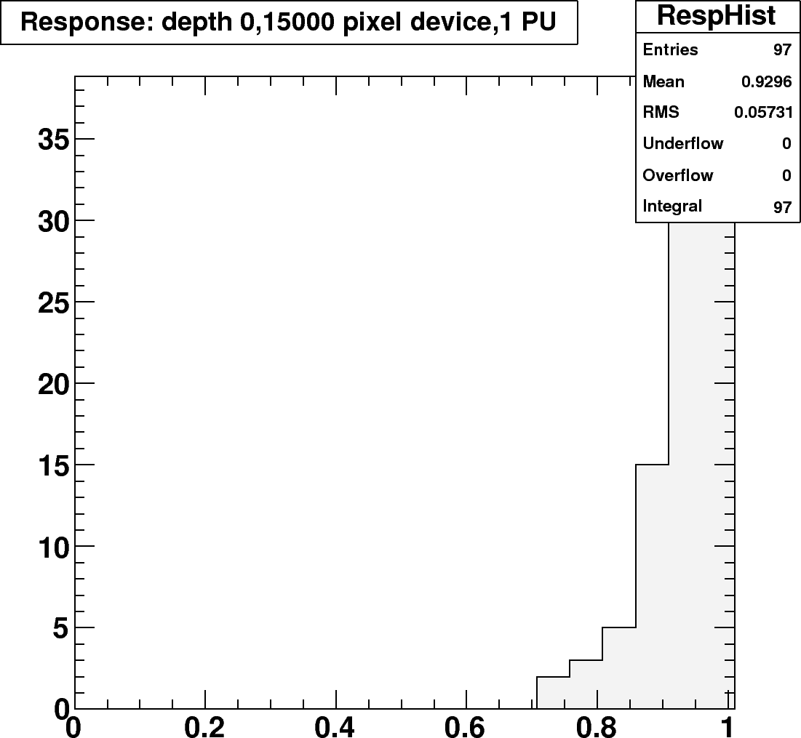
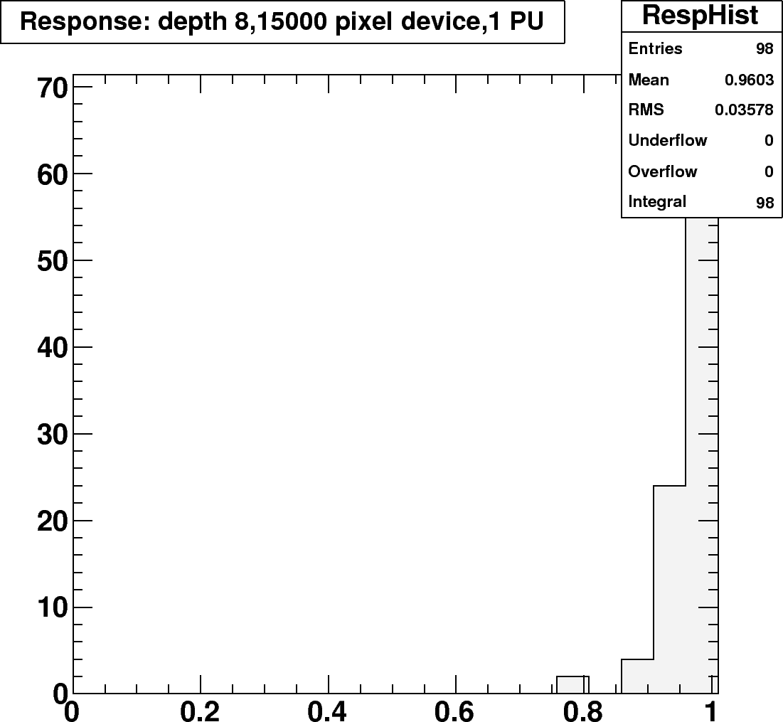
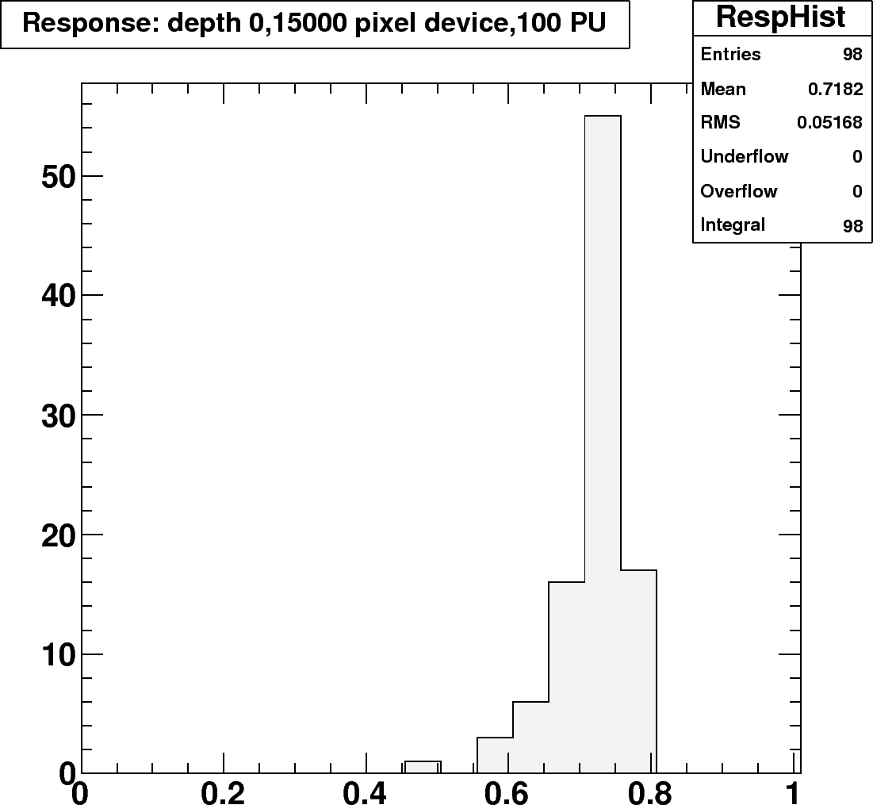
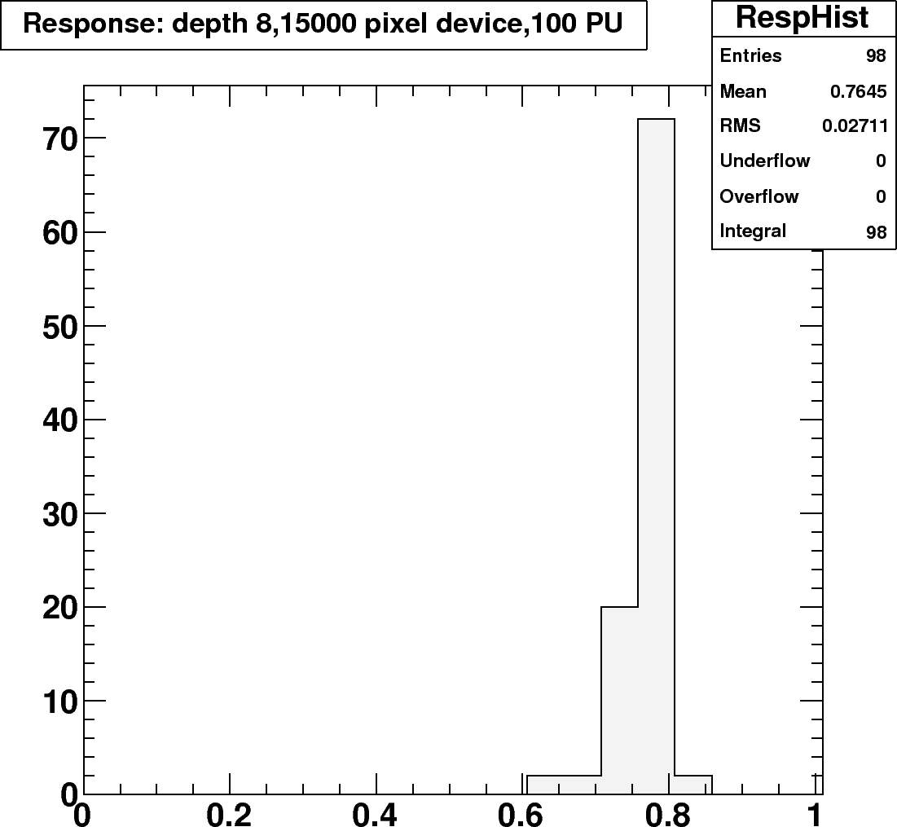
Zecotek 15k - Response
Saturation
1 PU
History
100 PU

Slide 16
Zecotek 40k
Average fractional response to 1 TeV single pions for 1 PU, 20 PU and 100 PU
Barrel towers 9-12
L0 | L1 | L2 | L3 | L4 | L5 | L6 | L7 | L8 | L9 | L10 | L11 | L12 | L13 | L14 | L15 | L16
0.97 | 0.98 | 0.98 | 0.98 | 0.98 | 0.98 | 0.98 | 0.98 | 0.98 | 0.99 | 0.99 | 0.99 | 0.99 | 0.99 | 0.99 | 0.99 | 0.99
0.90 | 0.91 | 0.91 | 0.91 | 0.92 | 0.92 | 0.92 | 0.92 | 0.92 | 0.93 | 0.93 | 0.93 | 0.93 | 0.93 | 0.93 | 0.93 | 0.93
0.80 | 0.82 | 0.82 | 0.82 | 0.82 | 0.83 | 0.83 | 0.83 | 0.83 | 0.83 | 0.83 | 0.84 | 0.84 | 0.83 | 0.84 | 0.84 | 0.83
Zecotek 40k seems to have the needed dynamic range.
The historical pileup is still a significant problem.

Slide 17
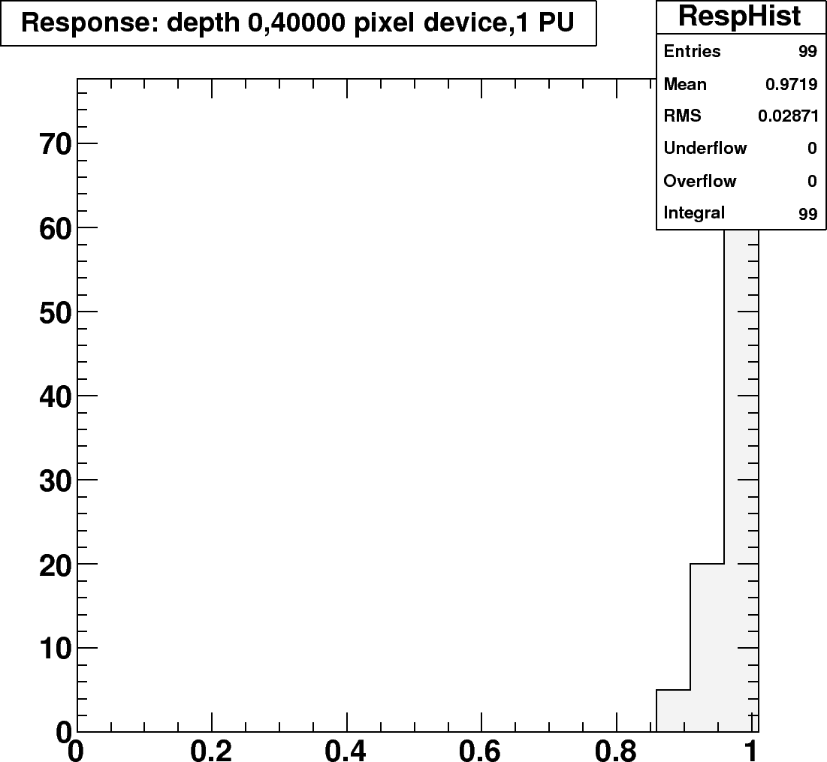
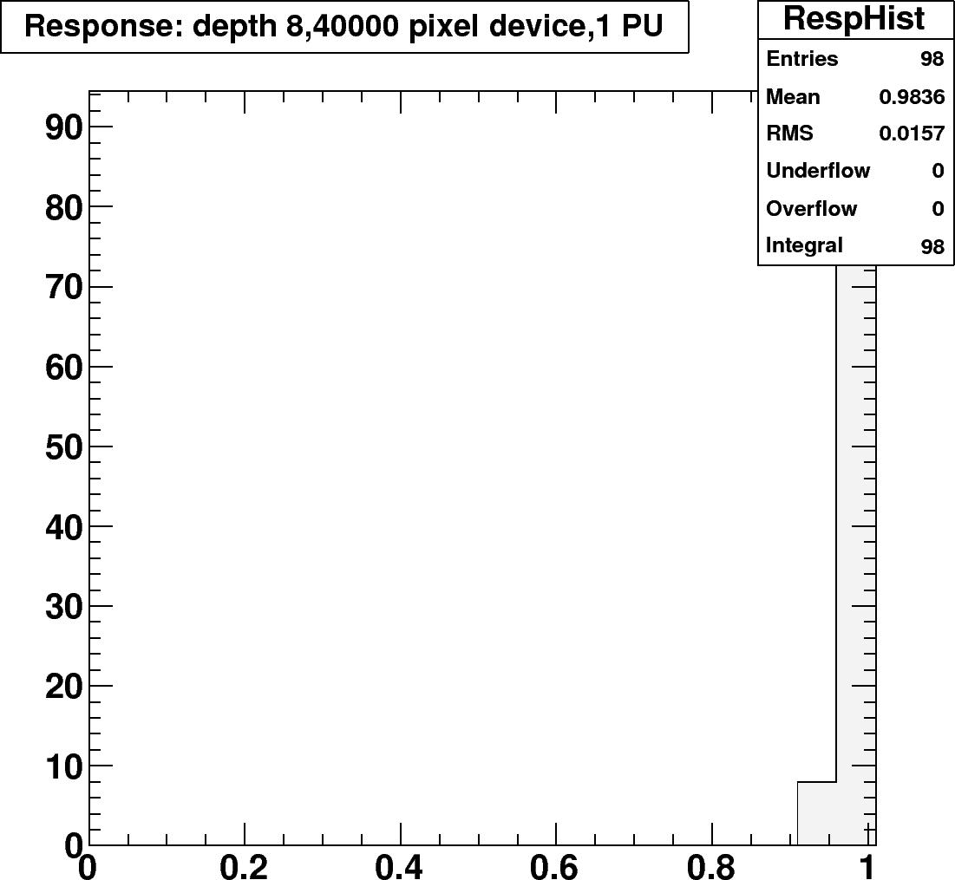
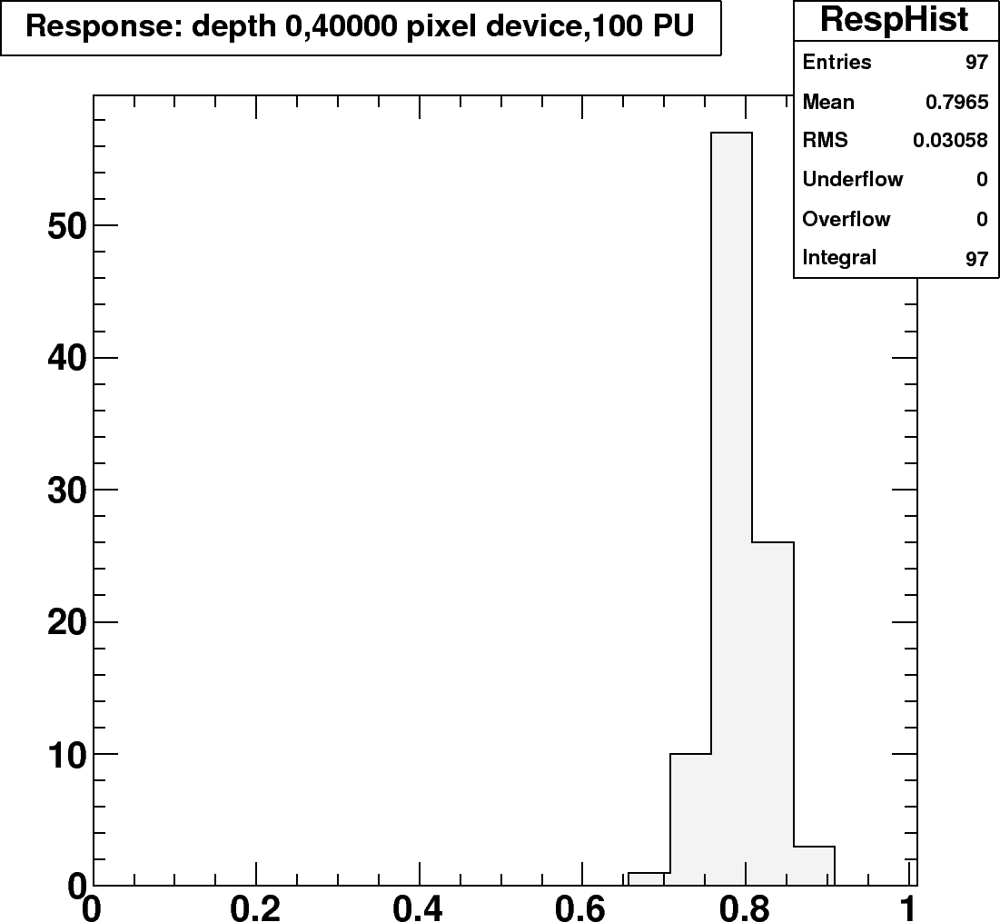
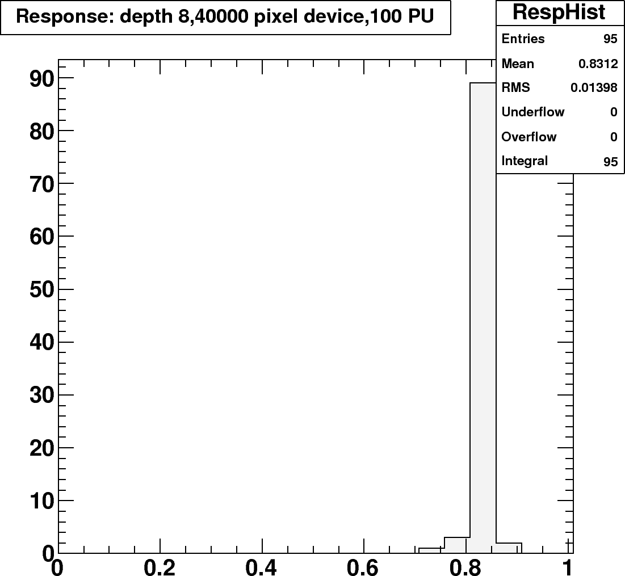
Zecotek 40k - Response
Lower Saturation
History induced response is still problematic
1 PU
100 PU

Slide 18
Hypothetical SiPMs
Zecotek 40k, 10x faster
Average fractional response to 1 TeV single pions for 1 PU, 20 PU and 100 PU
Barrel towers 9-12
L0 | L1 | L2 | L3 | L4 | L5 | L6 | L7 | L8 | L9 | L10 | L11 | L12 | L13 | L14 | L15 | L16
0.98 | 0.98 | 0.98 | 0.98 | 0.98 | 0.98 | 0.98 | 0.99 | 0.99 | 0.99 | 0.99 | 0.99 | 0.99 | 0.99 | 1.00 | 1.00 | 0.99
0.97 | 0.97 | 0.97 | 0.97 | 0.97 | 0.97 | 0.98 | 0.98 | 0.98 | 0.98 | 0.98 | 0.98 | 0.99 | 0.99 | 0.99 | 0.99 | 0.98
0.92 | 0.94 | 0.94 | 0.94 | 0.94 | 0.94 | 0.95 | 0.94 | 0.95 | 0.95 | 0.95 | 0.95 | 0.95 | 0.95 | 0.96 | 0.96 | 0.95
The historical pileup is not such a problem.
It looks like this one would be doable.

Slide 19
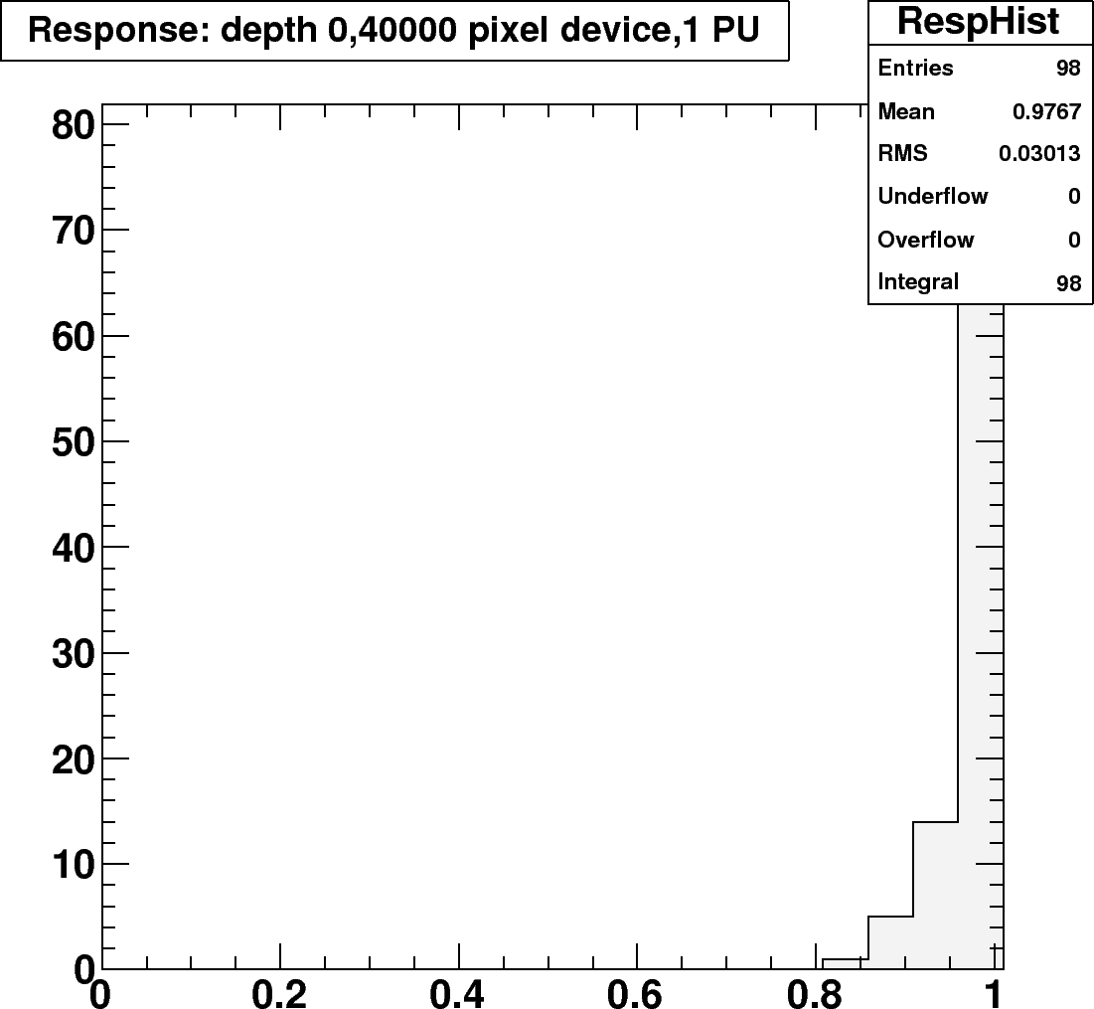
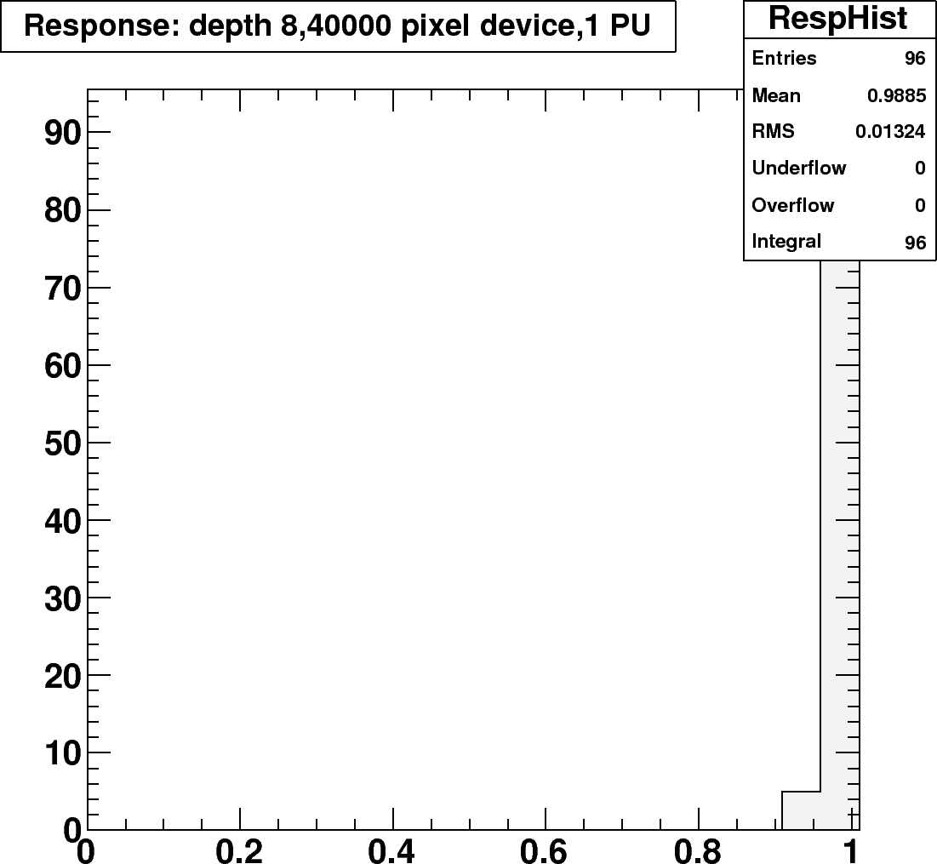
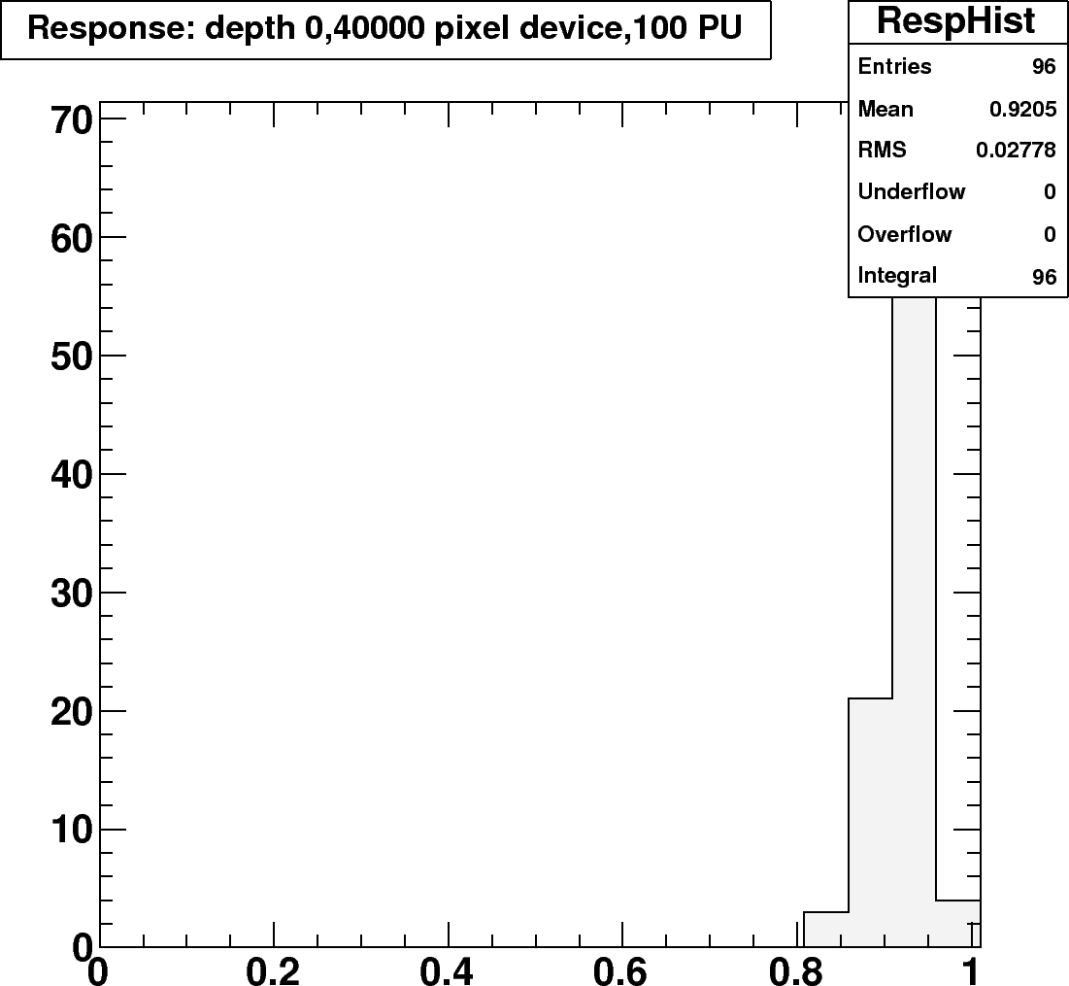
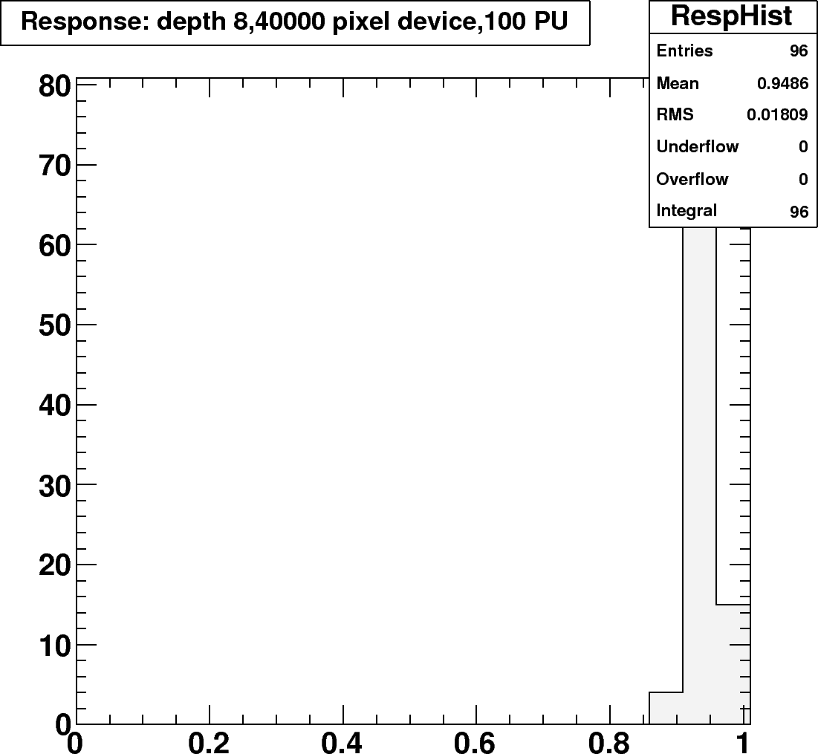
Zecotek 40k, 10x - Response
1 PU
Almost fast enough to not see the effects.
100 PU

Slide 20
HB/HE with an ODU
Fibers from layers would be optically mixed before the photodetector.
The mixed light would then shine on a 3x3 mm SiPM for each predefined longitudinal depth.
  For this study:
    Depth 0: first layer
    Depth 1: 3 layers
    Depth 2: 3 layers
    Depth 3: rest of layers
    Depth 4: HO (where applicable)
The dynamic range really comes into play.

Slide 21
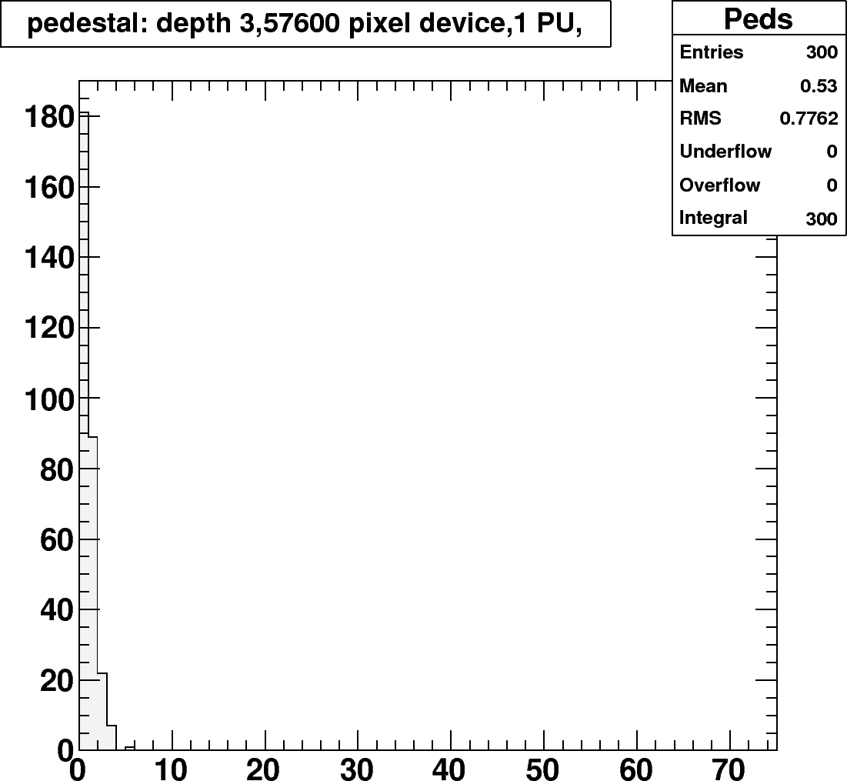
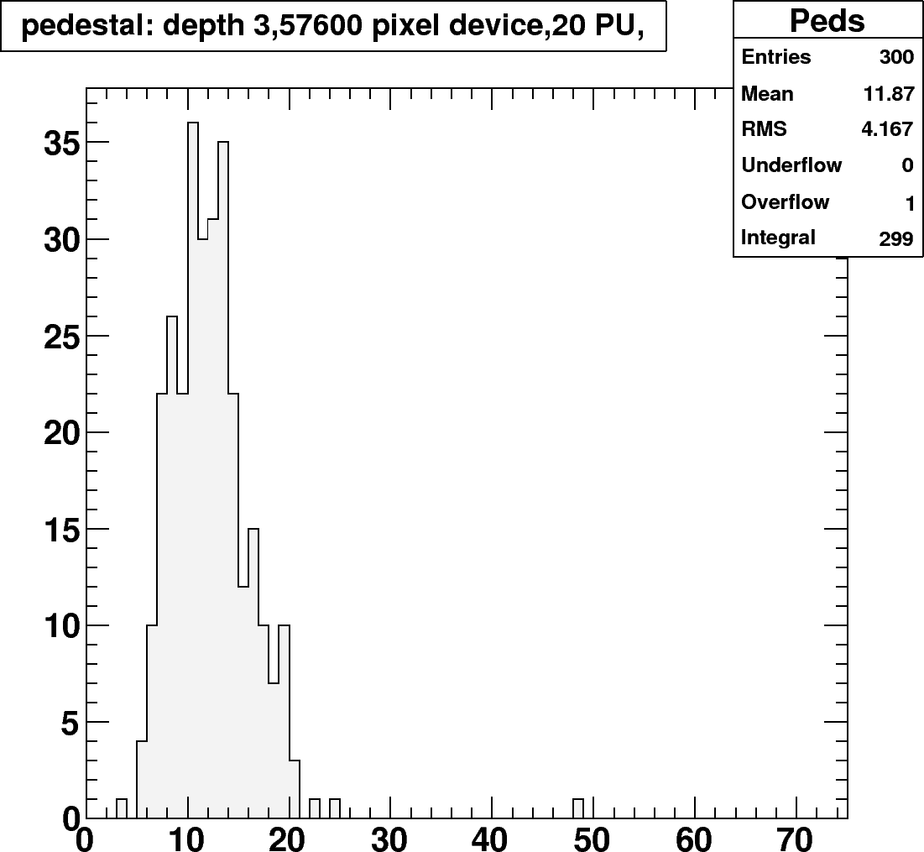
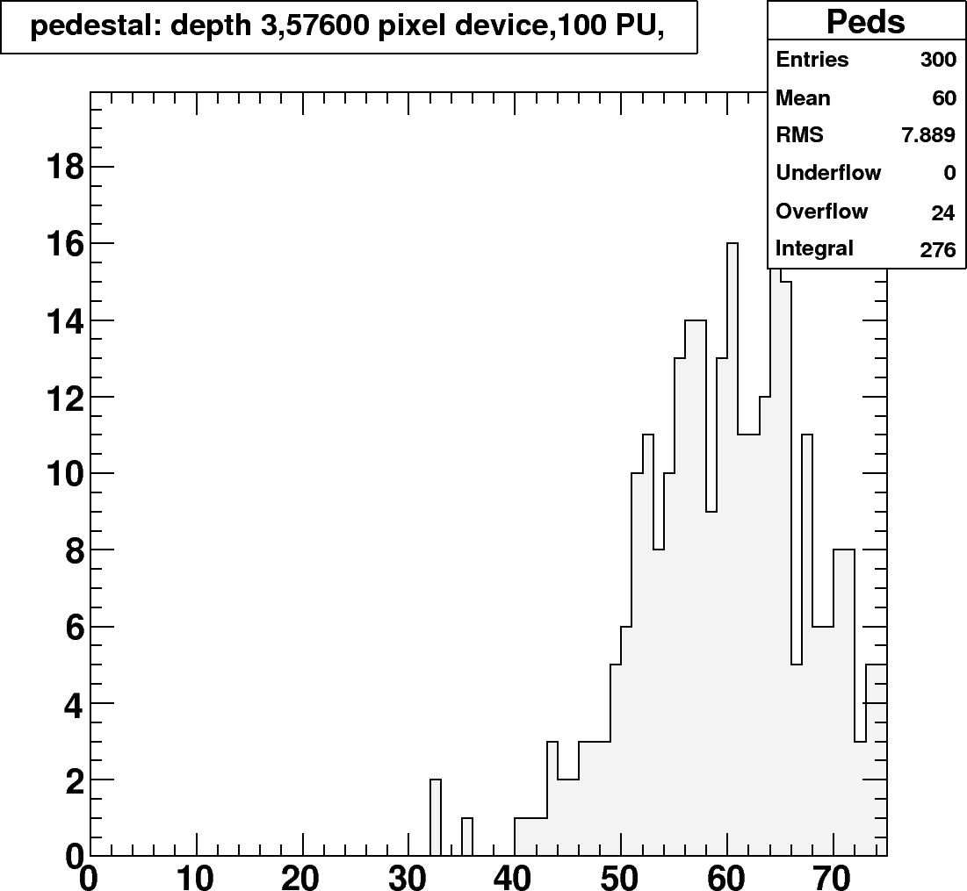
Depth Occupancy
Depth 3 has 20 to 25 p.e./μs/interaction.
  Others are smaller. Depth 0 is the same as the EDU option.

Slide 22
Hamamatsu 1600 /mm²
Average fractional response to 1 TeV single pions for 1 PU, 20 PU and 100 PU
Barrel towers 9-12
Depth 0 | Depth 1 | Depth 2 | Depth 3
0.94 | 0.85 | 0.89 | 0.84
0.94 | 0.86 | 0.88 | 0.82
0.95 | 0.85 | 0.88 | 0.83
The response is problematic because of saturation.

Slide 23
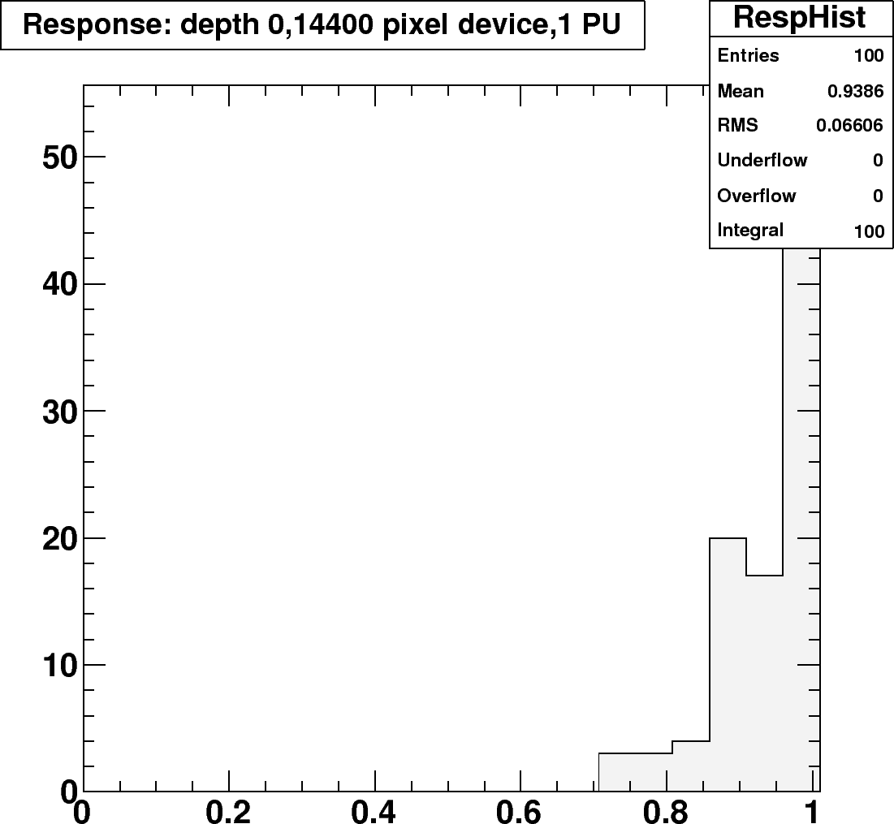
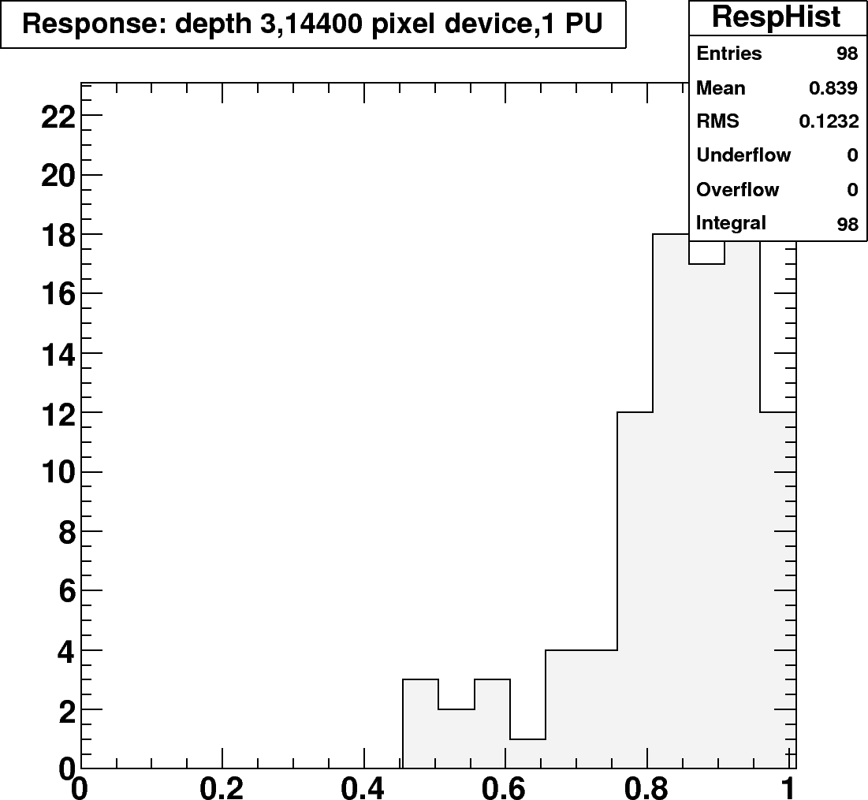
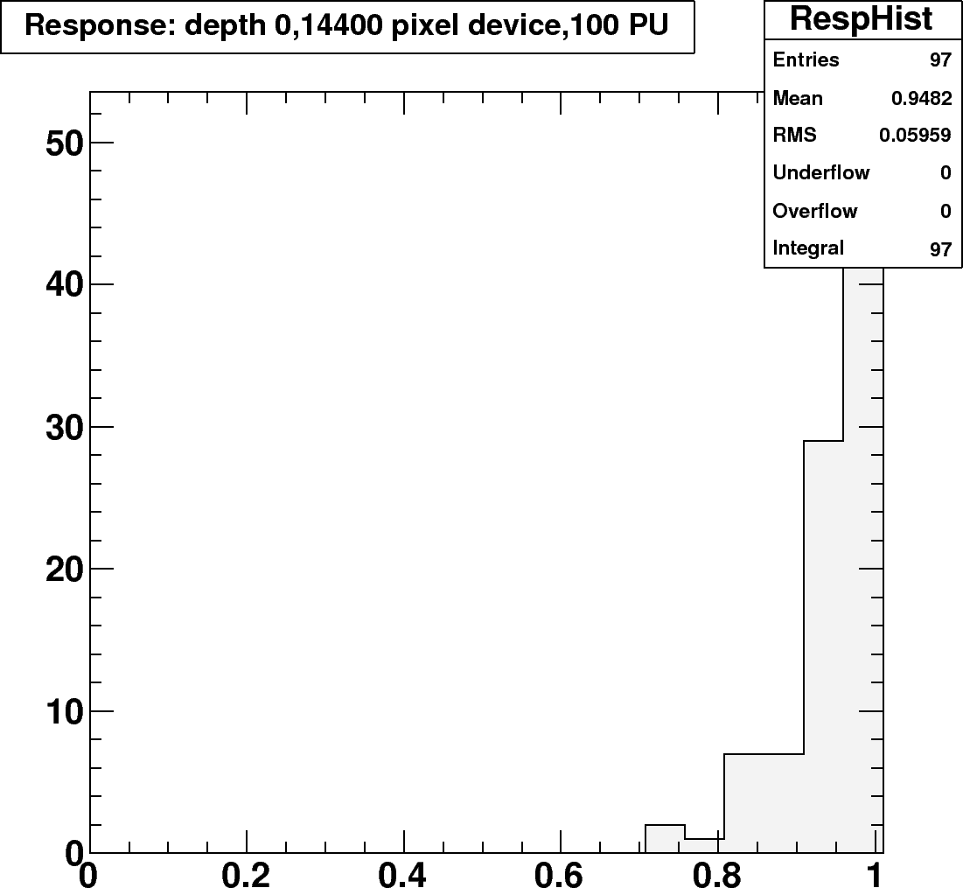
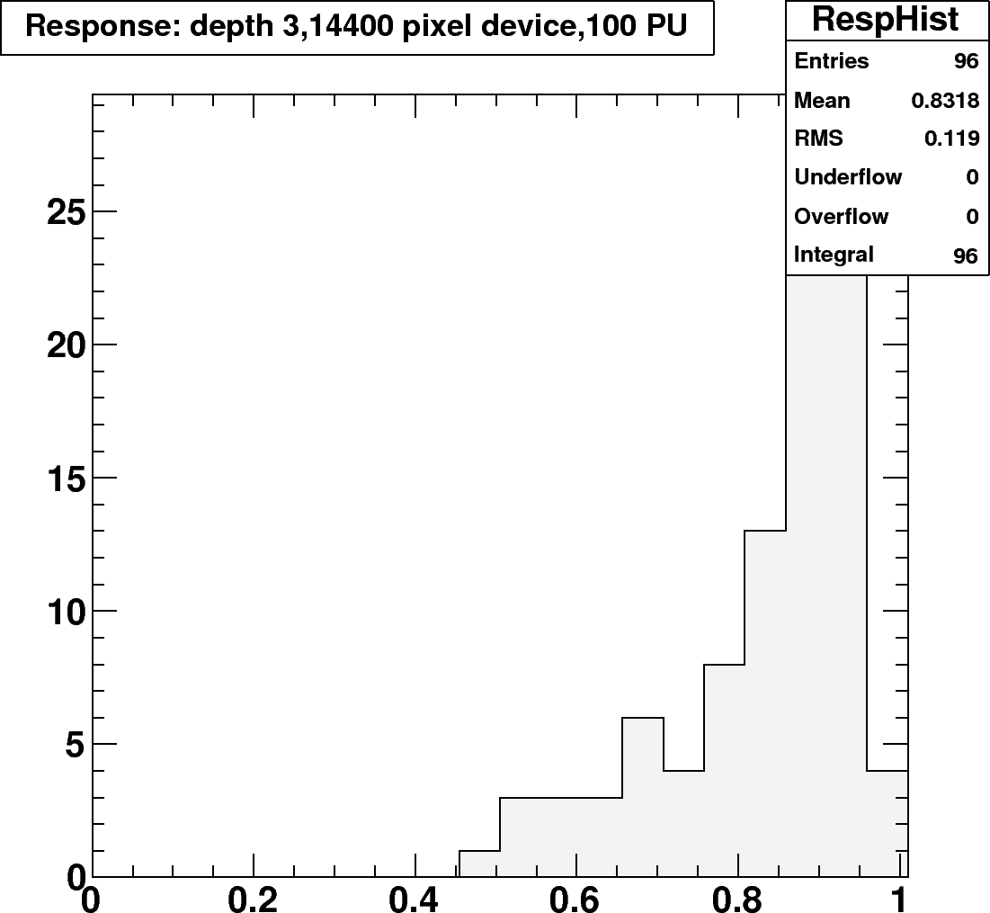
Hamamatsu 1600 - Response
1 PU
Considerable Saturation
100 PU

Slide 24
Hypothetical SiPM
Hamamatsu 6400 /mm²
Average fractional response to 1 TeV single pions for 1 PU, 20 PU and 100 PU
Barrel towers 9-12
Depth 0 | Depth 1 | Depth 2 | Depth 3
0.98 | 0.96 | 0.96 | 0.95
0.98 | 0.96 | 0.97 | 0.95
0.98 | 0.96 | 0.97 | 0.94
Here the pixel count is quadrupled so the saturation is reduced.

Slide 25

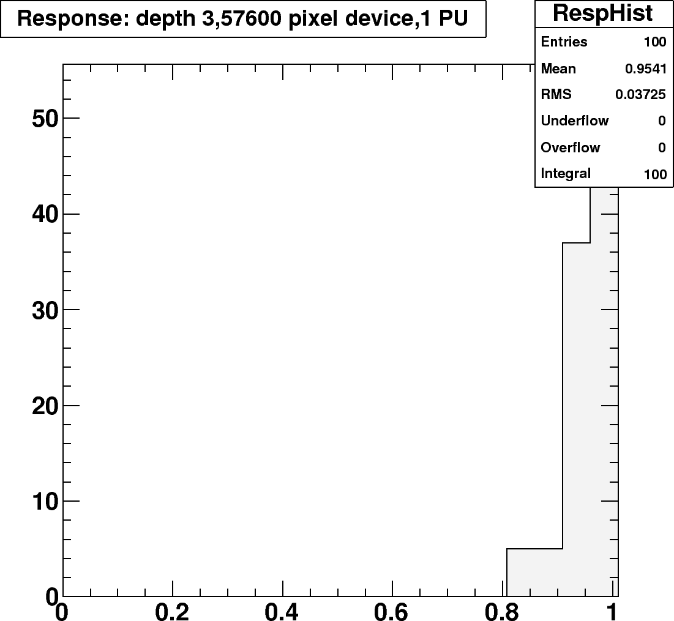


Hamamatsu 6400 - Response
1 PU
Slight Saturation
100 PU

Slide 26
Summary
The Zecotek devices have the dynamic range that is needed to meet the requirements of the Hcal.
The current Zecotek devices are too slow to be used in high specific luminosity conditions.
The Hamamatsu devices are fast enough to use in high luminosity conditions.
The Hamamatsu SiPM lack the dynamic range needed for an HB/HE upgrade.

Slide 27
In the future
Because HO requirements are not as extreme
  The current generation of Hamamatsu devices with 1600 pixels/mm² would be sufficient.
  The Zecotek devices have the dynamic range, but even in the HO suffer with their history at the highest luminosity.
With the improvements, either device could be worked into an HCAL upgrade.
  For Hamamatsu devices, we need to work with them to improve the density to achieve greater dynamic range.
  For Zecotek devices, we would need to work with them to improve the recovery time of their pixels.

