Slide 1
Tracker Phase II ie everything except pixels including some track trigger
Geoff Hall
October 2009

Slide 2
Phase II sessions
Organised as summaries, because:
  limited time available
    future longer workshops will allow to cover all ongoing activities in more detail
  regular meetings are held, eg weekly or biweekly, especially of TUPO and simulations
    TUPO beginning to address system design, as well as lower level issues
  past the “brainstorming” phase ?
    but new ideas are still welcome to overcome difficult challenges
  and still expect that Phase II system will only be defined when data from LHC makes clear what will be the real physics objectives
    however engineering details is a lengthy process

Slide 3
Sensors
Large prototype & irradiation activity proposed
  Several major questions which have impact throughout system
    eg Lorentz effect, charge sharing, sensor type, pT and outer tracker module development,
  very large evaluation programme, from Spring 2010
    needs good preparation
  plenty of scope for further US involvement

Slide 4
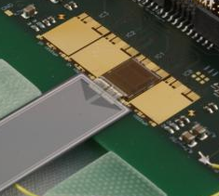
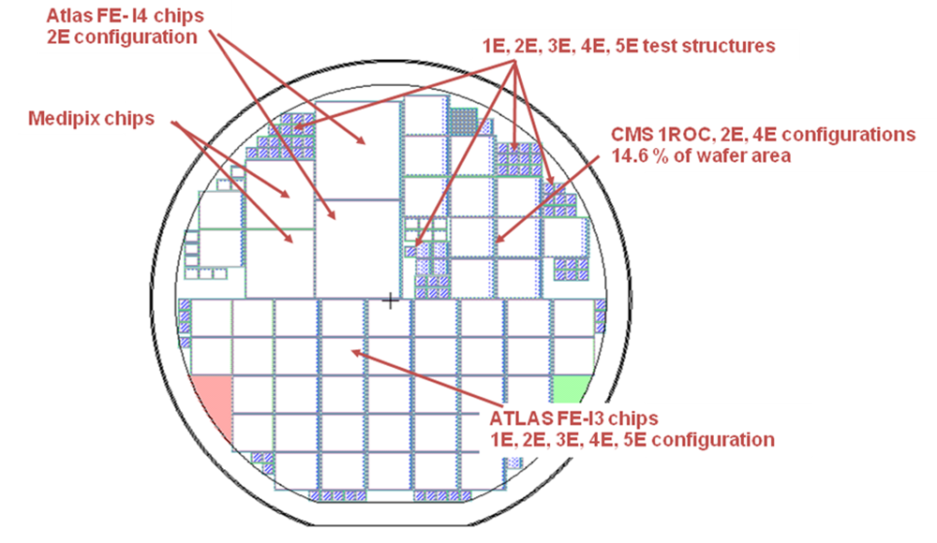
Sensor R&D
SiBT finished another test beam run this year with n-MCz and p-MCz sensors. Preliminary results look promising.
  MCz material looks suitable for the SLHC, at least for outer radii
A common calibration campaign started, please join
CEC processed together with ITE(Warsaw) wafers to evaluate connectivity schemes
  First results from a test beam show that PA integration into sensor is possible in a double metal design but has some problems with a single metal design.
3D sensors for future inner pixel layers have been processed at SINTEF; Proposal from Purdue and FNAL
  In collaboration with Medipix and ATLAS
  Supported by simulations
  IV looks ok
  Wafers sent to IZM for bumping
  Plan to have a test beam at FNAL
PA in sensor

Slide 5
HPK Submission
Description
  Input from several parties: CEC, CERN, INFN, PSI, US
  Large technology phase space: MCz, FZ; p-in-n, n-in-p, different thicknesses etc.
  Strip, strixel and pixel plus test structures and diodes plus ...
Schedule
  All wafer material in hand
  First masks designs received 15.10.09 from HPK
  several changes requested to HPK
  reply positive
  ➔ especially missing translation of structures from p-in-n to n-in-p will give some further delay
  Estimated delivery March
Irradiation & testing plan
  Very ambitious plan developed
  Institutes are requested to volunteer
  Participating institutes are encouraged to start preparing
    Calibration started
See http://indico.cern.ch/sessionDisplay.py?sessionId=7&slotId=0&confId=67916#2009-10-29

Slide 6
System developments

Slide 7
System design
ASICs
  considerable work programme ahead, identifying blocks now
    at early stage of identifying contributors
  not one CMS chip yet produced in 130nm CMOS
    many assumptions about using 90nm or finer
  funding may also limit rate of progress
TUPO
  ~weekly forum for system discussions
  participation could usefully grow
Power
  DC-DC conversion scheme developing well
  Remember that this is not yet fully proven either
    Phase I pixel system will help but Phase II will extend further
  To be included in early module prototyping?

Slide 8
Building Blocks
Front-End circuits:
  Preamp-Shaper
  Leakage compensation
  Discriminator
  Discriminator Reference and control
  Bias DAC
  Bandgap voltage reference
Timing
  PLL
    Programmable delay clock source
Digital Blocks
  Event Storage memory
  Slow Control Interface
  GBT (e-Link) adapter
  Various Low Power Techniques
Interfaces
  Slow control interface
  Low Power digital link
Low cost interconnection technology
  Macro cells for C4 bump bonding (@150-225 μ pitch)
NB significant effort, yet to begin, including evaluation
C4 bonding assumed to be widely used in future but so far very little direct experience

Slide 9
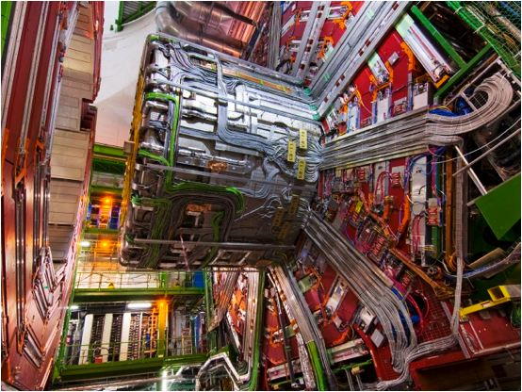
Reminder of system constraints
Services surveyed by Hans Postema (Sept 2007)
  ~2000 power cables, 60km, carrying 15kA (+ 400 control)
    probably can operate at higher voltage but not more current
  ~200 cooling loops with ~20km pipe
  600 optical cables, with 12 x 8 fibres, 36km
  gas flushing pipes: 24 cold, 4 warm
Power, assuming 12V supply
  15kA x 12V x 75% (DC-DC) = 135kW
  allow 25% safety margin ≈ 100kW maximum
  Present plant ~300kVA for much smaller total
Cooling – assuming CO₂ system – engineers optimistic
  system issues not yet evaluated, other than tolerable pressure
Trigger: processing of tracker data
  although less urgent, not too soon to evaluate impact on future trigger
Off-detector – rack space and cooling
  some layouts have large requirements, even if limits tolerable

Slide 10
Layouts
Agnostic tool developed to evaluate system designs
  very easy to make optimistic assumptions
  identify ”bottlenecks” which would benefit from extra attention
Expert tool embodying much past experience
  services, material, module boundaries, module quantisation of detector layers, etc
Example of method in use
  penalty of using identical rectangular modules in outer tracker is only ~5% (no. modules, power, etc) with several important advantages
Don’t mistake objective evaluation for conclusions
  it is intended to answer questions which are posed, not to be bible
  answers are as good as quality of input
  other tools are needed to model system design aspects such as data flow

Slide 11
Layout extremes?
Hybrid
  Channels: 19M outer tracker + 115M pT layers
  Total power 37kW <X> = 0.55X₀
  6272 Trigger GBTs +1696 readout GBTs
All-trigger
  Channels: 1240M
  Total power 148kW <X> =1.19X₀
  27830 trigger GBTs + 6048 readout GBTs
Assumptions
  Readout: 0.5mW/channel
  PT layer: 0.1mW/channel
  GBT: 2W/link for 5Gbps (3.2Gbps data)
What can be improved?

Slide 12
PT module definition
NB original ideas were conceptual designs, not necessarily intended for final implementation
what issues have arisen?
  large number of DC-DC converters, several required per module
    several voltages (analogue, digital-1, digital-2?, laser)
  transmitter most likely on module
    1/module is practical, n module/TX is harder
    but high local power dissipation
    what scope do we have to follow commercial link evolution?
  modules are relatively small
    larger modules could provide partial solution, but raises new issues
  modelling the data flow is needed to properly analyse the system
    sharing links adds new ASIC components for local buffers and time stamping becomes inevitable (if not already)

Slide 13
Layout optimisation
Trigger primitive providers not yet fully optimised
  Probably (several?) factors of 10% (?) can be gained in PT module
  Not yet a single working module of any type (inc. cluster width)
    several big technical issues not yet (started to be) solved
    demonstration will be essential by TDR stage
Links
  potential scope for big improvement
  GBT prototypes look capable of 10Gbps (6.4Gbps data)
  Can power be optimised for tracker requirement?
  important requirements for clock logic (PLLs), error correction and robustness in SLHC environment – needs validation
  off-detector components are presumably easier to address
Follow up action:
  investigate – and resource – improved GBT – and radiation performance

Slide 14
Track-trigger system issues
One example: N boards and architecture
  100 W/board @ 10Gbps/2W? say 20W for functions => 40GBT/board
  Hybrid layout : ~80 receiver boards + 20 readout + x trigger processor
  All trigger layout: ~350 receiver boards + 75 readout + x trigger processor
40 x 6.4 Gbps i/p = 256 Gbps
too simple picture?
Receives data,
reorganises, buffers different time slots,
serialises for trigger
8 x 32 Gbps?
trigger
processor
8 x 32 Gbps?
not much scope for data reduction here?
Assumptions can certainly be questioned. But detailed study is required. Modelling tool is required for data flow and organisation to identify all components. Crucial dependence on PT module performance.

Slide 15
Summary - actions
Sensors
  contributions needed to evaluation and irradiation study programme
ASICs
  effort now needed to develop blocks and larger components
    preparations for evaluation should not be overlooked
Power
  encouraging progress but still early days with DC-DC conversion
System development
  Forum exists, and is working: TUPO
  Need modelling tool to guide data flow aspects of design
High speed links
  crucial area for further investment
Simulations
  covered in other summary, but much further work

