Slide 1
CE-related info in the WLCG IS
Julia Andreeva, CERN IT
IS Evolution Task Force meeting

Slide 2
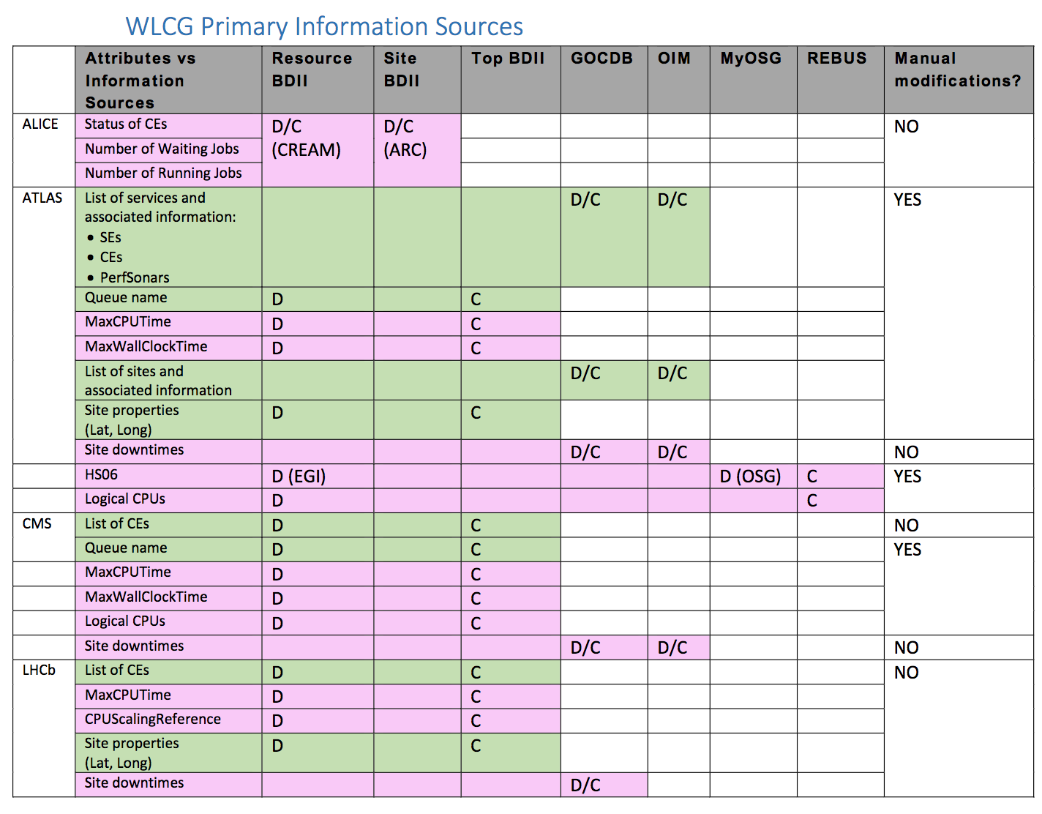
Information required by the experiments

Slide 3
Attribute | Source | Static/Dynamic | In CRIC
CE list | GocDB/OIM | static | yes
Queue list | BDII/ Condor publisher/ Glidein XML configuration file | static | yes
MaxCPUTime | BDII | Semi-static | yes
MaxWallClockTime | BDII | Semi-static | yes
HS06 | BDII/MyOSG | Semi-static | yes
Logical CPU | REBUS | Semi-static | yes
# waiting jobs | BDII | dynamic | NO
# running jobs | BDII | dynamic | NO
Downtime info | GocDB | dynamic | YES

Slide 4
Static attributes
For static and semi-static information we bootstrap CRIC from any available sources, can be even experiment specific
For sites which do run BDII, we continue to use data from BDII
For EGI sites which won’t run BDII, there are two possible scenarios:
  update info in CRIC through UI (API)
  Expose CE/queues info in JSON file, similarly to what we agreed for storage. If we consider this option, we have to agree on the format
  Apel client would need to be modified to get infor from CRIC instead of BDII
For OSG sites for ATLAS get info from Condor publisher, for CMS from Glidein XML configuration file

Slide 5
Dynamic attributes
The only experiment requiring dynamic attributes like number of pending/running jobs is ALICE
ALICE will continue to rely on BDII where it is available. For sites which won’t run BDII, there is a way around

