Slide 1
AC loss for EuroCirCol 16 T designs
Susana Izquierdo Bermudez, Davide Tommasini, Bernardo Bordini
Acknowledgements: Fernando Toral, Vittorio Marinozzi, Clement Lorin
01-11-2017

Slide 2
Losses
Three sources:
  Magnetization losses
    Proportional to the superconductor J_{c} and filament size (D_{eff})
  Inter-strand coupling loss (ISCC)
    Low thanks to the use of cored cable
  Inter-filament coupling losses (IFCC)
    Low at the typical ramp-rate of an accelerator as LHC/FCC (10 A/s)
  dB_{p}/dI (11T) ~ 1 T/kA
Our assumption: ISCC and IFCC are negligible, only strand magnetization losses are considered
Low field: from 0.1 to 6 kA
High field: From 6 kA to 11.85 kA
Measurements:
Gerard Willering & Hugo Bajas

Slide 3
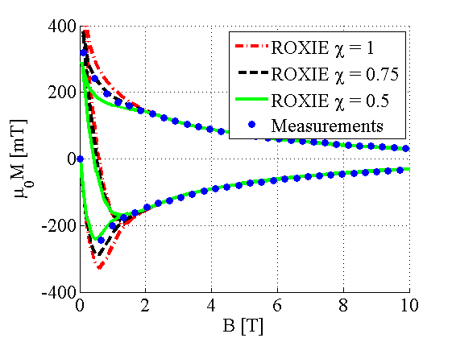
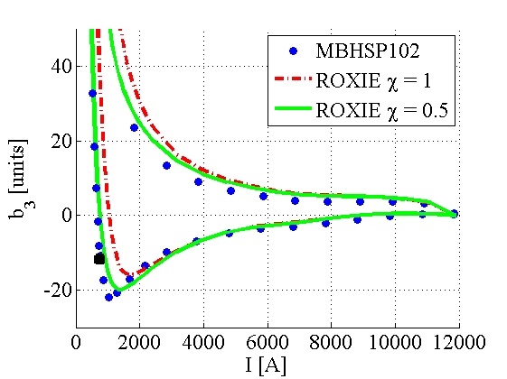
Modelling SC magnetization
Semi-analytical hysteresis model for the superconductor, developed in [1], and implemented in ROXIE [1].
Limited accuracy at low field, partially due the reduction on magnetization observed in Nb₃Sn due to flux jumps [2], which can be overcome by introducing a reduction on the strand magnetization below a given field level.
Model has been validated in 11 T [2] and MQXF [3] magnets
[1] C. Vollinger, Superconductor magnetization modelling for the numerical calculation of field errors in accelerator magnets. PhD thesis, 202
[2] S. Izquierdo Bermudez, et.al, Persistent Current Magnetization effects in High-Field Superconducting Accelerator magnets, IEEE 2016
[3] S. Izquierdo Bermudez, et.al, Magnetic Analysis of the Nb3Sn low-beta Quadrupole for the High Luminosity LHC, IEEE 2017

Slide 4
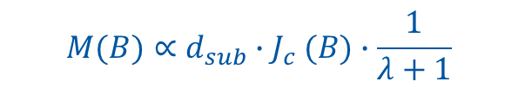
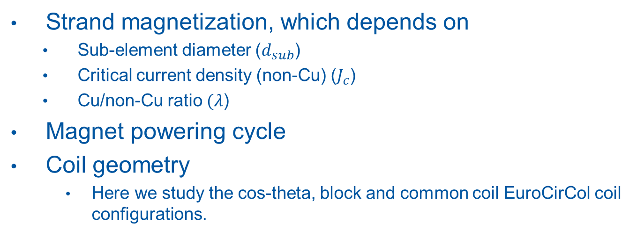
AC Losses – Parameter dependence
Strand magnetization, which depends on
  Sub-element diameter ($d_{sub}$)
  Critical current density (non-Cu) ($J_{c}$)
  Cu/non-Cu ratio $(λ$)
Magnet powering cycle
Coil geometry
    Here we study the cos-theta, block and common coil EuroCirCol coil configurations.
$$M(B)∝d_{sub}{∙J}_{c}(B)∙\frac{1}{λ+1}$$
Cos-theta
Block
Common-coil

Slide 5

Superconductor parameters
Superconductor current density as specified for EuroCirCol
  T_{c0} = 16 K
  B_{c20} =29.38 T
  α = 0.96
  C₀ = 275880 A/mm² T
  3 % cabling degradation
Reference: D_{eff} = 50 µm, no reduction due to flux jumps
Sensitivity analysis to:
  Effective filament size D_{eff} = 20 µm, D_{eff} = 50 µm
  Reduction of strand magnetization at low field due to flux jumps χ= 0.5-1
$$B_{c2}\left(T\right)=B_{c20}∙\left(1−t^{1.52}\right)$$
$$J_{C}=\frac{C(t)}{B_{p}}∙b^{0.5}∙{(1−b)}^{2}$$
$$C\left(t\right)=C_{0}∙{(1−t^{1.52})}^{α}∙{(1−t^{2})}^{α}$$

Slide 6
Cycle
Beam Dump
Pre-cycle
Range of interest for losses evaluation
Current [A]
Quench
Time [s]
Reset current
Injection

Slide 7
Cycle - Parameters
INJECTION: For FCC (collision energy 100 TeV)
  ([1] D. Shuttle FCC week 2017) :
    Baseline: 3.3 TeV from LHC (acceleration ratio = 15.2)
RESET CURRENT:
    Compromise between field quality and magnetization loss during operation
      Reference value: 100 A
      Sensitivity study of the AC loss as a function of the reset current, with a maximum reset current = injection current
[1]https://indico.cern.ch/event/556692/contributions/2483405/attachments/1466498/2267552/Berlin_wide2.pdf

Slide 8
Sensitivity to coil geometry
When normalizing the to the area of superconductor, the AC loss for the 3 designs is within 3 %
Small room of optimization of the AC-loss with an optimization of the turns location
Coil geometry |  | Cos-theta | Block | Common Coil
Deff | µm | 50 | 50 | 50
Xi | -- | 1 | 1 | 1
I1 | Inom (50 TeV) | 11060 | 10465 | 16100
I2 | Ireset | 100 | 100 | 100
I3 | Iinj (3.3 TeV) | 729.96 | 690.69 | 1062.6
I4 | Inom (50 TeV) | 11060 | 10465 | 16100
AC-loss (2 Ap) | J/m | 18330 | 19603 | 23489
AC-loss/Asc | J/m₃ | 4728455 | 4633384 | 4776274

Slide 9
Sensitivity to the reset current
  Non-negligible reduction of the loss when increasing the reset current (we gain 17 % going from I_{reset} = 100 A to I_{reset} = I_{inj})
  The impact on field dynamics needs to be evaluated, since the change on b₃ from injection to nominal will be very large.
Coil geometry |  | Cos-theta | Cos-theta | Cos-theta | Cos-theta | Cos-theta
Deff | µm | 50 (HF) | 50 (HF) | 50 (HF) | 50 (HF) | 50 (HF)
Xi | -- | 1 | 1 | 1 | 1 | 1
I1 | Inom (50 TeV) | 11060 | 11060 | 11060 | 11060 | 11060
I2 | Ireset | 100 | 0 | -250 | 500 | 729.96
I3 | Iinj (3.3 TeV) | 729.96 | 729.96 | 729.96 | 729.96 | 729.96
I4 | Inom (50 TeV) | 11060 | 11060 | 11060 | 11060 | 11060
AC-loss (2 Ap) | J/m | 18330 | 18739 | 21058 | 16104 | 15079

Slide 10
Sensitivity to filament size
The larger contribution to the losses is coming from the high field layers.
A reduction of D_{eff} from 50 µm to 20 µm in the low field cable decrease the magnetization losses by 20 %
A reduction of D_{eff} from 50 µm to 20 µm in the low and high field cable decrease the magnetization losses by 57 %
LF
HF
Coil geometry |  | Cos-theta | Cos-theta | Cos-theta | Cos-theta | Cos-theta | Cos-theta
Deff | µm | 50 (HF) | 50 (HF) | 50 (HF)/20 (LF) | 50 (HF)/20 (LF) | 20 (HF)/20 (LF) | 20 (HF)/20 (LF)
Xi | -- | 1 | 0.5 | 1 | 0.5 | 1 | 0.5
I1 | Inom (50 TeV) | 11060 | 11060 | 11060 | 11060 | 11060 | 11060
I2 | Ireset | 100 | 100 | 100 | 100 | 100 | 100
I3 | Iinj (3.3 TeV) | 729.96 | 729.96 | 729.96 | 729.96 | 729.96 | 729.96
I4 | Inom (50 TeV) | 11060 | 11060 | 11060 | 11060 | 11060 | 11060
AC-loss (2 Ap) | J/m | 18330 | 16685 | 14340 | 12980 | 8026 | 7127

Slide 11
Our thoughts
15 kJ/m is what we would expect with today’s target specification (focusing on J_{c}, not on small filaments)
10 kJ/m is a reasonable target, since we are already close to achieve a good low field conductor with D_{eff} = 20 µm
  We recommend to take this as the baseline
5 kJ/m could be achieved by a successful implementation of new concepts (artificial pinning)

Slide 12
Additional slides

Slide 13
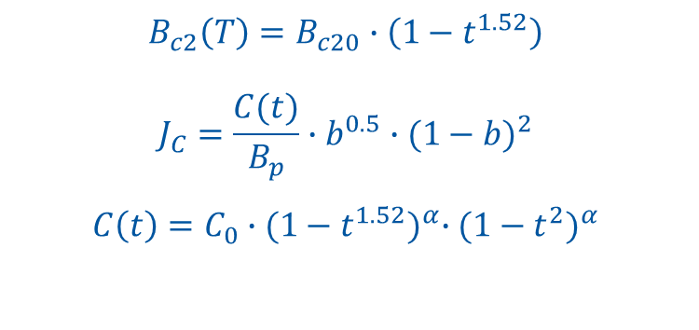
Superconductor parametrization
$$B_{c2}\left(T\right)=B_{c20}∙\left(1−t^{1.52}\right)$$
$$J_{C}=\frac{C(t)}{B_{p}}∙b^{0.5}∙{(1−b)}^{2}$$
$$C\left(t\right)=C_{0}∙{(1−t^{1.52})}^{α}∙{(1−t^{2})}^{α}$$
 | Hi-Lumi | FCC
T_{c0} (K) | 16 | 16
B_{c20} (T) | 29.38 | 29.38
α | 0.96 | 0.96
C₀(A/mm²T) | 188870 | 275880
J_{c} at 4.2 K | Hi-Lumi | FCC
12 T | 2500 | 3610
15 T | 1340 | 1960
18 T | 625 | 915

Slide 15
Notes
In the LHC:
  Losses during ramp = 0.5 kJ/m
  Fast discharge = 3 kJ/m
  Still, what is defining the size of the cryogenic system is the loss during ramp since after the fast discharge there is no beam
The maximum allowable dT:
  50 mK for the LHC
  2.1 K for FCC, which means 2.15 K in the coil. If we want to keep the 50 mK in the FCC we would need 300 l/m of Helium, which is too much!

