Slide 1



FoCal meeting,
CERN, November 15, 2017
Activities for FoCal
in Kharkiv
Technological mock-up
of detector layer
for FoCal mTower
LTU:
Slava Borshchov
Ihor Tymchuk (speaker)
Maksym Protsenko
Yuliia Taranova
NIKHEF:
Thomas Peitzmann Ton van den Brink
viatcheslav.borshchov@cern.ch, ihor.tymchuk@cern.ch

Slide 2
Outline
Tasks of activity
Composition of the mock-up
Performed works
Developed and fabricated components
Assembly sequence
Obtained results
Further steps
Conclusions
FoCal meeting, November 15, 2017
viatcheslav.borshchov@cern.ch, ihor.tymchuk@cern.ch

Slide 3
FoCal mTower
3
,,mTower”
24 layers,
24x2 ALPIDE chips
Note: figure is received from Ton
FoCal meeting, November 15, 2017
viatcheslav.borshchov@cern.ch, ihor.tymchuk@cern.ch

Slide 4
mTower: detector layer composition
4
Note: figure is received from Ton
FoCal meeting, November 15, 2017
viatcheslav.borshchov@cern.ch, ihor.tymchuk@cern.ch

Slide 5
Tasks of activity
Development and fabrication of technological mock-up of detector layer for FoCal mTower for verifying developed approach
Defining possible design/technological issues at fabrication and/or assembly of mock-up and its components
Note: proposal on development of possible approach received Sept.21,2017
FoCal meeting, November 15, 2017
viatcheslav.borshchov@cern.ch, ihor.tymchuk@cern.ch

Slide 6
Performed works
6
Approach for realization has been developed
Assembly procedure has been developed
Technological mock-up is developed and designed
Components are fabricated
Mock-up is assembled
FoCal meeting, November 15, 2017
viatcheslav.borshchov@cern.ch, ihor.tymchuk@cern.ch

Slide 7
Nature of the approach
7
For chips-to-flex connection ,,chipcables” are used
All flex cables and boards are made of adhesiveless foiled aluminium-polyimide dielectrics (Al 30um thick, Pi 20um thick)
Interconnection technique is SpTAB
Flex is 4-layered board: bottom+spacer+top+coverlayer
FoCal meeting, November 15, 2017
viatcheslav.borshchov@cern.ch, ihor.tymchuk@cern.ch

Slide 8
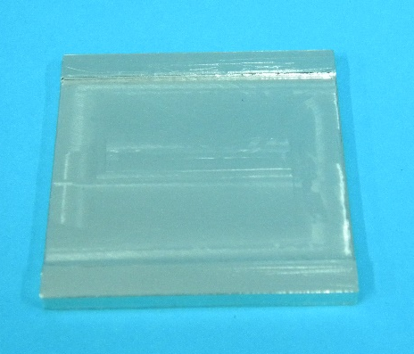
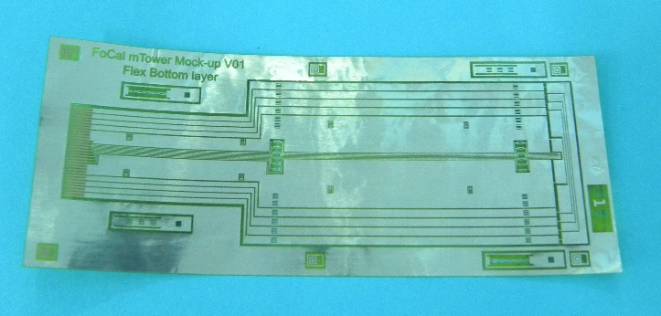
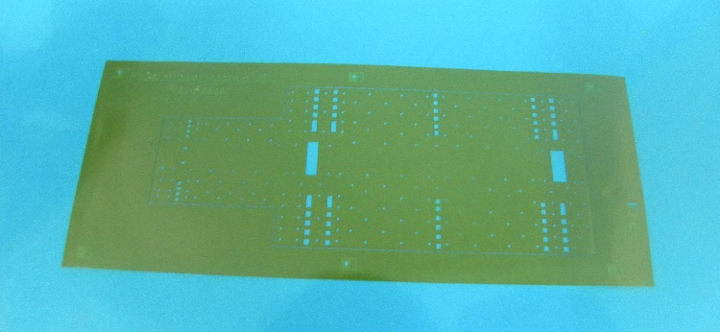
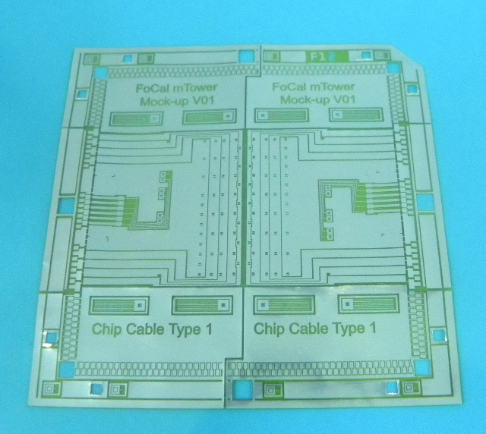
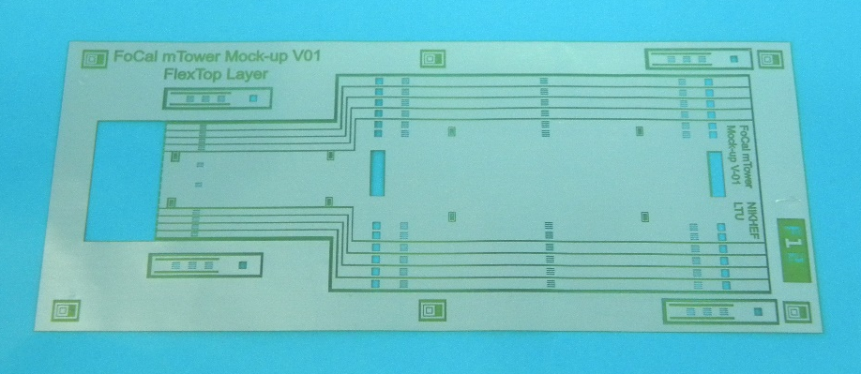
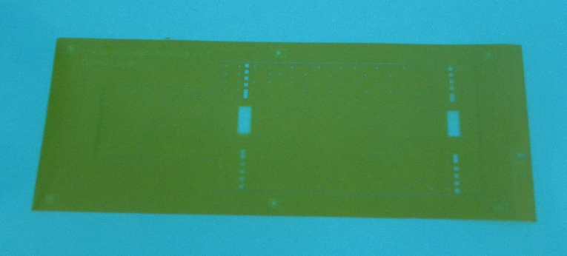
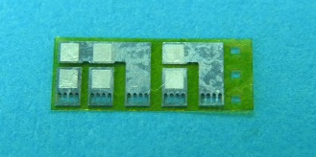
Developed and fabricated components
(for one mock-up)
8
Absorber (1 pc)
Flex bottom layer (1 pc)
Flex spacer layer (1 pc)
Chipcable (2 pcs)
Flex top layer (1 pc)
Flex cover layer (1 pc)
SMD Flex mount (4pcs)
FoCal meeting, November 15, 2017
viatcheslav.borshchov@cern.ch, ihor.tymchuk@cern.ch

Slide 9
Main assembly steps
Assembling MAPSs with chipcables
Assembling multilayered flex
Mounting cutout cables with MAPSs on absorber
Mounting SMDs on chipcable
Mounting flex on absorber with cables
FoCal meeting, November 15, 2017
viatcheslav.borshchov@cern.ch, ihor.tymchuk@cern.ch

Slide 10
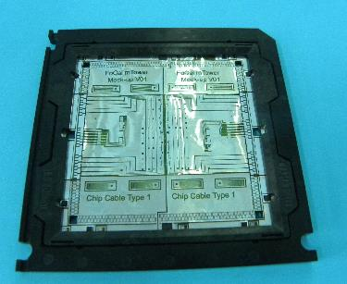
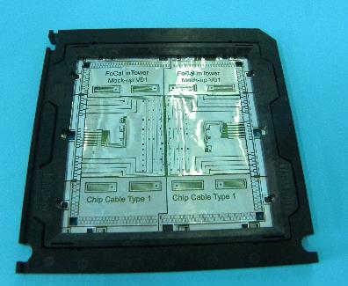
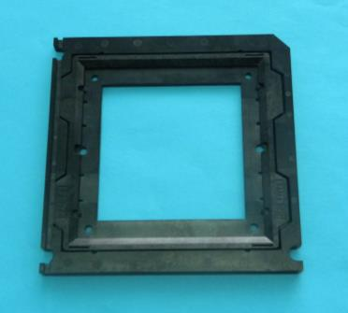
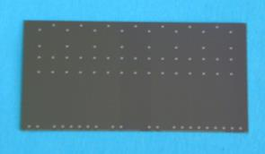
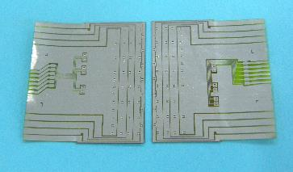
Step 1: assembling MAPS with chipcables and SMDs
Chipcable
Framed cable
Aligning,
SpTAB,
Testing,
Protecting bonds
Test frame
Cutting-off work areas
MAPSs
Cutout cables
(with MAPS)
Notes:
each chipcable is developed for 2 sensors
testing MAPS on cable allows to exclude mounting defective MAPSs in detector layer and mTower
FoCal meeting, November 15, 2017
viatcheslav.borshchov@cern.ch, ihor.tymchuk@cern.ch

Slide 11
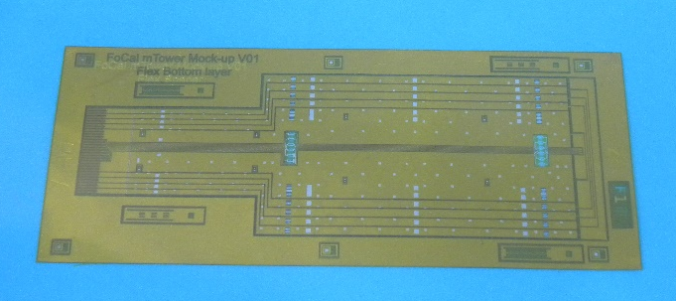
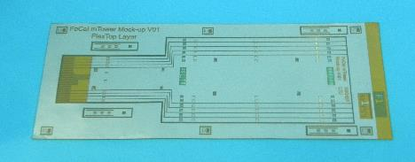
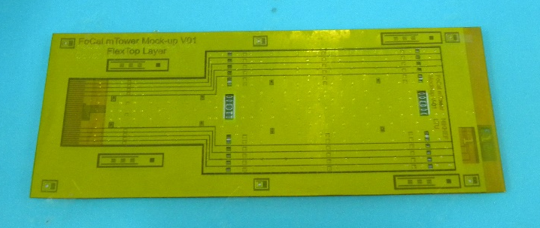
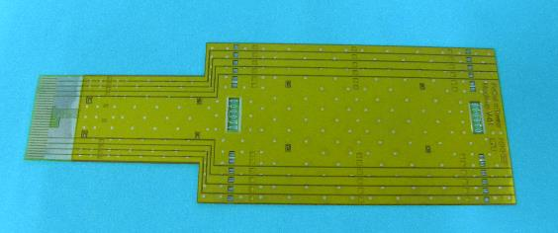
Step 2: assembling multilayered flex
11
Flex bottom layer
Flex spacer layer
Note:
- layout is developed for 100 Ohm impedance
Aligning,
laminating
Two-layered flex
Flex top layer
Aligning,
SpTAB,
Testing,
protecting bonds
Three-layered flex
Flex cover layer
Aligning,
laminating
Multilayered flex (work area)
Four-layered flex
Removing technological areas
FoCal meeting, November 15, 2017
viatcheslav.borshchov@cern.ch, ihor.tymchuk@cern.ch

Slide 12
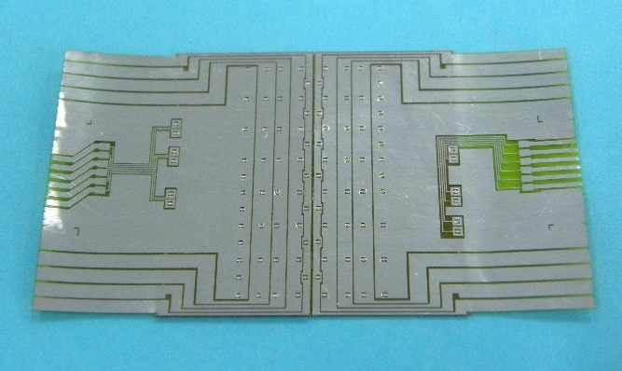
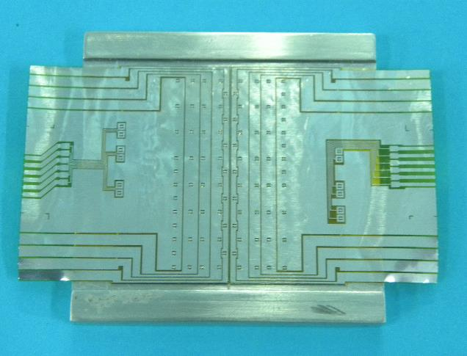
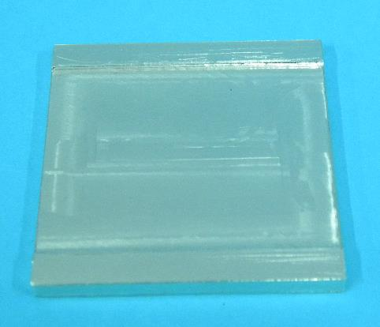
Step 3: mounting MAPSs on absorber
12
Multilayered flex
Chips on absorber
Absorber
Aligning,
laminating
Note: for better robustness and reliability dielectric spacers are placed between chipcables and absorber (for each chip)
FoCal meeting, November 15, 2017
viatcheslav.borshchov@cern.ch, ihor.tymchuk@cern.ch

Slide 13

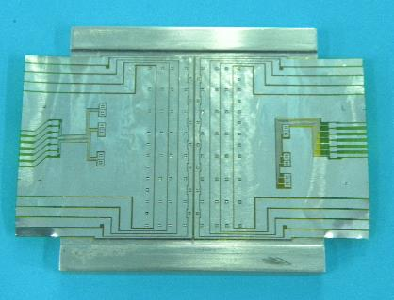
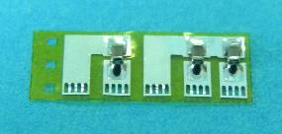
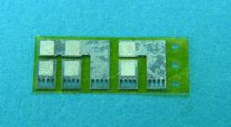
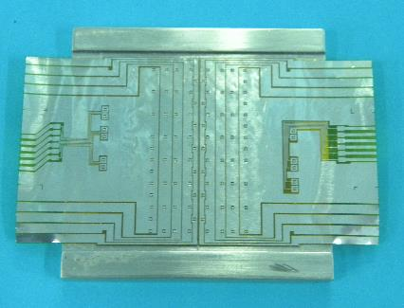
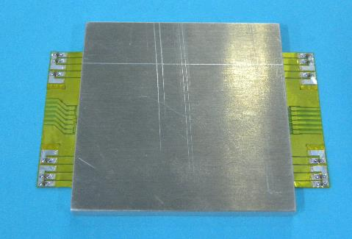
Step 4: mounting SMDs on chipcable
13
SMDs (0402,
1,1mmx0,6mmx0,6mm)
Chips on absorber
Flex Mount with SMDs
Flex Mount
Aligning,
SpTAB,
Testing,
protecting bonds
Soldering
Chips on absorber with SMDs
Front view
Rear view
FoCal meeting, November 15, 2017
viatcheslav.borshchov@cern.ch, ihor.tymchuk@cern.ch

Slide 14
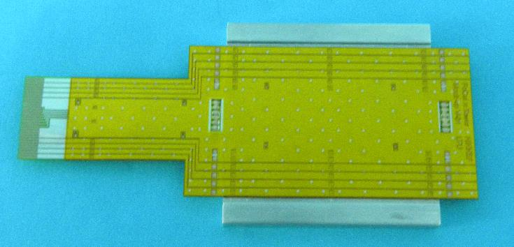
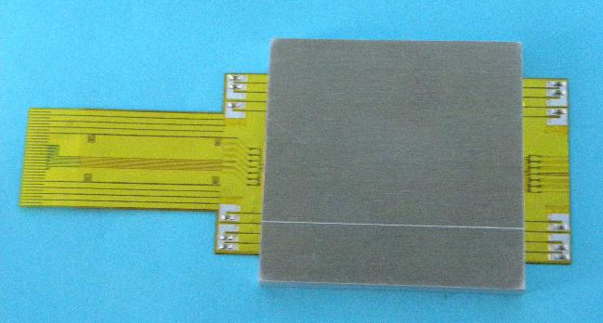
Step 5: mounting flex on absorber
14
Chips on absorber with SMDs
Multilayered flex (work area)
Aligning,
SpTAB,
Testing,
protecting bonds
Detector layer mock-up
Front view
Rear view
FoCal meeting, November 15, 2017
viatcheslav.borshchov@cern.ch, ihor.tymchuk@cern.ch

Slide 15
Open issues
Aligning MAPS chips on absorber – requirements and approach need to be clarified/specified
Type of glue for mounting MAPS chips on absorber (type, requirements?)
FoCal meeting, November 15, 2017
viatcheslav.borshchov@cern.ch, ihor.tymchuk@cern.ch

Slide 16
Obtained results
At fabrication of components and assembly of mock-up and assembly units any major issues were not observed
Observed issues need to be discussed
Some minor modifications in design need to be applied
Proposed approach for possible realization of detector layer for FoCal mTower is verified
FoCal meeting, November 15, 2017
viatcheslav.borshchov@cern.ch, ihor.tymchuk@cern.ch

Slide 17
Next steps
Development and manufacture of few real prototypes
Development and manufacture technological jig for assembly
Creation of test setup at LTU for functional test of MAPS
Development and verification of test procedures for MAPS and detector layers functional tests
FoCal meeting, November 15, 2017
viatcheslav.borshchov@cern.ch, ihor.tymchuk@cern.ch

Slide 18
Conclusions
Mock-up of mTower detector layer is developed and fabricated
Proposed approach for possible realization of detector layer is verified
Proposed approach might be considered as a base line for FoCal mTower detector layer development based on MAPS
Approach need to be tested on prototypes (next step) with real ALPIDE chips
FoCal meeting, November 15, 2017
viatcheslav.borshchov@cern.ch, ihor.tymchuk@cern.ch

Slide 19
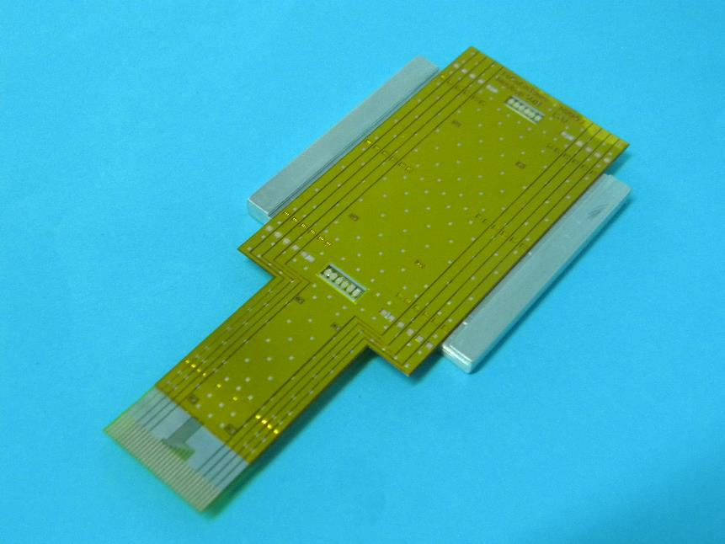
Thanks a lot
for your attention!
FoCal meeting, November 15, 2017
viatcheslav.borshchov@cern.ch, ihor.tymchuk@cern.ch

