Slide 1
RETRAINING AND DETRAINING
IN THE LHC
LHC Machine Advisory Committee,
CERN 26th October 2009
E. Todesco
Magnets, Superconductors and Cryostats Group
Technology Department, CERN
Acknowledgements: C. Lorin, A. Musso, A. Siemko, L. Rossi, A. Verweij, and all the colleagues involved in manufacturing, testing and commissioning

Slide 2
CONTENTS
Available data
Forecast to 7 TeV
  MonteCarlo
  Previous estimates
  Extrapolation
The Firm3 anomaly
  Virgin cycle
  Detraining after thermal cycle
Analysis
  Homogeneity of the production
  Correlations vs storage time
  Correlations vs elastic modulus

Slide 3
THE AVAILABLE DATA FROM
HARDWARE COMMISSIONING
Sector 5-6 has been trained up to 6.6 TeV
  First quench at 10 kA, 700 A gained rapidly (5 quenches)
  Then a slow training all in Firm3 magnets
  Only one magnet quenched twice (perhaps), only one detraining
    Remember that in this sector 55% are from Firm3, but …
Training in 5-6 during hardware commissioning

Slide 4
THE AVAILABLE DATA FROM
HARDWARE COMMISSIONING
Other sectors:
  5 TeV (8.46 kA) – all sectors went to this energy wihtout quenches
  5.5 TeV (9.31 kA) – 6 sectors went to this energy with 1 quench
  6 TeV (10.16 kA) – 2 sectors (4-5 and 5-6) went to this energy with 3 quenches
  6.5 TeV (11.0 kA) – 1 sector (5-6) went to this energy with 17 quenches

Slide 5
CONTENTS
Available data
Forecast to 7 TeV
  MonteCarlo
  Previous estimates
  Extrapolation
The Firm3 anomaly
  Virgin cycle
  Detraining after thermal cycle
Analysis
  Homogeneity of the production
  Correlations vs storage time
  Correlations vs elastic modulus

Slide 6
FORECAST BASED ON SURFACE TEST DATA: MONTECARLO ON 5-6
MonteCarlo method based on surface test data (SM18):
  For each 5-6 magnet:
    Take the first virgin quench measured in surface (available for all)
    Add the correlation with the quench after a thermal cycle, as measured on the 138 dipoles tested in surface, split per Firm
    This correlation has a linear part, plus a random one, this is why you need a MonteCarlo
Correlation between 1st virgin quench and 1st quench after thermal cycle measured in 138 dipoles
[B. Bellesia, N. Catalan Lesheras, E. Todesco, Chamonix 2009]

Slide 7
FORECAST BASED ON SURFACE TEST DATA:
MONTECARLO ON 5-6
MonteCarlo method based on surface test data:
    ☺ Gives the first quench level (10 kA)
    ☺ Accounts of the fact that training is dominated by Firm3 in the range 10-11 kA, with a bit of Firm2 and nothing from Firm1
    ☹ Overestimates level reached after 26 quench by 500 A
    ☹ Slope is different!!
MonteCarlo forecast for 5-6 and hardware commissioning data
[B. Bellesia, N. Catalan Lesheras, E. Todesco, Chamonix 2009]

Slide 8
FORECAST BASED ON SURFACE TEST DATA: MONTECARLO EXTENDED TO THE LHC
MonteCarlo method:
  For 5-6 to reach nominal: 5 quenches from Firm1, 15 from Firm2, 35 from Firm3
  Correcting for the composition of 5-6, we get 400 quenches to reach nominal for the LHC, or 50 quenches per octant

Slide 9
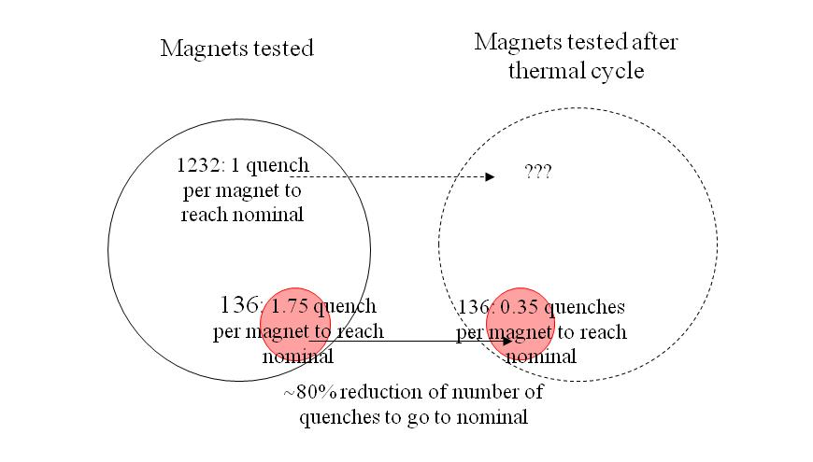
FORECAST BASED ON SURFACE TEST DATA:
COMPARISON WITH PREVIOUS ESITMATES
Previous estimates to reach nominal in the tunnel
  SCALING-1 HYPOTHESIS: Applying the 80% reduction to the whole sample → 0.2 quenches needed to go to nominal → 30 quenches per octant
  [P. Pugnat, A. Siemko, IEEE Trans. Appl. Supercond. 17 (2007) 1091]

Slide 10
FORECAST BASED ON SURFACE TEST DATA:
COMPARISON WITH PREVIOUS ESITMATES
On the other hand …
  SCALING-2 HYPOTHESIS: assuming that all magnets after thermal cycle behave as the sampled ones → 0.35 quenches per octant to reach nominal applies to the LHC → 50 quenches to reach nominal
  [C. Lorin, A. Siemko, E. Todesco, A. Verweij, MT-21 IEEE Trans. Appl. Supercond. 20 (2010) to be published]

Slide 11
FORECAST BASED ON HARWARE COMMISSIONING DATA: EXTRAPOLATION
Empirical extrapolation of hardware commissioning data based on exponential fit (very pessimistic)
  ~200 quenches per sector 5-6
  For generic sector having 33% of Firm3: 110±35 quenches per octant to reach nominal [A. Verweij, Chamonix 2009]
The exponential fit of current vs quench number for 5-6 hardware commissioning

Slide 12
FORECAST: SUMMARY
For 6.5 TeV, a short training is expected (10-15 quenches per octant)
  Needed time: a few days of training per sector
Last method: MonteCarlo for Firm1 and Firm2, plus total loss of memory of Firm3
  Remember Firm3 took 1 quench per magnet to go to 7 TeV in virgin conditions
  Estimate= 72 (Firm1)+155 (Firm2)+416 (Firm3)=640 quenches = 80 quenches per octant
Summary training to 7 TeV

Slide 13
CONTENTS
Available data
Forecast to 7 TeV
  MonteCarlo
  Previous estimates
  Extrapolation
The Firm3 anomaly
  Virgin cycle
  Detraining after thermal cycle
Analysis
  Homogeneity of the production
  Correlations vs storage time
  Correlations vs elastic modulus

Slide 14
THE FIRM3 ANOMALY
Firm3 anomalies in quench perfomance were visible in two different aspects in surface test data
  (1) Virgin training: Firm3 is dominating the training at low fields
    Around 10 kA, Firm3 quenches are more numerous than Firm2 and Firm1
    But the Firm3 magnets were the first to reach ultimate! This is why they had a lot of bonus
Cumulated performance of the dipoles during virgin training
[B. Bellesia, N. Catalan Lesheras and E. Todesco, Chamonix 2009]

Slide 15
THE FIRM3 ANOMALY
Firm3 anomalies in quench perfomance were visible in two different aspects in surface test data
  (2) De-training after thermal cycle
    On the 138 magnets tested after thermal cycle, Firm3 is the only one showing more detraining, and net loss after thermal cycle in a few cases
Correlation between level of the first virgin quench and gain after thermal cycle

Slide 16
THE FIRM3 ANOMALY
  Nevertheless, during hardware commissioning the Firm3 detraining was much worse
    Please note: plot is not fair, we compare a distribution of 84 magnets (balls) in 5-6, unveiled up to the dotted line, with a distribution of 36 magnets tested after thermal cycle (crosses)
Correlation between level of the 1st quench and gain after thermal cycle,
Firm3 magnets, and hardware commissioning data

Slide 17
A FIRM3 ANOMALY ?
  An additional « strangeness » of Firm3 (w.r.t. Firm1 and Firm2): location of the second quench
    95%-100% of the 1st quench is in the heads, in all firms
    10% of the 2nd quench is in the straight part for Firm1 and Firm2, 2% only for Firm3
    Is this relevant ?
    Does it mean that Firm3 has worse heads or that it has a better straight part ?
Average and stdev of first and second virgin quenches, and fraction of them in the heads (measured on a sample)
[courtesy of C. Lorin]

Slide 18
CONTENTS
Available data
Forecast to 7 TeV
  MonteCarlo
  Previous estimates
  Extrapolation
The Firm3 anomaly
  Virgin cycle
  Detraining after thermal cycle
Some analysis
  Homogeneity of the production
  Correlations vs storage time
  Correlations vs elastic modulus

Slide 19
ANALYSIS: HOMOEGENITY
1st question: are Firm3 magnets in 5-6 anomalous w.r.t. the whole Firm3 production?
  No, the cumulated training of Firm3 magnets in 5-6 is very similar to the whole batch
Cumulated performance of virgin training of all Firm3 magnets, and of Firm3 magnets in 5-6

Slide 20
ANALYSIS: HOMOEGENITY
1st question: are Firm3 magnets in 5-6 anomalous w.r.t. the whole Firm3 production?
  But it is true that there has been a degradation along the production: first 100 very good, than worse
  5-6 contains a specific batch, mainly magnets from 3300 to 3400
Firm3 magnets installed in 5-6
Cumulated virgin training of Firm3 magnets, split in four batches
[courtesy of C. Lorin]

Slide 21
ANALYSIS: HOMOEGENITY
2nd question: is this detraining due to storage time ?
  There is no indication of a correlation with storage time
Storage time for magnets in 5-6 versus quenched magnets
[courtesy of A. Musso and C. Lorin]

Slide 22
ANALYSIS: HOMOEGENITY
3nd question: is this due to softer coils ?
  There is no indication of a correlation with measured elastic modulus
Elastic modulus of coils for magnets in 5-6, inner layer
[courtesy of A. Musso and C. Lorin]

Slide 23
ANALYSIS: HOMOEGENITY
3nd question: is this due to softer coils ?
  There is no indication of a correlation with measured elastic modulus
Elastic modulus of coils for magnets in 5-6, outer layer
[courtesy of A. Musso and C. Lorin]

Slide 24
CONCLUSIONS AND ACTIONS
LHC Energy:
  6.5 TeV is at hand with a very limited training, a few days per sector
  7 TeV will need more training - we have no data!
    HC commissioning data of other sectors will not come before 1 year
Causes of Firm3 anomaly are under analysis
  Evidence of anomalies in surface test data:
    Slow training at low fields and detraining after thermal cycle ,
  But this is not the whole story!

Slide 25
CONCLUSIONS AND ACTIONS
Actions
  Continue the analysis of correlations with production parameters
  One could make an extensive campaign of quenches over several thermal cycles on 2 magnets per Firm, with quench location [proposal from G .De Rijk]
    After the incident this is possible, before all Firm3 magnets were in the tunnel ☺
  But …
    One could risk to damage the spares
    The statistics could be not significant
    The magnets from Firm3 come out of the incident → one would keep the doubt of a bias

