Slide 2
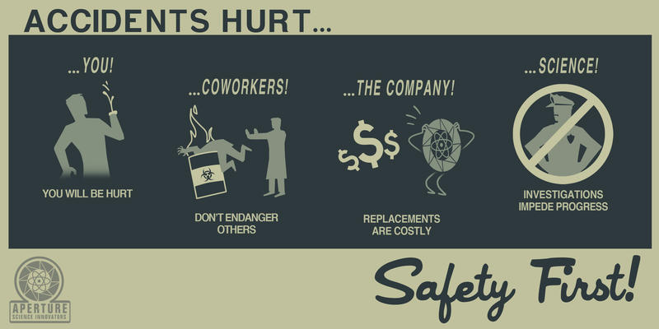
Incidents and accidents
Lessons learned
https://indico.cern.ch/event/679768
cern.ch/ep-th-safety
ep-safety-office@cern.ch

Slide 3
Agenda
CERN 2016 accidents statistics
Faintness and first-aid
Fire
Evacuation drills

Slide 4
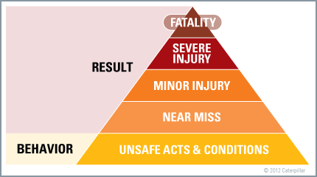
What do we want to avoid?

Slide 5
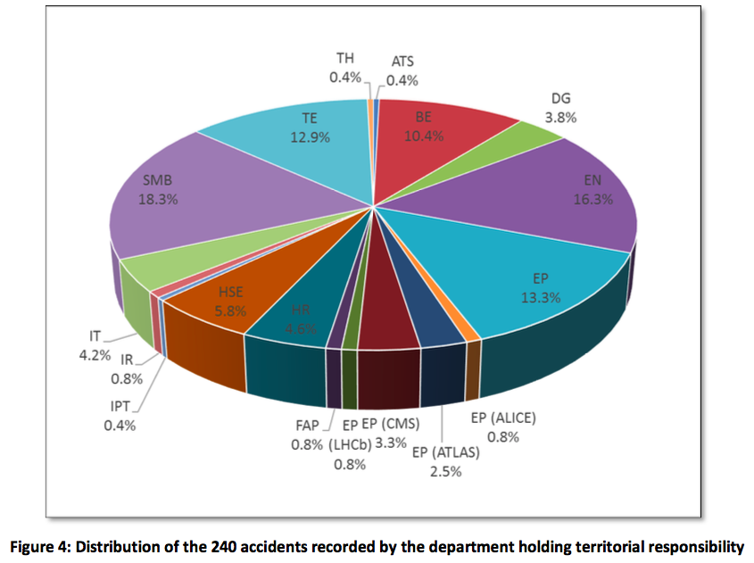
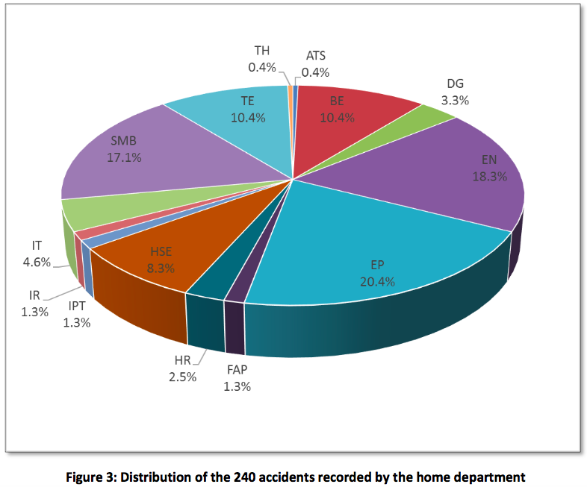
Accidents: 2016 CERN’s statistics
240 accidents in 2016, 103 on MPE, 53 on MPA (resp. 86 and 83 in 2015)

Slide 6
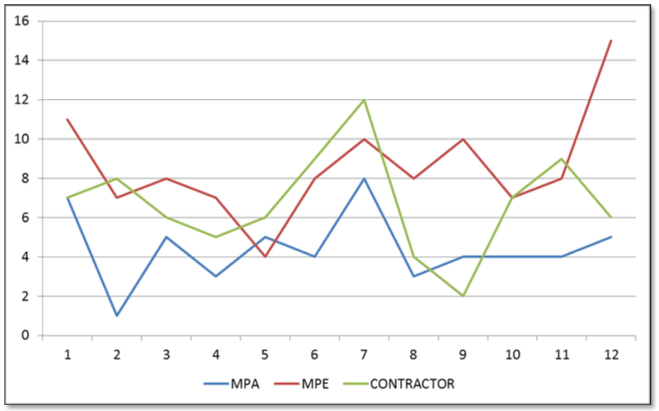
Accidents: 2016 CERN’s statistics

Slide 7
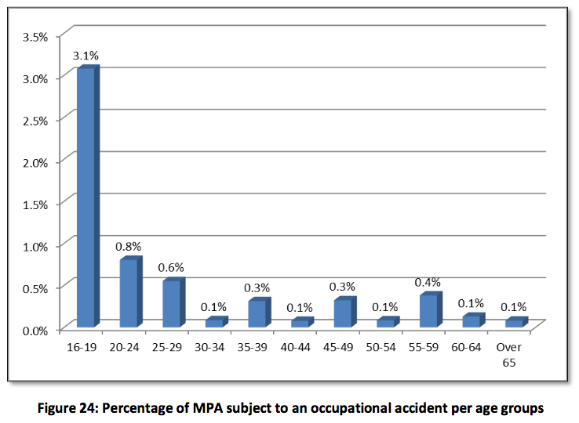
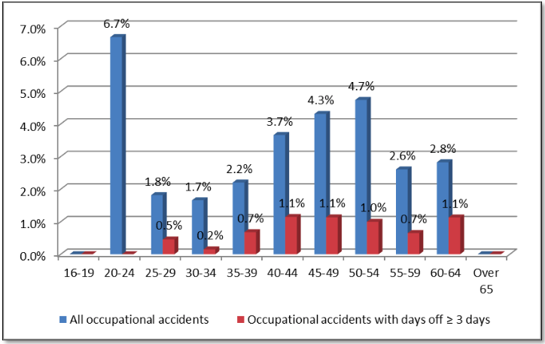
Accidents: 2016 CERN’s statistics

Slide 8
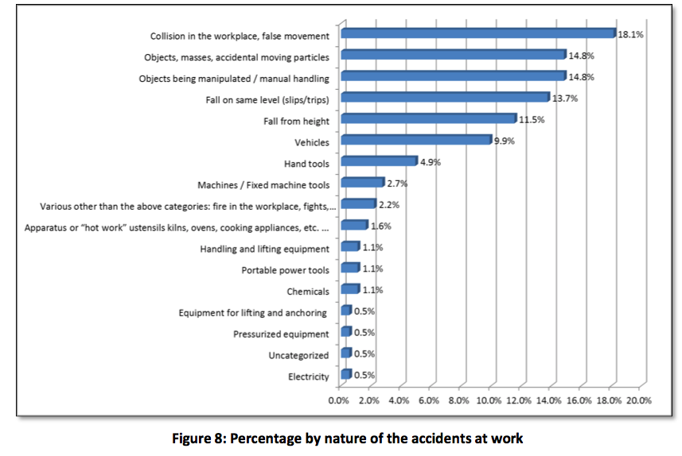
Accidents: 2016 CERN’s statistics

Slide 9
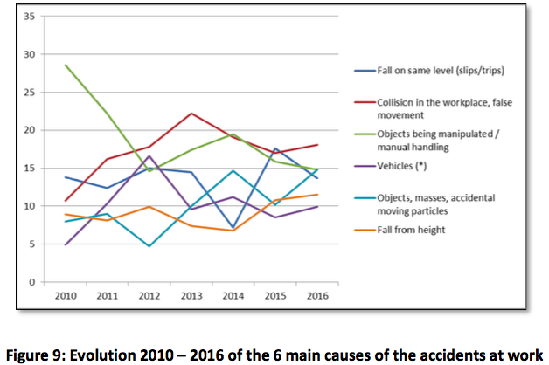
Accidents: 2016 CERN’s statistics

Slide 10
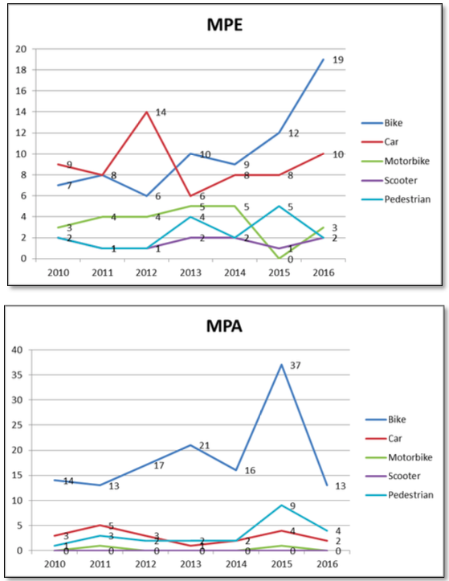
Accidents: 2016 CERN’s statistics

Slide 11
Faintness
Two faintnesses on Meyrin site related to heart issues in Nov. 2017
  Quick alert and intervention from Emergency services
  One didn’t survive.
Let’s get trained to react in case of an emergency

Slide 12
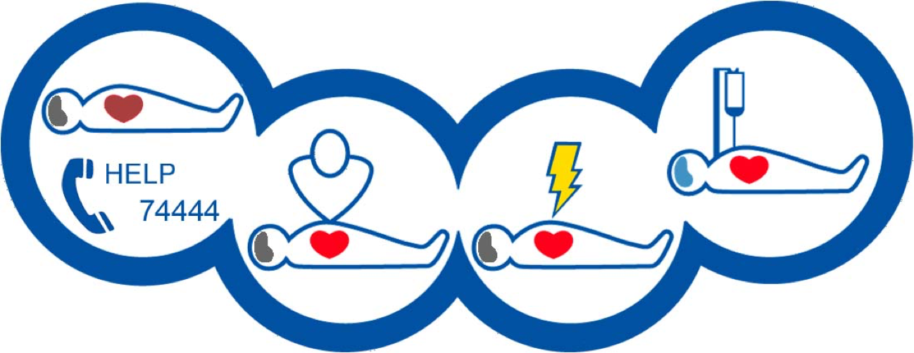
First-aid
First-aid training course:
    Initial courses (8h)
      EN: https://edh.cern.ch/Document/Personnel/TRN/new?course=STAID01IE
      FR: https://edh.cern.ch/Document/Personnel/TRN/new?course=STAID01IF
    Refresher courses (4h)
      EN https://edh.cern.ch/Document/Personnel/TRN/new?course=STAID01RE
      FR https://edh.cern.ch/Document/Personnel/TRN/new?course=STAID01RF
    Short version (1h) – Defibrillator and chest compressions
      EN https://edh.cern.ch/Document/Personnel/TRN/new?course=STDEF01IE
      FR https://edh.cern.ch/Document/Personnel/TRN/new?course=STDEF01IF

Slide 13
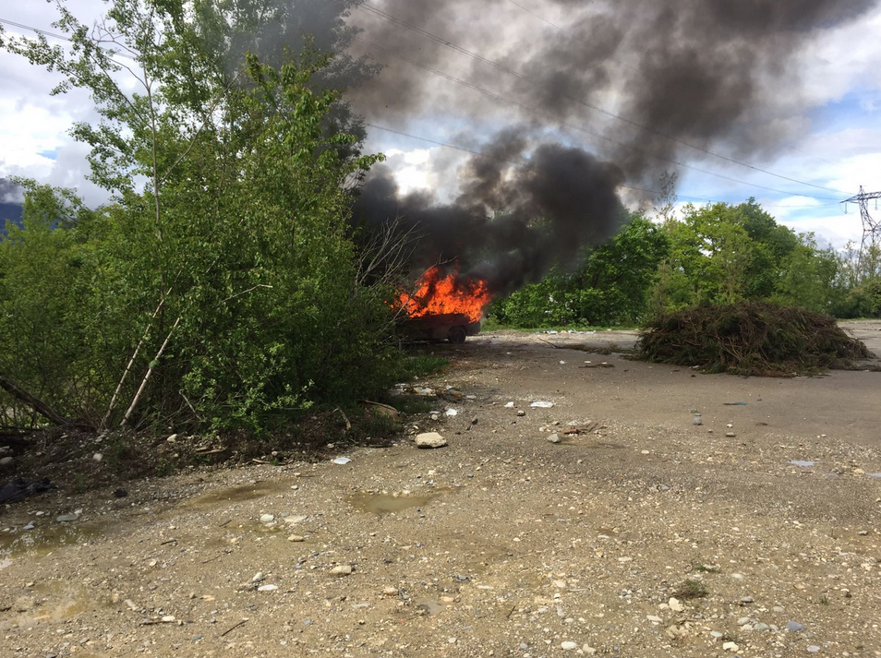
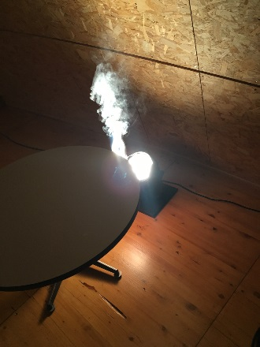
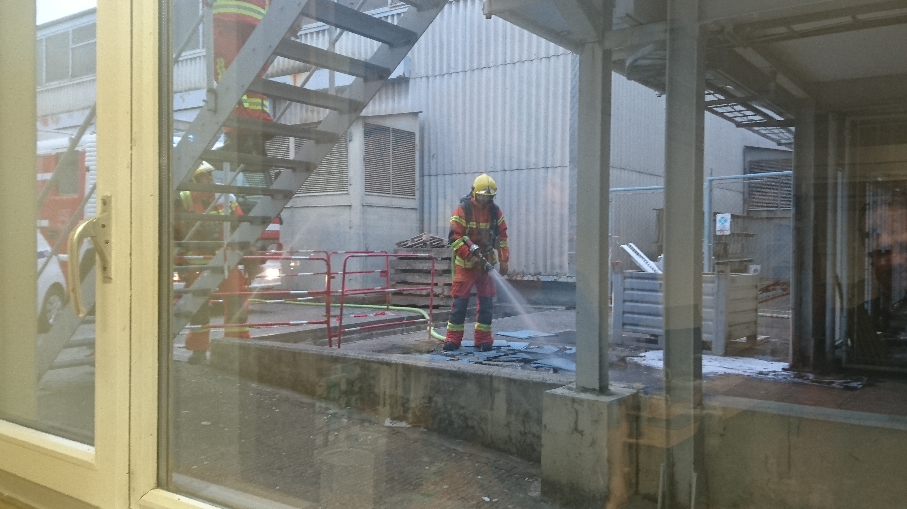
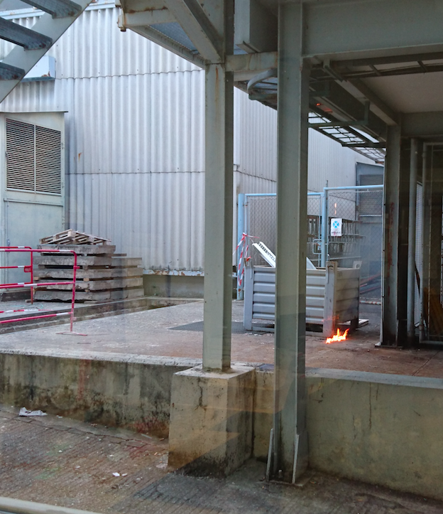
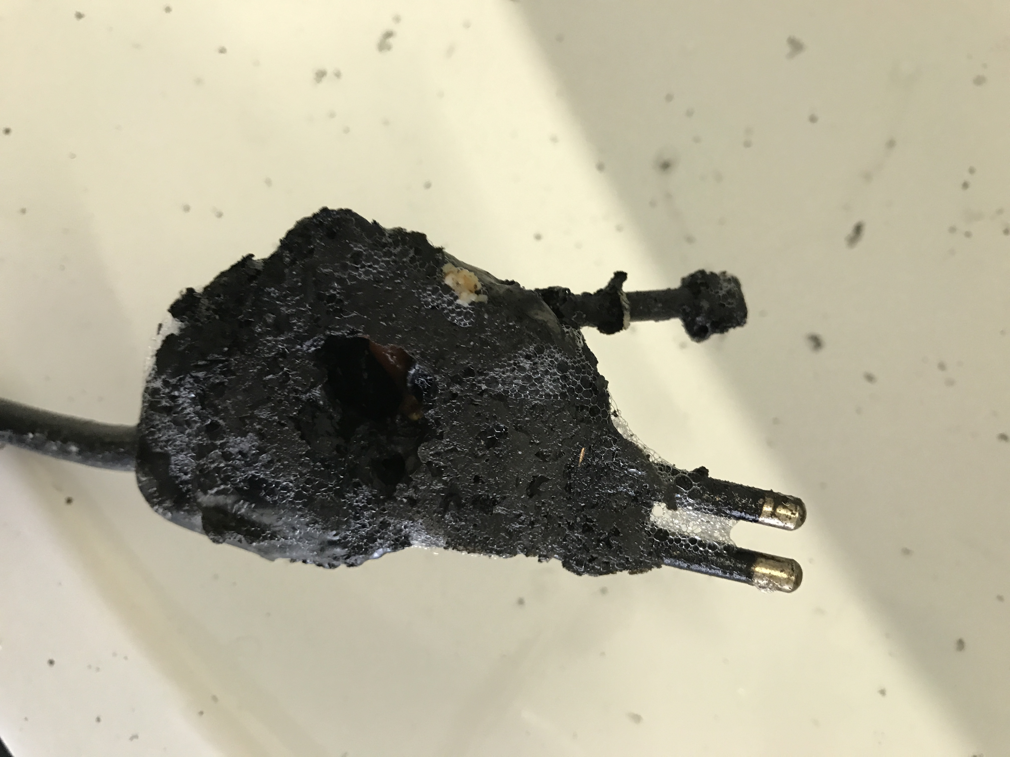
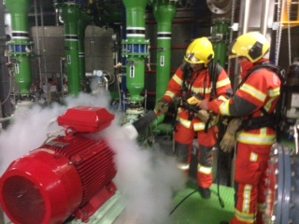
Fire
21 fires at CERN since 1st Jan. 2017
  4 underground
  4 outdoor
  8 caused by electrical installation or equipment
  6 extinguished with fire extinguisher by the personnel

Slide 14
Fire – what made the difference
Quick detection and alert
  Smoke detection (automatic or human)
  AL3 or 74444 (0041 22 767 4444)
Quick reaction
  Fire extinguisher
  AUL
Personnel trained and vigilant
  Fire extinguisher
  Reduced amount of combustible material
  Type of combustible (IS23 and IS41)

Slide 15
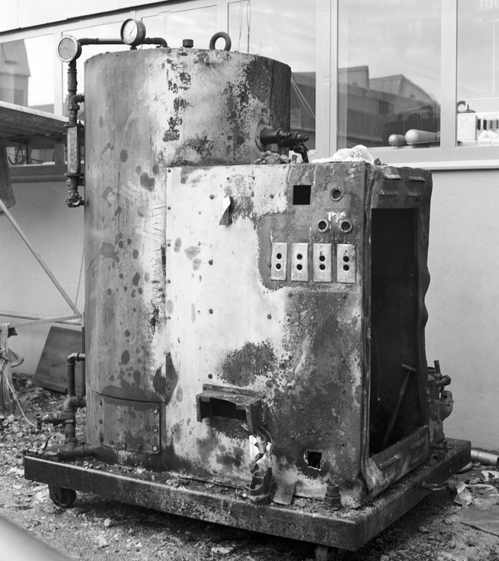
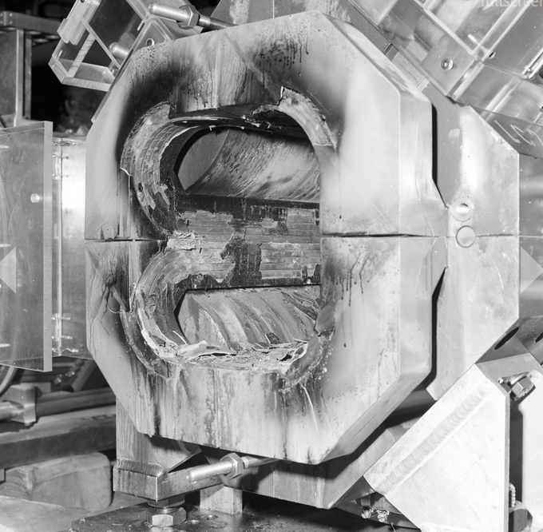
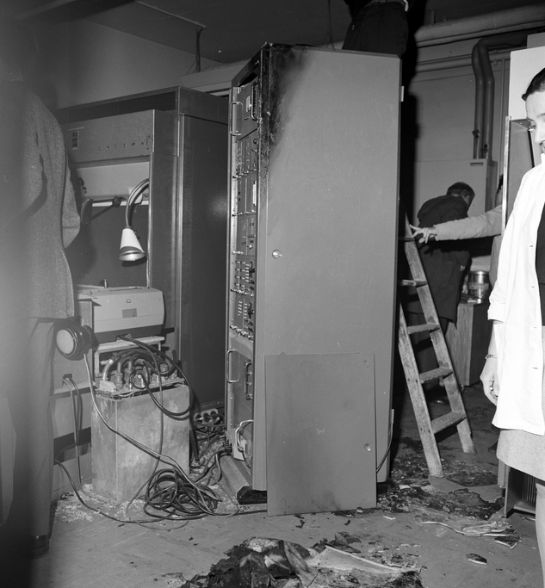
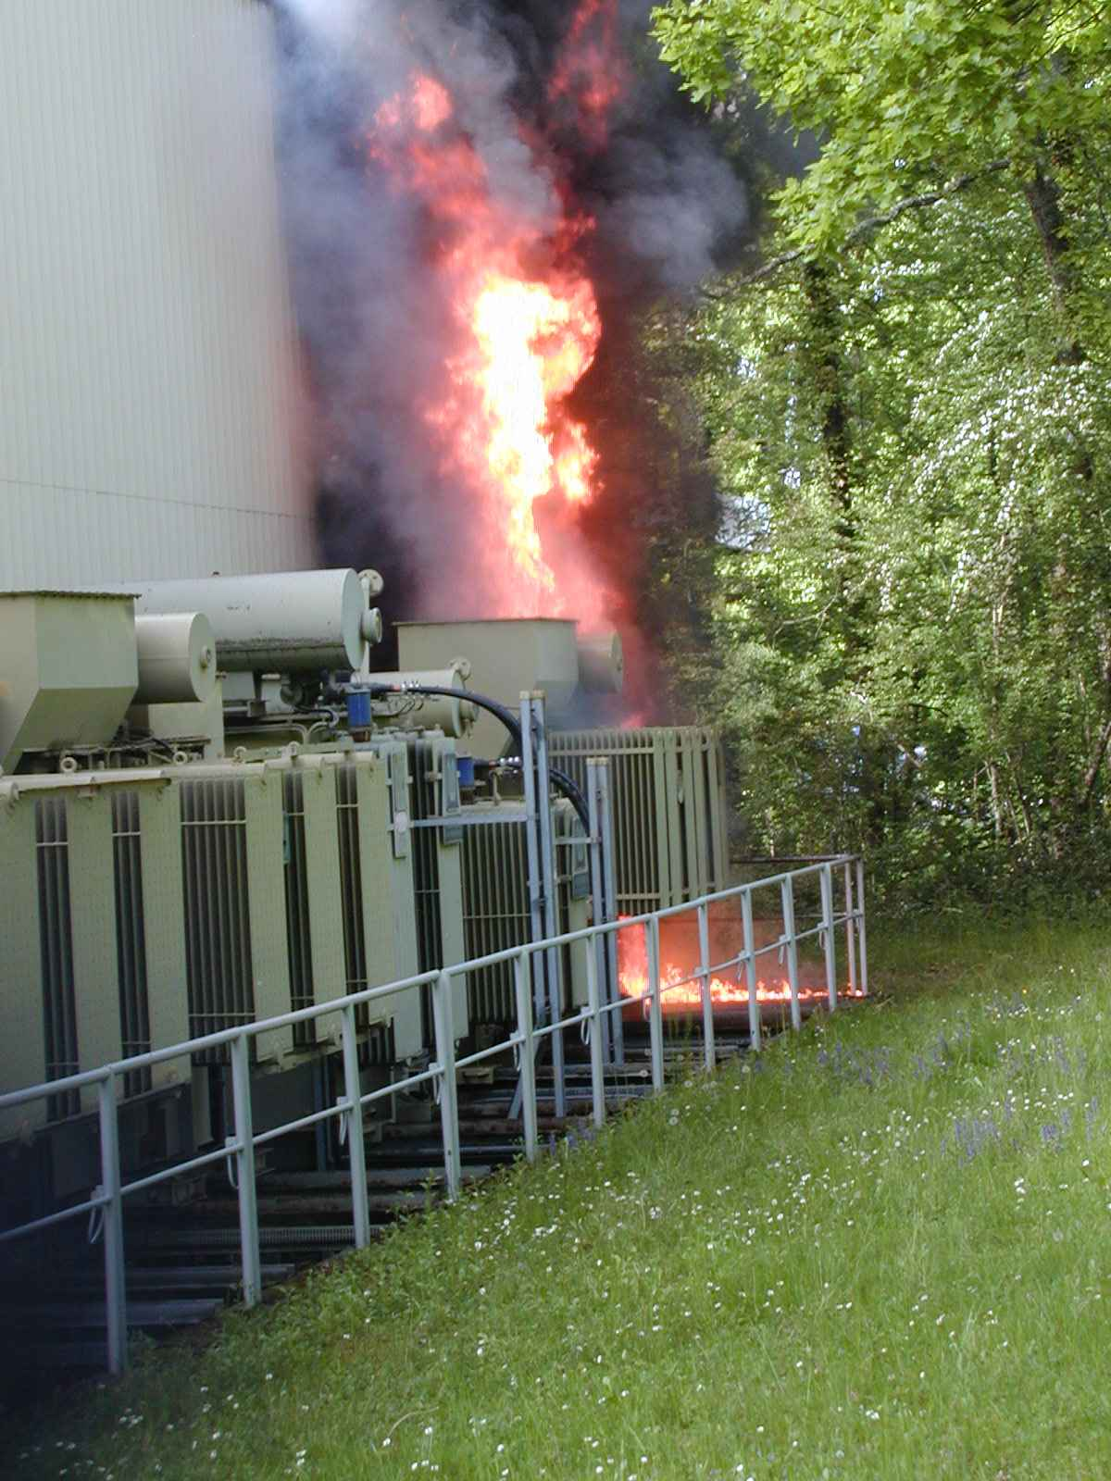
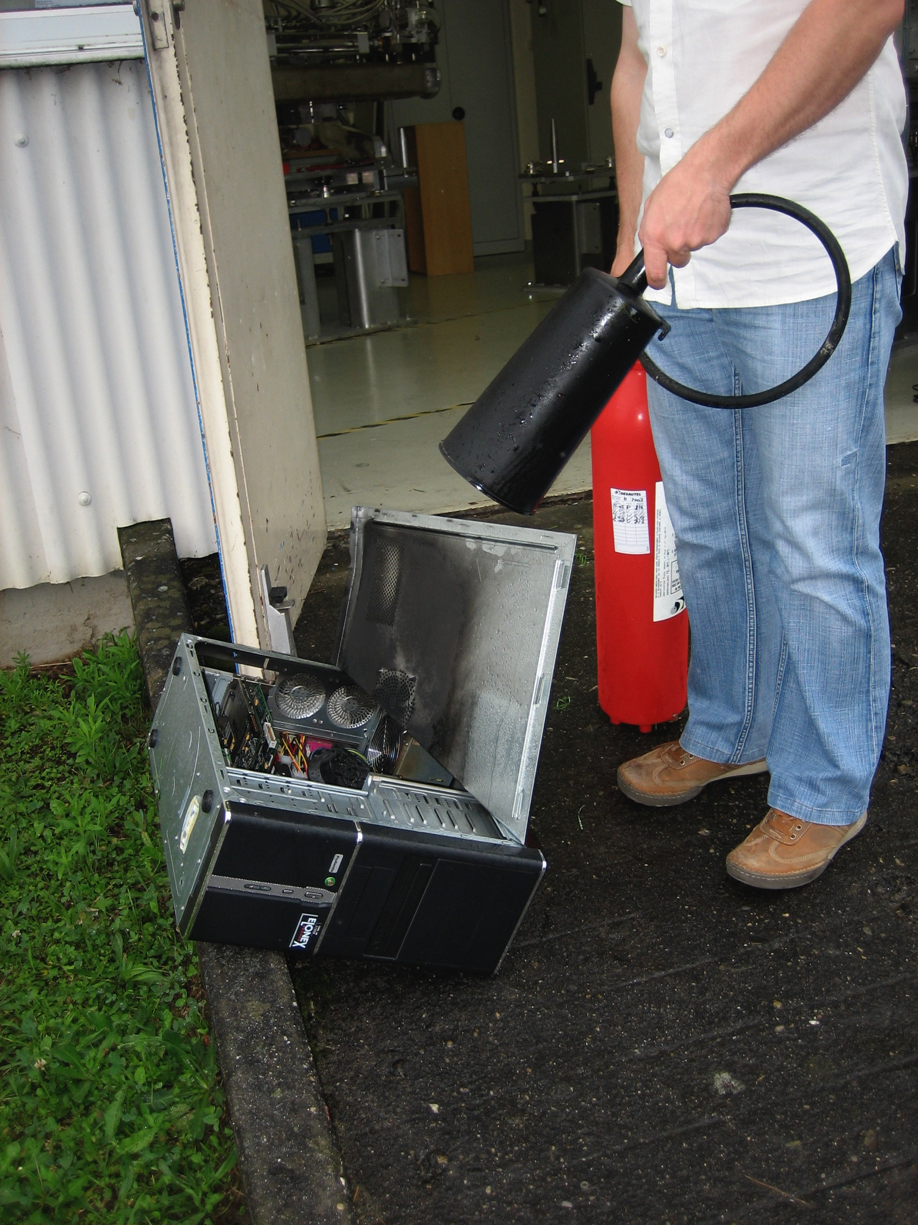
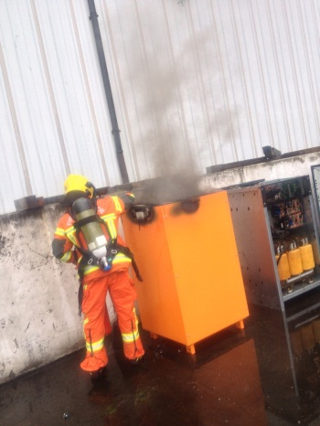
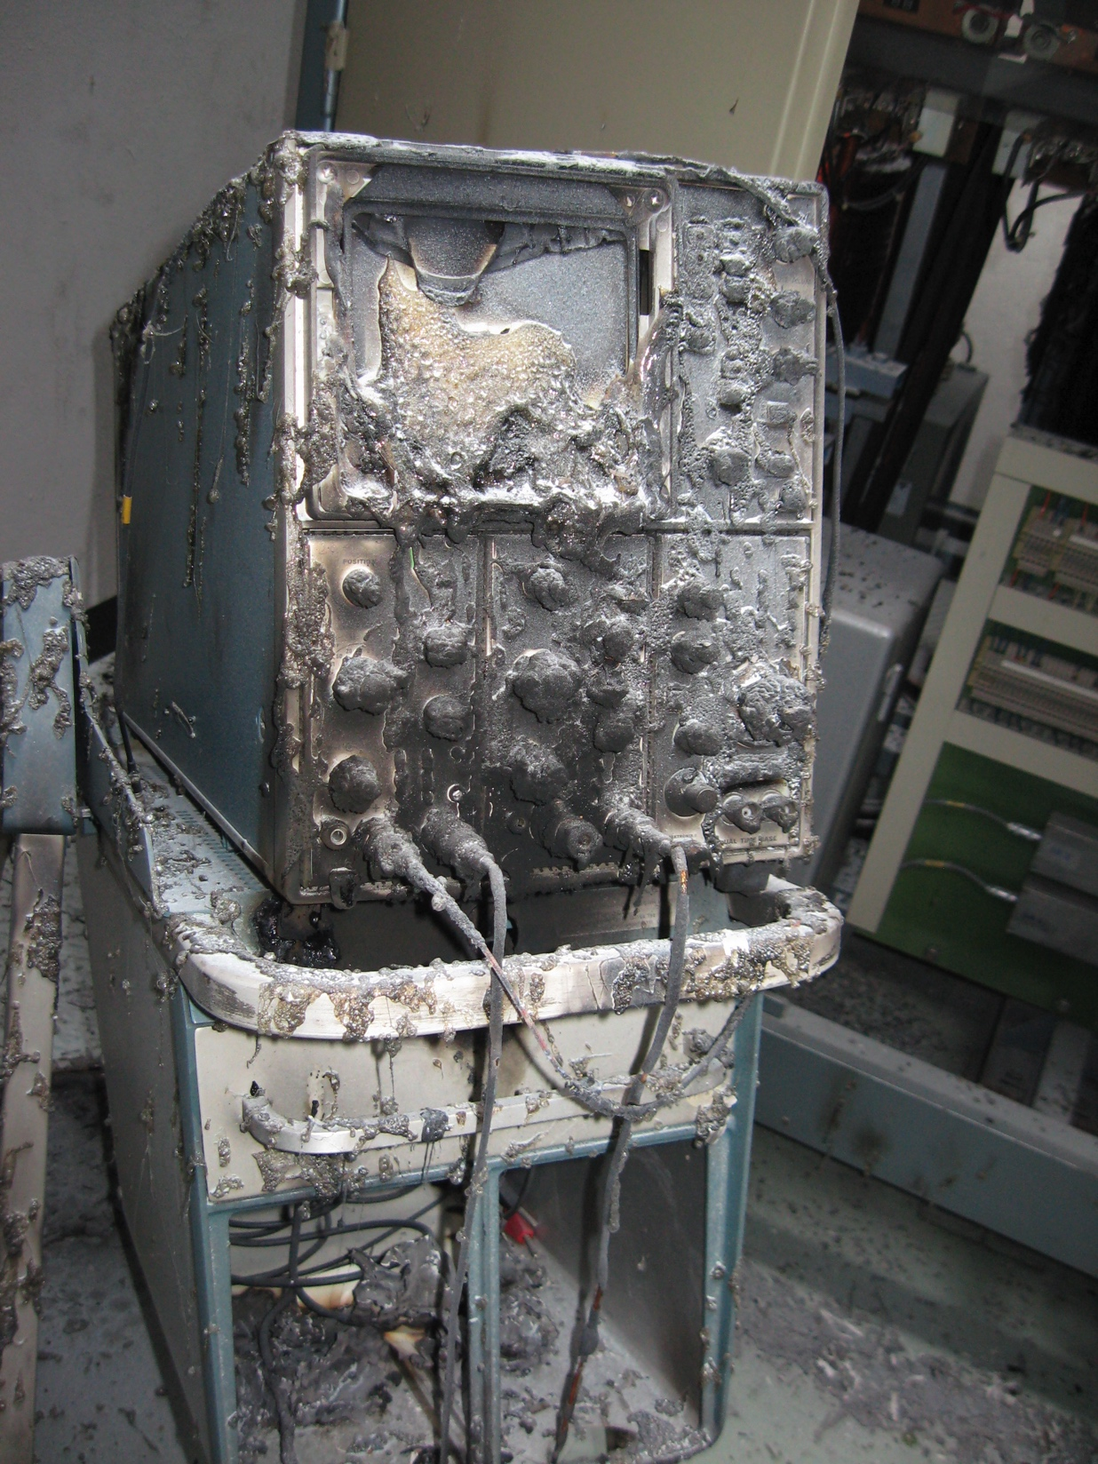
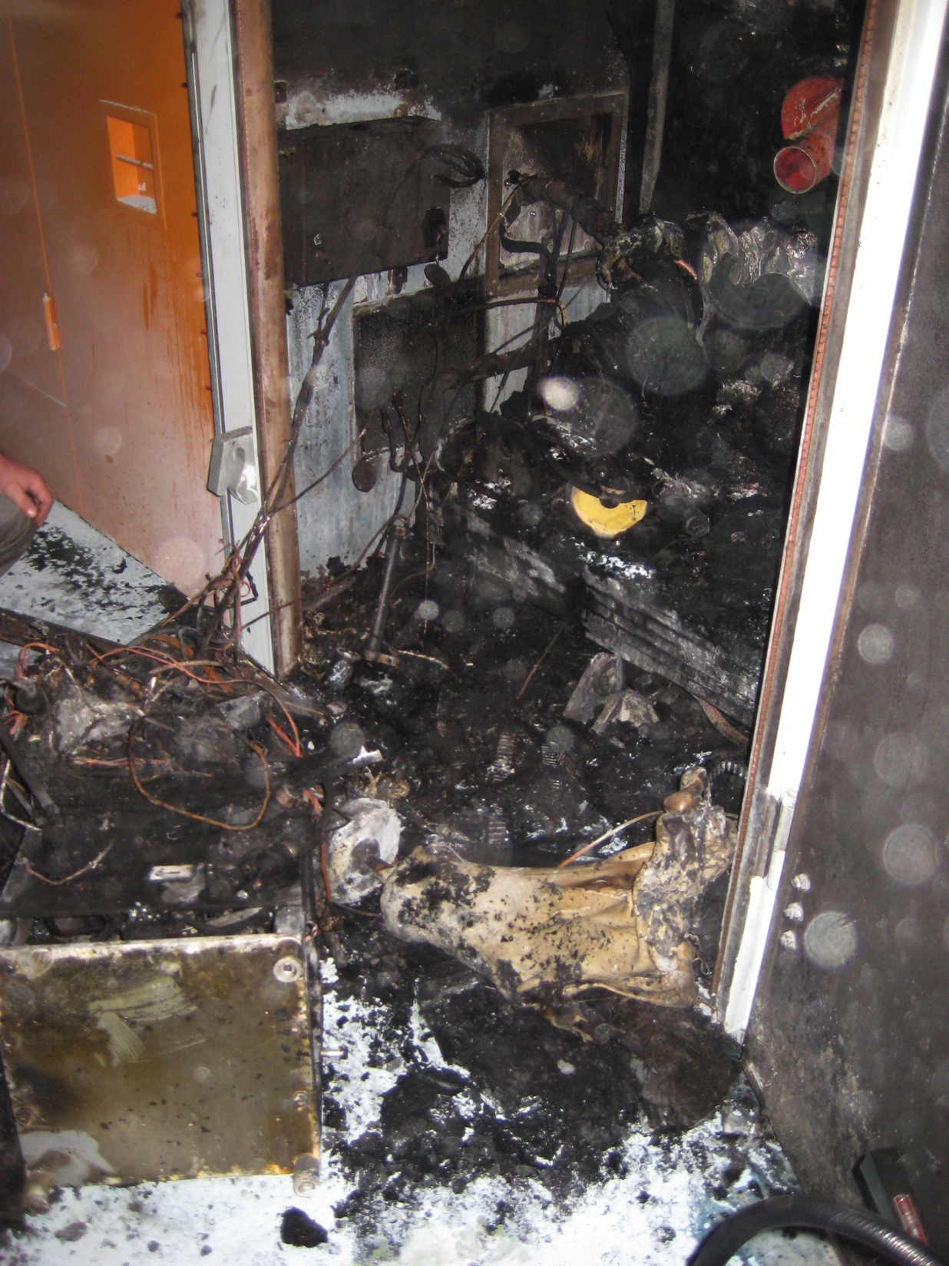
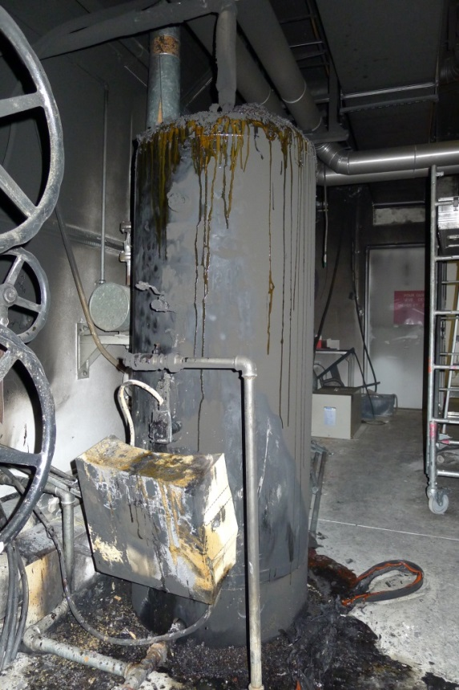
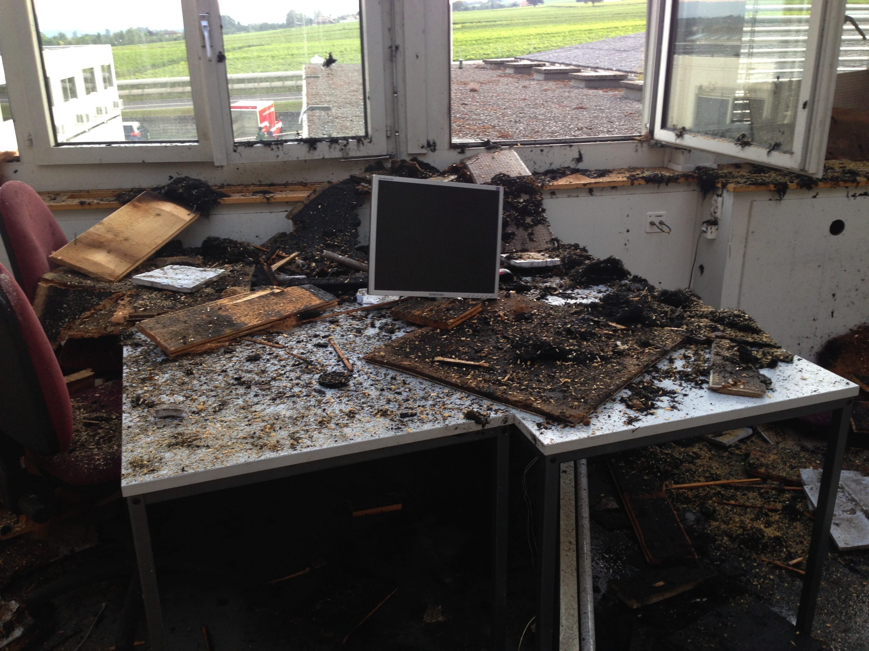
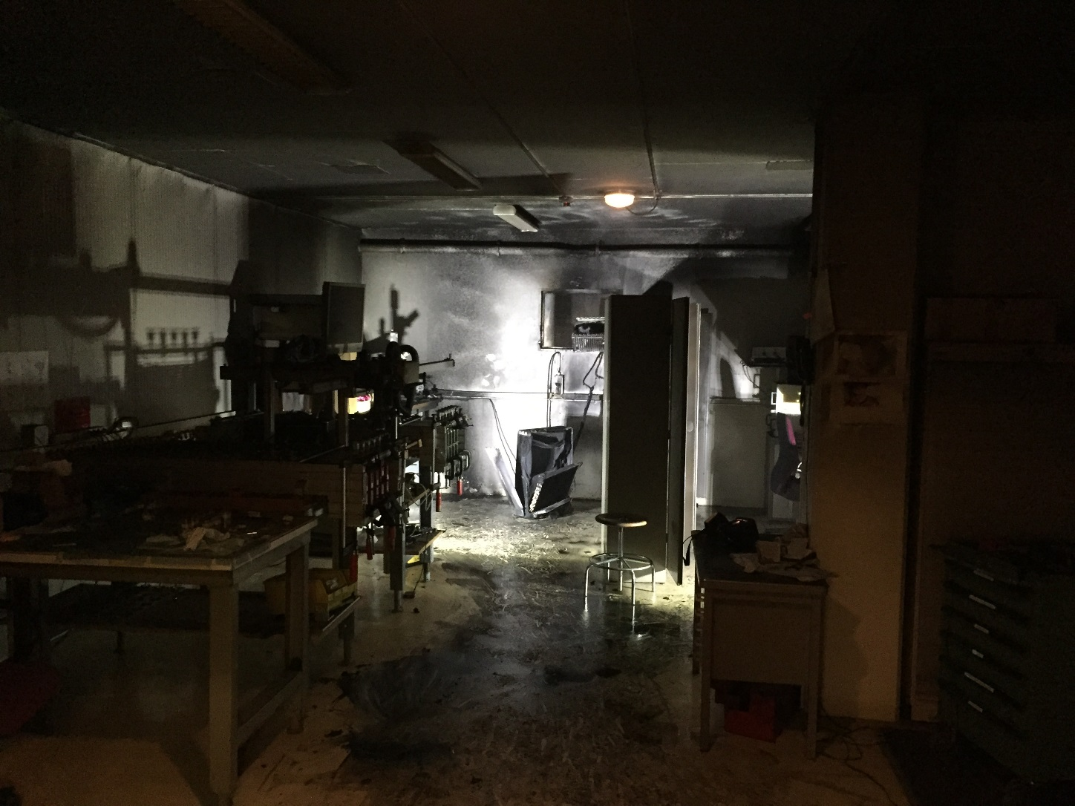
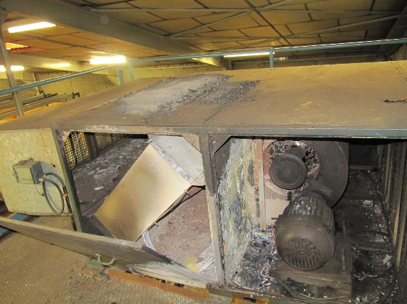
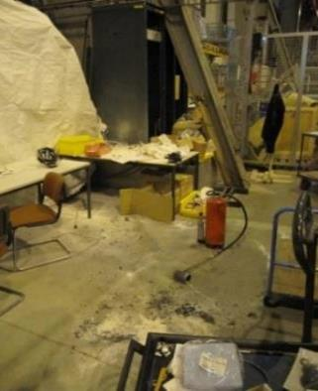
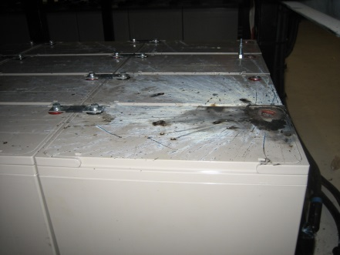
Fire-extinguisher training course is highly recommended to all personnel!

Slide 16
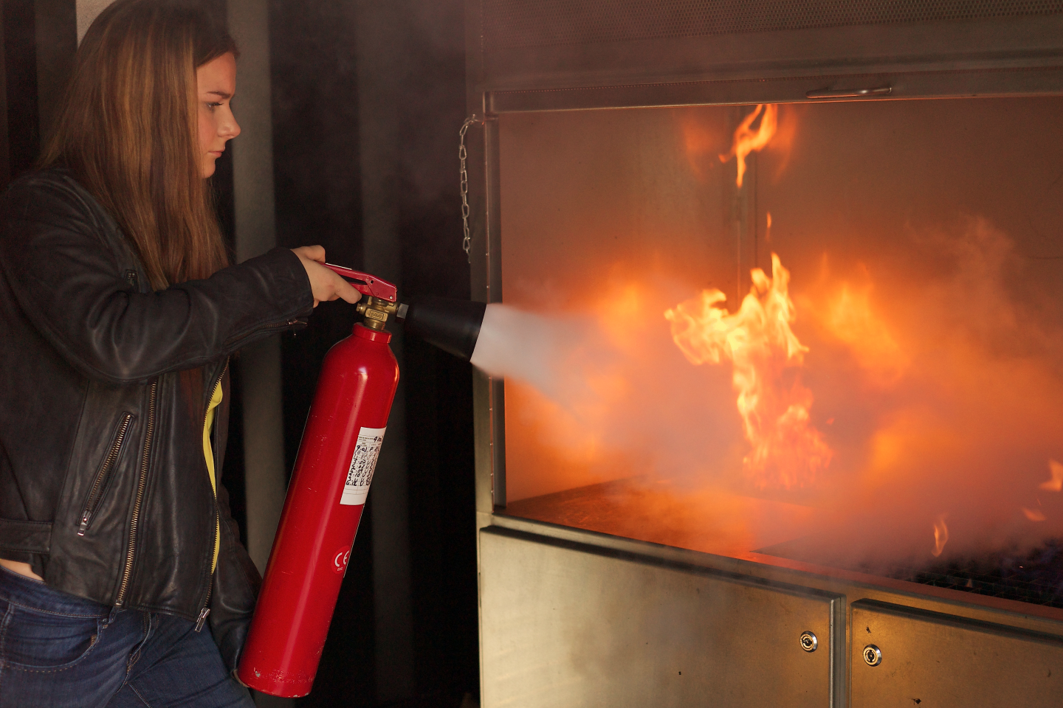
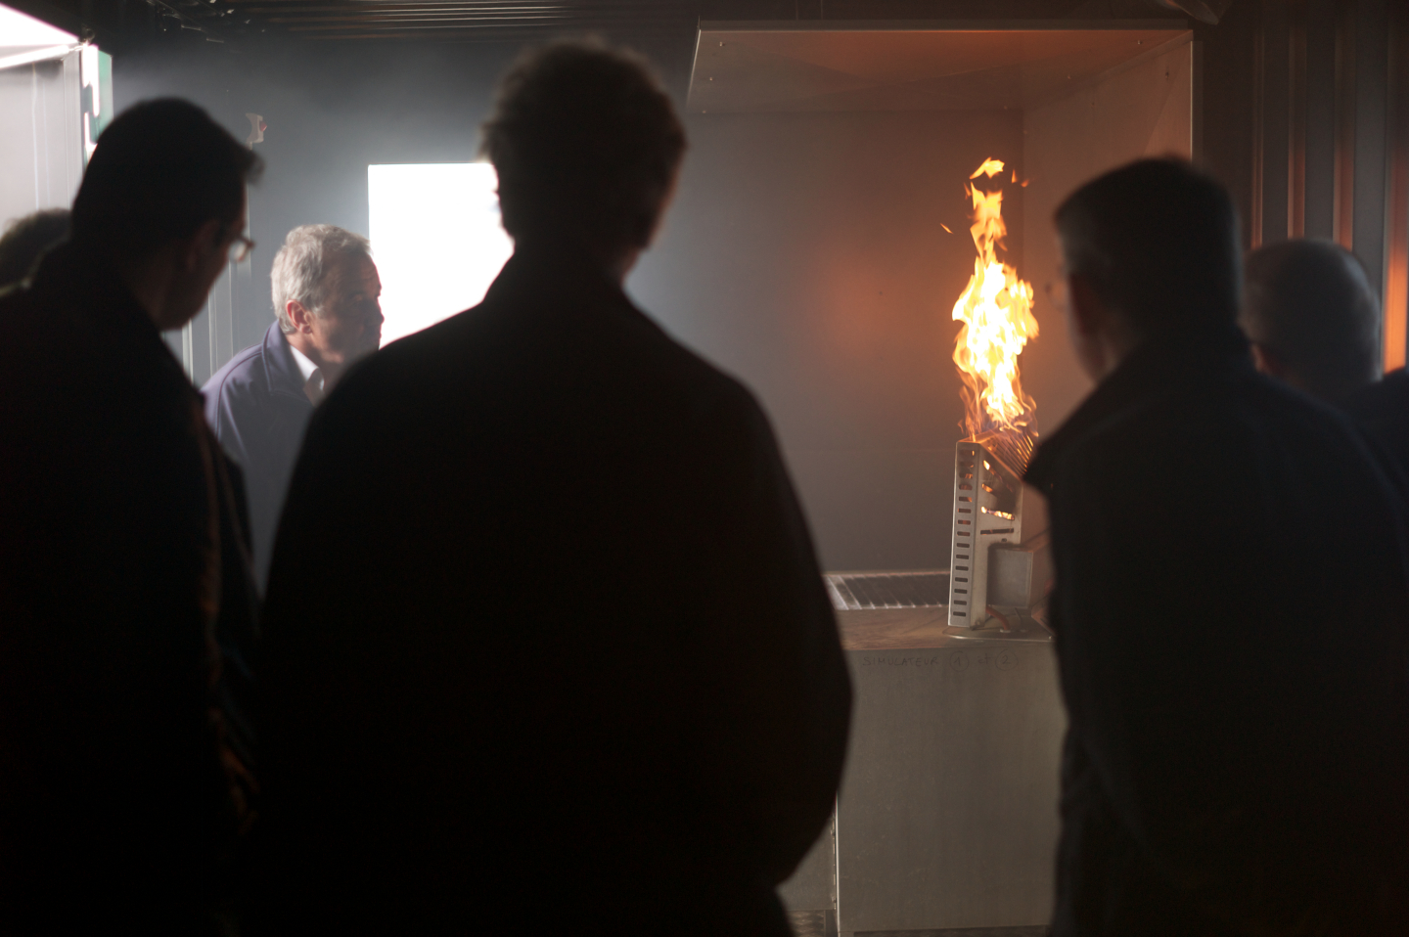
Fire extinguisher
Get trained: short (2h), free, fun, interesting for your work and your private life, and you meet fire-fighters!
  EN: https://edh.cern.ch/Document/Personnel/TRN/new?course=STFIE01IE
  FR: https://edh.cern.ch/Document/Personnel/TRN/new?course=STFIE01IF

Slide 17
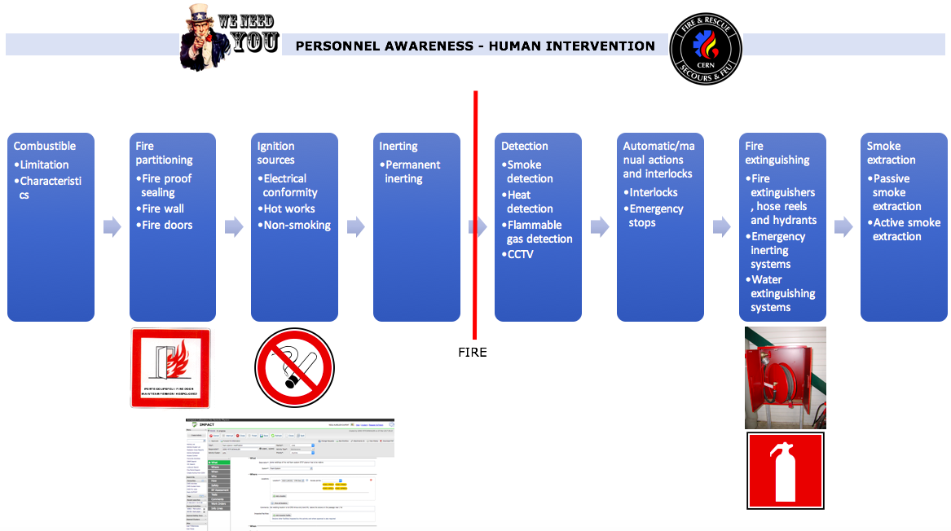
Fire prevention – day to day

Slide 18
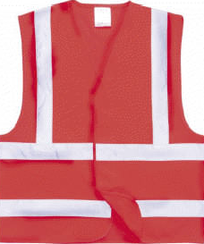
Evacuation exercises in 2017
Several evacuation drills organized with the help of HSE Unit – reports available in EDMS:
  AD Hall, in collaboration with EN Dep.
  EHN1, in collaboration with EN Dep.
  SCX5
  B.28
Participation to evacuation drill as observers
  B.35
Roughly 10-15 evacuation drills per year at CERN
  List validated by the DSOC
  If you identify a need for your building, please contact us

Slide 19
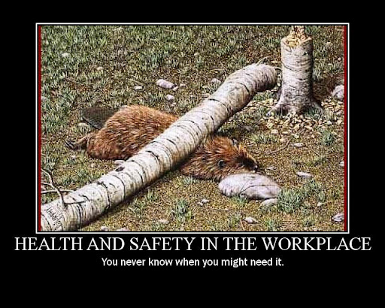
Thanks for your attention

Slide 20
Spare slides

Slide 21
The 9 general principles of prevention
1
2
3
Avoid
the risks
Evaluate
the risks
Fight the risks at their source
Replace dangerous items by safer or less dangerous items
Adapt the workplace to technical progress
6
4
5
Adapt the work
to the individual
Include
prevention in the work planning
Take collective prevention
measures
7
8
9
Give appropriate instructions
Notes:
Éviter les risques

Slide 22
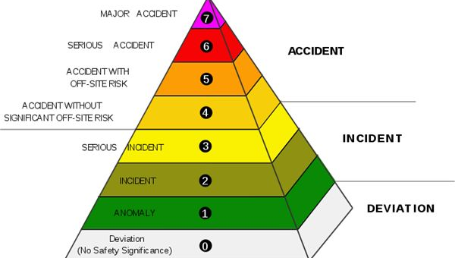
What do we want to avoid?

Slide 23
